Slide 1



Python basics. training
Facilitated By
RITEB, Anthony Chetmen (OCP, MCSP, MCSE )
Software Engineer | Scientific Officer
ICT Unit, NCRS Consult,
National Centre For Remote Sensing, Jos.
Powered By: NCRS Consult Ltd, Jos

Slide 2

introduction
Founded in the year 1989 by Guido Van Russom
High level, interpretive, general purpose dynamic
programming language with strong emphasis on
Code readability.
It comes with a vast and comprehensive standard
library, as well as automatic memory management
and various features.

Slide 3








Applications of python
Automation
Applications Development
Artificial Intelligence
Websites
Machine Learning
Games, 3D Graphics
Deep Learning
Education
Data Analytics

Slide 4







Businesses running on python
Better search features to its users.
Better search features to its users.
Uses python to share files between users.
Promotes python as it’s educational language.
Scientist at NASA uses python to perform scientific calculations.
Uses ML to understand their customers needs to retain them for longer.
Uses python for their cybersecurity analysis, encryption/decryption purposes.

Slide 5
Future of python
Future Looks Bright!
Python does not appear to be going away anytime soon, as its user base is large and increasing. Python is used by many well-known organizations, and numerous OS developers support it, making Python’s future look bright.
It’s widely utilized in the industry of information security. In 2007, 2010, and 2018, Python was named TIOBE’s Programming Language of the Year. This award is given to the language that has had the greatest increase in popularity over the course of the year.
Because it enables functional programming, object-oriented programming, and parallel programming paradigms. Python has become a highly adaptable alternative.

Slide 6
Common terms in python
Immutable
this is an object within the code that is assigned a fixed value. This could include tuples, strings, and numbers. You can’t alter the object and you will need to create a new object with a different value and store it first. This can be helpful in some cases, such as the keys in a dictionary.
Interactive
one thing that a lot of beginners like about Python is that it is so interactive. You can try out some different things in the interpreter and see how they will react right away in the results. It is a good way to improve your programming skills, test out a new idea you have and more.
String
this is one of the most basic types that you will find in Python that will store text and alphanumeric characters. The strings will store text so that the string type can then be used to hold onto binary data.
Type
this is a category or sort of data that is represented in the programming languages. These types are going to differ in their properties, they including immutable and mutable options, as well as in their functions and methods. Python includes a few of these including dictionary types, tuple, list, floating point, long, integer, and string.

Slide 7
Common terms cont’d
Mutable
these are the objects that will be able to change their value within the program, but which are able to keep their original identity.
Object
within Python, this is any data with a state, such as a value or an attribute, as well as a defined behavior, or a method.
List
this is a datatype within Python that is built in. It contains a mutable sequence of values that are sorted. It can include immutable values of numbers and strings as well.
Function
this is a block of code that is invoked when using a calling program. It is best used in order to provide a calculation or an autonomous service.
Class
this is a template that is used for creating user-defined objects.
Tuple
this is a datatype that has been built into Python. This datatype is an immutable ordered sequence of values. The sequence is the only part that is immutable. It can contain some mutable values, such as having a dictionary inside it, where the value’s can change.

Slide 8
Common terms cont’d
IDLE
this stands for Integrated Development Environment for Python. This is the basic interpreter and editor environment that you can use along with Python. It is good for those who are just beginning with this and can work for those on a budget. It is a clear example of code and won’t waste a lot of time or space.
Docstring
this is a string that will appear lexically first expression
inside a module, function, or class definition. The object will be available to documentation tools.
List
this is a datatype within Python that is built in. It contains a mutable sequence of values that are sorted. It can include immutable values of numbers and strings as well.
Triple Quoted String
this is a string that has three instances of either the
single quote or the double quote. It could have something like ‘’’I love tacos’’’. They are used for many reasons. They can help you to have double and single quotes in a string and they make it easier to go over a few lines of code without issues.
It is also used to comment off lines of code not needed in the course of development.
Text Editor
They are basically applications used to write, update python code. E.g Notepad++, VS Code, PyCharm, Text Wrangler.

Slide 9
Course Content
What is Python?
Features of Python
Who Uses Python?
Installing Python & PyCharm IDE
Naming Convention
Python Basics
Data Types
Type Conversions
Operators
Flow Controls
Functions
File Handling
Error Handling

Slide 10
What is python?
Open Source
Created by Guido Van Russom in 1989
Inspired his favorite show’s (Flying Circus) creator ‘Monty Python’
Easy To Learn
Large Standard Library
High Level, Interpreted language with easy syntax and dynamic semantics.
OOP

Slide 11
Features of python?
Simplicity
Python is designed such that you think more of the code and less of the syntax.
Open Source
Being open source is awesome, which means that Python is free for everyone.
Embeddable & Extensible
Python allows code of other languages such as C, C++ to be embedded into it so that certain functions can be performed, making Python even more powerful.
Portability
Python code can be written in one computer and executed in another without any hassle, making code sharing much easier.
Interpreted
The tasks of CPU and Memory Management are handled by Python itself.
Huge Libraries
Python has a huge set of libraries such as NumPy, MatPlotLib, Scikit-Learn which helps in solving problems.
OOP
Object orientation helps break down complex problems of the world into code and help provide security to it to obtain better solutions.

Slide 12
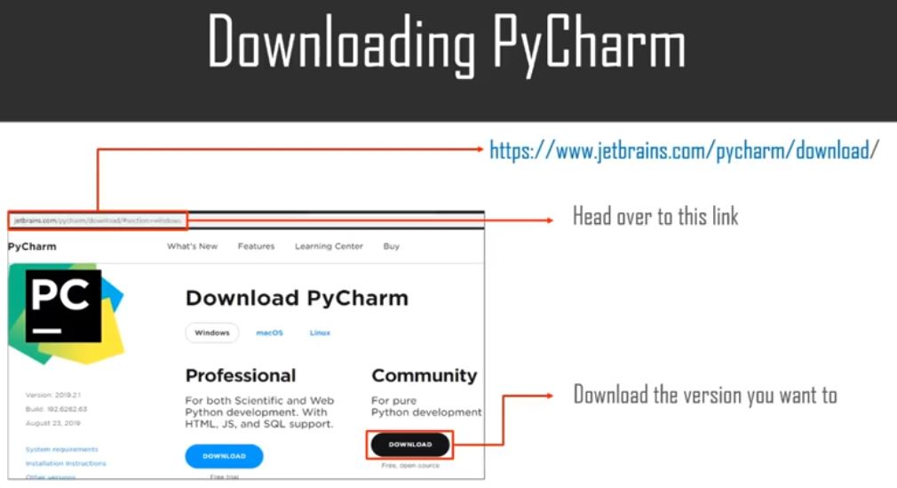
Installing python & pycharm IDE

Slide 13
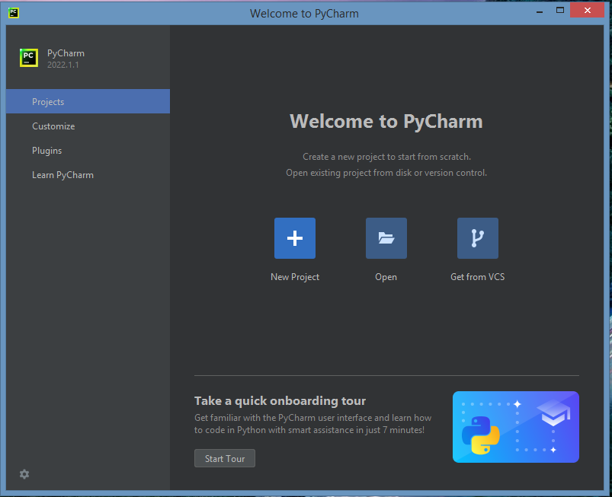

Slide 14
Writing your first program
Task 1
Type this lines below into your opened python file in your IDE environment:
print(‘Welcome to Python Basics Training at NCRS Consult’)
Click on ‘Run’ or Play icon on your IDE gutter to run your python file.
OR
Open Terminal window and type in the below:
python file_name.py

Slide 15
Naming convention in python
Standard: word_word2 e.g first_name, last_name, cost_price
firstName, lastName, extentedPrice, unitPrice

Slide 16
Data types in python
Numeric
Strings
Lists
Dictionaries
Set
Tuples

Slide 17
Numeric Data types
Numbers
Numbers in Python must start with a number digit, (0-9); a dot (period), which is a decimal point; or a an hyphen(-) used as a negative sign for negative numbers. A number can contain only one decimal point. It should contain no letters, spaces, dollar sign, or anything else that isn't part of a normal number.
Types | Example
Integer | 1, 5, 356
Float | 3.142
Complex | 10 + 3j
Numeric data types are used to store numerical values in the variable.
Numeric data types are not mutable.

Slide 18
Example of Good and Bad Python Numbers
Numbers | Status | Reason
1 | Good | A whole number (integer)
1.1 | Good | A number with a decimal point
1234567.89 | Good | A large number with decimal point and no space
-2 | Good | A negative number as indicated by a starting hyphen
.99 | Good | A number that starts with a decimal point bcos its less than one
$1.99 | Bad | Contains a $ dollar sign
12,345.67 | Bad | Contains a comma
1101 3232 | Bad | Contains a space
97140-3384 | Bad | Contains a hyphen
123-45-6789 | Bad | Contains two hyphens
127.0.0.1 | Bad | Only one decimal point is allowed
(267)555-1234 | Bad | Contains parenthesis and hyphen
123 Oak Tree Lane | Bad | Contains spaces and words

Slide 20
string Data types
Strings
Strings are ordered immutable collection of text representation. It about the most used data type in python.
String can have heterogeneous data types in them.
String data types are not mutable.
Example
course = “Python for beginners”
Initializing an empty List
a = “” or a = ‘’
Accessing Character in a String (Slicing)
This is done using indexing; course[0] = ‘new data’ print(course[0])

Slide 21
String Methods
 | Method | Description
1. | index() | get a character at the index position of the string
2. | strip() | removes white spaces from a string without changing the string characters
3. | swapcase() | changes the case of first character and rest of string to opposite case
4. | casefold() | sets the first character to lower case in a string
5. | count() | counts the number of times a character(s) in found in a string
6. | capitalize() | sets the first character of a string to uppercase
7. | upper() | sets all characters in a string to uppercase
8. | lower() | sets all characters in a string to lowercase
9. | startswith() | checks if a string starts with a character(s) or substring
10. | endswith() | checks if a string ends with a character(s) or substring
11. | find() | returns the first index that it finds a character or substring in a string
12. | replace() | replaces a character(s) or substring in string with a new one and returns the string
13. | split() | converts substrings of a string to new elements of a list, accepts a delimiter as argument

Slide 22
String Slicing
Slicing (start_index:stop_index:skip_index)
Example | Description | Result/Output
my_string[:] | accessing all elements at once
my_string[3] | accessing the 3rd elements in the string
my_string[0:4] | accessing the elements from index 0 to 3 excluding index 4
my_string[::-1] | accessing the elements in reverse order
my_string[0:5:2] | accessing the elements from index 0 to 5 and skipping 2 elements

Slide 23
String Operators
 | Operator | Purpose
1. | x in s | Returns true is if x is contained in string s
2. | x not in s | Returns true is if x is not contained in string s
3. | s * n or n * s | Repeats string s at n number of times
4. | s[i] | sets the first character to lower case in a string
5. | s[i:j]
6. | s[i:j:k] | A slice of string s from i to j with step of k
7. | min(s) | The smallest (lowest) item of string s
8. | max(s) | The largest (highest) item of string s
9. | s.index(x[, i[, j]]) | The numeric position of the first occurrence of x in string s. the optional i and j lets you limit the search to the characters from i to j
10. | s.count(x) | The total number of times string x occurs in the larger string s

Slide 24
Formatting a string
String formatting: %, .format, f-String
% - string | old formatting style
var = “old” my_var = “The pattern is %s” % var
% - decimal | float | old formatting style
var = 5.3456 my_var = “The number is %d” % var my_var = “The price is %.2f” % var
.format | new formatting style
cust_name = “John” price = 5.3456 my_string = “The item was sold to {} for ${:.2f}”.format(cust_name, price) print(my_string)
f-String | latest formatting style
cust_name = “John” price = 5.3456 my_string = f“The item was sold to {cust_name} for ${price}” print(my_string)

Slide 25
List Data types
List
Lists are the same as arrays. Ordered and allows duplicate elements.
Lists can have heterogeneous (they can have values with different data-types) data types in them.
List data types are mutable.
Example
a = [‘cup’, ‘apple’, ‘banana’, cherry]
Initializing an empty List
a = [ ] my_list = list([1, 2, 3, 4, 5])
Accessing Element in a List
This is done using indexing; my_list[0] = ‘new_value’ print(my_list[0])

Slide 26
List Methods
 | Method | Description
1. | insert() | adds a new element to an index position in the the list
2. | append() | adds a new element to the end of the list
3. | pop() | removes the last element from a list and returns the element value
4. | remove() | removes a specify element from a list
5. | copy() | copies all elements in a list
6. | extend() | extends the elements of a list with all elements of a new list
7. | reverse() | reverse the order of elements in the list
8. | count() | returns the number of times an element exists in a list
9. | sort() | organizes the elements in a list in ascending order
10. | clear() | removes all elements/items from the list

Slide 27
List Slicing
Slicing (start_index:stop_index:skip_index)
Example | Description | Result/Output
my_string[:] | accessing all elements at once
my_string[3] | accessing the 3rd elements in the string
my_string[2:] | accessing the elements from index 2 to the end of the list
my_string[0:4] | accessing the elements from index 0 to 3 excluding index 4
my_string[::-1] | accessing the elements in reverse order
my_string[0:5:2] | accessing the elements from index 0 to 5 and skipping 2 elements
my_string[2::1]

Slide 28
Dictionary Data type
Dictionaries
Dictionaries are used to hold key, value pairs.
Dictionaries can have heterogeneous data.
Dictionaries data type are mutable.
Example
my_dict = {‘name’ : ‘Python’, ‘id’ : ‘34125’, ‘location’: ‘Jos’}
Initializing an empty List
my_dict = [ ] my_dict = list([1, 2, 3, 4, 5])
Accessing Element in a Dictionary
This is done using key; my_dict[‘key’] = ‘value’ print(my_dict[‘key’])

Slide 29
Dictionary Methods
 | Method | Description
1. | values() | returns all the values in the dictionary
2. | keys(key_name) | returns all the keys inside a dictionary
3. | pop(key) | removes the last element from a dictionary and returns the element value
4. | popitem(object) | removes the last pair in the dictionary
5. | copy(object) | copies all key-value pairs in a dictionary
6. | get(key) | returns the value of a key in a dictionary
7. | items() | Returns the keys and values in a dictionary
8. | clear() | removes all elements/items in a dictionary

Slide 30
Dictionary Slicing
Slicing (start_index:stop_index:skip_index)
Example | Description | Result/Output
my_dict[:] | accessing all elements at once
my_dict[3] | accessing the 3rd elements in the string
my_dict[0:4] | accessing the elements from index 0 to 3 excluding index 4
my_dict[::-1] | accessing the elements in reverse order
my_dict[0:5:2] | accessing the elements from index 0 to 5 and skipping 2 elements

Slide 31
tuple Data type
Tuples
Tuples is an ordered collection, immutable and allows duplicate elements.
Tuples can have heterogeneous data.
Tuple data type are not mutable and this makes them faster than List.
Example
my_tuple = (‘Maxwell’, 30, ‘Abuja’)
Initializing an empty List
my_tuple = () my_tuple = tuple(1, 2, 3, 4, 5)
Accessing Element in a Tuple
This is done using index; my_tuple[index_no] = ‘value’ print(my_tuple)

Slide 32
Tuple Methods
 | Method | Description
1. | insert() | adds a new element to an index position in the the list
2. | append() | adds a new element to the end of the list
3. | pop() | removes the last element from a list and returns the element value
4. | remove() | removes a specify element from a list
5. | copy() | copies all elements in a list
6. | extend() | extends the elements of a list with all elements of a new list
7. | reverse() | reverse the order of elements in the list
8. | count() | returns the number of times an element exists in a list
9. | sort() | organizes the elements in a list in ascending order
10. | clear() | removes all elements/items from the list
11. | index() | returns an element in the index position of a tuple

Slide 33
Tuple Slicing
Slicing (start_index:stop_index:skip_index)
Example | Description | Result/Output
my_tuple[:] | accessing all elements at once
my_tuple[3] | accessing the 3rd elements in the string
my_tuple[0:4] | accessing the elements from index 0 to 3 excluding index 4
my_tuple[::-1] | accessing the elements in reverse order
my_tuple[0:5:2] | accessing the elements from index 0 to 5 and skipping 2 elements
my_tuple[-1] | accessing the last element of the tuple

Slide 34
set Data type
Sets
Sets are unordered collection of data and doesn’t allow duplicate element.
Sets can have heterogeneous data.
Sets data type are mutable.
Example
my_set = {‘name’, ‘Python’, ‘id’, 34125, ‘location’, ‘Jos’}
Initializing an empty Set
my_set = { } my_set = set(1, 2, 3, 4, 5) my_set = set([1, 2, 3, 4, 5])
Accessing Element in a Set
This is done using key; my_set[‘key’] = ‘value’ print(my_set[‘key’])

Slide 35
Set Methods
 | Methods | Description
1. | add(element) | adds a new element to a set
2. | append() | adds a new element to the end of the set
3. | pop() | removes an arbitrary element from a set and returns the element
4. | remove(element) | removes an element that is present in a set (element must exist else error)
5. | discard() | removes an element in a list if it exists
6. | union() | combines the elements of two sets without duplication
7. | intersection() | returns the common elements between two set without duplication
8. | difference() | returns the difference in elements between two set without duplication
9. | symmetric_difference() | returns all the elements in two sets that don’t intersect without duplication
10. | update() | updates a set with elements that are found in another set without duplication
11. | intersection_update() | updates a set only with elements that are both found in another set without duplicate
12. | clear() | removes all elements/items from the set

Slide 36
Set Slicing
Slicing (start_index:stop_index:skip_index)
Example | Description | Result/Output
my_set[:] | accessing all elements at once
my_set[3] | accessing the 3rd elements in the string
my_set[0:4] | accessing the elements from index 0 to 3 excluding index 4
my_set[::-1] | accessing the elements in reverse order
my_set[0:5:2] | accessing the elements from index 0 to 5 and skipping 2 elements

Slide 37
Data type conversion in python
This involves converting variable(s) from one data-type to another.
However, you should exercise caution when performing data-type conversion, not all cases are allowed in python.
There are pre-built functions in python to help achieve this type of operation.
Example | Observation | Status
int -> str | accessing all elements at once | allowed
str -> int | all elements must be numbers | allowed ? ?
str -> tuple | very much allowed | allowed
str -> list | very much allowed | allowed
Example In Action
Integer: my_int = 50 Conversion to String: my_string = str(my_int) Conversion to Integer: my_int = int(my_string)
Example In Action
Str: my_str = ‘Python Basic’ Conversion to List: my_list = list(my_str) Conversion to String: my_str = str(my_list)
Example In Action
Tuple: my_tuple = (4, 23, 15) Conversion to String: my_string = str(my_tuple) Conversion to Tuple: my_string = tuple(my_string)

Slide 38
operators in python
Operator | Description | Sample | Example In Action
+ | Addition | a + b | 1 + 1 = 2
- | Subtraction | a - b | 10 – 1 = 9
* | Multiplication | a * b | 3 * 15 = 15
/ | Division | a / b | 10 / 5 = 2
% | Modulus | a % b | 11 % 5 = 1
** | Exponent | a ** b | 2 ** 3 = 8
// | Floor Division | a // b | 11 // 5 = 2
Arithmetic Operators: used for mathematical/statistical calculations
Logical/Comparison Operators:
Operator | Description | Example
> | Greater than | a > b
< | Less than | a < b
>= | Greater than or equal to | a >= b
<= | Less than or equal to | a <= b
== | Comparison | a == b
!= | Not equal to | a != b
is | Object Identity
is not | Negated object identity
: Boolean Operators
Operator | Description
or | Either x or y is true | x or y
and | Both x and y are true | x and y
not | Negated object identity | not x
in
not in

Slide 39
Flow controls in python
Operator | Description
!= | Not equal to | a != b
in |  | a in b
is not | Negated object identity | a is not b
is | Object Identity | a is b

Slide 40
functions in python
Functions are declared in python with the keyword def and followed by a function_name and a colon(:) immediately.
Next is to move to the next line and indent every other line that will make your block of code for that function.
An optional keyword is used to return value out of your function where necessary.
Keyword | Explanation
def | function declaration
function_name | the name of your function
return | Used to return a value from function(optional)
*args | optional argument to receive input
**kwargs | optional keyword argument
Example In Action
def calc_age(year): age = 2022 – int(year) return age my_age = calc_age(1982) print(my_age, ‘ years’)
Example In Action
def add_numbers(number1, number2): result = number1 + number2 return result add_numbers(12, 25)

Slide 41
File handling in python
File handling operations are used to perform I/O (read, write and update) tasks to files in python.
This is made possible by a pre-built/in-built function named open.
Attributes buffering, encoding, errors, newline and closefd are optional keyword arguments (**kwargs).
Function | Explanation
open | function name for file I/O operations
file_path | the name of your file to read, write or update
mode | There are 3 file handling modes: w = write, denoted as ‘w’ r = read, denoted as ‘r’ r+ = read and write, denoted as ‘r+’
file_handler = open(file_path, mode, buffering, encoding, errors, newline, closefd)
Example In Action
import io file_handler = open(‘testfile.txt’, ‘w’) my_string = ‘Python basics tutorial’ file_handler.writelines(my_string + ‘\n’) file_handler.close()

Slide 42
Error handling in python
File handling operations are used to perform I/O (read, write and update) tasks to files in python.
This is made possible by a pre-built/in-built(builtin) function named open.
Example In Action
import io try: file_handler = open(‘testfile.txt’, ‘w’) my_string = ‘Python basics tutorial’ file_handler.writelines(my_string + ‘\n’) file_handler.close() except FileExistsError as fx_err: print(str(fx_err.strerror)) except FileNotFoundError as fnf_err: print(str(fnf_err.strerror)) finally: print(‘display a message!’)
Error Types
ValueError | io.UnsupportedOperation
TypeError | NameError
IndexError | RuntimeError
FileExistsError | NotADirectoryError
FileNotFoundError | ModuleNotFoundError
NotImplementedError | ProcessLookupError
OverflowError | RecursionError
PermissionError | ReferenceError

Slide 43
conclusion

Slide 44
Thank you
For listening.

