Slide 1
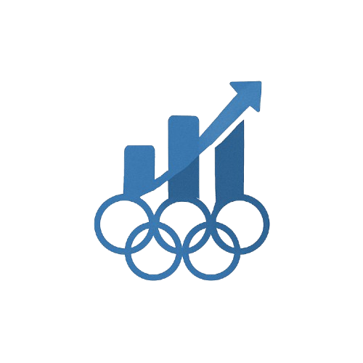

CS661: Big Data Visual Analytics
Group 10
Prof Soumya Datta
Computer Science Department, IITK

Slide 2
Olympus Insight
Topic Seection
Why Olympic? Olympics offer a rich historical dataset spanning over 125 years, making it an exceptional subject for analysis. It provide strong societal, geopolitical, and athletic insights, reflecting broader global trends and shifts over time. Through various visual representation we try to interpret and analyze the data.
Data Procurement and processing
Data Composition
Source
Kaggle (1896-2016 Data)
World Bank (GDP, HDI indicators)
Data cleaning
Normalized country names, handled missing medals, filtered invalid records.
Athlete-Level Data (Age/Gender/Nationality etc.)
Event-specific Data (Sports type, venue, participation etc.)
National Metrics (HDI, Economy etc.)
Temporal Patterns

Slide 3
Module based structure
Clean-segregated sections
Used gender, economy, host status etc data for better insight.
Hosted the application on github to create a live, interaction application
Visualization
UI Designing
Insight generation
Analytics Backend
Deployment
Graph choices
SciVis and InfoVis techniques used
Deployed ML algorithm for medal prediction

Slide 4
Modules
Home
Basic Info to get started
Dashboard for easy navigation
Global View
3D globe using plotly’s choropleth with color mapping for medal efficiency and country-wise info on hovering for quick view
Easy navigation to country profile pages using callback methods
Country Profile
More detailed analysis of historical outlook, medal and athlete distribution
More detailed outlook on gender participation, medal efficiency and top sports
Country Comparison
Standard bar and line graphs for easy Comparison between two countries’ performance
Animated graph, normalized radar and Bubble chart for advanced analysis
Olympic Year Profile
Provides a snapshot of a specific edition of olympics along with it’s emblem and mascot
Includes an interactive medal table and a word cloud highlighting country dominance
Sport Profile
Interactive filters for year, olympic type and unique events.
Top Athletes and attributes, Medal (Bar Chart), Gender Dist. (Pie chart), Age Distribution and other analysis.
More Analysis
• Sport Attribute Heatmap and Medal distribution.
• Medal trend of top 10 country (Interactive line plot).
•Comparing characteristics with other sports average. (Bar plots)
Economic Factors
Correlation between economic situations of countries and medal tally
Charts showing medal winning trends across diff HDI level countries
Host Analysis
Compares a host country's performance in three time periods
Visual comparisons involve - medal counts, no. of athlete’s participating & performance changes
Prediction
Predicting medals using LSTM and Decision tree regressor.
Model and breakout sport analysis.

Slide 5
Thank you
Olympus Insight
http://16.16.65.202:8050/

