Slide 1
Topdown Game
Iiro Surakka
Matti Jokitulppo
Mika Lehtinen

Slide 2
Game
Topdown shooter game
Four unique weapons
Three awesome maps
Four dangerous enemies
Skill-based color changing mechanic
Slow down mechanic
Local co-op
Insert awesome picture of the game here

Slide 3
Color changing mechanic
Player has a shield which absorbs projectiles
You can swap between two shield colors
You can only absorb projectiles of same color as your shield
Insert color changing video here

Slide 4
Slow down mechanic
Players can charge their slow down bar
They can drain it by slowing down time
While time is slowed you shoot at normal rate
Insert slow down video here

Slide 5




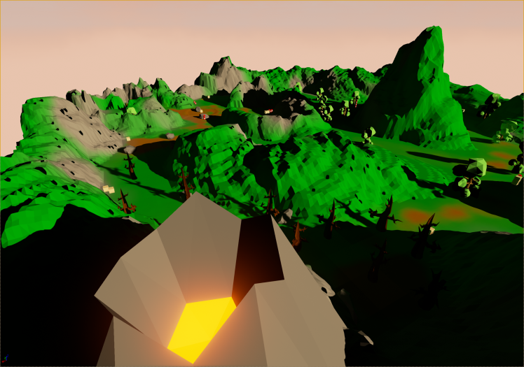
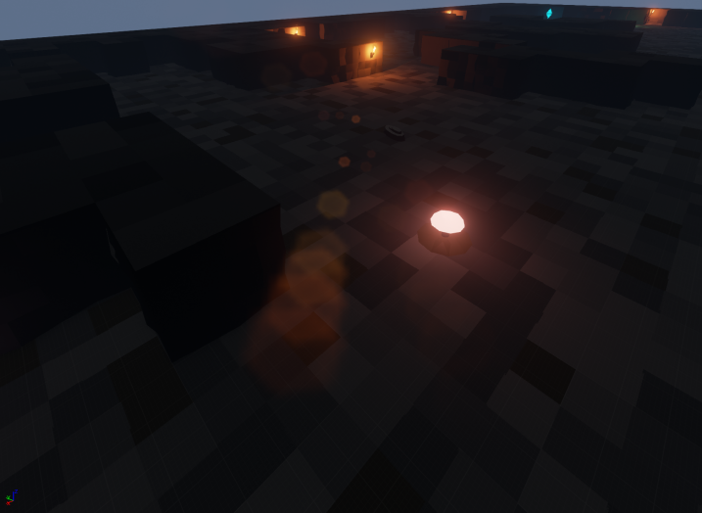
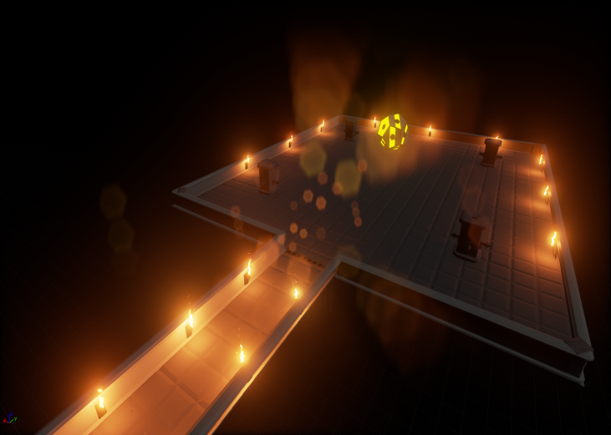
Content
Four unique weapons
Machine gun Missile Launcher Lightning gun Shotgun
Three awesome maps
Jungle Cave Boss
Insert weapon image here
Insert weapon image here
Insert weapon image here
Insert weapon image here
Insert map image here
Insert map image here
Insert map image here

Slide 6
More content
Four dangerous enemies
Swarm enemy Crystal enemy Worm Beholder
Insert enemy image here
Insert enemy image here
Insert enemy image here
Insert enemy image here

Slide 7
Premise
Little previous Unreal Engine 4 experience
Wanted to use Unreal Engine 4 because it seemed better than Unity
Had few game ideas but this seemed the most doable in the course time frame

Slide 8
Development process
Developed some amount at school but mostly home
School computers inadequate for Unreal Engine 4 editor
GitHub for version control
Issues for feature completion and time tracking
Wiki for documentation
Skype and meeting in school for communication

Slide 9
Cut features
Local co-op instead of online
Models
Many weapons
Ammo
Better player animations
Originally planned enemies
Made different kind of enemies instead
Tileset for cave map

Slide 10
Problems
Tried to use C++ but ran into problems with Blueprint integration and hot-reloading
Unreal Engine 4
Many crashes and memory leaks
Likes to modify files randomly => version control usage harder
Blueprints are binary files => developers can’t modify them simultaneosly
Merge tool added in 4.7 but doesn’t work all the time
Blueprint debugging
No step over
Watching values doesn’t work half the time
Blueprints start to fail compiling and saving randomly
Bad error messages and stuff likes to fail silently

Slide 11
What we learned
Unreal Engine 4 isn’t good as it first seemed
Modeling and animating

Slide 12
Demo

