Slide 1
Topdown Game
Iiro Surakka
Matti Jokitulppo
Mika Lehtinen

Slide 2
Game overview
Topdown shooter game
Four unique weapons
Three awesome maps
Four dangerous enemies
Skill-based color changing mechanic
Slow down mechanic
Local co-op (2 players)
Insert awesome picture of the game here

Slide 3
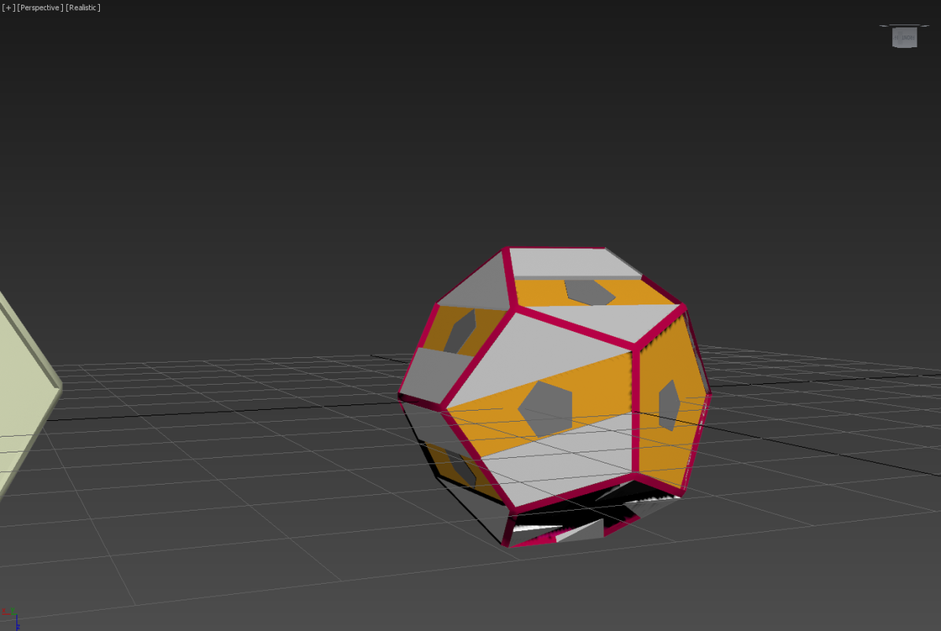
Universe
Plot: You’re a guy with a weapon and you shoot stuff til the next level
Low-poly art style
Quick to model meshes
Stylized with particle effects, physics, materials and post-processing

Slide 4
Color changing mechanic
Player has a shield which absorbs projectiles
You can swap between two shield colors
You can only absorb projectiles of same color as your shield
Insert color changing video here

Slide 5
Slow down mechanic
Players can charge their slow down bar
They can drain it by slowing down time
While time is slowed you shoot at normal rate
Insert slow down video here

Slide 6




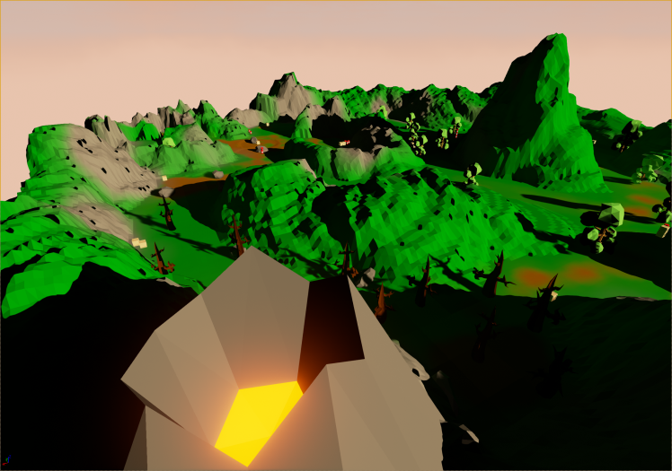
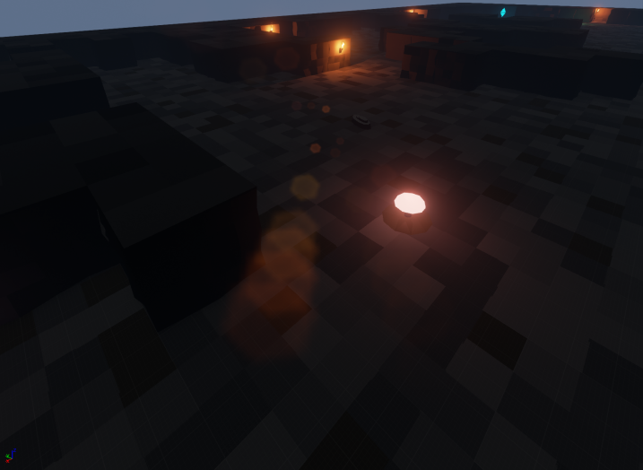
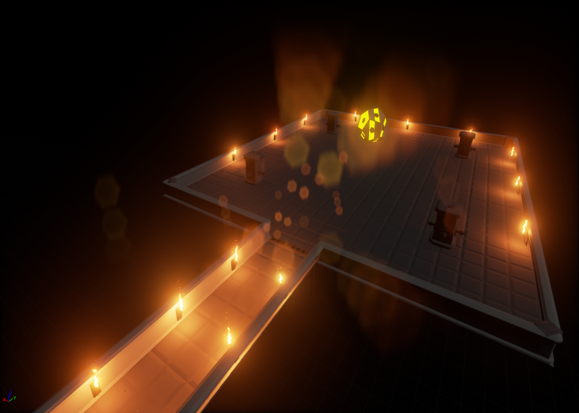
Content
Four unique weapons
Machine gun Missile Launcher Lightning gun Shotgun
Three awesome maps
Jungle Cave Boss
Insert map image here
Insert map image here
Insert map image here

Slide 7
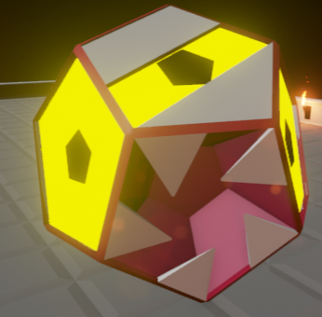
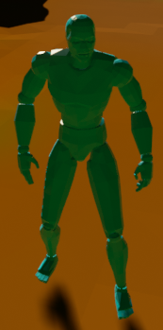
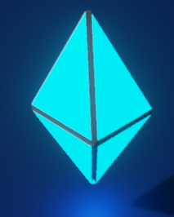
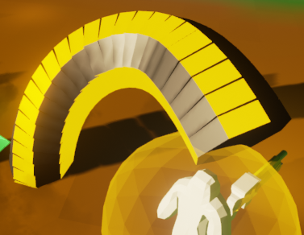
More content
Four dangerous enemies
Swarm enemy Crystal enemy Worm Beholder

Slide 8
Game structure
Either single player or local co-op (max 2 players)
Three levels (along with menu, credits etc...)
Duration: 15-20 minutes
Progressively harder New Game +
Randomly generated parts for replay value
Enemy placement
Weapons and drops
Entire 2nd level

Slide 9
Competitors
Not a lot of competing games on the market
Ours is a pretty unique mix of different gameplay mechanics
Similiar games
Ikaruga
Cave Story
Nuclear Throne
Teleglitch

Slide 10
Key strengths
We’re not really planning to sel this thing, it’s just for fun. That being said:
Selling points
Randomly generated content -> increased replay value
Multiplayer -> play with your friends
Lots of cool graphical effects and sounds and polish

Slide 11
Project premise
Little previous Unreal Engine 4 experience
Wanted to use Unreal Engine 4 because it seemed better than Unity
Had few game ideas but this seemed the most doable in the course time frame

Slide 12
Development process
Developed some amount at school but mostly home
School computers inadequate for Unreal Engine 4 editor
Bad hardware
Old versions
GitHub for version control
Issues for feature completion and time tracking
Wiki for documentation
Skype and meeting in school for communication

Slide 13
Cut features
Local co-op instead of online
Models
Many weapons
Ammo
Better player animations
Originally planned enemies
Made different kind of enemies instead
Tileset for cave map

Slide 14
Problems
Tried to use C++ but ran into problems with Blueprint integration and hot-reloading
Unreal Engine 4
Many crashes and memory leaks
Likes to modify files randomly => version control usage harder
Blueprints are binary files => developers can’t modify them simultaneosly
Merge tool added in 4.7 but doesn’t work all the time
Blueprint debugging
No step over
Watching values doesn’t work half the time
Blueprints start to fail compiling and saving randomly
Bad error messages and stuff likes to fail silently

Slide 15
Lessons learned
Game development with UE4
Issue tracking and management with GitHub
Unreal Engine 4 isn’t as good as it first seemed
However, lot of progress has been made reg. engine
Modeling and animating
It’s hard!

Slide 16
Demo

Slide 17
Questions?
Download: http://yx.fi/7au

