Slide 1
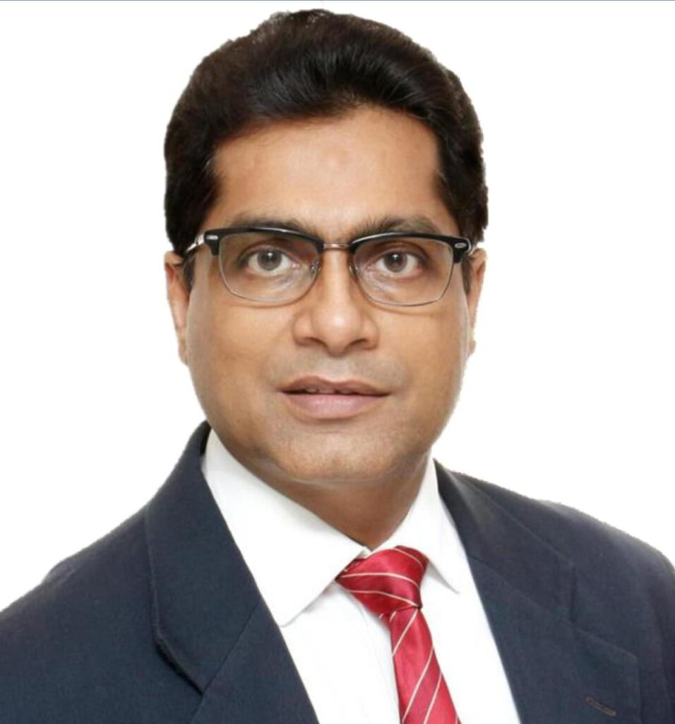
CURRENT POSITIONS
Central Council Member, ICAI
Trustee & Managing Committee Member, Hindustan Medical Institution (Birla Group)
Chairman, Internal Audit Standards Board, ICAI
Independent Director, Om Freight Forwarders Limited
Vice Chairman, Auditing & Assurance Standards Board, ICAI
Member, Regional Advisory Committee of Direct Tax, Calcutta
Convenor, Estate Development Directorate, ICAI
Member, Airport Advisory Committee (Silchar, Assam)
Deputy Convenor, Region & Branch Affairs Directorate, ICAI
President, Government Boys Higher Secondary School, an educational institution established in 1863
CA. RAVI KR. PATWA
PAST POSITIONS
PROFESSIONAL ACTIVITIES
Managing Partner
RKP Associates
Chartered Accountants
Chairman, Assam State Council of FICCI & Member, National Council of FICCI
Training for CAG officials, PSU MDs, Directors & Financial Institutions
Advisor, National Council — Institute of Internal Auditors of India
Speaker at national/international CA conferences & seminars across India
OFFICES · EASTERN INDIA
Chairman, EIRC of ICAI (2022–23)
Kolkata · Guwahati · Bhubaneshwar
Patna · Siliguri · Silchar · Cuttack
Ranchi · Kharsia
Represented India at two Indo-Bangla Trade Summits
Chairman, Batgach — Largest CA Network in India (2015–17)
President, Calcutta Chapter — Institute of Internal Auditors (2019–20)
Member of Governing Bodies — Educational & Social Service Organizations
Chairman, Guwahati Branch of ICAI (2008–09)

