Slide 1
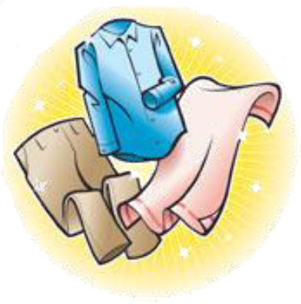
Sorting Criteria
Subtask 5 – RSD Robot System Design

Slide 2
Introduction
Task description
  Everybody knows that washing black and white together is a bad idea, but there are a lot more criteria to consider, to prepare a wash
    Appropriate colors for joint was
    Washing conditions –e.g. temperature, centrifugation, spinning speed, drying
  The appropriate amount of laundry should be prepared in piles or containers, which correspond to the load size of a washing machine
  When elders move in their clothes will be tagged (subtask 6), but the washing recipes of each item should also be registered
    That task should be simple for the staff
Challenges
  Together with group of subtask 6 create an easy an appropriate interface for registering clothes and washing recipes
  Control criteria for the robot arm in subtask 4
  Close collaboration with subtask 4 and 6
  Perhaps some “untagged” clothes should be put in washing bags?
Technologies available
  Investigate possible technologies
Notes:
Back-end communication (Database) and sorting of the data

Slide 3



Entire System
Subtask 5 Area
Subtask 4 Area
Data Base server
MySQL
MySQL Library
Subtask 3 Area
Sort Console App
.NETC#
RFID Console App
Subtask 6 Area
Scanner Library
Socket Transfer Server
Notes:
1# Console Application: Current entire system (not extended)
2# Console Application: Future system (extended system) All into one application which have parts: MySQL Library, Sorting Algorithm, Scanner Library, Socket Transfer Server
Sorting Algorithm: primary task. Sorting criteria’s to control robot hand.
Data Base Server: Make one global data base for any subtask. We provided access to any who asked.
Socket Transfer server: subtask used C++, based on Linux platform. Probably of that they decided to use sockets to make general communication. Here is only additional task from subtask 4.
Scanner Library and MySQL Library: idea was to make one library for data base and scanner/reader. My opinion it is not very good. Because there will be one module mixed two different things like a data base connection/management and scanner connection/management. Better solution to make #2 Console Application, because application have independently modules an they can be easily changed (maybe moved to another technology).

Slide 4
Collaboration
With subtask 4 (Drop-off and sorting robot)
  Provide list of scanned clothes using defined protocol
With subtask 6 (Tagging clothes)
  Provide access to database through created library
  Provide library of RFID readers
With subtask 3 (Positioning of laundry robot)
  Allocate data base space to store data
    Created tables
    Provided general libraries
    Provided configuration tool

Slide 5
Possible Technologies
Why MySQL?
  Open source database, Ease to use, Fast performance, Reliable
  Most popular, Used by Yahoo!, Alcatel-Lucent, Google, Nokia, YouTube and many others
Why create a Socket Server?
  Simple Socket Transfer, Only for subtask 4
What we choose
  C# .NET 3.5
  MySQL
  .dll (dynamic Link Library)
  Sockets (Stream(TCP) or Datagram(UDP))

Slide 6
System Design
Different methods for transfer:
  MySQL
    DLL Library
    Agreed with the other Subtask
  Socket
    Does not rely on DLL, but defined protocol
    Required by Subtask 4

Slide 7
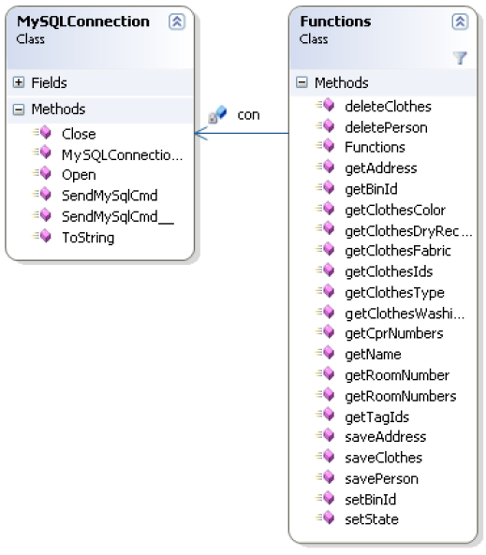
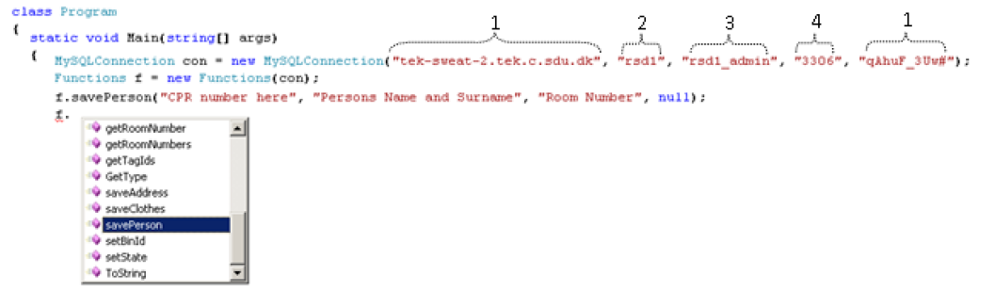
MySQL Library
DLL (dynamic link library)
  MySQL Connection
  Functions
Functions using query

Slide 8
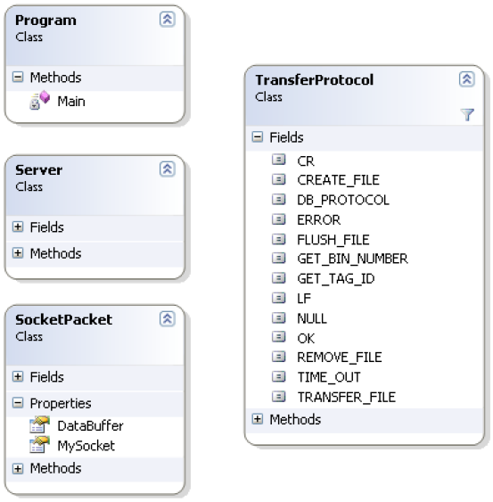
Transfer Socket Server
A console application that:
  Transfers to MySQL Server
  Gets data from MySQL Server
Transfers via sockets (TCP)
  Using a defined protocol
Incoming socket packet
  Trigger event

Slide 9
Task
Subtask3 | Subtask4 | Subtask5 | Subtask6 | Subtask7
MySQL Library |  | MySQL Library |  | ???
Data Base |  | Data Base |  | ???
Data Base configurator | Socket Transfer Server |  |  | ???
 | Sorting Algorithm |  |  | ???
 | RFID controller (driver) |  |  | ???
 | Produce List of Clothes |  |  | ???

Slide 10
Extra:Future Work
Optimize the modules
  Sorting, protocol
Make a visual representation of the sorting
  For optimization and feedback
Create a more unified system
  One Server with:
    SQL database
    Transfer socket application
    Sorting application

Slide 11
#1 Sorting Algorithm
Sorting Algorithm
White
Colored
HW
95˚
HW
95˚
30˚
40˚
60˚
30˚
40˚
60˚
Ten different bins
Not optimal
White
Colored
HW
95˚
HW
95˚
30˚
60˚
30˚
60˚
40˚
40˚

