Slide 1
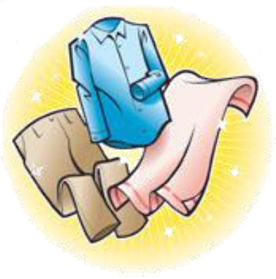
Sorting Criteria
Subtask 5 – RSD Robot System Design

Slide 2
Introduction
Task description
  Everybody knows that washing black and white together is a bad idea, but there are a lot more criteria to consider, to prepare a wash
    Appropriate colors for joint was
    Washing conditions –e.g. temperature, centrifugation, spinning speed, drying
  The appropriate amount of laundry should be prepared in piles or containers, which correspond to the load size of a washing machine
  When elders move in their clothes will be tagged (subtask 6), but the washing recipes of each item should also be registered
    That task should be simple for the staff
Challenges
  Together with group of subtask 6 create an easy an appropriate interface for registering clothes and washing recipes
  Control criteria for the robot arm in subtask 4
  Close collaboration with subtask 4 and 6
  Perhaps some “untagged” clothes should be put in washing bags?
Technologies available
  Investigate possible technologies

Slide 3
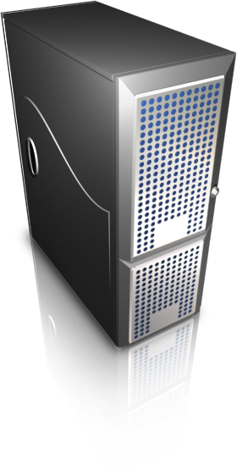

Entire System
Data Base server
Subtask 5 Area
MySQL
Sorting Algorithm
1# Console Application
White
Colored
MySQL Library
HW
95˚
HW
95˚
30˚
40˚
60˚
30˚
40˚
60˚
.NETC#
White
Colored
HW
95˚
HW
95˚
30˚
40˚
60˚
30˚
40˚
60˚
2# Console Application
HW
White
Colored
30˚
95˚
HW
95˚
40˚
60˚
30˚
40˚
60˚
Subtask 6 Area
Scanner Library
Socket Transfer Server
Subtask 4 Area
Notes:
1# Console Application: Current entire system (not extended)
2# Console Application: Future system (extended system) All into one application which have parts: MySQL Library, Sorting Algorithm, Scanner Library, Socket Transfer Server
Sorting Algorithm: primary task. Sorting criteria’s to control robot hand.
Data Base Server: Make one global data base for any subtask. We provided access to any who asked.
Socket Transfer server: subtask used C++, however based on Linux platform. Probably o that they decided to use socket to make general communication. Here is only additional task from subtask 4. There is not primary task.
Scanner Library and MySQL Library: idea was to make one library for data base and scanner/reader. My opinion it is not very good. Because there will be one module mixed two different things like a data base connection/management and scanner connection/management. Better solution to make #2 Console Application, because application have independently modules an they can be easily changed (maybe moved to another technology).

Slide 4
Sorting Criteria
Sorting Algorithm
White
Colored
HW
95˚
HW
95˚
30˚
40˚
60˚
30˚
40˚
60˚
Ten different bins
Not optimum
White
Colored
HW
95˚
HW
95˚
30˚
60˚
30˚
60˚
40˚
40˚

Slide 5
Data Base and MySQL
Data Base server
Why MySQL:
Relational database
Open source database
Ease to use
Fast performance
Reliable
Most popular open source DB in the world
It is used by Yahoo!, Alcatel-Lucent, Google, Nokia, YouTube and many others
MySQL
MySQL Library
.NETC#

Slide 6
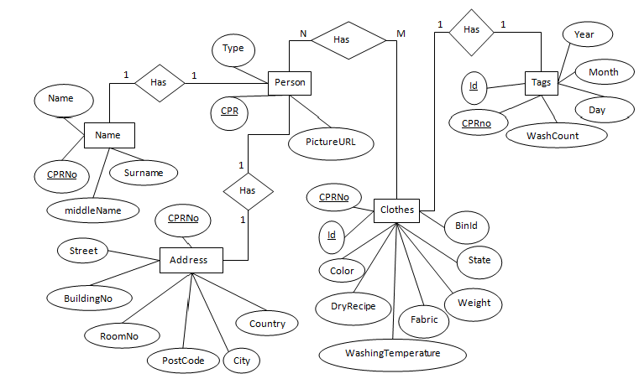
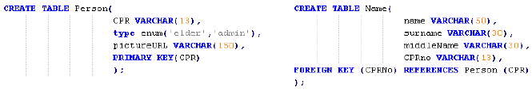
ER Diagram
MySQL Library
.NETC#

Slide 7
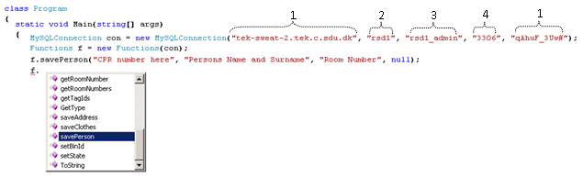
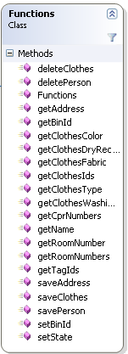
MySQL Library
MySQL Library
.NETC#

Slide 8
Console application
1# Console Application
HW
White
Colored
30˚
95˚
HW
95˚
40˚
60˚
30˚
40˚
60˚
List of Clothes (from RFID)
Console Application
(Use sorting algorithm)
BIN numbers to database

Slide 9
Conclusion
Subtask3 | Subtask4 | Subtask5 | Subtask6 | Subtask7
MySQL Library |  | MySQL Library |  | ???
Data Base |  | Data Base |  | ???
 | Socket Transfer Server |  |  | ???
 | Sorting Algorithm |  |  | ???
 | RFID controller |  |  | ???
 | Produce List of Clothes |  |  | ???

