Slide 1
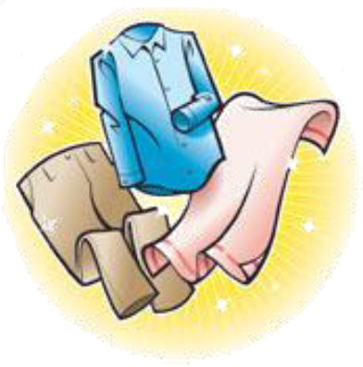
Sorting Criteria
Subtask 5 – RSD Robot System Design

Slide 2
Introduction
Task description
  Everybody knows that washing black and white together is a bad idea, but there are a lot more criteria to consider, to prepare a wash
    Appropriate colors for joint was
    Washing conditions –e.g. temperature, centrifugation, spinning speed, drying
  The appropriate amount of laundry should be prepared in piles or containers, which correspond to the load size of a washing machine
  When elders move in their clothes will be tagged (subtask 6), but the washing recipes of each item should also be registered
    That task should be simple for the staff
Challenges
  Together with group of subtask 6 create an easy an appropriate interface for registering clothes and washing recipes
  Control criteria for the robot arm in subtask 4
  Close collaboration with subtask 4 and 6
  Perhaps some “untagged” clothes should be put in washing bags?
Technologies available
  Investigate possible technologies

Slide 3
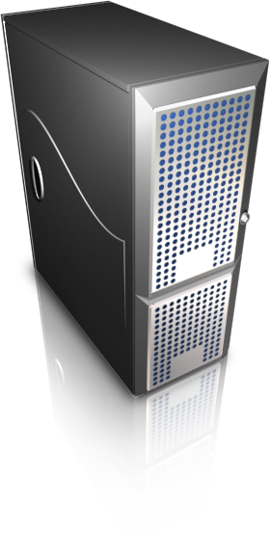

Entire System
Data Base server
Subtask 5 Area
MySQL
Sorting Algorithm
1# Console Application
White
Colored
MySQL Library
HW
95˚
HW
95˚
30˚
40˚
60˚
30˚
40˚
60˚
.NETC#
White
Colored
HW
95˚
HW
95˚
30˚
40˚
60˚
30˚
40˚
60˚
2# Console Application
HW
White
Colored
30˚
95˚
HW
95˚
40˚
60˚
30˚
40˚
60˚
Subtask 6 Area
Scanner Library
Socket Transfer Server
Subtask 4 Area
Notes:
1# Console Application: Current entire system (not extended)
2# Console Application: Future system (extended system) All into one application which have parts: MySQL Library, Sorting Algorithm, Scanner Library, Socket Transfer Server
Sorting Algorithm: primary task. Sorting criteria’s to control robot hand.
Data Base Server: Make one global data base for any subtask. We provided access to any who asked.
Socket Transfer server: subtask used C++, based on Linux platform. Probably of that they decided to use sockets to make general communication. Here is only additional task from subtask 4.
Scanner Library and MySQL Library: idea was to make one library for data base and scanner/reader. My opinion it is not very good. Because there will be one module mixed two different things like a data base connection/management and scanner connection/management. Better solution to make #2 Console Application, because application have independently modules an they can be easily changed (maybe moved to another technology).

Slide 4
System Design
1# Console Application
HW
White
Colored
Extension
30˚
95˚
HW
95˚
40˚
60˚
30˚
40˚
60˚
2# Console Application
Connect scanner
Read clothes in defined interval
Stop read under Time-out
Sort clothes
Write BinID’s
HW
White
Colored
30˚
95˚
HW
95˚
40˚
60˚
30˚
40˚
60˚
Time Out
Read interval
t
List of Clothes
MySQL Library
Sorting Algorithm
BinID
White
Colored
.NETC#
DB
HW
95˚
HW
95˚
30˚
40˚
60˚
30˚
40˚
60˚

Slide 5
#1 Sorting Algorithm
Sorting Algorithm
White
Colored
HW
95˚
HW
95˚
30˚
40˚
60˚
30˚
40˚
60˚
Ten different bins
Not optimal
White
Colored
HW
95˚
HW
95˚
30˚
60˚
30˚
60˚
40˚
40˚

Slide 6
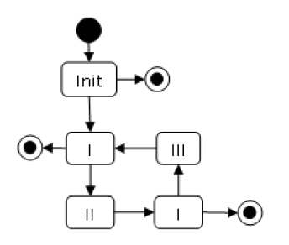
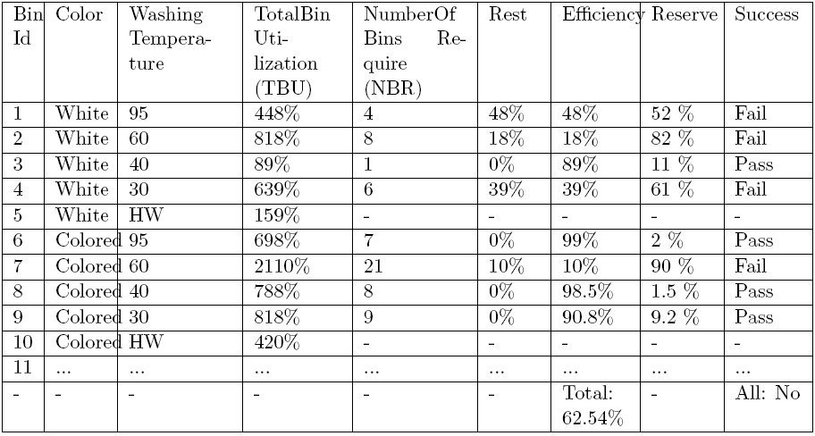
#2 Sorting Algorithm
Sorting Algorithm
White
Colored
HW
95˚
HW
95˚
30˚
40˚
60˚
30˚
40˚
60˚

Slide 7
Conclusion
Subtask3 | Subtask4 | Subtask5 | Subtask6 | Subtask7
MySQL Library |  | MySQL Library |  | ???
Data Base |  | Data Base |  | ???
 | Socket Transfer Server |  |  | ???
 | Sorting Algorithm |  |  | ???
 | RFID controller |  |  | ???
 | Produce List of Clothes |  |  | ???

