Slide 1
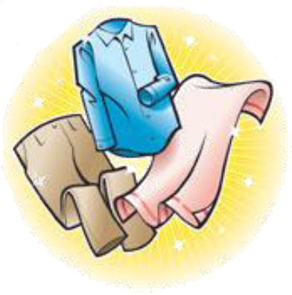
Sorting Criteria
Subtask 5 – RSD Robot System Design

Slide 2
Introduction
Task description
  Everybody knows that washing black and white together is a bad idea, but there are a lot more criteria to consider, to prepare a wash
    Appropriate colors for joint was
    Washing conditions –e.g. temperature, centrifugation, spinning speed, drying
  The appropriate amount of laundry should be prepared in piles or containers, which correspond to the load size of a washing machine
  When elders move in their clothes will be tagged (subtask 6), but the washing recipes of each item should also be registered
    That task should be simple for the staff
Challenges
  Together with group of subtask 6 create an easy an appropriate interface for registering clothes and washing recipes
  Control criteria for the robot arm in subtask 4
  Close collaboration with subtask 4 and 6
  Perhaps some “untagged” clothes should be put in washing bags?
Technologies available
  Investigate possible technologies

Slide 3
Collaboration
With subtask 4 (Drop-off and sorting robot)
  Positioning of laundry robot
With subtask 6 (Tagging clothes)
  Provide access to database through created library
  Provide library of RFID readers
With subtask 3 (Positioning of laundry robot)
  Allocate data base space to store data
    Created tables
    Provided general libraries
    Provided configuration tool

Slide 4
Possible Technologies
Why MySQL?
Why create a Socket Server?

Slide 5
System Design
Complete systems design:

Slide 6
MySQL Library

Slide 7
Transfer Socket Server

Slide 8
Conclusion

Slide 9
Extra:Sorting Criteria

Slide 10
Extra:Future Work

