Slide 1
Chapter 2:
Data and Expressions
C# Software Solutions
Foundations of Program Design
First Edition
by
John Lewis

Slide 2
Data and Expressions
Let's explore some other fundamental programming concepts
Chapter 2 focuses on:
  character strings
  primitive data
  the declaration and use of variables
  expressions and operator precedence
  data conversions
  accepting input from the user
  introduction to graphics
2-<number>

Slide 3
Outline
Character Strings
Variables and Assignment
Primitive Data Types
Expressions
Data Conversion
Interactive Programs
Graphics
Drawing Shapes
2-<number>

Slide 4
Character Strings
A string of characters can be represented as a string literal by putting double quotes around the text:
Examples:
  "This is a string literal."
  "123 Main Street"
  "X"
Every character string is an object in C#, defined by the String class
Every string literal represents a String object
2-<number>

Slide 5
The WriteLine Method
In the Lincoln program from Chapter 1, we invoked the WriteLine method to print a character string
The Console.Out object represents a destination (the monitor screen) to which we can send output
Console.Out.WriteLine("Whatever you are, be a good one.");
object
method
name
information provided to the method
(parameters)
2-<number>

Slide 6
The Write Method
The Console.Out object provides another service as well
The Write method is similar to the WriteLine method, except that it does not advance to the next line
Therefore anything printed after a Write statement will appear on the same line
See Countdown.cs
2-<number>

Slide 7
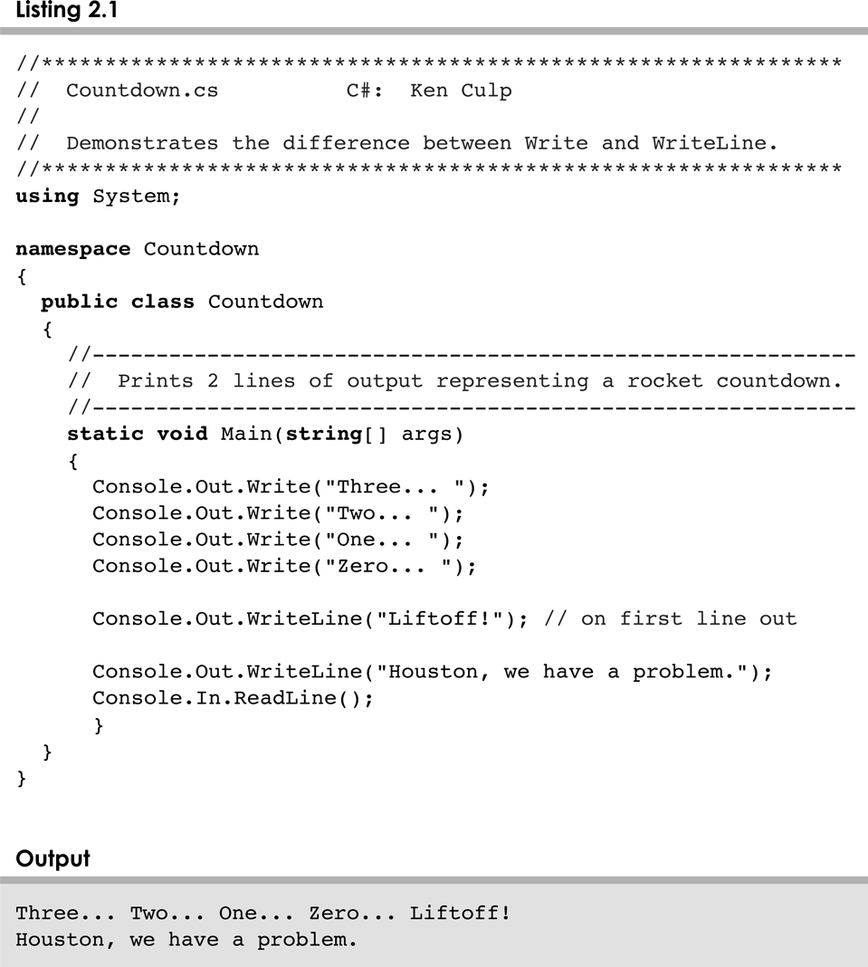
Countdown.cs
2-<number>

Slide 8
String Concatenation
The string concatenation operator (+) is used to append one string to the end of another
"Peanut butter " + "and jelly"
It can also be used to append a number to a string
A string literal cannot be broken across two lines in a program
See Facts.cs
2-<number>

Slide 9
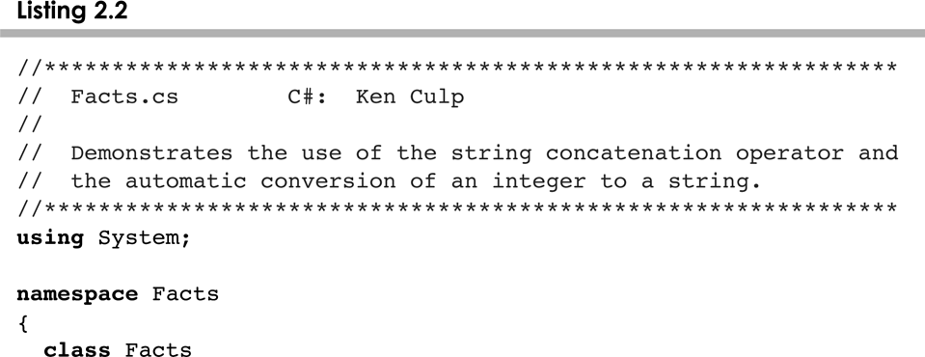
Facts.cs
2-<number>

Slide 10
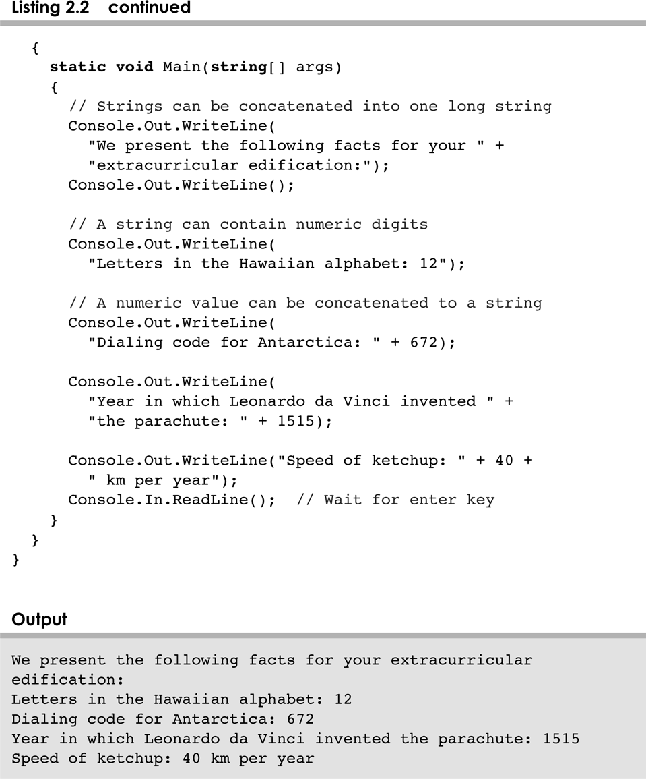
Facts.cs
2-<number>

Slide 11
String Concatenation
The + operator is also used for arithmetic addition
The function that it performs depends on the type of the information on which it operates
If both operands are strings, or if one is a string and one is a number, it performs string concatenation
If both operands are numeric, it adds them
The + operator is evaluated left to right, but parentheses can be used to force the order
See Addition.cs
2-<number>

Slide 12
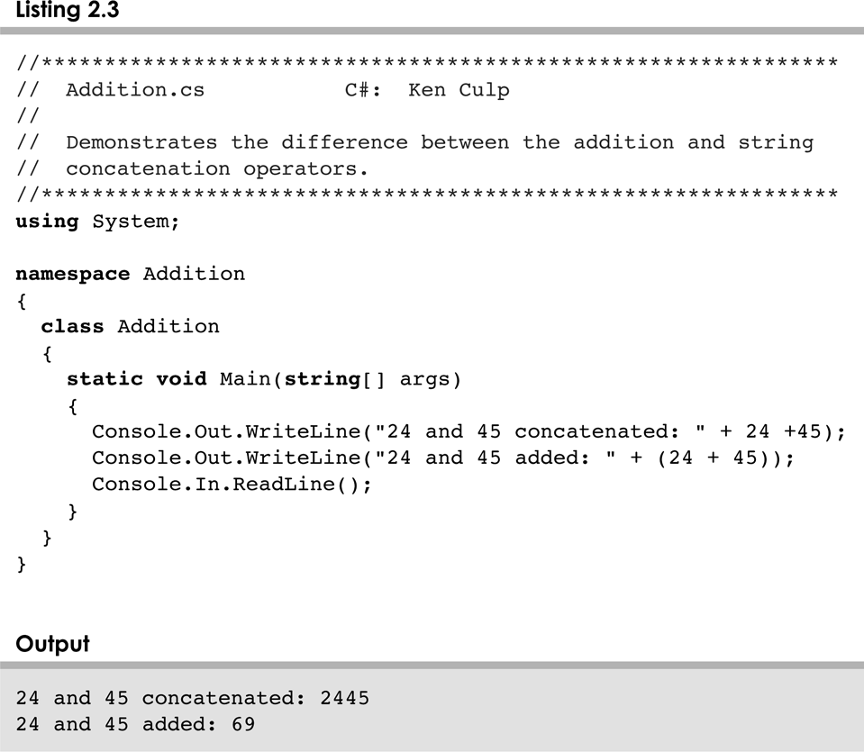
Addition.cs
2-<number>

Slide 13
Escape Sequences
What if we wanted to print a the quote character?
The following line would confuse the compiler because it would interpret the second quote as the end of the string
System.out.println ("I said "Hello" to you.");
An escape sequence is a series of characters that represents a special character
An escape sequence begins with a backslash character (\)
System.out.println ("I said \"Hello\" to you.");
2-<number>

Slide 14
Escape Sequences
Some C# escape sequences:
Escape Sequence
\b
\t
\n
\r
\"
\'
\\
Meaning
backspace
tab
newline
carriage return
double quote
single quote
backslash
See Roses.cs
2-<number>

Slide 15
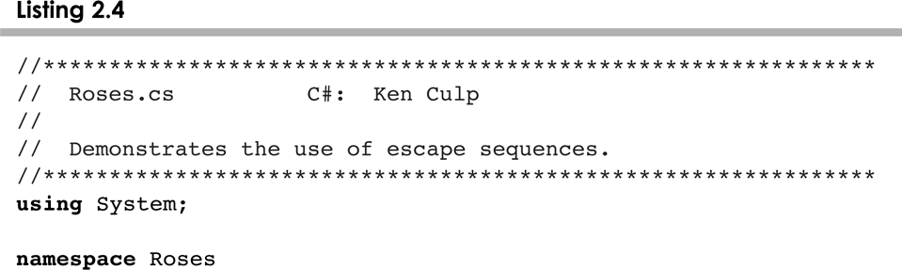
Roses.cs
2-<number>

Slide 16
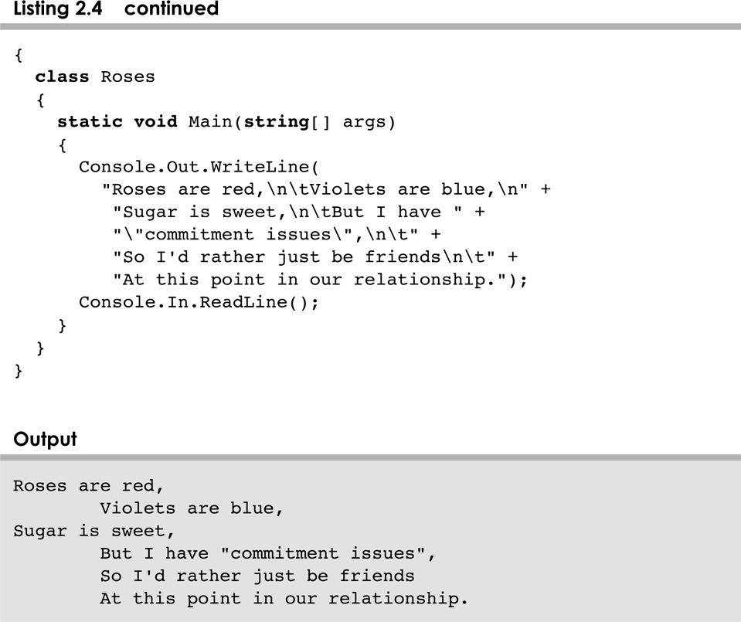
Roses.cs
2-<number>

Slide 17
Outline
Character Strings
Variables and Assignment
Primitive Data Types
Expressions
Data Conversion
Interactive Programs
Graphics
Drawing Shapes
2-<number>

Slide 18
Variables
A variable is a name for a location in memory
A variable must be declared by specifying the variable's name and the type of information that it will hold
data type
variable name
int total;
int count, temp, result;
Multiple variables can be created in one declaration
2-<number>

Slide 19
Variable Initialization
A variable can be given an initial value in the declaration
int sum = 0;
int base = 32, max = 149;
When a variable is referenced in a program, its current value is used
See PianoKeys.cs
2-<number>

Slide 20
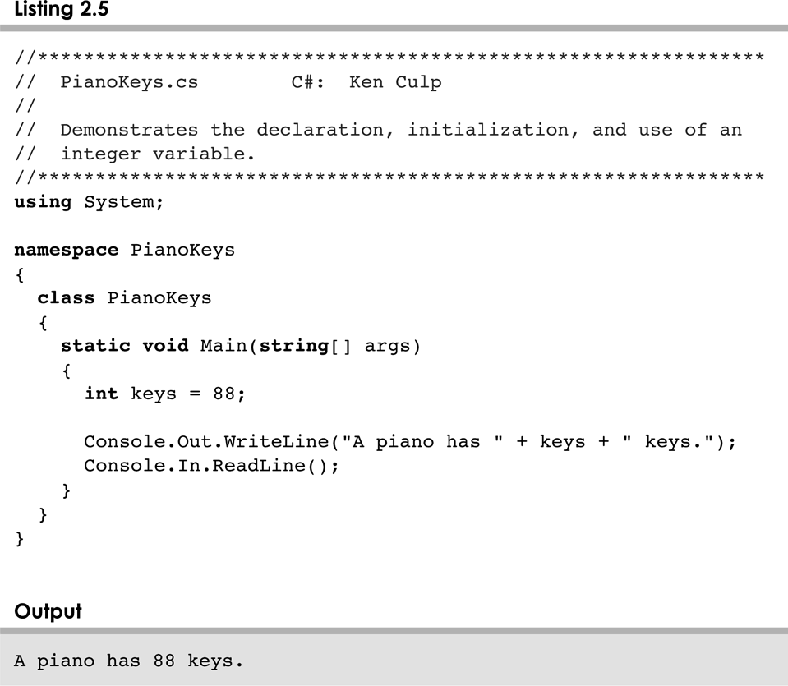
PianoKeys.cs
2-<number>

Slide 21
Assignment
An assignment statement changes the value of a variable
The assignment operator is the = sign
total = 55;
The expression on the right is evaluated and the result is stored in the variable on the left
The value that was in total is overwritten
You can only assign a value to a variable that is consistent with the variable's declared type
See Geometry.cs
2-<number>

Slide 22
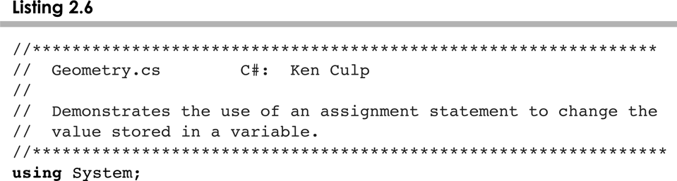
Geometry.cs
2-<number>

Slide 23
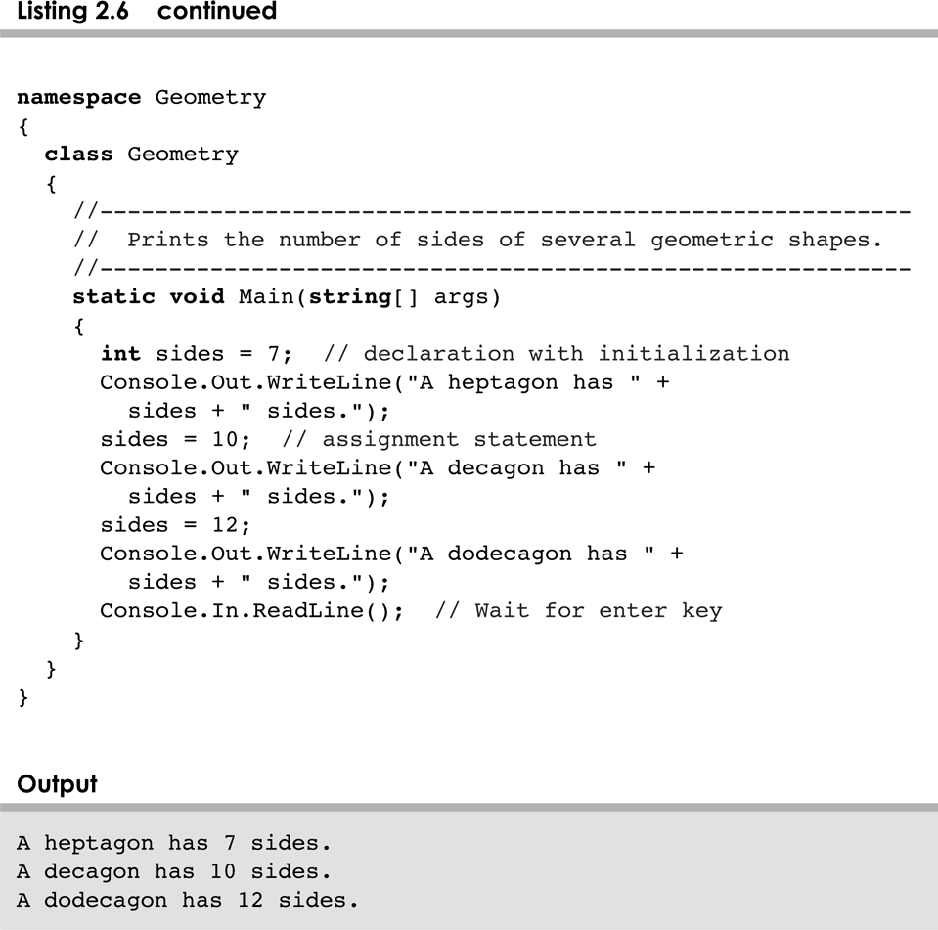
Geometry.cs
2-<number>

Slide 24
Constants
A constant is an identifier that is similar to a variable except that it holds the same value during its entire existence
As the name implies, it is constant, not variable
The compiler will issue an error if you try to change the value of a constant
In C#, we use the const modifier to declare a constant
const int MIN_HEIGHT = 69;
2-<number>

Slide 25
Constants
Constants are useful for three important reasons
First, they give meaning to otherwise unclear literal values
  For example, MAX_LOAD means more than the literal 250
Second, they facilitate program maintenance
  If a constant is used in multiple places, its value need only be updated in one place
Third, they formally establish that a value should not change, avoiding inadvertent errors by other programmers
2-<number>

Slide 26
Outline
Character Strings
Variables and Assignment
Primitive Data Types
Expressions
Data Conversion
Interactive Programs
Graphics
Applets
Drawing Shapes
2-<number>

Slide 27
Primitive Data
There are 13 primitive data types in C#
Eight of them represent integers:
  byte, sbyte,short, ushort,int, uint,long, ulong
Three of them represent floating point numbers:
  float, double,decimal
One of them represents characters:
  char
And one of them represents boolean values:
  bool
2-<number>

Slide 28
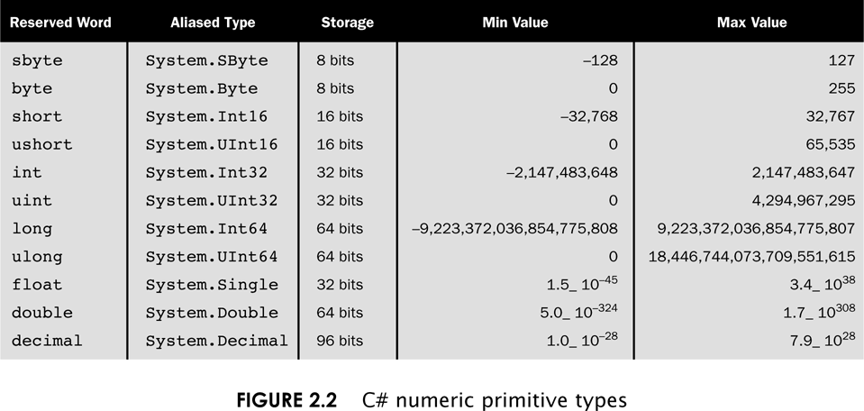
Numeric Primitive Data
2-<number>

Slide 29
Characters
A char variable stores a single character
Character literals are delimited by single quotes:
'a' 'X' '7' '$' ',' '\n'
Example declarations:
  char topGrade = 'A';
  char terminator = ';', separator = ' ';
Note the distinction between a primitive character variable, which holds only one character, and a String object, which can hold multiple characters
2-<number>

Slide 30
Character Sets
A character set is an ordered list of characters, with each character corresponding to a unique number
A char variable in C# can store any character from the Unicode character set
The Unicode character set uses sixteen bits per character, allowing for 65,536 unique characters
It is an international character set, containing symbols and characters from many world languages
2-<number>

Slide 31
Characters
The ASCII character set is older and smaller than Unicode, but is still quite popular
The ASCII characters are a subset of the Unicode character set, including:
uppercase letters
lowercase letters
punctuation
digits
special symbols
control characters
A, B, C, …
a, b, c, …
period, semi-colon, …
0, 1, 2, …
&, |, \, …
carriage return, tab, ...
2-<number>

Slide 32
Boolean
A bool value represents a true or false condition
The reserved words true and false are the only valid values for a boolean type
bool done = false;
A bool variable can also be used to represent any two states, such as a light bulb being on or off
2-<number>

Slide 33
Outline
Character Strings
Variables and Assignment
Primitive Data Types
Expressions
Data Conversion
Interactive Programs
Graphics
Drawing Shapes
2-<number>

Slide 34
Expressions
An expression is a combination of one or more operators and operands
Arithmetic expressions compute numeric results and make use of the arithmetic operators:
Addition
Subtraction
Multiplication
Division
Remainder
+
-
*
/
%
If either or both operands used by an arithmetic operator are floating point, then the result is a floating point
2-<number>

Slide 35
Division and Remainder
If both operands to the division operator (/) are integers, the result is an integer (the fractional part is discarded)
14 / 3 equals
4
8 / 12 equals
0
The remainder operator (%) returns the remainder after dividing the second operand into the first
14 % 3 equals
2
8 % 12 equals
8
2-<number>

Slide 36
Operator Precedence
Operators can be combined into complex expressions
result = total + count / max - offset;
Operators have a well-defined precedence which determines the order in which they are evaluated
Multiplication, division, and remainder are evaluated prior to addition, subtraction, and string concatenation
Arithmetic operators with the same precedence are evaluated from left to right, but parentheses can be used to force the evaluation order
2-<number>

Slide 37
Operator Precedence
What is the order of evaluation in the following expressions?
a + b + c + d + e
a + b * c - d / e
1
2
3
4
3
1
4
2
a / (b + c) - d % e
2
1
4
3
a / (b * (c + (d - e)))
4
3
2
1
2-<number>

Slide 38
Expression Trees
The evaluation of a particular expression can be shown using an expression tree
The operators lower in the tree have higher precedence for that expression
+
a + (b – c) / d
a
/
-
d
b
c
2-<number>

Slide 39
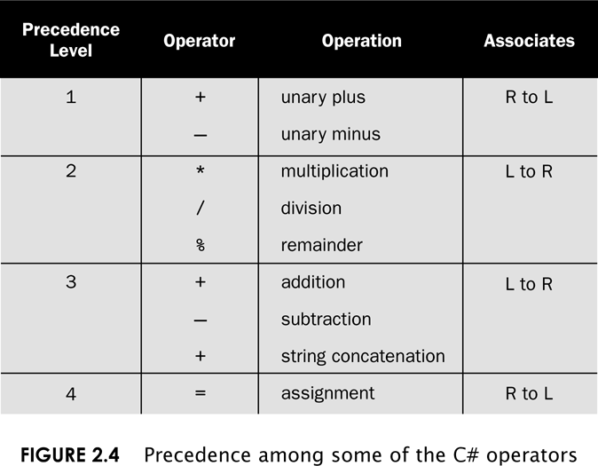
Operator Precedence
2-<number>

Slide 40
Assignment Revisited
The assignment operator has a lower precedence than the arithmetic operators
First the expression on the right hand
side of the = operator is evaluated
answer = sum / 4 + MAX * lowest;
4
1
3
2
Then the result is stored in the
variable on the left hand side
2-<number>

Slide 41
Assignment Revisited
The right and left hand sides of an assignment statement can contain the same variable
First, one is added to the
original value of count
count = count + 1;
Then the result is stored back into count
(overwriting the original value)
See TempConverter.cs
2-<number>

Slide 42
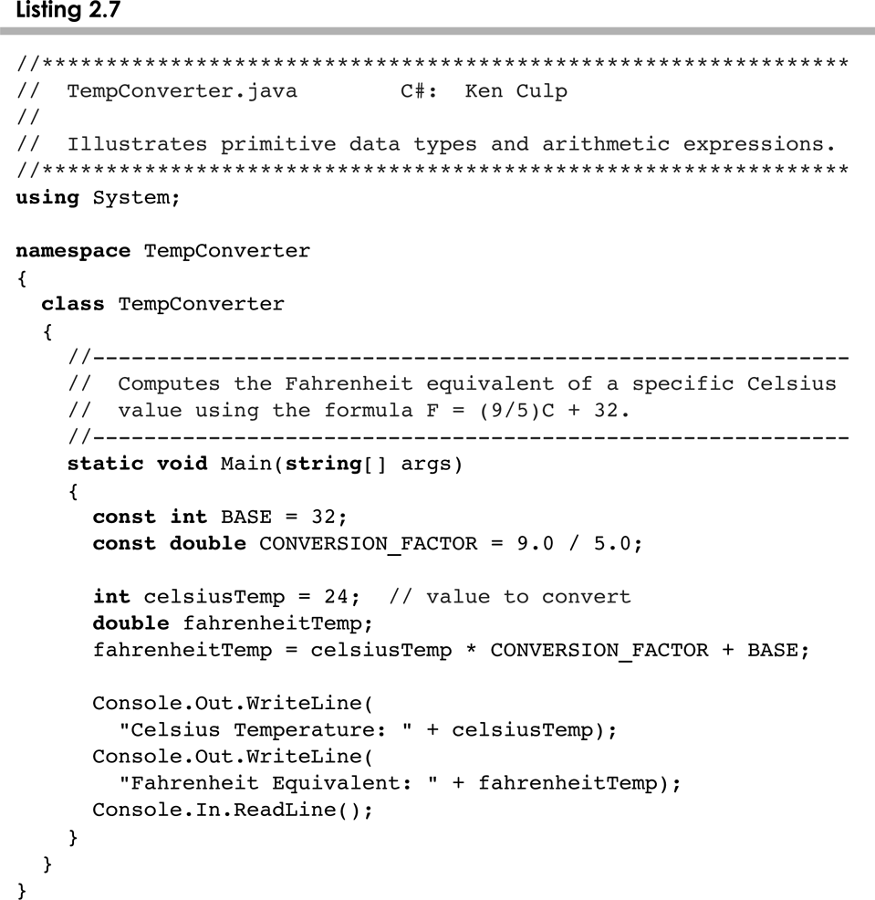
TempConverter.cs
2-<number>

Slide 43
Increment and Decrement
The increment and decrement operators use only one operand
The increment operator (++) adds one to its operand
The decrement operator (--) subtracts one from its operand
The statement
count++;
is functionally equivalent to
count = count + 1;
2-<number>

Slide 44
Increment and Decrement
The increment and decrement operators can be applied in postfix form:
count++
or prefix form:
++count
When used as part of a larger expression, the two forms can have different effects
Because of their subtleties, the increment and decrement operators should be used with care
2-<number>

Slide 45
Assignment Operators
Often we perform an operation on a variable, and then store the result back into that variable
C# provides assignment operators to simplify that process
For example, the statement
num += count;
is equivalent to
num = num + count;
2-<number>

Slide 46
Assignment Operators
There are many assignment operators in C#, including the following:
Operator
+=
-=
*=
/=
%=
Example
x += y
x -= y
x *= y
x /= y
x %= y
Equivalent To
x = x + y
x = x - y
x = x * y
x = x / y
x = x % y
2-<number>

Slide 47
Assignment Operators
The right hand side of an assignment operator can be a complex expression
The entire right-hand expression is evaluated first, then the result is combined with the original variable
Therefore
result /= (total-MIN) % num;
is equivalent to
result = result / ((total-MIN) % num);
2-<number>

Slide 48
Assignment Operators
The behavior of some assignment operators depends on the types of the operands
If the operands to the += operator are strings, the assignment operator performs string concatenation
The behavior of an assignment operator (+=) is always consistent with the behavior of the corresponding operator (+)
2-<number>

Slide 49
Outline
Character Strings
Variables and Assignment
Primitive Data Types
Expressions
Data Conversion
Interactive Programs
Graphics
Drawing Shapes
2-<number>

Slide 50
Data Conversion
Sometimes it is convenient to convert data from one type to another
For example, in a particular situation we may want to treat an integer as a floating point value
These conversions do not change the type of a variable or the value that's stored in it – they only convert a value as part of a computation
2-<number>

Slide 51
Data Conversion
Conversions must be handled carefully to avoid losing information
Widening conversions are safest because they tend to go from a small data type to a larger one (such as a short to an int)
Narrowing conversions can lose information because they tend to go from a large data type to a smaller one (such as an int to a short)
In C#, data conversions can occur in three ways:
  assignment conversion
  promotion
  casting
2-<number>

Slide 52
Assignment Conversion
Assignment conversion occurs when a value of one type is assigned to a variable of another
If money is a float variable and dollars is an int variable, the following assignment converts the value in dollars to a float
    money = dollars
Only widening conversions can happen via assignment
Note that the value or type of dollars did not change
2-<number>

Slide 53
Data Conversion
Promotion happens automatically when operators in expressions convert their operands
For example, if sum is a float and count is an int, the value of count is converted to a floating point value to perform the following calculation:
result = sum / count;
2-<number>

Slide 54
Casting
Casting is the most powerful, and dangerous, technique for conversion
Both widening and narrowing conversions can be accomplished by explicitly casting a value
To cast, the type is put in parentheses in front of the value being converted
For example, if total and count are integers, but we want a floating point result when dividing them, we can cast total:
result = (float) total / count;
2-<number>

Slide 55
Outline
Character Strings
Variables and Assignment
Primitive Data Types
Expressions
Data Conversion
Interactive Programs
Graphics
Drawing Shapes
2-<number>

Slide 56
Interactive Programs
Programs generally need input on which to operate
The Console class provides convenient methods for reading input values of various types
Keyboard input is represented by the Console.In object
See Echo.cs
2-<number>

Slide 57
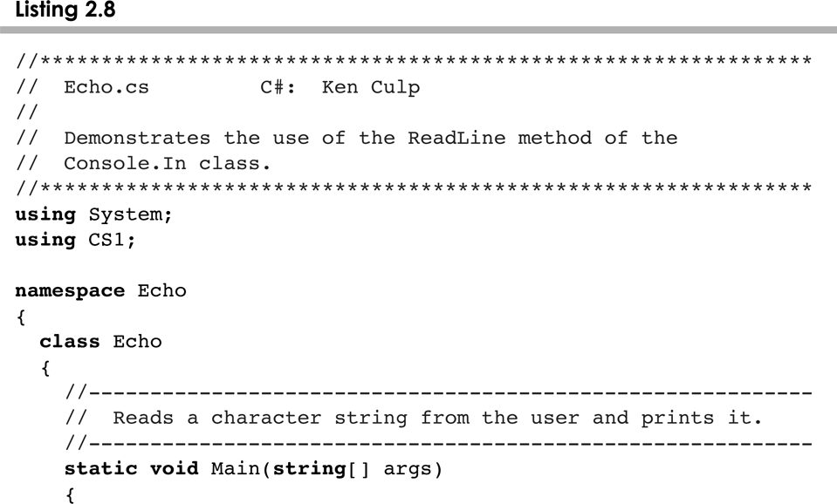
Echo.cs
2-<number>

Slide 58
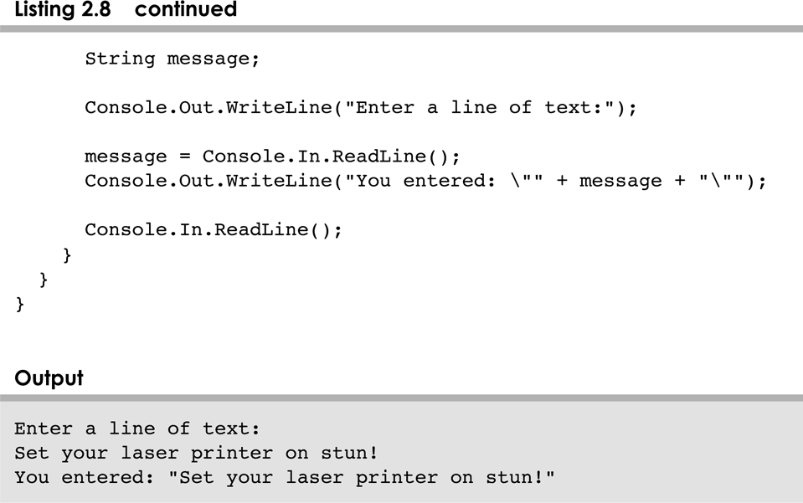
Echo.cs
2-<number>

Slide 59
Numeric Input
The ReadLine() method always return a string
If an interactive program require numeric information to be typed to the keyboard then you have to add an additional step to move the data from string to the appropriate numeric form
To convert from string to another form, we use the Parse static method associated with the type of date we require
double myDouble = double.Parse(myString);
Int myInt = int.Parse(myString();
See GasMileage.cs
2-<number>

Slide 60
Outline
Character Strings
Variables and Assignment
Primitive Data Types
Expressions
Data Conversion
Interactive Programs
Graphics
Drawing Shapes
2-<number>

Slide 61
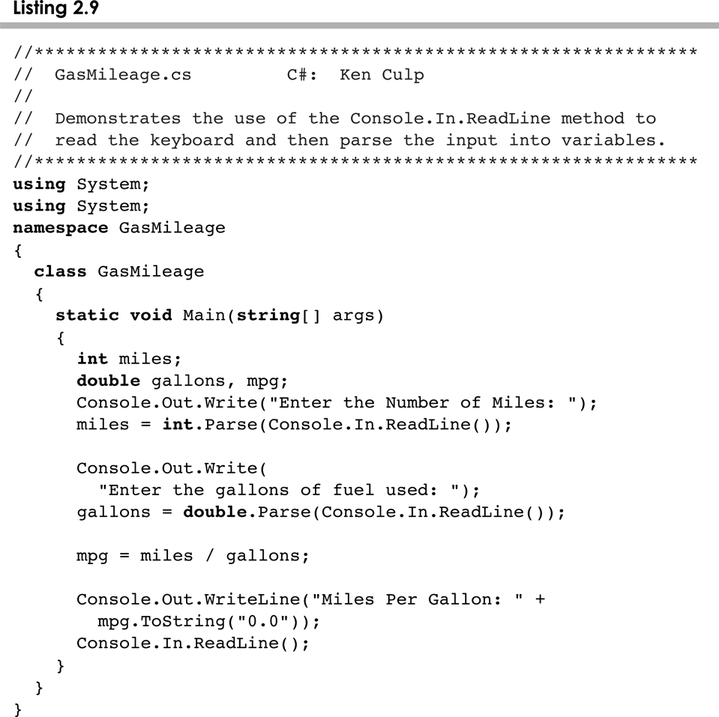
GasMileage.cs
2-<number>

Slide 62
Introduction to Graphics
The last few sections of each chapter of the textbook focus on graphics and graphical user interfaces
A picture or drawing must be digitized for storage on a computer
A picture is made up of pixels (picture elements), and each pixel is stored separately
The number of pixels used to represent a picture is called the picture resolution
The number of pixels that can be displayed by a monitor is called the monitor resolution
2-<number>

Slide 63
Coordinate Systems
Each pixel can be identified using a two-dimensional coordinate system
When referring to a pixel in a Java program, we use a coordinate system with the origin in the top-left corner
(0, 0)
112
X
40
(112, 40)
Y
2-<number>

Slide 64
Representing Color
A black and white picture could be stored using one bit per pixel (0 = white and 1 = black)
A colored picture requires more information; there are several techniques for representing colors
For example, every color can be represented as a mixture of the three additive primary colors Red, Green, and Blue
Each color is represented by three numbers between 0 and 255 that collectively are called an RGB value
2-<number>

Slide 65
The Color Class
A color in a Java program is represented as an object created from the Color class
The Color class also contains several predefined colors, including the following:
Object
Color.black
Color.blue
Color.cyan
Color.orange
Color.white
Color.yellow
RGB Value
0, 0, 0
0, 0, 255
0, 255, 255
255, 200, 0
255, 255, 255
255, 255, 0
2-<number>

Slide 66
Outline
Character Strings
Variables and Assignment
Primitive Data Types
Expressions
Data Conversion
Interactive Programs
Graphics
Drawing Shapes
2-<number>

Slide 67
Outline
Character Strings
Variables and Assignment
Primitive Data Types
Expressions
Data Conversion
Interactive Programs
Graphics
Drawing Shapes
2-<number>

Slide 68
Drawing Shapes
Let's explore some of the methods of the Graphics class that draw shapes in more detail
A shape can be filled or unfilled, depending on which method is invoked
The method parameters specify coordinates and sizes
Shapes with curves, like an oval, are usually drawn by specifying the shape’s bounding rectangle
An arc can be thought of as a section of an oval
2-<number>

Slide 69
Drawing a Line
10
150
X
20
45
Y
page.drawLine (10, 20, 150, 45);
or
page.drawLine (150, 45, 10, 20);
2-<number>

Slide 70
Drawing a Rectangle
50
X
20
40
100
Y
page.drawRect (50, 20, 100, 40);
2-<number>

Slide 71
Drawing an Oval
175
X
20
80
bounding
rectangle
Y
50
page.drawOval (175, 20, 50, 80);
2-<number>

Slide 72
Drawing Shapes
Every drawing surface has a background color
Every graphics context has a current foreground color
Both can be set explicitly
See Snowman.java
2-<number>

Slide 73
Summary
Chapter 2 focused on:
  character strings
  primitive data
  the declaration and use of variables
  expressions and operator precedence
  data conversions
  accepting input from the user
  introduction to graphics
2-<number>

