Slide 1

Chapter 4:
Writing Classes
C# Software Solutions
Foundations of Program Design
First Edition
by
John Lewis

Slide 2
Writing Classes
We've been using predefined classes. Now we will learn to write our own classes to define objects
Chapter 4 focuses on:
  class definitions
  instance data
  encapsulation and Java modifiers
  method declaration and parameter passing
  constructors
  graphical objects
  events and listeners
  buttons and text fields
4-<number>

Slide 3
Outline
Anatomy of a Class
Encapsulation
Anatomy of a Method
Graphical Objects
Graphical User Interfaces
Buttons and Text Fields
4-<number>

Slide 4
Writing Classes
The programs we’ve written in previous examples have used classes defined in the C# standard class library
Now we will begin to design programs that rely on classes that we write ourselves
The class that contains the Main method is just the starting point of a program
True object-oriented programming is based on defining classes that represent objects with well-defined characteristics and functionality
4-<number>

Slide 5
Classes and Objects
Recall from our overview of objects in Chapter 1 that an object has state and behavior
Consider a six-sided die (singular of dice)
  It’s state can be defined as which face is showing
  It’s primary behavior is that it can be rolled
We can represent a die in software by designing a class called Die that models this state and behavior
  The class serves as the blueprint for a die object
We can then instantiate as many die objects as we need for any particular program
4-<number>

Slide 6
Classes
A class can contain data declarations and method declarations
int size, weight;
char category;
Data declarations
Method declarations
4-<number>

Slide 7
Classes
The values of the data define the state of an object created from the class
The functionality of the methods define the behaviors of the object
For our Die class, we might declare an integer that represents the current value showing on the face
One of the methods would “roll” the die by setting that value to a random number between one and six
4-<number>

Slide 8
Classes
We’ll want to design the Die class with other data and methods to make it a versatile and reusable resource
Any given program will not necessarily use all aspects of a given class
See RollingDice.java
See Die.java
4-<number>
Notes:
Et simpelt terningspil.
I dette Terningspil indgår 2 Terninger. Terningerne kan kastes enkeltvis eller samtidig. Hver terning har 6 sider med værdierne 1 – 6. Når terningerne er kastet vises resultatet som summen af værdierne på de 2 terninger.

Slide 9
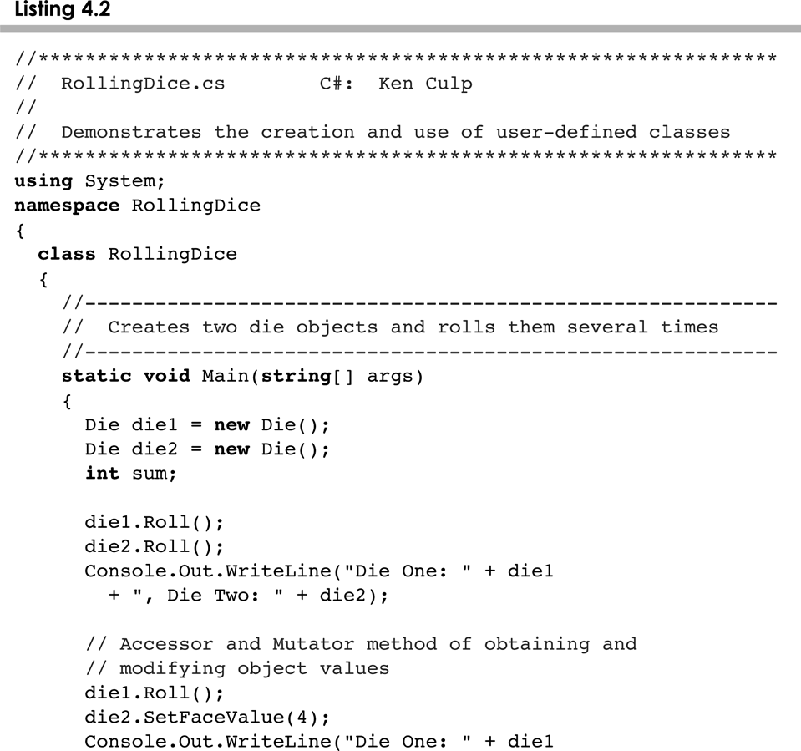
RollingDice.cs
4-<number>

Slide 10
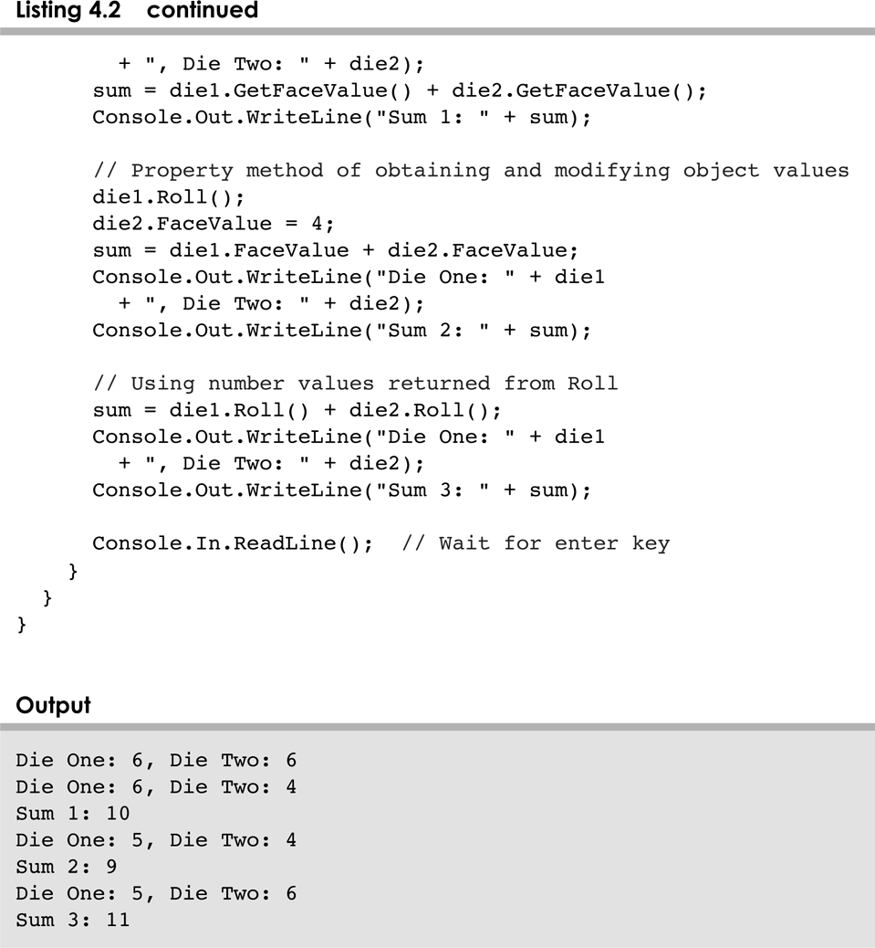
RollingDice.cs
4-<number>

Slide 11
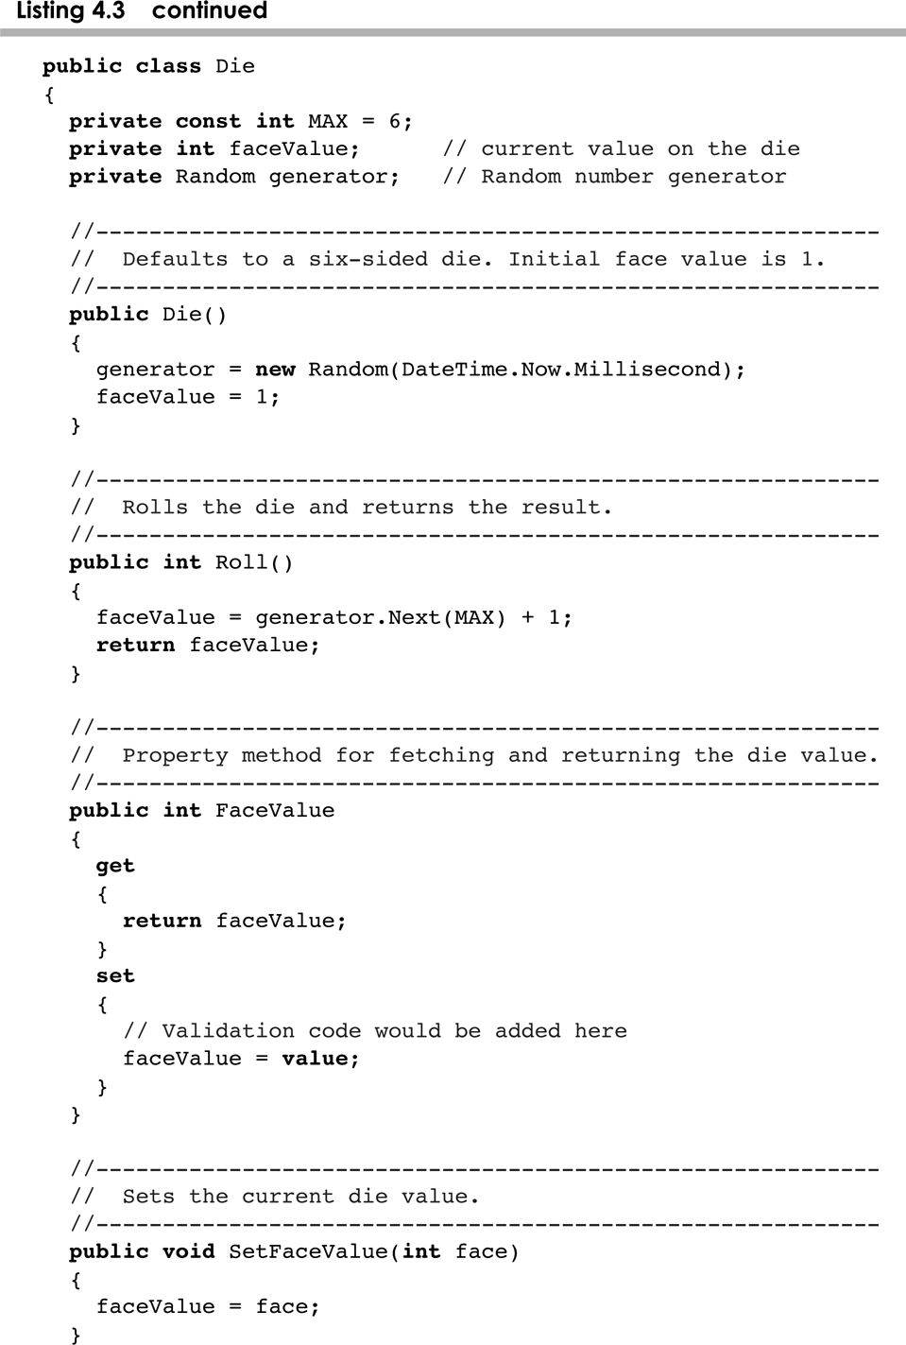
Die.cs
4-<number>

Slide 12
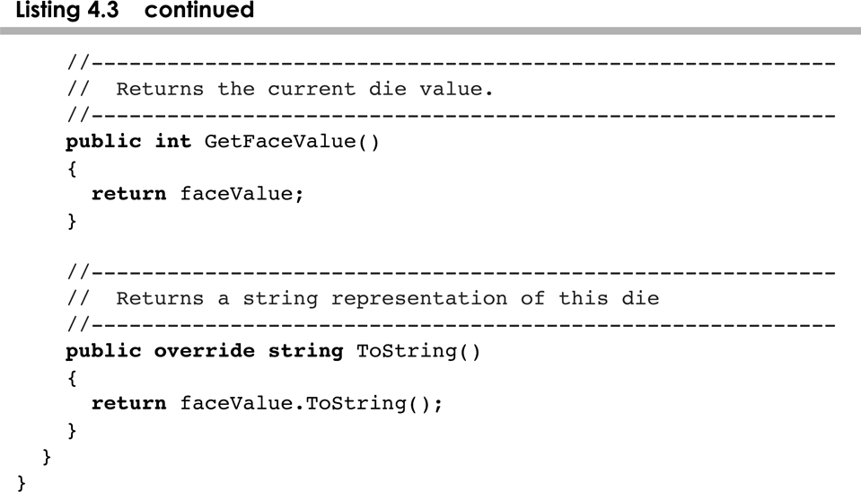
Die.cs
4-<number>

Slide 13
The Die Class
The Die class contains two data values
  a constant MAX that represents the maximum face value
  an integer faceValue that represents the current face value
The roll method uses the Next method of the Random class to determine a new face value
There are also methods to explicitly set and retrieve the current face value at any time
4-<number>

Slide 14
The toString Method
All classes that represent objects should define a ToString method
The ToString method returns a character string that represents the object in some way
It is called automatically when an object is concatenated to a string or when it is passed to the WriteLine method
4-<number>

Slide 15
Constructors
As mentioned previously, a constructor is a special method that is used to set up an object when it is initially created
A constructor has the same name as the class
The Die constructor is used to set the initial face value of each new die object to one
We examine constructors in more detail later in this chapter
4-<number>

Slide 16
Data Scope
The scope of data is the area in a program in which that data can be referenced (used)
Data declared at the class level can be referenced by all methods in that class
Data declared within a method can be used only in that method
Data declared within a method is called local data
4-<number>

Slide 17
Instance Data
The faceValue variable in the Die class is called instance data because each instance (object) that is created has its own version of it
A class declares the type of the data, but it does not reserve any memory space for it
Every time a Die object is created, a new faceValue variable is created as well
The objects of a class share the method definitions, but each object has its own data space
That's the only way two objects can have different states
4-<number>

Slide 18
Instance Data
We can depict the two Die objects from the RollingDice program as follows:
die1
faceValue
5
die2
faceValue
2
Each object maintains its own faceValue variable, and thus its own state
4-<number>

Slide 19
UML Diagrams
UML stands for the Unified Modeling Language
UML diagrams show relationships among classes and objects
A UML class diagram consists of one or more classes, each with sections for the class name, attributes (data), and operations (methods)
Lines between classes represent associations
A dotted arrow shows that one class uses the other (calls its methods)
4-<number>

Slide 20
UML Class Diagrams
A UML class diagram for the RollingDice program:
RollingDice
Die
faceValue : int
main (args : String[]) : void
roll() : int
setFaceValue (int value) : void
getFaceValue() : int
toString() : String
4-<number>

Slide 21
Outline
Anatomy of a Class
Encapsulation
Anatomy of a Method
Graphical Objects
Graphical User Interfaces
Buttons and Text Fields
4-<number>

Slide 22
Encapsulation
We can take one of two views of an object:
  internal - the details of the variables and methods of the class that defines it
  external - the services that an object provides and how the object interacts with the rest of the system
From the external view, an object is an encapsulated entity, providing a set of specific services
These services define the interface to the object
4-<number>

Slide 23
Encapsulation
One object (called the client) may use another object for the services it provides
The client of an object may request its services (call its methods), but it should not have to be aware of how those services are accomplished
Any changes to the object's state (its variables) should be made by that object's methods
We should make it difficult, if not impossible, for a client to access an object’s variables directly
That is, an object should be self-governing
4-<number>

Slide 24
Encapsulation
An encapsulated object can be thought of as a black box -- its inner workings are hidden from the client
The client invokes the interface methods of the object, which manages the instance data
Client
Methods
Data
4-<number>

Slide 25
Visibility Modifiers
In Java, we accomplish encapsulation through the appropriate use of visibility modifiers
A modifier is a C# reserved word that specifies particular characteristics of a method or data
We've used the const modifier to define constants
C# has three visibility modifiers: public, protected, and private
The protected modifier involves inheritance, which we will discuss later
4-<number>

Slide 26
Visibility Modifiers
Members of a class that are declared with public visibility can be referenced anywhere
Members of a class that are declared with private visibility can be referenced only within that class
Members declared without a visibility modifier have default visibility and can be referenced by any class in the same NameSpace
An overview of all C# modifiers is presented in Appendix E
4-<number>

Slide 27
Visibility Modifiers
Public variables violate encapsulation because they allow the client to “reach in” and modify the values directly
Therefore instance variables should not be declared with public visibility
It is acceptable to give a constant public visibility, which allows it to be used outside of the class
Public constants do not violate encapsulation because, although the client can access it, its value cannot be changed
4-<number>

Slide 28
Visibility Modifiers
Methods that provide the object's services are declared with public visibility so that they can be invoked by clients
Public methods are also called service methods
A method created simply to assist a service method is called a support method
Since a support method is not intended to be called by a client, it should not be declared with public visibility
4-<number>

Slide 29
Visibility Modifiers
public
private
Violate
encapsulation
Enforce
encapsulation
Variables
Support other
methods in the
class
Provide services
to clients
Methods
4-<number>

Slide 30
Accessors and Mutators
Because instance data is private, a class usually provides services to access and modify data values
An accessor method returns the current value of a variable
A mutator method changes the value of a variable
The names of accessor and mutator methods take the form getX and setX, respectively, where X is the name of the value
They are sometimes called “getters” and “setters”
4-<number>

Slide 31
Mutator Restrictions
The use of mutators gives the class designer the ability to restrict a client’s options to modify an object’s state
A mutator is often designed so that the values of variables can be set only within particular limits
For example, the SetFaceValue mutator of the Die class should have restricted the value to the valid range (1 to MAX)
We’ll see in Chapter 5 how such restrictions can be implemented
4-<number>

Slide 32
Outline
Anatomy of a Class
Encapsulation
Anatomy of a Method
Graphical Objects
Graphical User Interfaces
Buttons and Text Fields
4-<number>

Slide 33
Method Declarations
Let’s now examine method declarations in more detail
A method declaration specifies the code that will be executed when the method is invoked (called)
When a method is invoked, the flow of control jumps to the method and executes its code
When complete, the flow returns to the place where the method was called and continues
The invocation may or may not return a value, depending on how the method is defined
4-<number>

Slide 34
Method Control Flow
If the called method is in the same class, only the method name is needed
compute
myMethod
myMethod();
4-<number>

Slide 35
Method Control Flow
The called method is often part of another class or object
main
doIt
helpMe
obj.doIt();
helpMe();
4-<number>

Slide 36
Method Header
A method declaration begins with a method header (signature)
char Calc (int num1, int num2, String message)
method
name
parameter list
return
type
The parameter list specifies the type
and name of each parameter
The name of a parameter in the method
declaration is called a formal parameter
4-<number>

Slide 37
Method Body
The method header is followed by the method body
char Calc (int num1, int num2, String message)
{
int sum = num1 + num2;
char result = message.CharAt (sum);
return result;
}
sum and result
are local data
They are created each time the method is called, and are destroyed when it finishes executing
The return expression
must be consistent with
the return type
4-<number>

Slide 38
The return Statement
The return type of a method indicates the type of value that the method sends back to the calling location
A method that does not return a value has a void return type
A return statement specifies the value that will be returned
return expression;
Its expression must conform to the return type
4-<number>

Slide 39
Parameters
When a method is called, the actual parameters in the invocation are copied into the formal parameters in the method header
ch = obj.Calc (25, count, "Hello");
char Calc (int num1, int num2, String message)
{
int sum = num1 + num2;
char result = message.CharAt (sum);
return result;
}
4-<number>

Slide 40
Local Data
As we’ve seen, local variables can be declared inside a method
The formal parameters of a method create automatic local variables when the method is invoked
When the method finishes, all local variables are destroyed (including the formal parameters)
Keep in mind that instance variables, declared at the class level, exists as long as the object exists
4-<number>

Slide 41
Bank Account Example
Let’s look at another example that demonstrates the implementation details of classes and methods
We’ll represent a bank account by a class named Account
It’s state can include the account number, the current balance, and the name of the owner
An account’s behaviors (or services) include deposits and withdrawals, and adding interest
4-<number>

Slide 42
Driver Programs
A driver program drives the use of other, more interesting parts of a program
Driver programs are often used to test other parts of the software
The Transactions class contains a Main method that drives the use of the Account class, exercising its services
See Transactions.java
See Account.java
4-<number>

Slide 43
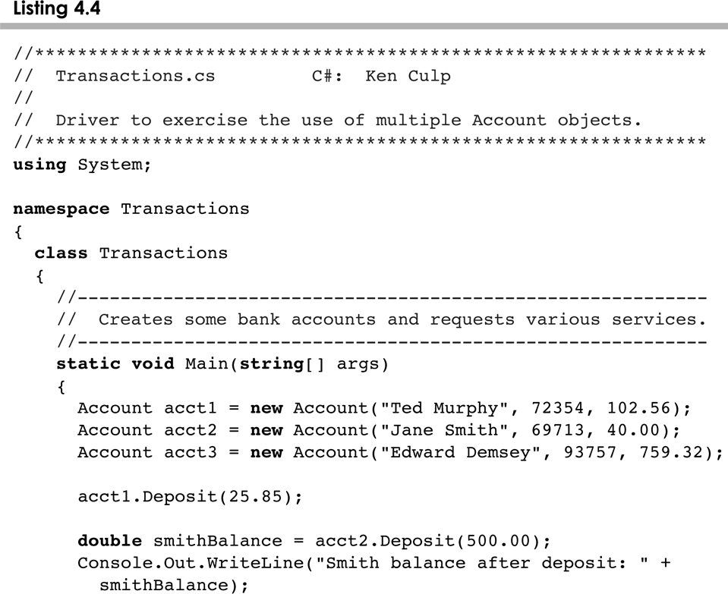
Transactions.cs
4-<number>

Slide 44
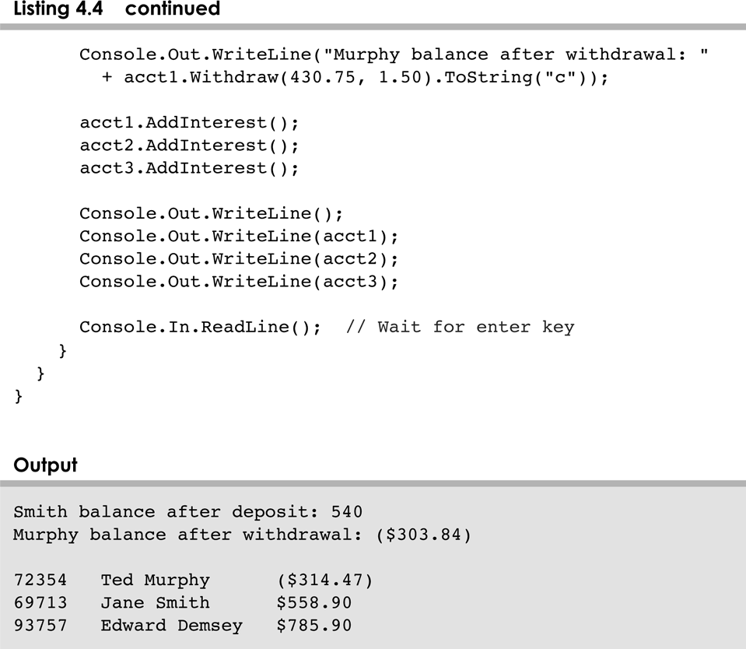
Trancactions.cs
4-<number>

Slide 45
Bank Account Example
acct1
acctNumber
72354
balance
102.56
name
“Ted Murphy”
acct2
acctNumber
69713
balance
40.00
name
“Jane Smith”
4-<number>

Slide 46
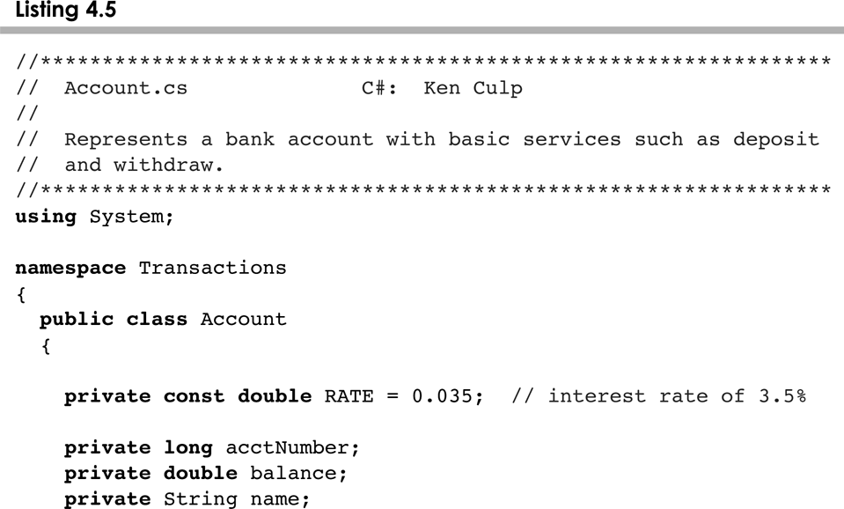
Account.cs
4-<number>

Slide 47
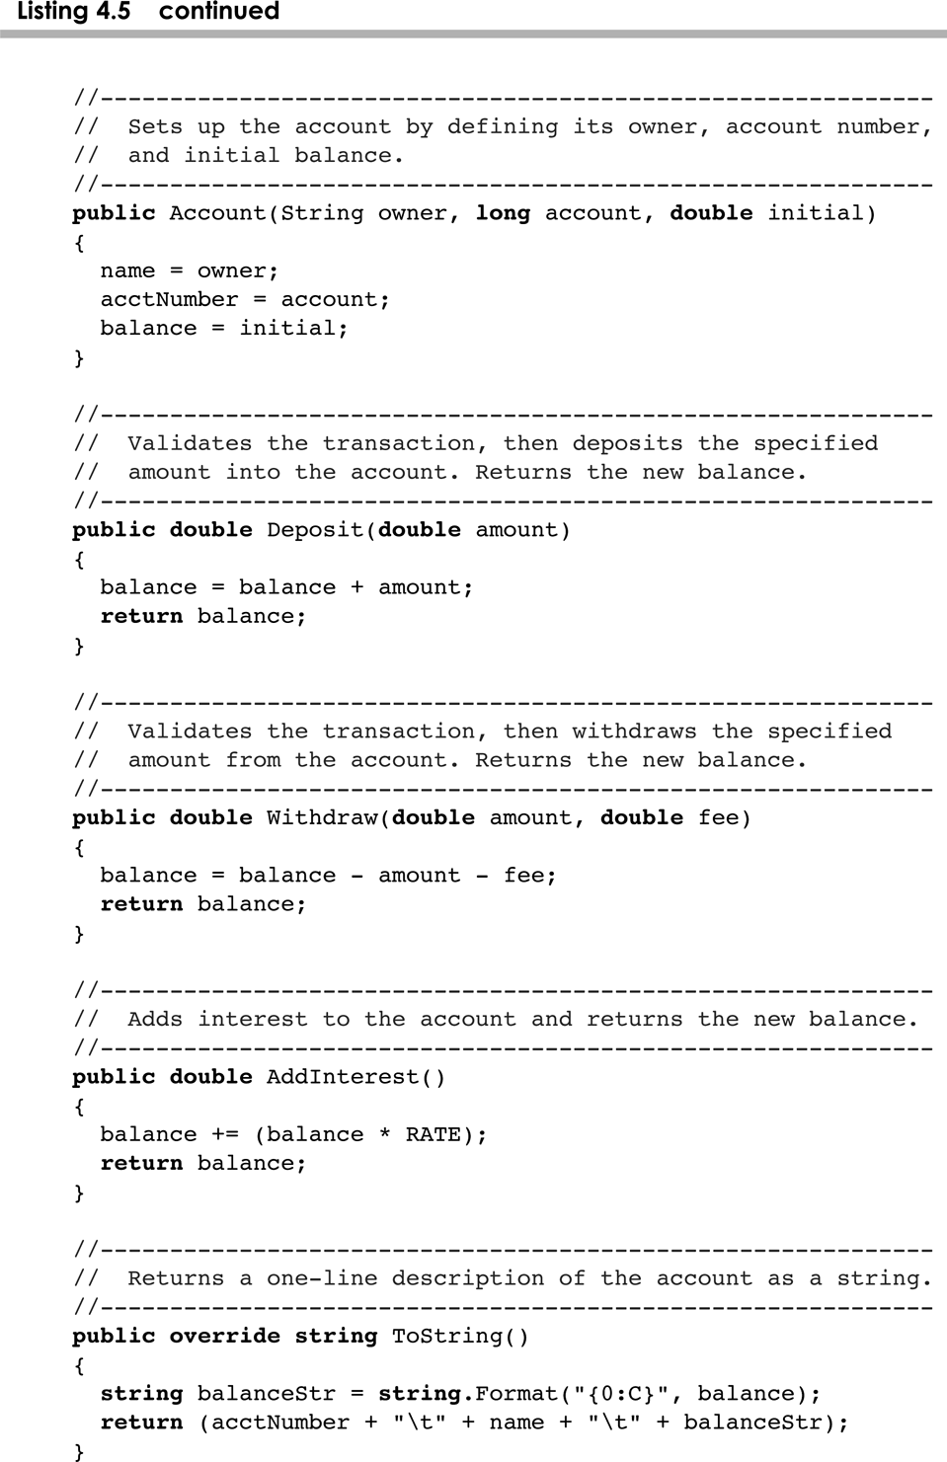
Account.cs
4-<number>

Slide 48
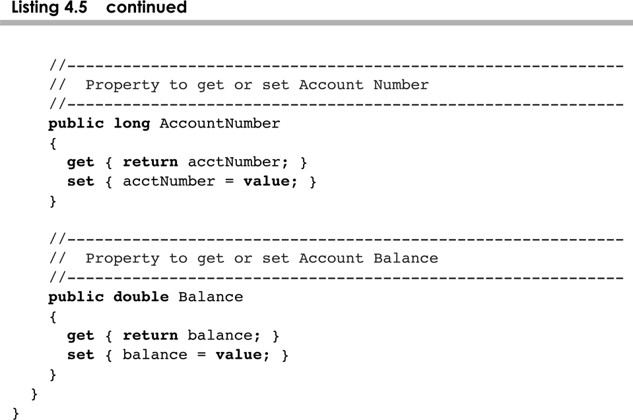
Account.cs
4-<number>

Slide 49
Bank Account Example
There are some improvements that can be made to the Account class
Formal getters and setters could have been defined for all data
The design of some methods could also be more robust, such as verifying that the amount parameter to the Withdraw method is positive
4-<number>

Slide 50
Constructors Revisited
Note that a constructor has no return type specified in the method header, not even void
A common error is to put a return type on a constructor, which makes it a “regular” method that happens to have the same name as the class
The programmer does not have to define a constructor for a class
Each class has a default constructor that accepts no parameters
4-<number>

Slide 51
Outline
Anatomy of a Class
Encapsulation
Anatomy of a Method
Graphical Objects
Graphical User Interfaces
Buttons and Text Fields
4-<number>

Slide 52
Graphical Objects
Some objects contain information that determines how the object should be represented visually
Most GUI components are graphical objects
We can have some effect on how components get drawn
We did this in Chapter 2 when we defined the paint method of an applet
Let's look at some other examples of graphical objects
4-<number>

Slide 53
Smiling Face Example
The SmilingFace program draws a face by defining the paintComponent method of a panel
See SmilingFace.java
See SmilingFacePanel.java
The main method of the SmilingFace class instantiates a SmilingFacePanel and displays it
The SmilingFacePanel class is derived from the JPanel class using inheritance
4-<number>

Slide 54
Smiling Face Example
Every Swing component has a paintComponent method
The paintComponent method accepts a Graphics object that represents the graphics context for the panel
We define the paintComponent method to draw the face with appropriate calls to the Graphics methods
Note the difference between drawing on a panel and adding other GUI components to a panel
4-<number>

Slide 55
Splat Example
The Splat example is structured a bit differently
It draws a set of colored circles on a panel, but each circle is represented as a separate object that maintains its own graphical information
The paintComponent method of the panel "asks" each circle to draw itself
See Splat.java
See SplatPanel.java
See Circle.java
4-<number>

Slide 56
Outline
Anatomy of a Class
Encapsulation
Anatomy of a Method
Graphical Objects
Graphical User Interfaces
Buttons and Text Fields
4-<number>

Slide 57
Graphical User Interfaces
A Graphical User Interface (GUI) in Java is created with at least three kinds of objects:
  components
  events
  listeners
We've previously discussed components, which are objects that represent screen elements
  labels, buttons, text fields, menus, etc.
Some components are containers that hold and organize other components
  frames, panels, applets, dialog boxes
4-<number>

Slide 58
Events
An event is an object that represents some activity to which we may want to respond
For example, we may want our program to perform some action when the following occurs:
  the mouse is moved
  the mouse is dragged
  a mouse button is clicked
  a graphical button is clicked
  a keyboard key is pressed
  a timer expires
Events often correspond to user actions, but not always
4-<number>

Slide 59
Events and Listeners
The Java standard class library contains several classes that represent typical events
Components, such as a graphical button, generate (or fire) an event when it occurs
A listener object "waits" for an event to occur and responds accordingly
We can design listener objects to take whatever actions are appropriate when an event occurs
4-<number>

Slide 60
Events and Listeners
Event
Component
Listener
A component object
may generate an event
A corresponding listener
object is designed to
respond to the event
When the event occurs, the component calls
the appropriate method of the listener,
passing an object that describes the event
4-<number>

Slide 61
GUI Development
Generally we use components and events that are predefined by classes in the Java class library
Therefore, to create a Java program that uses a GUI we must:
  instantiate and set up the necessary components
  implement listener classes for any events we care about
  establish the relationship between listeners and components that generate the corresponding events
Let's now explore some new components and see how this all comes together
4-<number>

Slide 62
Outline
Anatomy of a Class
Encapsulation
Anatomy of a Method
Graphical Objects
Graphical User Interfaces
Buttons and Text Fields
4-<number>

Slide 63
Buttons
A push button is a component that allows the user to initiate an action by pressing a graphical button using the mouse
A push button is defined by the JButton class
It generates an action event
The PushCounter example displays a push button that increments a counter each time it is pushed
See PushCounter.java
See PushCounterPanel.java
4-<number>

Slide 64
Push Counter Example
The components of the GUI are the button, a label to display the counter, a panel to organize the components, and the main frame
The PushCounterPanel class is represents the panel used to display the button and label
The PushCounterPanel class is derived from JPanel using inheritance
The constructor of PushCounterPanel sets up the elements of the GUI and initializes the counter to zero
4-<number>

Slide 65
Push Counter Example
The ButtonListener class is the listener for the action event generated by the button
It is implemented as an inner class, which means it is defined within the body of another class
That facilitates the communication between the listener and the GUI components
Inner classes should only be used in situations where there is an intimate relationship between the two classes and the inner class is not needed in any other context
4-<number>

Slide 66
Push Counter Example
Listener classes are written by implementing a listener interface
The ButtonListener class implements the ActionListener interface
An interface is a list of methods that the implementing class must define
The only method in the ActionListener interface is the actionPerformed method
The Java class library contains interfaces for many types of events
We discuss interfaces in more detail in Chapter 6
4-<number>

Slide 67
Push Counter Example
The PushCounterPanel constructor:
  instantiates the ButtonListener object
  establishes the relationship between the button and the listener by the call to addActionListener
When the user presses the button, the button component creates an ActionEvent object and calls the actionPerformed method of the listener
The actionPerformed method increments the counter and resets the text of the label
4-<number>

Slide 68
Text Fields
Let's look at another GUI example that uses another type of component
A text field allows the user to enter one line of input
If the cursor is in the text field, the text field component generates an action event when the enter key is pressed
See Fahrenheit.java
See FahrenheitPanel.java
4-<number>

Slide 69
Fahrenheit Example
Like the PushCounter example, the GUI is set up in a separate panel class
The TempListener inner class defines the listener for the action event generated by the text field
The FahrenheitPanel constructor instantiates the listener and adds it to the text field
When the user types a temperature and presses enter, the text field generates the action event and calls the actionPerformed method of the listener
The actionPerformed method computes the conversion and updates the result label
4-<number>

Slide 70
Summary
Chapter 4 focused on:
  class definitions
  instance data
  encapsulation and Java modifiers
  method declaration and parameter passing
  constructors
  graphical objects
  events and listeners
  buttons and text fields
4-<number>

