Slide 1
Chapter 7:
Arrays
C# Software Solutions
Foundations of Program Design
First Edition
by
John Lewis

Slide 2
Arrays
Arrays are objects that help us organize large amounts of information
Chapter 7 focuses on:
  array declaration and use
  bounds checking and capacity
  arrays that store object references
  variable length parameter lists
  multidimensional arrays
  the ArrayList class
  polygons and polylines
  mouse events and keyboard events
7-<number>

Slide 3
Outline
Declaring and Using Arrays
Arrays of Objects
Variable Length Parameter Lists
Two-Dimensional Arrays
The ArrayList Class
Polygons and Polylines
Mouse Events and Key Events
7-<number>

Slide 4
Arrays
An array is an ordered list of values
The entire array
has a single name
Each value has a numeric index
0 1 2 3 4 5 6 7 8 9
scores
79 87 94 82 67 98 87 81 74 91
An array of size N is indexed from zero to N-1
This array holds 10 values that are indexed from 0 to 9
7-<number>

Slide 5
Arrays
A particular value in an array is referenced using the array name followed by the index in brackets
For example, the expression
scores[2]
refers to the value 94 (the 3rd value in the array)
That expression represents a place to store a single integer and can be used wherever an integer variable can be used
7-<number>

Slide 6
Arrays
For example, an array element can be assigned a value, printed, or used in a calculation:
scores[2] = 89;
scores[first] = scores[first] + 2;
mean = (scores[0] + scores[1])/2;
Console.Out.WriteLine ("Top = " + scores[5]);
7-<number>

Slide 7
Arrays
The values held in an array are called array elements
An array stores multiple values of the same type – the element type
The element type can be a primitive type or an object reference
Therefore, we can create an array of integers, an array of characters, an array of String objects, an array of Coin objects, etc.
In C#, the array itself is an object that must be instantiated
7-<number>

Slide 8
Arrays
Another way to depict the scores array:
scores
79
87
94
82
67
98
87
81
74
91
7-<number>

Slide 9
Declaring Arrays
The scores array could be declared as follows:
int[] scores = new int[10];
The type of the variable scores is int[] (an array of integers)
Note that the array type does not specify its size, but each object of that type has a specific size
The reference variable scores is set to a new array object that can hold 10 integers
7-<number>

Slide 10
Declaring Arrays
Some other examples of array declarations:
float[] prices = new float[500];
bool[] flags;
flags = new bool[20];
char[] codes = new char[1750];
7-<number>

Slide 11
Using Arrays
The iterator version of the for loop can be used when processing array elements
foreach (int score in scores)
Console.Out.WriteLine(score);
This is only appropriate when processing all array elements from top (lowest index) to bottom (highest index)
See BasicArray.cs
7-<number>

Slide 12
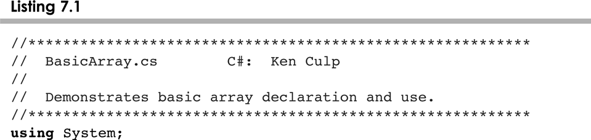
BasicArray.cs
7-<number>

Slide 13
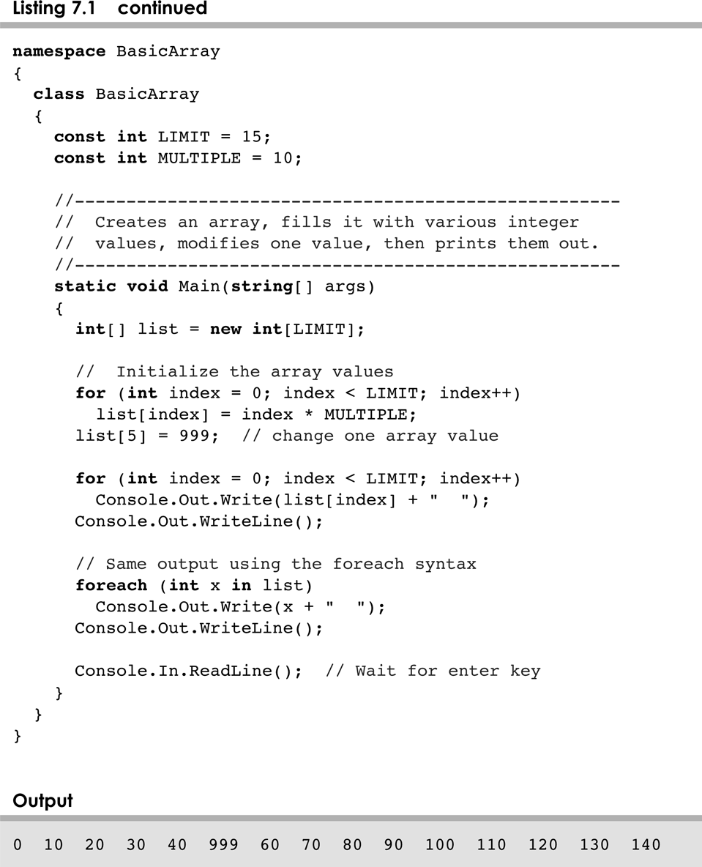
BasicArray.cs
7-<number>

Slide 14
Bounds Checking
Once an array is created, it has a fixed size
An index used in an array reference must specify a valid element
That is, the index value must be in range 0 to N-1
The C# interpreter throws an ArrayIndexOutOfBoundsException if an array index is out of bounds
This is called automatic bounds checking
7-<number>

Slide 15
Bounds Checking
For example, if the array codes can hold 100 values, it can be indexed using only the numbers 0 to 99
If the value of count is 100, then the following reference will cause an exception to be thrown:
Console.Out.WriteLine (codes[count]);
It’s common to introduce off-by-one errors when using arrays
problem
for (int index=0; index <= 100; index++)
codes[index] = index*50 + epsilon;
7-<number>

Slide 16
Bounds Checking
Each array object has a public constant called length that stores the size of the array
It is referenced using the array name:
scores.Length
Note that Length holds the number of elements, not the largest index
See ReverseOrder.cs
See LetterCount.cs
7-<number>

Slide 17
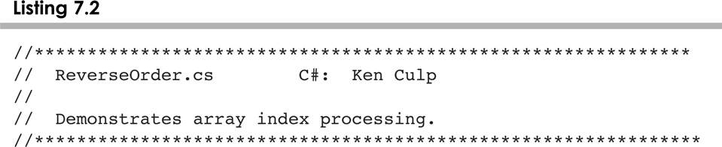
ReverseOrder.cs
7-<number>

Slide 18
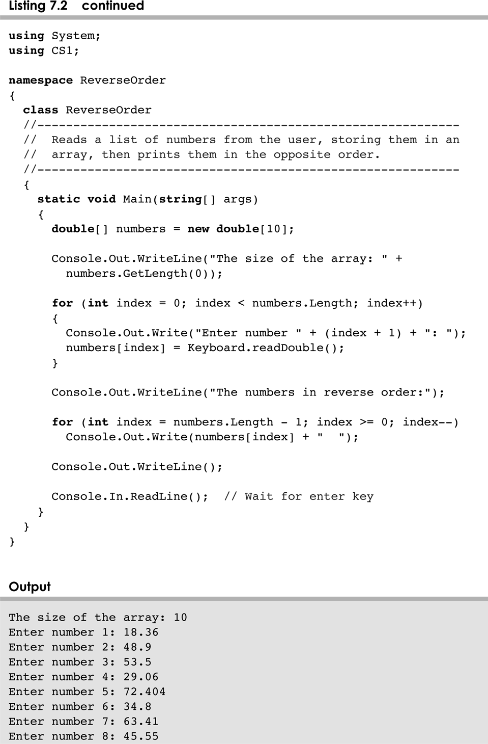
ReverseOrder.cs
7-<number>

Slide 19
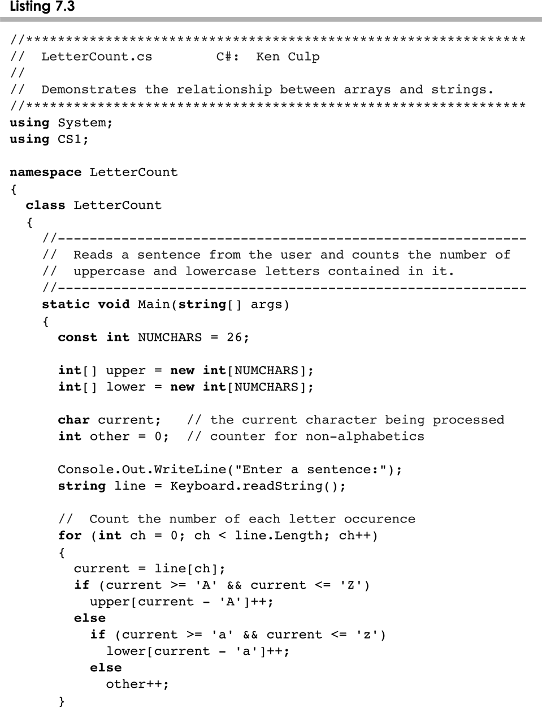
LetterCount.cs
7-<number>

Slide 20
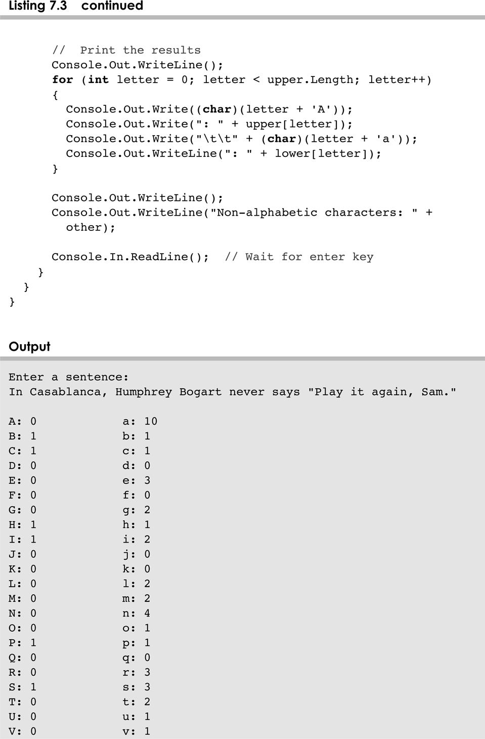
LetterCount.cs
7-<number>

Slide 21
Alternate Array Syntax
The brackets of the array type can be associated with the element type or with the name of the array
Therefore the following two declarations are equivalent:
float[] prices;
float prices[];
The first format generally is more readable and should be used
7-<number>

Slide 22
Initializer Lists
An initializer list can be used to instantiate and fill an array in one step
The values are delimited by braces and separated by commas
Examples:
int[] units = {147, 323, 89, 933, 540,
269, 97, 114, 298, 476};
char[] letterGrades = {'A', 'B', 'C', 'D', ’F'};
7-<number>

Slide 23
Initializer Lists
Note that when an initializer list is used:
  the new operator is not used
  no size value is specified
The size of the array is determined by the number of items in the initializer list
An initializer list can be used only in the array declaration
See Primes.cs
7-<number>

Slide 24
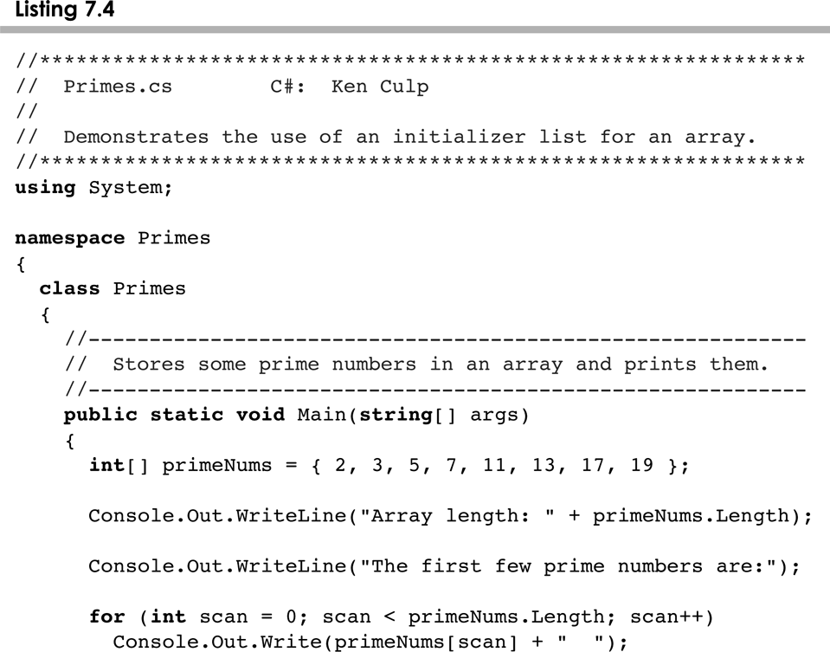
Prices.cs
7-<number>

Slide 25
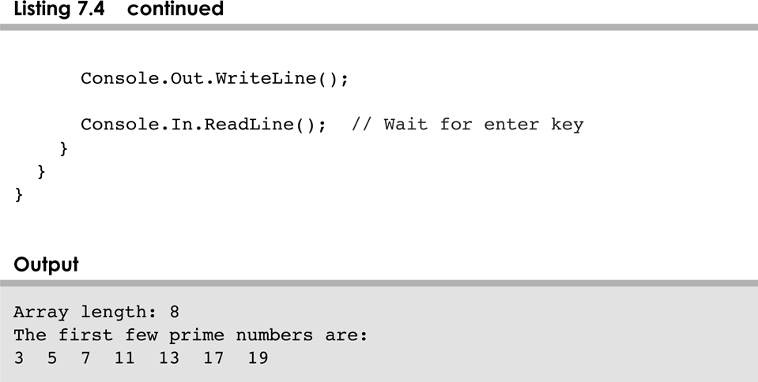
Prices.cs
7-<number>

Slide 26
Arrays as Parameters
An entire array can be passed as a parameter to a method
Like any other object, the reference to the array is passed, making the formal and actual parameters aliases of each other
Therefore, changing an array element within the method changes the original
An individual array element can be passed to a method as well, in which case the type of the formal parameter is the same as the element type
7-<number>

Slide 27
Outline
Declaring and Using Arrays
Arrays of Objects
Variable Length Parameter Lists
Two-Dimensional Arrays
The ArrayList Class
Polygons and Polylines
Mouse Events and Key Events
7-<number>

Slide 28
Arrays of Objects
The elements of an array can be object references
The following declaration reserves space to store 5 references to String objects
String[] words = new String[5];
It does NOT create the String objects themselves
Initially an array of objects holds null references
Each object stored in an array must be instantiated separately
7-<number>

Slide 29
Arrays of Objects
The words array when initially declared:
words
-
-
-
-
-
At this point, the following reference would throw a NullPointerException:
Console.Out.WriteLine(words[0]);
7-<number>

Slide 30
Arrays of Objects
After some String objects are created and stored in the array:
words
“friendship”
“loyalty”
“honor”
-
-
7-<number>

Slide 31
Arrays of Objects
Keep in mind that String objects can be created using literals
The following declaration creates an array object called verbs and fills it with four String objects created using string literals
String[] verbs = {"play", "work", "eat", "sleep"};
7-<number>

Slide 32
Arrays of Objects
The following example creates an array of Grade objects, each with a string representation and a numeric lower bound
See GradeRange.cs
See Grade.cs
Now let's look at an example that manages a collection of CD objects
See Tunes.cs
See CDCollection.cs
See CD.cs
7-<number>

Slide 33
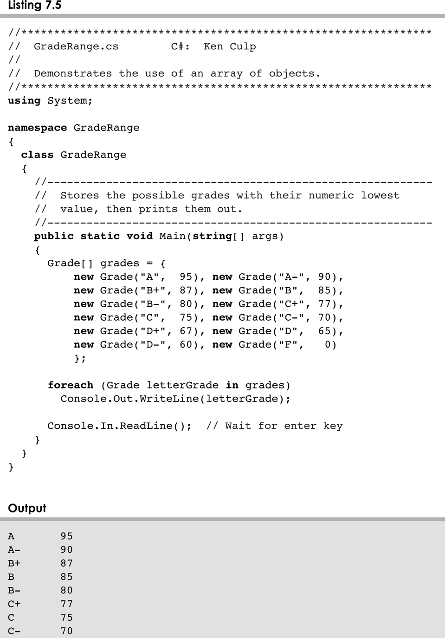
GradeRange.cs
7-<number>

Slide 34
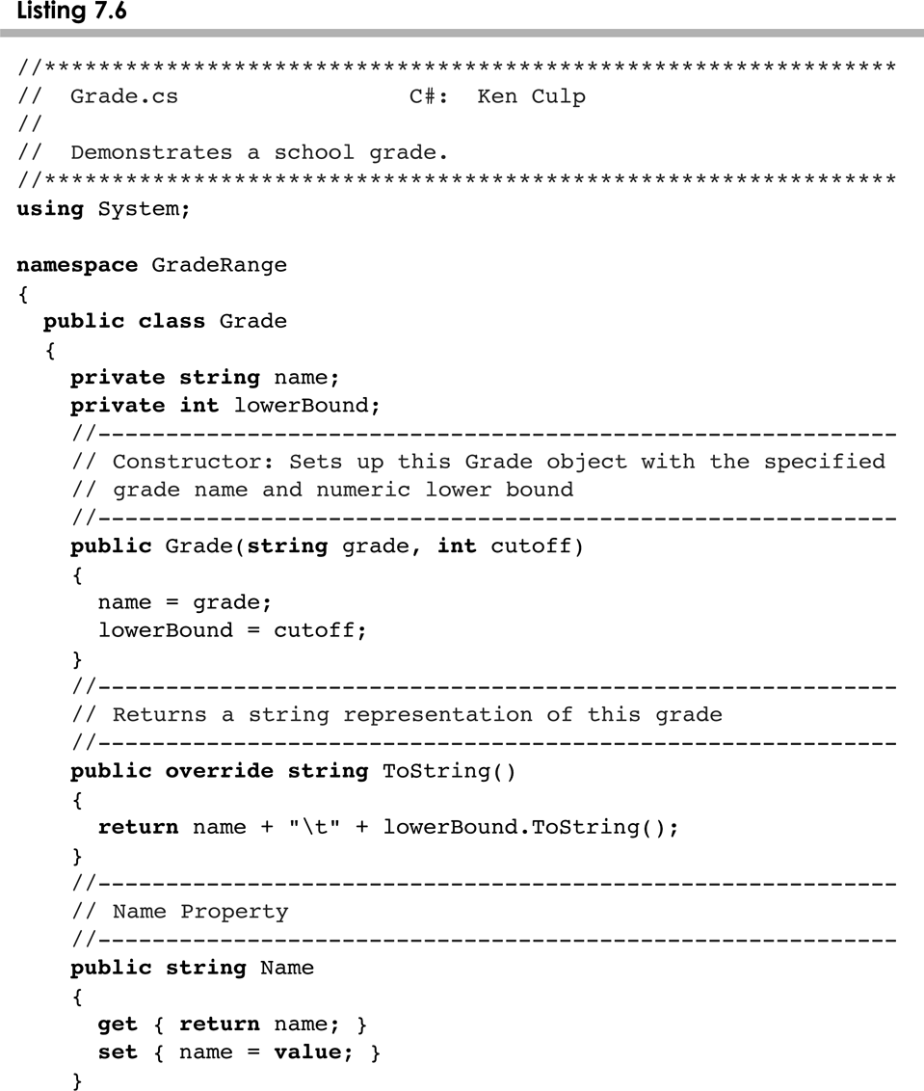
Grade.cs
7-<number>

Slide 35
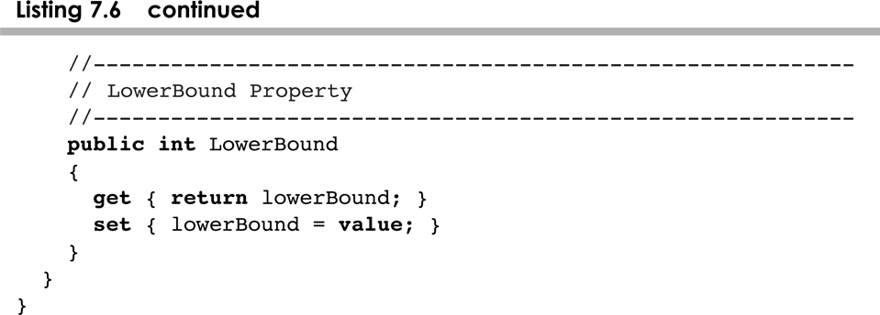
Grade.cs
7-<number>

Slide 36
Arrays of Objects
A UML diagram for the Tunes program:
Tunes
CDCollection
- collection : CD[]
- count : int
- totalCost : double
+ main (args : String[]) : void
+ addCD (title : String, artist : String,
cost : double, tracks : int) : void
+ toString() : String
- increaseSize() : void
CD
- title : String
- artist : String
- cost : double
- tracks : int
1
*
+ toString() : String
7-<number>

Slide 37
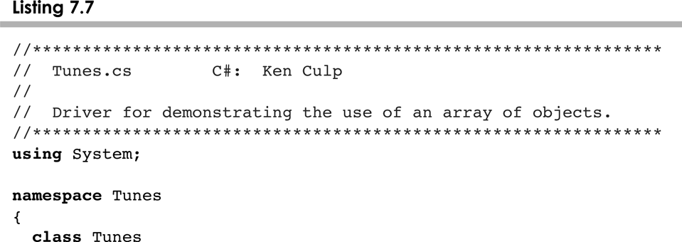
Tunes.cs
7-<number>

Slide 38
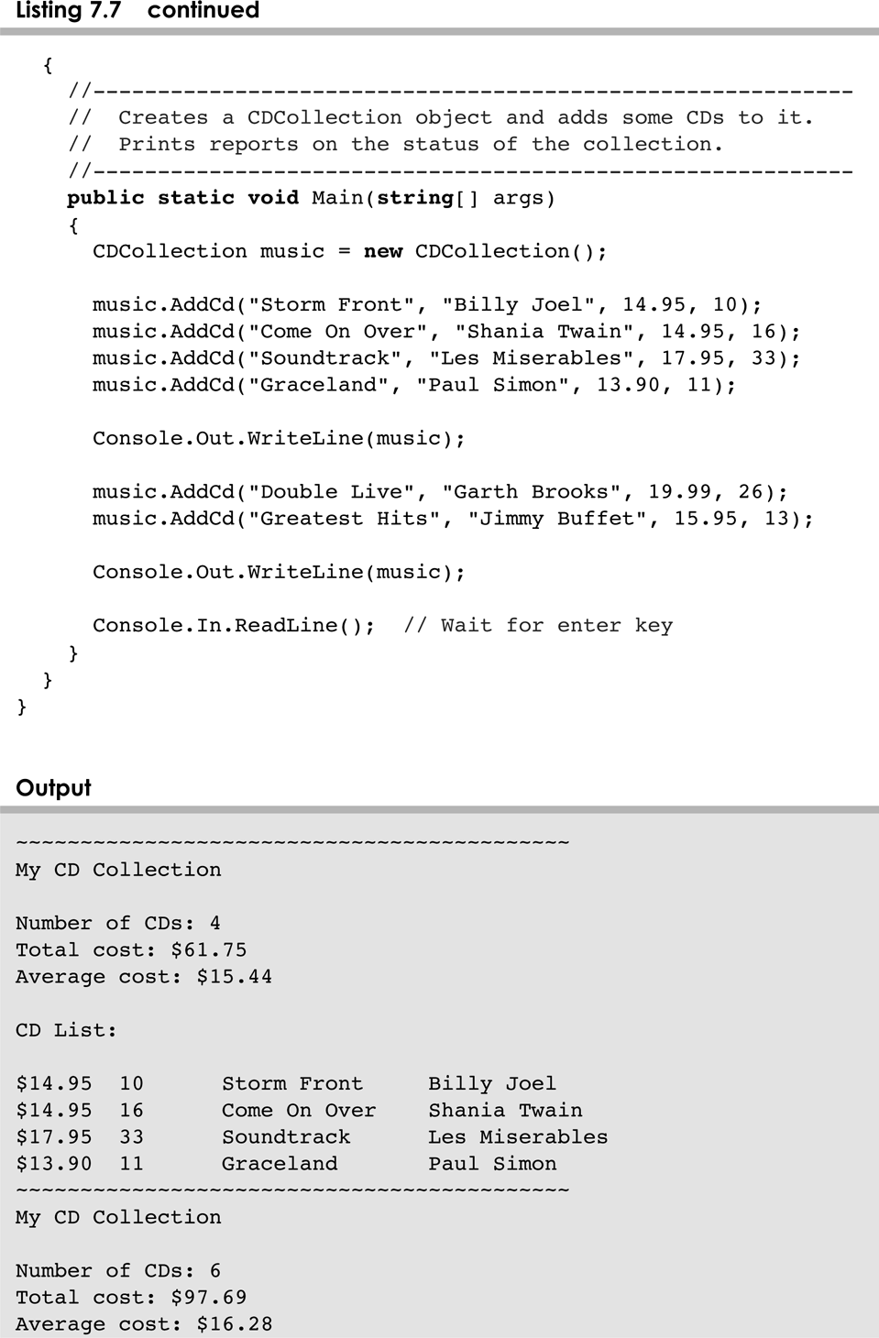
Tunes.cs
7-<number>

Slide 39
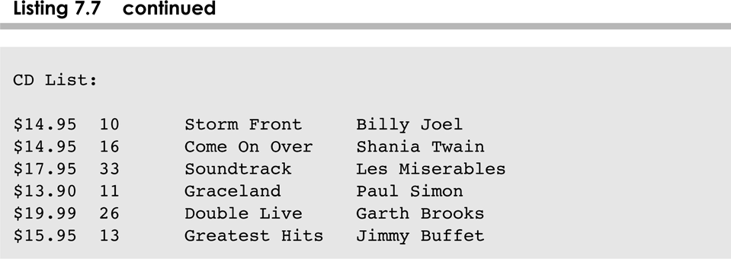
Tunes.cs
7-<number>

Slide 40
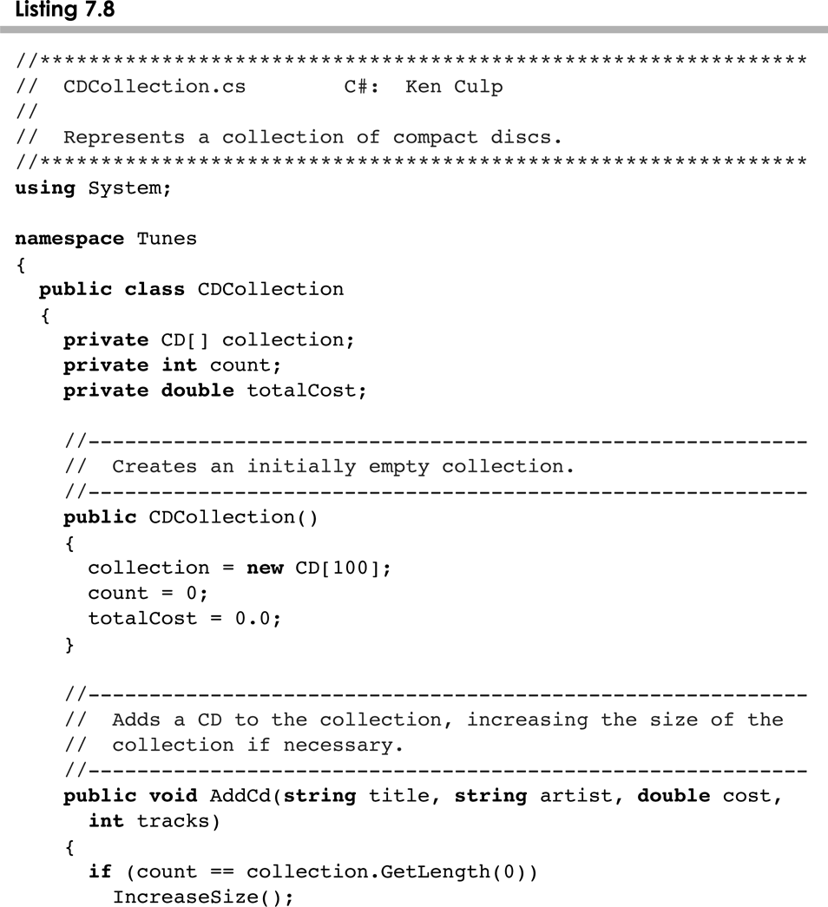
CDCollection.cs
7-<number>

Slide 41
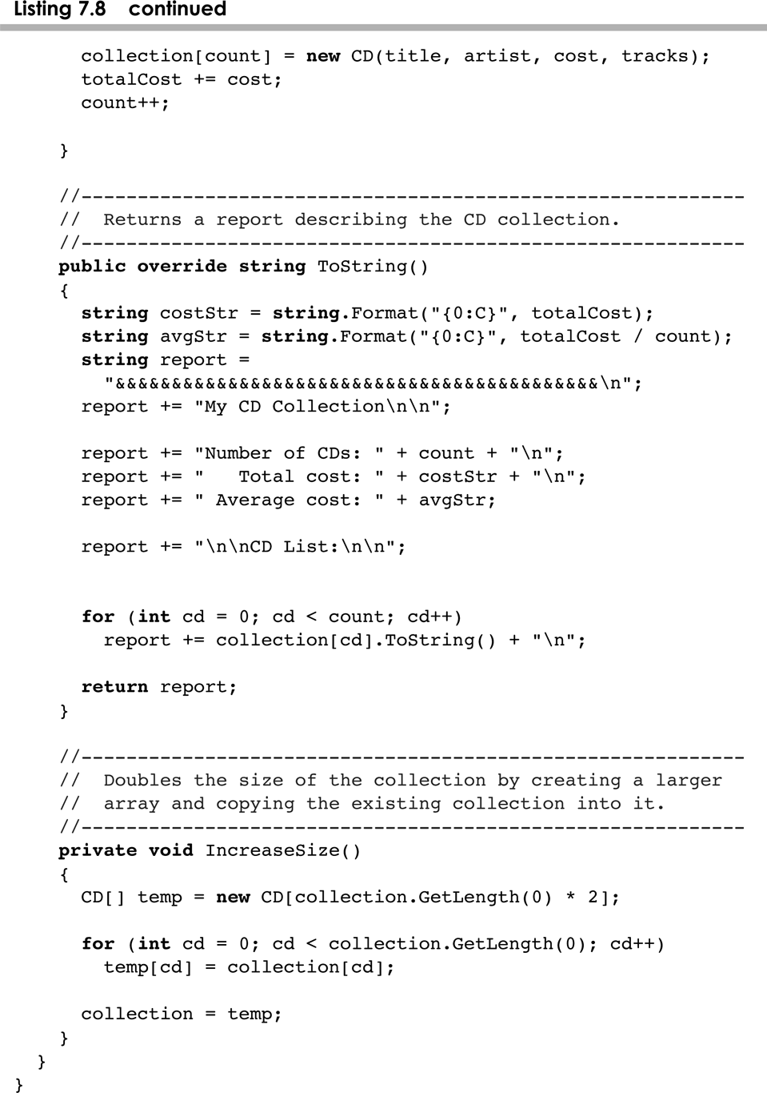
CDCollection.cs
7-<number>

Slide 42
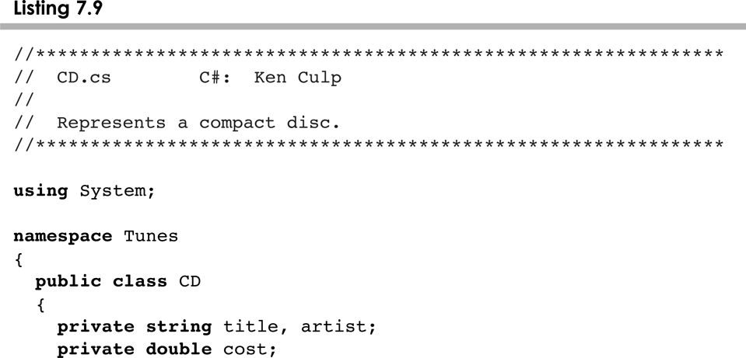
CD.cs
7-<number>

Slide 43
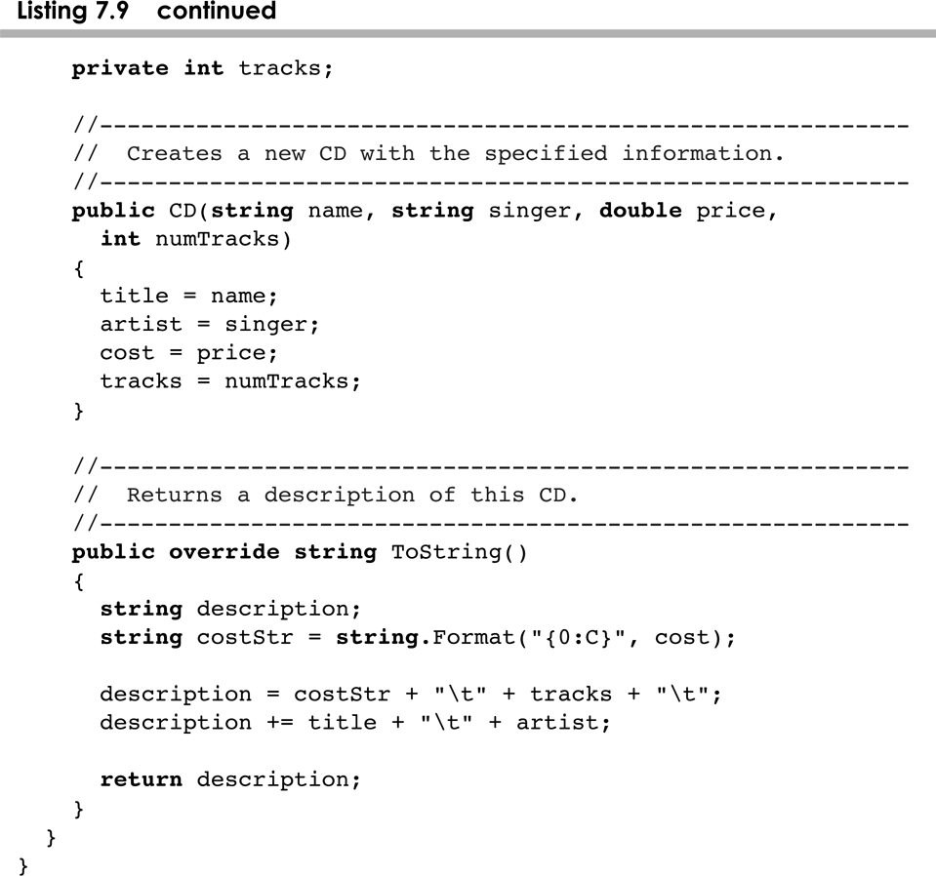
CD.cs
7-<number>

Slide 44
Command-Line Arguments
The signature of the main method indicates that it takes an array of String objects as a parameter
These values come from command-line arguments that are provided when the interpreter is invoked
For example, the following invocation of the interpreter passes three String objects into main:
>StateEval pennsylvania texas arizona
These strings are stored at indexes 0-2 of the array parameter of the Main method
See NameTag.cs
7-<number>

Slide 45
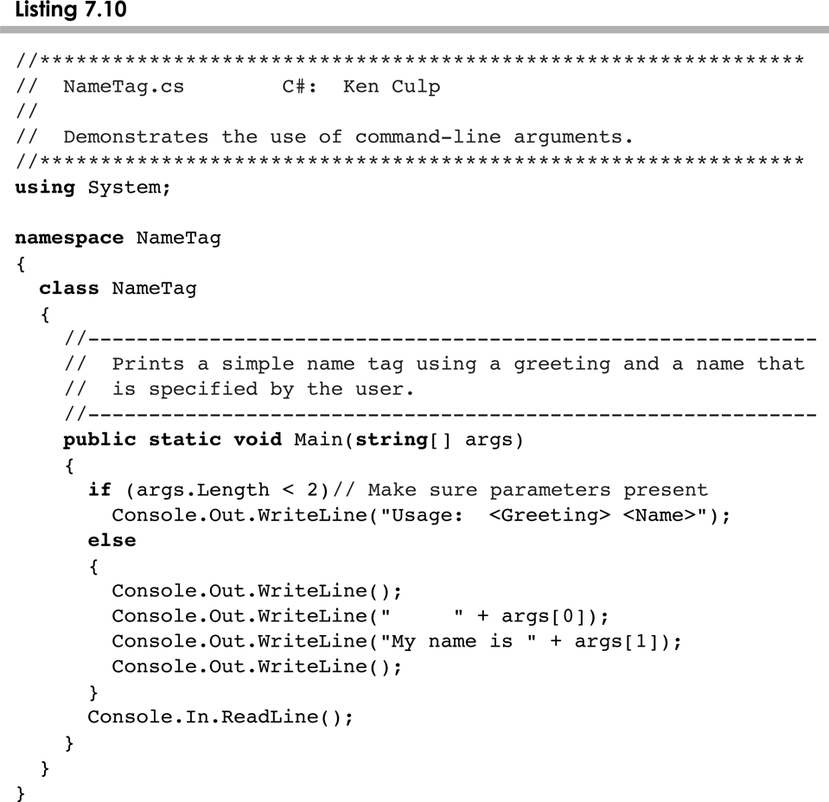
NameTag.cs
7-<number>

Slide 46
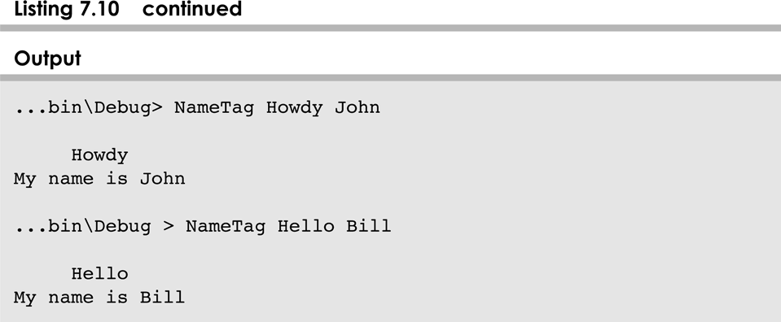
NameTag.cs
7-<number>

Slide 47
Outline
Declaring and Using Arrays
Arrays of Objects
Variable Length Parameter Lists
Two-Dimensional Arrays
The ArrayList Class
Polygons and Polylines
Mouse Events and Key Events
7-<number>

Slide 48
Variable Length Parameter Lists
Suppose we wanted to create a method that processed a different amount of data from one invocation to the next
For example, let's define a method called Average that returns the average of a set of integer parameters
// one call to average three values
mean1 = Average (42, 69, 37);
// another call to average seven values
mean2 = Average (35, 43, 93, 23, 40, 21, 75);
7-<number>

Slide 49
Variable Length Parameter Lists
We could define overloaded versions of the Average method
  Downside: we'd need a separate version of the method for each parameter count
We could define the method to accept an array of integers
  Downside: we'd have to create the array and store the integers prior to calling the method each time
Instead, C# provides a convenient way to create variable length parameter lists
7-<number>

Slide 50
Variable Length Parameter Lists
Using special syntax in the formal parameter list, we can define a method to accept any number of parameters of the same type
For each call, the parameters are automatically put into an array for easy processing in the method
Indicates a variable length parameter list
public double average (params int[] list)
{
// whatever
}
element
type
array
name
7-<number>

Slide 51
Variable Length Parameter Lists
public double Average (params int[] list)
{
double result = 0.0;
if (list.Length != 0)
{
int sum = 0;
foreach (int num in list)
sum += num;
result = (double)num / list.Length;
}
return result;
}
7-<number>

Slide 52
Variable Length Parameter Lists
The type of the parameter can be any primitive or object type
public void printGrades(params Grade[] grades)
{
foreach(Grade letterGrade in grades)
Console.Out.WriteLine(letterGrade);
}
7-<number>

Slide 53
Variable Length Parameter Lists
A method that accepts a variable number of parameters can also accept other parameters
The following method accepts an int, a String object, and a variable number of double values into an array called nums
public void test (int count, String name,
params double[] nums)
{
// whatever
}
7-<number>

Slide 54
Variable Length Parameter Lists
The varying number of parameters must come last in the formal arguments
A single method cannot accept two sets of varying parameters
Constructors can also be set up to accept a variable number of parameters
See VariableParameters.cs
See Family.cs
7-<number>

Slide 55
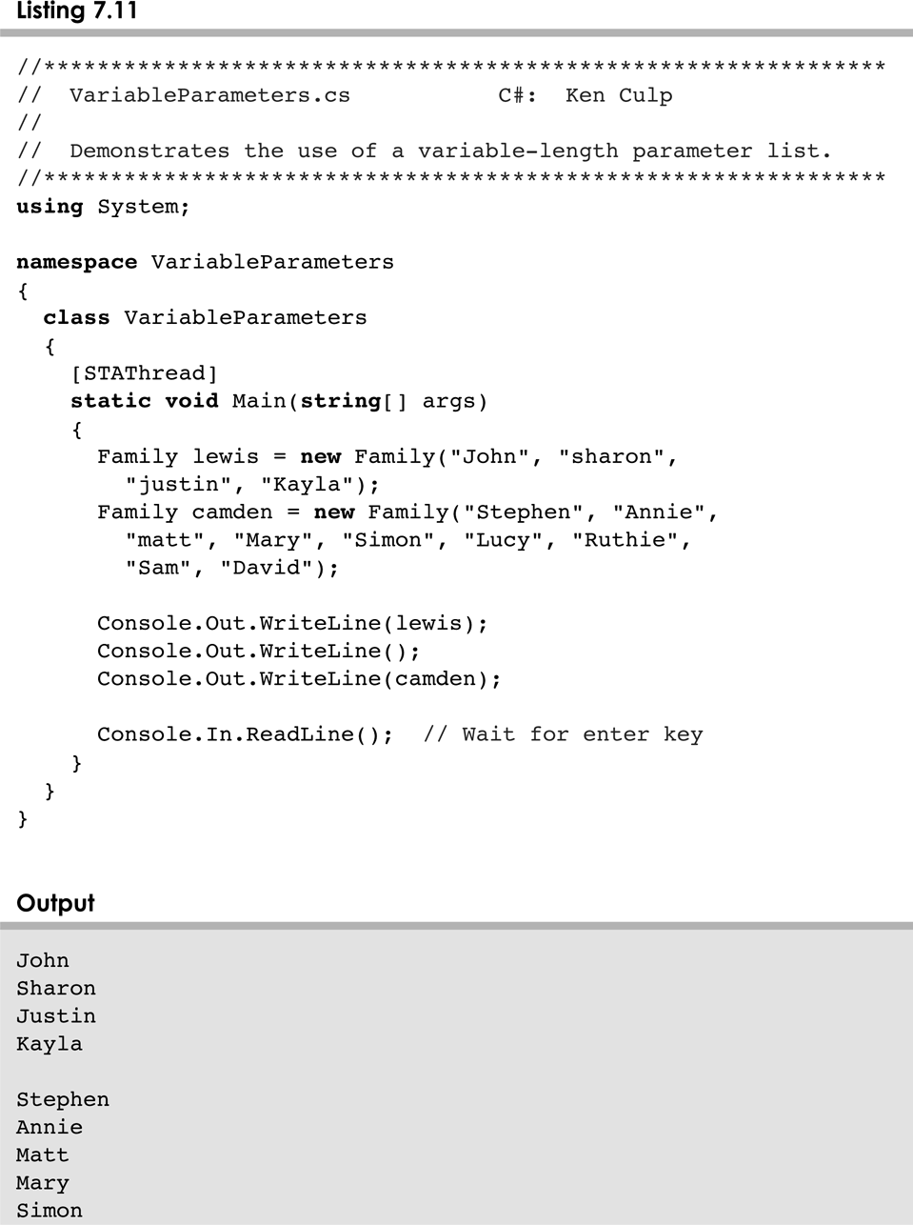
VariableParameters.cs
7-<number>

Slide 56
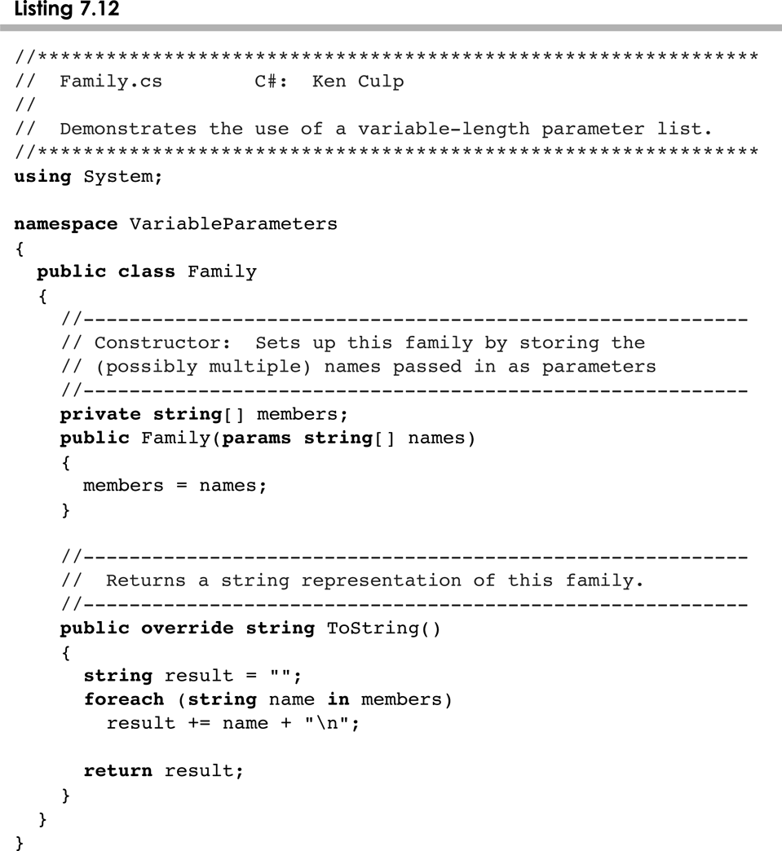
Family.cs
7-<number>

Slide 57
Outline
Declaring and Using Arrays
Arrays of Objects
Variable Length Parameter Lists
Two-Dimensional Arrays
The ArrayList Class
Polygons and Polylines
Mouse Events and Key Events
7-<number>

Slide 58
Two-Dimensional Arrays
A one-dimensional array stores a list of elements
A two-dimensional array can be thought of as a table of elements, with rows and columns
one
dimension
two
dimensions
7-<number>

Slide 59
Two-Dimensional Arrays
To be precise, in C# a two-dimensional array is an array of arrays
A two-dimensional array is declared by specifying the size of each dimension separated by comma:
int[,] scores = new int[12, 50];
A array element is referenced using two index values:
value = scores[3,6]
The array stored in one row can be specified using one index
7-<number>

Slide 60
Two-Dimensional Arrays
Expression | Type | Description
table | int[,] | 2D array of integers, or array of integer arrays
table[5] | int[] | array of integers
table[5,12] | int | integer
See TwoDArray.cs
See SodaSurvey.cs
7-<number>

Slide 61
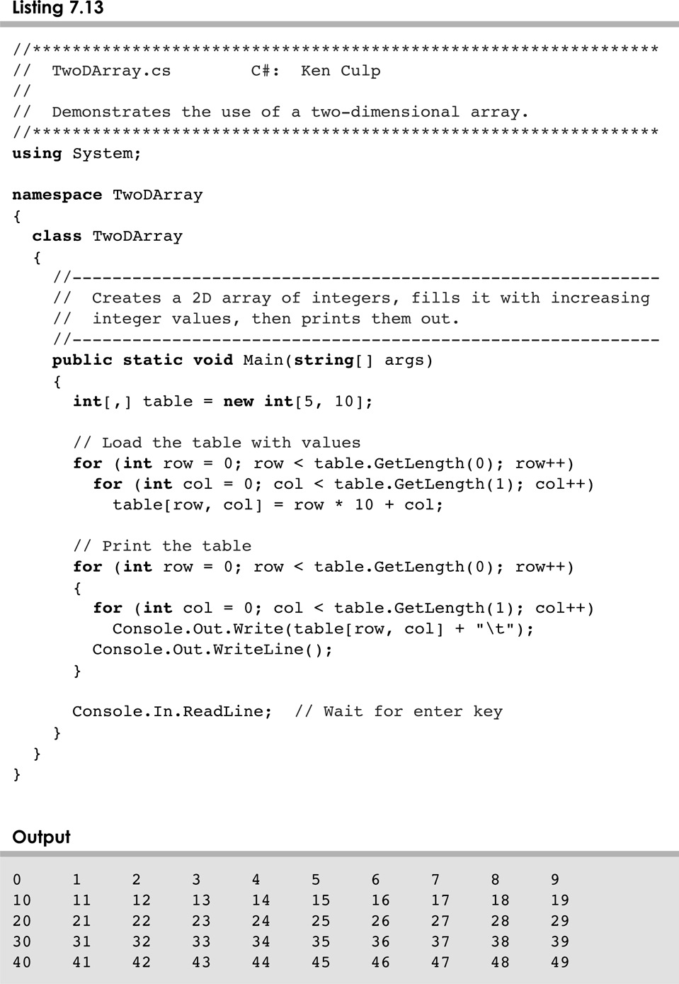
TwoArrays.cs
7-<number>

Slide 62
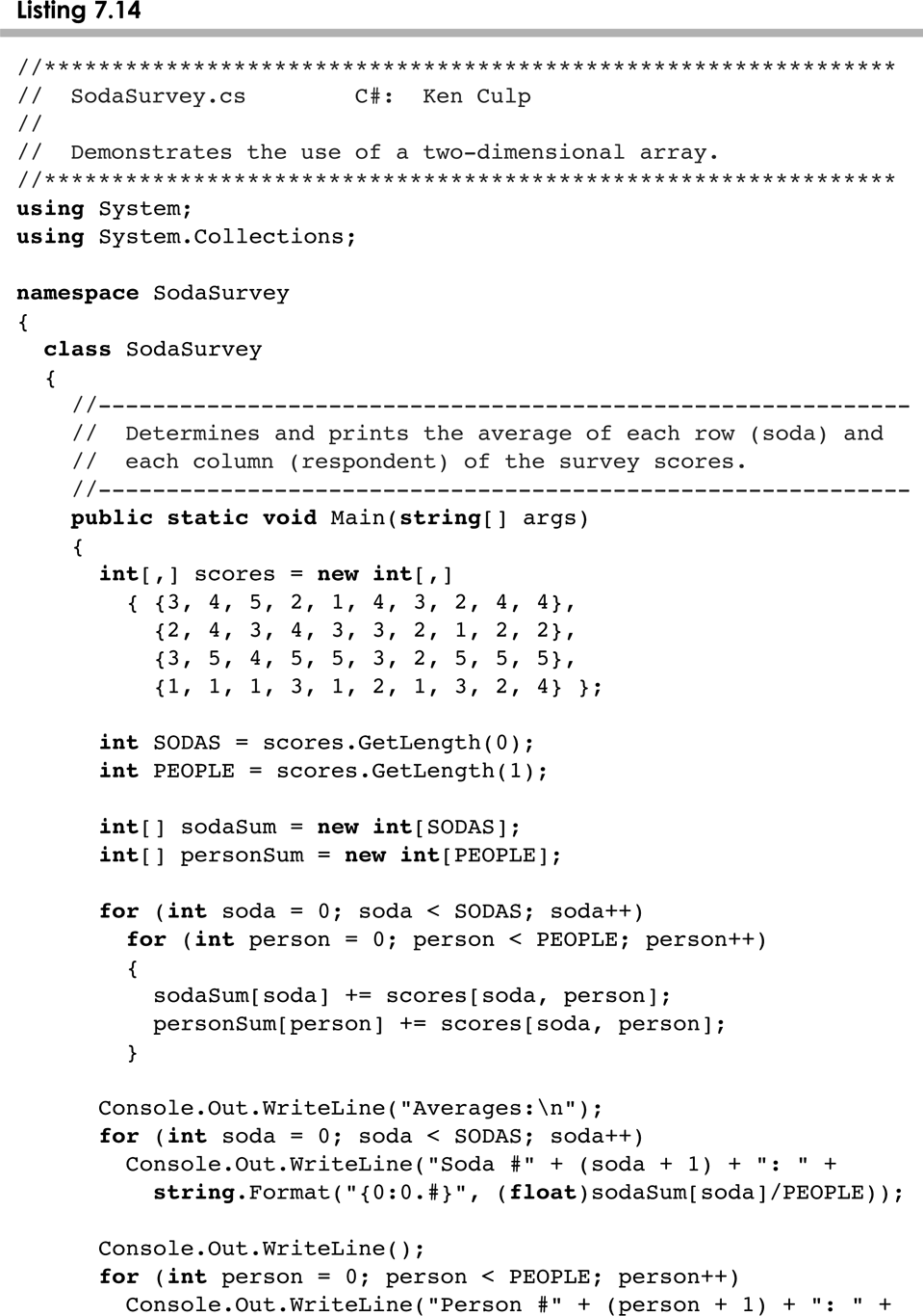
SodaSurvey.cs
7-<number>

Slide 63
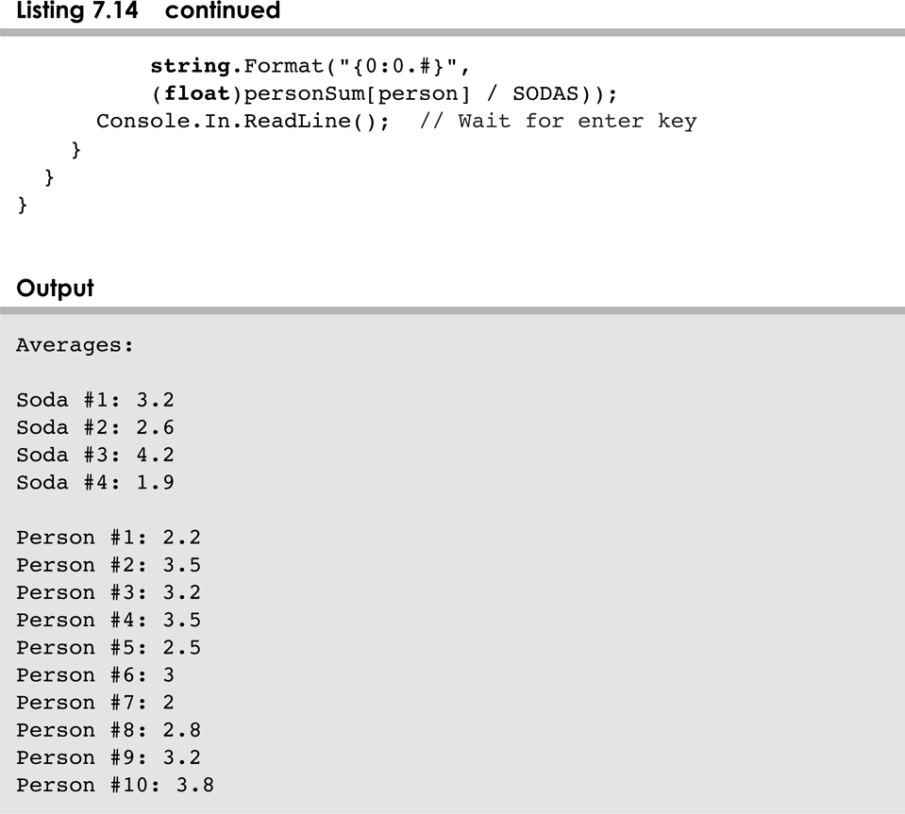
SodaSurvey.cs
7-<number>

Slide 64
Multidimensional Arrays
An array can have many dimensions – if it has more than one dimension, it is called a multidimensional array
Each dimension subdivides the previous one into the specified number of elements
Each dimension has its own Length constant
Because each dimension is an array of array references, the arrays within one dimension can be of different lengths
  these are sometimes called ragged arrays
7-<number>

Slide 65
Outline
Declaring and Using Arrays
Arrays of Objects
Variable Length Parameter Lists
Two-Dimensional Arrays
The ArrayList Class
Polygons and Polylines
Mouse Events and Key Events
7-<number>

Slide 66
The ArrayList Class
The ArrayList class is part of the System package
Like an array, it can store a list of values and reference each one using a numeric index
However, you cannot use the bracket syntax with an ArrayList object
Furthermore, an ArrayList object grows and shrinks as needed, adjusting its capacity as necessary
7-<number>

Slide 67
The ArrayList Class
Elements can be inserted or removed with a single method invocation
When an element is inserted, the other elements "move aside" to make room
Likewise, when an element is removed, the list "collapses" to close the gap
The indexes of the elements adjust accordingly
7-<number>

Slide 68
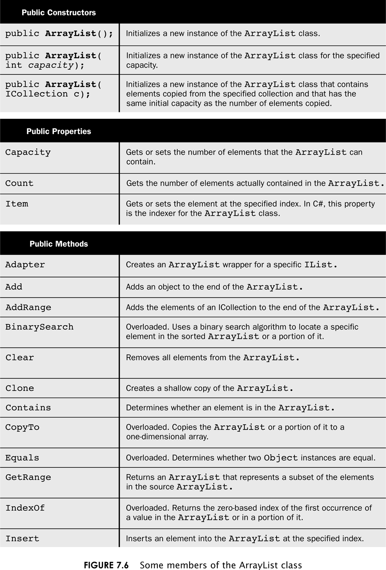
ArraList class
7-<number>

Slide 69
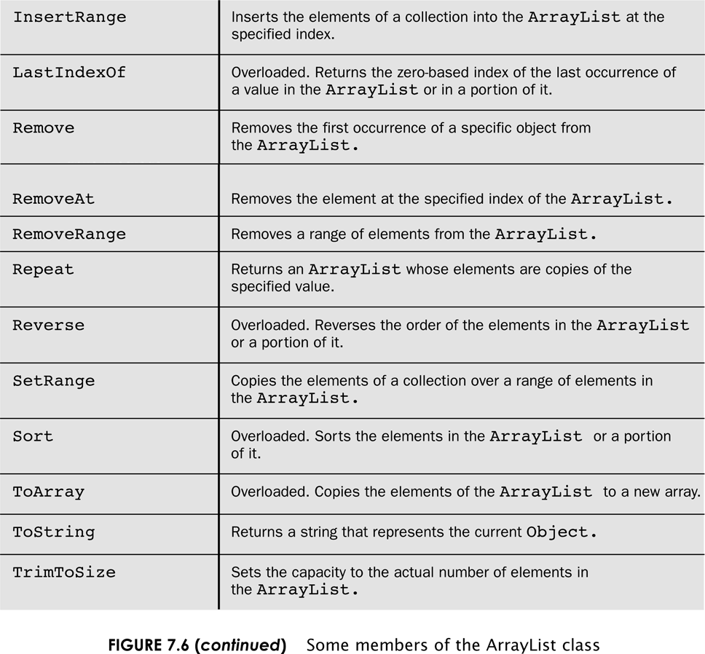
ArrayList class
7-<number>

Slide 70
The ArrayList Class
An ArrayList stores references to the Object class, which allows it to store any kind of object
See Beatles.cs
We can also define an ArrayList object to accept a particular type of object
The following declaration creates an ArrayList object that only stores Family objects
ArrayList<Family> reunion = new ArrayList<Family>
This is an example of generics, which are discussed further in Chapter 12
7-<number>

Slide 71
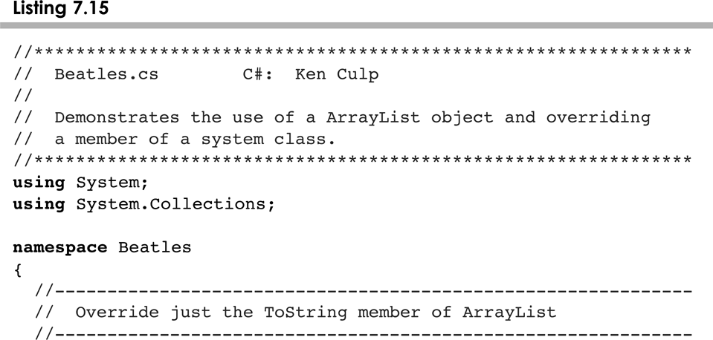
Beatles.cs
7-<number>

Slide 72
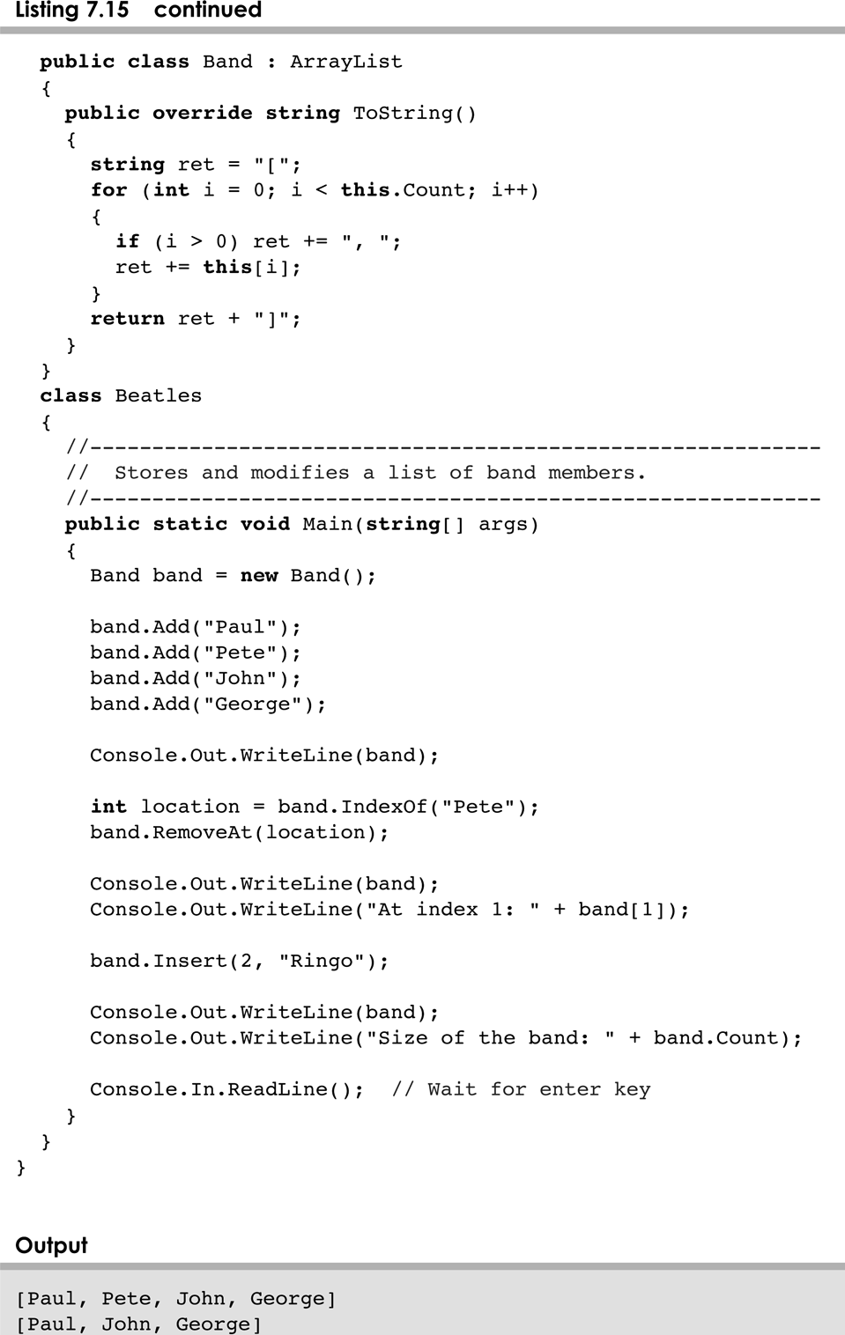
Beatles.cs
7-<number>

Slide 73
ArrayList Efficiency
The ArrayList class is implemented using an underlying array
The array is manipulated so that indexes remain continuous as elements are added or removed
If elements are added to and removed from the end of the list, this processing is fairly efficient
But as elements are inserted and removed from the front or middle of the list, the remaining elements are shifted
7-<number>

Slide 74
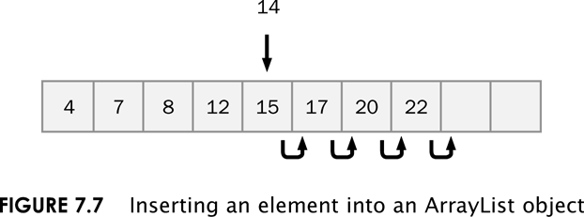
ArrayList Efficiency
7-<number>

Slide 75
Outline
Declaring and Using Arrays
Arrays of Objects
Variable Length Parameter Lists
Two-Dimensional Arrays
The ArrayList Class
Polygons and Polylines
Mouse Events and Key Events
7-<number>

Slide 76
Polygons and Polylines
Arrays can be helpful in graphics processing
For example, they can be used to store a list of coordinates
A polygon is a multisided, closed shape
A polyline is similar to a polygon except that its endpoints do not meet, and it cannot be filled
See Rocket.java
See RocketPanel.java
7-<number>

Slide 77
The Polygon Class
The Polygon class can also be used to define and draw a polygon
It is part of the java.awt pacakage
Versions of the overloaded drawPolygon and fillPolygon methods take a single Polygon object as a parameter instead of arrays of coordinates
A Polygon object encapsulates the coordinates of the polygon
7-<number>

Slide 78
Outline
Declaring and Using Arrays
Arrays of Objects
Variable Length Parameter Lists
Two-Dimensional Arrays
The ArrayList Class
Polygons and Polylines
Mouse Events and Key Events
7-<number>

Slide 79
Mouse Events
Events related to the mouse are separated into mouse events and mouse motion events
Mouse Events:
mouse pressed | the mouse button is pressed down
mouse released | the mouse button is released
mouse clicked | the mouse button is pressed down and released without moving the mouse in between
mouse entered | the mouse pointer is moved onto (over) a component
mouse exited | the mouse pointer is moved off of a component
7-<number>

Slide 80
Mouse Events
Mouse Motion Events:
mouse moved | the mouse is moved
mouse dragged | the mouse is moved while the mouse button is pressed down
Listeners for mouse events are created using the MouseListener and MouseMotionListener interfaces
A MouseEvent object is passed to the appropriate method when a mouse event occurs
7-<number>

Slide 81
Mouse Events
For a given program, we may only care about one or two mouse events
To satisfy the implementation of a listener interface, empty methods must be provided for unused events
See Dots.java
See DotsPanel.java
7-<number>

Slide 82
Mouse Events
Rubberbanding is the visual effect in which a shape is "stretched" as it is drawn using the mouse
The following example continually redraws a line as the mouse is dragged
See RubberLines.java
See RubberLinesPanel.java
7-<number>

Slide 83
Key Events
A key event is generated when the user types on the keyboard
key pressed | a key on the keyboard is pressed down
key released | a key on the keyboard is released
key typed | a key on the keyboard is pressed down and released
Listeners for key events are created by implementing the KeyListener interface
A KeyEvent object is passed to the appropriate method when a key event occurs
7-<number>

Slide 84
Key Events
The component that generates a key event is the one that has the current keyboard focus
Constants in the KeyEvent class can be used to determine which key was pressed
The following example "moves" an image of an arrow as the user types the keyboard arrow keys
See Direction.java
See DirectionPanel.java
7-<number>

Slide 85
Summary
Chapter 7 has focused on:
  array declaration and use
  bounds checking and capacity
  arrays that store object references
  variable length parameter lists
  multidimensional arrays
  the ArrayList class
  polygons and polylines
  mouse events and keyboard events
7-<number>

