Slide 1
Chapter 8:
Inheritance
C# Software Solutions
Foundations of Program Design
First Edition
by
John Lewis

Slide 2
Inheritance
Inheritance is a fundamental object-oriented design technique used to create and organize reusable classes
Chapter 8 focuses on:
  deriving new classes from existing classes
  the protected modifier
  creating class hierarchies
  abstract classes
  indirect visibility of inherited members
  designing for inheritance
  the GUI component class hierarchy
  extending listener adapter classes
  the Timer class
8-<number>

Slide 3
Outline
Creating Subclasses
Overriding Methods
Class Hierarchies
Inheritance and Visibility
Designing for Inheritance
Inheritance and GUIs
The Timer Class
8-<number>

Slide 4
Inheritance
Inheritance allows a software developer to derive a new class from an existing one
The existing class is called the parent class, or superclass, or base class
The derived class is called the child class or subclass
As the name implies, the child inherits characteristics of the parent
That is, the child class inherits the methods and data defined by the parent class
8-<number>

Slide 5
Inheritance
Inheritance relationships are shown in a UML class diagram using a solid arrow with an unfilled triangular arrowhead pointing to the parent class
Vehicle
Car
Proper inheritance creates an is-a relationship, meaning the child is a more specific version of the parent
8-<number>

Slide 6
Inheritance
A programmer can tailor a derived class as needed by adding new variables or methods, or by modifying the inherited ones
Software reuse is a fundamental benefit of inheritance
By using existing software components to create new ones, we capitalize on all the effort that went into the design, implementation, and testing of the existing software
8-<number>

Slide 7
Deriving Subclasses
In C#, we use the colon (:) to establish an inheritance relationship
class Car : Vehicle
{
// class contents
}
See Words.cs
See Book.cs
See Dictionary.cs
8-<number>

Slide 8
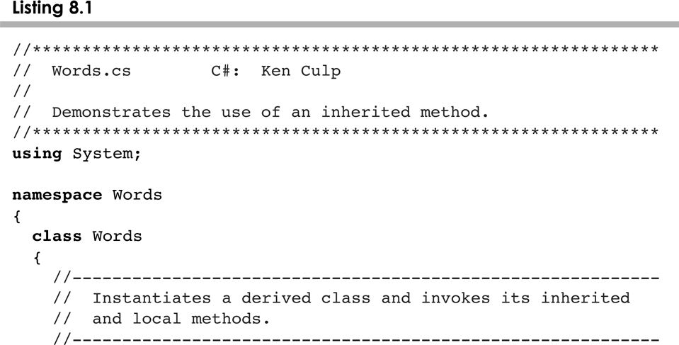
Words.cs
8-<number>

Slide 9
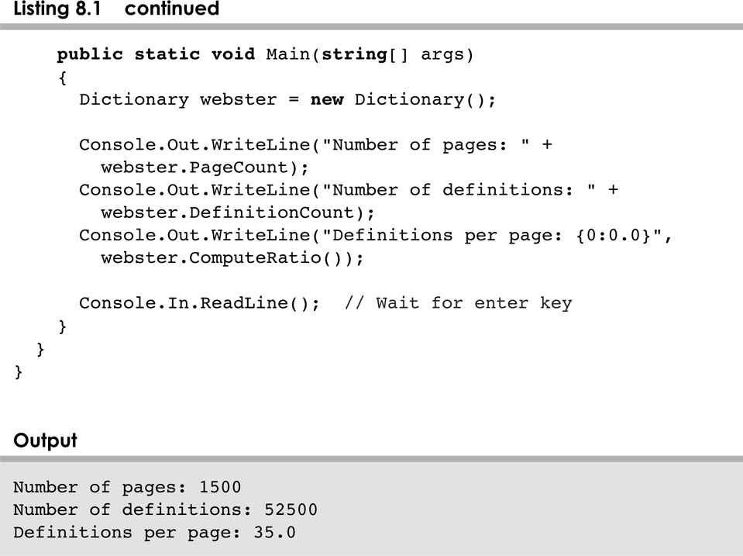
Words.cs
8-<number>

Slide 10
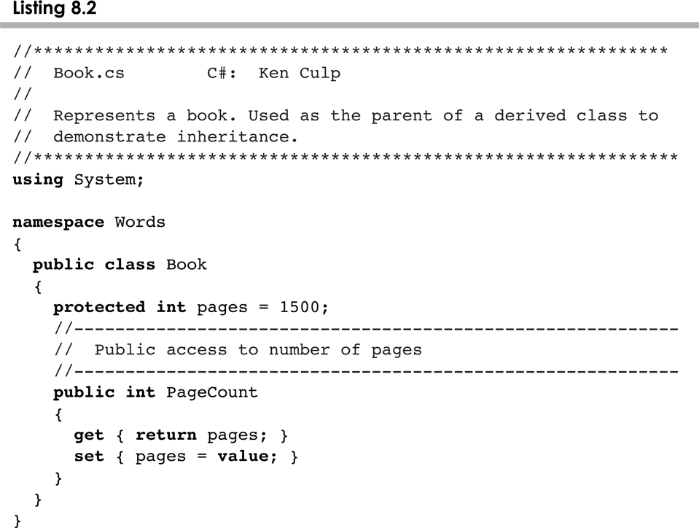
Book.cs
8-<number>

Slide 11
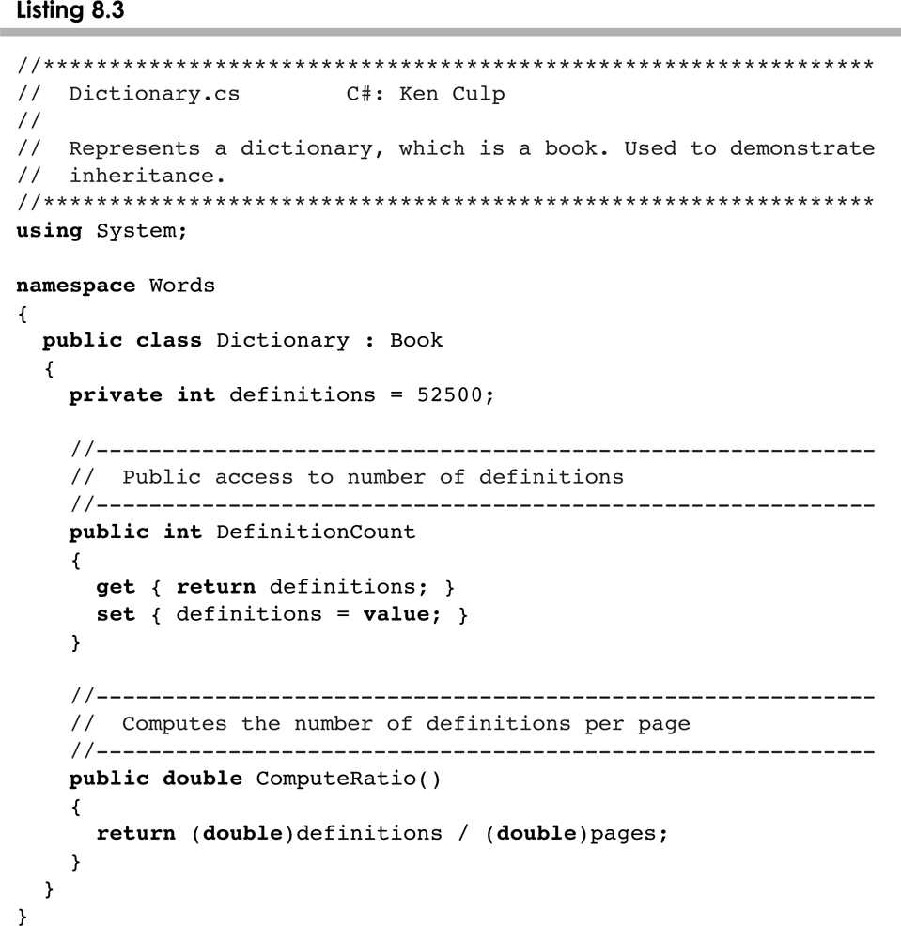
Dictionary.cs
8-<number>

Slide 12
The protected Modifier
Visibility modifiers affect the way that class members can be used in a child class
Variables and methods declared with private visibility cannot be referenced by name in a child class
They can be referenced in the child class if they are declared with public visibility -- but public variables violate the principle of encapsulation
There is a third visibility modifier that helps in inheritance situations: protected
8-<number>

Slide 13
The protected Modifier
The protected modifier allows a child class to reference a variable or method directly in the child class
It provides more encapsulation than public visibility, but is not as tightly encapsulated as private visibility
A protected variable is visible to any class in the same package as the parent class
The details of all C# modifiers are discussed in Appendix G
Protected variables and methods can be shown with a # symbol preceding them in UML diagrams
8-<number>

Slide 14
Class Diagram for Words
Book
# pages : int
+ pageMessage() : void
Words
Dictionary
- definitions : int
+ main (args : String[]) : void
+ definitionMessage() : void
8-<number>

Slide 15
The super Reference
Constructors are not inherited, even though they have public visibility
Yet we often want to use the parent's constructor to set up the "parent's part" of the object
The base reference can be used to refer to the parent class, and often is used to invoke the parent's constructor
See Words2.cs
See Book2.cs
See Dictionary2.cs
8-<number>

Slide 16
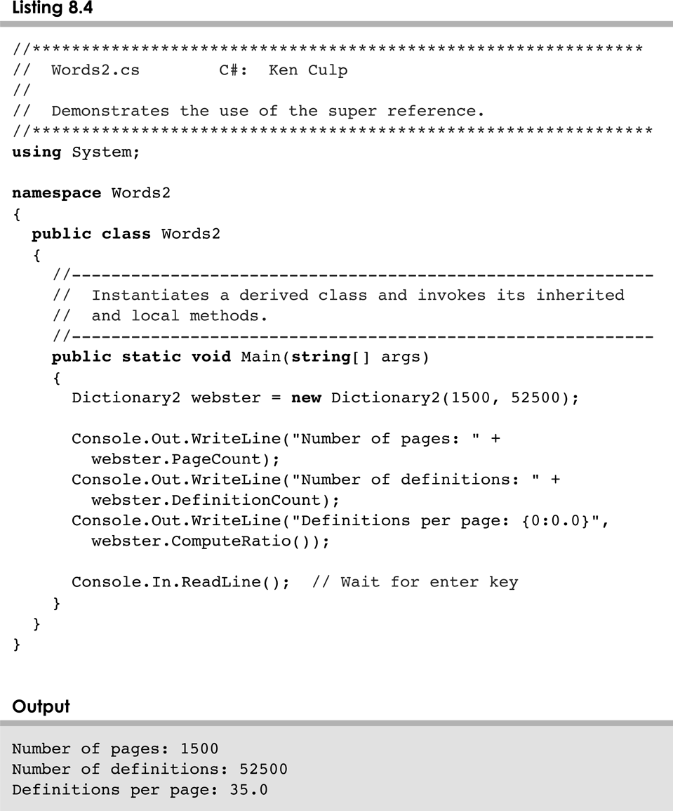
Words2.cs
8-<number>

Slide 17
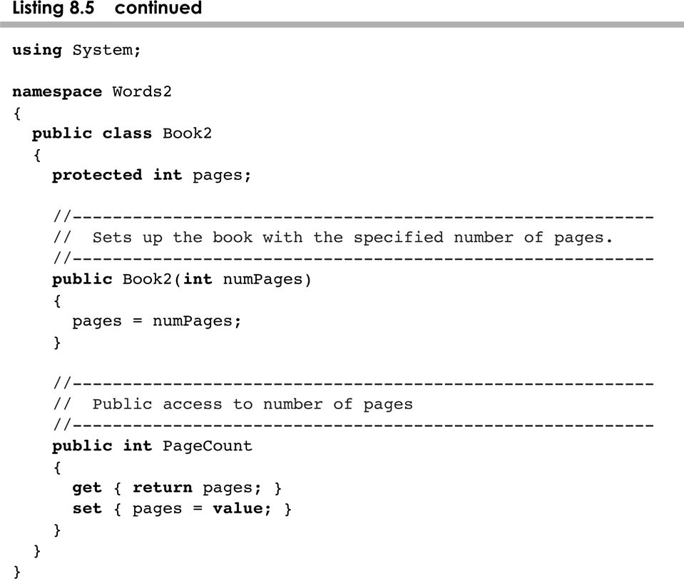
Words2.cs
8-<number>

Slide 18
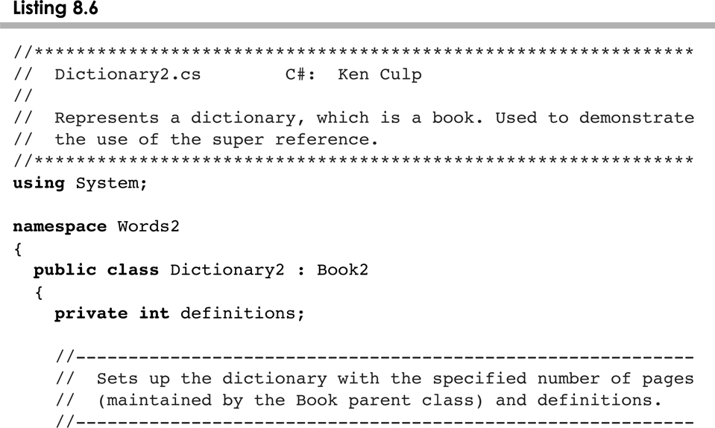
Dictionary2.cs
8-<number>

Slide 19
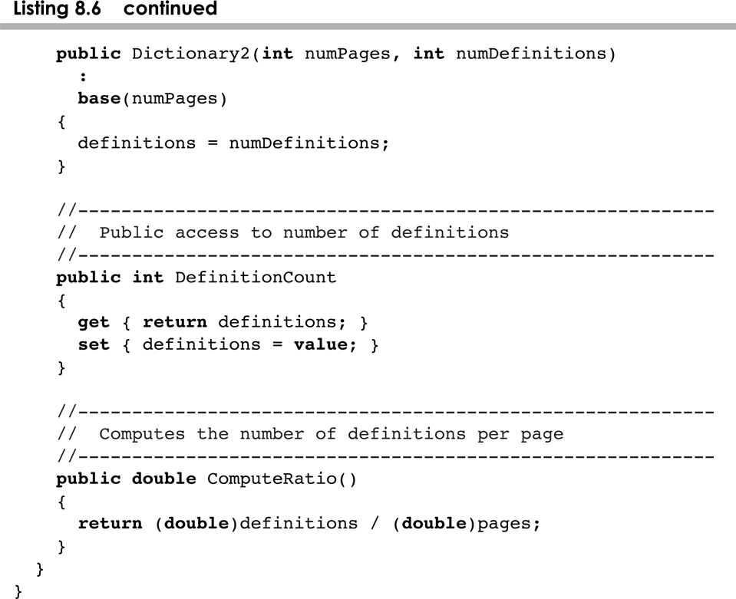
Dictionary2.cs
8-<number>

Slide 20
The base Reference
A child’s constructor is responsible for calling the parent’s constructor
The first line of a child’s constructor should use the base reference to call the parent’s constructor
The base reference can also be used to reference other variables and methods defined in the parent’s class
8-<number>

Slide 21
Multiple Inheritance
C# supports single inheritance, meaning that a derived class can have only one parent class
Multiple inheritance allows a class to be derived from two or more classes, inheriting the members of all parents
Collisions, such as the same variable name in two parents, have to be resolved
C# does not support multiple inheritance
In most cases, the use of interfaces gives us aspects of multiple inheritance without the overhead
8-<number>

Slide 22
Outline
Creating Subclasses
Overriding Methods
Class Hierarchies
Inheritance and Visibility
Designing for Inheritance
Inheritance and GUIs
The Timer Class
8-<number>

Slide 23
Overriding Methods
A child class can override the definition of an inherited method in favor of its own
The new method must have the same signature as the parent's method, but can have a different body
The type of the object executing the method determines which version of the method is invoked
See Messages.cs
See Thought.cs
See Advice.cs
8-<number>

Slide 24
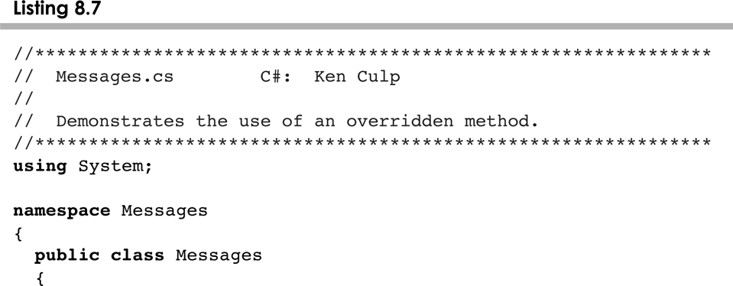
Messages.cs
8-<number>

Slide 25
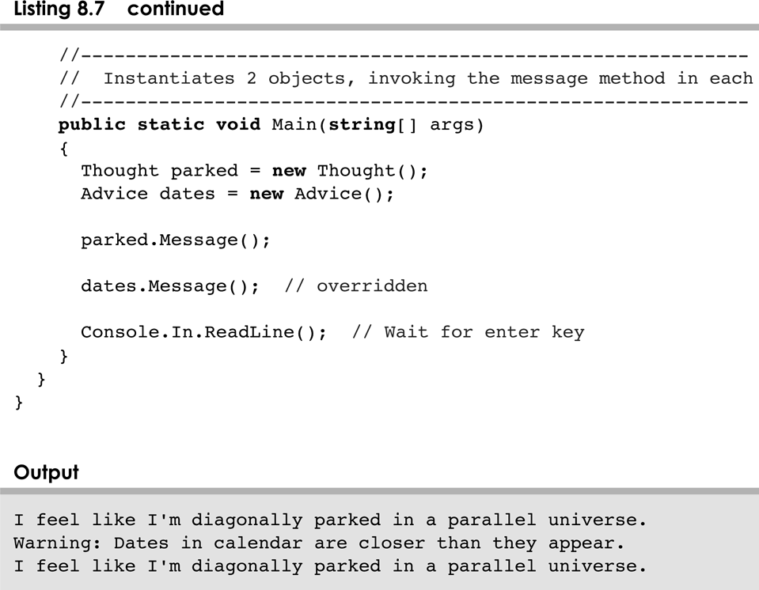
Messages.cs
8-<number>

Slide 26
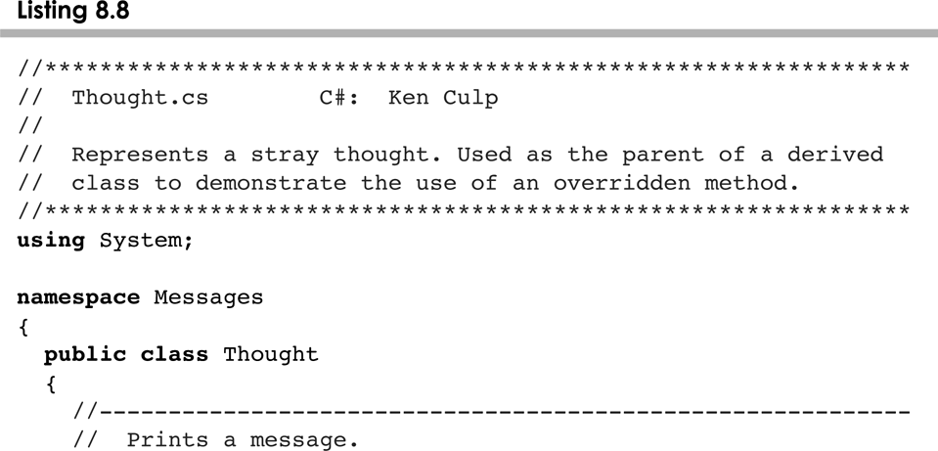
Thought.cs
8-<number>

Slide 27
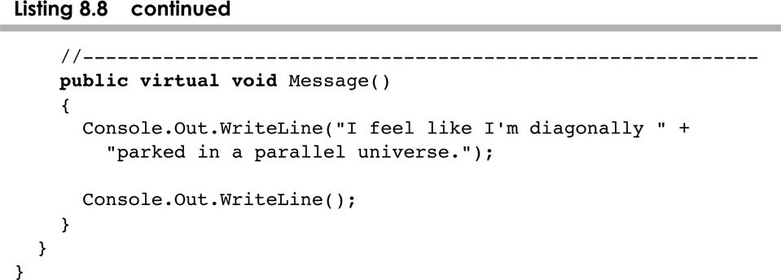
Thought.cs
8-<number>

Slide 28
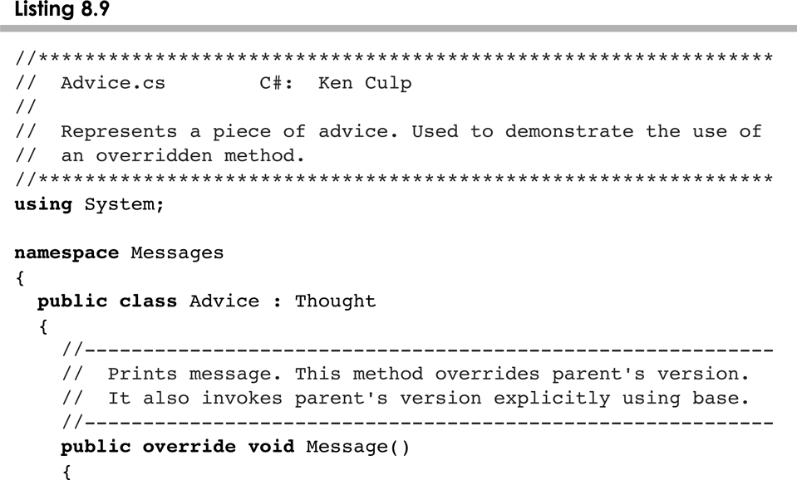
Advice.cs
8-<number>

Slide 29
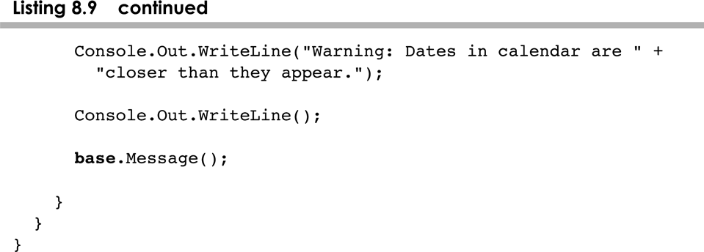
Advice.cs
8-<number>

Slide 30
Overriding
A method in the parent class can be invoked explicitly using the base reference
If a method is declared with the sealed modifier, it cannot be overridden
The concept of overriding can be applied to data and is called shadowing variables
Shadowing variables should be avoided because it tends to cause unnecessarily confusing code
The sealed keyword can be used on classes too, to prevent inheritance
8-<number>

Slide 31
Overloading vs. Overriding
Overloading deals with multiple methods with the same name in the same class, but with different signatures
Overriding deals with two methods, one in a parent class and one in a child class, that have the same signature
Overloading lets you define a similar operation in different ways for different parameters
Overriding lets you define a similar operation in different ways for different object types
If a method in a base class do not specify virtual a method with the same signature can be used by using the word new: public new void Method(){}
8-<number>

Slide 32
Outline
Creating Subclasses
Overriding Methods
Class Hierarchies
Inheritance and Visibility
Designing for Inheritance
Inheritance and GUIs
The Timer Class
8-<number>

Slide 33
Class Hierarchies
A child class of one parent can be the parent of another child, forming a class hierarchy
Business
RetailBusiness
ServiceBusiness
KMart
Macys
Kinkos
8-<number>

Slide 34
Class Hierarchies
Two children of the same parent are called siblings
Common features should be put as high in the hierarchy as is reasonable
An inherited member is passed continually down the line
Therefore, a child class inherits from all its ancestor classes
There is no single class hierarchy that is appropriate for all situations
8-<number>

Slide 35
The Object Class
A class called Object or object is defined in C#
All classes are derived from the Object class
If a class is not explicitly defined to be the child of an existing class, it is assumed to be the child of the Object class
Therefore, the Object class is the ultimate root of all class hierarchies
8-<number>

Slide 36
The Object Class
The Object class contains a few useful methods, which are inherited by all classes
For example, the ToString method is defined in the Object class
Every time we define the ToString method, we are actually overriding an inherited definition
The ToString method in the Object class is defined to return a string that contains the name of the object’s class along with some other information
8-<number>

Slide 37
The Object Class
The Equals method of the Object class returns true if two references are aliases
We can override Equals in any class to define equality in some more appropriate way
As we've seen, the String class defines the Equals method to return true if two String objects contain the same characters
The designers of the String class have overridden the Equals method inherited from Object in favor of a more useful version
8-<number>

Slide 38
Abstract Classes
An abstract class is a placeholder in a class hierarchy that represents a generic concept
An abstract class cannot be instantiated
We use the modifier abstract on the class header to declare a class as abstract:
public abstract class Product
{
// contents
}
8-<number>

Slide 39
Abstract Classes
An abstract class often contains abstract methods with no definitions (like an interface)
Unlike an interface, the abstract modifier must be applied to each abstract method
Also, an abstract class typically contains non-abstract methods with full definitions
A class declared as abstract does not have to contain abstract methods -- simply declaring it as abstract makes it so
8-<number>

Slide 40
Abstract Classes
The child of an abstract class must override the abstract methods of the parent, or it too will be considered abstract
An abstract method cannot be defined as static
The use of abstract classes is an important element of software design – it allows us to establish common elements in a hierarchy that are too generic to instantiate
8-<number>

Slide 41
Interface Hierarchies
Inheritance can be applied to interfaces as well as classes
That is, one interface can be derived from another interface
The child interface inherits all abstract methods of the parent
A class implementing the child interface must define all methods from both the ancestor and child interfaces
Note that class hierarchies and interface hierarchies are distinct (they do not overlap)
8-<number>

Slide 42
Outline
Creating Subclasses
Overriding Methods
Class Hierarchies
Inheritance and Visibility
Designing for Inheritance
Inheritance and GUIs
The Timer Class
8-<number>

Slide 43
Visibility Revisited
It's important to understand one subtle issue related to inheritance and visibility
All variables and methods of a parent class, even private members, are inherited by its children
As we've mentioned, private members cannot be referenced by name in the child class
However, private members inherited by child classes exist and can be referenced indirectly
8-<number>

Slide 44
Visibility Revisited
Because the parent can refer to the private member, the child can reference it indirectly using its parent's methods
The base reference can be used to refer to the parent class, even if no object of the parent exists
See FoodAnalyzer.cs
See FoodItem.cs
See Pizza.cs
8-<number>

Slide 45
Outline
Creating Subclasses
Overriding Methods
Class Hierarchies
Inheritance and Visibility
Designing for Inheritance
Inheritance and GUIs
The Timer Class
8-<number>

Slide 46
Designing for Inheritance
As we've discussed, taking the time to create a good software design reaps long-term benefits
Inheritance issues are an important part of an object-oriented design
Properly designed inheritance relationships can contribute greatly to the elegance, maintainabilty, and reuse of the software
Let's summarize some of the issues regarding inheritance that relate to a good software design
8-<number>

Slide 47
Inheritance Design Issues
Every derivation should be an is-a relationship
Think about the potential future of a class hierarchy, and design classes to be reusable and flexible
Find common characteristics of classes and push them as high in the class hierarchy as appropriate
Override methods as appropriate to tailor or change the functionality of a child
Add new variables to children, but don't redefine (shadow) inherited variables
8-<number>

Slide 48
Inheritance Design Issues
Allow each class to manage its own data; use the base reference to invoke the parent's constructor to set up its data
Even if there are no current uses for them, override general methods such as ToString and Equals with appropriate definitions
Use abstract classes to represent general concepts that lower classes have in common
Use visibility modifiers carefully to provide needed access without violating encapsulation
8-<number>

Slide 49
Outline
Creating Subclasses
Overriding Methods
Class Hierarchies
Inheritance and Visibility
Designing for Inheritance
Inheritance and GUIs
The Timer Class
8-<number>

Slide 50
The Component Class Hierarchy
The Java classes that define GUI components are part of a class hierarchy
Swing GUI components typically are derived from the JComponent class which is derived from the Container class which is derived from the Component class
Many Swing components can serve as (limited) containers, because they are derived from the Container class
For example, a JLabel object can contain an ImageIcon
8-<number>

Slide 51
The Component Class Hierarchy
An applet is a good example of inheritance
Recall that when we define an applet, we extend the Applet class or the JApplet class
The Applet and JApplet classes already handle all the details about applet creation and execution, including:
  interaction with a Web browser
  accepting applet parameters through HTML
  enforcing security restrictions
8-<number>

Slide 52
The Component Class Hierarchy
Our applet classes only have to deal with issues that specifically relate to what our particular applet will do
When we define paintComponent method of an applet, we are actually overriding a method defined originally in the JComponent class and inherited by the JApplet class
8-<number>

Slide 53
Event Adapter Classes
Inheritance also gives us a alternate technique for creating listener classes
We've seen that listener classes can be created by implementing a particular interface, such as MouseListener
We can also create a listener class by extending an event adapter class
Each listener interface that has more than one method has a corresponding adapter class, such as the MouseAdapter class
8-<number>

Slide 54
Event Adapter Classes
Each adapter class implements the corresponding listener and provides empty method definitions
When you derive a listener class from an adapter class, you only need to override the event methods that pertain to the program
Empty definitions for unused event methods do not need to be defined because they are provided via inheritance
See OffCenter.java
See OffCenterPanel.java
8-<number>

Slide 55
Outline
Creating Subclasses
Overriding Methods
Class Hierarchies
Inheritance and Visibility
Designing for Inheritance
Inheritance and GUIs
The Timer Class
8-<number>

Slide 56
The Timer Class
The Timer class of the javax.swing package is a GUI component, but it has no visual representation
A Timer object generates an action event at specified intervals
Timers can be used to manage any events that are based on a timed interval, such as an animation
To create the illusion of movement, we use a timer to change the scene after an appropriate delay
8-<number>

Slide 57
The Timer Class
The start and stop methods of the Timer class start and stop the timer
The delay can be set using the Timer constructor or using the setDelay method
See Rebound.java
See ReboundPanel.java
8-<number>

Slide 58
Summary
Chapter 8 focused on:
  deriving new classes from existing classes
  the protected modifier
  creating class hierarchies
  abstract classes
  indirect visibility of inherited members
  designing for inheritance
  the GUI component class hierarchy
  extending listener adapter classes
  the Timer class
8-<number>

