Slide 1
Chapter 10:
Exceptions
C# Software Solutions
Foundations of Program Design
First Edition
by
John Lewis

Slide 2
Exceptions
Exception handling is an important aspect of object-oriented design
Chapter 10 focuses on:
  the purpose of exceptions
  exception messages
  the try-catch statement
  propagating exceptions
  the exception class hierarchy
  GUI mnemonics and tool tips
  more GUI components and containers
10-<number>

Slide 3
Outline
Exception Handling
The try-catch Statement
Exception Classes
I/O Exceptions
Tool Tips and Mnemonics
Combo Boxes
Scroll Panes and Split Panes
10-<number>

Slide 4
Exceptions
An exception is an object that describes an unusual or erroneous situation
Exceptions are thrown by a program, and may be caught and handled by another part of the program
A program can be separated into a normal execution flow and an exception execution flow
An error is also represented as an object in C#, but usually represents a unrecoverable situation and should not be caught
10-<number>

Slide 5
Exception Handling
C# has a predefined set of exceptions and errors that can occur during execution
A program can deal with an exception in one of three ways:
  ignore it
  handle it where it occurs
  handle it an another place in the program
The manner in which an exception is processed is an important design consideration
10-<number>

Slide 6
Exception Handling
If an exception is ignored by the program, the program will terminate abnormally and produce an appropriate message
The message includes a call stack trace that:
  indicates the line on which the exception occurred
  shows the method call trail that lead to the attempted execution of the offending line
See Zero.cs
10-<number>

Slide 7
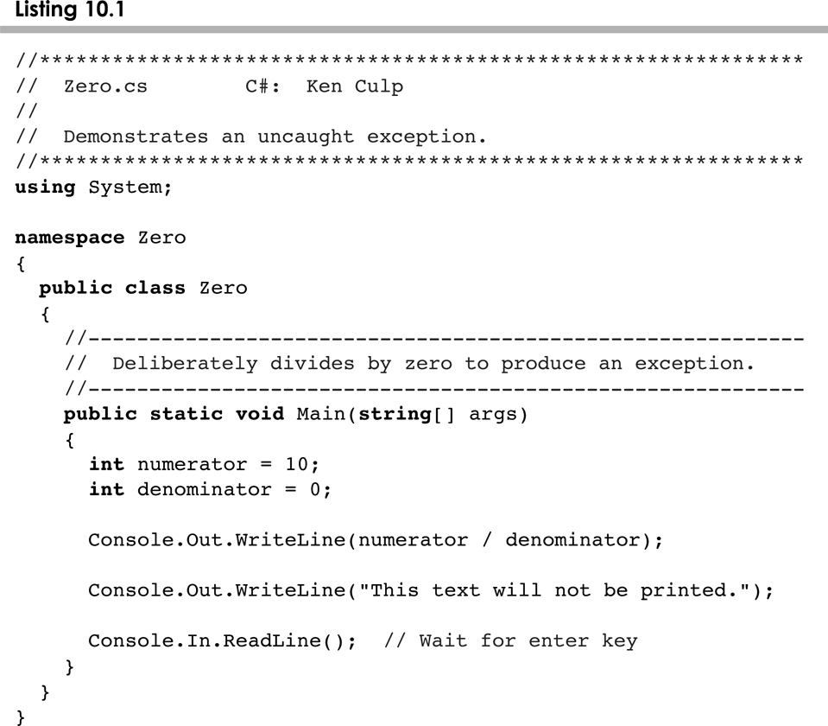
Zero.cs
10-<number>

Slide 8
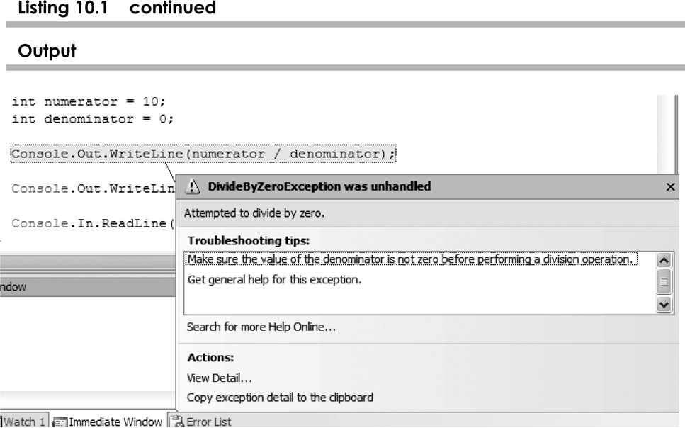
Zero.cs
10-<number>

Slide 9
Outline
Exception Handling
The try-catch Statement
Exception Classes
I/O Exceptions
Tool Tips and Mnemonics
Combo Boxes
Scroll Panes and Split Panes
10-<number>

Slide 10
The try Statement
To handle an exception in a program, the line that throws the exception is executed within a try block
A try block is followed by one or more catch clauses
Each catch clause has an associated exception type and is called an exception handler
When an exception occurs, processing continues at the first catch clause that matches the exception type
See ProductCodes.cs
10-<number>

Slide 11
The finally Clause
A try statement can have an optional clause following the catch clauses, designated by the reserved word finally
The statements in the finally clause always are executed
If no exception is generated, the statements in the finally clause are executed after the statements in the try block complete
If an exception is generated, the statements in the finally clause are executed after the statements in the appropriate catch clause complete
10-<number>

Slide 12
Exception Handling
Example:
try
{
  Console.Out.WriteLine(Integer.parseInt(numString);
  }
  catch(NumberFormatExeption e)
  {
  Console.Out.WriteLine(“Caught an exception”)
  }
  finally
  {
  Console.Out.WriteLine(“Done”);
  }
  See DivideByZeroCaught.cs
10-<number>

Slide 13
Exception Propagation
An exception can be handled at a higher level if it is not appropriate to handle it where it occurs
Exceptions propagate up through the method calling hierarchy until they are caught and handled or until they reach the level of the main method
A try block that contains a call to a method in which an exception is thrown can be used to catch that exception
See Propagation.cs
See ExceptionScope.cs
10-<number>

Slide 14
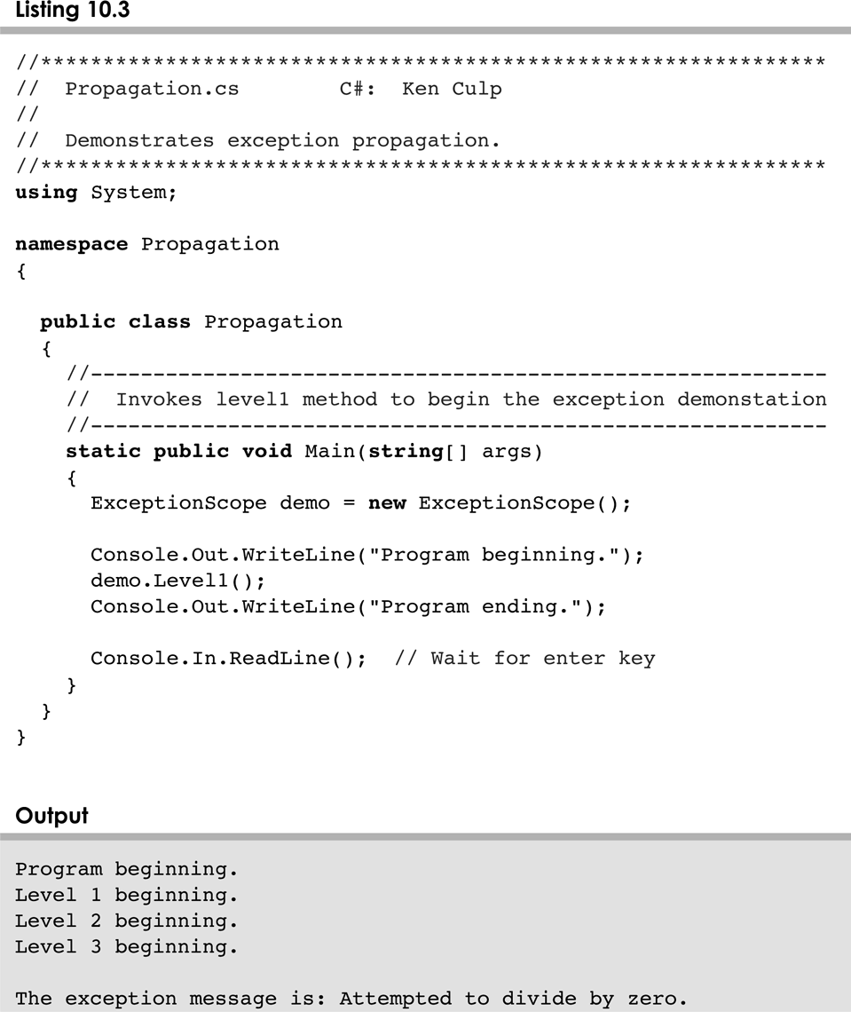
Propagation.cs
10-<number>

Slide 15
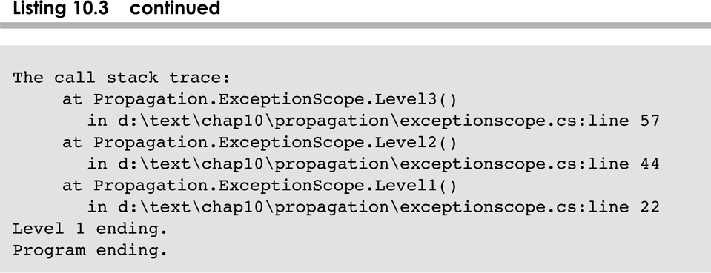
Propagation.cs
10-<number>

Slide 16
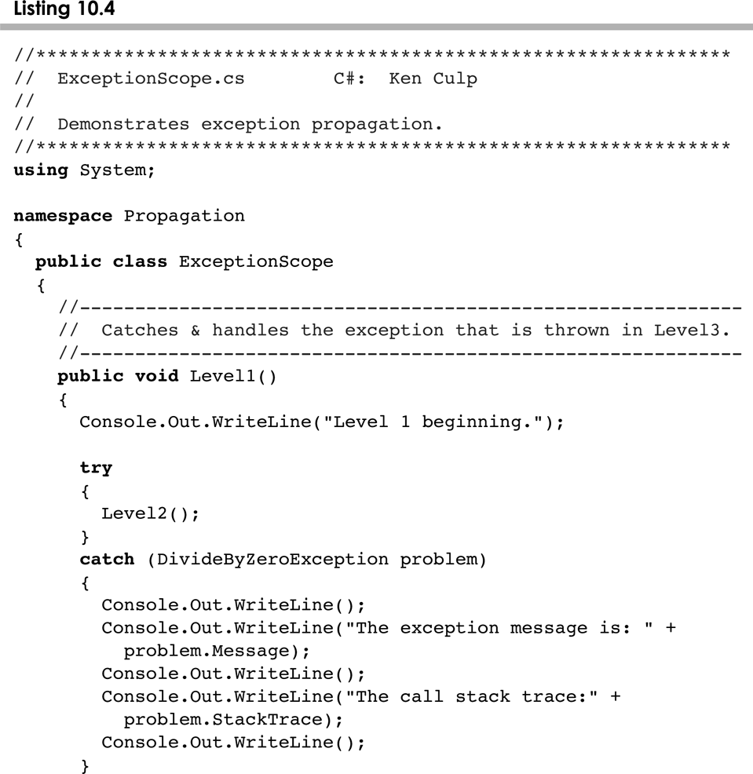
ExceptionScope.cs
10-<number>

Slide 17
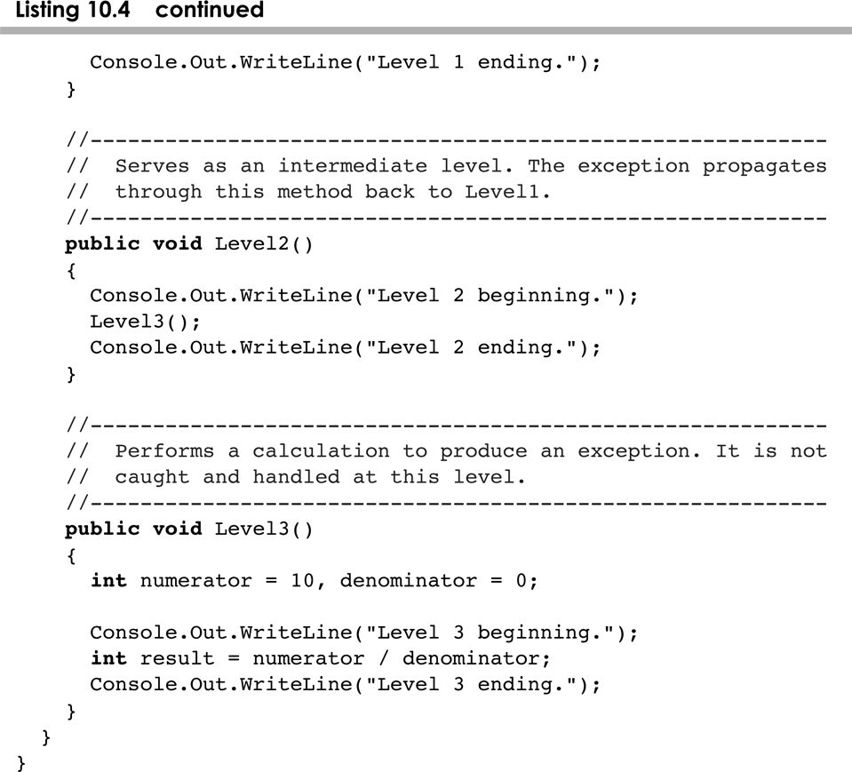
PropagationScope.cs
10-<number>

Slide 18
Outline
Exception Handling
The try-catch Statement
Exception Classes
I/O Exceptions
Tool Tips and Mnemonics
Combo Boxes
Scroll Panes and Split Panes
10-<number>

Slide 19
The Exception Class Hierarchy
Classes that define exceptions are related by inheritance, forming an exception class hierarchy figure 10.1 in your book
The exception class is defined in the System namespace and is parent to all the other Exception classes
A programmer can define an exception by extending the Exception class or one of its descendants
The parent class used depends on how the new exception will be used
10-<number>

Slide 20
The throw Statement
We can define our own exceptions by deriving a class from Exception or one of its decendants
Exceptions are thrown using the throw statement
Usually a throw statement is executed inside an if statement that evaluates a condition to see if the exception should be thrown
See CreatingExceptions.cs
See OutOfRangeException.cs
10-<number>

Slide 21
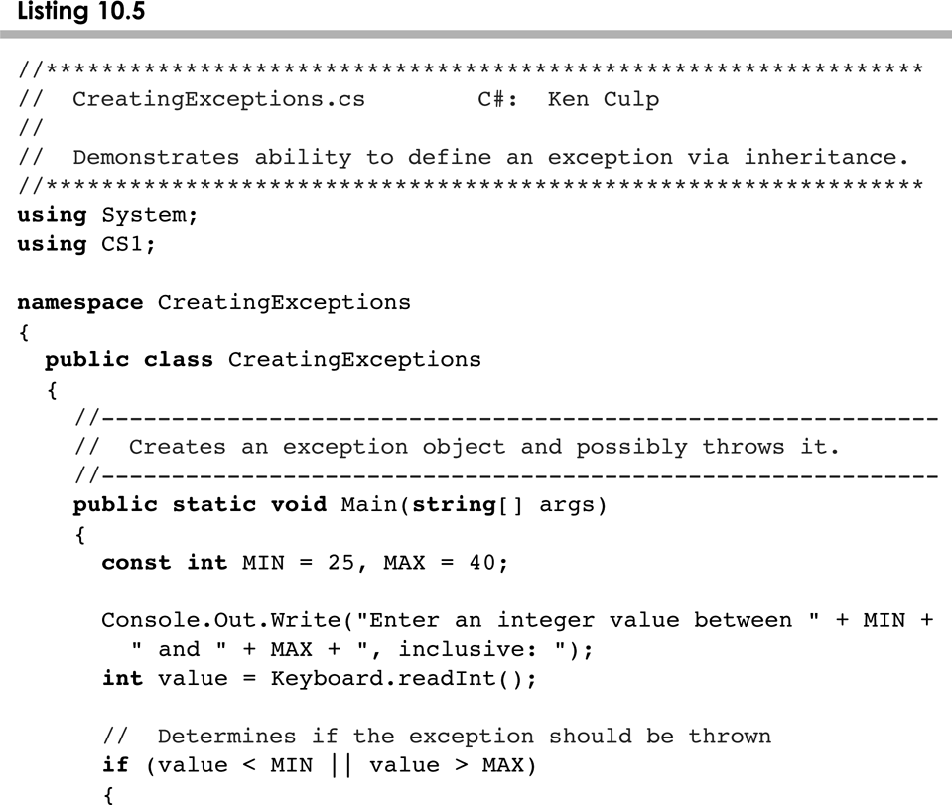
CreatingExceptions.cs
10-<number>

Slide 22
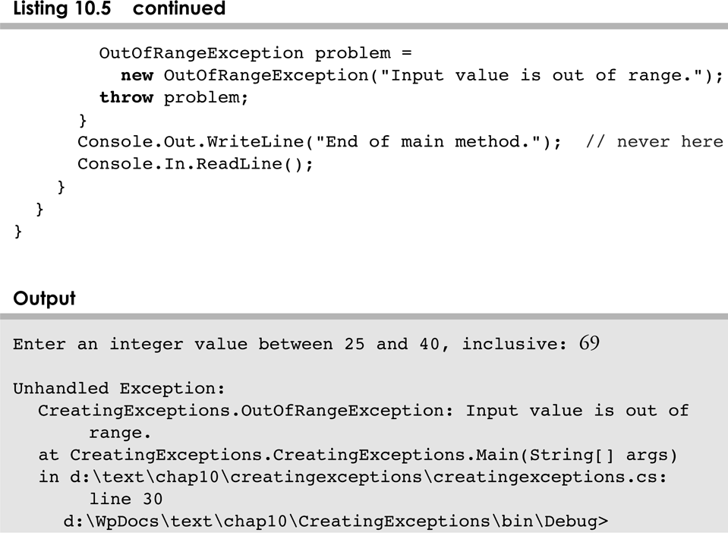
CreatingExceptions.cs
10-<number>

Slide 23
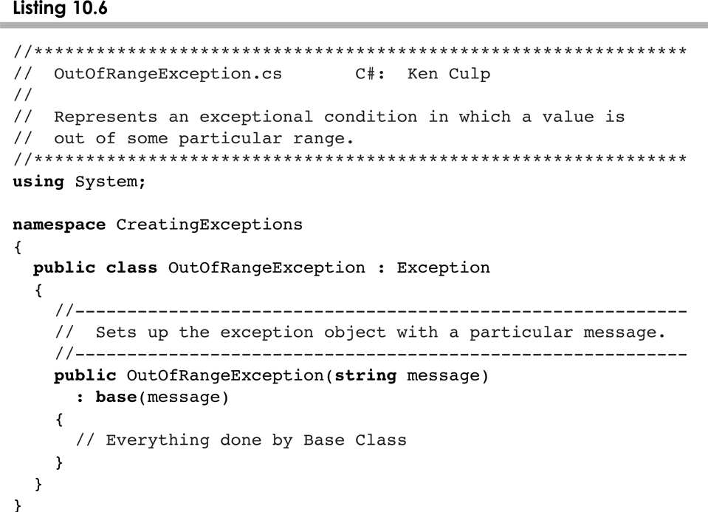
OutOfRangeException.cs
10-<number>

Slide 24
Outline
Exception Handling
The try-catch Statement
Exception Classes
I/O Exceptions
Tool Tips and Mnemonics
Combo Boxes
Scroll Panes and Split Panes
10-<number>

Slide 25
I/O Exceptions
Let's examine issues related to exceptions and I/O
A stream is a sequence of bytes that flow from a source to a destination
In a program, we read information from an input stream and write information to an output stream
A program can manage multiple streams simultaneously
10-<number>

Slide 26
Standard I/O
There are three standard I/O streams:
  standard output – defined by Console.Out
  standard input – defined by Console.In
  standard error – defined by Console.Error
We use Console.out when we execute WriteLine statements
Console.out and Console.Error typically represent a particular window on the monitor screen
Console.In typically represents keyboard input, which we've used many times
10-<number>

Slide 27
The IOException Class
Operations performed by some I/O classes may throw an IOException
  A file might not exist
  Even if the file exists, a program may not be able to find it
  The file might not contain the kind of data we expect
IOException is defined in the System.IO namespace
10-<number>

Slide 28
Writing Text Files
In Chapter 5 we explored the use of the StreamReader class to read input from a text file
Let's now examine other classes that let us write data to a text file
The StreamWriter class represents a text output file, but with minimal support for manipulating data
System.IO is an object of the TextWriter class, which provides Write and WrintLine methods defined for them
10-<number>

Slide 29
Writing Text Files
Finally, we'll also use the StreamWriter class for advanced internationalization and error checking
We build the class that represents the output file by combining these classes appropriately
See TestData.cs
10-<number>

Slide 30
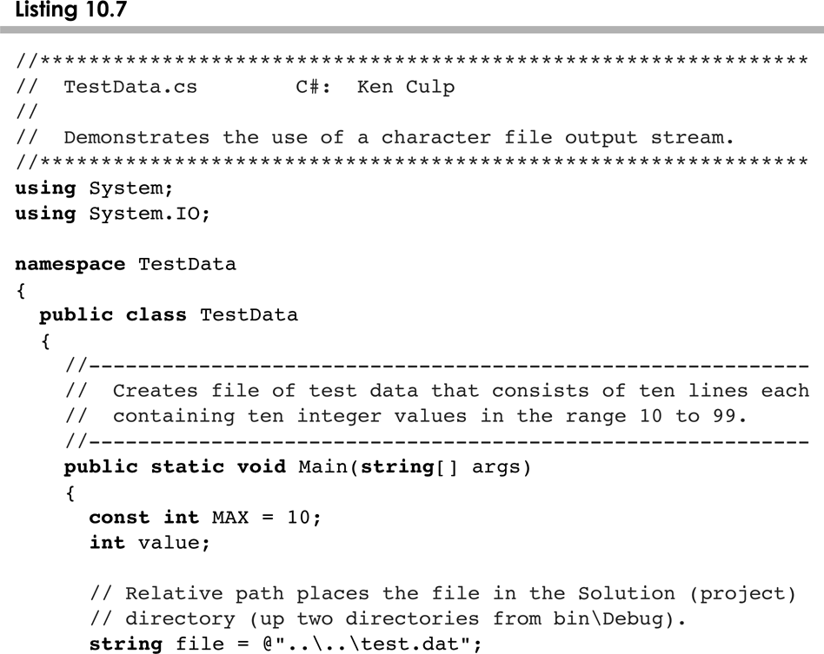
TestData.cs
10-<number>

Slide 31
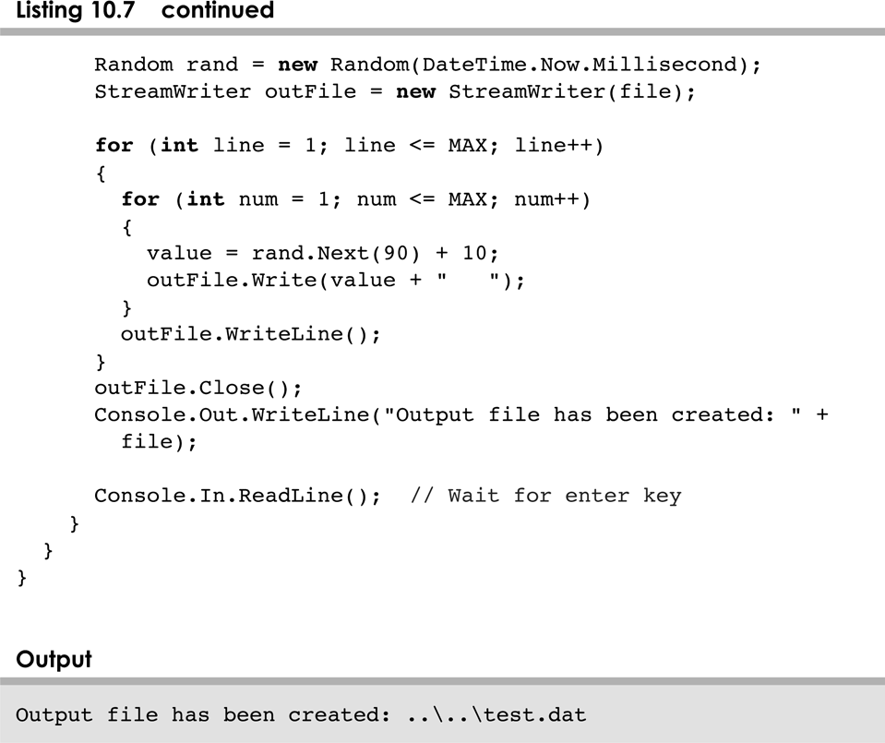
TestData.cs
10-<number>

Slide 32
Outline
Exception Handling
The try-catch Statement
Exception Classes
I/O Exceptions
Tool Tips and Mnemonics
Combo Boxes
Scroll Panes and Split Panes
10-<number>

Slide 33
Tool Tips
A tool tip provides a short pop-up description when the mouse cursor rests momentarily on a component
A tool tip is assigned using the setToolTipText method of a Swing component
JButton button = new JButton ("Compute");
button.setToolTipText ("Calculate size");
10-<number>

Slide 34
Mnemonics
A mnemonic is a keyboard alternative for pushing a button or selecting a menu option
The mnemonic character should be chosen from the component's label, and is underlined
The user activates the component by holding down the ALT key and pressing the mnemonic character
A mnemonic is established using the setMnemonic method:
JButton button = new JButton ("Calculate");
button.setMnemonic ("C");
10-<number>

Slide 35
Disabled Components
Components can be disabled if they should not be used
A disabled component is "grayed out" and will not respond to user interaction
The status is set using the setEnabled method:
JButton button = new JButton (“Do It”);
button.setEnabled (false);
10-<number>

Slide 36
GUI Design
The right combination of special features such as tool tips and mnemonics can enhance the usefulness of a GUI
See LightBulb.java
See LightBulbPanel.java
See LightBulbControls.java
10-<number>

Slide 37
Outline
Exception Handling
The try-catch Statement
Exception Classes
I/O Exceptions
Tool Tips and Mnemonics
Combo Boxes
Scroll Panes and Split Panes
10-<number>

Slide 38
Combo Boxes
A combo box provides a menu from which the user can choose one of several options
The currently selected option is shown in the combo box
A combo box shows its options only when the user presses it using the mouse
Options can be established using an array of strings or using the addItem method
10-<number>

Slide 39
The JukeBox Program
A combo box generates an action event when the user makes a selection from it
See JukeBox.java
See JukeBoxControls.java
10-<number>

Slide 40
Outline
Exception Handling
The try-catch Statement
Exception Classes
I/O Exceptions
Tool Tips and Mnemonics
Combo Boxes
Scroll Panes and Split Panes
10-<number>

Slide 41
Scroll Panes
A scroll pane is useful for images or information too large to fit in a reasonably-sized area
A scroll pane offers a limited view of the component it contains
It provides vertical and/or horizontal scroll bars that allow the user to scroll to other areas of the component
No event listener is needed for a scroll pane
See TransitMap.java
10-<number>

Slide 42
Split Panes
A split pane (JSplitPane) is a container that displays two components separated by a moveable divider bar
The two components can be displayed side by side, or one on top of the other
Moveable Divider Bar
Top Component
Left
Component
Right
Component
Bottom Component
10-<number>

Slide 43
Split Panes
The orientation of the split pane is set using the HORIZONTAL_SPLIT or VERTICAL_SPLIT constants
The divider bar can be set so that it can be fully expanded with one click of the mouse
The components can be continuously adjusted as the divider bar is moved, or wait until it stops moving
Split panes can be nested
10-<number>

Slide 44
Lists
The Swing Jlist class represents a list of items from which the user can choose
The contents of a JList object can be specified using an array of objects
A JList object generates a list selection event when the current selection changes
See PickImage.java
See ListPanel.java
10-<number>

Slide 45
Lists
A JList object can be set so that multiple items can be selected at the same time
The list selection mode can be one of three options:
  single selection – only one item can be selected at a time
  single interval selection – multiple, contiguous items can be selected at a time
  multiple interval selection – any combination of items can be selected
The list selection mode is defined by a ListSelectionModel object
10-<number>

Slide 46
Summary
Chapter 10 has focused on:
    the purpose of exceptions
    exception messages
    the try-catch statement
    propagating exceptions
    the exception class hierarchy
    GUI mnemonics and tool tips
    more GUI components and containers
10-<number>

