Slide 1
Chapter 10A:
File Streams and Exceptions
C# Software Solutions
Foundations of Program Design
First Edition
by
John Lewis

Slide 2
Files and Streams
Some of the power of a program comes from its ability to remember information from one run to the next
Chapter 10A focuses on:
  Files and streams in text files
  Streams for output
  Streams for input
  I/O Exceptions
  Comma separated Files
  Object Streams
10-<number>

Slide 3
Outline
Files and Streams
Streams for output
Streams for input
I/O Exceptions
Comma separated Files
Object Streams
10-<number>

Slide 4
File Streams
A stream is a sequence of bytes that flow from a source to a destination
In a program, we read information from an input stream and write information to an output stream
A program can manage multiple streams simultaneously
10-<number>

Slide 5
Standard I/O
There are three standard I/O streams:
  standard output – defined by Console.Out
  standard input – defined by Console.In
  standard error – defined by Console.Error
We use Console.out when we execute WriteLine statements
Console.out and Console.Error typically represent a particular window on the monitor screen
Console.In typically represents keyboard input, which we've used many times
10-<number>

Slide 6
Writing Text Files
In Chapter 5 we explored the use of the StreamReader class to read input from a text file
Let's now examine other classes that let us write data to a text file
The StreamWriter class represents a text output file, but with minimal support for manipulating data
System.IO is an object of the TextWriter class, which provides Write and WrintLine methods defined for them
10-<number>

Slide 7
Streams for Output
If we want our program to write text to a disk file, it must create a new file or it must write to an existing file
using System.IO;
…
string outFileName = “myData.txt”;
StreamWriter outStream = new StreamWriter(outFileName);
Or
StreamWriter outStream = File.CreateText(outFileName);
10-<number>

Slide 8
Streams for Output
Now you can use WriteLine or Wrint to write a line to the file
outStream.WriteLine(“this text will…”);
outStream.Write(“This text will…\r\n”);
And Finally close the file
outStream.Close();
10-<number>

Slide 9
Streams for Output
If the file exists, it can be either overwritten or appended to
string outFileName = “myData.txt”;
StreamWriter outStream = new StreamWriter(outFileName);
StreamWriter outStream = new StreamWriter(outFileName, true);
10-<number>

Slide 10
Writing Text Files
Finally, we'll also use the StreamWriter class for advanced internationalization and error checking
We build the class that represents the output file by combining these classes appropriately
See TestData.cs
10-<number>

Slide 11
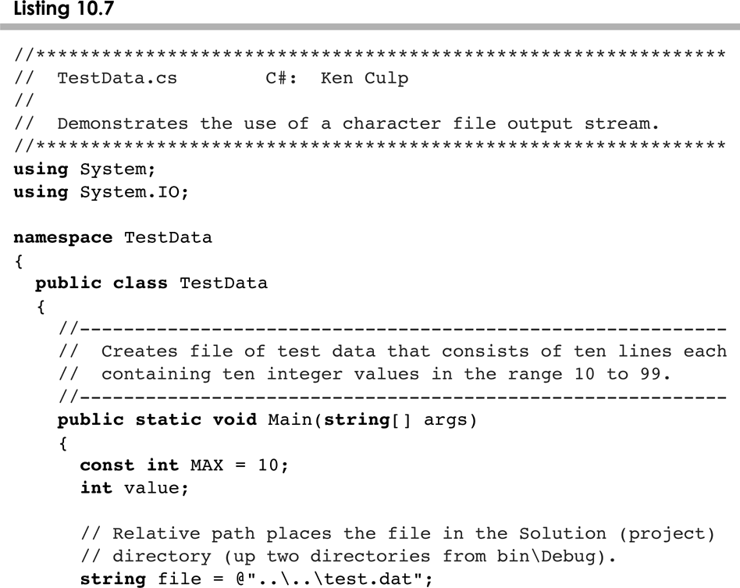
TestData.cs
10-<number>

Slide 12
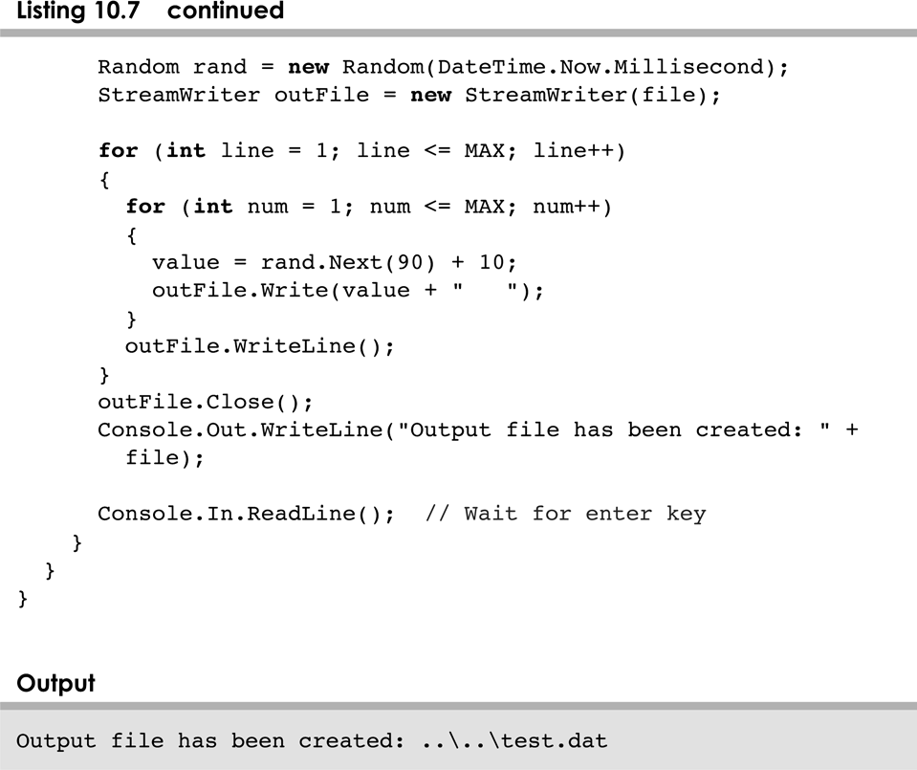
TestData.cs
10-<number>

Slide 13
Streams for Input
If a text file already exists and our progra needs to read from it, we should create an instance of StreamReader
using System.IO;
…
string inFileName = “myData.txt”;
StreamReader inStream = new StreamReader(inFileName);
Or
StreamReader inStream = File.OpenText(inFileName);
10-<number>

Slide 14
Streams for Input
Now you can use ReadLine or Read to read a line or a character from the file
string s = inStream.ReadLine();
int k = 0;
while((k = inStream.Read()) != -1){
char c = (char)k;
k++;
}
And Finally close the file
inStream.Close();
10-<number>

Slide 15
The IOException Class
Operations performed by some I/O classes may throw an IOException
  A file might not exist
  Even if the file exists, a program may not be able to find it
  The file might not contain the kind of data we expect
IOException is defined in the System.IO namespace
10-<number>

Slide 16
File Exception
Several Exception types exists, which would be applicable when opening a file
IOException
DirectoryNotFoundException
FileLoadException
FileNotFoundException
PathTooLongException
And many more
10-<number>

Slide 17
Comma separated Files
Often so called comma separated files are used
In such files strings are separated by comma or another character
Comma separated files can be used as a simple form of a data base
Spreadsheets can be converted to comma separated files and read into your program
When read into your program, separated strings should be placed in a String Array
10-<number>

Slide 18
Comma separated Files
Example:
string[] words = new string[10];
char[] separator = {‘,’};
string line = inStream.ReadLine();
while(line != null){
words = line.Split(separator);
Console.Out.WriteLine(words[0].Trim());
…
}
10-<number>

Slide 19
Object Streams
By use of Object Streams you can save and store objects on files
Objects has to be Serialized when saved and Deserialized when loaded
The attribute [Serializable] must be placed in front of the class definition for objects which should be saved on files.
10-<number>

Slide 20
Object Streams example
using System.IO;
using System.Runtime.Serialization.Formatters.Binary;
namespace ObjectStreamTest
{
public class ObjectStream
{
static public void Save(object data)
{
FileStream file = new FileStream("store.bin", FileMode.Create);
BinaryFormatter formatter = new BinaryFormatter();
formatter.Serialize(file, data);
file.Close();
}
static public object Load()
{
FileStream file = new FileStream("store.bin", FileMode.OpenOrCreate);
object data = null;
if (file.Length != 0)
{
BinaryFormatter formatter = new BinaryFormatter();
data = formatter.Deserialize(file);
}
file.Close();
return data;
}
}
}
10-<number>

Slide 21
Summary
Chapter 10A has focused on:
  Files and streams in text files
  Streams for output
  Streams for input
  I/O Exceptions
  Comma separated Files
  Object Streams
10-<number>

