Slide 1
Chapter 3:
Using Classes and Objects
C# Software Solutions
Foundations of Program Design
First Edition
by
John Lewis

Slide 2
Using Classes and Objects
We can create more interesting programs using predefined classes and related objects
Chapter 3 focuses on:
  object creation and object references
  the String class and its methods
  the C# standard class library
  the Random and Math classes
  formatting output
  enumerated types
  graphical components and containers
  labels and images
3-<number>

Slide 3
Outline
Creating Objects
The String and StringBuilder Classes
.Net and Base Class Libraries
  Random and Math classes
Formatting Output
Enumerated Types
Components and Containers
Images
3-<number>

Slide 4
Creating Objects
A variable holds either a primitive type or a reference to an object
A class name can be used as a type to declare an object reference variable
String title;
No object is created with this declaration
An object reference variable holds the address of an object
The object itself must be created separately
3-<number>

Slide 5
Creating Objects
Generally, we use the new operator to create an object
title = new String (“C# Software Solutions");
This calls the String constructor, which is
a special method that sets up the object
Creating an object is called instantiation
An object is an instance of a particular class
3-<number>

Slide 6
Invoking Methods
We've seen that once an object has been instantiated, we can use the dot operator to invoke its methods
count = title.length()
A method may return a value, which can be used in an assignment or expression
A method invocation can be thought of as asking an object to perform a service
3-<number>

Slide 7
References
Note that a primitive variable contains the value itself, but an object variable contains the address of the object
An object reference can be thought of as a pointer to the location of the object
Rather than dealing with arbitrary addresses, we often depict a reference graphically
num1
38
name1
"Steve Jobs"
3-<number>

Slide 8
Assignment Revisited
The act of assignment takes a copy of a value and stores it in a variable
For primitive types:
num1
38
Before:
num2
96
num2 = num1;
num1
38
After:
num2
38
3-<number>

Slide 9
Reference Assignment
For object references, assignment copies the address:
name1
"Steve Jobs"
Before:
name2
"Steve Wozniak"
name2 = name1;
name1
"Steve Jobs"
After:
name2
3-<number>

Slide 10
Aliases
Two or more references that refer to the same object are called aliases of each other
That creates an interesting situation: one object can be accessed using multiple reference variables
Aliases can be useful, but should be managed carefully
Changing an object through one reference changes it for all of its aliases, because there is really only one object
3-<number>

Slide 11
Garbage Collection
When an object no longer has any valid references to it, it can no longer be accessed by the program
The object is useless, and therefore is called garbage
C# performs automatic garbage collection periodically, returning an object's memory to the system for future use
In other languages, the programmer is responsible for performing garbage collection
3-<number>

Slide 12
Outline
Creating Objects
The String and StringBuilder Classes
.Net and Base Class Libraries
Formatting Output
Enumerated Types
Components and Containers
Images
3-<number>

Slide 13
The String Class
Because strings are so common, we don't have to use the new operator to create a String object
title = "Java Software Solutions";
This is special syntax that works only for strings
Each string literal (enclosed in double quotes) represents a String object
3-<number>

Slide 14
String Methods
Once a String object has been created, neither its value nor its length can be changed
Thus we say that an object of the String class is immutable
However, several methods of the String class return new String objects that are modified versions of the original
See the list of String methods on page 114 and 115
3-<number>

Slide 15
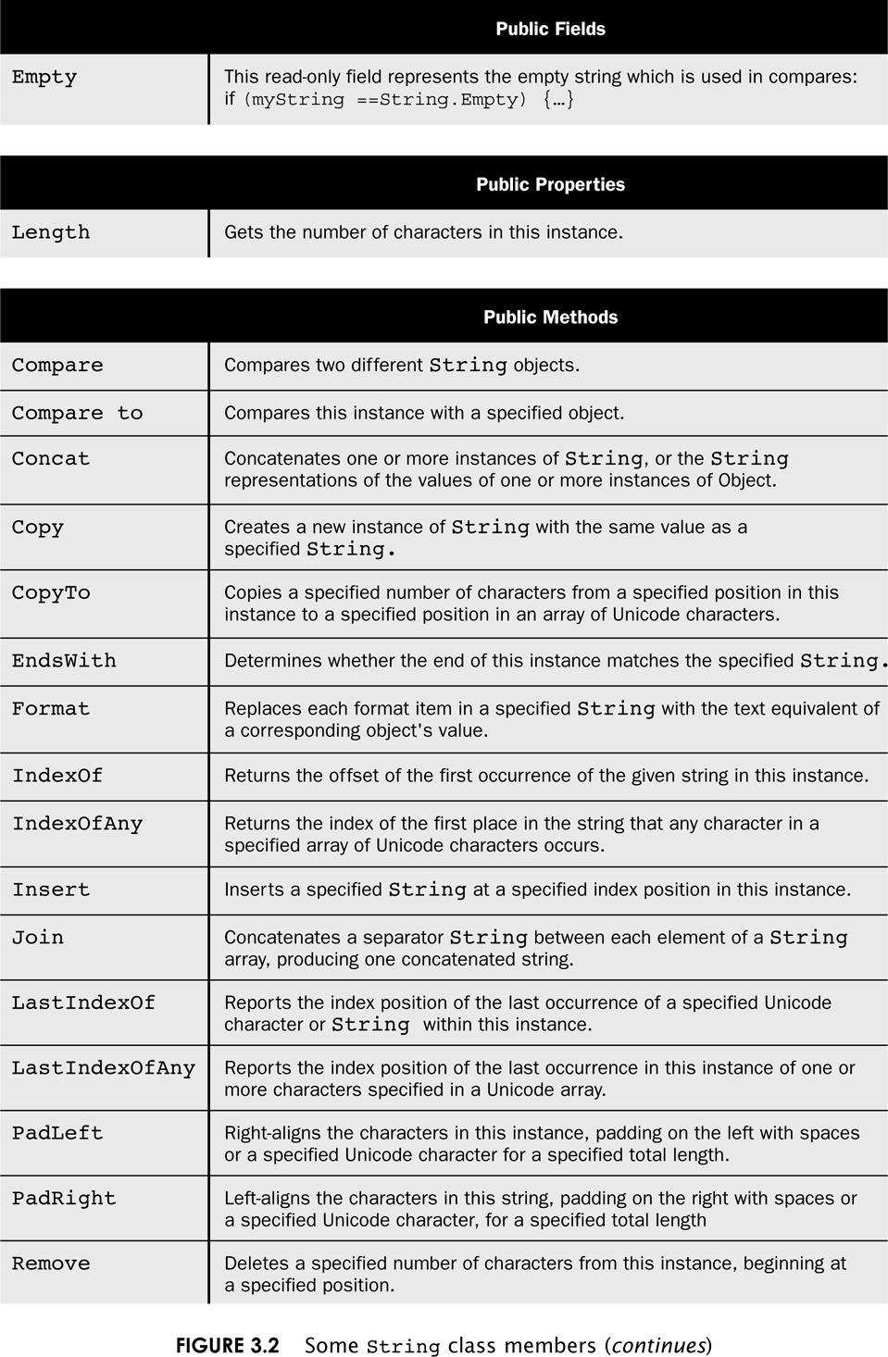
String Methods
3-<number>

Slide 16
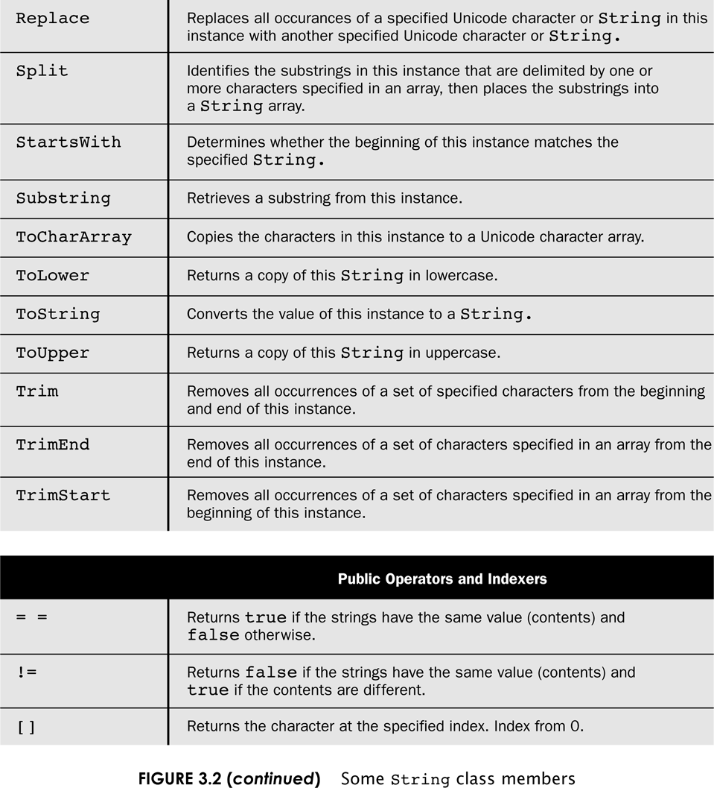
String Methods
3-<number>

Slide 17
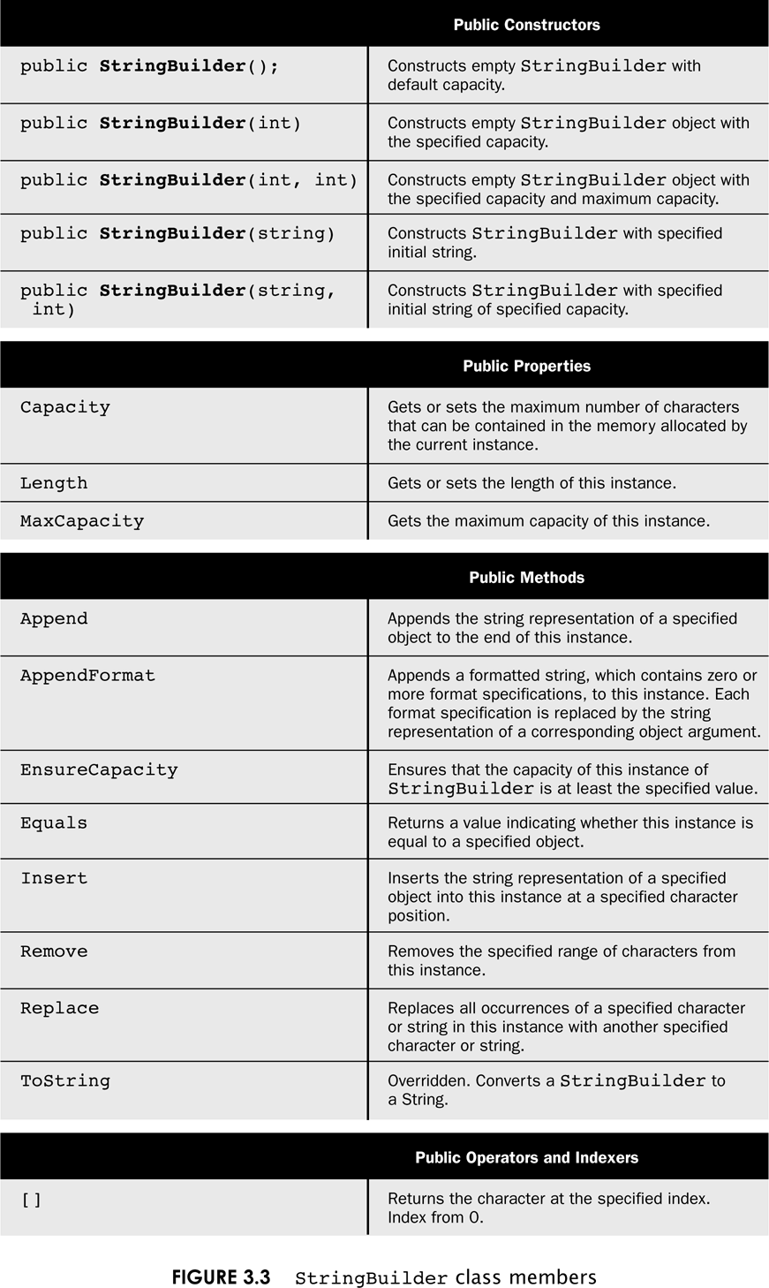
StringBuilder Methods
3-<number>

Slide 18
String Indexes
It is occasionally helpful to refer to a particular character within a string
This can be done by specifying the character's numeric index
The indexes begin at zero in each string
In the string "Hello", the character 'H' is at index 0 and the 'o' is at index 4
See StringMutation.cs
3-<number>

Slide 19
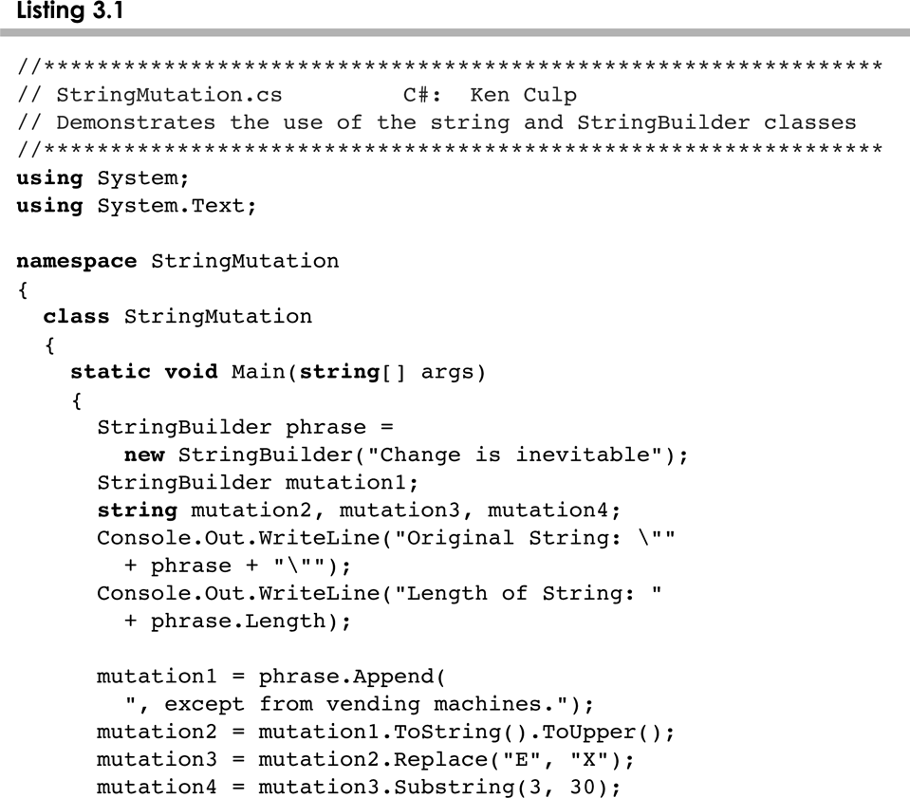
StringMutation.cs
3-<number>

Slide 20
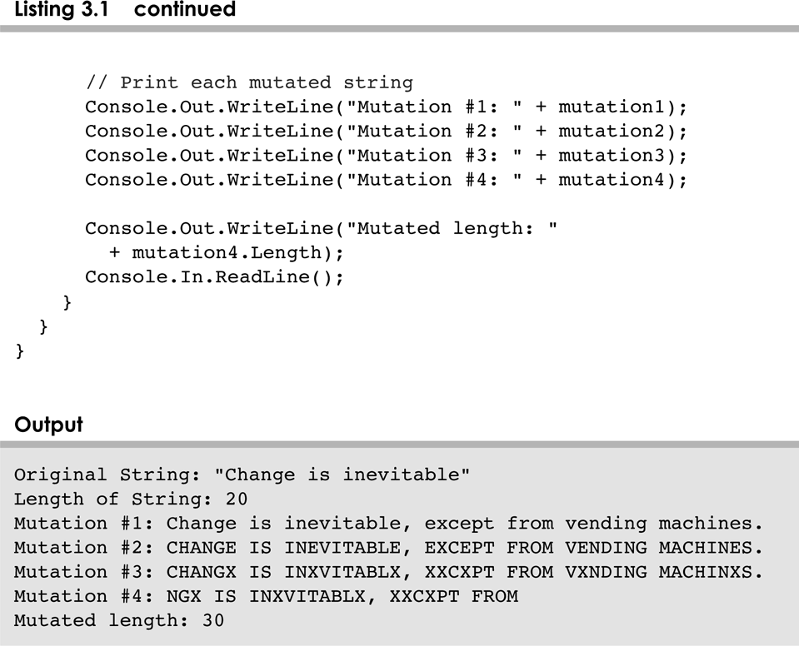
StringMutation.cs
3-<number>

Slide 21
Outline
Creating Objects
The String Class
.Net and Base Class Libraries
Formatting Output
Enumerated Types
Components and Containers
Images
3-<number>

Slide 22
Class Libraries
A class library is a collection of classes that we can use when developing programs
The C# standard class library is part of .Net Framework
Various classes we've already used (Console, String) are part of the C# standard class library
Other class libraries can be obtained through third party vendors, or you can create them yourself
3-<number>

Slide 23
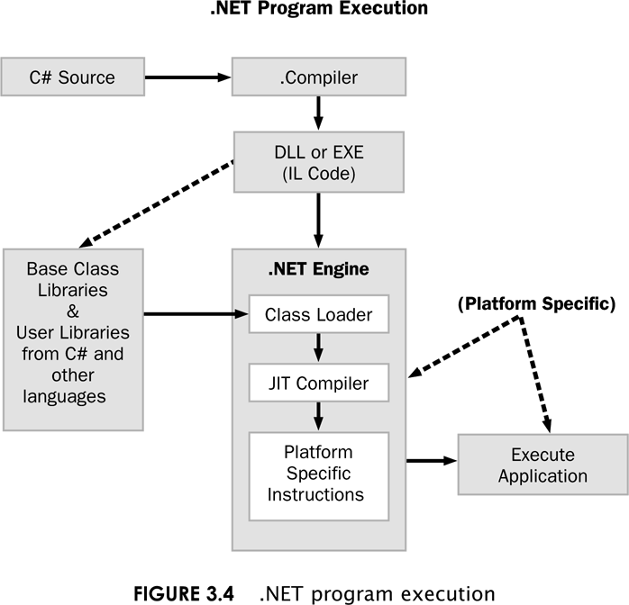
.Net program Execution
3-<number>

Slide 24
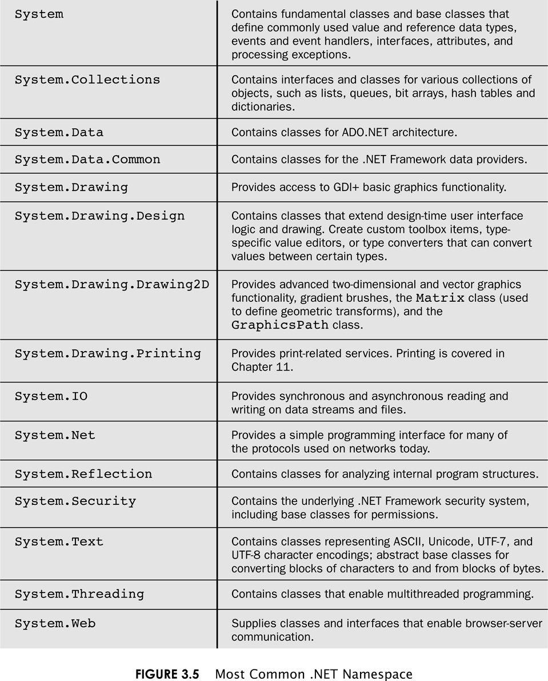
.Net Namespaces
3-<number>

Slide 25
The using Declaration
When you want to use a class from a namespace, you could use its fully qualified name
System.text.Stringbuilder phrase = new …
Or you can import the namespace, and then use just the class name
Using System.text;
StringBuilder phrase = new …
3-<number>

Slide 26
The Random Class
The Random class is part of the System package
It provides methods that generate pseudorandom numbers
A Random object performs complicated calculations based on a seed value to produce a stream of seemingly random values
See RandomNumbers.cs
3-<number>

Slide 27
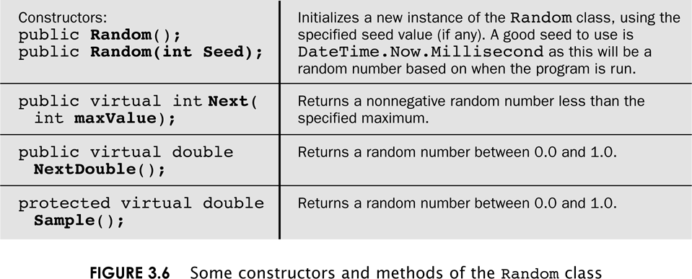
The Random Class
3-<number>

Slide 28
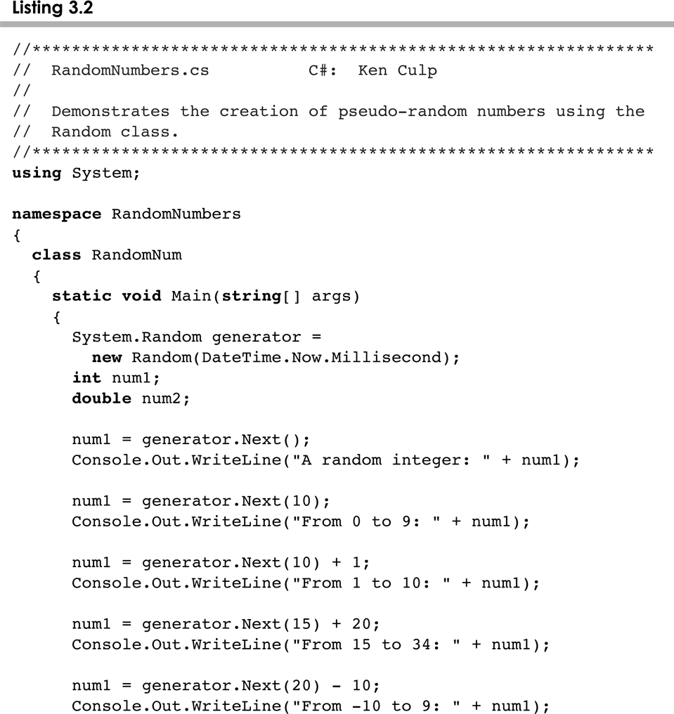
RandomNumber.cs
3-<number>

Slide 29
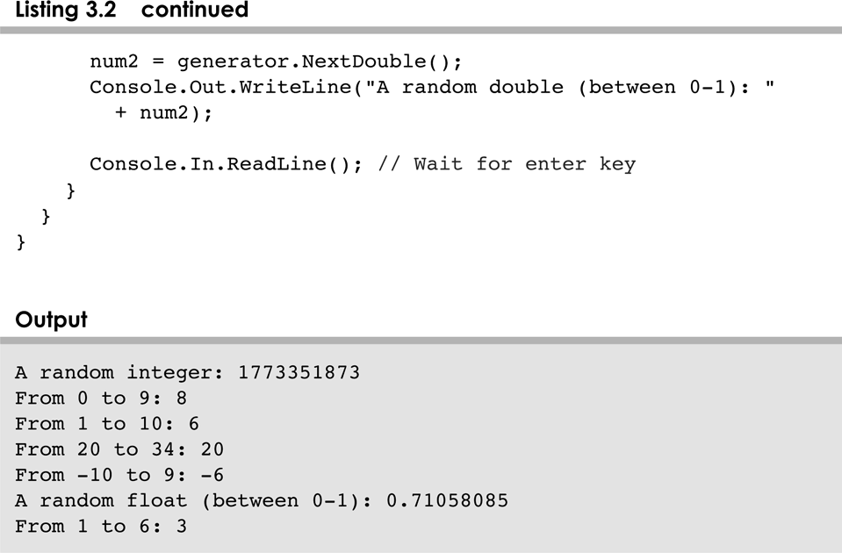
RandomNumber.cs
3-<number>

Slide 30
The Math Class
The Math class is part of the System package
The Math class contains methods that perform various mathematical functions
These include:
  absolute value
  square root
  exponentiation
  trigonometric functions
3-<number>

Slide 31
The Math Class
The methods of the Math class are static methods (also called class methods)
Static methods can be invoked through the class name – no object of the Math class is needed
value = Math.cos(90) + Math.sqrt(delta);
See Quadratic.cs
We discuss static methods further in Chapter 6
3-<number>

Slide 32
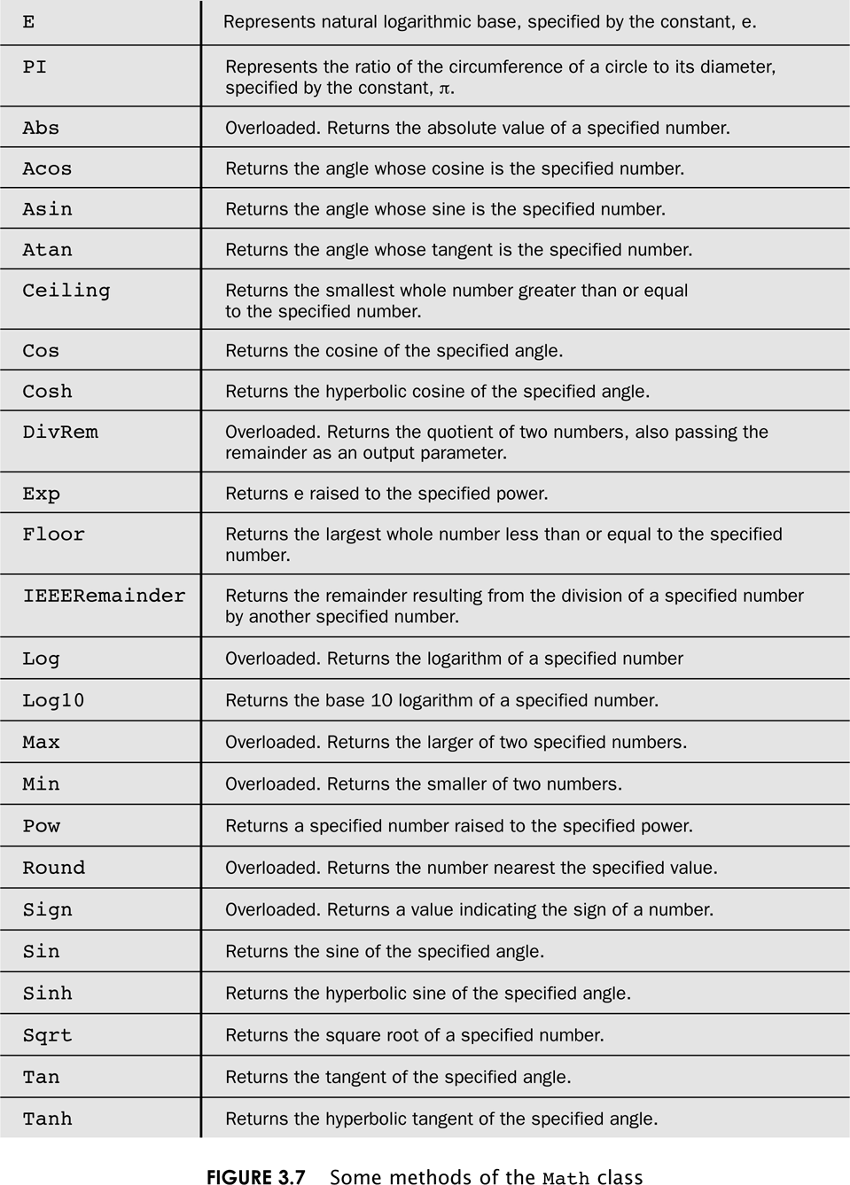
The Math Class
3-<number>

Slide 33
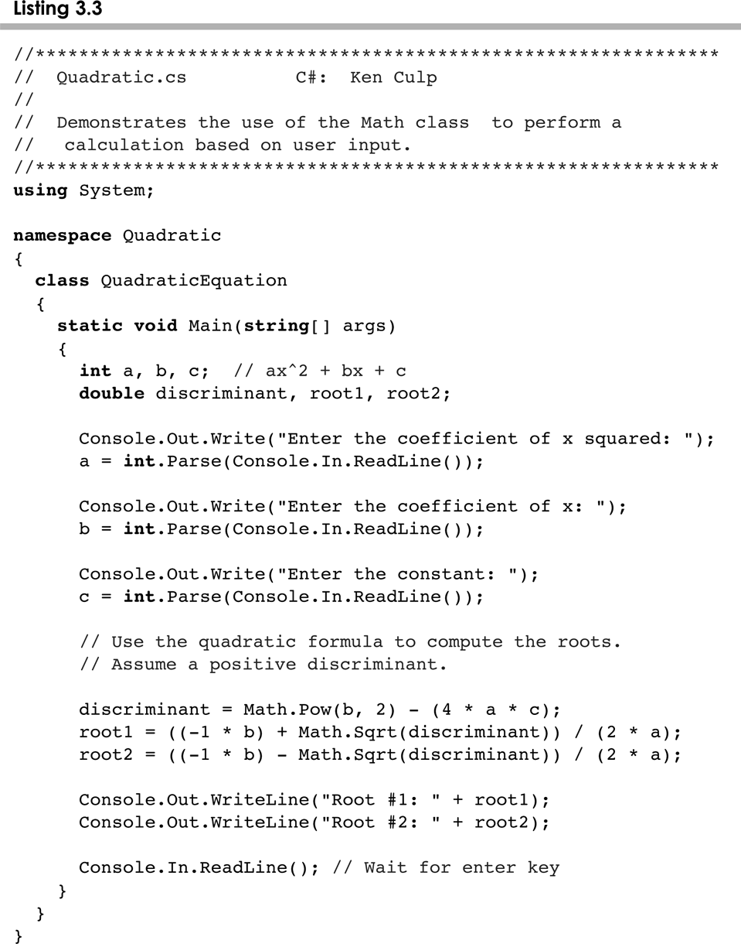
Quadratic.cs
3-<number>

Slide 34
Outline
Creating Objects
The String Class
Packages
Formatting Output
Enumerated Types
Components and Containers
Images
3-<number>

Slide 35
Formatting Output
It is often necessary to format values in certain ways so that they can be presented properly
The C# contains possibilities to provide formatting capabilities
The Standard Numeric Formatting
The Custom Numeric Formatting
The Composite Formatting
See Purchase.cs and CircleStats.cs
3-<number>

Slide 36
Outline
Creating Objects
The String Class
Packages
Formatting Output
Enumerated Types
Components and Containers
Images
3-<number>

Slide 37
Enumerated Types
C# allows you to define an enumerated type, which can then be used to declare variables
An enumerated type establishes all possible values for a variable of that type
The values are identifiers of your own choosing
The following declaration creates an enumerated type called Season
enum Season {winter, spring, summer, fall};
Any number of values can be listed
3-<number>

Slide 38
Enumerated Types
Once a type is defined, a variable of that type can be declared
Season time;
and it can be assigned a value
time = Season.fall;
The values are specified through the name of the type
Enumerated types are type-safe – you cannot assign any value other than those listed
3-<number>

Slide 39
Ordinal Values
Internally, each value of an enumerated type is stored as an integer, called its ordinal value
The first value in an enumerated type has an ordinal value of zero, the second one, and so on
However, you cannot assign a numeric value to an enumerated type, even if it corresponds to a valid ordinal value
3-<number>

Slide 40
Enumerated Types
The declaration of an enumerated type is a special type of class, and each variable of that type is an object
The ordinal value can be returned by use of a ToString method associated with enumerated types
See IceCream.cs
3-<number>

Slide 41
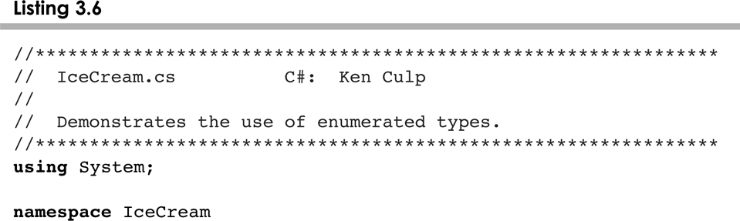
IceCreme.cs
3-<number>

Slide 42
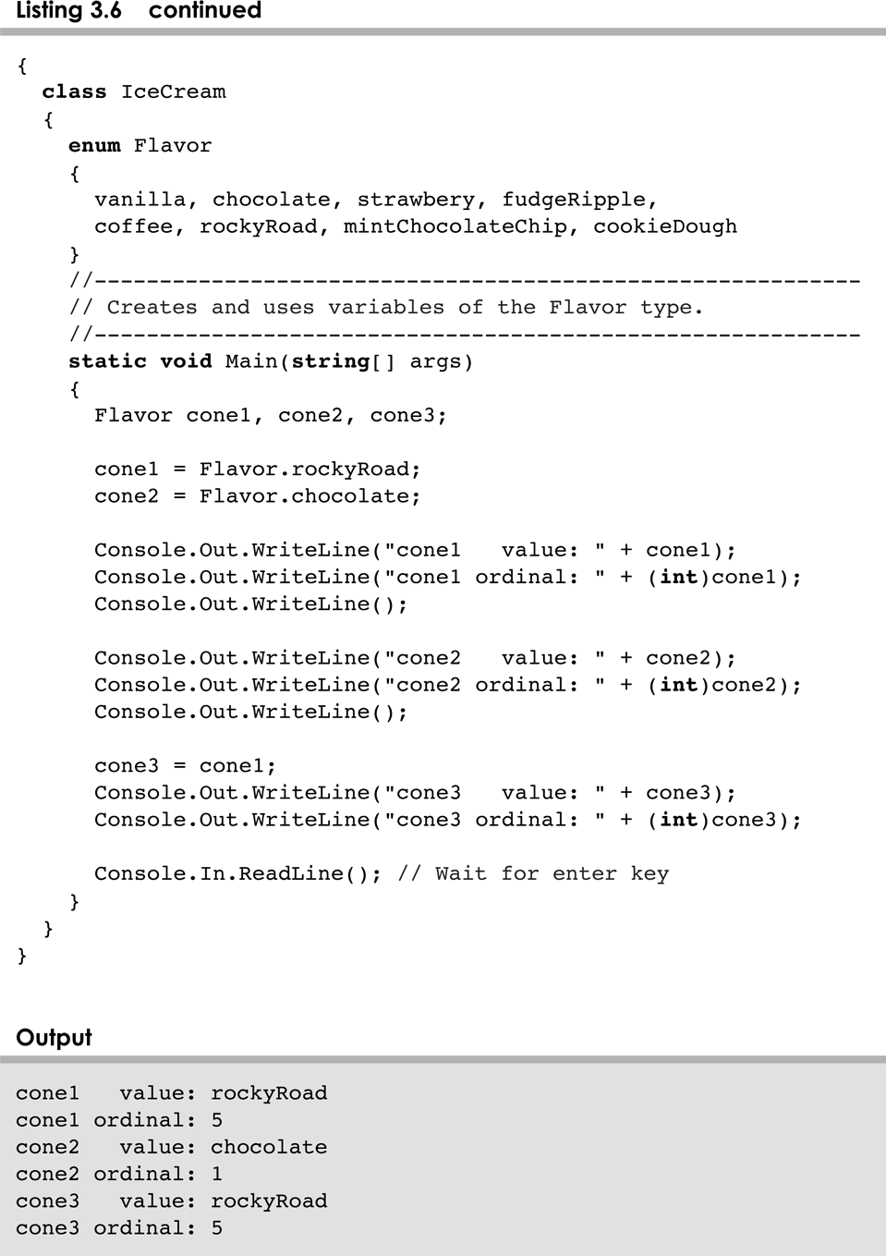
IceCreme.cs
3-<number>

Slide 43
Outline
Creating Objects
The String Class
Packages
Formatting Output
Enumerated Types
Components and Containers
Images
3-<number>

Slide 44
Autoboxing
Autoboxing is the automatic conversion of a primitive value to a corresponding wrapper object:
Integer obj;
int num = 42;
obj = num;
The assignment creates the appropriate Integer object
The reverse conversion (called unboxing) also occurs automatically as needed
3-<number>

Slide 45
Outline
Creating Objects
The String Class
Packages
Formatting Output
Enumerated Types
Wrapper Classes
Components and Containers
Images
3-<number>

Slide 46
Graphical Applications
Except for the applets seen in Chapter 2, the example programs we've explored thus far have been text-based
They are called command-line applications, which interact with the user using simple text prompts
Let's examine some Java applications that have graphical components
These components will serve as a foundation to programs that have true graphical user interfaces (GUIs)
3-<number>

Slide 47
GUI Components
A GUI component is an object that represents a screen element such as a button or a text field
GUI-related classes are defined primarily in the java.awt and the javax.swing packages
The Abstract Windowing Toolkit (AWT) was the original Java GUI package
The Swing package provides additional and more versatile components
Both packages are needed to create a Java GUI-based program
3-<number>

Slide 48
GUI Containers
A GUI container is a component that is used to hold and organize other components
A frame is a container that is used to display a GUI-based Java application
A frame is displayed as a separate window with a title bar – it can be repositioned and resized on the screen as needed
A panel is a container that cannot be displayed on its own but is used to organize other components
A panel must be added to another container to be displayed
3-<number>

Slide 49
GUI Containers
A GUI container can be classified as either heavyweight or lightweight
A heavyweight container is one that is managed by the underlying operating system
A lightweight container is managed by the Java program itself
Occasionally this distinction is important
A frame is a heavyweight container and a panel is a lightweight container
3-<number>

Slide 50
Labels
A label is a GUI component that displays a line of text
Labels are usually used to display information or identify other components in the interface
Let's look at a program that organizes two labels in a panel and displays that panel in a frame
See Authority.java
This program is not interactive, but the frame can be repositioned and resized
3-<number>

Slide 51
Nested Panels
Containers that contain other components make up the containment hierarchy of an interface
This hierarchy can be as intricate as needed to create the visual effect desired
The following example nests two panels inside a third panel – note the effect this has as the frame is resized
See NestedPanels.java
3-<number>

Slide 52
Outline
Creating Objects
The String Class
Packages
Formatting Output
Enumerated Types
Wrapper Classes
Components and Containers
Images
3-<number>

Slide 53
Images
Images are often used in a programs with a graphical interface
Java can manage images in both JPEG and GIF formats
As we've seen, a JLabel object can be used to display a line of text
It can also be used to display an image
That is, a label can be composed of text, and image, or both at the same time
3-<number>

Slide 54
Images
The ImageIcon class is used to represent an image that is stored in a label
The position of the text relative to the image can be set explicitly
The alignment of the text and image within the label can be set as well
See LabelDemo.java
3-<number>

Slide 55
Summary
Chapter 3 focused on:
  object creation and object references
  the String class and its methods
  the Java standard class library
  the Random and Math classes
  formatting output
  enumerated types
  wrapper classes
  graphical components and containers
  labels and images
3-<number>

