Slide 1

Chapter 5:
Conditionals and Loops
C# Software Solutions
Foundations of Program Design
First Edition
by
John Lewis

Slide 2
Conditionals and Loops
Now we will examine programming statements that allow us to:
  make decisions
  repeat processing steps in a loop
Chapter 5 focuses on:
  boolean expressions
  conditional statements
  comparing data
  repetition statements
  more drawing techniques
  more GUI components
5-<number>

Slide 3
Outline
The if Statement and Conditions
Other Conditional Statements
Comparing Data
The while Statement
Other Repetition Statements
Decisions and Graphics
More Components
5-<number>

Slide 4
Flow of Control
Unless specified otherwise, the order of statement execution through a method is linear: one statement after another in sequence
Some programming statements allow us to:
  decide whether or not to execute a particular statement
  execute a statement over and over, repetitively
These decisions are based on boolean expressions (or conditions) that evaluate to true or false
The order of statement execution is called the flow of control
5-<number>

Slide 5
Conditional Statements
A conditional statement lets us choose which statement will be executed next
Therefore they are sometimes called selection statements
Conditional statements give us the power to make basic decisions
The C# conditional statements are the:
  if statement
  if-else statement
  switch statement
5-<number>

Slide 6
The if Statement
The if statement has the following syntax:
The condition must be a
boolean expression. It must
evaluate to either true or false.
if is a C#
reserved word
if ( condition )
statement;
If the condition is true, the statement is executed.
If it is false, the statement is skipped.
5-<number>

Slide 7
Logic of an if statement
condition
evaluated
true
false
statement
5-<number>

Slide 8
Boolean Expressions
A condition often uses one of C#'s equality operators or relational operators, which all return boolean results:
      == equal to
      != not equal to
      < less than
      > greater than
      <= less than or equal to
      >= greater than or equal to
Note the difference between the equality operator (==) and the assignment operator (=)
5-<number>

Slide 9
The if Statement
An example of an if statement:
if (sum > MAX)
delta = sum - MAX;
Console.Out.WriteLine("The sum is " + sum);
First the condition is evaluated -- the value of sum is either greater than the value of MAX, or it is not
If the condition is true, the assignment statement is executed -- if it isn’t, it is skipped.
Either way, the call to WriteLine is executed next
See Age.cs
5-<number>

Slide 10
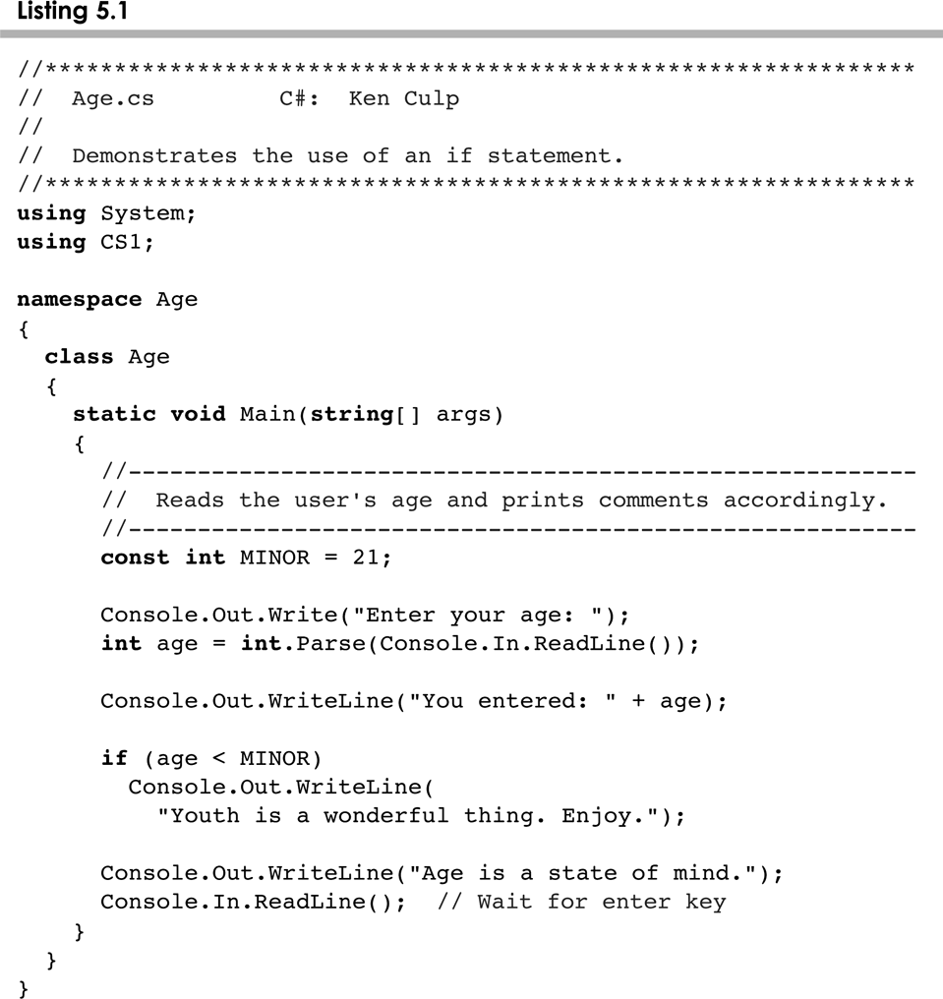
Age.cs
5-<number>

Slide 11
Indentation
The statement controlled by the if statement is indented to indicate that relationship
The use of a consistent indentation style makes a program easier to read and understand
Although it makes no difference to the compiler, proper indentation is crucial
"Always code as if the person who ends up maintaining your code will be a violent psychopath who knows where you live."
-- Martin Golding
5-<number>

Slide 12
The if Statement
What do the following statements do?
if (top >= MAXIMUM)
top = 0;
Sets top to zero if the current value of top is greater than or equal to the value of MAXIMUM
if (total != stock + warehouse)
inventoryError = true;
Sets a flag to true if the value of total is not equal to the sum of stock and warehouse
The precedence of the arithmetic operators is higher than the precedence of the equality and relational operators
5-<number>

Slide 13
Logical Operators
Boolean expressions can also use the following logical operators:
  ! Logical NOT
  && Logical AND
  || Logical OR
They all take boolean operands and produce boolean results
Logical NOT is a unary operator (it operates on one operand)
Logical AND and logical OR are binary operators (each operates on two operands)
5-<number>

Slide 14
Logical NOT
The logical NOT operation is also called logical negation or logical complement
If some boolean condition a is true, then !a is false; if a is false, then !a is true
Logical expressions can be shown using a truth table
a | !a
true | false
false | true
5-<number>

Slide 15
Logical AND and Logical OR
The logical AND expression
a && b
is true if both a and b are true, and false otherwise
The logical OR expression
a || b
is true if a or b or both are true, and false otherwise
5-<number>

Slide 16
Logical Operators
Expressions that use logical operators can form complex conditions
if (total < MAX+5 && !found)
Console.Out.WriteLine("Processing…");
All logical operators have lower precedence than the relational operators
Logical NOT has higher precedence than logical AND and logical OR
5-<number>

Slide 17
Logical Operators
A truth table shows all possible true-false combinations of the terms
Since && and || each have two operands, there are four possible combinations of conditions a and b
a | b | a && b | a || b
true | true | true | true
true | false | false | true
false | true | false | true
false | false | false | false
5-<number>

Slide 18
Boolean Expressions
Specific expressions can be evaluated using truth tables
total < MAX | found | !found | total < MAX && !found
false | false | true | false
false | true | false | false
true | false | true | true
true | true | false | false
5-<number>

Slide 19
Short-Circuited Operators
The processing of logical AND and logical OR is “short-circuited”
If the left operand is sufficient to determine the result, the right operand is not evaluated
if (count != 0 && total/count > MAX)
Console.Out.WriteLine("Testing…");
This type of processing must be used carefully
5-<number>

Slide 20
Outline
The if Statement and Conditions
Other Conditional Statements
Comparing Data
The while Statement
Other Repetition Statements
Decisions and Graphics
More Components
5-<number>

Slide 21
The if-else Statement
An else clause can be added to an if statement to make an if-else statement
if ( condition )
statement1;
else
statement2;
If the condition is true, statement1 is executed; if the condition is false, statement2 is executed
One or the other will be executed, but not both
See Wages.cs
5-<number>

Slide 22
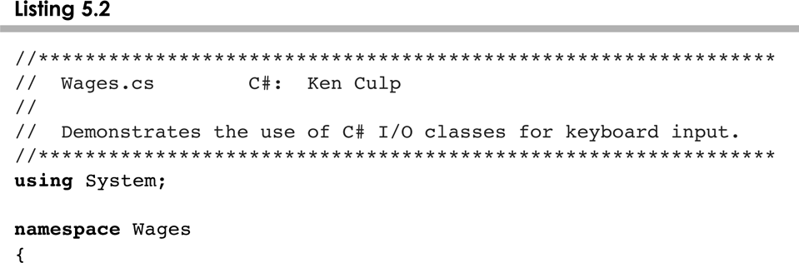
Wages.cs
5-<number>

Slide 23
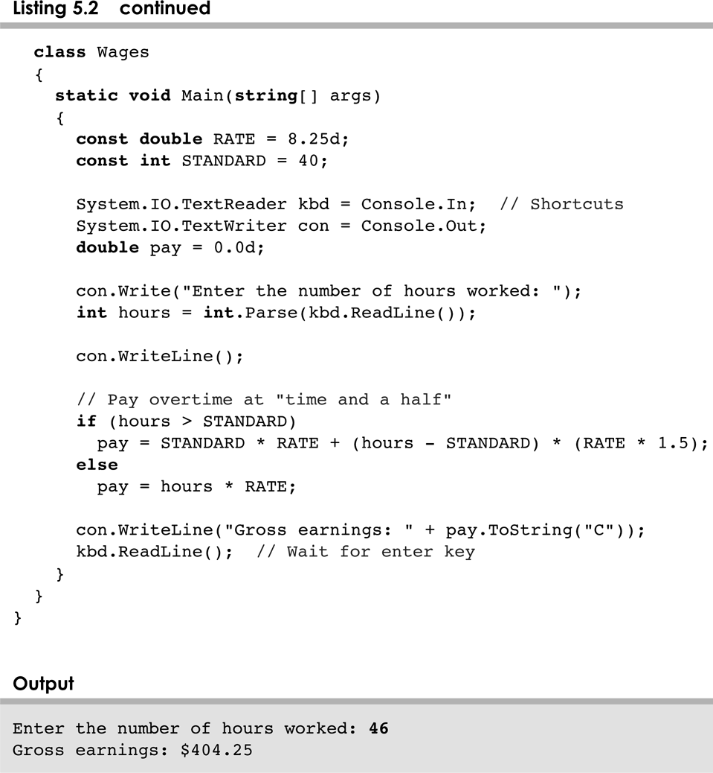
Wages.cs
5-<number>

Slide 24
Logic of an if-else statement
condition
evaluated
true
false
statement1
statement2
5-<number>

Slide 25
The Coin Class
Let's examine a class that represents a coin that can be flipped
Instance data is used to indicate which face (heads or tails) is currently showing
See CoinFlip.cs
See Coin.cs
5-<number>

Slide 26
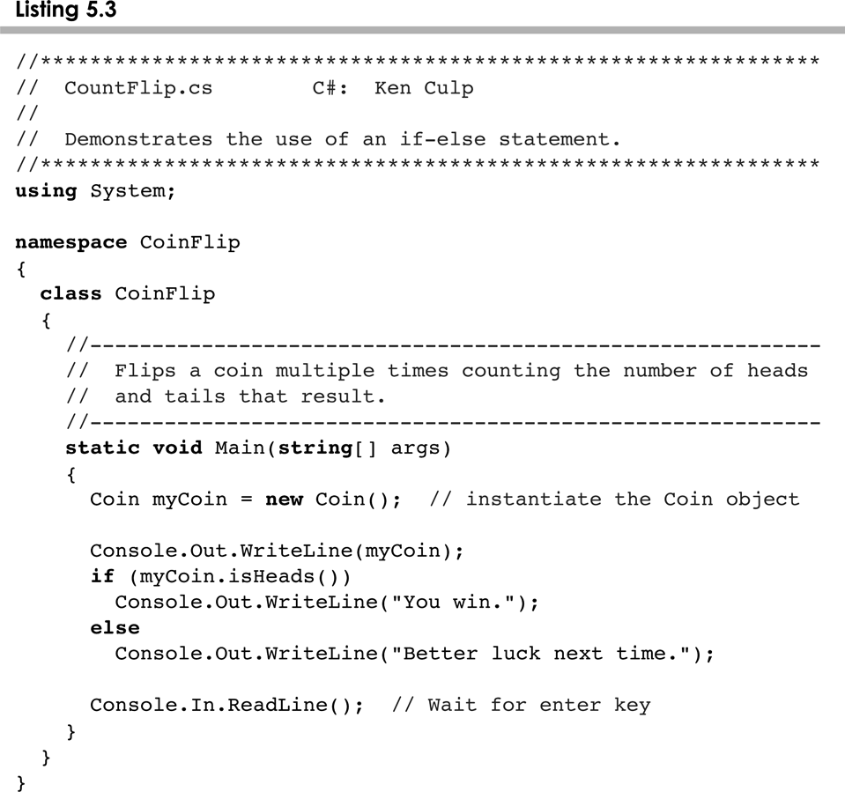
CoinFlip.cs
5-<number>

Slide 27
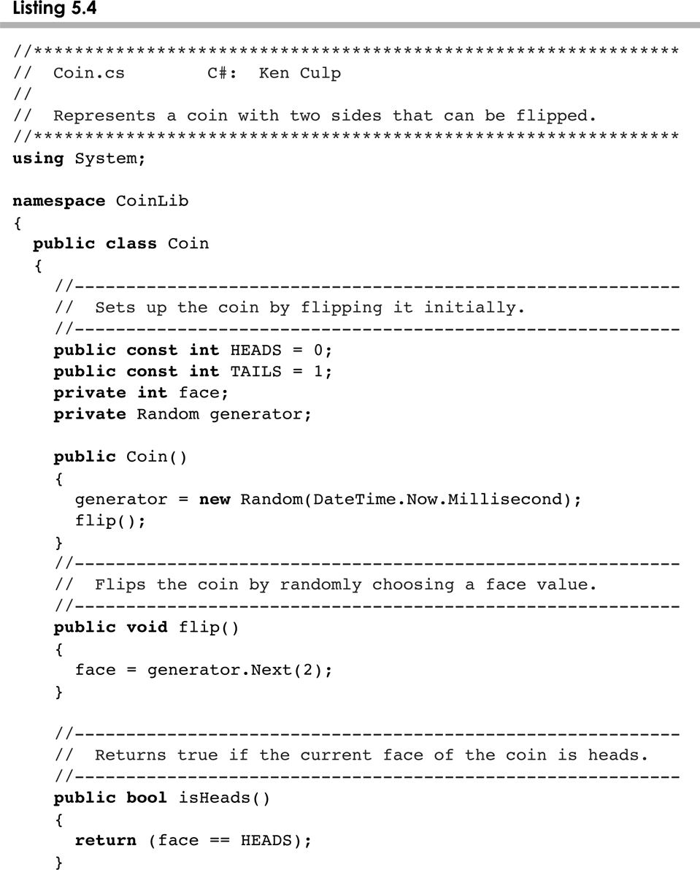
Coin.cs
5-<number>

Slide 28
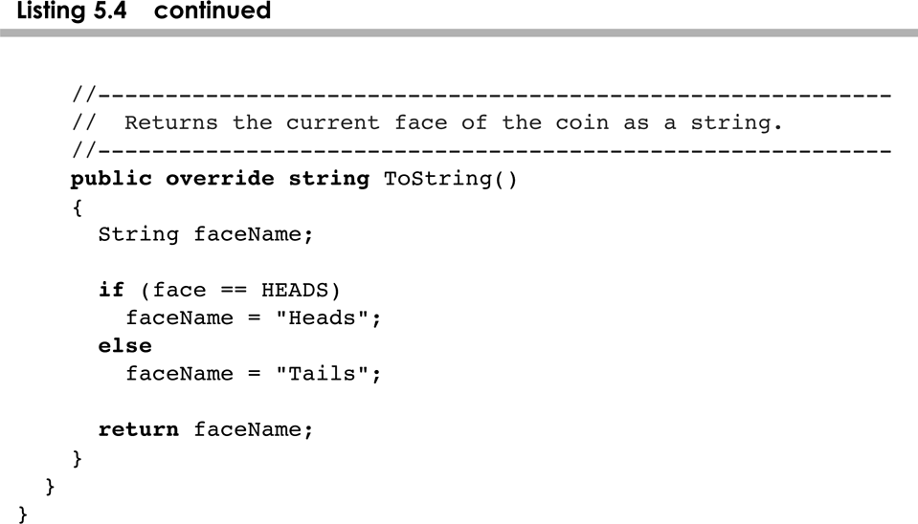
Coin.cs
5-<number>

Slide 29
Indentation Revisited
Remember that indentation is for the human reader, and is ignored by the computer
if (total > MAX)
Console.Out.WriteLine("Error!!");
errorCount++;
Despite what is implied by the indentation, the increment will occur whether the condition is true or not
5-<number>

Slide 30
Block Statements
Several statements can be grouped together into a block statement delimited by braces
A block statement can be used wherever a statement is called for in the C# syntax rules
if (total > MAX)
{
Console.Out.WriteLine("Error!!");
errorCount++;
}
5-<number>

Slide 31
Block Statements
In an if-else statement, the if portion, or the else portion, or both, could be block statements
if (total > MAX)
{
Console.Out.WriteLine("Error!!");
errorCount++;
}
else
{
Console.Out.WriteLine("Total: " + total);
current = total*2;
}
See Guessing.cs
5-<number>

Slide 32
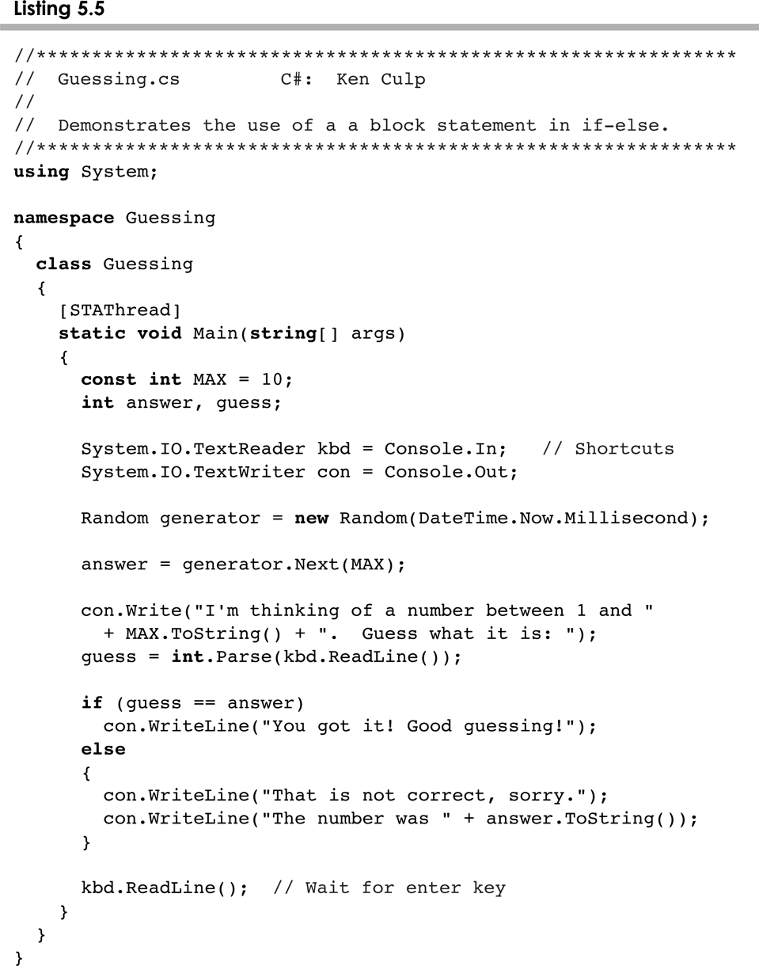
Guessing.cs
5-<number>

Slide 33
The Conditional Operator
C# has a conditional operator that uses a boolean condition to determine which of two expressions is evaluated
Its syntax is:
condition ? expression1 : expression2
If the condition is true, expression1 is evaluated; if it is false, expression2 is evaluated
The value of the entire conditional operator is the value of the selected expression
5-<number>

Slide 34
The Conditional Operator
The conditional operator is similar to an if-else statement, except that it is an expression that returns a value
For example:
larger = ((num1 > num2) ? num1 : num2);
If num1 is greater than num2, then num1 is assigned to larger; otherwise, num2 is assigned to larger
The conditional operator is ternary because it requires three operands
5-<number>

Slide 35
The Conditional Operator
Another example:
Console.Out.WriteLine("Your change is " + count +
((count == 1) ? "Dime" : "Dimes"));
If count equals 1, then "Dime" is printed
If count is anything other than 1, then "Dimes" is printed
5-<number>

Slide 36
Nested if Statements
The statement executed as a result of an if statement or else clause could be another if statement
These are called nested if statements
See MinOfThree.cs
An else clause is matched to the last unmatched if (no matter what the indentation implies)
Braces can be used to specify the if statement to which an else clause belongs
5-<number>

Slide 37
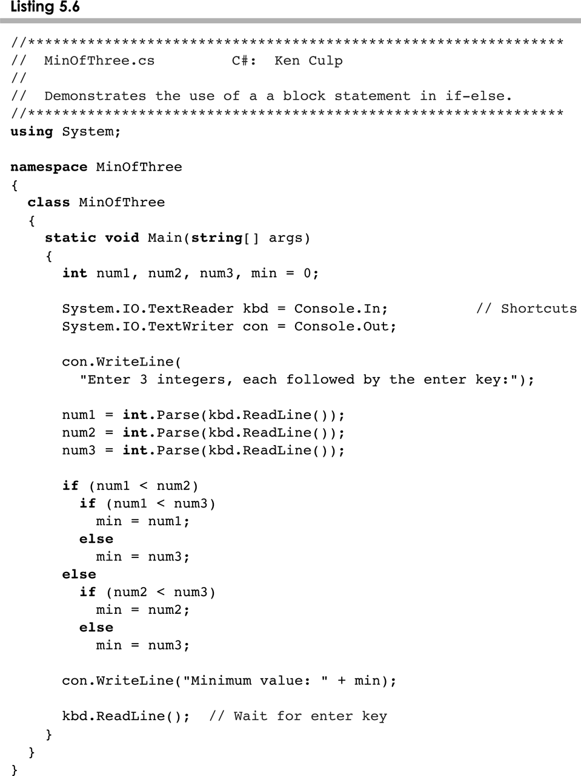
MinOfThree
5-<number>

Slide 38
The switch Statement
The switch statement provides another way to decide which statement to execute next
The switch statement evaluates an expression, then attempts to match the result to one of several possible cases
Each case contains a value and a list of statements
The flow of control transfers to statement associated with the first case value that matches
5-<number>

Slide 39
The switch Statement
The general syntax of a switch statement is:
switch
and
case
are
reserved
words
switch ( expression )
{
case value1 :
statement-list1
case value2 :
statement-list2
case value3 :
statement-list3
case ...
}
If expression
matches value2,
control jumps
to here
5-<number>

Slide 40
The switch Statement
Often a break statement is used as the last statement in each case's statement list
A break statement causes control to transfer to the end of the switch statement
If a break statement is not used, the flow of control will continue into the next case
Sometimes this may be appropriate, but often we want to execute only the statements associated with one case
5-<number>

Slide 41
The switch Statement
An example of a switch statement:
switch (option)
{
case 'A':
aCount++;
break;
case 'B':
bCount++;
break;
case 'C':
cCount++;
break;
}
5-<number>

Slide 42
The switch Statement
A switch statement can have an optional default case
The default case has no associated value and simply uses the reserved word default
If the default case is present, control will transfer to it if no other case value matches
If there is no default case, and no other value matches, control falls through to the statement after the switch
5-<number>

Slide 43
The switch Statement
The expression of a switch statement must result in an integral type, meaning an integer int or a char or an enumerated type
It cannot be a boolean value or a floating point value (float or double) even (byte, short and long) cannot be used
You cannot perform relational checks with a switch statement
See GradeReport.cs
5-<number>

Slide 44
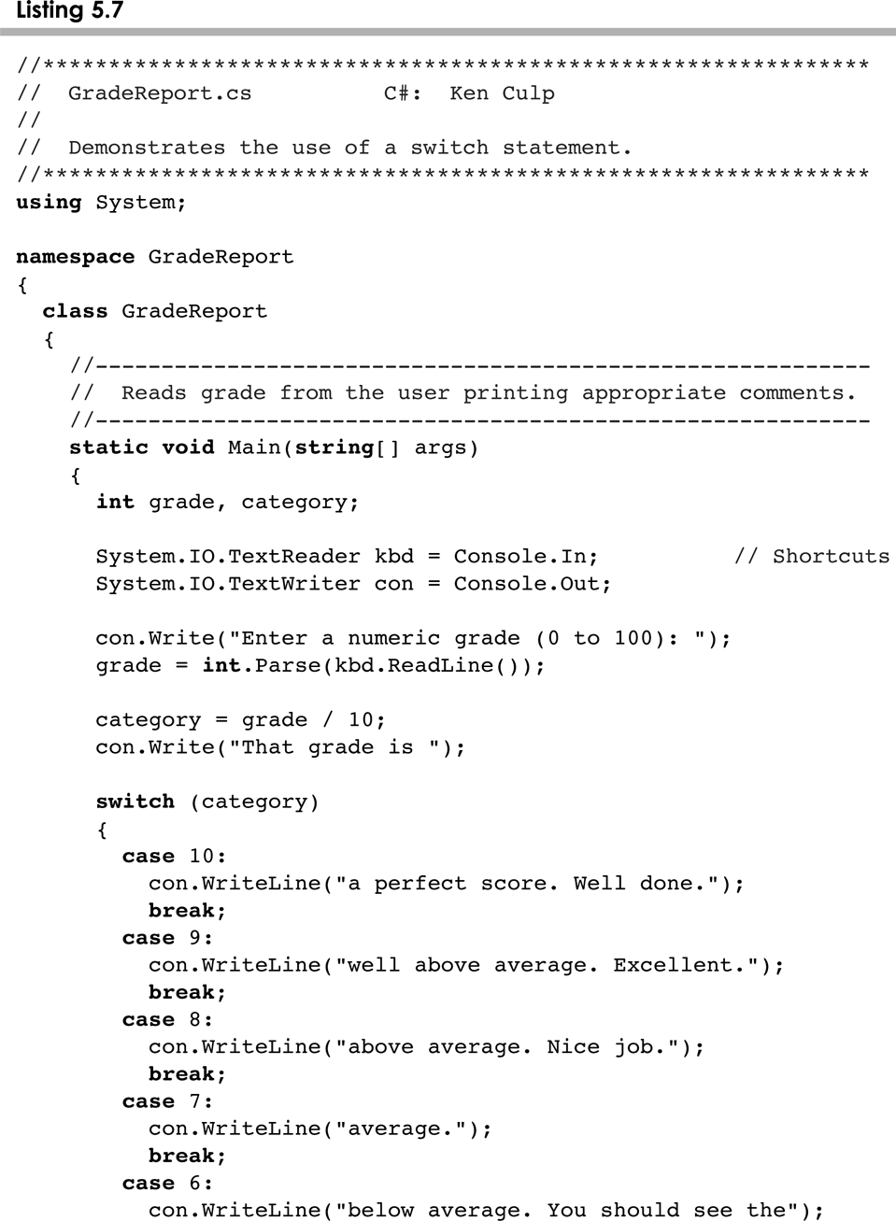
GradeReport.cs
5-<number>

Slide 45
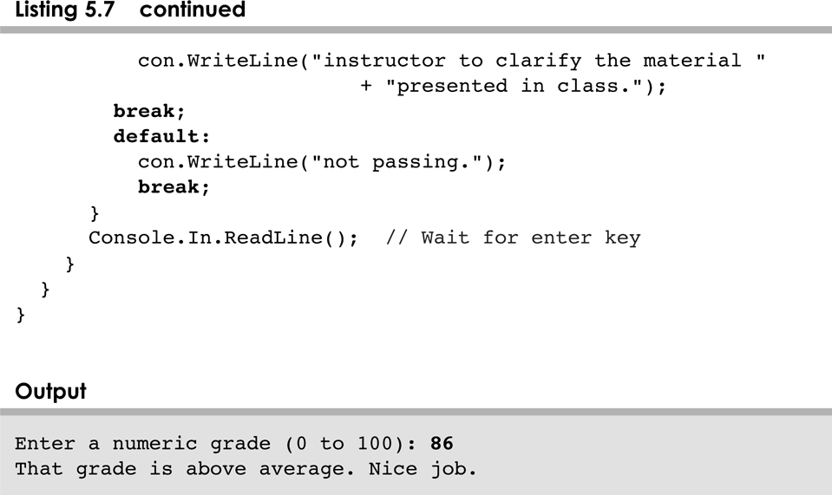
GradeReport.cs
5-<number>

Slide 46
Outline
The if Statement and Conditions
Other Conditional Statements
Comparing Data
The while Statement
Other Repetition Statements
Decisions and Graphics
More Components
5-<number>

Slide 47
Comparing Data
When comparing data using boolean expressions, it's important to understand the nuances of certain data types
Let's examine some key situations:
  Comparing floating point values for equality
  Comparing characters
  Comparing strings (alphabetical order)
  Comparing object vs. comparing object references
5-<number>

Slide 48
Comparing Float Values
You should rarely use the equality operator (==) when comparing two floating point values (float or double)
Two floating point values are equal only if their underlying binary representations match exactly
Computations often result in slight differences that may be irrelevant
In many situations, you might consider two floating point numbers to be "close enough" even if they aren't exactly equal
5-<number>

Slide 49
Comparing Float Values
To determine the equality of two floats, you may want to use the following technique:
if (Math.abs(f1 - f2) < TOLERANCE)
Console.Out.WriteLine("Essentially equal");
If the difference between the two floating point values is less than the tolerance, they are considered to be equal
The tolerance could be set to any appropriate level, such as 0.000001
5-<number>

Slide 50
Comparing Characters
As we've discussed, C# character data is based on the Unicode character set
Unicode establishes a particular numeric value for each character, and therefore an ordering
We can use relational operators on character data based on this ordering
For example, the character '+' is less than the character 'J' because it comes before it in the Unicode character set
Appendix B provides an overview of Unicode
5-<number>

Slide 51
Comparing Characters
In Unicode, the digit characters (0-9) are contiguous and in order
Likewise, the uppercase letters (A-Z) and lowercase letters (a-z) are contiguous and in order
Characters | Unicode Values
0 – 9 | 48 through 57
A – Z | 65 through 90
a – z | 97 through 122
5-<number>

Slide 52
Comparing Strings
Remember that in C# a character string is an object
In C#, comparing two objects of type string is a value compare
String x = “1234”;
String y = “1234”;
if (x == y)
Console.Out.WriteLine("Same");
else
Console.Out.WriteLine(“Different");
5-<number>

Slide 53
Comparing Strings
The String class contains a method called compareTo to determine if one string comes before another
A call to name1.compareTo(name2)
  returns zero if name1 and name2 are equal (contain the same characters)
  returns a negative value if name1 is less than name2
  returns a positive value if name1 is greater than name2
5-<number>

Slide 54
Comparing Strings
if (name1.compareTo(name2) < 0)
Console.Out.WriteLine (name1 + "comes first");
else
if (name1.compareTo(name2) == 0)
Console.Out.WriteLine ("Same name");
else
Console.Out.WriteLine (name2 + "comes first");
Because comparing characters and strings is based on a character set, it is called a lexicographic ordering
5-<number>

Slide 55
Lexicographic Ordering
Lexicographic ordering is not strictly alphabetical when uppercase and lowercase characters are mixed
For example, the string "Great" comes before the string "fantastic" because all of the uppercase letters come before all of the lowercase letters in Unicode
Also, short strings come before longer strings with the same prefix (lexicographically)
Therefore "book" comes before "bookcase"
5-<number>

Slide 56
Outline
The if Statement and Conditions
Other Conditional Statements
Comparing Data
The while Statement
Other Repetition Statements
Decisions and Graphics
More Components
5-<number>

Slide 57
Repetition Statements
Repetition statements allow us to execute a statement multiple times
Often they are referred to as loops
Like conditional statements, they are controlled by boolean expressions
C# has three kinds of repetition statements:
  the while loop
  the do loop
  the for loop
The programmer should choose the right kind of loop for the situation
5-<number>

Slide 58
The while Statement
A while statement has the following syntax:
while ( condition )
statement;
If the condition is true, the statement is executed
Then the condition is evaluated again, and if it is still true, the statement is executed again
The statement is executed repeatedly until the condition becomes false
5-<number>

Slide 59
Logic of a while Loop
condition
evaluated
true
false
statement
5-<number>

Slide 60
The while Statement
An example of a while statement:
int count = 1;
while (count <= 5)
{
Console.Out.WriteLine (count);
count++;
}
If the condition of a while loop is false initially, the statement is never executed
Therefore, the body of a while loop will execute zero or more times
5-<number>

Slide 61
The while Statement
Let's look at some examples of loop processing
A loop can be used to maintain a running sum
A sentinel value is a special input value that represents the end of input
See Average.cs
A loop can also be used for input validation, making a program more robust
See WinPercentage.cs
5-<number>

Slide 62
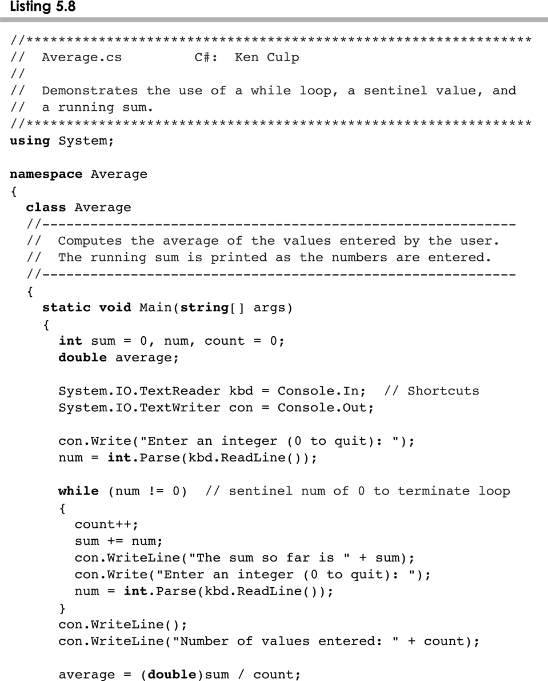
Average.cs
5-<number>

Slide 63
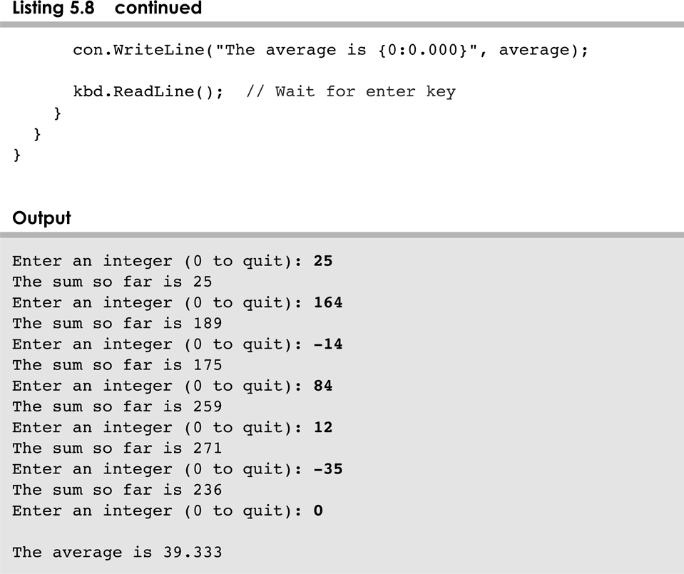
Average.cs
5-<number>

Slide 64
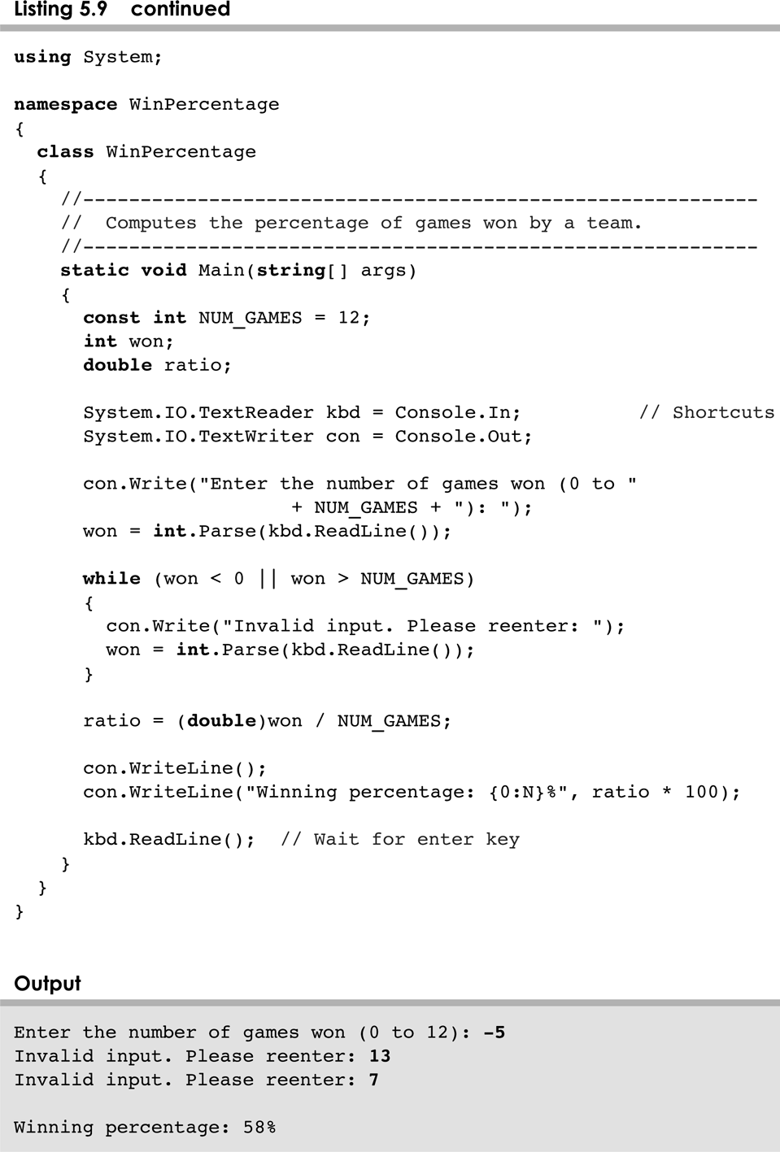
WinPercentage
5-<number>

Slide 65
Infinite Loops
The body of a while loop eventually must make the condition false
If not, it is called an infinite loop, which will execute until the user interrupts the program
This is a common logical error
You should always double check the logic of a program to ensure that your loops will terminate normally
5-<number>

Slide 66
Infinite Loops
An example of an infinite loop:
int count = 1;
while (count <= 25)
{
Console.Out.WriteLine(count);
count = count - 1;
}
This loop will continue executing until interrupted (Control-C) or until an underflow error occurs
5-<number>

Slide 67
Nested Loops
Similar to nested if statements, loops can be nested as well
That is, the body of a loop can contain another loop
For each iteration of the outer loop, the inner loop iterates completely
See PalindromeTester.cs
5-<number>

Slide 68
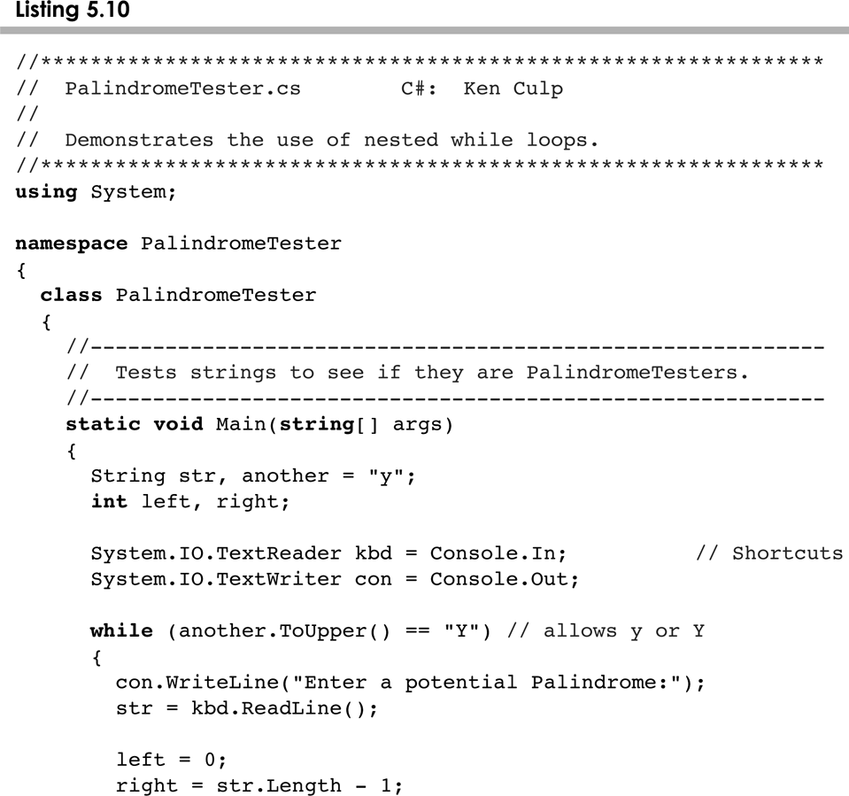
PalindromeTester.cs
5-<number>

Slide 69
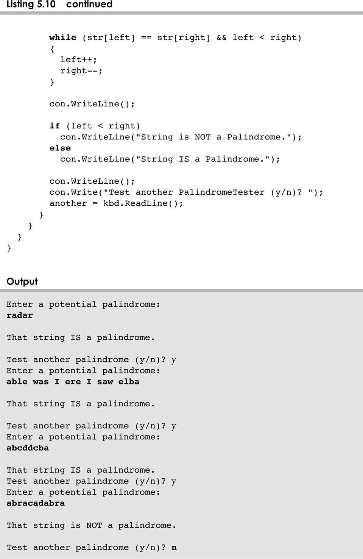
PalindromeTester.cs
5-<number>

Slide 70
Nested Loops
How many times will the string "Here" be printed?
count1 = 1;
while (count1 <= 10)
{
count2 = 1;
while (count2 <= 20)
{
Console.Out.WriteLine("Here");
count2++;
}
count1++;
}
10 * 20 = 200
5-<number>

Slide 71
Outline
The if Statement and Conditions
Other Conditional Statements
Comparing Data
The while Statement
Other Repetition Statements
Decisions and Graphics
More Components
5-<number>

Slide 72
The do Statement
A do statement has the following syntax:
do
{
statement;
}
while ( condition )
The statement is executed once initially, and then the condition is evaluated
The statement is executed repeatedly until the condition becomes false
5-<number>

Slide 73
Logic of a do Loop
statement
true
condition
evaluated
false
5-<number>

Slide 74
The do Statement
An example of a do loop:
int count = 0;
do
{
count++;
Console.Out.WriteLine(count);
} while (count < 5);
The body of a do loop executes at least once
See ReverseNumber.cs
5-<number>

Slide 75
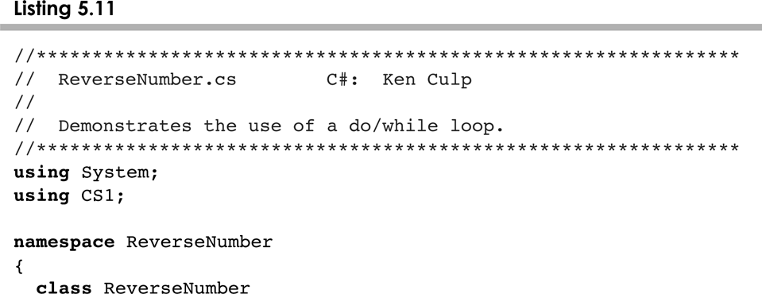
ReverseNumber.cs
5-<number>

Slide 76
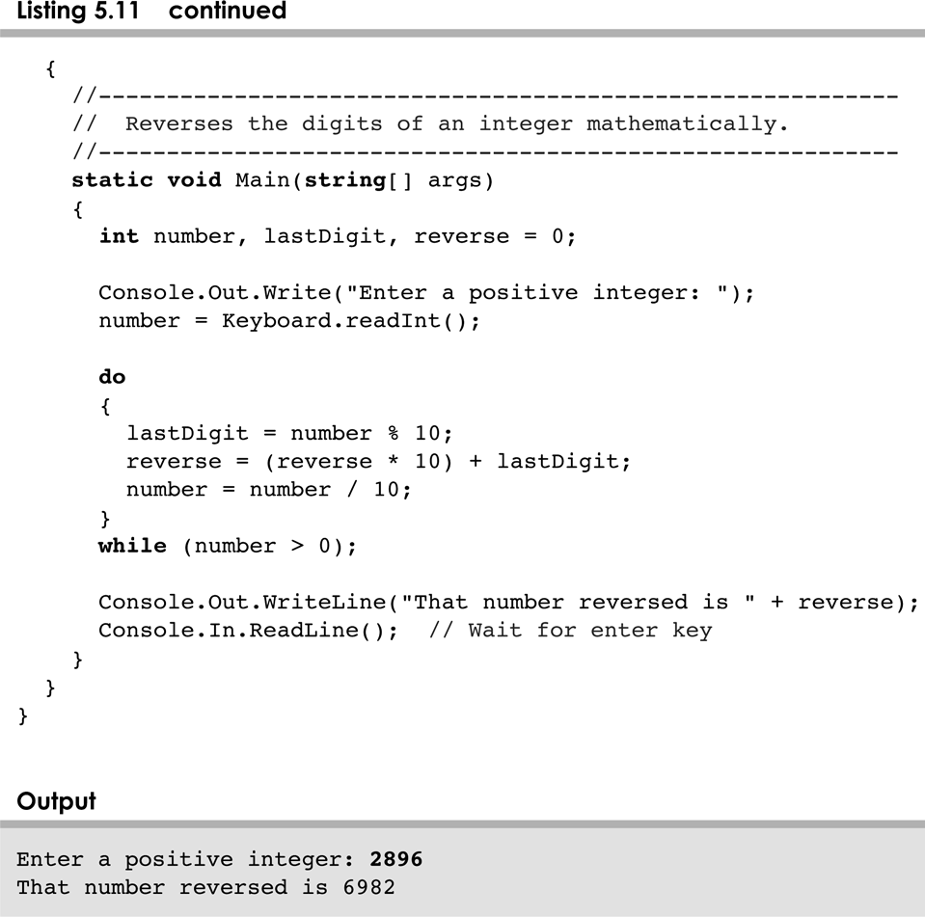
ReverseNumber.cs
5-<number>

Slide 77
Comparing while and do
The while Loop
The do Loop
statement
condition
evaluated
true
false
condition
evaluated
true
statement
false
5-<number>

Slide 78
The for Statement
A for statement has the following syntax:
The initialization
is executed once
before the loop begins
The statement is
executed until the
condition becomes false
for ( initialization ; condition ; increment )
statement;
The increment portion is executed at the end of each iteration
5-<number>

Slide 79
Logic of a for loop
initialization
condition
evaluated
true
false
statement
increment
5-<number>

Slide 80
The for Statement
A for loop is functionally equivalent to the following while loop structure:
initialization;
while ( condition )
{
statement;
increment;
}
5-<number>

Slide 81
The for Statement
An example of a for loop:
for (int count=1; count <= 5; count++)
System.out.println (count);
The initialization section can be used to declare a variable
Like a while loop, the condition of a for loop is tested prior to executing the loop body
Therefore, the body of a for loop will execute zero or more times
5-<number>

Slide 82
The for Statement
The increment section can perform any calculation
for (int num=100; num > 0; num -= 5)
Console.Out.WriteLine(num);
A for loop is well suited for executing statements a specific number of times that can be calculated or determined in advance
See Multiples.cs
See Stars.cs
5-<number>

Slide 83
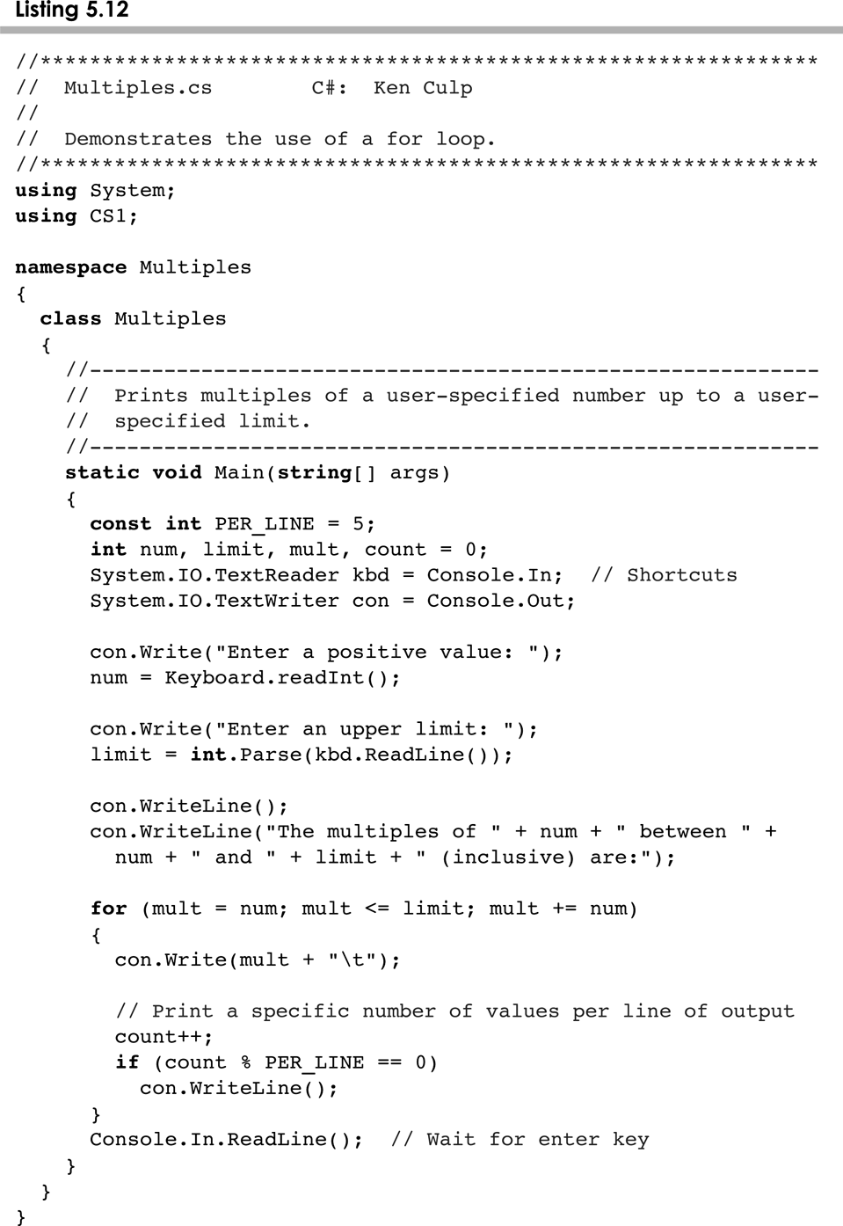
Multiples.cs
5-<number>

Slide 84
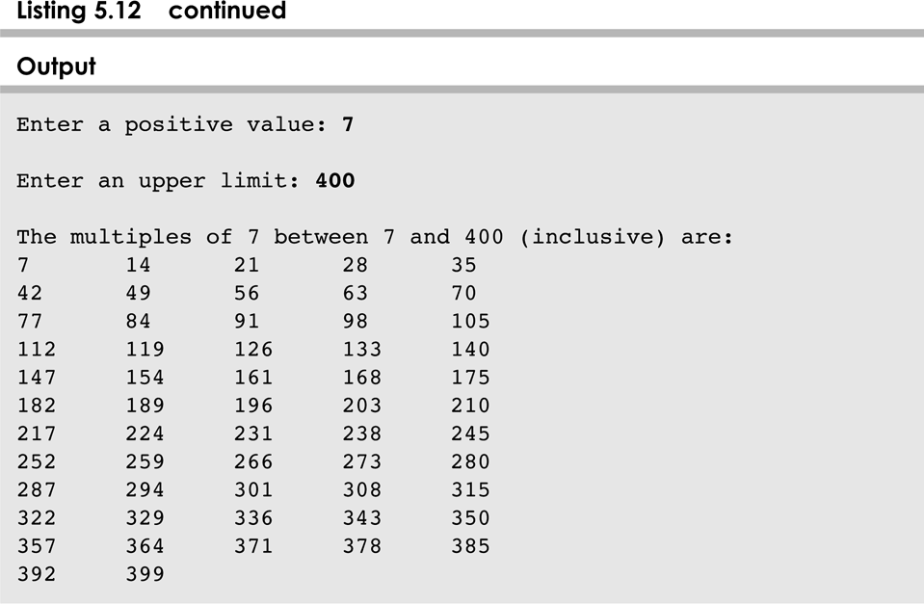
Multiples.cs
5-<number>

Slide 85
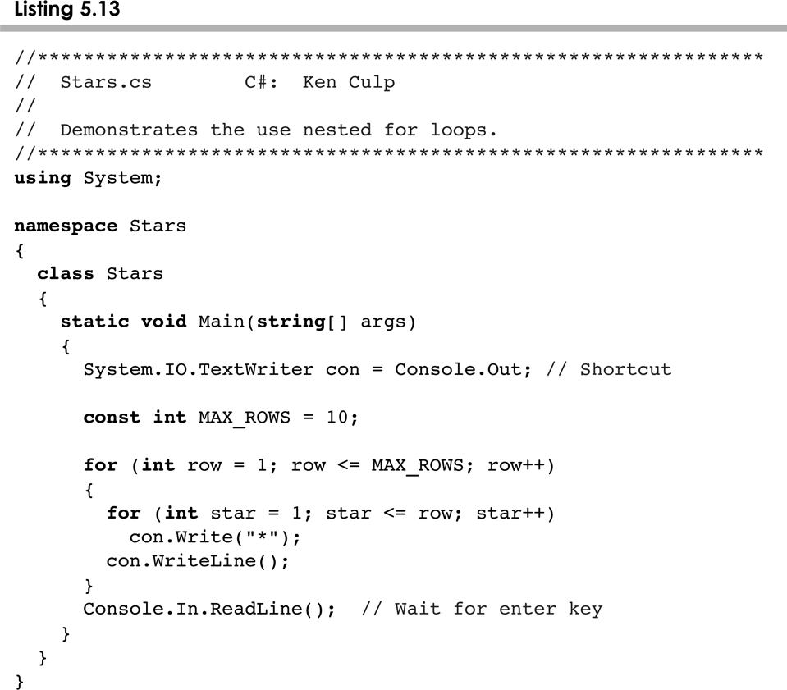
Stars.cs
5-<number>

Slide 86
The for Statement
Each expression in the header of a for loop is optional
If the initialization is left out, no initialization is performed
If the condition is left out, it is always considered to be true, and therefore creates an infinite loop
If the increment is left out, no increment operation is performed
    for( ; ; ); what is this?
5-<number>

Slide 87
The foreach Statement
The foreach syntax is most handy when working with arrays or collections
This variant of the for loop simplifies the repetitive processing the items
The following code segment uses a for loop to write every character of a sentence to the console
For(int i=0; i<sentence.Length; i++)
Console.Out.WriteLine(sentence[i]);
5-<number>

Slide 88
The foreach Statement
foreach is a much simpler code
foreach(char c in sentence)
Console.Out.WriteLine(c);
This style of for loop can be read "for each character in sentence, …“
The general form of a foreach statement is:
foreach(typeOfItemInCollection item in collection)
{…}
5-<number>

Slide 89
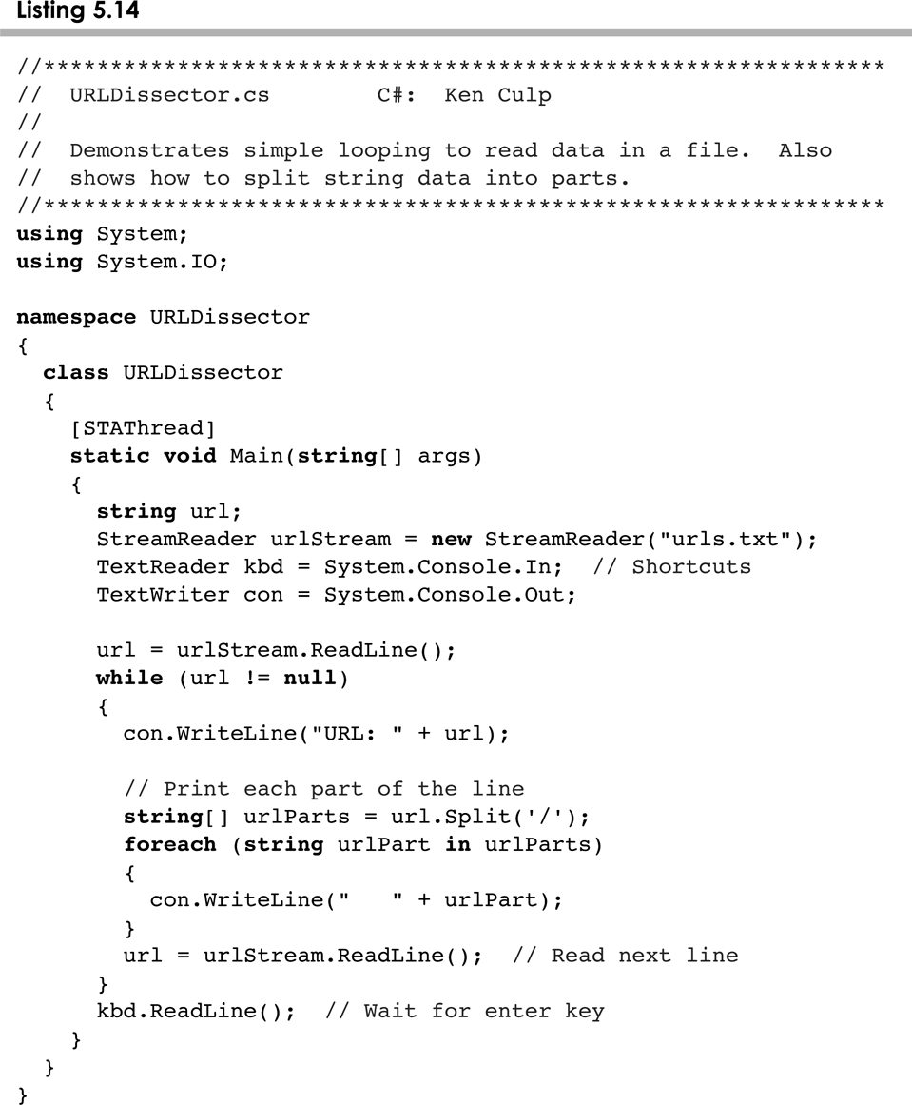
foreach Examples
5-<number>

Slide 90
Summary
Chapter 5 focused on:
  boolean expressions
  conditional statements
  comparing data
  repetition statements
5-<number>

Slide 91
Outline
The if Statement and Conditions
Other Conditional Statements
Comparing Data
The while Statement
Other Repetition Statements
Decisions and Graphics
More Components
5-<number>

Slide 92
Drawing Techniques
Conditionals and loops enhance our ability to generate interesting graphics
See Bullseye.java
See BullseyePanel.java
See Boxes.java
See BoxesPanel.java
5-<number>

Slide 93
Determining Event Sources
Recall that interactive GUIs require establishing a relationship between components and the listeners that respond to component events
One listener object can be used to listen to two different components
The source of the event can be determined by using the getSource method of the event passed to the listener
See LeftRight.java
See LeftRightPanel.java
5-<number>

Slide 94
Outline
The if Statement and Conditions
Other Conditional Statements
Comparing Data
The while Statement
Iterators
Other Repetition Statements
Decisions and Graphics
More Components
5-<number>

Slide 95
Dialog Boxes
A dialog box is a window that appears on top of any currently active window
It may be used to:
  convey information
  confirm an action
  allow the user to enter data
  pick a color
  choose a file
A dialog box usually has a specific, solitary purpose, and the user interaction with it is brief
5-<number>

Slide 96
Dialog Boxes
The JOptionPane class provides methods that simplify the creation of some types of dialog boxes
See EvenOdd.java
We examine dialog boxes for choosing colors and files in Chapter 9
5-<number>

Slide 97
Check Boxes
A check box is a button that can be toggled on or off
It is represented by the JCheckBox class
Unlike a push button, which generates an action event, a check box generates an item event whenever it changes state (is checked on or off)
The ItemListener interface is used to define item event listeners
The check box calls the itemStateChanged method of the listener when it is toggled
5-<number>

Slide 98
Check Boxes
Let's examine a program that uses check boxes to determine the style of a label's text string
It uses the Font class, which represents a character font's:
  family name (such as Times or Courier)
  style (bold, italic, or both)
  font size
See StyleOptions.java
See StyleOptionsPanel.java
5-<number>

Slide 99
Radio Buttons
A group of radio buttons represents a set of mutually exclusive options – only one can be selected at any given time
When a radio button from a group is selected, the button that is currently "on" in the group is automatically toggled off
To define the group of radio buttons that will work together, each radio button is added to a ButtonGroup object
A radio button generates an action event
5-<number>

Slide 100
Radio Buttons
Let's look at a program that uses radio buttons to determine which line of text to display
See QuoteOptions.java
See QuoteOptionsPanel.java
Compare and contrast check boxes and radio buttons
  Check boxes work independently to provide a boolean option
  Radio buttons work as a group to provide a set of mutually exclusive options
5-<number>

Slide 101
Summary
Chapter 5 focused on:
  boolean expressions
  conditional statements
  comparing data
  repetition statements
  iterators
  more drawing techniques
  more GUI components
5-<number>

