Slide 1
Chapter 6:
Object-Oriented Design
C# Software Solutions
Foundations of Program Design
First Edition
by
John Lewis

Slide 2
Object-Oriented Design
Now we can extend our discussion of the design of classes and objects
Chapter 6 focuses on:
  software development activities
  determining the classes and objects that are needed for a program
  the relationships that can exist among classes
  the static modifier
  writing interfaces
  the design of enumerated type classes
  method design and method overloading
  GUI design and layout managers
6-<number>

Slide 3
Outline
Software Development Activities
Identifying Classes and Objects
Static Variables and Methods
Class Relationships
Interfaces
Enumerated Types Revisited
Method Design
Testing
GUI Design and Layout
6-<number>

Slide 4
Program Development
The creation of software involves four basic activities:
  establishing the requirements
  creating a design
  implementing the code
  testing the implementation
These activities are not strictly linear – they overlap and interact
6-<number>

Slide 5
Requirements
Software requirements specify the tasks that a program must accomplish
  what to do, not how to do it
Often an initial set of requirements is provided, but they should be critiqued and expanded
It is difficult to establish detailed, unambiguous, and complete requirements
Careful attention to the requirements can save significant time and expense in the overall project
6-<number>

Slide 6
Design
A software design specifies how a program will accomplish its requirements
That is, a software design determines:
  how the solution can be broken down into manageable pieces
  what each piece will do
An object-oriented design determines which classes and objects are needed, and specifies how they will interact
Low level design details include how individual methods will accomplish their tasks
6-<number>

Slide 7
Implementation
Implementation is the process of translating a design into source code
Novice programmers often think that writing code is the heart of software development, but actually it should be the least creative step
Almost all important decisions are made during requirements and design stages
Implementation should focus on coding details, including style guidelines and documentation
6-<number>

Slide 8
Testing
Testing attempts to ensure that the program will solve the intended problem under all the constraints specified in the requirements
A program should be thoroughly tested with the goal of finding errors
Debugging is the process of determining the cause of a problem and fixing it
We revisit the details of the testing process later in this chapter
6-<number>

Slide 9
Outline
Software Development Activities
Identifying Classes and Objects
Static Variables and Methods
Class Relationships
Interfaces
Enumerated Types Revisited
Method Design
Testing
GUI Design and Layout
6-<number>

Slide 10
Identifying Classes and Objects
The core activity of object-oriented design is determining the classes and objects that will make up the solution
The classes may be part of a class library, reused from a previous project, or newly written
One way to identify potential classes is to identify the objects discussed in the requirements
Objects are generally nouns, and the services that an object provides are generally verbs
6-<number>

Slide 11
Identifying Classes and Objects
A partial requirements document:
The user must be allowed to specify each product by
its primary characteristics, including its name and
product number. If the bar code does not match the
product, then an error should be generated to the
message window and entered into the error log. The
summary report of all transactions must be structured
as specified in section 7.A.
Of course, not all nouns will correspond to
a class or object in the final solution
6-<number>

Slide 12
Identifying Classes and Objects
Remember that a class represents a group (classification) of objects with the same behaviors
Generally, classes that represent objects should be given names that are singular nouns
Examples: Coin, Student, Message
A class represents the concept of one such object
We are free to instantiate as many of each object as needed
6-<number>

Slide 13
Identifying Classes and Objects
Sometimes it is challenging to decide whether something should be represented as a class
For example, should an employee's address be represented as a set of instance variables or as an Address object
The more you examine the problem and its details the more clear these issues become
When a class becomes too complex, it often should be decomposed into multiple smaller classes to distribute the responsibilities
6-<number>

Slide 14
Identifying Classes and Objects
We want to define classes with the proper amount of detail
For example, it may be unnecessary to create separate classes for each type of appliance in a house
It may be sufficient to define a more general Appliance class with appropriate instance data
It all depends on the details of the problem being solved
6-<number>

Slide 15
Identifying Classes and Objects
Part of identifying the classes we need is the process of assigning responsibilities to each class
Every activity that a program must accomplish must be represented by one or more methods in one or more classes
We generally use verbs for the names of methods
In early stages it is not necessary to determine every method of every class – begin with primary responsibilities and evolve the design
6-<number>

Slide 16
Outline
Software Development Activities
Identifying Classes and Objects
Static Variables and Methods
Class Relationships
Interfaces
Enumerated Types Revisited
Method Design
Testing
GUI Design and Layout
6-<number>

Slide 17
Static Class Members
Recall that a static method is one that can be invoked through its class name
For example, the methods of the Math class are static:
result = Math.sqrt(25)
Variables can be static as well
Determining if a method or variable should be static is an important design decision
6-<number>

Slide 18
The static Modifier
We declare static methods and variables using the static modifier
It associates the method or variable with the class rather than with an object of that class
Static methods are sometimes called class methods and static variables are sometimes called class variables
Let's carefully consider the implications of each
6-<number>

Slide 19
Static Variables
Normally, each object has its own data space, but if a variable is declared as static, only one copy of the variable exists
private static float price;
Memory space for a static variable is created when the class is first referenced
All objects instantiated from the class share its static variables
Changing the value of a static variable in one object changes it for all others
6-<number>

Slide 20
Static Methods
class Helper
{
public static int cube (int num)
{
return num * num * num;
}
}
Because it is declared as static, the method
can be invoked as
value = Helper.cube(5);
6-<number>

Slide 21
Static Class Members
The order of the modifiers can be interchanged, but by convention visibility modifiers come first
Recall that the main method is static – it is invoked by the C# interpreter without creating an object
Static methods cannot reference instance variables because instance variables don't exist until an object exists
However, a static method can reference static variables or local variables
6-<number>

Slide 22
Static Class Members
Static methods and static variables often work together
The following example keeps track of how many Slogan objects have been created using a static variable, and makes that information available using a static method
See SloganCounter.java
See Slogan.java
6-<number>

Slide 23
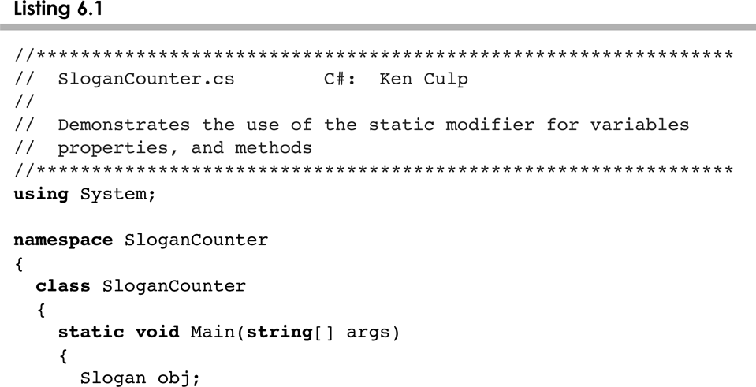
SloganCounter.cs
6-<number>

Slide 24
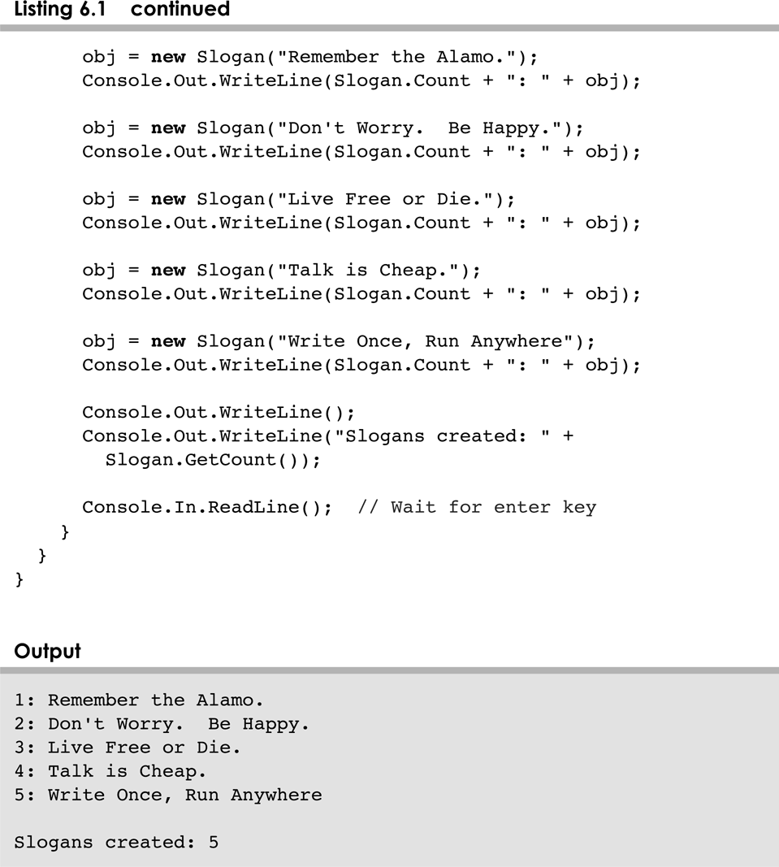
SloganCounter.cs
6-<number>

Slide 25
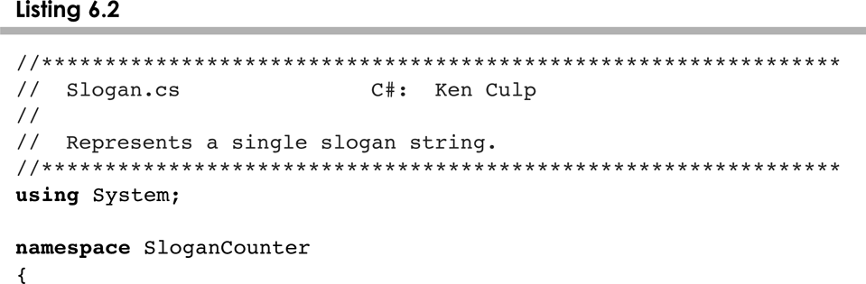
Slogan.cs
6-<number>

Slide 26
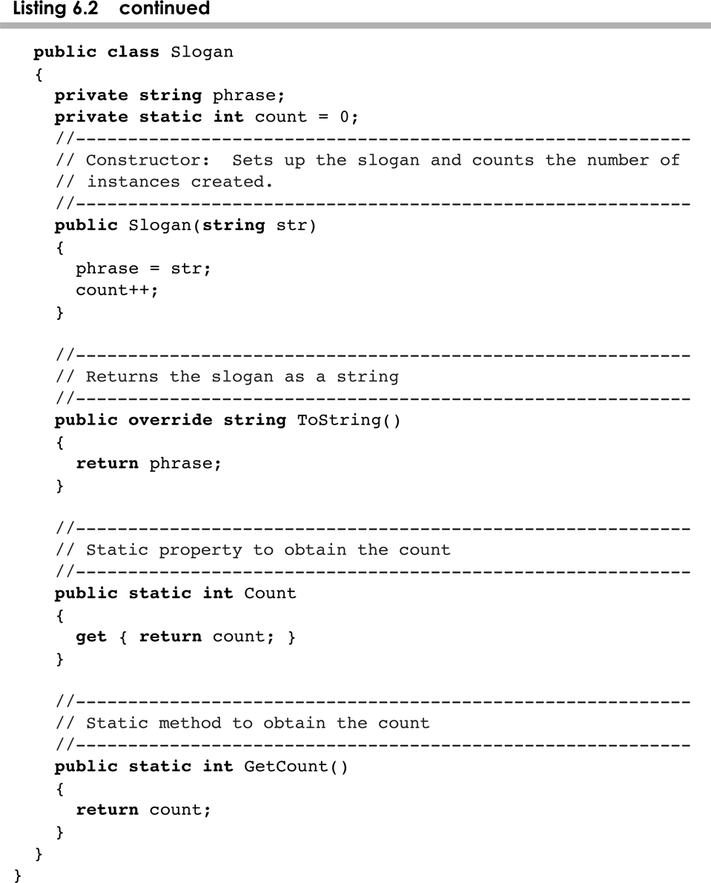
Slogan.cs
6-<number>

Slide 27
Outline
Software Development Activities
Identifying Classes and Objects
Static Variables and Methods
Class Relationships
Interfaces
Enumerated Types Revisited
Method Design
Testing
GUI Design and Layout
6-<number>

Slide 28
Class Relationships
Classes in a software system can have various types of relationships to each other
Three of the most common relationships:
  Dependency: A uses B
  Aggregation: A has-a B (and Composition)
  Inheritance: A is-a B (Generalization)
Let's discuss dependency and aggregation further
Inheritance is discussed in detail in Chapter 8
6-<number>

Slide 29
Dependency
A dependency exists when one class relies on another in some way, usually by invoking the methods of the other
We've seen dependencies in many previous examples
We don't want numerous or complex dependencies among classes
Nor do we want complex classes that don't depend on others
A good design strikes the right balance
6-<number>

Slide 30
Dependency
Some dependencies occur between objects of the same class
A method of the class may accept an object of the same class as a parameter
For example, the concat method of the String class takes as a parameter another String object
str3 = str1.concat(str2);
This drives home the idea that the service is being requested from a particular object
6-<number>

Slide 31
Dependency
The following example defines a class called Rational to represent a rational number
A rational number is a value that can be represented as the ratio of two integers
Some methods of the Rational class accept another Rational object as a parameter
See RationalTester.java
See RationalNumber.java
6-<number>

Slide 32
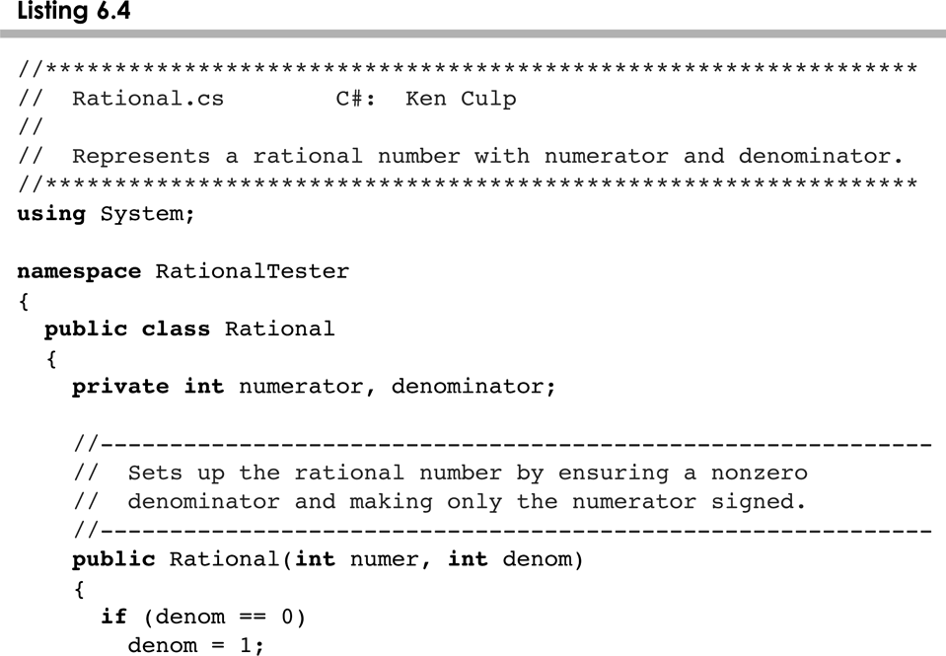
Rational.cs
6-<number>

Slide 33
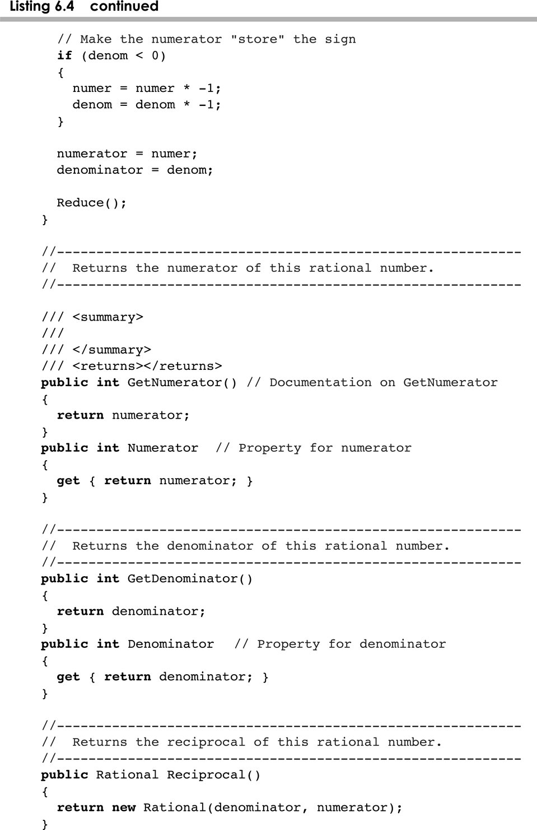
Rational.cs
6-<number>

Slide 34
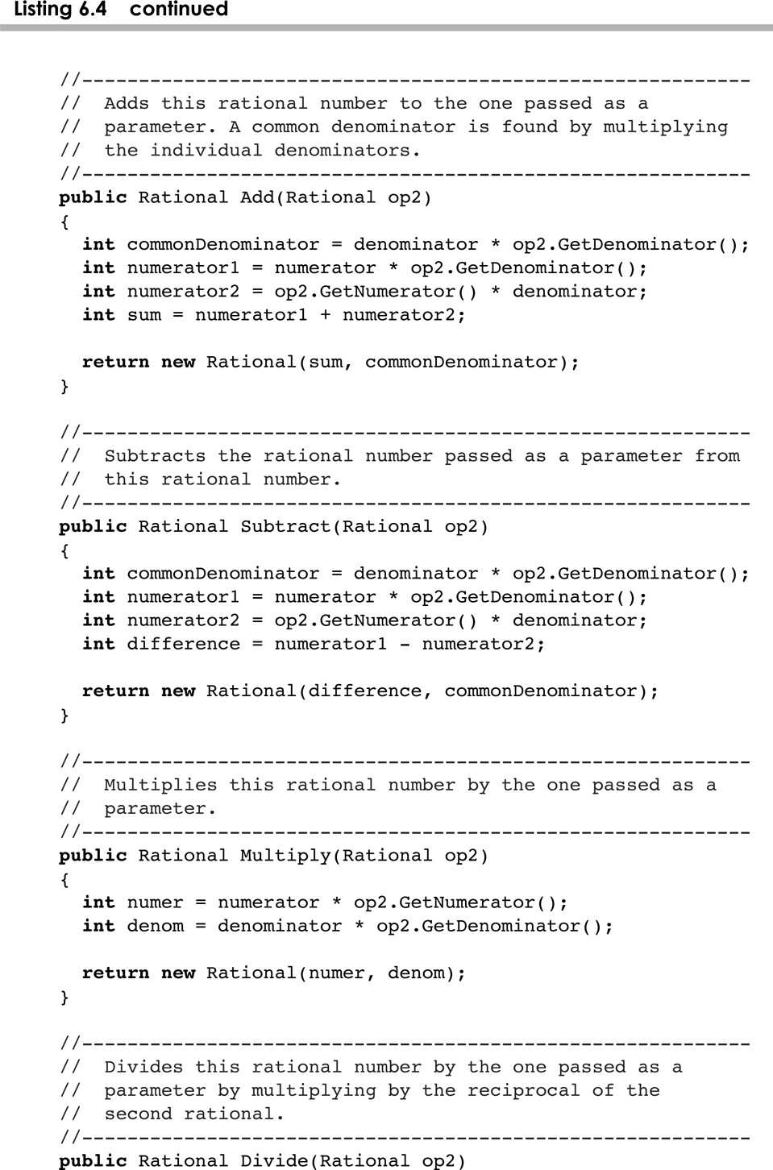
Rational.cs
6-<number>

Slide 35
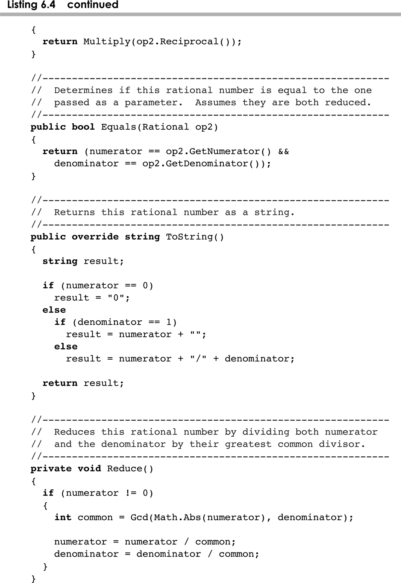
Rational.cs
6-<number>

Slide 36
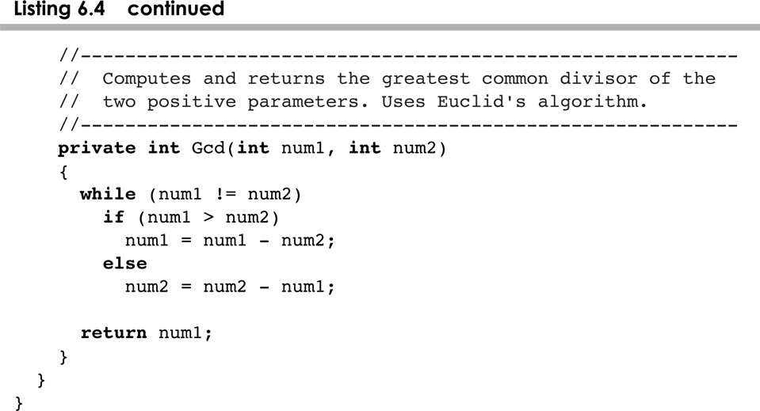
Rational.cs
6-<number>

Slide 37
Aggregation
An aggregate is an object that is made up of other objects
Therefore aggregation is a has-a relationship
  A car has a chassis
In software, an aggregate object contains references to other objects as instance data
The aggregate object is defined in part by the objects that make it up
This is a special kind of dependency – the aggregate usually relies on the objects that compose it
6-<number>

Slide 38
Aggregation
In the following example, a Student object is composed, in part, of Address objects
A student has an address (in fact each student has two addresses)
See StudentBody.java
See Student.java
See Address.java
An aggregation association is shown in a UML class diagram using an open diamond at the aggregate end
6-<number>

Slide 39
Aggregation in UML
StudentBody
Student
- firstName : String
- lastName : String
- homeAddress : Address
- schoolAddress : Address
+ main (args : String[]) : void
+ toString() : String
Address
- streetAddress : String
- city : String
- state : String
- zipCode : long
+ toString() : String
6-<number>

Slide 40
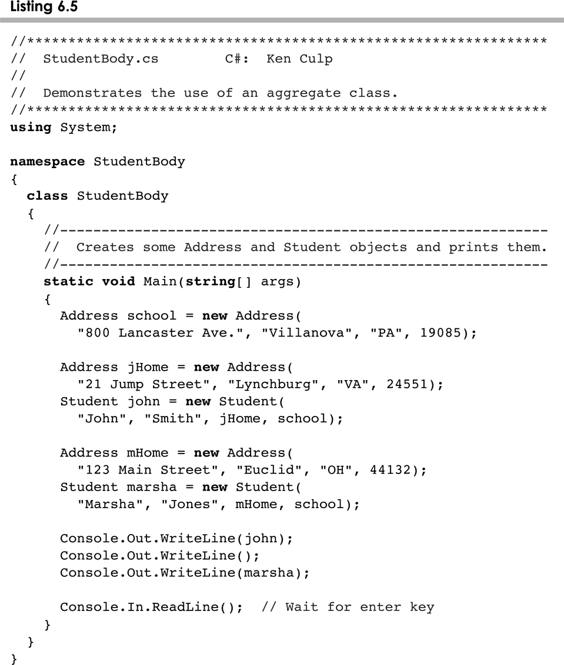
StudentBody.cs
6-<number>

Slide 41
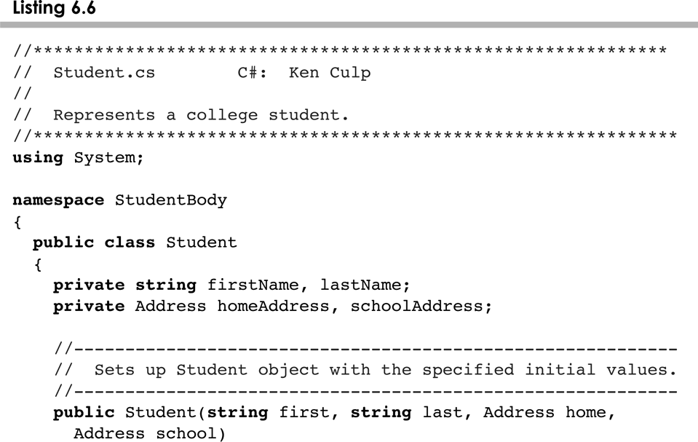
Student.cs
6-<number>

Slide 42
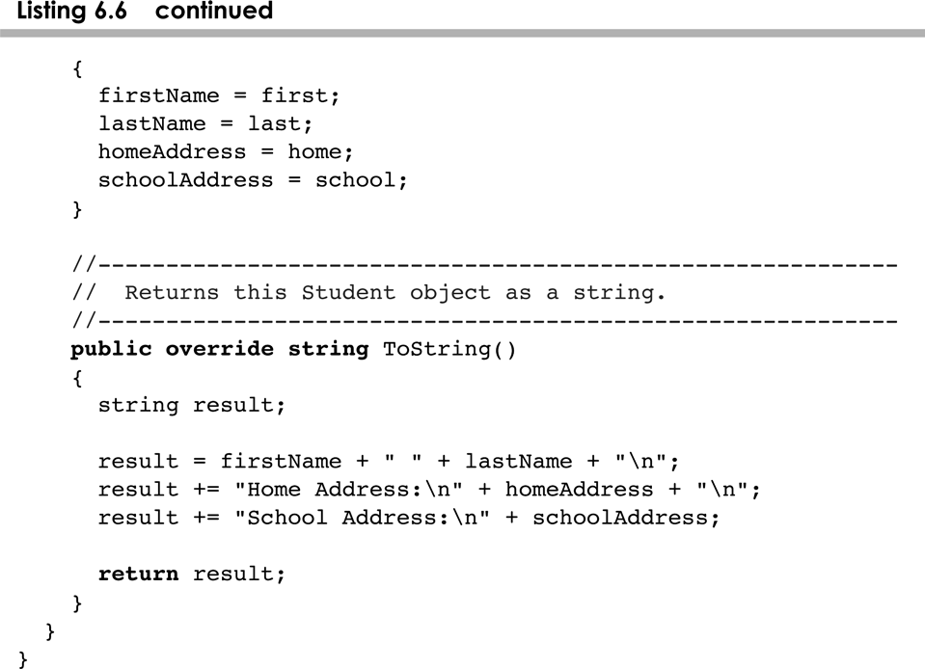
Student.cs
6-<number>

Slide 43
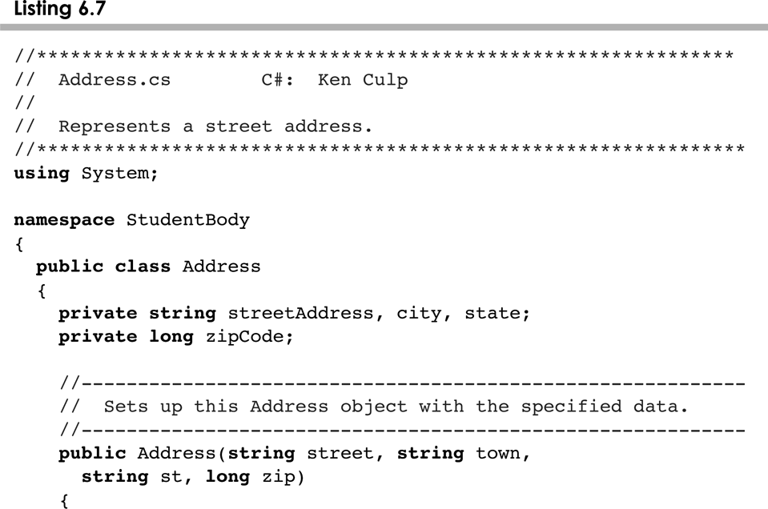
Address.cs
6-<number>

Slide 44
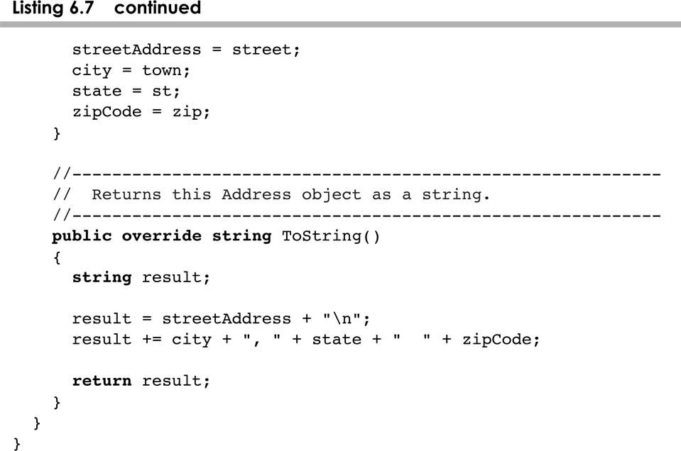
Address.cs
6-<number>

Slide 45
The this Reference
The this reference allows an object to refer to itself
That is, the this reference, used inside a method, refers to the object through which the method is being executed
Suppose the this reference is used in a method called tryMe, which is invoked as follows:
obj1.tryMe();
obj2.tryMe();
In the first invocation, the this reference refers to obj1; in the second it refers to obj2
6-<number>

Slide 46
The this reference
The this reference can be used to distinguish the instance variables of a class from corresponding method parameters with the same names
The constructor of the Account class (from Chapter 4) could have been written as follows:
public Account (Sring name, long acctNumber,
double balance)
{
this.name = name;
this.acctNumber = acctNumber;
this.balance = balance;
}
6-<number>

Slide 47
Outline
Software Development Activities
Identifying Classes and Objects
Static Variables and Methods
Class Relationships
Interfaces
Enumerated Types Revisited
Method Design
Testing
GUI Design and Layout
6-<number>

Slide 48
Interfaces
A C# interface is a collection of abstract methods and constants
An abstract method is a method header without a method body
An abstract method can be declared using the modifier abstract, but because all methods in an interface are abstract, usually it is left off
An interface is used to establish a set of methods that a class will implement
6-<number>

Slide 49
Interfaces
Normally interface names begin with I
None of the methods in
an interface are given
a definition (body)
public IDoable
{
public void DoThis();
public int DoThat();
public void DoThis2 (float value, char ch);
public bool DoTheOther (int num);
}
A semicolon immediately
follows each method header
6-<number>

Slide 50
Interfaces
An interface cannot be instantiated
Methods in an interface have public visibility by default
A class formally implements an interface by:
  stating so in the class header
  providing implementations for each abstract method in the interface
If a class asserts that it implements an interface, it must define all methods in the interface
6-<number>

Slide 51
Interfaces
public class CanDo : IDoable
{
public void DoThis ()
{
// whatever
}
public void DoThat ()
{
// whatever
}
// etc.
}
A colon is used
to show Inheritance
Each method listed
in IDoable is
given a definition
6-<number>

Slide 52
Interfaces
A class that implements an interface can implement other methods as well
See Complexity.java
See Question.java
See MiniQuiz.java
In addition to (or instead of) abstract methods, an interface can contain constants
When a class implements an interface, it gains access to all its constants
6-<number>

Slide 53
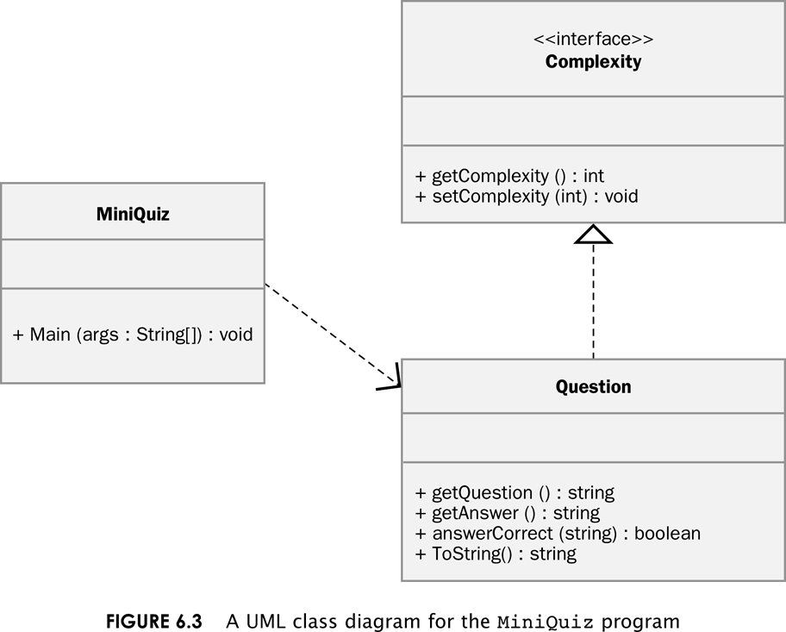
Miniquiz program
6-<number>

Slide 54
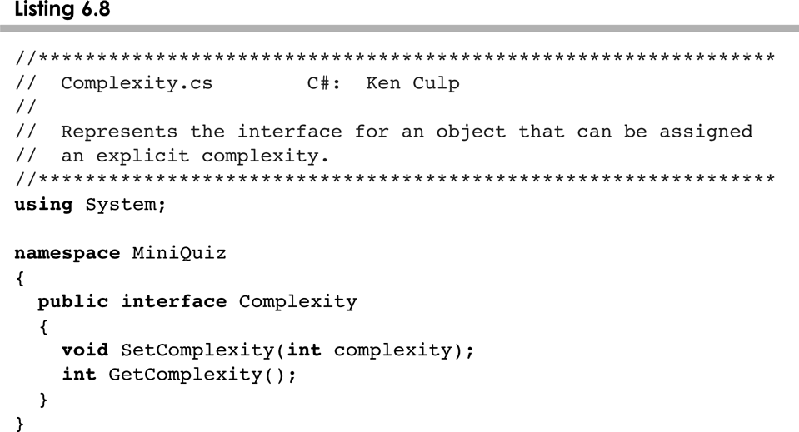
Complexity.cs
6-<number>

Slide 55
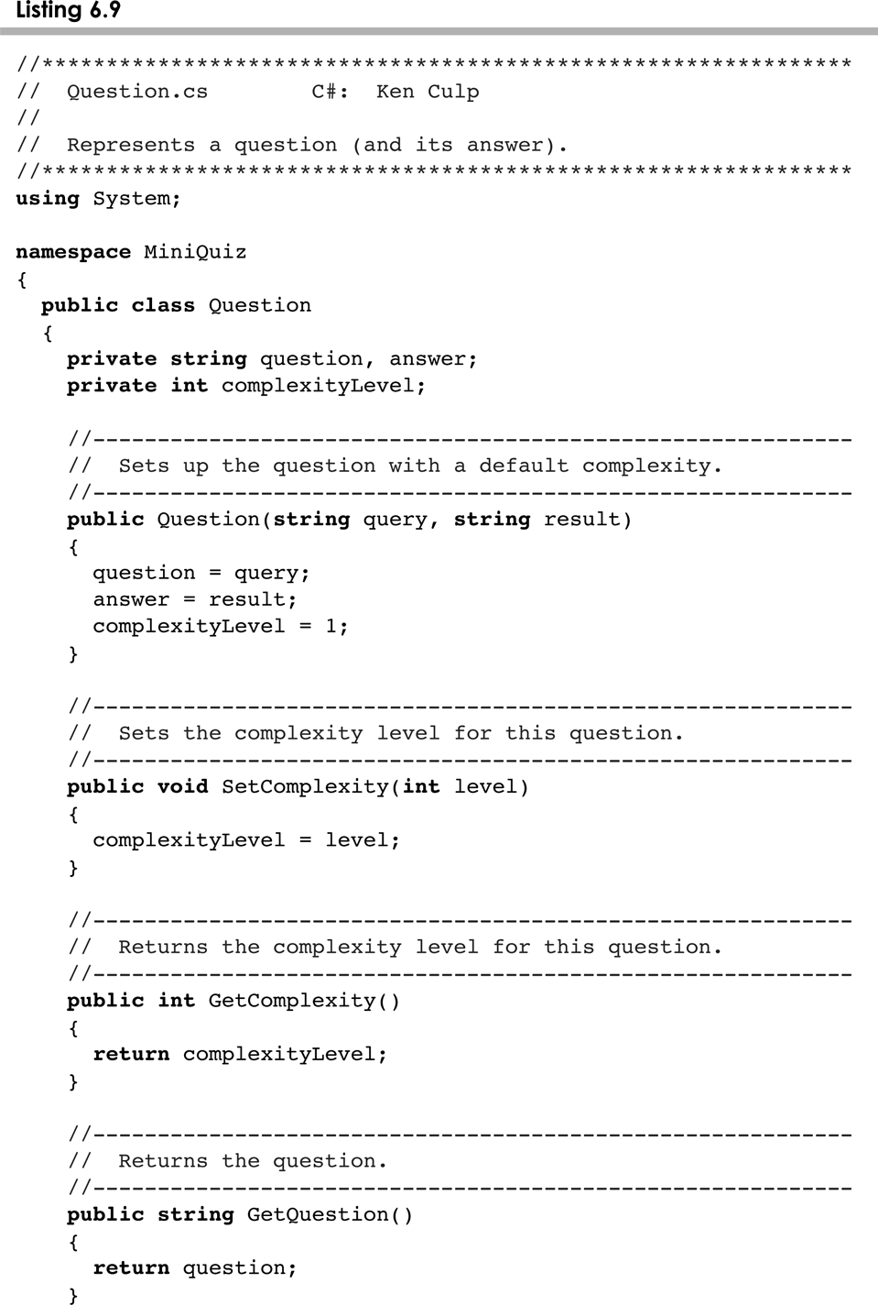
Complexity.cs
6-<number>

Slide 56
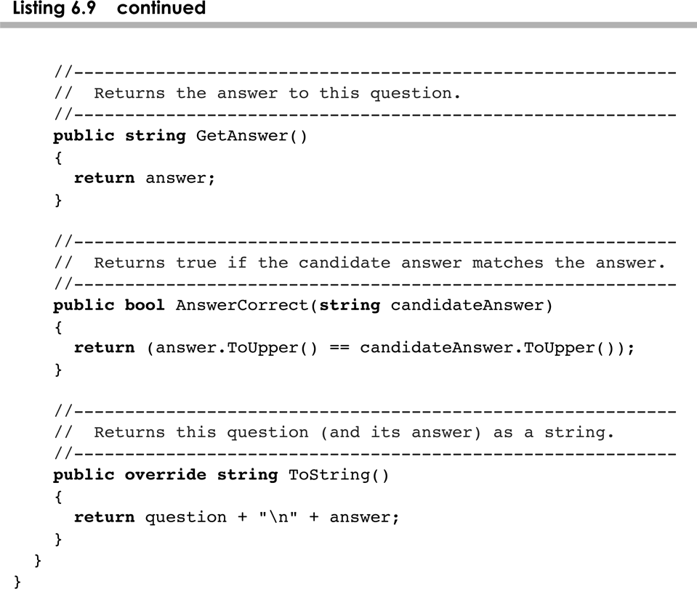
Complexity.cs
6-<number>

Slide 57
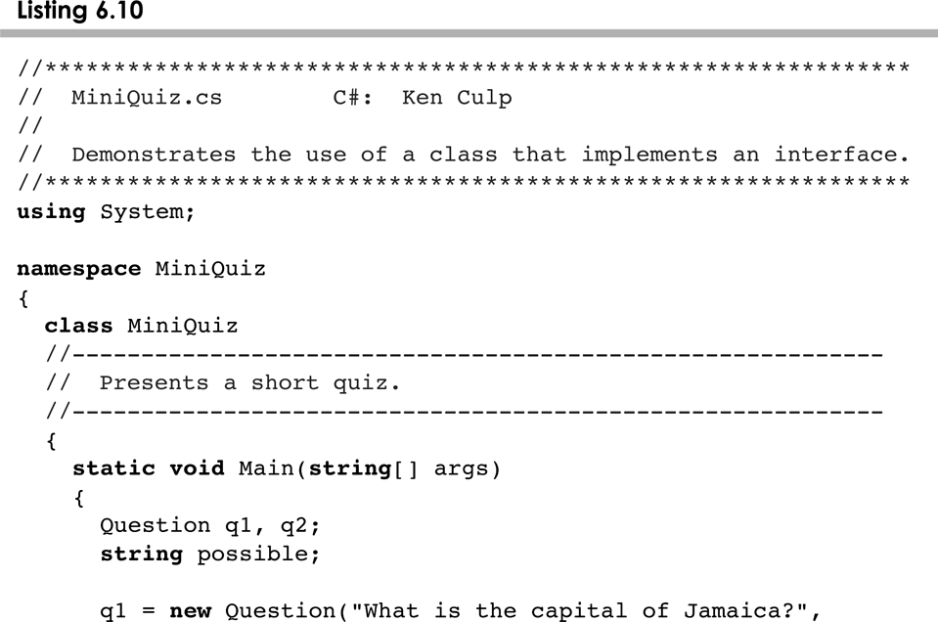
MiniQuiz.cs
6-<number>

Slide 58
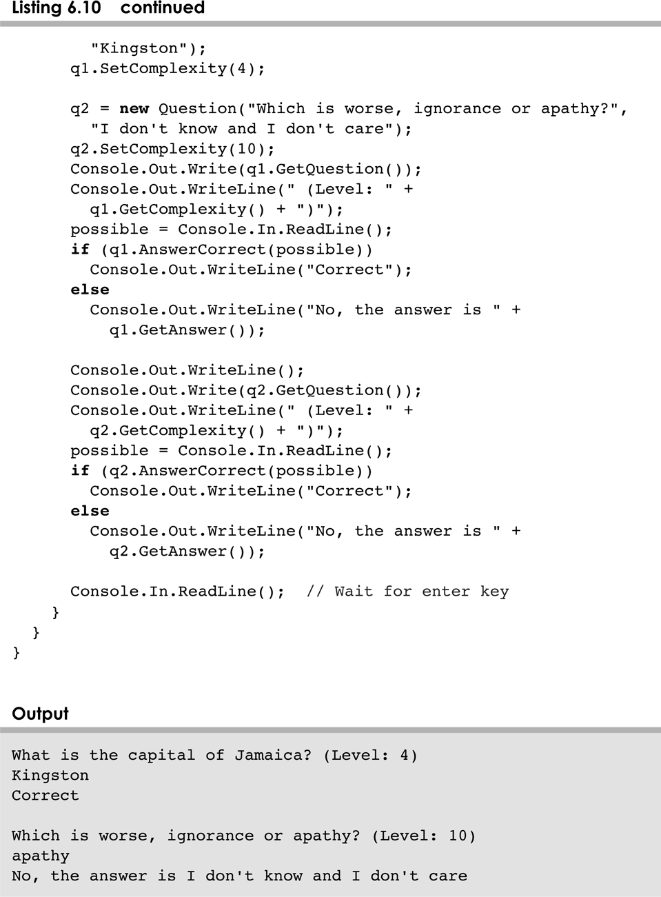
MiniQuiz.cs
6-<number>

Slide 59
Interfaces
A class can implement multiple interfaces
The interfaces are listed in the class header
The class must implement all methods in all interfaces listed in the header
class ManyThings : Iinterface1, Iinterface2
{
// all methods of both interfaces
}
6-<number>

Slide 60
Interfaces
The C# standard class library contains many helpful interfaces
The IComparable interface contains one abstract method called CompareTo, which is used to compare two objects
We discussed the CompareTo method of the String class in Chapter 5
The String class implements Comparable, giving us the ability to put strings in lexicographic order
6-<number>

Slide 61
The Comparable Interface
Any class can implement IComparable to provide a mechanism for comparing objects of that type
if (obj1.CompareTo(obj2) < 0)
Console.Out.WriteLine ("obj1 is less than obj2");
The value returned from CompareTo should be negative is obj1 is less that obj2, 0 if they are equal, and positive if obj1 is greater than obj2
When a programmer designs a class that implements the IComparable interface, it should follow this intent
6-<number>

Slide 62
The Comparable Interface
It's up to the programmer to determine what makes one object less than another
For example, you may define the CompareTo method of an Employee class to order employees by name (alphabetically) or by employee number
The implementation of the method can be as straightforward or as complex as needed for the situation
6-<number>

Slide 63
Outline
Software Development Activities
Identifying Classes and Objects
Static Variables and Methods
Class Relationships
Interfaces
Method Design
Testing
GUI Design and Layout
6-<number>

Slide 64
Outline
Software Development Activities
Identifying Classes and Objects
Static Variables and Methods
Class Relationships
Interfaces
Method Design
Testing
GUI Design and Layout
6-<number>

Slide 65
Method Design
As we've discussed, high-level design issues include:
  identifying primary classes and objects
  assigning primary responsibilities
After establishing high-level design issues, its important to address low-level issues such as the design of key methods
For some methods, careful planning is needed to make sure they contribute to an efficient and elegant system design
6-<number>

Slide 66
Method Design
An algorithm is a step-by-step process for solving a problem
Examples: a recipe, travel directions
Every method implements an algorithm that determines how the method accomplishes its goals
An algorithm may be expressed in pseudocode, a mixture of code statements and English that communicate the steps to take
6-<number>

Slide 67
Method Decomposition
A method should be relatively small, so that it can be understood as a single entity
A potentially large method should be decomposed into several smaller methods as needed for clarity
A public service method of an object may call one or more private support methods to help it accomplish its goal
Support methods might call other support methods if appropriate
6-<number>

Slide 68
Method Decomposition
Let's look at an example that requires method decomposition – translating English into Pig Latin
Pig Latin is a language in which each word is modified by moving the initial sound of the word to the end and adding "ay"
Words that begin with vowels have the "yay" sound added on the end
book
ookbay
table
abletay
item
itemyay
chair
airchay
6-<number>

Slide 69
Method Decomposition
The primary objective (translating a sentence) is too complicated for one method to accomplish
Therefore we look for natural ways to decompose the solution into pieces
Translating a sentence can be decomposed into the process of translating each word
The process of translating a word can be separated into translating words that:
  begin with vowels
  begin with consonant blends (sh, cr, th, etc.)
  begin with single consonants
6-<number>

Slide 70
Method Decomposition
See PigLatin.java
See PigLatinTranslator.java
In a UML class diagram, the visibility of a variable or method can be shown using special characters
Public members are preceded by a plus sign
Private members are preceded by a minus sign
6-<number>

Slide 71
Class Diagram for Pig Latin
PigLatin
+ main (args : String[]) : void
PigLatinTranslator
+ translate (sentence : String) : String
- translateWord (word : String) : String
- beginsWithVowel (word : String) : boolean
- beginsWithBlend (word : String) : boolean
6-<number>

Slide 72
Objects as Parameters
Another important issue related to method design involves parameter passing
Parameters in a C# method are passed by value
A copy of the actual parameter (the value passed in) is stored into the formal parameter (in the method header)
Therefore passing parameters is similar to an assignment statement
When an object is passed to a method, the actual parameter and the formal parameter become aliases of each other
6-<number>

Slide 73
Passing Objects to Methods
What a method does with a parameter may or may not have a permanent effect (outside the method)
See ParameterTester.java
See ParameterModifier.java
See Num.java
Note the difference between changing the internal state of an object versus changing which object a reference points to
6-<number>

Slide 74
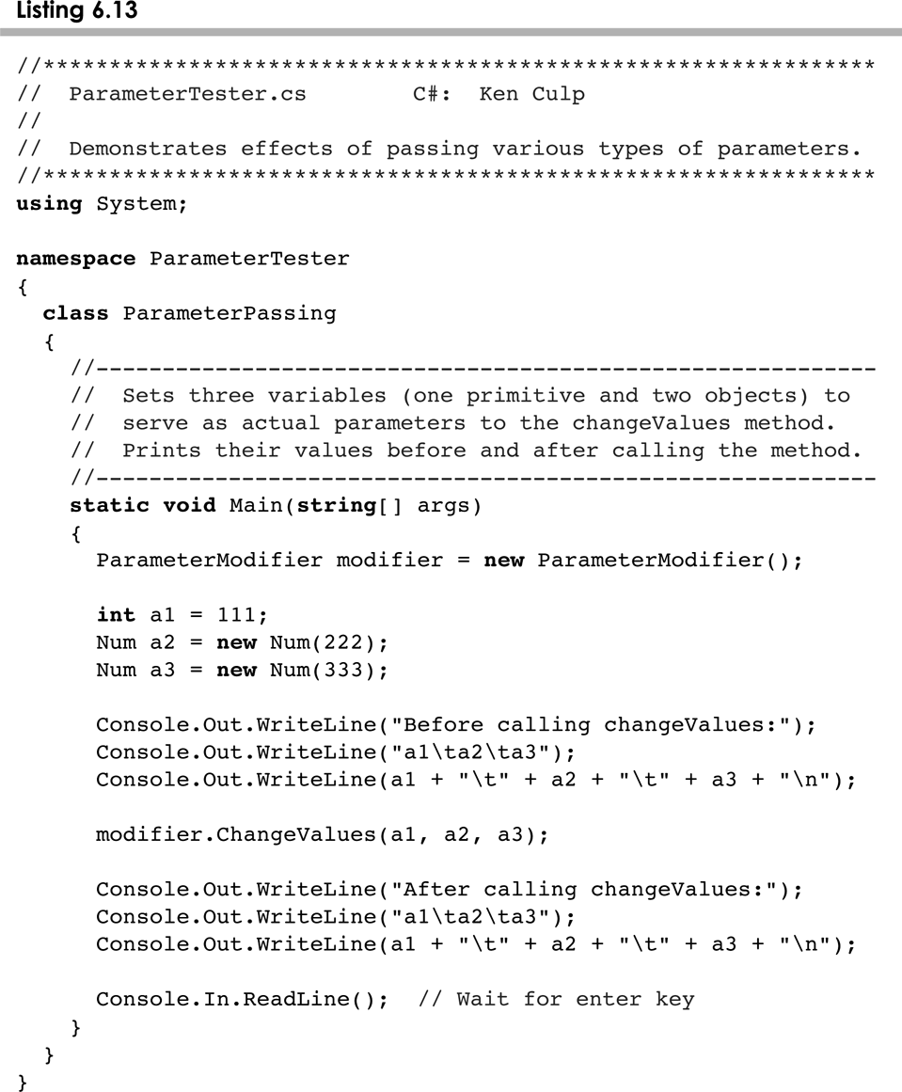
ParameterTeater.cs
6-<number>

Slide 75
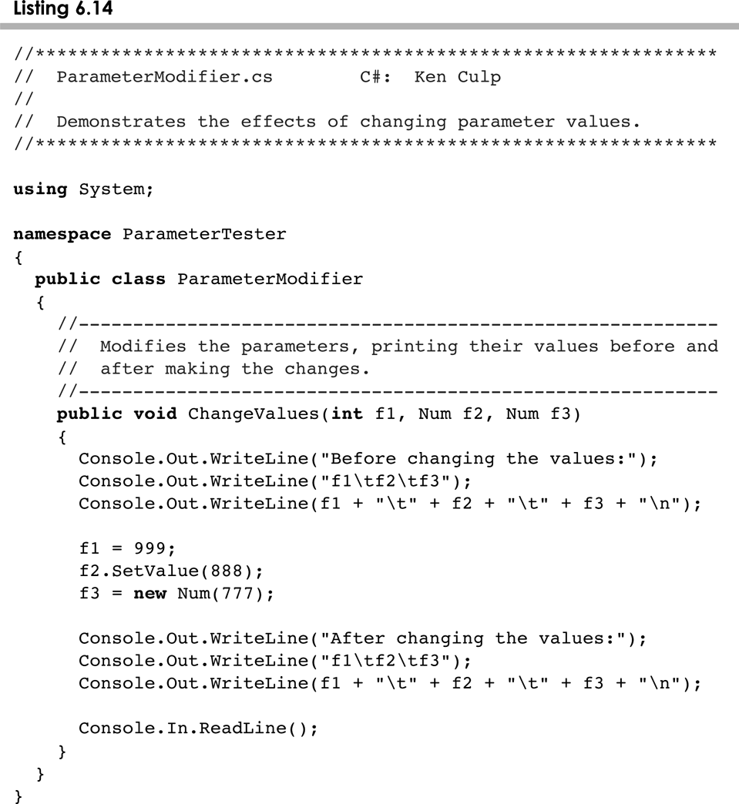
ParameterModifier.cs
6-<number>

Slide 76
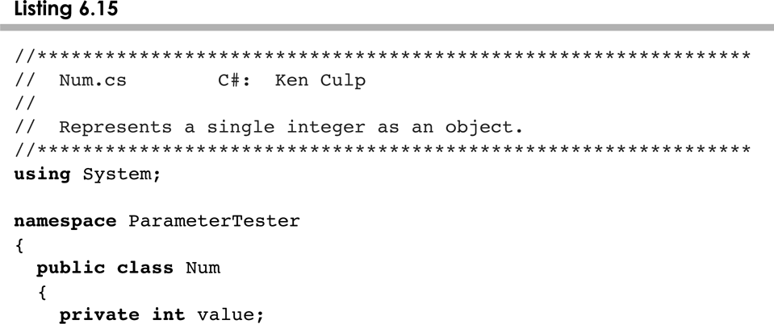
Num.cs
6-<number>

Slide 77
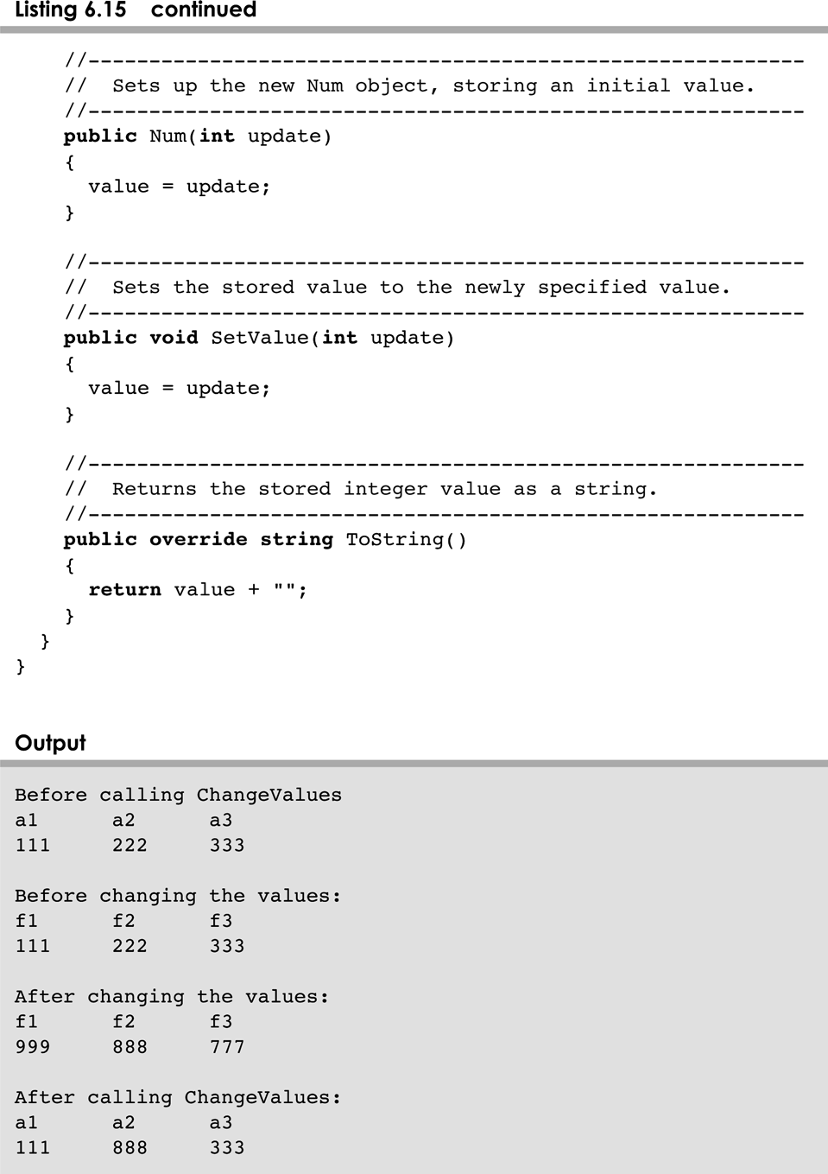
Num.cs
6-<number>

Slide 78
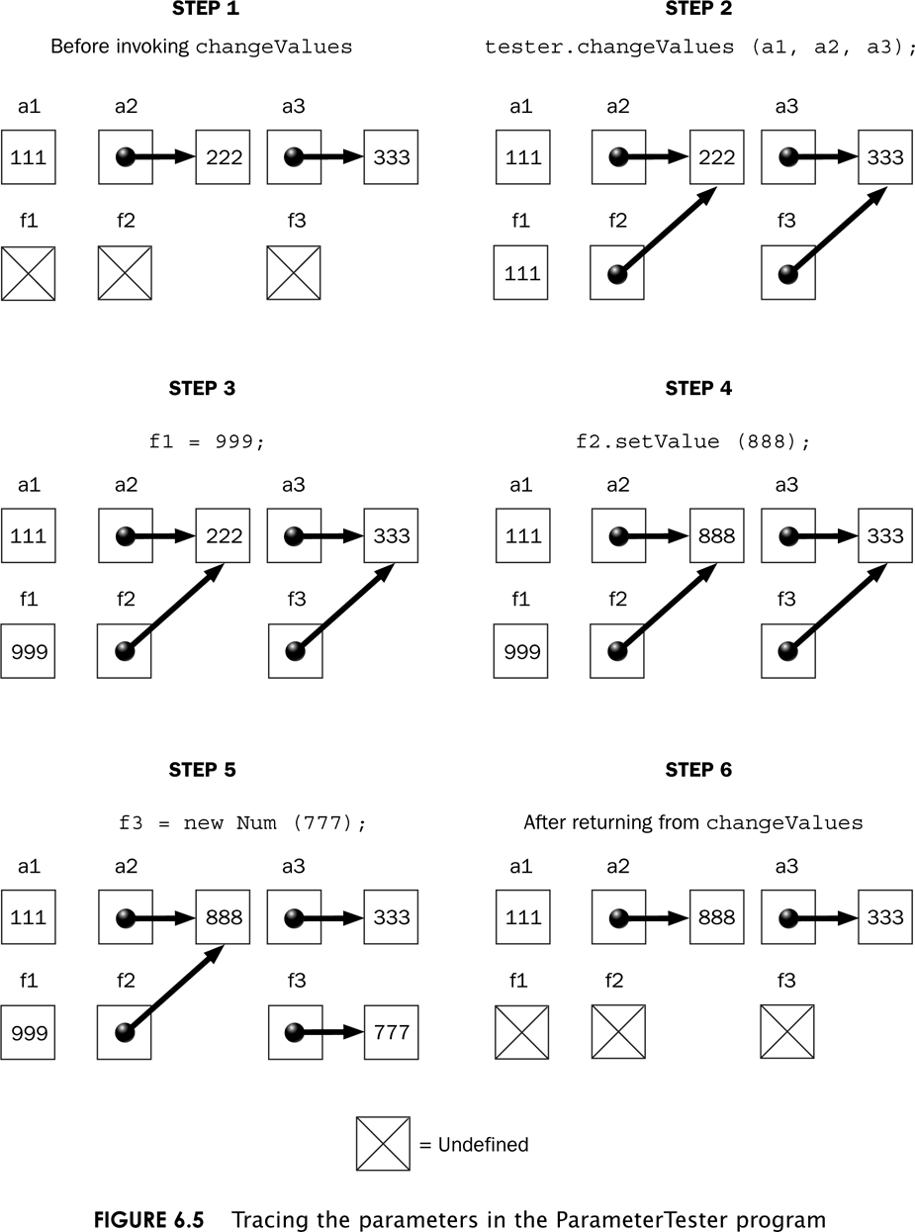
Tracing the Parameters
6-<number>

Slide 79
Method Overloading
Method overloading is the process of giving a single method name multiple definitions
If a method is overloaded, the method name is not sufficient to determine which method is being called
The signature of each overloaded method must be unique
The signature includes the number, type, and order of the parameters
6-<number>

Slide 80
Method Overloading
The compiler determines which method is being invoked by analyzing the parameters
float TryMe(int x)
{
return x + .375;
}
Invocation
result = TryMe(25, 4.32)
float TryMe(int x, float y)
{
return x*y;
}
6-<number>

Slide 81
Method Overloading
The WriteLine method is overloaded:
WriteLine(String s)
WriteLine(int i)
WriteLine(double d)
and so on...
The following lines invoke different versions of the WriteLine method:
Console.Out.WriteLine ("The total is:");
Console.Out.WriteLine(total);
6-<number>

Slide 82
Overloading Methods
The return type of the method is not part of the signature
That is, overloaded methods cannot differ only by their return type
Constructors can be overloaded
Overloaded constructors provide multiple ways to initialize a new object
6-<number>

Slide 83
Outline
Software Development Activities
Identifying Classes and Objects
Static Variables and Methods
Class Relationships
Interfaces
Enumerated Types Revisited
Method Design
Testing
GUI Design and Layout
6-<number>

Slide 84
Testing
Testing can mean many different things
It certainly includes running a completed program with various inputs
It also includes any evaluation performed by human or computer to assess quality
Some evaluations should occur before coding even begins
The earlier we find an problem, the easier and cheaper it is to fix
6-<number>

Slide 85
Testing
The goal of testing is to find errors
As we find and fix errors, we raise our confidence that a program will perform as intended
We can never really be sure that all errors have been eliminated
So when do we stop testing?
  Conceptual answer: Never
  Snide answer: When we run out of time
  Better answer: When we are willing to risk that an undiscovered error still exists
6-<number>

Slide 86
Reviews
A review is a meeting in which several people examine a design document or section of code
It is a common and effective form of human-based testing
Presenting a design or code to others:
  makes us think more carefully about it
  provides an outside perspective
Reviews are sometimes called inspections or walkthroughs
6-<number>

Slide 87
Test Cases
A test case is a set of input and user actions, coupled with the expected results
Often test cases are organized formally into test suites which are stored and reused as needed
For medium and large systems, testing must be a carefully managed process
Many organizations have a separate Quality Assurance (QA) department to lead testing efforts
6-<number>

Slide 88
Defect and Regression Testing
Defect testing is the execution of test cases to uncover errors
The act of fixing an error may introduce new errors
After fixing a set of errors we should perform regression testing – running previous test suites to ensure new errors haven't been introduced
It is not possible to create test cases for all possible input and user actions
Therefore we should design tests to maximize their ability to find problems
6-<number>

Slide 89
Black-Box Testing
In black-box testing, test cases are developed without considering the internal logic
They are based on the input and expected output
Input can be organized into equivalence categories
Two input values in the same equivalence category would produce similar results
Therefore a good test suite will cover all equivalence categories and focus on the boundaries between categories
6-<number>

Slide 90
White-Box Testing
White-box testing focuses on the internal structure of the code
The goal is to ensure that every path through the code is tested
Paths through the code are governed by any conditional or looping statements in a program
A good testing effort will include both black-box and white-box tests
6-<number>

Slide 91
Outline
Software Development Activities
Identifying Classes and Objects
Static Variables and Methods
Class Relationships
Interfaces
Enumerated Types Revisited
Method Design
Testing
GUI Design and Layout
6-<number>

Slide 92
GUI Design
We must remember that the goal of software is to help the user solve the problem
To that end, the GUI designer should:
  Know the user
  Prevent user errors
  Optimize user abilities
  Be consistent
Let's discuss each of these in more detail
6-<number>

Slide 93
Know the User
Knowing the user implies an understanding of:
  the user's true needs
  the user's common activities
  the user's level of expertise in the problem domain and in computer processing
We should also realize these issues may differ for different users
Remember, to the user, the interface is the program
6-<number>

Slide 94
Prevent User Errors
Whenever possible, we should design user interfaces that minimize possible user mistakes
We should choose the best GUI components for each task
For example, in a situation where there are only a few valid options, using a menu or radio buttons would be better than an open text field
Error messages should guide the user appropriately
6-<number>

Slide 95
Optimize User Abilities
Not all users are alike – some may be more familiar with the system than others
Knowledgeable users are sometimes called power users
We should provide multiple ways to accomplish a task whenever reasonable
  "wizards" to walk a user through a process
  short cuts for power users
Help facilities should be available but not intrusive
6-<number>

Slide 96
Be Consistent
Consistency is important – users get used to things appearing and working in certain ways
Colors should be used consistently to indicate similar types of information or processing
Screen layout should be consistent from one part of a system to another
For example, error messages should appear in consistent locations
6-<number>

Slide 97
Layout Managers
A layout manager is an object that determines the way that components are arranged in a container
There are several predefined layout managers defined in the Java standard class library:
Flow Layout
Border Layout
Card Layout
Grid Layout
GridBag Layout
Defined in the AWT
Box Layout
Overlay Layout
Defined in Swing
6-<number>

Slide 98
Layout Managers
Every container has a default layout manager, but we can explicitly set the layout manager as well
Each layout manager has its own particular rules governing how the components will be arranged
Some layout managers pay attention to a component's preferred size or alignment, while others do not
A layout manager attempts to adjust the layout as components are added and as containers are resized
6-<number>

Slide 99
Layout Managers
We can use the setLayout method of a container to change its layout manager
JPanel panel = new JPanel();
panel.setLayout(new BorderLayout());
The following example uses a tabbed pane, a container which permits one of several panes to be selected
See LayoutDemo.java
See IntroPanel.java
6-<number>

Slide 100
Flow Layout
Flow layout puts as many components as possible on a row, then moves to the next row
Rows are created as needed to accommodate all of the components
Components are displayed in the order they are added to the container
Each row of components is centered horizontally in the window by default, but could also be aligned left or right
Also, the horizontal and vertical gaps between the components can be explicitly set
See FlowPanel.java
6-<number>

Slide 101
Border Layout
A border layout defines five areas into which components can be added
North
West
Center
East
South
6-<number>

Slide 102
Border Layout
Each area displays one component (which could be a container such as a JPanel)
Each of the four outer areas enlarges as needed to accommodate the component added to it
If nothing is added to the outer areas, they take up no space and other areas expand to fill the void
The center area expands to fill space as needed
See BorderPanel.java
6-<number>

Slide 103
Grid Layout
A grid layout presents a container’s components in a rectangular grid of rows and columns
One component is placed in each cell of the grid, and all cells have the same size
As components are added to the container, they fill the grid from left-to-right and top-to-bottom (by default)
The size of each cell is determined by the overall size of the container
See GridPanel.java
6-<number>

Slide 104
Box Layout
A box layout organizes components horizontally (in one row) or vertically (in one column)
Components are placed top-to-bottom or left-to-right in the order in which they are added to the container
By combining multiple containers using box layout, many different configurations can be created
Multiple containers with box layouts are often preferred to one container that uses the more complicated gridbag layout manager
6-<number>

Slide 105
Box Layout
Invisible components can be added to a box layout container to take up space between components
  Rigid areas have a fixed size
  Glue specifies where excess space should go
A rigid area is created using the createRigidArea method of the Box class
Glue is created using the createHorizontalGlue or createVerticalGlue methods
See BoxPanel.java
6-<number>

Slide 106
Borders
A border can be put around any Swing component to define how the edges of the component should be drawn
Borders can be used effectively to group components visually
The BorderFactory class contains several static methods for creating border objects
A border is applied to a component using the setBorder method
6-<number>

Slide 107
Borders
An empty border
  buffers the space around the edge of a component
  otherwise has no visual effect
A line border
  surrounds the component with a simple line
  the line's color and thickness can be specified
An etched border
  creates the effect of an etched groove around a component
  uses colors for the highlight and shadow
6-<number>

Slide 108
Borders
A bevel border
  can be raised or lowered
  uses colors for the outer and inner highlights and shadows
A titled border
  places a title on or around the border
  the title can be oriented in many ways
A matte border
  specifies the sizes of the top, left, bottom, and right edges of the border separately
  uses either a solid color or an image
6-<number>

Slide 109
Borders
A compound border
  is a combination of two borders
  one or both of the borders can be a compound border
See BorderDemo.java
6-<number>

Slide 110
Summary
Chapter 6 has focused on:
  software development activities
  determining the classes and objects that are needed for a program
  the relationships that can exist among classes
  the static modifier
  writing interfaces
  the design of enumerated type classes
  method design and method overloading
  GUI design and layout managers
6-<number>

