Slide 1
DATA STRUCTURES
&
ALGORITHMS
By: Manoja Weerasekara
NSBM-Colombo

Slide 2
Lecture 04
Sequential Data Structures:
S & Q

Slide 3
Queue

Slide 4
Queue Data Structure
Queue, data structure is similar to stack.
Except Queue is FIFO.
The first element to be remove from the queue is the first element we inserted to the queue.

Slide 5
Creating a new Queue
The queue implementation is based on an array or list.
But queue restrict accesses.
Here are the minimal set of operations we'd need for an abstract queue:
Enter (or Insert) Places an object at the rear of the queue.
Delete (or Remove) Removes an object from the front of the queue and produces that object.
IsEmpty Reports whether the queue is empty or not.

Slide 6
Queue
Queue is an ordered collection of items (FIFO)
Items are deleted from the head (Front)
Items are added at the tail (Rear)
Queue ADT provides at least two access functions
Enqueue (queue, object): Inserts object onto tail Input: Object, queue identity; Output: error code
Dequeue (queue): Removes the object at the head
Input: queue identity; Output: Object

Slide 7
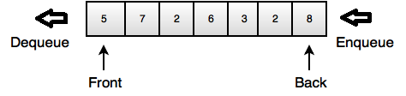
Queue ADT
struct queue { int head, tail;
int data[size]; };
int enqueue(struct queue *q, int item);
int dequeue(struct queue*q);
int init(struct queue* q); // set head and tail
int full(struct queue* q); // return 1 if full
int empty(struct queue* q); // return 1 if empty

Slide 8
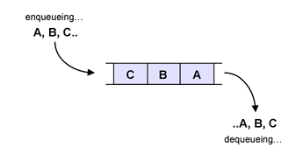
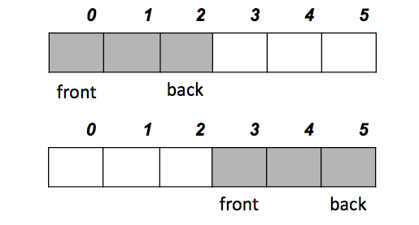
Queue in Action
Active part of the queue keeps on moving and hit the array limit at some stage ☹
PROBLEM…?

Slide 9
Solution: Circular Queue
Circular Queue Implementation

Slide 10
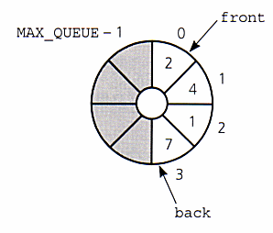
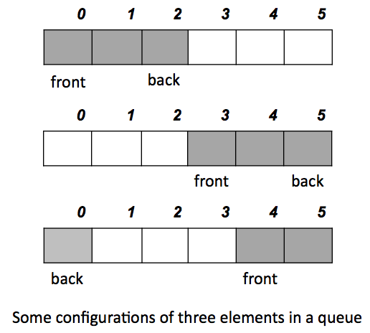
Circular Array Implementation

Slide 11
95
44
21
79
32
6
80
Rear
44
21
79
32
6
80
Front
Front
95
Rear

Slide 12
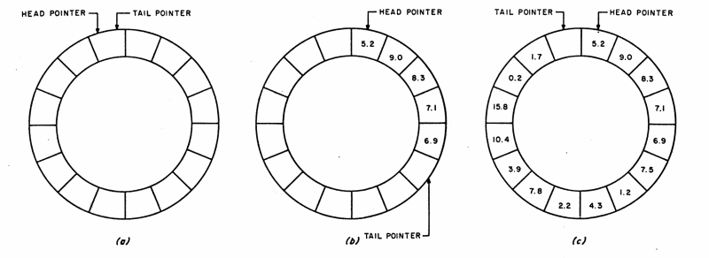
Circular Array Implementation

Slide 13
S& Q
Exercises:

Slide 14
1. Enqueue(10)
2. Enqueue(12)
3. Enqueue(9)
4. Enqueue(8)
5. Enqueue(3)
6. Dequeue()
7. Peek()
8. Enqueue(33)
9. Peek()
10. Dequeue()
Draw the resultant Queue after each operation

Slide 15
Infix: (5+3) * (8-2)
Postfix:
Use a xxxxxx to evaluate the postfix expression
Results:
5 9 3 + 4 2 * * 7 + *

Slide 16
BFS and DFS

Slide 17
F
B
C
A
E
H
D
G
Notes:
DFS: ABEGFCHD
BFS:ABDGEFCH

Slide 18
Thank You

