Slide 1
DATA STRUCTURES & ALGORITHMS
By: Manoja Weerasekara
NSBM-Colombo

Slide 2
Lecture 02
Searching Algorithms

Slide 3
Searching
Finding elements in large amounts of data
Determine whether array contains value matching key value
Linear search
Binary search

Slide 4
Searching an Array
Linear search
small arrays
unsorted arrays
Binary search
large arrays
sorted arrays

Slide 5
Linear Search Algorithm
Brute force algorithm, that starts searching the key from one end of the data set and proceed searching to the other end of the data set – Exhaustive Search.
Start at first element of the array.
Compare the value with the key
Continue with next element until a match is found or reach end of the array.
Note: On the average we have to compare the search key with half the elements in the array.

Slide 6
Linear Search - Example
Array numlist contains:
Searching for the the value 11:
linear search examines 17, 23, 5, and 11
Searching for the the value 7:
linear search examines 17, 23, 5, 11, 2, 29, and 3
17 | 23 | 5 | 11 | 2 | 29 | 3

Slide 7
Linear Search
Algorithm:
set found to false; set position to –1; set index to 0
while index < number of elements. and found is false
if list[index] is equal to search value
found = true
position = index
end if
add 1 to index
end while
return position

Slide 8
A Linear Search Function
int searchList(int list[], int numElems, int value) { int index = 0; // Used as a subscript to search array int position = -1; // To record position of search value boolean found = false; // Flag to indicate if value was found while (index < numElems && !found) { if (list[index] == value) // If the value is found { found = true; // Set the flag position = index; // Record the value's subscript } index++; // Go to the next element } return position; // Return the position, or -1 }

Slide 9
Linear Search
Benefits:
Easy to understand and implement
No assumption on data - can be in any order
Disadvantages:
Inefficient (slow) → O(n)
Best case scenario?
Average complexity?
Worst case scenario?

Slide 10
Binary Search Algorithm
Need the dataset to be sorted (say ascending order)
At each step check the middle item
If key == middle item → item found
If key < middle item → binary search the first half
If key > middle item → binary search the second half
Search ends either finding the item or after checking an array of size 1.

Slide 11
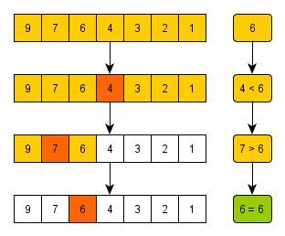
Binary Search Example

Slide 12
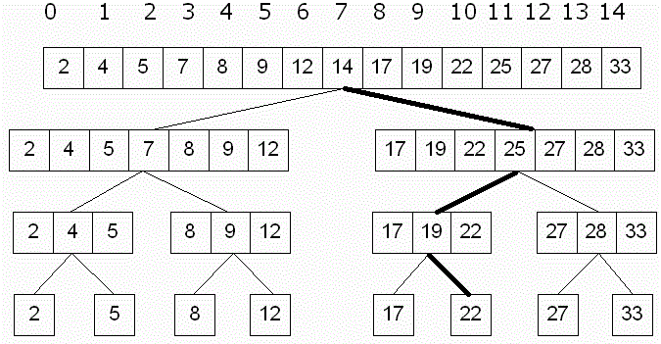
Binary Search Tree

Slide 13
Efficiency
Searching and array of 1024 elements will take at most 10 passes to find a match or determine that the element does not exist in the array.
512, 256, 128, 64, 32, 16, 8, 4, 2, 1
An array of one billion elements takes a maximum of 30 comparisons.
The bigger the array the better a binary search is as compared to a linear search
O(log n)

Slide 14
Binary Search
Set first index to 0. Set last index to the last subscript in the array.
Set found to false. Set position to -1.
While found is not true and first is less than or equal to last
Set middle to the subscript half-way between array[first] and array[last].
If array[middle] equals the desired value
Set found to true.
Set position to middle.
Else If array[middle] is greater than the desired value
Set last to middle - 1.
Else
Set first to middle + 1.
End If.
End While.
Return position.

Slide 15
A Binary Search Function
int binarySearch(int array[], int size, int value) { int first = 0, // First array element last = size - 1, // Last array element middle, // Mid point of search position = -1; // Position of search value boolean found = false; // Flag while (!found && first <= last) { middle = (first + last) / 2; // Calculate mid point if (array[middle] == value) // If value is found at mid { found = true; position = middle; } else if (array[middle] > value) // If value is in lower half last = middle - 1; else first = middle + 1; // If value is in upper half } return position; }

Slide 16
Carryout a Desk-Check for the above algorithm for the following data set:
data[] = { 12, 16, 23, 28, 34, 42, 47, 55, 64, 65, 66, 72 }
key = 54
Var | 1st call | 2nd call | 3rd call | 4th call
key
data
size
mid
data[mid]
return

Slide 17
Answer:
Var | 1st call | 2nd call | 3rd call | 4th call
key | 54 | 54 | 54 | 54
data | &data[0] | &data[7] | &data[7] | &data[7]
size | 12 | 5 | 2 | 1
mid | 6 | 2 | 1 | 0
data[mid] | 47 | 65 | 64 | 55
return | ? | ? | ? | -1

Slide 18
Thank You

