Slide 1


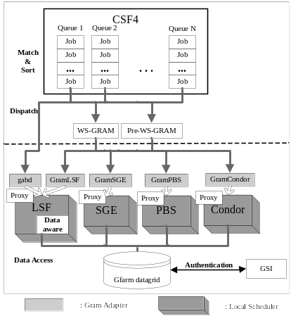
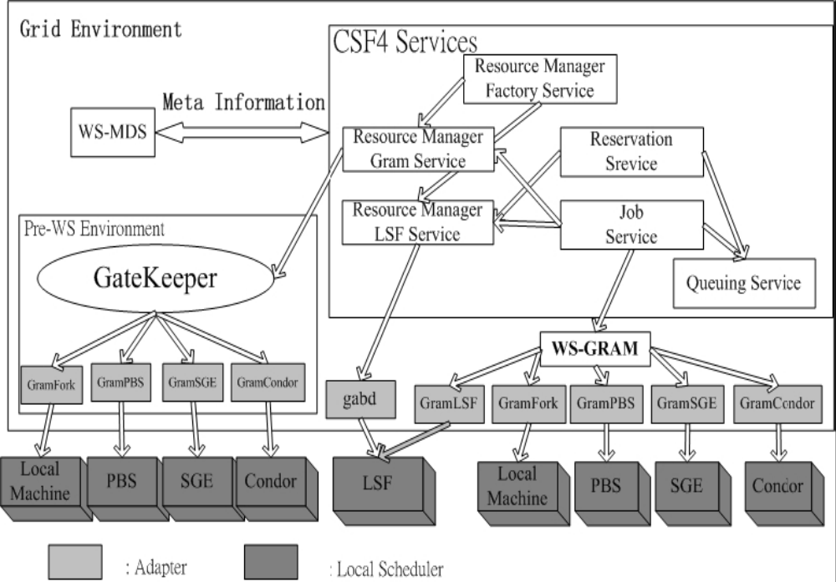
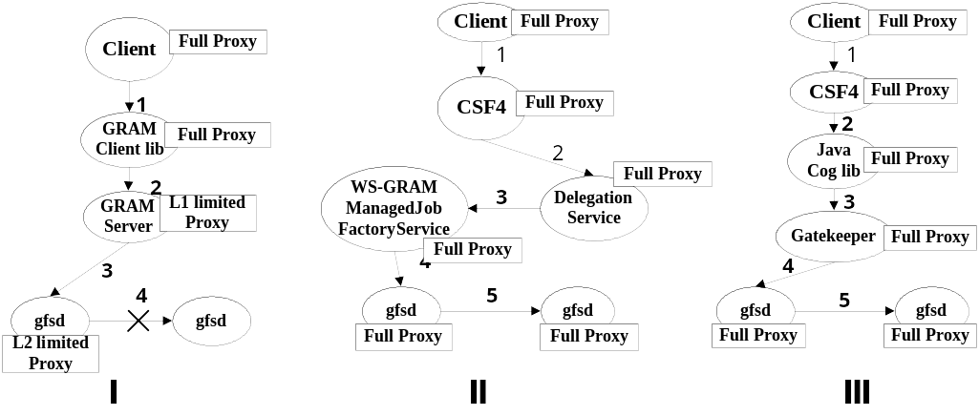
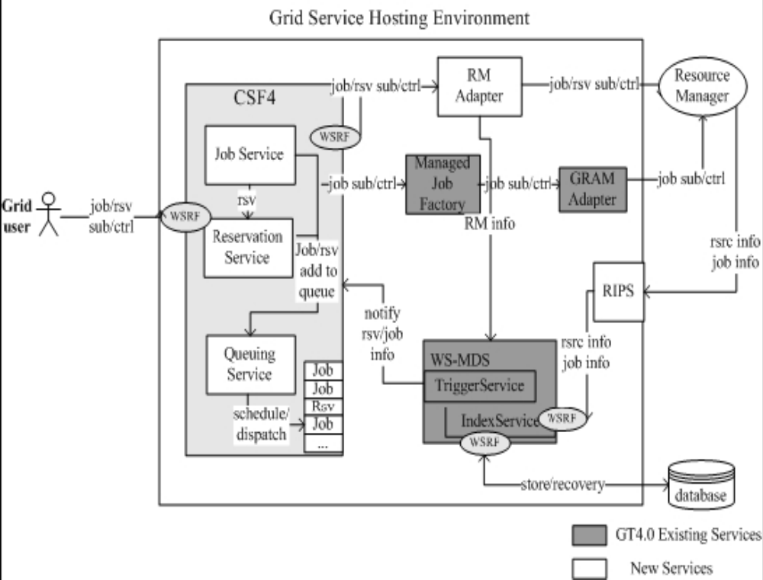
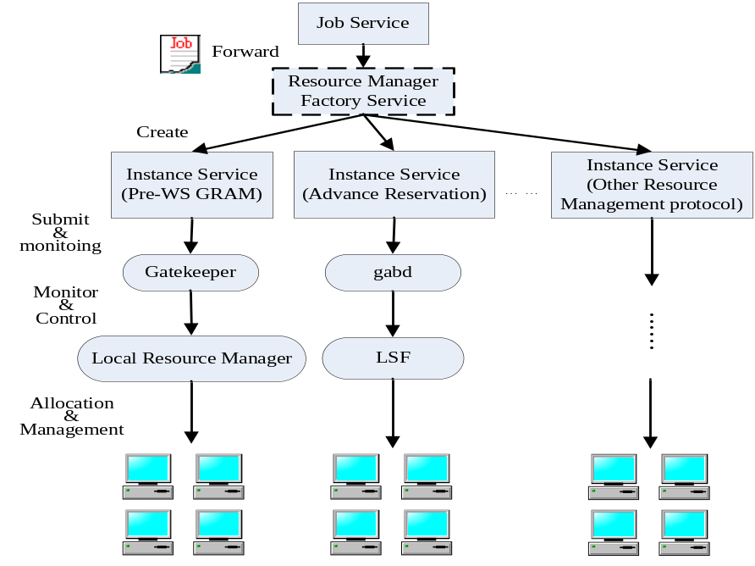
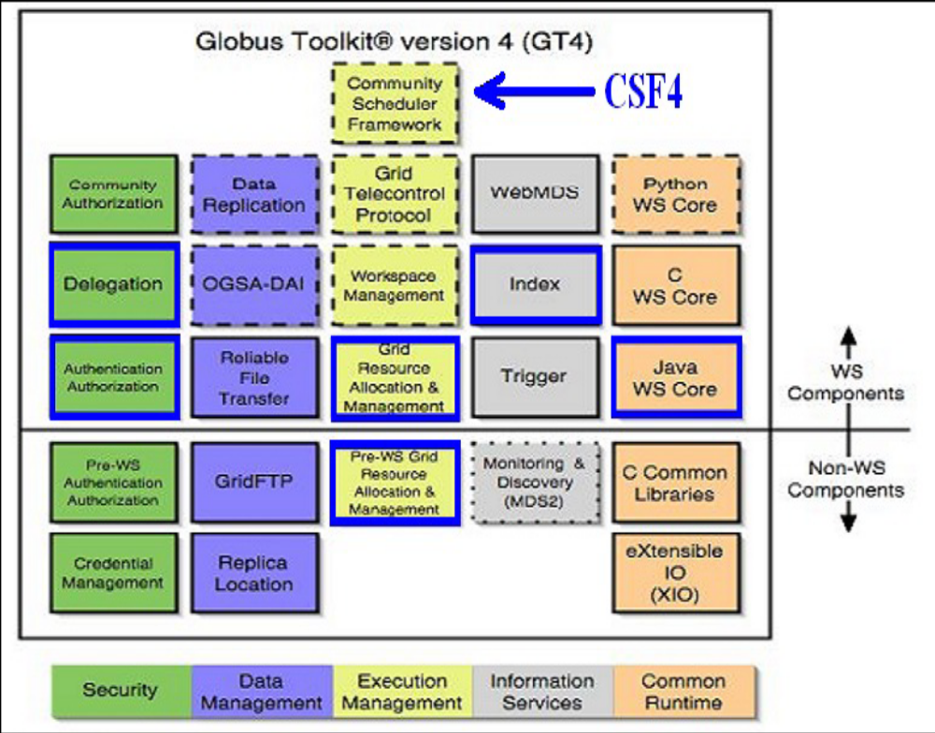
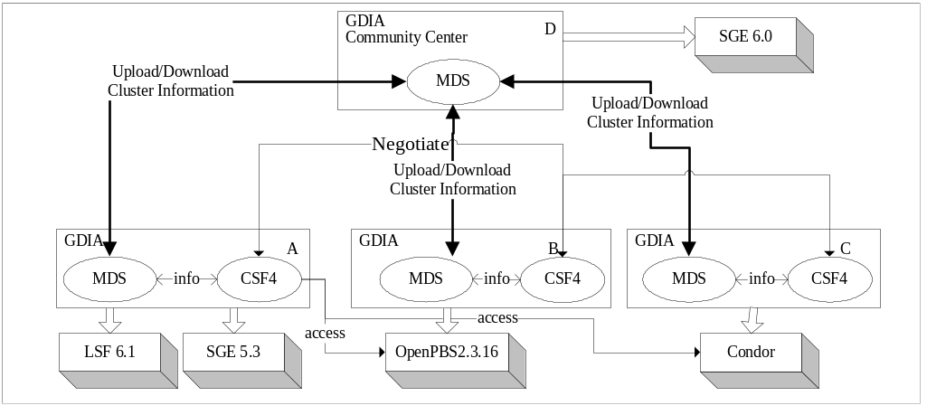
Jilin University
GDIA: A Scalable Grid Infrastructure for Data Intensive Applications
WEI Xiaohui (weixh@jlu.edu.cn), DING Zhaohui (zhaohui.ding@email.jlu.edu.cn), LUO Yuan (pp.jordan@email.jlu.edu.cn)
College of Computer Science and Technology, Jilin University, 2699 Qianjin Street,Changchun,130012,China
Abstract The applications in many scientific fields, like bioinformatics and high-energy physics etc, increasingly demand the computing infrastructures can provide more computing power and support huger amount of distributed data. GDIA, built on top of CSF4 meta-scheduler and Gfarm data grid, is a scalable grid infrastructure for data intensive applications. In this paper, we presented the architecture of GDIA and the new enhancements to CSF4 in GDIA. First, a flexible user proxy delegation mechanism was introduced to enable a job running with a full proxy. With the enhancement, the jobs can access the grid services with strict security requirement like Gfarm. Secondly, we redesigned CSF4’s resource manager service to support alternative protocols other than WS GRAM. At last, we discussed the scheduling issues in grids. GDIA is able to coordinate heterogeneous clusters belonging to different VOs via centralized or decentralized model. In current, GDIA has been deployed on PRAGMA’s grid test bed successfully to schedule data intensive applications. Introduction Background The applications in many scientific fields, such as bioinformatics and high-energy physics etc, increasingly demand more powerful computing environments and huge amount of distributed data. It is straightforward to build a scalable grid system using existing matured cluster computing technologies. Since the resources are distributed and managed in autonomic among multiple sites, resource management and job scheduling are great challenges in grids.PRAGMA [1]’s grid test bed consists of tens of clusters located in different countries and areas. Each site adopts different local schedulers, such as LSF, PBS, SGE, Condor etc. Some sites upgrade to GT4 already, but the others still prefer GT2. GDIA is designed to coordinate PRAGMA’s heterogeneous distributed resources into a daily use grid infrastructure. In the mean time, many PRAGMA users’ applications require a lot of data accessing, however, the users do not like to change their applications too much while running on the grid. Some sites, AIST for example, even enhanced their local schedulers to introduce the advanced features not supported by GRAM yet. Hence, building GDIA has to face such challenges. 1. Working with heterogeneous local schedulers. 2. Supporting global data access. 3. Extensible to new resource management protocols. 4. Easy to use. And we believe these challenges are common while building up any production grid environment. In this paper, we will discuss the design and deployment of GDIA in details. A key design principle of GDIA is to take advantage of existing grid technologies instead of reinventing wheels. Gfarm [7] data grid is designed for global petascale data-intensive computing. It provides a global parallel file system with online petascale storage, and can be deployed on tens of thousands of nodes in different clusters of a grid. So we choose Gfarm to support the global data accessing and data management in GDIA due to its good transparency to the end users. However, Gfarm require the jobs have a full user proxy as the data accessing may cross different domains. The problem is that a job has a limited proxy only after dispatched to local schedulers by meta-scheduler or job manager via GRAM protocol. We think a job with limited proxy could have potential troubles while accessing other grid services with high security requirements. Hence, we implement a flexible user proxy delegation mechanism in GDIA’s meta-scheduler, CSF4. With integrated with Gfarm, a job can access the data sets at any host in any cluster. CSF4 [1], developed by our team in 2005, is used in GDIA to coordinate heterogeneous local schedulers and provide a uniform resource access interface. CSF4 is the first WSRF [3] compliant open source meta-scheduler and released as an execution management component of GT4 [5], see figure 1. To meet the GDIA design goals, we did following enhancements to CSF4. Figure 1 CSF4 in Globus Toolkit First, a flexible user proxy delegation mechanism was introduced so that a job is able to run with a full proxy. With the enhancement, the jobs are able to access the grid services with strict security requirement like Gfarm. Secondly, we redesigned CSF4’s resource manager service so that it can support alternative protocols other than WS GRAM | to adapt different resource management protocols. With the enhancement, GDIA currently can support Pre-WS GRAM, WS GRAM and other customized protocols. At last, we enabled the decentralized scheduling model to CSF4 as we believe that the de-centralized and negotiation based grid job scheduling will become more and more popular in the future. As Gfarm’s lack of automated job scheduling and data management mechanism, we introduced a data-aware scheduling algorithm in local clusters to reserve the best hosts for job execution, and perform data stage-in and stage-out. CSF4 Architecture A grid system can be divided into five layers. From bottom up, they are fabric layer, connectivity layer, resource layer, collective layer and application layer. CSF4 is located in collective layer and takes charge of global resource management and job scheduling. It acts as an intermediary between a user community and local resources by providing a single point of task management and global policy enforcement. Figure 2 CSF4 Architecture CSF4 consists of a bunch of web services, which are Job Service, Reservation Service, Queuing Service, and Resource Manager Factory Service etc. See Figure 2. Job Service and Reservation Service provide the virtualized interface for end users to submit jobs and reserve resources. In concept, Queuing Service is the container holding the jobs, reservation requests and the scheduling policies to be applied. Multiple queues can be configured in CSF, and different queues may have different scheduling polices. At submission time, the user should specify a queue for the job. Otherwise, it will be put into the default queue. Resource manager adapter are responsible for aggregating information of distributed resources from local resource managers. Such information will be put into Global Index Service for scheduling jobs and reserving resources. The GRAM protocol is used in the communications between CSF4 and local job schedulers. Since LSF, PBS, and Condor use different protocols for local job submission and resource management, the GRAM adapters for specific local schedulers are included in GT4 packages, such as Gram-Fork, Gram-PBS and Gram-Condor etc. However, there is no such an adapter for SGE shipped with GT4. The one we used for testing is developed by London e-Science Centre, Gridwise Technologies and MCNC. RMFS As CSF4 is a WSRF compliant meta-scheduler, it works smoothly with WS GRAM protocol. However, in a grid environment, it is not practical to force all the clusters side adopt same resource management protocol. As mentioned earlier, one of the design goals of GDIA is to make good use of existing applications and computing infrastructures. Hence, we enhanced CSF4 to support the alternative protocols other than WS GRAM. ResourceMangerFactoryService(RMFS) is introduced to CSF4 to provide a virtual Resource Manager interface. Scheduler chooses the satisfied instance service according to job description and available resources, and the instance service handles the details of the resource management protocol. See Figure 3, implementing a new instance service means CSF4 support a new resource management protocol. The design of RMFS enables the cooperation of multiple resource management protocols. Moreover, it makes the system extensible to other new protocols. For example, the Advance Reservation instance service is able to make resource reservations in LSF clusters. The next section will present a RMFS’s instance service named RMGS for supporting Pre-WS GRAM protocol. | Figure 3. RMFS & RMGS RMGS GRAM2, called Pre-WS GRAM in GT4, is a Globus Toolkit 2 implementation of GRAM protocol. WS GRAM depends on web service technology. Since the traditional server/client model has a better performance than web service, GT2 is still widely used even after GT4 is released. However, the inter-operative interface between WS GRAM and Pre-WS GRAM components is not provided by Globus Toolkit 4. Therefore, CSF is not able to work with a GT2 local cluster if it only supports WS GRAM. If a job’s description is not in WS GRAM style, it will be dispatched via RMFS. For a Pre-WS GRAM job, RMFS will create an instance service, ResourceManagerGramService(RMGS), which works just as a GRAM Gatekeeper client. RMGS is responsible to submit the job to remote gatekeeper, and monitor the job running. After a job submitted via RMGS, Job Service will start a monitor thread to keep track of the job running status. The monitor thread will periodically send the query requests to RMGS, and update the job status to the job’s resource property. The life time of a RMGS is well managed by RMFS. All the jobs from same user will share one RMGS. Hence, a RMGS will be created once there are jobs need be dispatched and there is no RMGS available for the user. And a RMGS will be destroyed automatically when there is no running job from the user in the system. The mechanism avoids the cost of creating separated RMGS for each job submission or for each job status query request. With the above CSF4 enhancements, GDIA can not only use the exiting resources build on GT2 GRAM, but also enable the cooperation between WS GRAM and Pre-WS GRAM components. For example, GDIA can work with SGE5.3 via GT2 GramSGE and SGE6.0 via GT4 GramSGE at same time. More about CSF4: http://sourceforge.net/projects/gcsf http://www.globus.org/grid_software/computation/csf.php GDIA Overview The major design objectives of GDIA are, (1) to provide a scalable grid computing environment, (2) to make good use of existing applications and computing infrastructures, (3) to support global data access for data intensive applications. GDIA is made of a flexible number of clusters that can be added or removed from the system in dynamic via configuration. Each cluster site may have its own local policies enforced by its local job schedulers. As the protocols used by LSF, PBS, SGE and Condor etc, are different, the meta-scheduler CSF4 is used in GDIA to provide a virtualized and uniform resource access interface the end users. Figure 4. GDIA architecture As CSF4 is an OGSA/ WSRF compliant meta-scheduler, it works with LSF, PBS, SGE and Condor etc via standard WS GRAM protocols. Although GT4/WSRF has been adopted by more and more organizations and companies, a number of grid organizations still use GT2 as their grid infrastructure. In fact, some users like to use GT2 as it has the performance predominance compared with web service. Therefore, in order to provide more choices to the users and to support a smooth upgrade from GT2 to GT4, we enhance CSF4 to support both WS Gram and Pre WS Gram protocols. Hence, GDIA is able to coordinates heterogeneous local clusters deployed with either GT2 or GT4 environment. CSF acts as an intermediary between a user community and heterogeneous local resources by providing a single point of task management and global policy enforcement. | While the meta-scheduler takes charge of the global resource management and job scheduling, the local admin still can define its own policies for local resource management and job scheduling. Gfarm is integrated with CSF and local schedulers to provide a global virtual file system with huge amount of disk space, which gives the strong support to data intensive applications. For example, iGap [4] need access a non-redundant database(NR), a fold library stored in an object oriented database(POM), and a series of sequence profiles based on the fold library. It could analyze one protein at a time or a set of proteins at a time (as in a complete proteome). With the use of GDIA, there is no need or very easy to pre-stage the required databases to all the nodes used in a particular scheduled run. Also, there is no need to retrieve the data back to a single machine, as long as there are enough replicas available in case of node downtime or disk failure. At the same time, data-aware scheduling could be introduced in both local scheduler and meta-scheduler level to improve the job execution performance and reduce the network competition. A flexible user proxy delegation mechanism Many grid services which adopt GSI security standard normally require the user have a full delegated user proxy. In Gfarm system, on each node there is a daemon, called gfsd, to authenticate the user and perform the required file access operations. As gfsd only accepts user full proxy or level-1 limited proxy, Gfarm is not compliant to GRAM very well due to GRAM client delegates user proxy with limited delegation compulsively. Figure 5. Three methods of proxy delegation For example, see Figure 5-I, a user wants to submit a job to a remote cluster for execution via GRAM. As the GRAM client delegates user proxy with limited delegation compulsively, the job at remote cluster will possess a L1 limited user proxy at run time. While accessing the Gfarm file system, the job will delegate its user proxy to its local gfsd first. Then the local gfsd will get a L2 limited proxy of the user. After that, the local gfsd will perform the file I/O on behalf of the user. If the files to be accessed located on different Gfarm node, the authentication is required between local gfsd and remote gfsd. Since only L1 limited user proxy and full user proxy are accepted by gfsd, the authentication will fail. Originally, CSF4 just acts as a normal GRAM client when forwarding jobs to remote clusters. Hence, we met the above problem during deploying GDIA. The jobs always fail at remote cluster due to Gfarm file access error. To resolve the problem, we enhanced the CSF4 to delegate full user proxy while forwarding jobs. Two different methods can be used to delegate the proxy according to whether the remote cluster has a GT4 environment installed or not. See below, DelegationService is a new component in GT4, which provides an interface to enable the remote user to create proxies. If the remote cluster has GT4 installed, we enable CSF4 to make use of DelegationService to generate a full proxy at the remote cluster. As shown in figure 2-II, the GDIA user submits the job to CSF first. Then, CSF will generate a full user proxy for job via DelegationService at job forwarding time. The proxy will be preserved as a Resource Property of DelegationService. And this Resource Property’s Endpoint Reference is inserted to the job’s description script by CSF4 so that the job will have a full user proxy at run time. Therefore, the job can access Gfarm file system successfully. If the remote cluster is a GT2 environment (Gatekeeper), then DelegationService will not be available. In this case, we use Java Commodity Grid Kit (Java CoG) [6] instead of calling GRAM client library in CSF to let the remote Gatekeeper get a full user proxy for the job execution, see figure 2-III. With the above enhancement, GDIA is able to generate a full user proxy for a job at execution cluster. For security reason, the jobs’ proxy files are usually not stored in a share file system like Gfarm or NFS but in a local temp files for security reasons. To make sure the job can find its proxy file at run time, the proxy file need be setup to the execution host before starting the job. As the job execution host is not predictable and there is no share file system among hosts, a dynamic user proxy setup/cleanup mechanism is introduced to local scheduler. Before running the job, the mechanism will copy the proxy file to execution host and setup the environment variables properly. After the job | finish, the proxy file will be deleted in immediate. GDIA Job Scheduling There are two scheduling models in the grid environments,centralized scheduling and non-centralized scheduling. In centralized model, there is a meta-scheduler in the system to schedule all the jobs / resources of the system as a global manager, like Silver etc. Its advantages are, easy management, predicable scheduling behavior, and good performance etc. However, the centralized scheduling is not suitable for the scenarios like, when it is hard to get a whole picture of the system resources, or there is no central control in the system. Non-centralized or decentralized scheduling is applied to such situations. In this model, multiple intelligent entities schedule jobs/resources via mutual negotiation. The typical system is Nimrod/G. Decentralized scheduling is more scalable and autonomic. However, it requires the resource brokers can work with a common protocol like SNAP, and the negotiated result is unpredictable. GDIA supports both of centralized and non-centralized scheduling models. The non-centralized scheduling prototype is a new enhancement to CSF4 in GDIA. Centralized Scheduling As shown in figure 1, GDIA job scheduling consists of two steps: global job scheduling and local job scheduling. The global job scheduling is fulfilled by CSF4, in which CSF4 coordinates various local resource managers using WS GRAM or other protocols. As the local schedulers do not understand GRAM protocol, the GRAM adapter has to be installed for each cluster site. The GRAM adapters for LSF, PBS and Condor are available in GT4 package, while the GRAM adapter for SGE used by GDIA is developed by London e-Science Centre, Gridwise Technologies and MCNC [6]. CSF4 performs global job scheduling via QueuingService. For each queue, the users can customize different scheduling policies through configuration, or even write their own scheduling policies. The GDIA users just need submit the jobs to the proper queue. After that, CSF will perform the job scheduling according to the scheduling policies specified. Based on the job description, and the resource availability of each site, CSF will automatically decide job execution order and select the best cluster for the job execution. For example, CSF is able to distinguish the different format of the job description scripts. If a job is described in RSL1.0, then it will be sent to a cluster via Pre-WS GRAM protocol; and if a job is described in xml-style RSL, it will be dispatched to a local cluster via WS GRAM protocol instead. Moreover, as the resource advance feature is not supported by all local schedulers, the jobs with resource advance resource requirements will only be dispatched to the clusters that support the feature by CSF. Normally, a job will not be executed immediately after it is forwarded to a local cluster. The local scheduler will queue the job and re-schedule it based on its local job scheduling polices. If a local cluster supports resource reservation, CSF can take the advantage to reserve the resources for the job execution in advance so that the job will start quickly as the resource availability is guaranteed. On the other hand, GDIA also can take the advantage of the local scheduling policies to improve the system performance, for example, For data intensive jobs, without proper data management and job scheduling, the job execution performance will be degraded by network congestions. Therefore, we introduced a data-aware scheduling algorithm in local clusters to reserve the best hosts for job execution, and perform data stage-in and stage-out. The algorithm can adjust the distributions of the data replicas based on the actual requirements of jobs, and balance the load for each data replica in dynamic. Non-centralized scheduling GDIA can also be deployed in a grid community environment to work with other GDIA systems. Such a community consists of multiple GDIA sub-sites, see figure 4. We implemented a MDS information provider for CSF4 in GDIA so that the available resource manager information in each site is shared among the community. Figure 4. Non-Centralized scheduling In Figure 4, the community consists of four GDIA sites. In each site, the available resource manager information will be put into the local MDS via CSF4-RMFS and GT4-ManagedJobFactoryService. For example, in MDS of site A, there would be two resource manager information items. One is for LSF6.1 cluster | deploys on GT4, the other one is SGE5.3 cluster deploys on GT2. In the community,one of the MDSs should be configured as the center MDS. All of other MDSs will upload their information to the center MDS in period. And the center MDS will publish the aggregated information to the non-center MDSs periodically also. Thus, each MDS will have a whole picture of the available resource manager information in the community. There is no central control for job scheduling in the GDIA community. The decentralized job scheduling is done by each site’s CSF4 independently based on the user trust policies configured in the community. As long as the users in the community are mutual trust at each site, the jobs can be dispatched by CSF4 to remote site. For instance, the jobs submitted from site A can be forwarded to Site B’s clusters to run if the job’s owner is trusted by Site B. In PRAGMA test bed, the resources are managed in autonomic by different organizations, but the PRAGMA members are known to each other, hence, the user based resource sharing among the community is easy to be adoptable. Summary & Conclusion In this poster, we discussed the design and implementation of GDIA, a scalable grid infrastructure for data intensive applications, and the enhancements made to CSF4 meta-scheduler. GDIA is able to coordinate heterogeneous local clusters belonging to different VOs and provide a virtual global file system to grid users. The design goal of GDIA is to make it to be a real production grid environment. We still have a long way to go. In this paper, we made the below contributions. (a) We enabled CSF4 to support both Pre-WS GRAM and WS GRAM protocols so that GDIA can be deployed as a GT2 and GT4 mixed grid system. (b)In the mean time, a flexible user proxy delegation mechanism was introduced between CSF and local resource managers so that GDIA is able to integrate with Gfarm data grid system or other grid services with strict security requirement. With integrated with Gfarm, GDIA provides a strong support to data intensive applications. (c) We enabled the decentralized scheduling model to CSF4 as we believe that the de-centralized and negotiation based job scheduling will become more and more popular in grid systems. The new enhancements mentioned in the poster will be committed to sourceforge.net soon. Currently, we have deployed the GDIA system on PRAGMA test bed, which is consisted of more than 20 heterogeneous clusters located world wide with about 8,000GB disk space. Most of the sites have GT2 installed, and a few of them are GT4 enabled. We have successfully run iGap and other bioinformatics applications through GDIA. In the future, we are going to introduce more advance scheduling policies to meta-scheduler, such as co-scheduling to support large scale parallel jobs across multiple sites. As advance reservation is not supported by all the local schedulers, to synchronize the start up of a MPI job across multiple sites is a challenge. In the real world, each user has a different requirement. No matter how many scheduling polices are provided, no scheduler can meet all users’ needs. Therefore, it is also a priority for us to enhance CSF4’s scheduler plugin mechanism so that the end users can develop tailored scheduling policies in convenient. References [1] Wei Xiaohui, Ding Zhaohui, Yuan Shutao, Hou Chang, LI Huizhen, "CSF4: A WSRF Compliant Meta-Scheduler", GCA'06, June 26-29, 2006, Las Vegas, USA. [2] Osamu Tatebe, Youhei Morita, Satoshi Matsuoka et al. Grid Datafarm Architecture for Petascale Data Intensive Computing [C]. Proceedings of the 2nd IEEE/ACM International Symposium on Cluster Computing and the Grid, pp.102-110, 2002. [3] Marty Humphrey, Glenn Wasson, Jarek Gawor, Joe Bester, Sam Lang, Ian Foster, Stephen Pickles, Mark Mc Keown, Keith Jackson, Joshua Boverhof, Matt Rodriguez, Sam Meder, “State and Events for Web Services: A Comparison of Five WS-Resource Frame work and WS-Notification Implementations” 14th IEEE International Symposium on High Performance Distributed Computing (HPDC -14),Research Triangle Park, NC, 24-27 July 2005. [4] W. W. Li, G. B. Quinn, N. N. Alexandrov, P. E. Bourne, and I. N. Shindyalov, "A comparative proteomics resource: proteins of Arabidopsis thaliana," Genome Biol, vol. 4, pp. R51, 2003. [5] I. Foster. “Globus Toolkit Version 4: Software for Service-Oriented Systems.” IFIP International Conference on Network and Parallel Computing, Springer-Verlag LNCS 3779, pp 2-13, 2005. [6] Commodity Grid Kits - Middleware for Building Grid Computing Environments, Gregor von Laszewski, Jarek Gawor, Sriram Krishnan, and Keith Jackson. Chapter in Grid Computing: Making the Global Infrastructure a Reality, pages 639–656. Communications Networking and Distributed Systems. Wiley, 2003. [7] Xiaohui Wei, Wilfred W. Li, Osame Tatebe etc. Integrating Local Job Scheduler –LSF with Gfarm. ISPA2005, Springer-Verlag LNCS 3758, pp. 196-204 2005.

