Slide 1
OPHAN CARE SOFTWARE

Slide 2
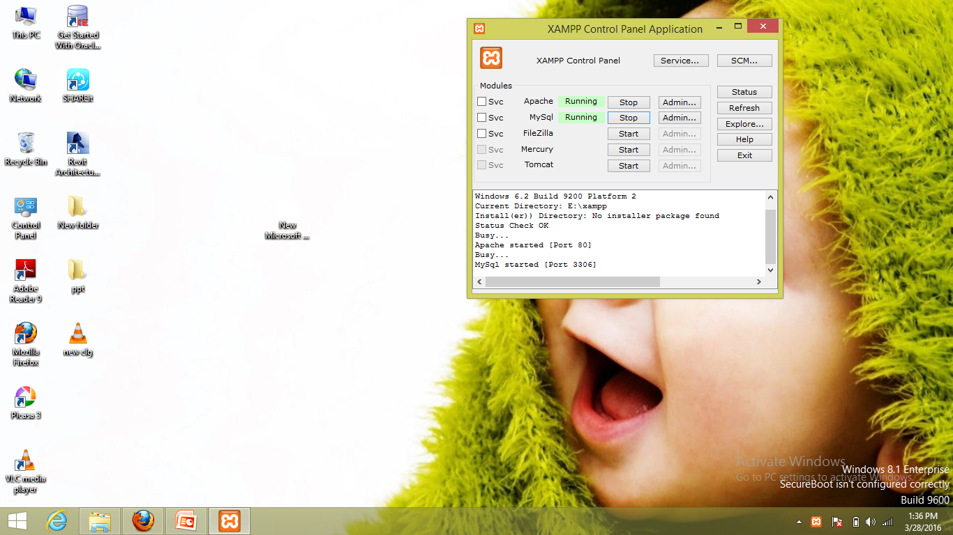
TO START APACHE SERVER

Slide 3
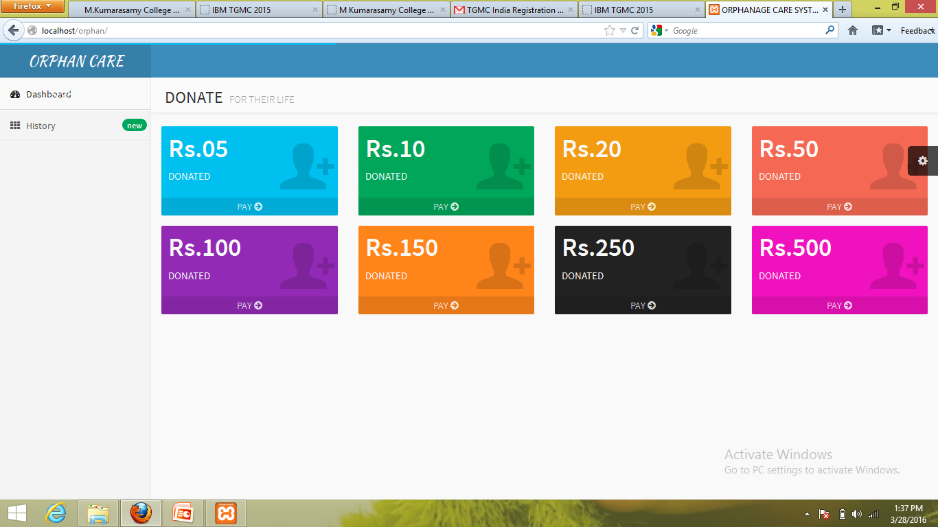
DONOR INTERFACE

Slide 4
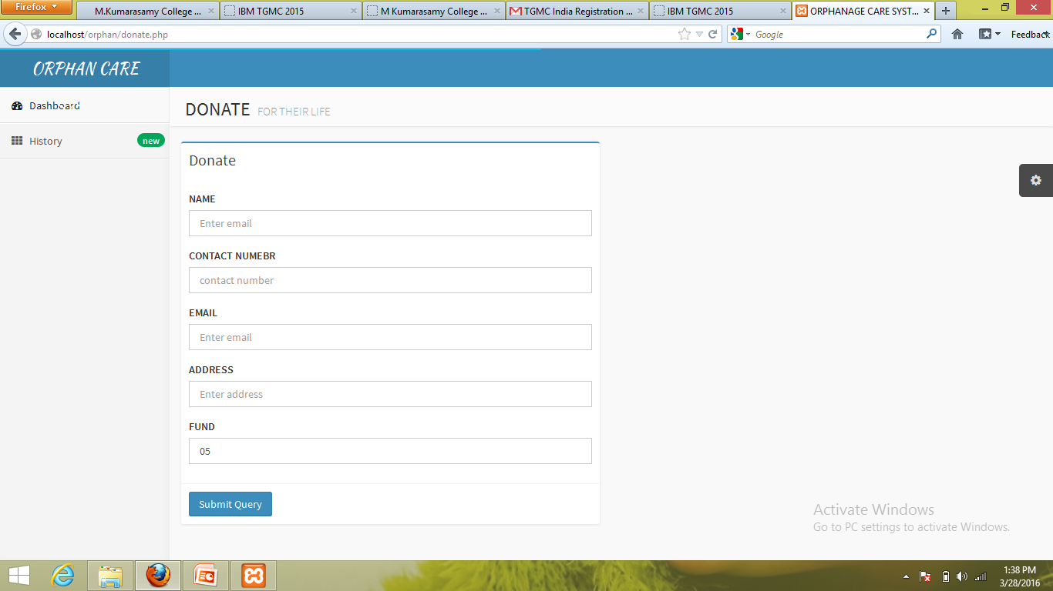
PROFILE TO DONATE

Slide 5
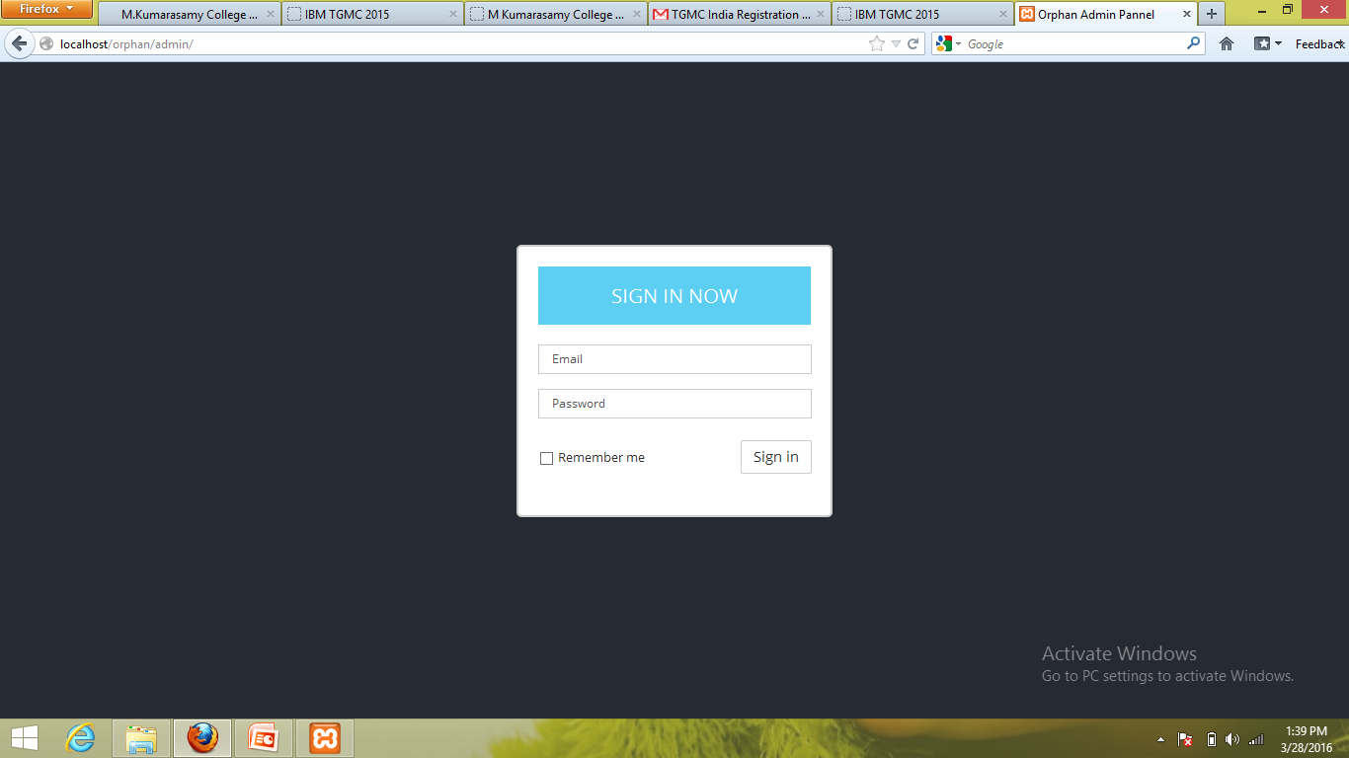
ADMIN TO DATABASE

Slide 6
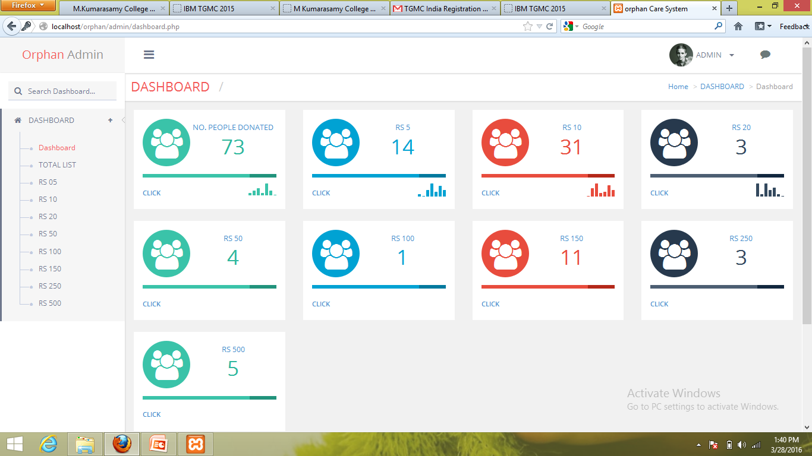
DATABASE

