Slide 1

KEYWORD EXTRACTION SYSTEM
A WEB APPLICATION FOR JOURNALISTS, RESEARCHERS & ANALYSTS
Built using PythON, STREAMLIT, AND SUMMA NLP
GROUP-13
PROMPT CRAFTERS

Slide 2

GROUP MENBERS
M.Kalyani - AP23110010343
B.Jahnavi - AP23110010342
B.Ishwarya - AP23110010646
D.Turvi - AP23110010391
S.L.S.Sanjana - AP23110010295

Slide 3
Problem Statement
  Large documents such as articles, reports, and research papers contain massive information.
  Manual reading is time-consuming, and identifying key ideas is difficult.

Slide 4
Objectives
  To extract meaningful keywords and keyphrases automatically
  To generate concise summaries of large documents
  To provide visual insights through word cloud
  To support journalists, researchers, and analysts in quick decision-making
  To build a simple and efficient web app using Streamlit

Slide 5
Proposed Solution
A hybrid NLP-based system combining rule-based text processing and TextRank ML algorithm to extract keywords, summaries, and visualizations.

Slide 6
Workflow
  User uploads or pastes text
  System preprocesses text
  TextRank extracts top keywords
  Text summary is generated
  Word cloud visualizes high-frequency words
  Outputs are displayed and downloadable

Slide 7
Dataset
  Dataset
  No fixed dataset required
  System works on any user-provided text (articles, reports, essays, investigations)

Slide 8
Methodology
  Text Preprocessing
  Keyword Extraction using TextRank (Summa library)
  Summarization using Extractive ML techniques
  Word Frequency Computation
  Visualization using WordCloud + Matplotlib
  Streamlit UI for interaction

Slide 9
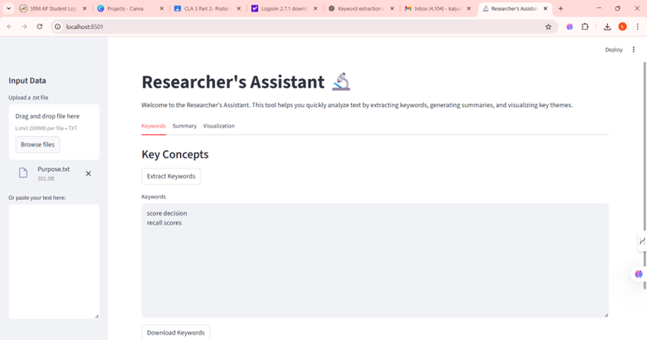
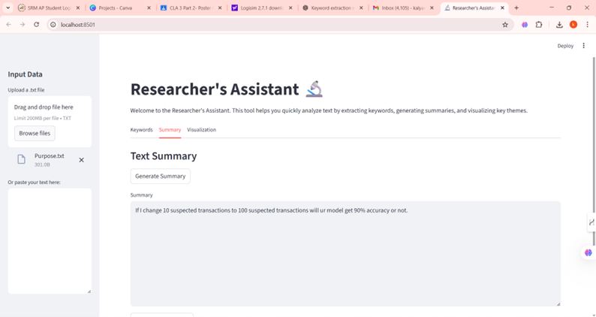
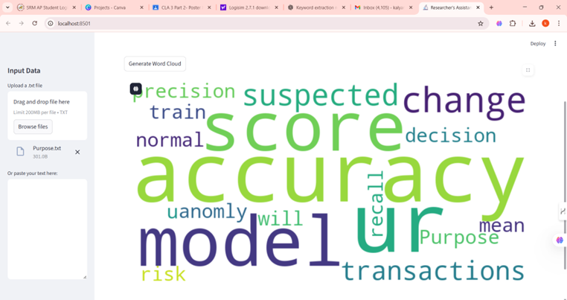

Slide 10
Technologies Used
Programming & Frameworks
  Python
  Streamlit
  Summa NLP
  WordCloud
  Matplotlib
Algorithms & Concepts
  TextRank Algorithm
  Rule-Based NLP
  Tokenization & Graph-Based Ranking
  Extractive Summarization

Slide 11
Results & Findings
Results
  Extracts accurate and meaningful keywords
  Generates concise summaries
  Produces visually appealing word clouds
  Supports multiple types of documents
  User-friendly and fast web-based tool
Findings
  TextRank performs well for unsupervised keyword extraction
  Hybrid rule-based + ML approach improves reliability
  Ideal for journalism, research, reporting, and analysis

Slide 12
Conclusion
The Keyword Extraction System successfully automates text analysis using NLP and ML techniques. It provides quick insights, improves productivity, and is easy to deploy for real-world use.

Slide 13
Future Scope
  PDF & DOCX file support
  Multi-language keyword extraction
  API version using FastAPI
  Integration with BERT/Transformer models
  Named Entity Recognition (NER)
  Topic Modeling (LDA, BERTopic)
  Mobile App Version

Slide 14
THANK YOU
QUESTIONS !

