Slide 1
Modeling
Modeling of virtual twins of the resources and parts (in the form of possible manufacturing process steps).

Slide 2








Roles and Workflows
Customer
Part Definition and Constraints
Manufacturing Expert
Definition of Manufacturing Possibilities and their PMPS (Part Manufacturing Process Steps)
Virtual Part
Searching the “best” Solution*
Modeling
Modeling
Manufacturing Possibility 1
Resource 1
PMPS 1
5x Forming
PMPS 2
2x Cutting
PMPS 3
15x Boring
PMPS 4
3x Surface
RS 1
Cutting (Price, Time , CO2-e)
RS 2
Drilling (Price, Time , CO2-e)
RS 3
Milling (Price, Time , CO2-e)
Consumables
Water
Waste
Consumables
Coolant
Waste
Consumables
Coolant
Waste
Constraints
Material
Surface
Constraints
Color
Size
Constraints
Hardness
Surface
Constraints
Humidity
Material
Abilities
Material
Surface
Abilities
Material
Radius
Abilities
Material
Size
Manufacturing Possibility 2
Resource 2
PMPS 1
22x Printing
PMPS 2
6x Cutting
PMPS 3
15x Boring
PMPS 4
3x Surface
RS 1
Cutting (Price, Time , CO2-e)
RS 2
Drilling (Price, Time , CO2-e)
RS 3
Milling (Price, Time , CO2-e)
Consumables
Water
Waste
Consumables
Coolant
Waste
Consumables
Coolant
Waste
Constraints
Material
Surface
Constraints
Color
Size
Constraints
Hardness
Surface
Constraints
Humidity
Material
Abilities
Material
Surface
Abilities
Material
Radius
Abilities
Material
Size
…
…
Virtual Resources
Definition of Resources and their RS (Resource Skills)
Service Provider
*Which combination of Resource Skills can execute all Part Manufacturing Process Steps with the defined Constraints and has the “best” evaluation criteria (price, time, CO2-e, …)?

Slide 3
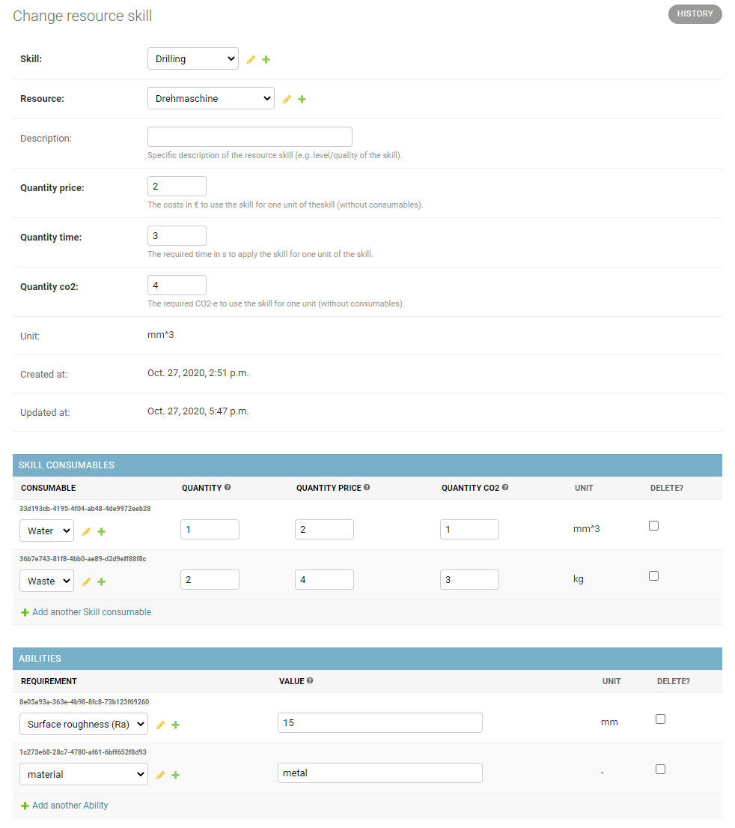
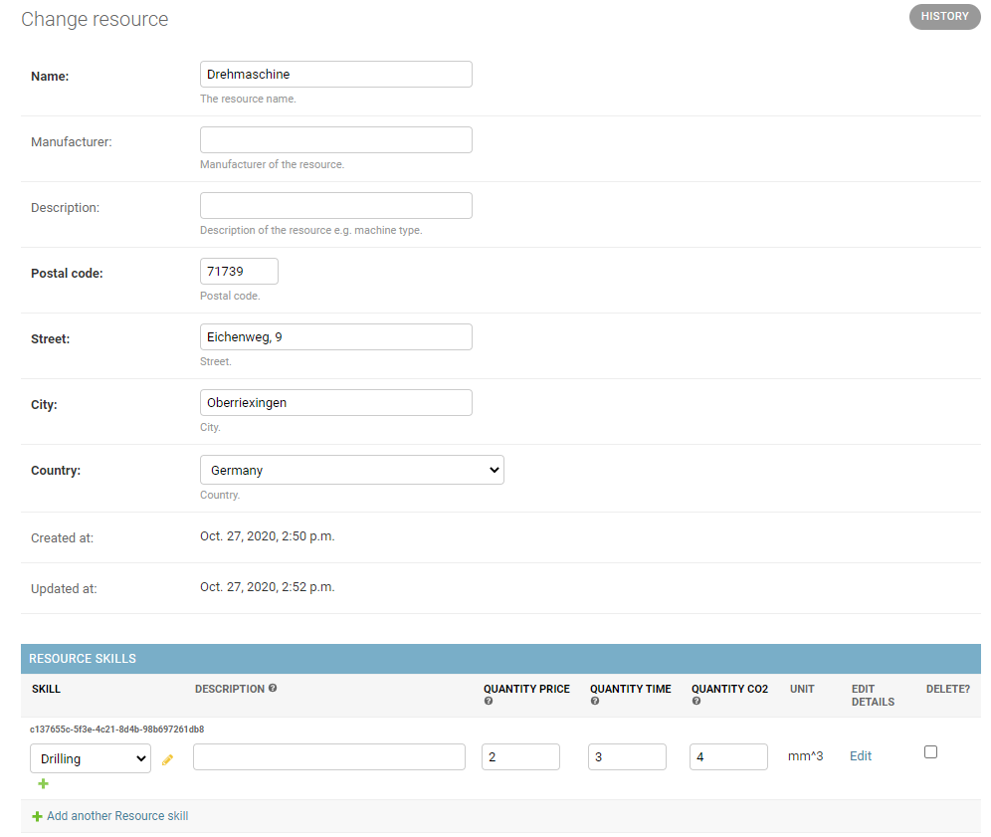
Resource

Slide 4
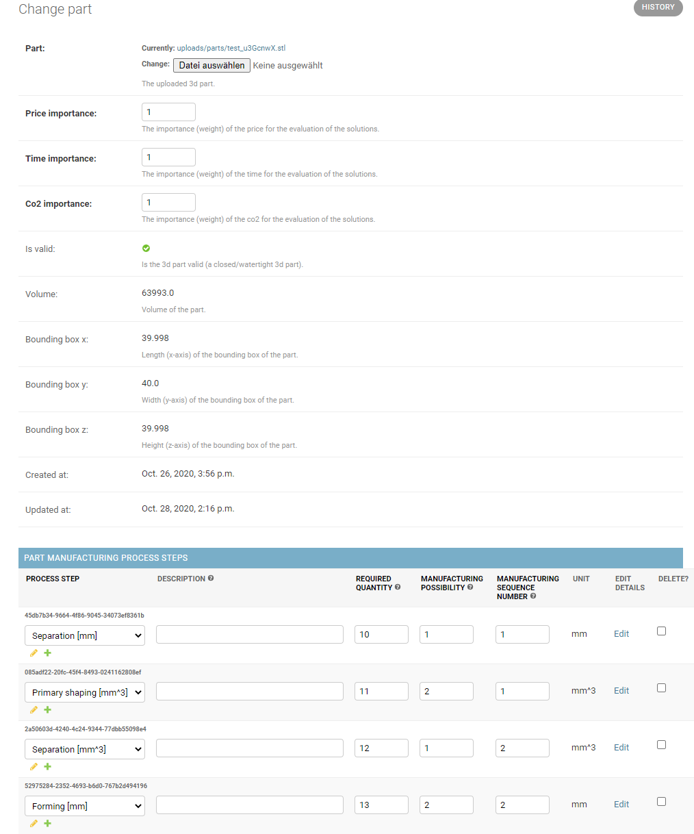
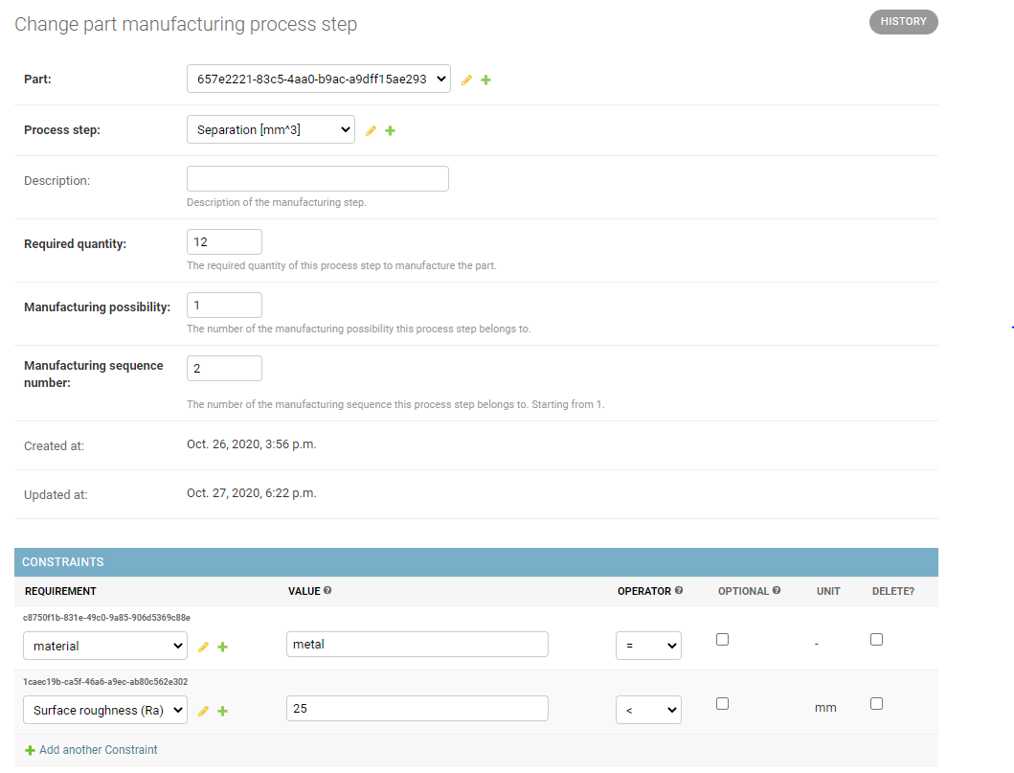
Part

Slide 5
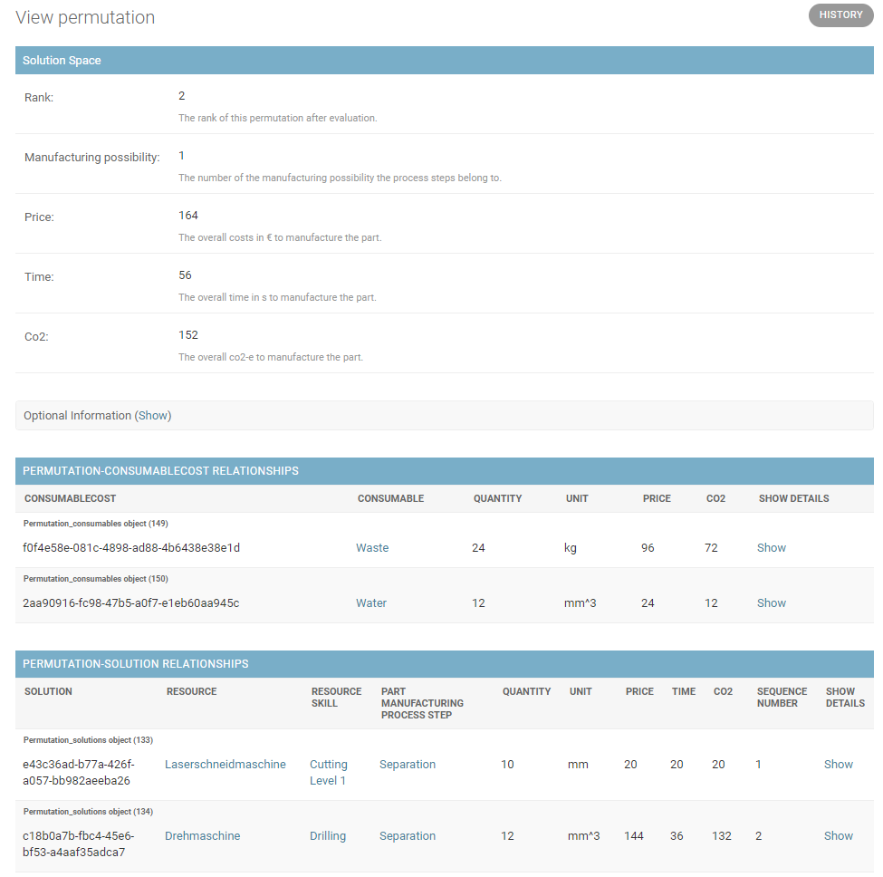
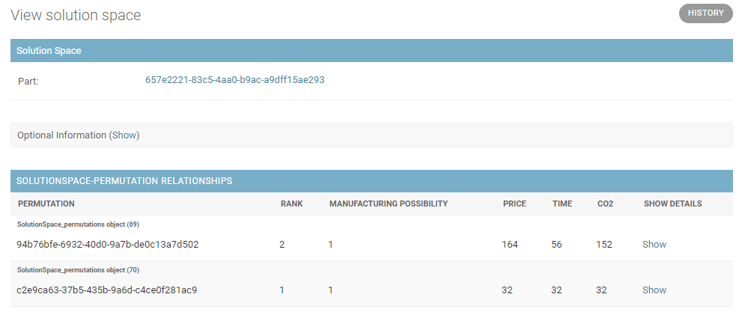
Solution Space

Slide 6
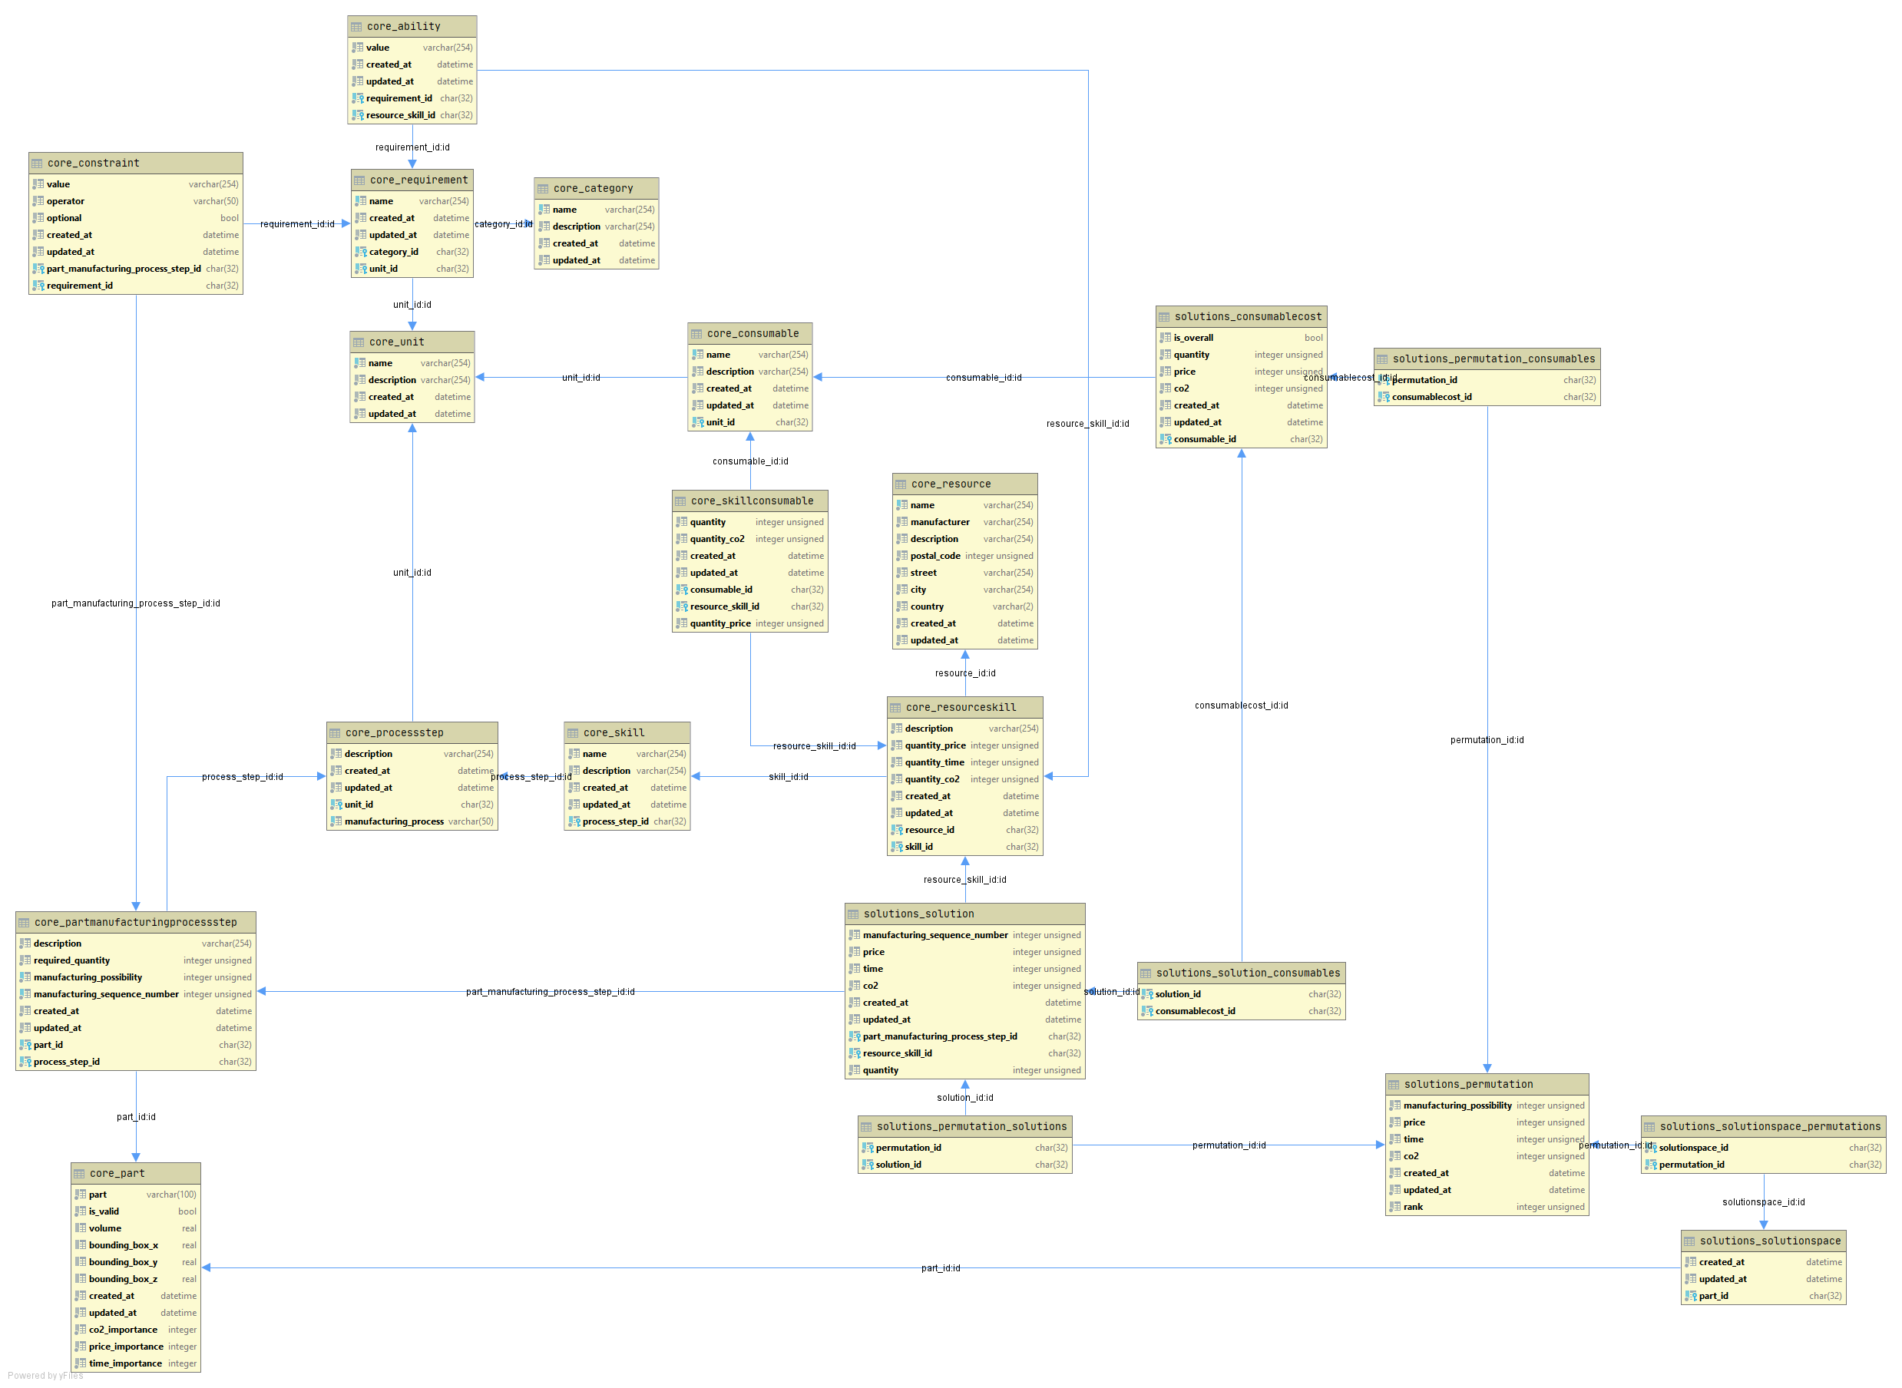
Overview
Starting Points
TBD by Customer
TBD by Service Provider
Solution

Slide 7
Multi Criteria Decision Analysis
Which combination of Resource Skills can execute all Part Manufacturing Process Steps with the defined Constraints and has the “best” evaluation criteria (price, time, CO2-e, …)?

Slide 9
Searching the Solution Space
We search for the resources with resource skills, which match the required process step of a part manufacturing process step (PMPS).
if resource_skill.skill.process_step == part_manufacturing_process_step.process_step
If constraints are defined, we check if the ability of the resource skill (RS) matches the constraint in dependence of the defined operator.
if constraint.operator == “<":
if ability.value < constraint.value:
fulfilled = True
elif …
Then we have the information for which part manufacturing process step, which resources skill is possible.
If one PMPS has no RS, this manufacturing possibility can not be manufactured and is removed from the solution space.
Manufacturing Possibility1: |-----PMPS1------| |-----PMPS2------| |------PMPS3-------| [[RS1, RS3, RS4], [RS6, RS7, RS9], [RS8, RS10, RS5]]
Manufacturing Possibility2: |-----PMPS1------| |-----PMPS2------| |------PMPS3-------| [[RS1, RS3, RS4], [RS6, RS7, RS9], [ ]]
…
Using this information, we create all possible permutations. A permutation is a unique combination of resource_skills, which fulfill all PMPS of a manufacturing possibility.
Permutation1: [RS1, RS6, RS8]
Permutation2: [RS1, RS6, RS10]
…

Slide 10
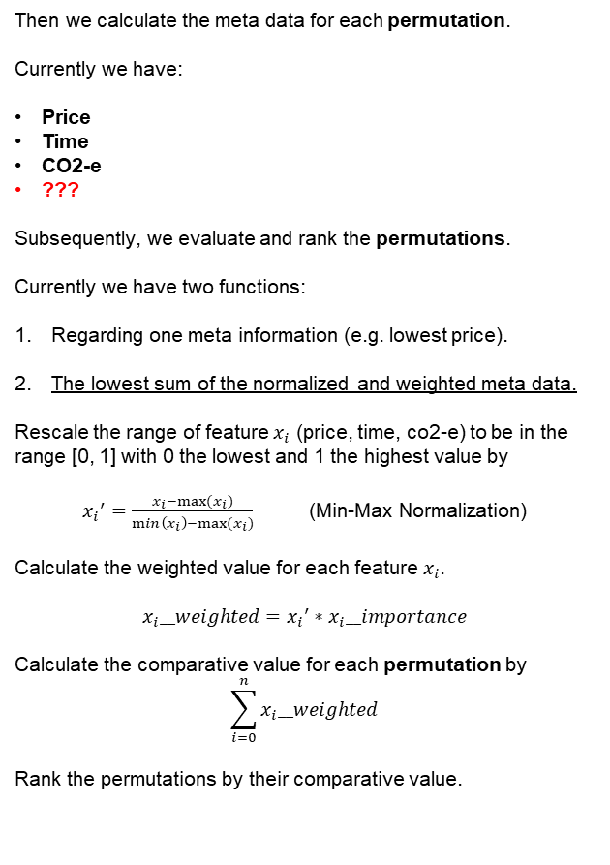
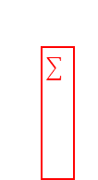
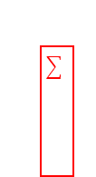
Evaluation and Ranking
Then we calculate the meta data for each permutation.
Currently we have:
Price
Time
CO2-e
???
Subsequently, we evaluate and rank the permutations.
Currently we have two functions:
Regarding one meta information (e.g. lowest price).
The lowest sum of the normalized and weighted meta data.
Rescale the range of feature $x_{i}$ (price, time, co2-e) to be in the range [0, 1] with 0 the lowest and 1 the highest value by
${x_{i}}^{′}=\frac{x_{i}−max⁡(x_{i})}{\min\left(x_{i}\right)−max⁡(x_{i})}$ (Min-Max Normalization)
Calculate the weighted value for each feature${ x}_{i}$.
$$x_{i}__weighted={x_{i}}^{′}∗x_{i}__importance$$
Calculate the comparative value for each permutation by
$$\sum_{i=0}^{n}{x_{i}__weighted}$$
Rank the permutations by their comparative value.
Summary of the consumables of each RS
Coming soon: CRITIC (CRiteria Importance Through Intercriteria Correlation)

Slide 11
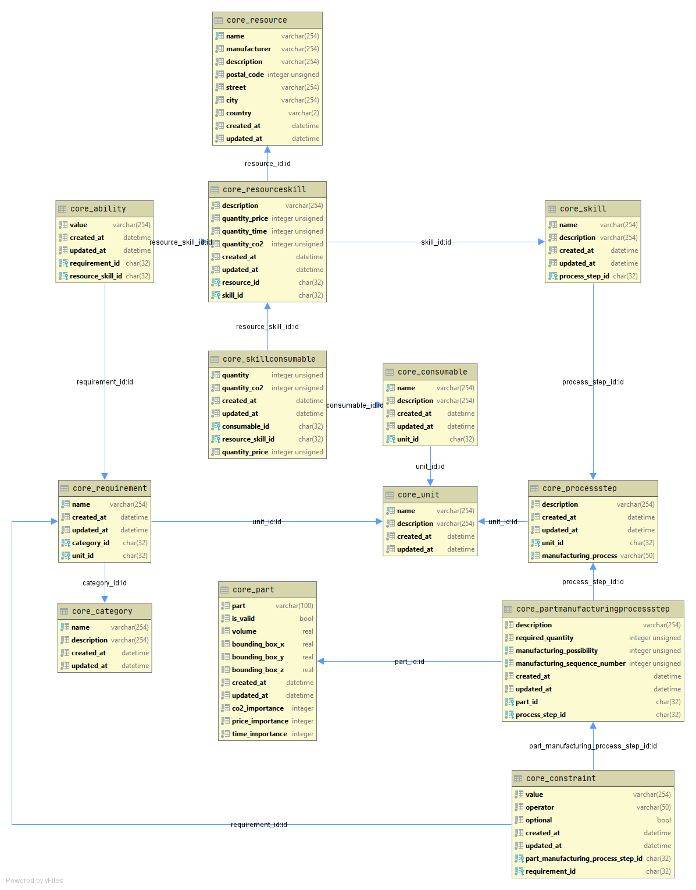
Core

Slide 12
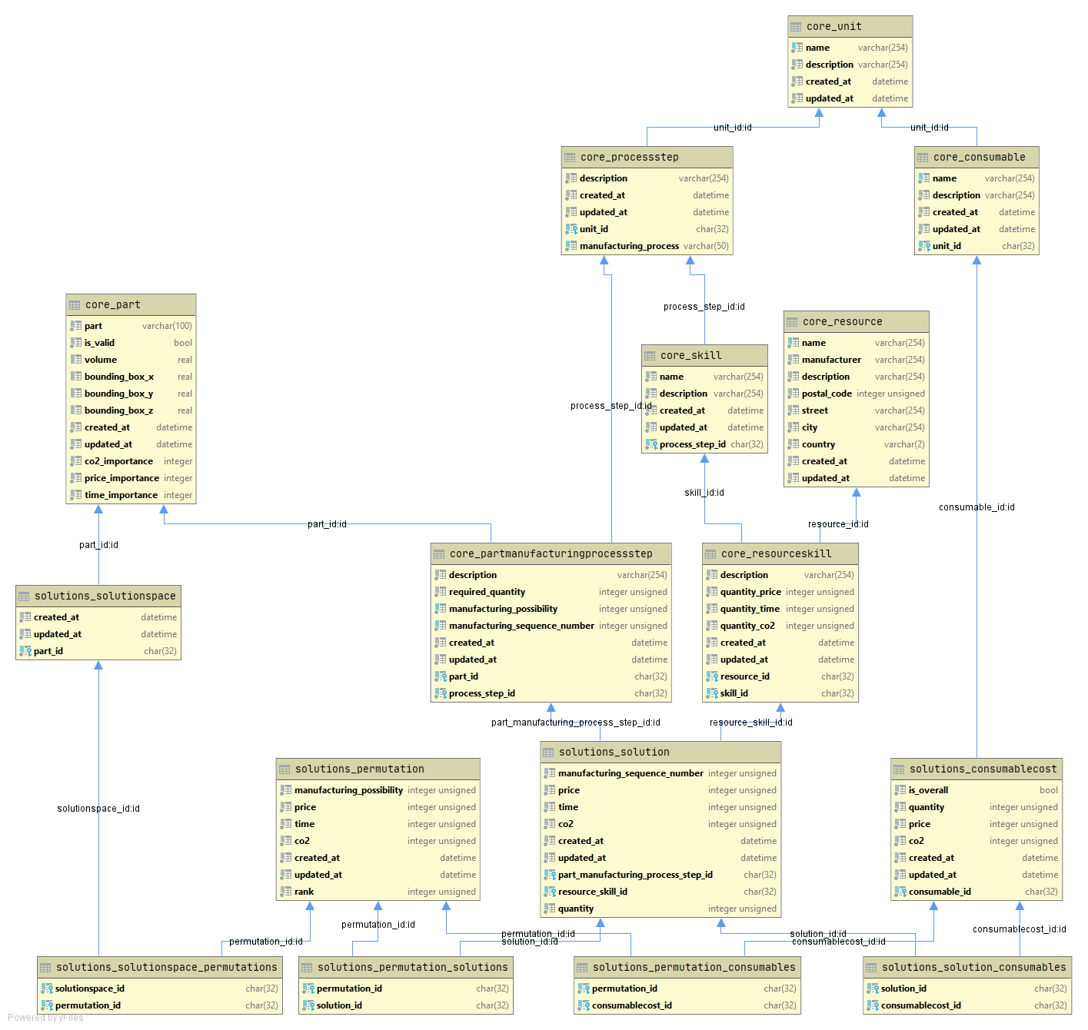
Solution

