Slide 1
Modeling
Modeling of virtual twins of the resources and parts (in the form of possible manufacturing process steps).

Slide 2
<<enumeration>> Operator
=
!=
<=
>=
<
>
Category
name: String
1
0..*
Ability
value: String
resource_skill
requirement
Requirement
name: String
unit
category
0..*
1
0..*
0..*
1
1
ResourceSkill
fixed_co2: Float
fixed_price: Float
fixed_time: Float
variable_co2: Float
variable_price: Float
variable_time: Float
abilities
skill_consumables
resource
skill
SkillConsumable
fixed_co2: Float
fixed_price: Float
fixed_quantity: Float
variable_co2: Float
variable_price: Float
variable_quantity: Float
consumable
resource_skill
0..*
1
0..*
Constraint
operator: Operator
optional: Boolean
value: String
part_manufacturing_process_step
requirement
0..*
0..*
0..*
0..*
1
1
1
Consumable
name: String
unit
Skill
name: String
process_step
Resource
name: String
manufacturer: String
resource_skills
0..*
0..*
1
1
1
ProcessStep
manufacturing_process: String
unit
PartManufacturingProcessStep
required_quantity: Float
manufacturing_possibility: Integer
manufacturing_sequence_number: Integer
part
process_step
constraints
Unit
name: String
1
0..*
1
0..*
1
Part
part: File
part_manufacturing_process_steps
1
0..*

Slide 3
<<enumeration>> Operator
=
!=
<=
>=
<
>
<<enumeration>> DataType
String
Boolean
Integer
Float
Unit
name: String
si_unit: String
description: String
Category
name: String
1
0..*
Ability
value: String
resource_skill: ResourceSkill
requirement: Requirement
Requirement
name: String
data_type: DataType
unit: Unit
category: Category
0..*
1
0..*
1
1
ResourceSkillConsumable
price: Float
co2: Float
fixed_quantity: Float
variable_quantity: Float
consumable: Consumable
resource_skill: ResourceSkill
ResourceSkill
fixed_co2: Float
fixed_price: Float
fixed_time: Float
variable_co2: Float
variable_price: Float
variable_time: Float
resource: Resource
skill: Skill
0..*
1
0..*
Constraint
operator: Operator
optional: Boolean
value: String
part_process_step: PartProcessStep
requirement: Requirement
0..*
0..*
0..*
0..*
1
1
1
Consumable
name: String
unit: Unit
Skill
name: String
process_step: ProcessStep
Resource
name: String
manufacturer: String
0..*
1
1
ProcessStep
manufacturing_process: String
unit: Unit
PartProcessStep
required_quantity: Float
manufacturing_possibility: Integer
manufacturing_sequence_number: Integer
part: Part
process_step: ProcessStep
1
0..*
Part
part: File
1
0..*

Slide 4
Part saved
List of ResourceSkills
List of PartProcessSteps
No more ResourceSkills
No more PartProcessSteps
ResourceSkill available
PartProcessStep available
Get next PartProcessStep
Get next ResourceSkill
ProcessSteps match
ProcessSteps don’t match
List of Constraints of the current PartProcessStep
Not every Constraint was fulfilled by the Abilities of the current ResourceSkill
No more Constraints
Ability fulfills Constraint
Ability doesn’t fulfill Constraint
All Constraints are fulfilled by the Abilities of the current ResourceSkill
Constraint available
Requirements match
Add ResourceSkill to List of possible ResourceSkills for the current PartProcessStep
Get next Constraint
Requirements don’t match
List of possible ResourceSkills for the current PartProcessStep
Get next Ability
No more Abilities
Ability available
List of Abilities of the current ResourceSkill

Slide 5
Manufacturing Possibility
Part Process Step 1
…
Part Process Step n
Can be executed by
Resource
Skill a
Resource
Skill b
Resource
Skill c
List of possible Resource Skills for each Part Process Step
…
…
…
Permutation 1
Resource
Skill x
Resource
Skill y
Resource
Skill z

Slide 6
Part Definition and Constraints
Customer
Manufacturing Expert
Definition of Manufacturing Possibilities and the underlying Part Process Steps
Results
Matching and Evaluation
Production Order
Part Definition and Constraints
Definition of Resources and the underlying Resource Skills
Automatic Part Decomposition
Customer
Manufacturing Expert
Service Provider
Definition of Manufacturing Possibilities and the underlying Part Process Steps
Results
Matching and Evaluation
Production Order
Definition of Resources and the underlying Resource Skills
Service Provider

Slide 7
Part to be manufactured
defines
Customer
Framework
Manufacturing Expert
Manufacturing Possibility
Constraint
has
Part Process Step
derives
Part Process Step
…
Matching and Evaluation
Which Resource Skills with their Abilities fulfill Part Process Steps with their Constraints?
Offer
Order
Resource
Ability
has
Resource Skill
derives
Consumable
uses
Resource Skill
Service Provider
…
Machine
…
Raw Material

Slide 8
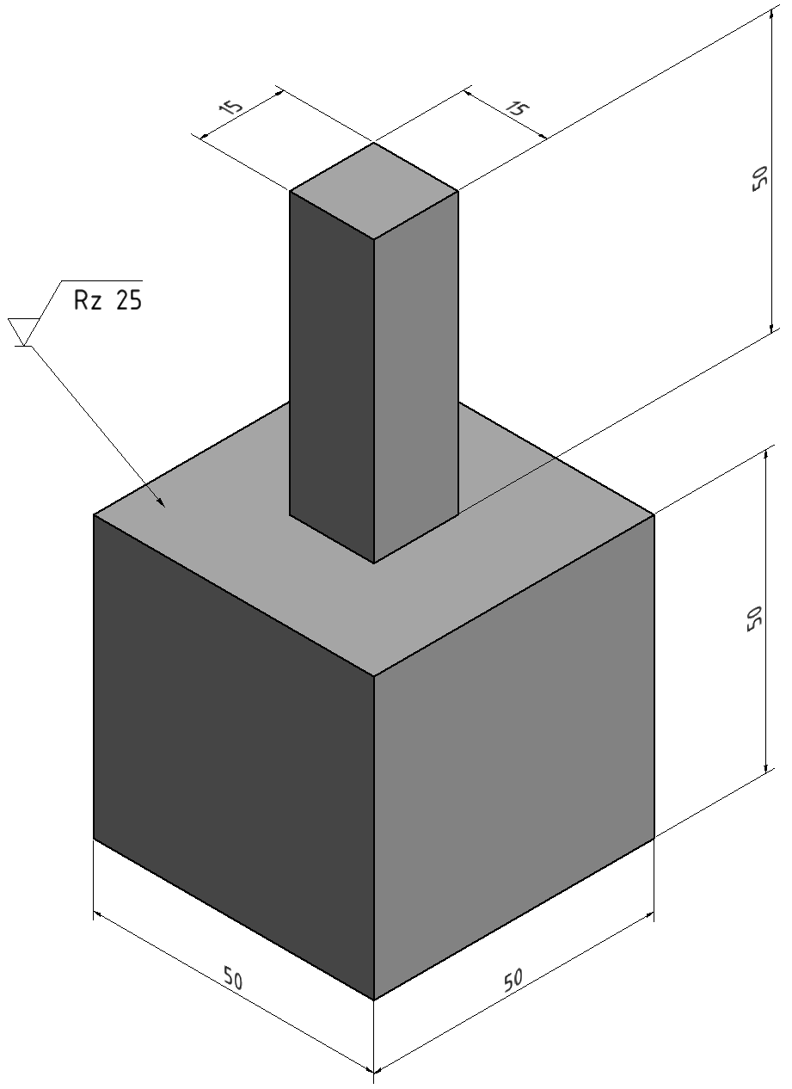

Slide 9
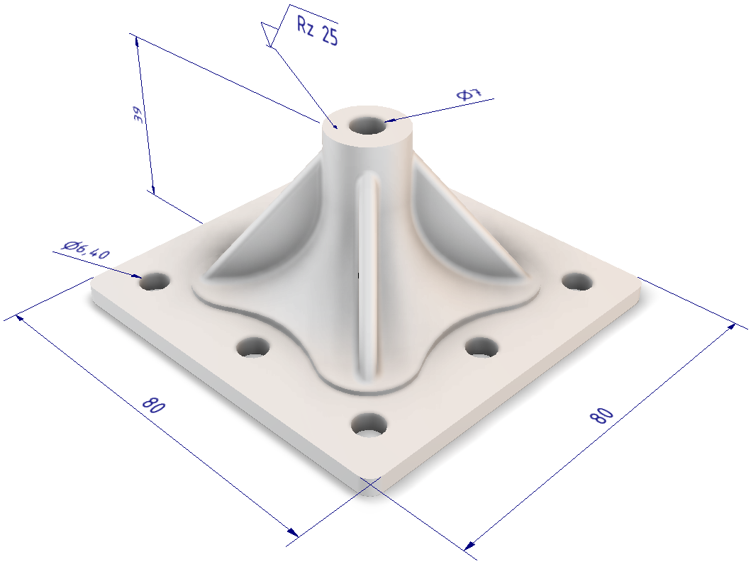
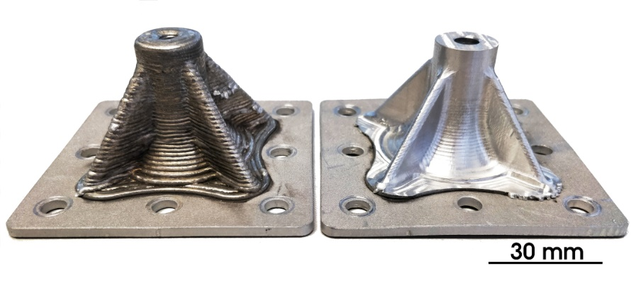
a)
b)
c)

Slide 10
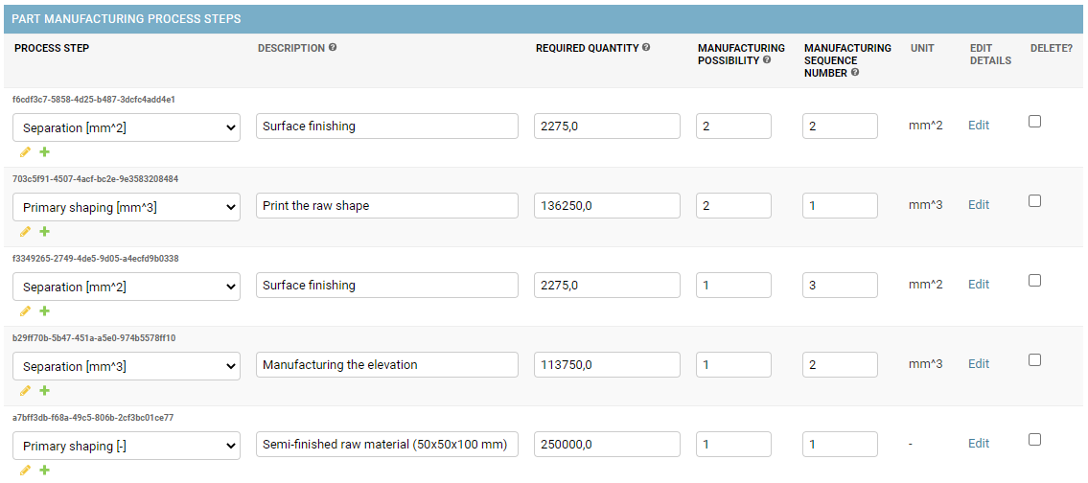
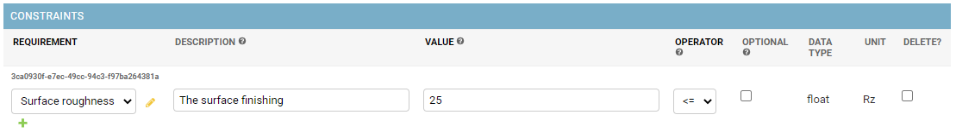
Possibility 2
1
Possibility 1
1
1

Slide 11
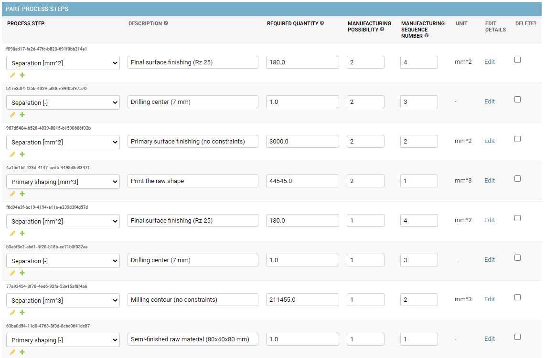
Possibility 2
Possibility 1

Slide 12
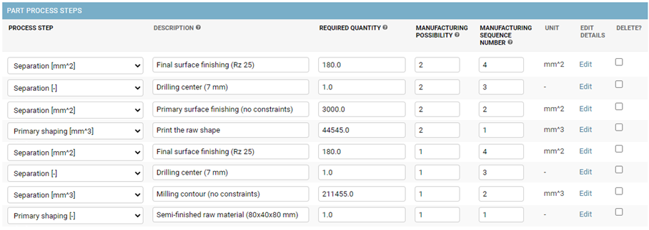
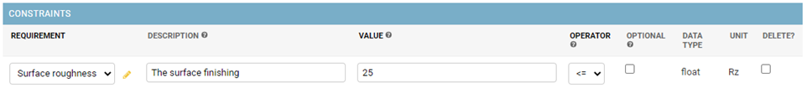
Possibility 2
1
Possibility 1
1
1

Slide 13
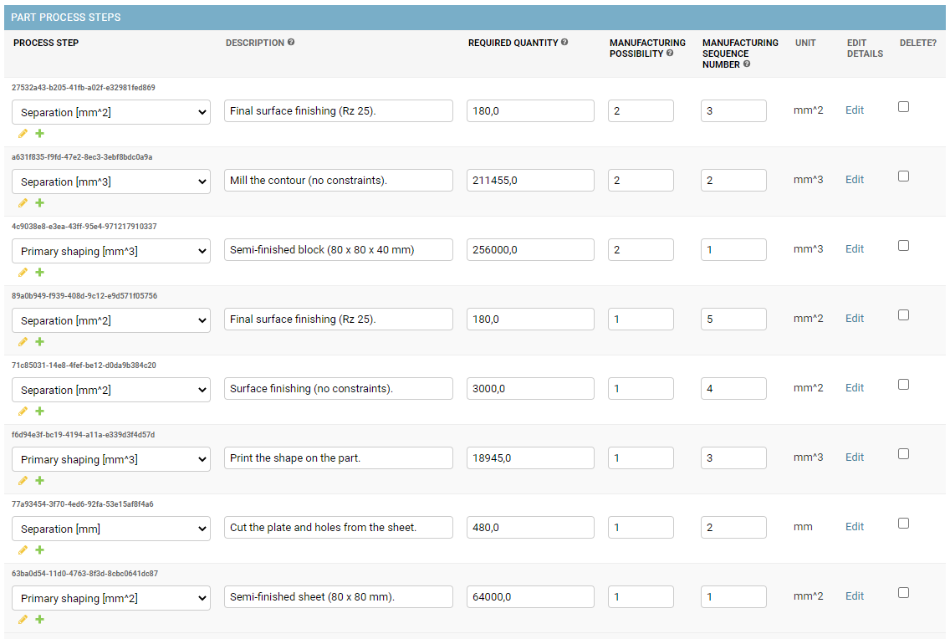
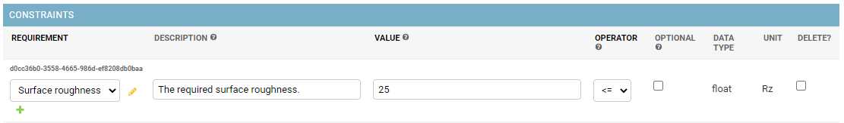
Possibility 2
a)
Possibility 1
a)
a)

Slide 14








Roles and Workflows
Customer
Part Definition and Constraints
Manufacturing Expert
Definition of Manufacturing Possibilities and their PMPS (Part Manufacturing Process Steps)
Virtual Part
Searching the “best” Solution*
Modeling
Modeling
Manufacturing Possibility 1
Resource 1
PMPS 1
5x Forming
PMPS 2
2x Cutting
PMPS 3
15x Boring
PMPS 4
3x Surface
RS 1
Cutting (Price, Time , CO2-e)
RS 2
Drilling (Price, Time , CO2-e)
RS 3
Milling (Price, Time , CO2-e)
Consumables
Water
Waste
Consumables
Coolant
Waste
Consumables
Coolant
Waste
Constraints
Material
Surface
Constraints
Color
Size
Constraints
Hardness
Surface
Constraints
Humidity
Material
Abilities
Material
Surface
Abilities
Material
Radius
Abilities
Material
Size
Manufacturing Possibility 2
Resource 2
PMPS 1
22x Printing
PMPS 2
6x Cutting
PMPS 3
15x Boring
PMPS 4
3x Surface
RS 1
Cutting (Price, Time , CO2-e)
RS 2
Drilling (Price, Time , CO2-e)
RS 3
Milling (Price, Time , CO2-e)
Consumables
Water
Waste
Consumables
Coolant
Waste
Consumables
Coolant
Waste
Constraints
Material
Surface
Constraints
Color
Size
Constraints
Hardness
Surface
Constraints
Humidity
Material
Abilities
Material
Surface
Abilities
Material
Radius
Abilities
Material
Size
…
…
Virtual Resources
Definition of Resources and their RS (Resource Skills)
Service Provider
*Which combination of Resource Skills can execute all Part Manufacturing Process Steps with the defined Constraints and has the “best” evaluation criteria (price, time, CO2-e, …)?

Slide 15
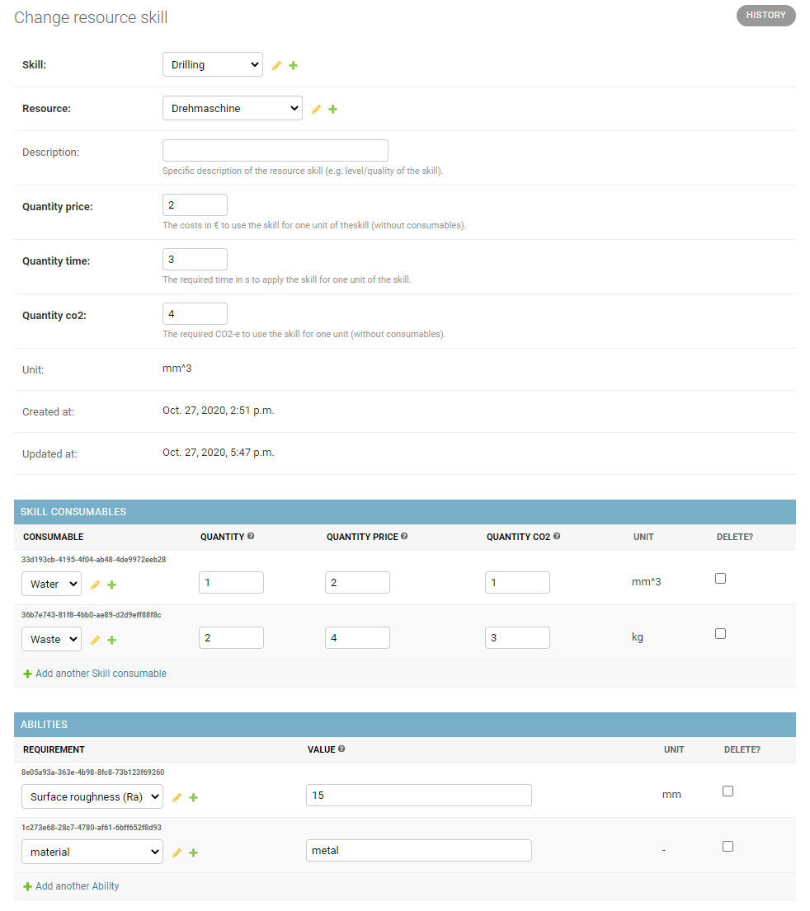
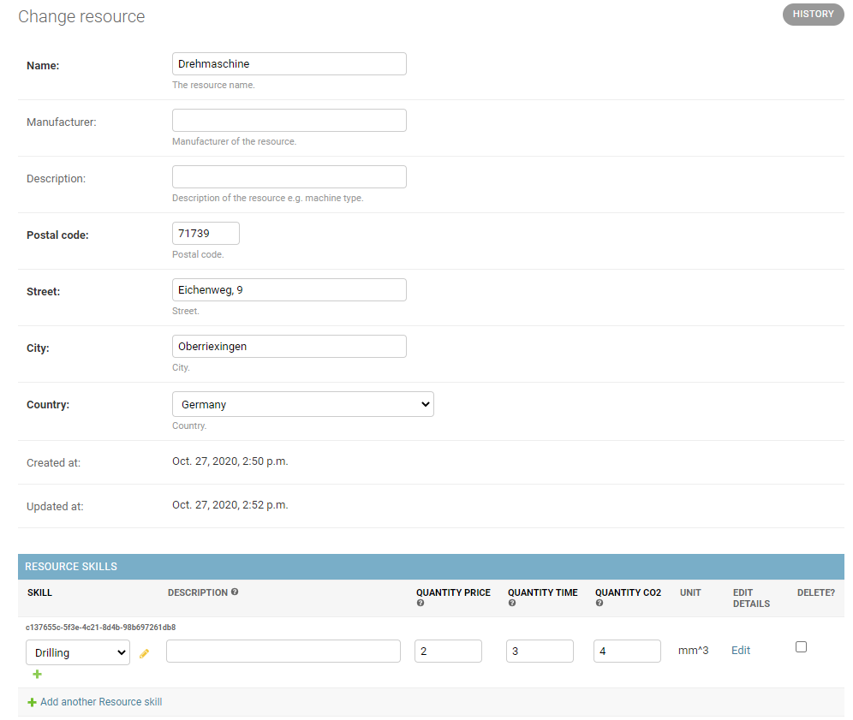
Resource

Slide 16
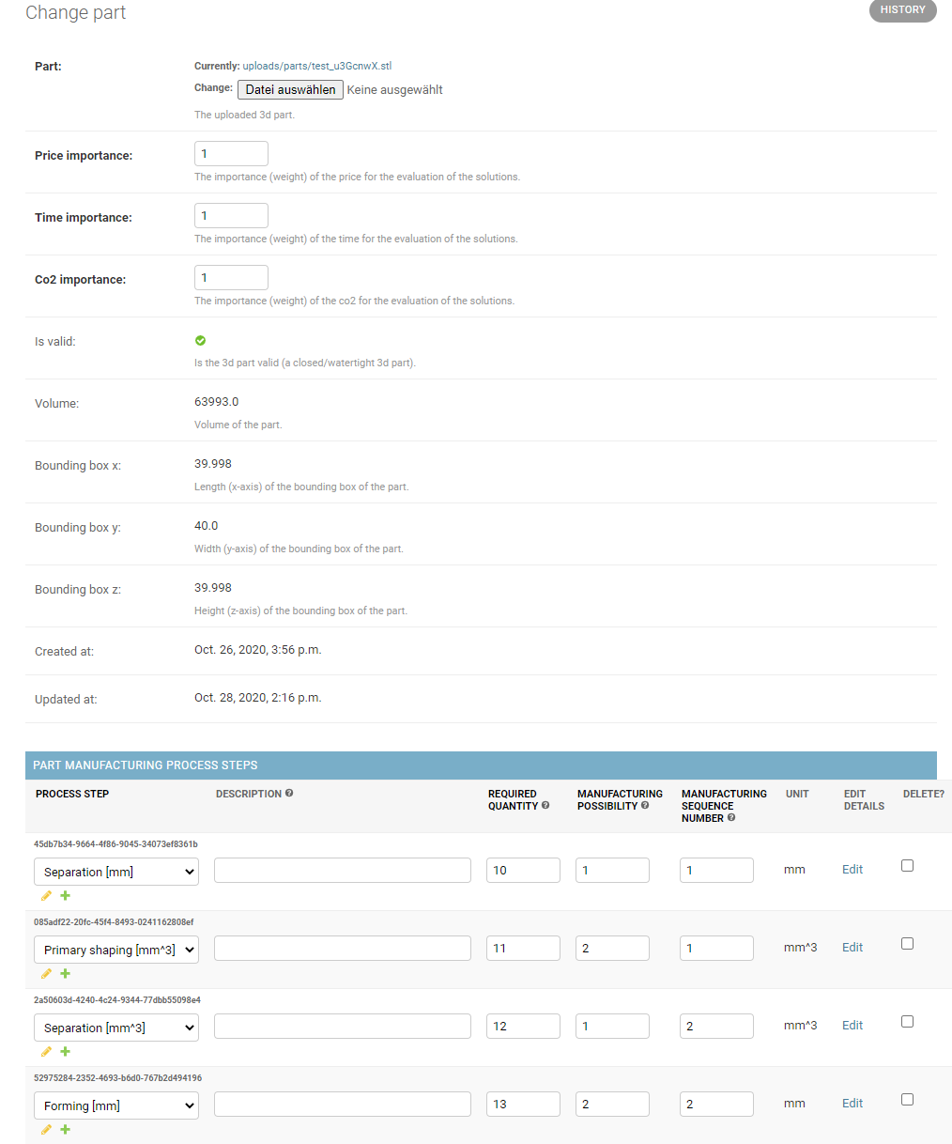
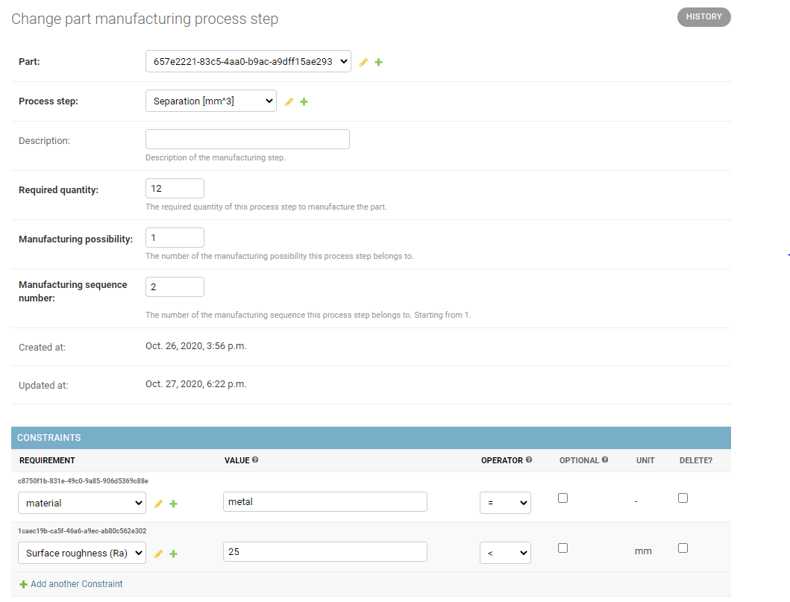
Part

Slide 17
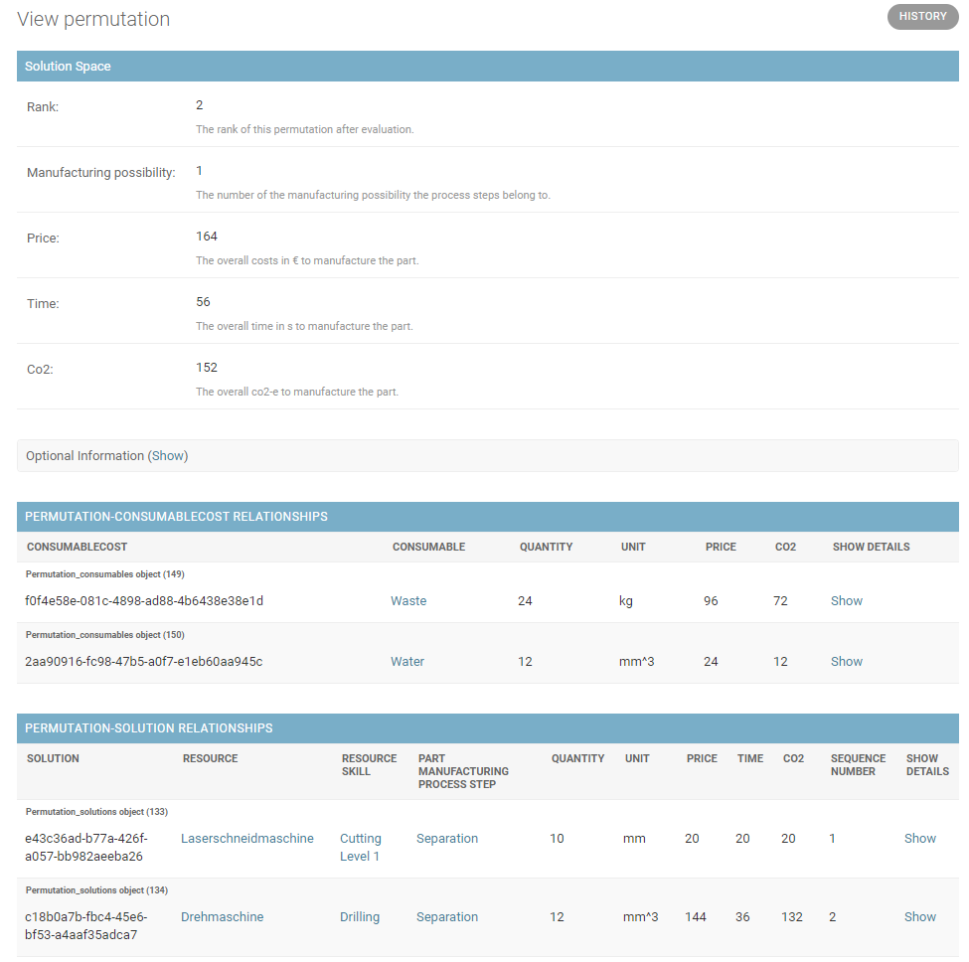
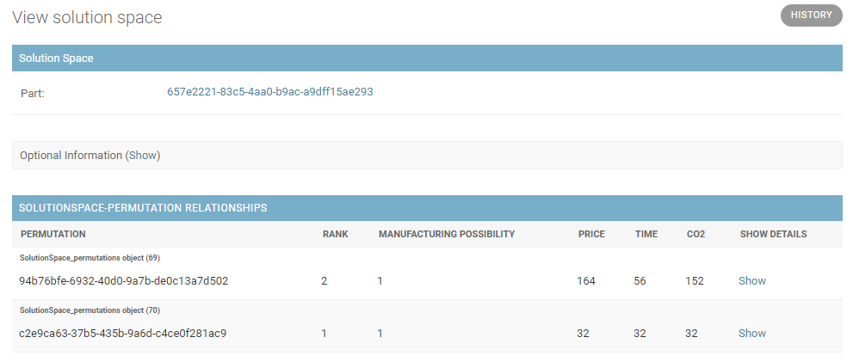
Solution Space

Slide 18
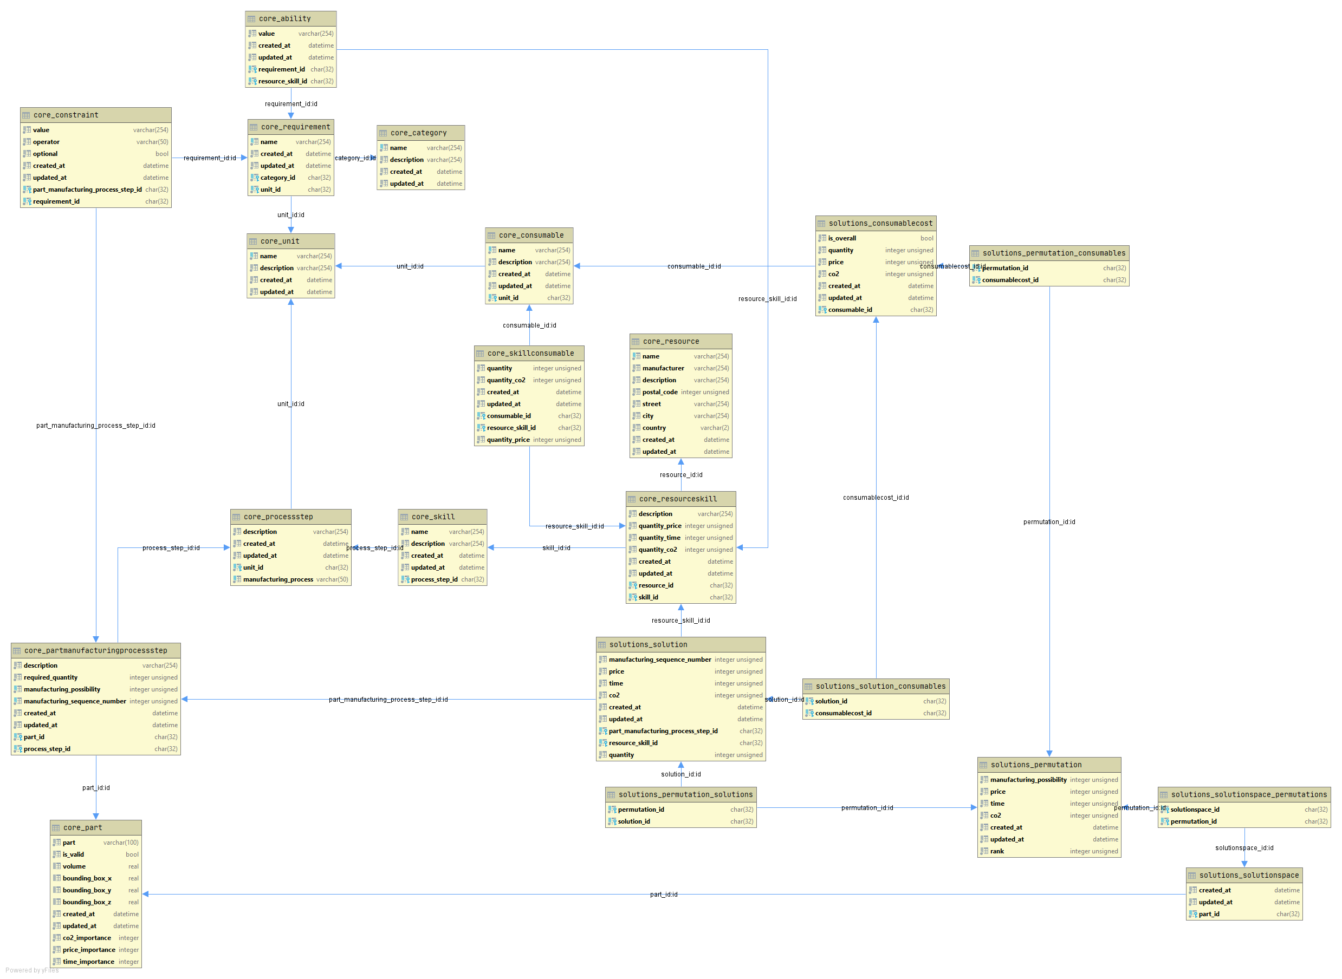
Overview
Starting Points
TBD by Customer
TBD by Service Provider
Solution

Slide 19
Multi Criteria Decision Analysis
Which combination of Resource Skills can execute all Part Manufacturing Process Steps with the defined Constraints and has the “best” evaluation criteria (price, time, CO2-e, …)?

Slide 20
Searching the Solution Space
We search for the resources with resource skills, which match the required process step of a part manufacturing process step (PMPS).
if resource_skill.skill.process_step == part_manufacturing_process_step.process_step
If constraints are defined, we check if the ability of the resource skill (RS) matches the constraint in dependence of the defined operator.
if constraint.operator == “<":
if ability.value < constraint.value:
fulfilled = True
elif …
Then we have the information for which part manufacturing process step, which resources skill is possible.
If one PMPS has no RS, this manufacturing possibility can not be manufactured and is removed from the solution space.
Manufacturing Possibility1: |-----PMPS1------| |-----PMPS2------| |------PMPS3-------| [[RS1, RS3, RS4], [RS6, RS7, RS9], [RS8, RS10, RS5]]
Manufacturing Possibility2: |-----PMPS1------| |-----PMPS2------| |------PMPS3-------| [[RS1, RS3, RS4], [RS6, RS7, RS9], [ ]]
…
Using this information, we create all possible permutations. A permutation is a unique combination of resource_skills, which fulfill all PMPS of a manufacturing possibility.
Permutation1: [RS1, RS6, RS8]
Permutation2: [RS1, RS6, RS10]
…

Slide 21
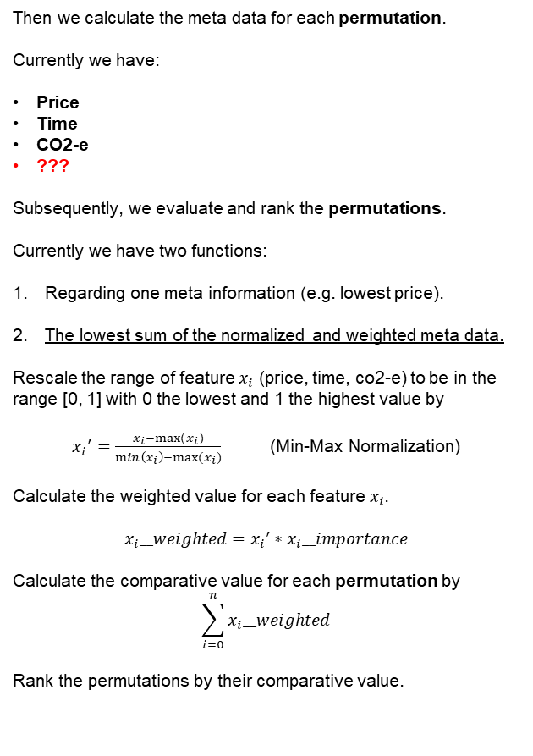


Evaluation and Ranking
Then we calculate the meta data for each permutation.
Currently we have:
Price
Time
CO2-e
???
Subsequently, we evaluate and rank the permutations.
Currently we have two functions:
Regarding one meta information (e.g. lowest price).
The lowest sum of the normalized and weighted meta data.
Rescale the range of feature $x_{i}$ (price, time, co2-e) to be in the range [0, 1] with 0 the lowest and 1 the highest value by
${x_{i}}^{′}=\frac{x_{i}−max⁡(x_{i})}{\min\left(x_{i}\right)−max⁡(x_{i})}$ (Min-Max Normalization)
Calculate the weighted value for each feature${ x}_{i}$.
$$x_{i}__weighted={x_{i}}^{′}∗x_{i}__importance$$
Calculate the comparative value for each permutation by
$$\sum_{i=0}^{n}{x_{i}__weighted}$$
Rank the permutations by their comparative value.
Summary of the consumables of each RS
Coming soon: CRITIC (CRiteria Importance Through Intercriteria Correlation)

Slide 22
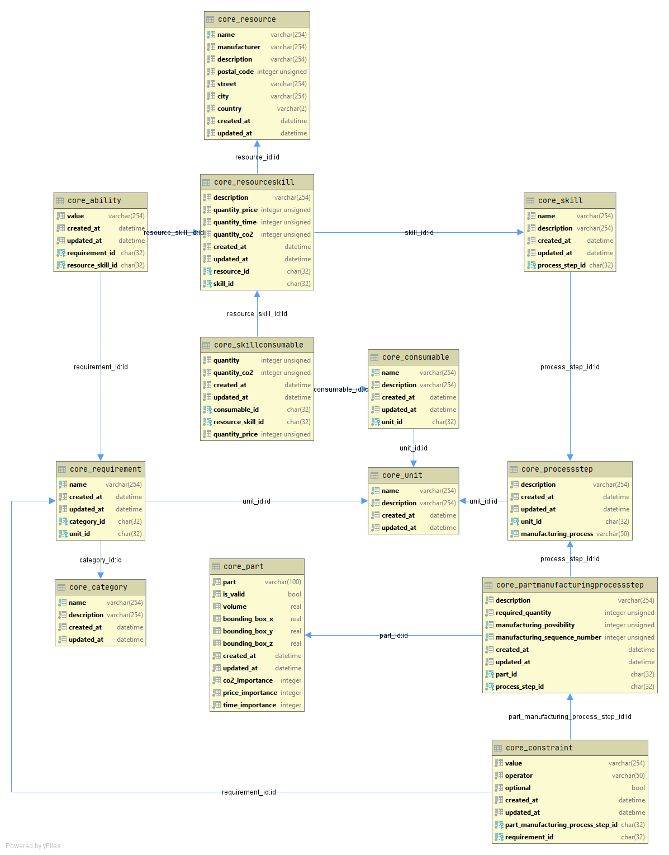
Core

Slide 23
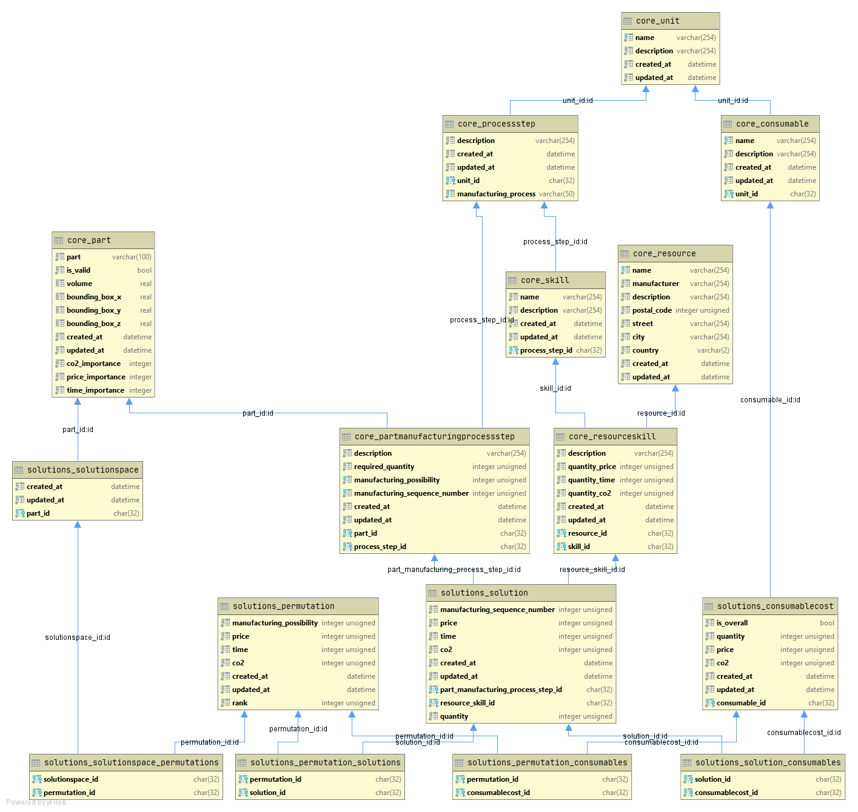
Solution

