Slide 1
Python Dictionaries

Slide 2
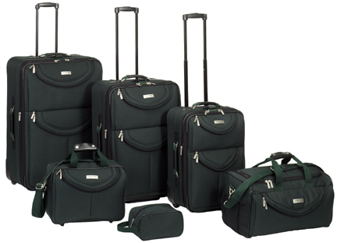
What is a Collection?
A collection is nice because we can put more than one value in them and carry them all around in one convenient package.
We have a bunch of values in a single “variable”
We do this by having more than one place “in” the variable.
We have ways of finding the different places in the variable

Slide 3
What is not a “Collection”
Most of our variables have one value in them - when we put a new value in the variable - the old value is over written
$ python
>>> x = 2
>>> x = 4
>>> print (x)
4

Slide 4
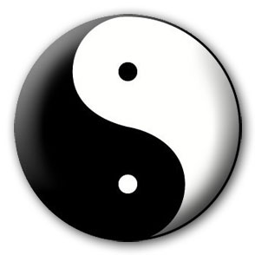


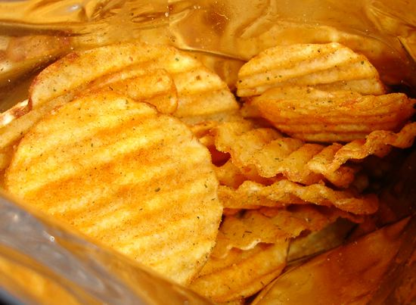
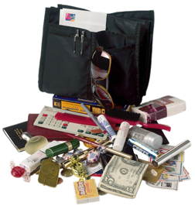
A Story of Two Collections..
List
  A linear collection of values that stay in order
Dictionary
  A “bag” of values, each with its own label
  Not in order

Slide 5
Dictionaries
tissue
calculator
perfume
money
candy

Slide 6
Dictionaries
unordered collection of data values, used to store data values like a map.
Dictionaries allow us to do fast access from database-like operations in Python
It uses curly braces eg..,
Syntax: <dict_name> = {key1: value1, key2: value2, key3: value3,…… key n: value n, }
Store pairs of entries called items
Eg: { 'CS' : '743-713-3350', 'UHPD' : '713-743-3333'}
Each pair of entries contains
  A key ==> Keys must be unique
  A value

Slide 7
Dictionaries
>>> purse = dict() (or) dict={}
>>> purse['money'] = 12
>>> purse['candy'] = 3
>>> purse['tissues'] = 75
>>> print (purse)
{'money': 12, 'tissues': 75, 'candy': 3}
>>> print (purse['candy'])
3
>>> purse['candy'] = purse['candy'] + 2’
>>> print (purse)
{'money': 12, 'tissues': 75, 'candy': 5}
Lists index their entries based on the position in the list
Dictionaries are like bags - no order
Mutable
So we index the things we put in the dictionary with a “lookup tag”

Slide 8
Comparing Lists and Dictionaries
Dictionaries are like Lists except that they use keys instead of numbers to look up values
# Creating an empty Dictionary
>>>Dict = {}
>>>print("Empty Dictionary: ")
>>>print(Dict)
{}
# Creating a Dictionary with Integer Keys
>>>Dict = {1: 'Geeks', 2: 'For', 3: 'Geeks'} >>>print("\nDictionary with the use of Integer Keys: ") >>>print(Dict)
{1: 'Geeks', 2: 'For', 3: 'Geeks'}
# Creating a Dictionary with Mixed keys
>>>Dict = {'Name': 'Geeks', 1: [1, 2, 3, 4]}
>>>print("\nDictionary with the use of Mixed Keys: ")
>>>print(Dict)
{'Name': 'Geeks', 1: [1, 2, 3, 4]}
>>> lst = list()
>>> lst.append(21)
>>> lst.append(183)
>>> print (lst)
[21, 183]
>>> lst[0] = 23
>>> print(lst)
[23, 183]

Slide 9
>>> lst = list()
>>> lst.append(21)
>>> lst.append(183)
>>> print lst
[21, 183]
>>> lst[0] = 23
>>> print lst
[23, 183]
List
Key
Value
[0]
21
lll
[1]
183
#create using dict() method
>>> ddd = dict()
>>> ddd['age'] = 21
>>> ddd['course'] = 182
>>> print ddd
{‘age': 21, 'course': 182}
>>> ddd['age'] = 23
>>> print ddd
{‘age': 23, 'course': 182}
Dictionary
Key
Value
['course']
183
ddd
['age']
21

Slide 10
Dictionary Literals (Constants)
Dictionary literals use curly braces and have a list of key : value pairs
You can make an empty dictionary using empty curly braces
>>> jjj = { 'chuck' : 1 , 'fred' : 42, 'jan': 100}
>>> print(jjj)
{'jan': 100, 'chuck': 1, 'fred': 42}
>>> ooo = { }
>>> print (ooo)
{}
>>>

Slide 11
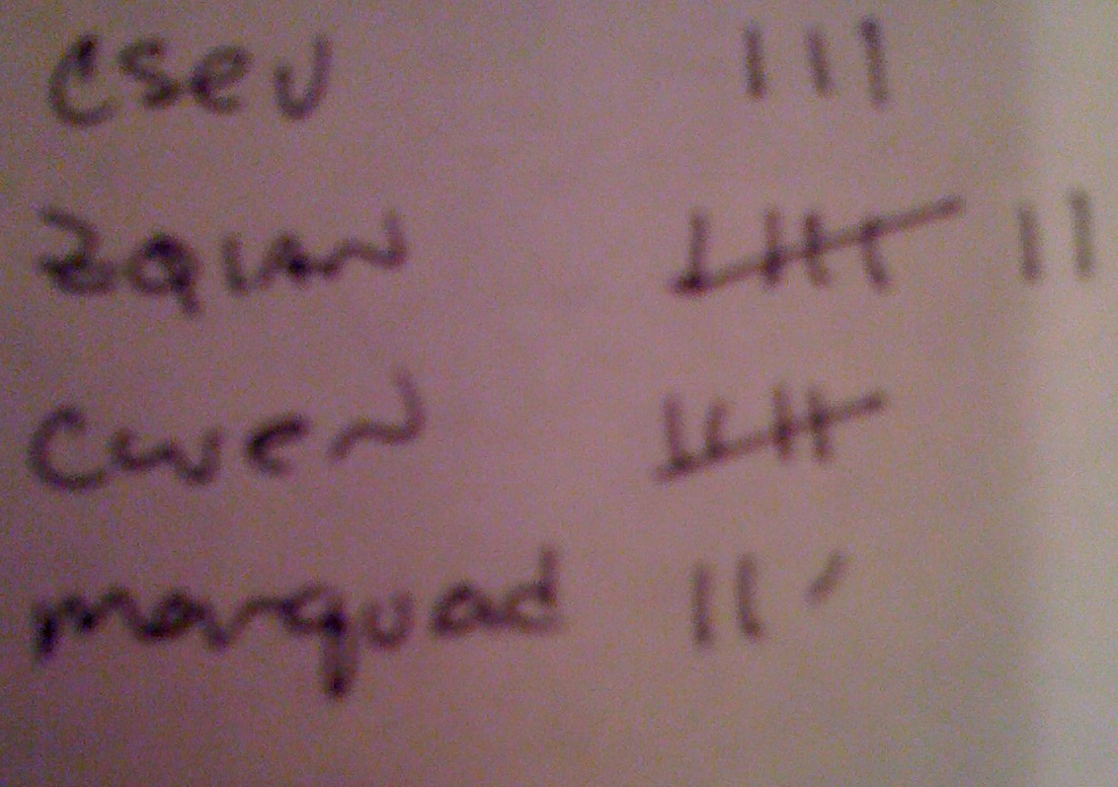
Many Counters with a Dictionary
One common use of dictionary is counting how often we “see” something
Key
Value
>>> ccc = dict()
>>> ccc['csev'] = 1
>>> ccc['cwen'] = 1
>>> print (ccc)
{'csev': 1, 'cwen': 1}
>>> ccc['cwen'] = ccc['cwen'] + 1
>>> print (ccc)
{'csev': 1, 'cwen': 2}

Slide 12
Dictionary Tracebacks
It is an error to reference a key which is not in the dictionary
We can use the in operator to see if a key is in the dictionary
>>> ccc = dict()
>>> print (ccc['csev'])
Traceback (most recent call last):
File "<stdin>", line 1, in <module>
KeyError: 'csev'
>>> print ('csev' in ccc)
False

Slide 13
Methods in dictionary
Method | Description
clear() | Removes all the elements from the dictionary
copy() | Returns a copy of the dictionary
fromkeys() | Returns a dictionary with the specified keys and values
get() | Returns the value of the specified key
items() | Returns a list containing a tuple for each key value pair
keys() | Returns a list containing the dictionary's keys
pop() | Removes the element with the specified key
popitem() | Removes the last inserted key-value pair
setdefault() | Returns the value of the specified key. If the key does not exist: insert the key, with the specified value
update() | Updates the dictionary with the specified key-value pairs
values() | Returns a list of all the values in the dictionary
if name in counts:
x = counts[name]
else :
x = 0

Slide 14
Methods in dictionary
get(), copy(), keys() and clear()
>>>car={"brand": "Ford","model": "Mustang","year": 1964}
>>>a=car.copy()
>>>print(a)
>>>x = car.get("model")
>>>print(x)
>>>x = car.keys()
print(x)
>>>car.clear()
>>>print(car)
Output:
{"brand": "Ford","model": "Mustang","year": 1964}
Mustang
dict_keys(['brand', 'model', 'year'])
{ }

Slide 15
Methods in dictionary
pop(), popitem(), update(), values()
>>>car={"brand": "Ford","model": "Mustang","year": 1964}
>>>car.pop(“model”)
>>>print(car)
>>>car.popitem()
>>>print(car)
>>>car.update(“color”:”white”)
>>>print(car)
>>>car.values()
>>>print(car)
Output:
{"brand": "Ford","year": 1964}
{"brand": "Ford“}
{"brand": "Ford","year": 1964, "color": "White"}
dict_values(['Ford', 'Mustang', 1964])

Slide 16
Word count result in dictionary
counts = dict() ( or ) counts ={}
names = ['csev', 'cwen', 'csev', 'zqian', 'cwen']
for name in names :
if name not in counts:
counts[name] = 1
else :
counts[name] = counts[name] + 1
print (counts)
Output
{'csev': 2, , 'cwen': 2, 'zqian': 1}

Slide 17

Simplified counting with get()
We can use get() and provide a default value of zero when the key is not yet in the dictionary - and then just add one
counts = dict()
names = ['csev', 'cwen', 'csev', 'zqian', 'cwen']
for name in names :
counts[name] = counts.get(name, 0) + 1
print(counts)
{'csev': 2, 'zqian': 1, 'cwen': 2}
Default

Slide 18

Simplified word counting with get()
counts = dict()
names = ['csev', 'cwen', 'csev', 'zqian', 'cwen']
for name in names :
counts[name] = counts.get(name, 0) + 1
print counts

Slide 19
Properties of Dictionary Keys
More than one key not Allowed (i.e) no duplicate key
Keys must be immutable, it may be numbers, Strings or tuples.
Dictionary Comprehension
  Contains an expression pair (key:value) followed by for loop inside curly
braces { }.
Eg program
squares={x:x*x for in range(6)}
print(squares)
Output:
{0:0,1:1,2:4,3:9,4:16,5:25}

Slide 20
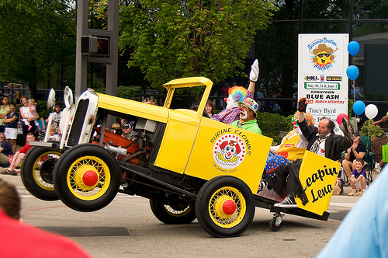

the clown ran after the car and the car ran into the tent and the tent fell down on the clown and the car

Slide 21
Counting Pattern
counts = dict()
print 'Enter a line of text:‘
line = raw_input('')
words = line.split()
print 'Words:', words
print 'Counting...’
for word in words:
counts[word] = counts.get(word,0) + 1
print 'Counts', counts
The general pattern to count the words in a line of text is to split the line into words, then loop thrugh the words and use a dictionary to track the count of each word independently.

Slide 22
Counting Words
python wordcount.py Enter a line of text:the clown ran after the car and the car ran into the tent and the tent fell down on the clown and the car
Words: ['the', 'clown', 'ran', 'after', 'the', 'car', 'and', 'the', 'car', 'ran', 'into', 'the', 'tent', 'and', 'the', 'tent', 'fell', 'down', 'on', 'the', 'clown', 'and', 'the', 'car']
Counting...
Counts {'and': 3, 'on': 1, 'ran': 2, 'car': 3, 'into': 1, 'after': 1, 'clown': 2, 'down': 1, 'fell': 1, 'the': 7, 'tent': 2}
http://www.flickr.com/photos/71502646@N00/2526007974/

Slide 23
python wordcount.py
Enter a line of text:the clown ran after the car and the car ran into the tent and the tent fell down on the clown and the car
Words: ['the', 'clown', 'ran', 'after', 'the', 'car', 'and', 'the', 'car', 'ran', 'into', 'the', 'tent', 'and', 'the', 'tent', 'fell', 'down', 'on', 'the', 'clown', 'and', 'the', 'car']Counting...
Counts {'and': 3, 'on': 1, 'ran': 2, 'car': 3, 'into': 1, 'after': 1, 'clown': 2, 'down': 1, 'fell': 1, 'the': 7, 'tent': 2}
counts = dict()
print 'Enter a line of text:
'line = raw_input('')
words = line.split()
print 'Words:', words
print 'Counting...’
for word in words:
counts[word] = counts.get(word,0) + 1
print 'Counts', counts

Slide 24
Definite Loops and Dictionaries
Even though dictionaries are not stored in order, we can write a for loop that goes through all the entries in a dictionary - actually it goes through all of the keys in the dictionary and looks up the values
>>> counts = { 'chuck' : 1 , 'fred' : 42, 'jan': 100}
>>> for key in counts:
... print key, counts[key]
...
jan 100chuck 1fred 42
>>>

Slide 25
Retrieving lists of Keys and Values
>>> jjj = { 'chuck' : 1 , 'fred' : 42, 'jan': 100}
>>> print (list(jjj))
['jan', 'chuck', 'fred']
>>> print(jjj.keys())
['jan', 'chuck', 'fred']
>>> print (jjj.values())
[100, 1, 42]
>>> print (jjj.items())
[('jan', 100), ('chuck', 1), ('fred', 42)]
You can get a list of keys, values or items (both) from a dictionary
What is a 'tuple'? - coming soon...

