Slide 1
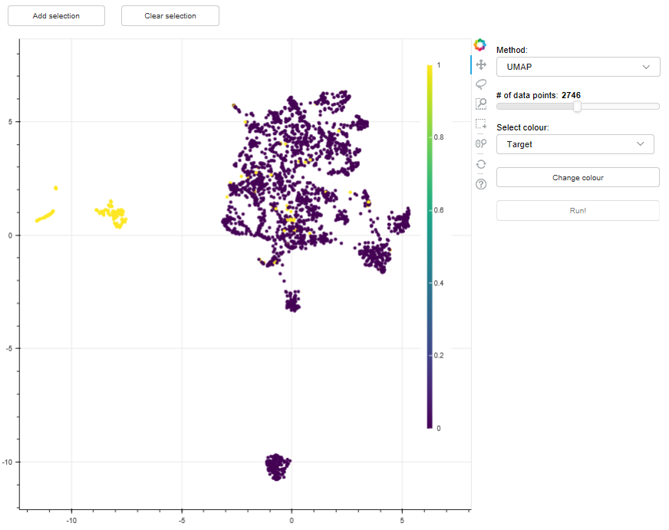
Data selection buttons
Bokeh tools
Visualisation controls

