Slide 1
Object-Oriented Internet Cloud Interoperability
Mariusz Postół Ph. D. (mariusz.postol@p.lodz.pl)
Piotr Szymczak
Institute of Information Technology, Lodz University of Technology
Notes:
I would like to present my research work related to Object-Oriented Internet focusing on the Reactive Interoperability. My name is Mariusz Postół and I am representing the Institute of Information Technology Technical University of Lodz.

Slide 2
Industrial highly distributed applications - human role
Human-centric
information origin or ultimate information destination is an operator
GUI Based Human Interface
Robustness (errors tolerance) depends on human interaction
Cloud-base IoT front-end
Machine-centric
Machine to Machine Communication (M2M)
Information creation, consumption, networking, and processing are achieved entirely without human interaction
No human interaction possible to improve solution robustness
Cyber-physical systems base on Machine-to-Machine communication

Slide 3
GUI Front-end As a service
OSI Model
HTTP Client
Application (HTTP)
GUI
SERVICE
Presentation
PROGRAM
Presentation
Logic
Data
Session
Transport (TCP)
Network (IP)
Data Link
Files
Database
Physical
Telemetry
Notes:
Piramida:
– by pokazać, gdzie jest góra i dół
Model warstwowy
Warstwy wyższe odwołują się do warstw niższych
API
Po co:
Możliwość wymiany technologia
Skalowanie
Współużywanie
Warstwy:

Slide 4
Telemetry => Cyber-physical Systems
Integrated machines interconnected over the Internet
Internet of Things (IoT)
Data holder mobility:
Mobile Device -Network attachment point
Mobile Application - Serverless data access – reactive communication
Mobile Data- Random location of data publication
Real-time processing
Notes:
Going beyond the smart factory realm, a similar concept may be used to make any general-purpose entities interoperable. Finally, we get cyber-physical systems where a variety of entities may be aggregated into distributed information processing solutions. In this case, we are opening the public connectivity domain, which requires a globally scoped infrastructure, i.e. the Internet.
For any generic solution addressing the design of the cyber-physical system, the data holder mobility must be considered as well. Mobile data means that it may come from mobile devices or be generated in unpredictable attachment points. If the data places exposition is arbitrary it means that the data appearance must be recognized and processed as an event. A good example of this scenario is a product (e.g. hygiene goods, cosmetics, drugs, etc.) global tracking system - an application domain where the IoT term has been coined. One of the arguments for the IoT is allowing distributed yet interlinked devices, machines, and objects (data holders) to interact with each other without relying on human interaction to set-up and commission the embedded intelligence. In case any kind of mobility has to be considered, the next engineering challenge is dynamic discoverability on the network and the possibility of establishing the semantic and security contexts of the parts composing the IoT application.

Slide 5
Introduction
M2M communication is foundation for disciplines
Cyber physical systems
Industry 4.0
IoT support
Challenges
Security
Multi-vendor parts => standardization
Meaningful communication without programming
Goal
Plug and Produce
Notes:
As I said the machine to machine communication is a foundation for the Cyber-physical system, Industry 4.0 solutions, and Internet of Things discipline. In the case of the cyber-physical systems, a variety of entities may be aggregated into distributed information processing solutions. In this case, we are opening the public connectivity domain, which requires the Internet as a globally scoped communication infrastructure. Parties interconnected over any network require special precautions that must be taken against malicious users to assure the best possible level of security. To address this security demand suitable protection methods may be applied to network traffic and data transfer object.
For network traffic it is accomplished using intermediary devices to enforce traffic selective availability based on security rules against unauthorized access,
For the data transfer object (simplifying data on the wire) it is accomplished using cipher algorithms against bitstreams formatted as a message traversing the network and containing process data.
The integration of a cyber-physical system using multi-vendor products requires that M2M communication must employ international standards as the interoperability foundation. To address the industry requirements we need meaningful communication without programming. This feature is coined as plug and produce.

Slide 6
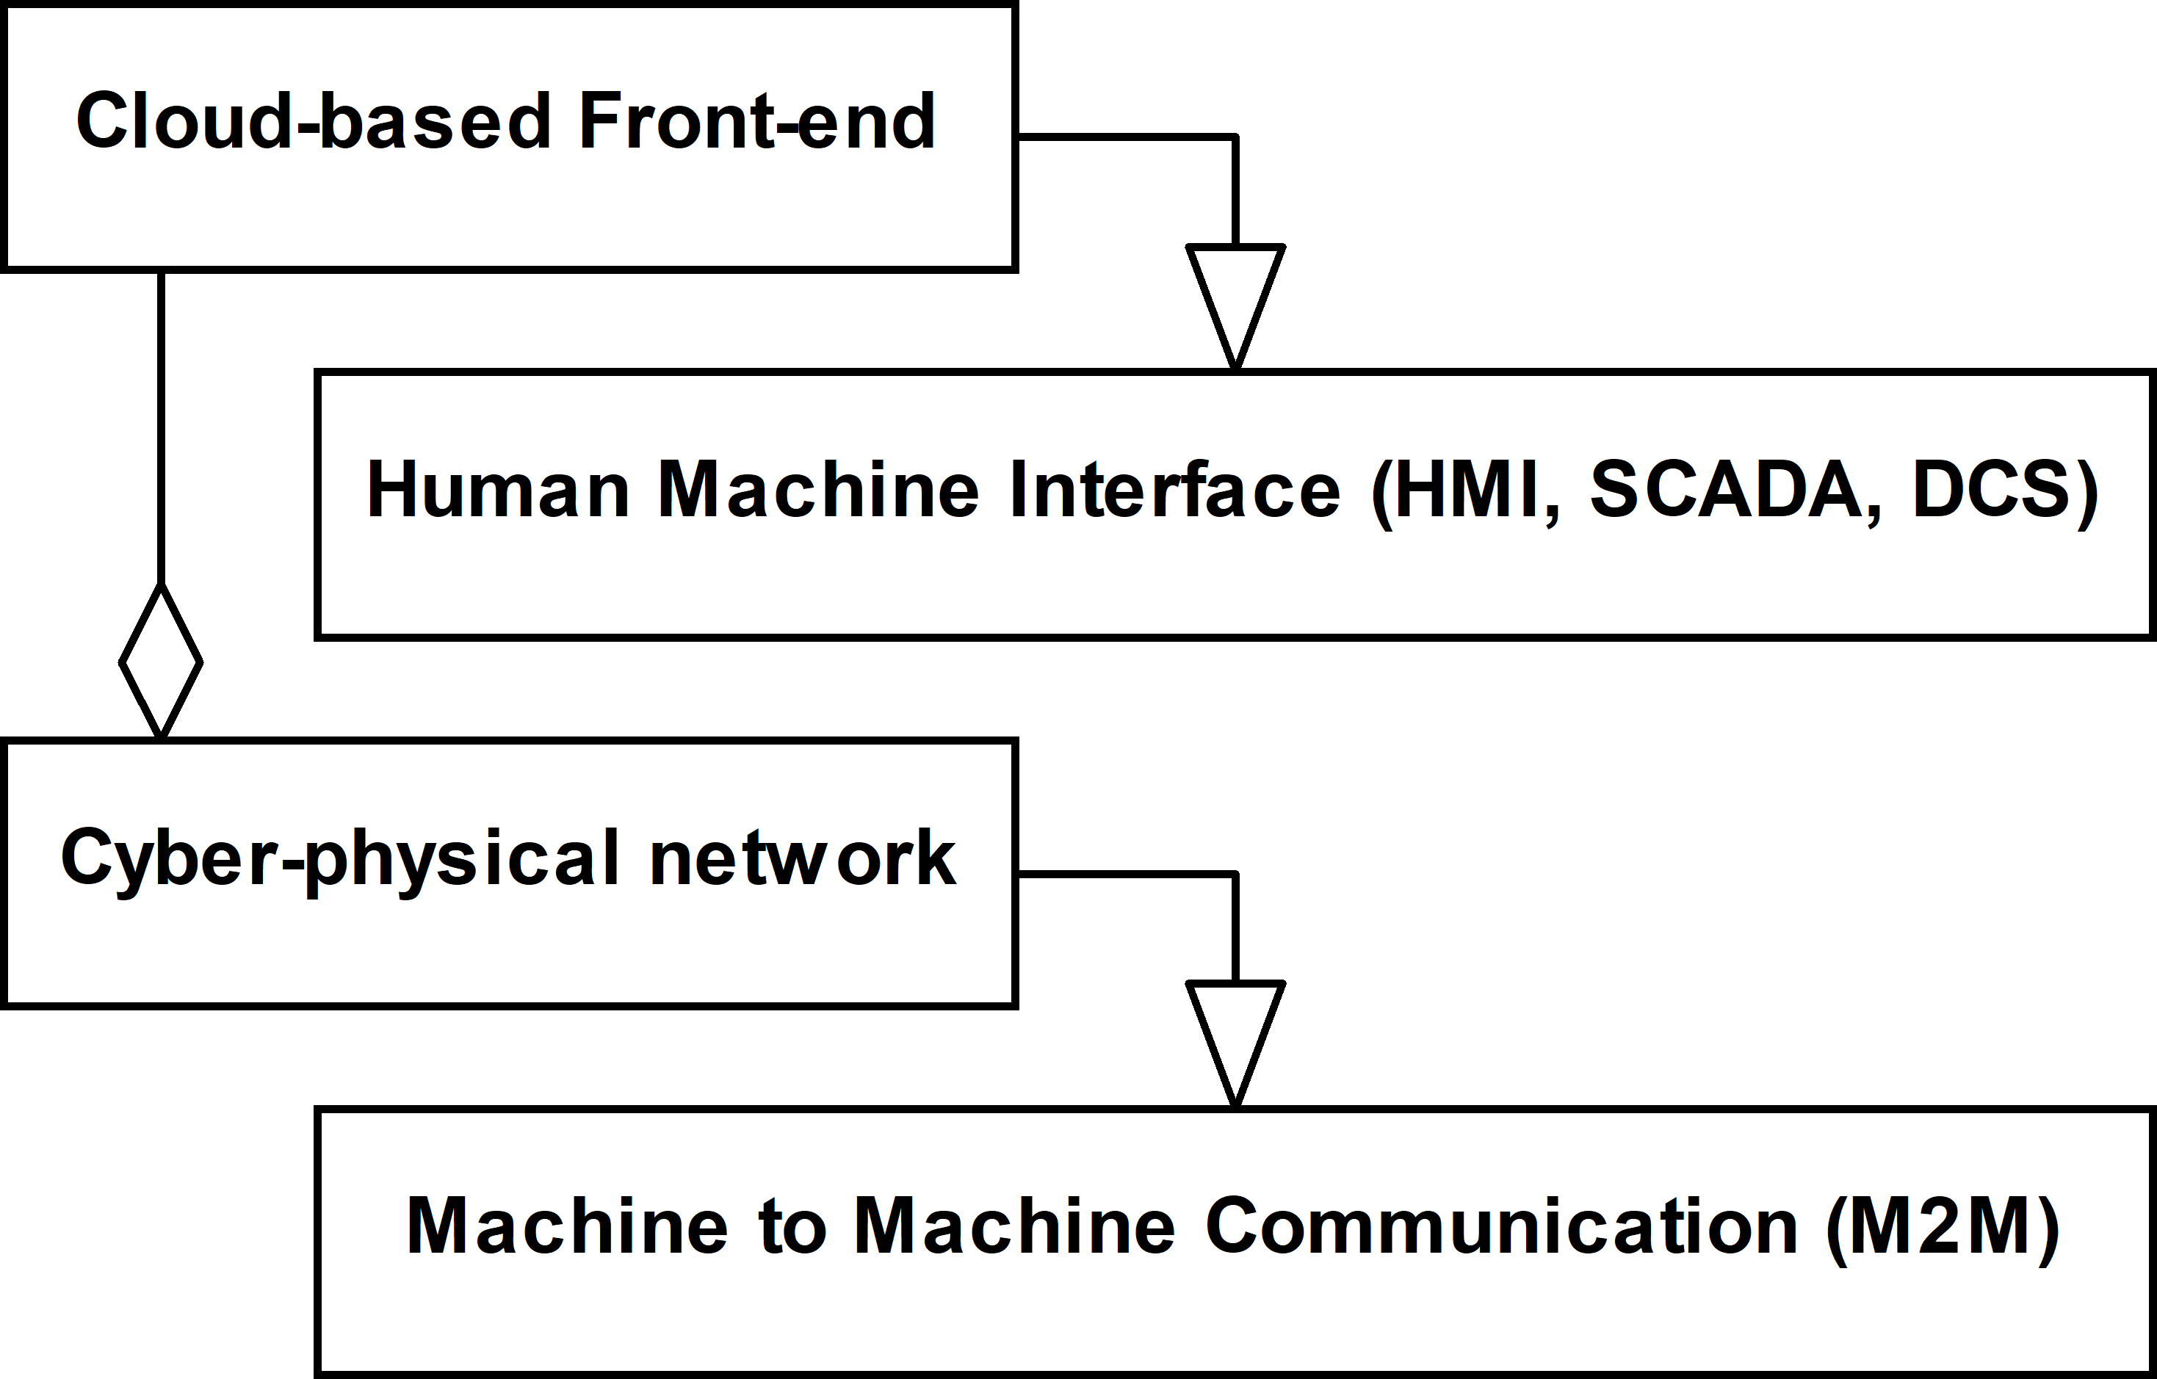
Direct Interconnection Interoperability Scenario

Slide 7
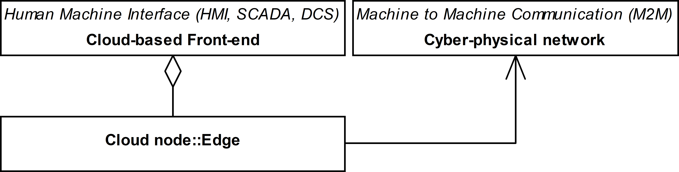
Edge Interconnection Interoperability Scenario

Slide 8
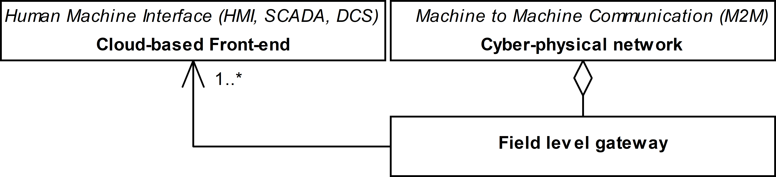
Field Level Gateway Interoperability Scenario

Slide 9
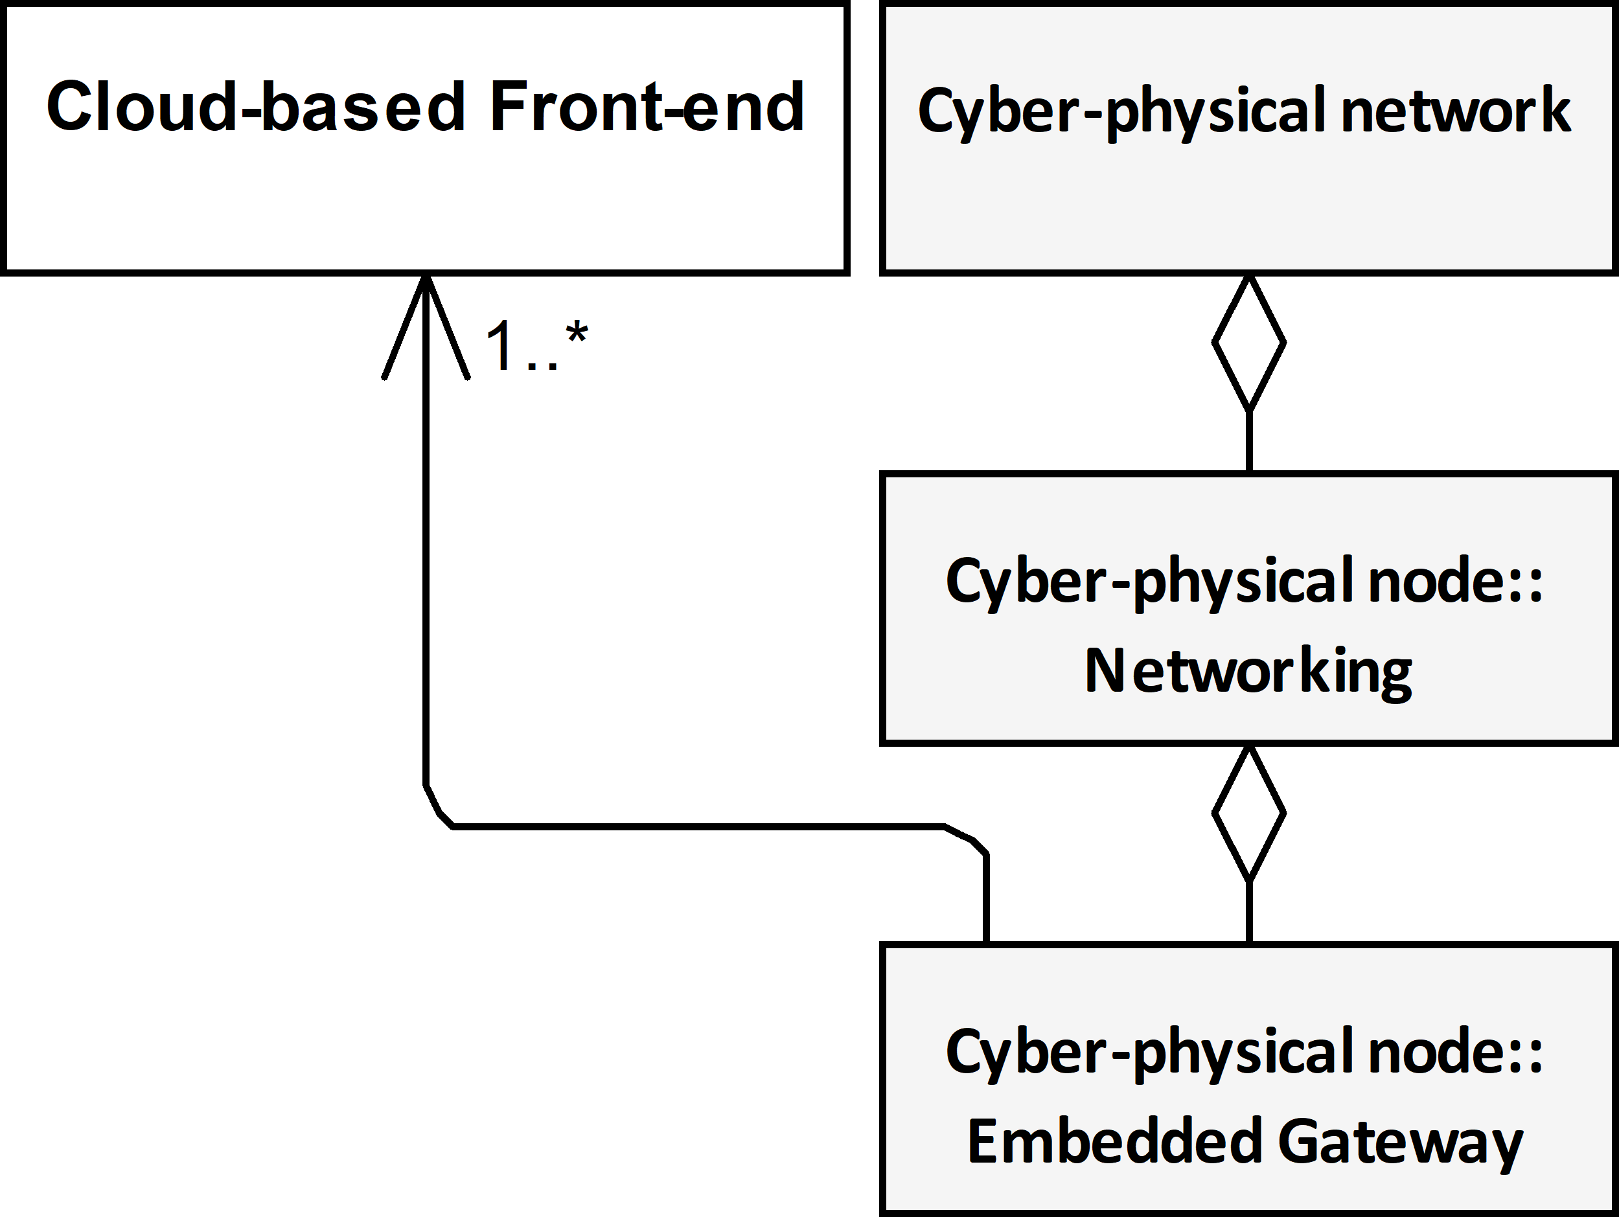
Embedded Gateway Interoperability Scenario

Slide 10
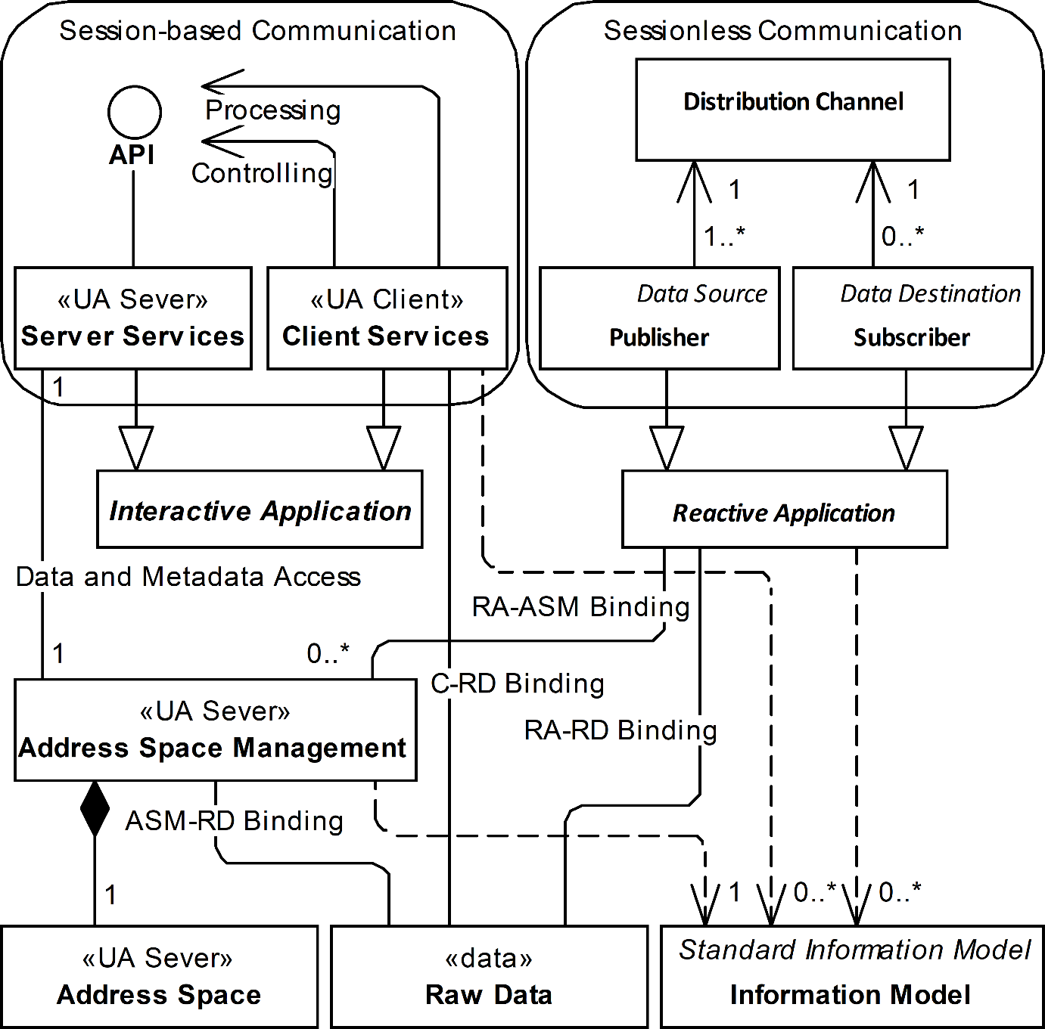
Sessionless (Reactive) vs Session Oriented (Interactive)

Slide 11
Observation
Only reactive interoperability can be used to address:
network traffic asymmetry
limits of the network traffic propagation for the security reasons, for example, enforced by a firewall
data holder mobility –
due to data origin mobility the network node may need to move from one attachment point to another losing its previous endpoint address
Notes:
This discussion can be concluded that only reactive interoperability can be used to overcome network traffic asymmetry and data holder mobility. Therefore the further work is concentrated on this communication scenario. Still, reusability of the existing concepts and solutions must be concerned.

Slide 12
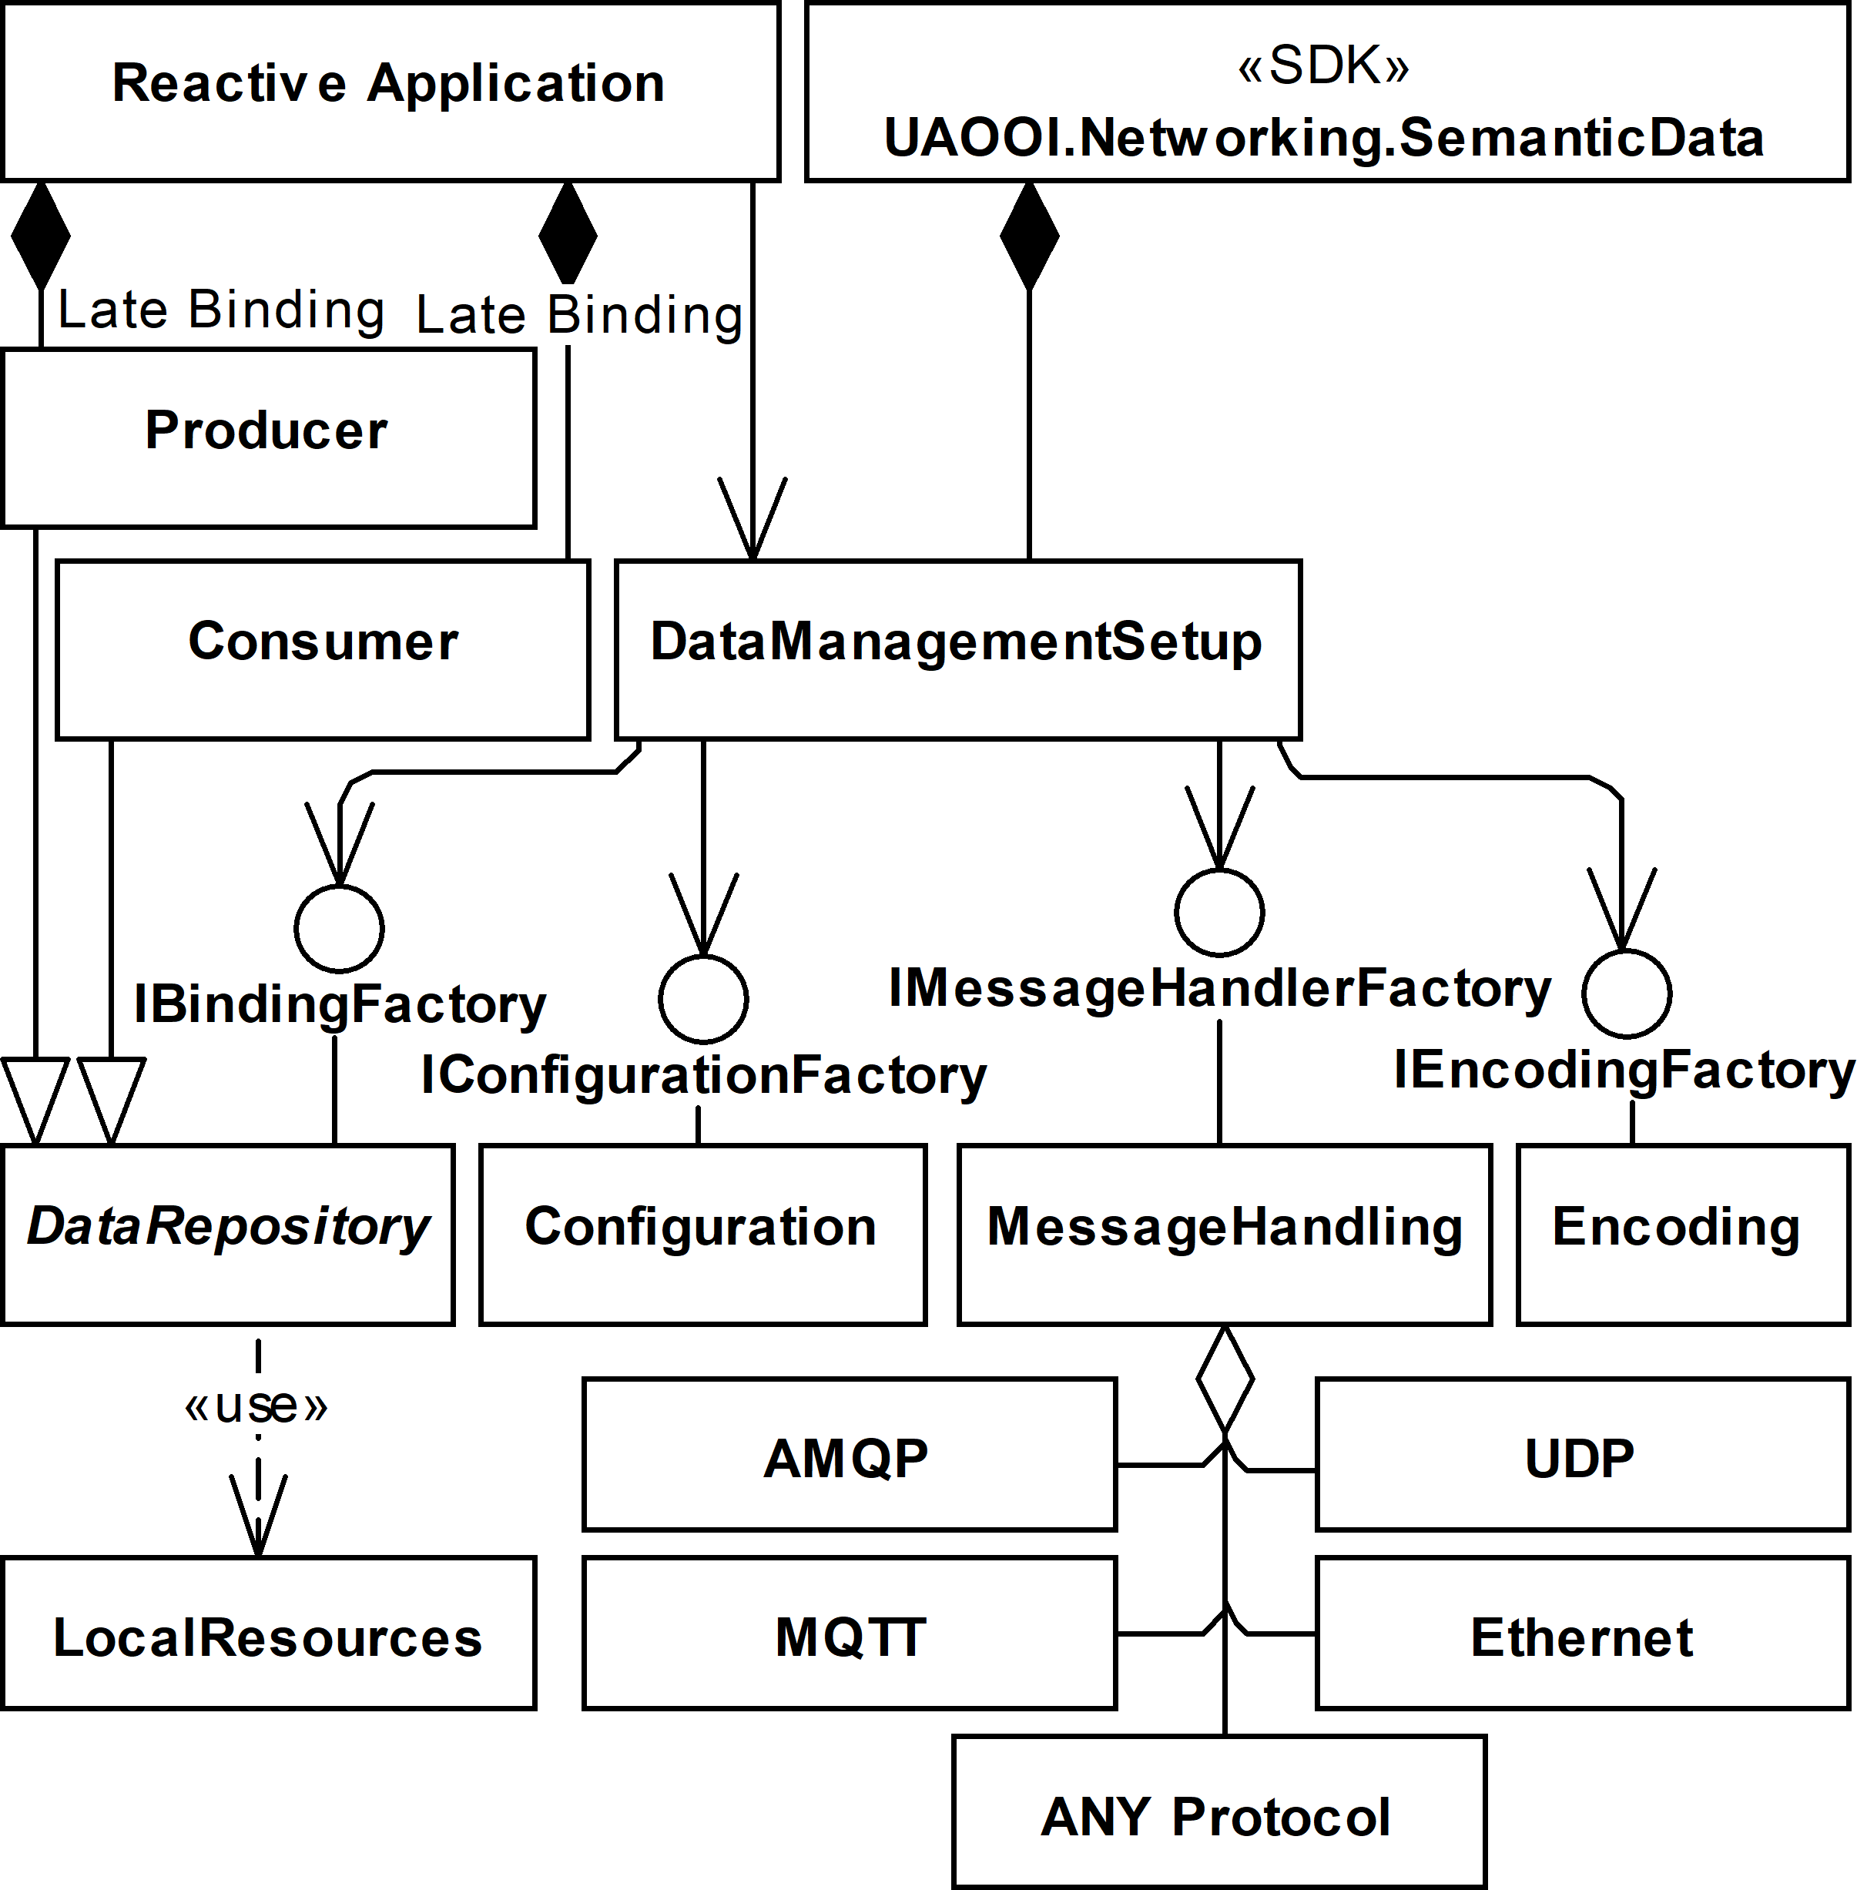
Reactive interoperability implementation

Slide 13
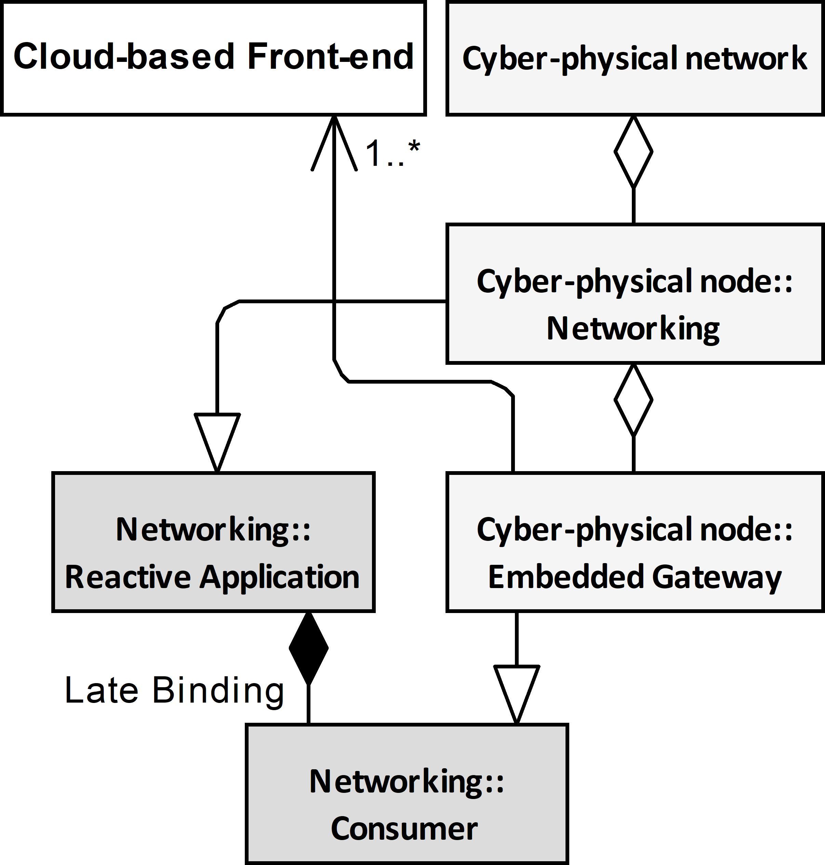
Implementation Domain Model

Slide 14
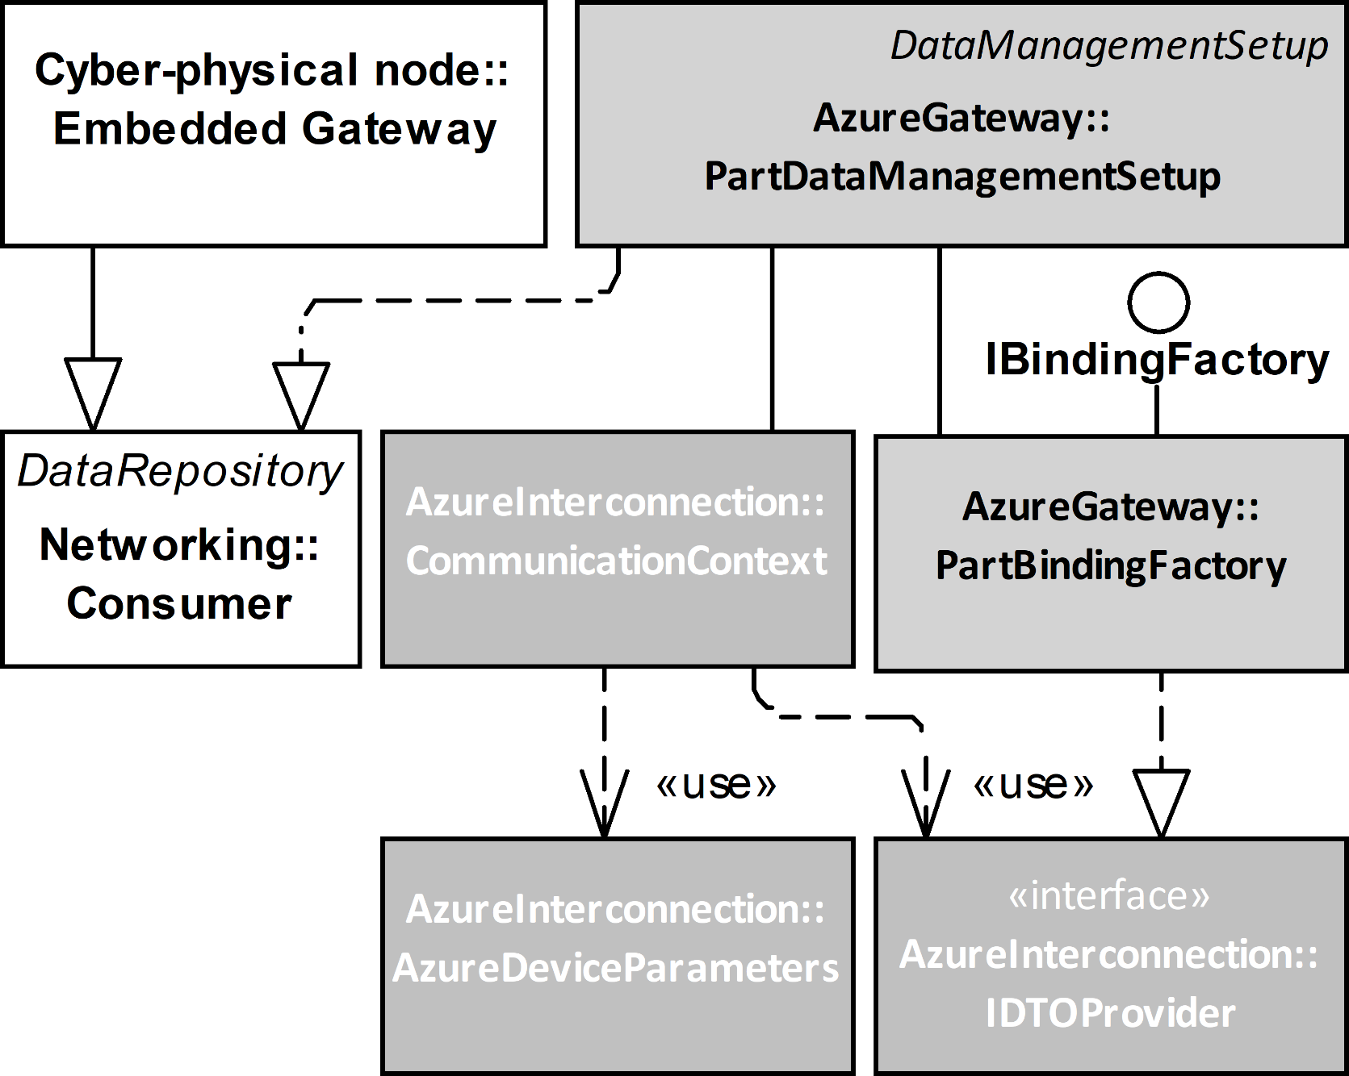
Implementation Architecture
PartBindingFactory: IDTOProvide
establish semantic context
data grouping
data mapping
data serialization (JSON)
factoring Data Transfer Object
CommunicationContext based on state machine
protocol selection
send Data Transfer Object to Cloud
security context
Out-of-band communictation
Notes:
Implementation contains two major components, namely CommunicationContext and PartBindingFactory.
PartBindingFactory is responsible to group and processing the data recovered from the messages exchanged over the network. Integrating these two different environments we must assume that metadata used to describe the data exchanged over the cyber-physical networks and the data exposed by the cloud solution are not compliant. For example, to be compliant with the specification the cyber-physical data exchange must be described using encoding required by the OPC Unified Architecture spec defined in parts 6 and 14 that offer a few incompatible alternatives. On the other hand, the cloud solution metadata may be described using Digital Tween Description Language that is also not stable. In other words, these two environment uses different domain-specific languages to describe syntax and semantics of the same process data. Therefore, based on the bitstreams meaning this class of the gateway must be also responsible to provide mapping at run time. The result of the mapping is converted to Data Transfer Object using JSON serialization. This Data Transfer object factoring mechanism must be conducted every time new data is to be sent to the cloud, but behavior implementation of the mapping may be considered as the design-time activity in a typical case.
CommunicationContext class sends the factored Data Transfer Objects using a communication channel established in advance. The Data Transfer Object is retrieved from the PartBindingFactory using the IDTOProvider interface.
The CommunicationContext maintains the data transfer channel with the cloud services using a well-known state machine pattern. It is responsible for protocols stack selection, authentication, and autorotation of a session created to establish a communication channel. The encoded JSON messages must be transferred to the cloud over the network using the selected protocol stack. The Azure supports HTTP, AMQP, and MQTT protocol stacks, which are all standard ones. It means that they have appropriate specification documentation. Consequently, it is possible to apply any available implementation compliant with an appropriate specification to achieve connectivity. In this case, all parameters required to establish connectivity and security contexts are up to the gateway's responsibility. Alternatively, the API offered by the dedicated frameworks (libraries) may be used. Using a framework, the configuration process may be reduced significantly, and the communication protocol selection has only an indirect impact on the interoperability features. In the proposed implementation, the Azure interconnection has been obtained using the above-mentioned frameworks.
Azure and PubSub use different security mechanisms so in the proposed solution establishing security-context is realized independently using the configuration. The CommunicationContext is responsible for establishing the connectivity and security contexts at the negotiation phase.

Slide 15
Implemenation – proof of concept
To promote and leverage
Reusability – using the same part in many scenarios
Flexibility
Interoperability in the multi-vendor environment
Deployment without programming
The following design patterns are applied
Separation of concerns
Dependency injection
Adaptive Programming
Standardization, i.e. OPC UA Part 14 PubSub
Notes:
It is a theory, just a set of assumptions that now we can use to propose a concrete implementation meeting the community expectation. I believe that a detailed description of the implementation is not relevant to us in contrast to an analysis of how to use the proposed domain model to make strategic design decisions and functionality distribution. From the above discussion we can learn that the main design decisions must concern reusability (it means using the same part in many scenarios), flexibility, interoperability in the multi-vendor environment, and last but not least deployment without programming.
To meet these requirements the mentioned on the scree design patterns have been used.
Separation of concerns - to allow independent development of the parts.
Dependency injection - to allow late binding of independently implemented parts.
Adaptive Programming used at the development and deployment stage to improve the adaptability of the program against changing the production environment.
Piece by piece integration of a cyber-physical system using multi-vendor products requires that machine to machine communication employs international standards as the interoperability foundation. Following the presented conclusions, OPC Unified Architecture Part 14 PubSub is selected in this respect. By design, this standard should support the required publisher-subscriber communication pattern, but it covers only partially the requirements of the applications concerned. Therefore, my proposals shall be recognized as far beyond the specification scope, although they are still compliant with the standard. Let me recall I propose to use type definitions as the principal to establish semantic and security context. It means reusability of the Information Model concept used by the session-oriented counterpart.

Slide 16
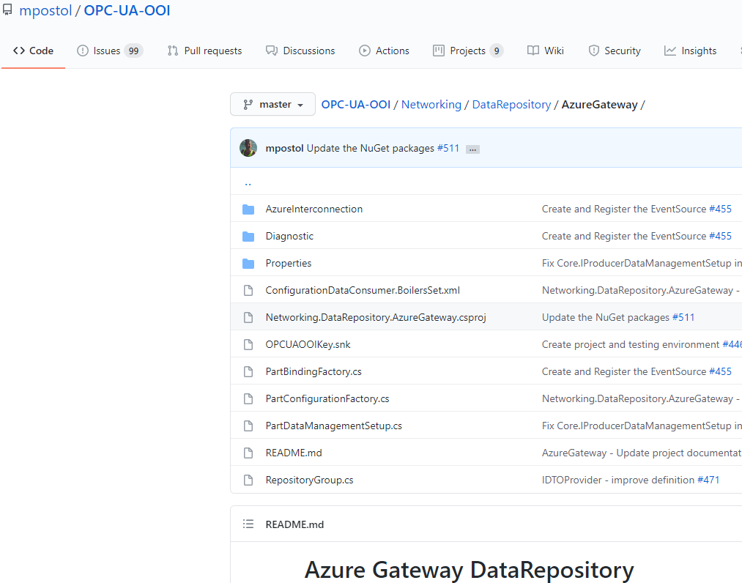
Proof of concept (pilot projects)

Slide 17
Conclusions and Further work
Process-Observer - machine to sensors connectivity
Attributed Data Transfer Object (TDO) – to control distribution channel behaviour
How to establish semantic/security context at run time
out-of-band communication
Semantic-data concept
Notes:
The results presented in the article prove that the composite nature of the disciplines concerned can be relaxed by the composite nature of the running programs and postponing parts binding up to the system deployment stage. It also improves flexibility and adaptability of the existing solutions against any modification of the production environment including but not limited to the selected interoperability standard change.
Future work will be focused on Machine to Sensors connectivity based on the Process-Observer concept. By design, it allows access to plant floor devices using a variety of Fieldbus industrial network protocols.
The next research direction is the usage of the Data Transfer Object to control the communication behavior using the attributes attached.
I am also going to investigate out-of-band communication to be used as a foundation for semantic and security context-maintenance at run-time.

Slide 18


Thank you
Notes:
Ladies and gentlemen, that's all, thank you very much for your attention. I hope the presentation was interesting and I didn't bore you. Interested persons, please contact me by email or phone. Once again, thank you for your attention and I invite you to cooperation.

