Slide 1
AJAX
Asynchronous JavaScript And XML

Slide 2
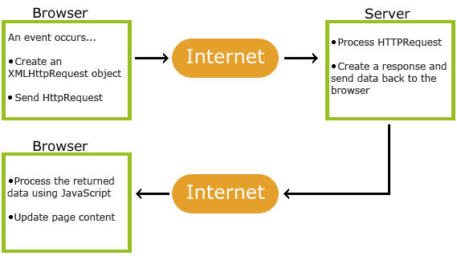
function loadDoc() { var xhttp = new XMLHttpRequest(); xhttp.onreadystatechange = function() { if (this.readyState == 4 && this.status == 200) { document.getElementById("demo").innerHTML = this.responseText; } }; xhttp.open("GET", "ajax_info.txt", true); xhttp.send(); }

Slide 3
XML
<?xml version="1.0" encoding="UTF-8"?> <CATALOG> <CD> <TITLE>Empire Burlesque</TITLE> <ARTIST>Bob Dylan</ARTIST> <COUNTRY>USA</COUNTRY> <COMPANY>Columbia</COMPANY> <PRICE>10.90</PRICE> <YEAR>1985</YEAR> </CD> <CD> <TITLE>Red</TITLE> <ARTIST>The Communards</ARTIST> <COUNTRY>UK</COUNTRY> <COMPANY>London</COMPANY> <PRICE>7.80</PRICE> <YEAR>1987</YEAR> </CD> <CD> <TITLE>Unchain my heart</TITLE> <ARTIST>Joe Cocker</ARTIST> <COUNTRY>USA</COUNTRY> <COMPANY>EMI</COMPANY> <PRICE>8.20</PRICE> <YEAR>1987</YEAR> </CD> </CATALOG>

Slide 4
function loadDoc() { var xhttp = new XMLHttpRequest(); xhttp.onreadystatechange = function() { if (this.readyState == 4 && this.status == 200) { myFunction(this); } }; xhttp.open("GET", "cd_catalog.xml", true); xhttp.send(); } function myFunction(xml) { var i; var xmlDoc = xml.responseXML; var table="<tr><th>Artist</th><th>Title</th></tr>"; var x = xmlDoc.getElementsByTagName("CD"); for (i = 0; i <x.length; i++) { table += "<tr><td>" + x[i].getElementsByTagName("ARTIST")[0].childNodes[0].nodeValue + "</td><td>" + x[i].getElementsByTagName("TITLE")[0].childNodes[0].nodeValue + "</td></tr>"; } document.getElementById("demo").innerHTML = table; }

Slide 5
<html> <head> <script> function showHint(str) { if (str.length == 0) { document.getElementById("txtHint").innerHTML = ""; return; } else { var xmlhttp = new XMLHttpRequest(); xmlhttp.onreadystatechange = function() { if (this.readyState == 4 && this.status == 200) { document.getElementById("txtHint").innerHTML = this.responseText; } }; xmlhttp.open("GET", "gethint.php?q=" + str, true); xmlhttp.send(); } } </script> </head> <body> <p><b>Start typing a name in the input field below:</b></p> <form> First name: <input type="text" onkeyup="showHint(this.value)"> </form> <p>Suggestions: <span id="txtHint"></span></p> </body> </html>

Slide 6
<?php // Array with names $a[] = "Anna"; // …… $a[] = "Vicky"; // get the q parameter from URL $q = $_REQUEST["q"]; $hint = ""; // lookup all hints from array if $q is different from "" if ($q !== "") { $q = strtolower($q); $len=strlen($q); foreach($a as $name) { if (stristr($q, substr($name, 0, $len))) { if ($hint === "") { $hint = $name; } else { $hint .= ", $name"; } } } } // Output "no suggestion" if no hint was found or output correct values echo $hint === "" ? "no suggestion" : $hint; ?>

Slide 7
JS Objects
var person = { firstName: "John", lastName : "Doe", id : [5566, 4234, 3423], fullName : function() { return this.firstName + " " + this.lastName; } };
person.lastName; person["lastName"]; var name = person.fullName(); name = person.fullName;

Slide 8
JSON JavaScript Object Notation
var myObj = {name: "John", age: 31, city: "New York"}; var myJSON = JSON.stringify(myObj); window.location = "demo_json.php?x=" + myJSON;
var myJSON = '{"name":"John", "age":31, "city":"New York"}'; var myObj = JSON.parse(myJSON); document.getElementById("demo").innerHTML = myObj.name;
<?php $jsonobj = '{"Peter":35,"Ben":37,"Joe":43}'; $obj = json_decode($jsonobj); echo $obj->Peter; echo $obj->Ben; echo $obj->Joe; ?>

Slide 9
Лабораторная 8
Создать страничку на которой по введённым данным будет получен определённый ответ от сервера.

