Slide 1

Overview of Retrieval models
University of Strathclyde
Dept. Computer and Information Sciences
Strathclyde-iSchool Research Group
Martin Halvey | Leif Azzopardi | Alexandros Ioannidis

Slide 2
Understanding different retrieval models

Slide 3
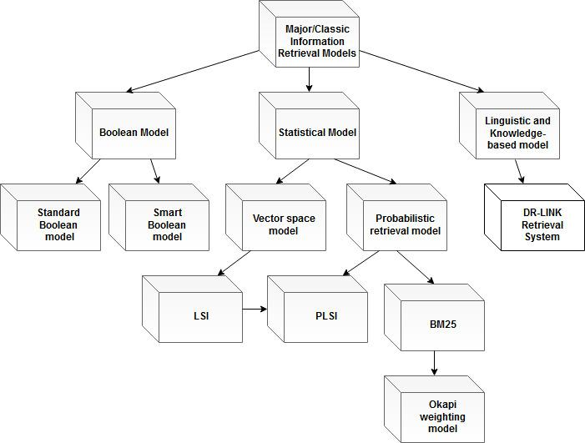
An overview of Retrieval models

Slide 4
Boolean Model

Slide 5
The model is supported by the occurrences of the query terms in the documents
The syntax of the Boolean retrieval is straightforward and structured and it lays its foundation in logical operations (AND, OR, NOT logical function) on terms.
It is also suggested that the syntax of the Boolean query could be expanded by adding
Proximity
Wild-cards
Field and sequence operators
The Boolean models consist the simplest form of ranking and have two possible results for query processing
True
or False
Some of the advantages and disadvantages of the Boolean retrieval model are
(+) the predictability of retrieved results and the various features included which is positive
(-) but also the query simplicity and the fact that it depends solely on the user.

Slide 6
Standard Boolean Model

Slide 7
The Standard Boolean model has as an objective to acquire
conceptual structure
and contextual information (Spoerri, 1993)
The model uses the common
Boolean operators
proximity and field operators
as well as stemming and trimming algorithms.
(+) Some of the advantages of this method is its easy implementation and the computational efficacy.
(-) However, this method has its own disadvantages, for example weighting index and query terms does not exist and also it is difficult to control the output due to the function of the Boolean operators

Slide 8
Smart Boolean Model

Slide 9
The smart Boolean model aims to structure the search of the formulation procedure.
The smart Boolean method utilises
Boolean topic representation
and various techniques to broaden and narrow queries (Spoerri, 1993)
(+) The advantages of the model is that there is no need for Boolean operators and helps users in query formulation.
(-) On the other hand, this method is associated with visualisation challenges such as conceptualising query representation

Slide 10
Statistical Model

Slide 11
The statistical models as the smart Boolean methodology make an effort to apprehend the entire meaning of the user's query, so as to not miss any relevant documents
Use of statistical information in the form of term frequencies to determine the relevance of documents with regards to a query
Statistical models produce as their output a list of documents ranked by their estimated relevance.
Statistical retrieval models address some of the problems of Boolean retrieval methods
(-) Structure to represent important linguistic features does not exist

Slide 12
Vector Space Model

Slide 13
A particularly famous information retrieval model is the VSM, which consists of a transformation function, a term weighting scheme and a similarity function
The vector space model utilises a vector in a multidimensional space of term weights for the construction of an index which will represent documents and queries. A collection of documents is represented by a matrix of term weights
The construction of the index includes lexical examination for the identification of important terms and morphological analysis such as stemming. Furthermore, the VSM does the ranking of documents by computing the cosine similarity, which is the distance between points depicting documents and query.
Additionally, the VSM sometimes can give a big ranking score to a document that has hardly any query terms, if these appear in the corpus uncommonly, but repeatedly in that document. The VSM makes two assumptions, the higher similarity a document and a query vector have, the higher the probability that the document answer the query

Slide 14
Latent Semantic Indexing/Analysis (LSI/LSA)

Slide 15
The model makes an effort to experiment with the dependence between terms
This allows to solve some challenges associated with accurate term matching
The model accomplishes better results than the VSM model and surpasses the problems associated with mapping studies and terms to vectors in the latent semantic space, according to term frequency
(Lee et al., 2010)
The model performs a method called feature extraction process of reducing the number of random variables that transforms the representation of documents and queries to their reduced latent space representation, which allows stronger appraisal of similarity
(-) The latent semantic space form used by the model is dense, this makes it challenging to index solely on distinctive dimensions. The latent topic dimension can not be selected to a discretionary number, because it is limited by the rank of the matrix (Hofmann, 1999)
(+) The model has ready to use implementations in software libraries such as 'scipy' and 'gensim'

Slide 16
Probabilistic Retrieval Model

Slide 17
The probabilistic retrieval models depend on the probability ranking principle
An information retrieval ranks the documents according to their likelihood of relevance to the query by considering all the evidence available (Belkin et al, 1992)
The probabilistic retrieval models utilise the statistical distribution of the terms in both the related and non-related documents and many other sources of evidence to rank documents (Spoerri, 1993)
The ranking of a document in probabilistic retrieval models considers the probabilities associated with the information need (Spoerri, 1993)
(+) Provide users with a relevance ranking of the retrieved documents and therefore this enables users to control the output by setting a relevance threshold or by specifying a certain number of documents to display

Slide 18
BM25 - Okapi Weighting Model

Slide 19
Is a bag of words retrieval function that ranks a set of documents based on the query terms appearing in each document
The BM25 weighting scheme is a group of retrieval and ranking models with slight variations
(Liu et al., 2009)
Focus on document scoring by considering both term frequency and document length. This type of probabilistic ranking models have been used in many document collections and favourably in TREC evaluation applications
The Okapi weighting model formula utilises the frequency of terms in documents, the length and the average length of documents in a collection, b scaling by text report length parameter, K1 variable for adjusting the term frequency of the text reports and several other tuning parameters including K2 and K3

Slide 20
Probabilistic LSI/LSA
(PLSI / PLSA)

Slide 21
The model was suggested as a solution that overcomes the shortfalls presented by the representation that LSA utilises
The PLSA model, is statistical model named aspect model. This model connects an unobserved class variable (z), with each observation a word (w) from all the observations of a statistical sample, such as a collection of words, with a class variable (d) from another sample such as a collection of observed documents
The PLSA model for indexing has two variations of the model the PLSI-U model and the PLSI-Q model
The PLSI-U model is a context-dependent unigram model to equalise the experimental word distributions in documents
The PLSI-Q is a latent space model which adds a low-dimensional document/query representation for the evaluation of similarities and allows the integration of several different models, but considering global term weights is partly answered by integrating the cosine similarity scores, which improves the accuracy of categorisation and speed of training
(-) PLSI often times suffers from overfitting due to the dimensionality of the p(z|d) parameter
(Hoffman, 1999)

Slide 22
Linguistic and Knowledge-Based Model

Slide 23
The linguistic and knowledge-based models depend on the existence of accurate distinct word strings as described by the logical depiction of the query (Spoerri, 1993)
These type of models often utilise artificial intelligence techniques and focus on implementing
Stemming
syntactic
and semantic examination
for retrieving documents effectively
and determine ambiguity connected with keyword-based retrieval (Spoerri, 1993)
An example of linguistic and
knowledge-based model is the DR-link retrieval system, which focuses on apprehending the conceptual level and understanding the meaning of the user's query by utilising linguistic text processing approaches

Slide 24
Comparison of different retrieval models

Slide 25
Boolean and Statistical Model

Slide 26
The disadvantage of the Boolean model is that it can only determine if the search query is relevant or not, and not the grade of relevance
Additionally, with the Boolean models it’s difficult to rank outputs and to perform relevance feedback.
Output documents of statistical models are ranked according to similarity (e.g. tf, idf) to query
Automatic relevance feedback with statistical models:
Related documents included to query
Non related documents extracted from query

Slide 27
Standard Boolean Model
and Smart Boolean Model

Slide 28
The standard Boolean model is easy to implement and computationally efficient and it is frequently used by large document databases
But the model does no
ranking
and no weighting of index and of query terms
The standard Boolean model is also associated with the challenge of building Boolean queries - users do mistakes when they form a Boolean query, because they go back to their knowledge of English
On the other hand with the smart Boolean model there’s no need for Boolean operators and there’s help with query reformulation for the user
The smart Boolean also uses narrowing techniques for the query

Slide 29
Vector Space Model and Probabilistic Retrieval Model

Slide 30
With VSM it’s difficult to identify the level of significance of words in a document
Additionally, it’s difficult to decide the level of similarity between a document and the query
The SVM provides partial matching and ranked results, misses semantic and syntactic information
The Probabilistic model ranks the output according to cosine and probability of relevance
With the probabilistic model the queries can be easier to formulate because users do not have to learn a query language and can use natural language.
The uncertainty inherent in the choice of query concepts can be represented with the probabilistic models

Slide 31
LSI and BM25

Slide 32
LSI associated with accurate term matching, has important disadvantages sometimes, because of the ambiguity often caused by not using precise words, individual distinctness in word usage and personal preferences
BM25 is an efficient retrieval model, and particularly efficient with the ad-hoc retrieval tasks especially for TREC collections
Generally the BM25 uses TF and IDF for its calculation
The BM25 however has nonlinear term-frequency saturation since it has an upper limit for term frequency (term significance)
But with some methods for document length normalization the BM25 often achieves even better performance than BM25 with TF-IDF

Slide 33
LSI and PLSI
LSA and PLSA

Slide 34
LSI maps terms and documents into a latent semantic space with SVD singular value decomposition but it lacks in terms of solid probabilistic foundation
PLSI models mapping each word in a document is drawn from a mixture model determined by multinomial random variables
Some of the advantages of the PLSA model is the factor representation and that it's statistical foundation since it depends on the Law of Likelihood (an accepted framework for defining published statistical evidence)
PLSA is more solid than the corresponding of LSA
The probabilistic model enables to systematically integrate a variety of models. Furthermore, the model utilises factor analysis, which enables effective handling of ambiguous words and allows to differentiate between a variety of meanings and kinds of word usage

Slide 35
Understanding how each model is performed (scoring)

Slide 36
Standard Boolean Model

Slide 37
Collection of actual documents A = {A₁ = bike, A ₂ = car, A₃ = metro}
Collection of terms T = {T₁ , T₂ , T₃ , T₄}
Collection of documents D = {D₁ , D₂ , D₃ }
D1 = {bike, car}
D2 = {car, bus}
D3 = {car, metro}
Let the query Q, Q = car AND bus
The following sets S₁ and S₂ of documents D_{i} are retrieved S₁ = {D₁, D₂, D₃} => S₂ = {D₂}
The the following documents Di are retrieved with regards to Q: {D₁, D₂, D₃} INTERSECTION {D2} =
{D2} This means that the actual document A ₂ (corresponding to D₂ ) is the correct answer to Q.

Slide 38
Smart Boolean Model

Slide 39
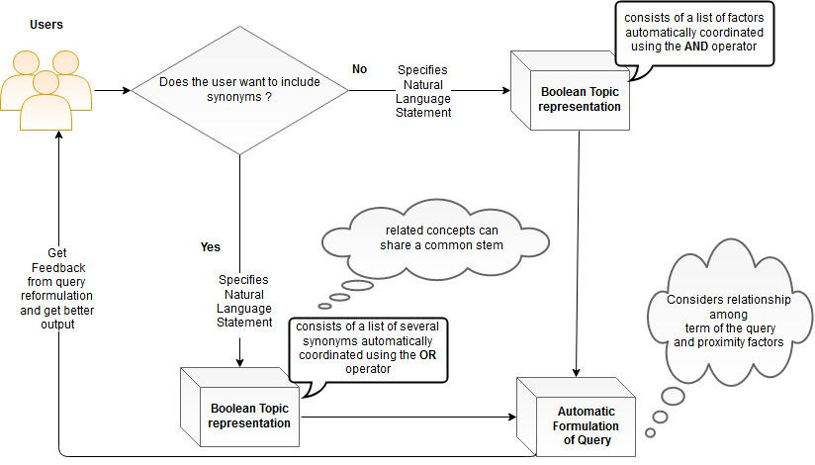
The smart Boolean model incorporates user interaction
which assists the improving process of better results

Slide 40
BM25

Slide 41
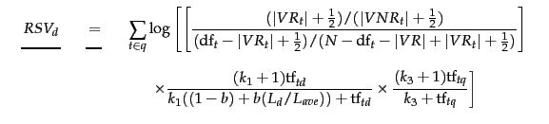

BM25
BM11 (for b = 1)
BM15 (for b = 0)
Okapi BM25
BM25F is a BM25 variation in which the document is considered to be composed from fields with different degrees of importance, term relevance saturation and length normalization
BM25+
Scoring Formulas
VR = { d ∈ V , R d , q = 1 } ⊂ R and VNR = { d ∈ V , R d , q = 0}, k₁ k₂ k₃ are tuning parameters, b controls length normalisation, tf: term frequency, idf: inverted document frequency
Additional free parameter δ for controlling training data

Slide 42
LSI

Slide 43
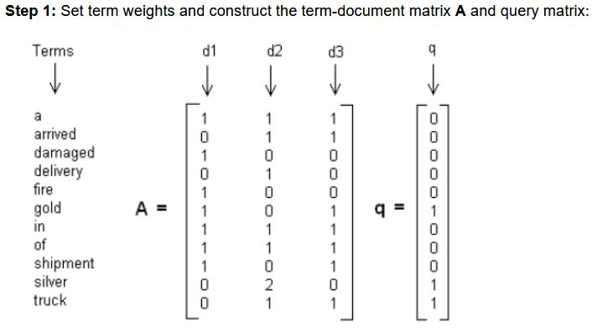
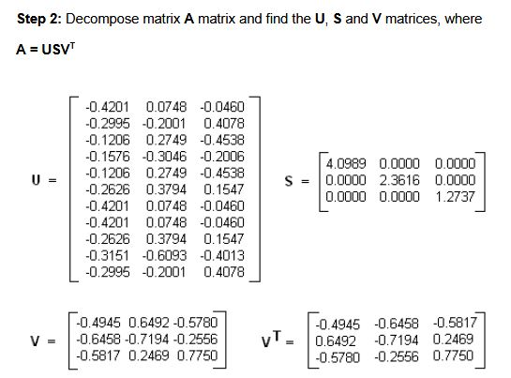
A “collection” consists of the following “documents”: Query: gold silver truck
D1 = Shipment of gold damaged in a fire
D2 = Delivery of silver arrived in a silver truck
D3 = Shipment of gold arrived in a truck

Slide 44
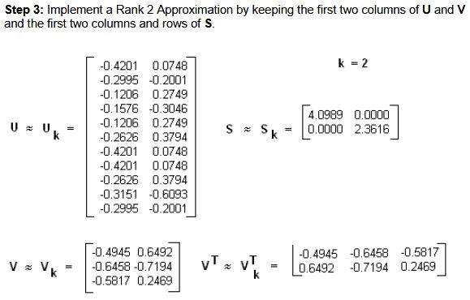
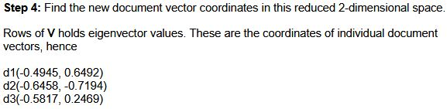

Slide 45
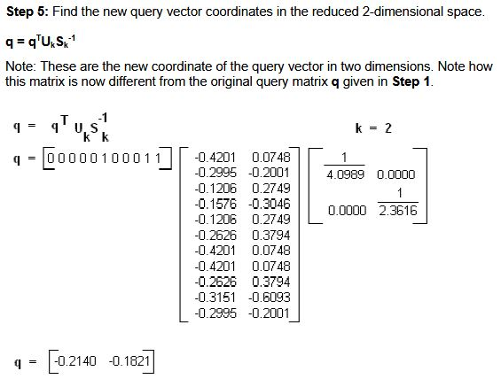
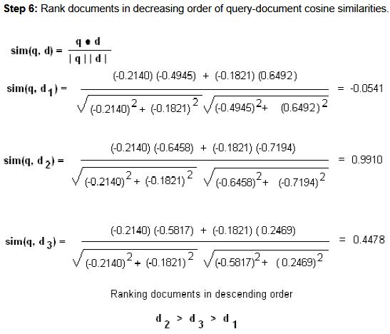
Example taken from
Grossman and Frieder’s
Information Retrieval, Algorithms and Heuristics

Slide 46
PLSI

Slide 47

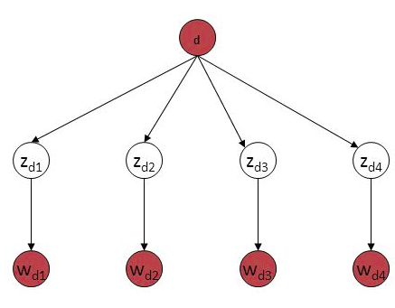
Each word in a document can be seen as
a sample from mixture model
Mixture model consists of
multinomial variables (depicting topics)
P(d,w) = p(d) Σ P(z) P(w|z)P(d|z)
Therefore each word of d is generated from a single topic z
Each document is depicted as a list of mixing proportions for these mixture variables/topics
d and w are observed variables, where d stands for the document index variable and w stands for a word drawn from the word distribution of this word’s topic P(w|c)
C a word’s topic drawn from the document’s topic distribution P(c|d) , topic c is a latent variable represented as z oftentimes
Z E Z
Expected Maximisation algorithm is used to learn maximum likelihood parameters of the model
d
c
w
N
M

Slide 48
Learning to Rank

Slide 49
Learning to rank methodologies are the ones that consist from the following constituents
Input
output
hypothesis space
and loss function (Liu et al., 2009)
Moreover, learning to rank techniques, are characterised by the subsequent properties
being feature based
and discriminatively trained
Being feature based means that all the records under consideration go through the process of feature extraction, where each document for a corresponding query is depicted as a feature vector - Being discriminatively trained, means that the learning process is implemented by machine utilising training data sets and connecting various features, without the need of a probabilistic framework, for showing objects and the accuracy of the prediction (Liu et al., 2009)
Examples of feature vector representation are the BM25 and PageRank score as well as the frequency of the query terms.
An advantage of feature-based methods when learning to rank, is that it allows the connection of multiple vectors, which assists the advancement of a retrieval model by considering it's output in every iteration

Slide 50
Methodologies of learning to rank

Slide 51
There are three different methodologies for learning to rank,
the pointwise methodology
the pairwise methodology
and the listwise methodology
consisting of four components each
input space
output space
hypothesis space
loss function

Slide 52
The pointwise methodology

Slide 53
Consists of the input space, which includes the feature vector of each document
The output space, which includes the level of relevance of each document
The hypothesis space, which includes the scoring functions that transform the input as a relevance prediction of each document (Liu et al., 2009)
Lastly, it also consists of the loss function which includes the regression, classification and ordinal loss.
However, the pointwise methodology has its own disadvantages, for example, it does not consider that a query can correspond to multiple documents

Slide 54
The pairwise methodology

Slide 55
The pairwise methodology, consists of the input space, which includes a pair of documents depicted as feature vectors
The output space includes the pairwise preference among each combination of documents
The hypothesis space containing bi-variate functions that produces the relative arrangement between the pair of documents (Liu et al., 2009)
It also consists of the loss function, which computes the discrepancy among the bi-variate functions of the hypothesis and the ground truth label output

Slide 56
The listwise methodology

Slide 57
The listwise methodology, consists of the input space, which includes the complete group of documents connected with a query
The output space, which includes the levels of relevance of all documents connected with the query or simply the ranked list of all documents.
Moreover, it consists of the hypothesis space, which includes the multivariate functions that predict the relevance of the documents
And the loss function, which considers for the calculation of difference both the positions of the records in the sorted list of all documents connected with the query and the ground truth archive

Slide 58
References - BibTeX
1. @inproceedings{lee2010empirical, title={An empirical comparison of four text mining methods}, author={Lee, Sangno and Baker, Jeff and Song, Jaeki and Wetherbe, James C}, booktitle={System Sciences (HICSS), 2010 43rd Hawaii International Conference on}, pages={1--10}, year={2010}, organization={IEEE} }
2. @inproceedings{hofmann1999probabilistic, title={Probabilistic latent semantic indexing}, author={Hofmann, Thomas}, booktitle={Proceedings of the 22nd annual international ACM SIGIR conference on Research and development in information retrieval}, pages={50--57}, year={1999}, organization={ACM} }
3. @article{liu2009learning, title={Learning to rank for information retrieval}, author={Liu, Tie-Yan and others}, journal={Foundations and Trends{\textregistered} in Information Retrieval}, volume={3}, number={3}, pages={225--331}, year={2009}, publisher={Now Publishers, Inc.} }
4. @inproceedings{spoerri1993infocrystal, title={InfoCrystal: A visual tool for information retrieval \& management}, author={Spoerri, Anselm}, booktitle={Proceedings of the second international conference on Information and knowledge management}, pages={11--20}, year={1993}, organization={ACM} }
5. @book{grossman2012information, title={Information retrieval: Algorithms and heuristics}, author={Grossman, David A and Frieder, Ophir}, volume={15}, year={2012}, publisher={Springer Science \& Business Media} }
6. @inproceedings{hofmann1999probabilistic, title={Probabilistic latent semantic indexing}, author={Hofmann, Thomas}, booktitle={Proceedings of the 22nd annual international ACM SIGIR conference on Research and development in information retrieval}, pages={50--57}, year={1999}, organization={ACM} }

Slide 59

Thank you for paying attention

Slide 60

Contact
Martin Halvey
Leif Azzopardi
Alexandros Ioannidis
martin.halvey@strath.ac.uk
leif.azzopardi@strath.ac.uk
alexandros.ioannidis@strath.ac.uk
www.strath.ac.uk/science/computerinformationsciences/

