Slide 1
Workshops Attendance
Alexandros Ioannidis

Slide 2
Attended the workshop named Coding Dojo – “Surprise Kata” Wednesday, November 15, 2017, at 6:00 PM, JP Morgan 141 Bothwell Street, Glasgow, G2 7EQ
I
Ss
M
D
P

Slide 3
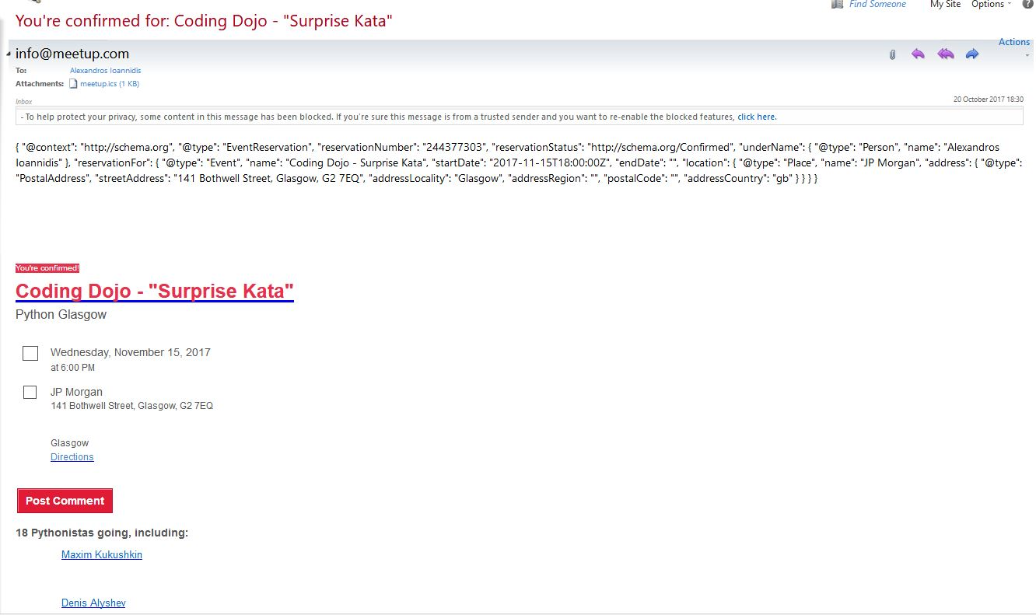

Slide 4
- SIAA 2017: 1st International Workshop on Investigating Social Interactions with Artificial Agents - Comparing human and machine recognition of children’s touchscreen stroke gestures - - -
Organisers: Thierry Chaminade, Fabrice Lefevre, Noël Ngyuen, and Magalie Ochs

Slide 5
Some of the concepts covered in the workshops include the following Issues that are causing delays or impending progress
Nonverbal communication (e.g. vocal behavior, forward posture, mutual gaze, nonverbal behavioural cues etc.)
Cues: (expressions, gaze, etc.), vocalisations, self-touching, distances, attractiveness
Codes: physical appearance, voice behavior, face behavior, space, enrollment, etc.
Functions: forming impressions, expression emotion, relational messages, deception management power persuasion
New social signals
The SSPNet Mobile Corpus, number of calls 60, number of subjects 120, avg length 11m: 48s, total annotated cues 16235, etc.
Time distribution across laughter, back-channel, silence, overlapping, etc.
Definition of measuring behavior
Cues and gender differences (female and male comparisons)
Role differences (cues)

Slide 6
Subjects invest around 25% of their time in nonverbal communication during speech disposition
Non verbal cues account for at least two major social dimensions (gender and role)
Non verbal communication is predictive of the main outcome of the interactions
The Chat Corpus, number of chats 30, number of subjects 60, avg length 3,980.4 keys, total annotated cues 20390, etc.
Occurrence distribution
Automatic Recognition
The PsychoFlickr Corpus
Composition
Multiple instance regression (e.g.Cluster regression, kNN, naïve bayes, etc)
Pictures appear to act as social signals
Significant correlations between low-level visual features and personality traits
Possible to predict the personality traits using low-level visual characteristics

Slide 7
Social signals are the physical and machine detectable evidence of both social and psychological phenomena
Automatic detection and interpretation of social signals make machines socially intelligent
Some models seem to apply not only to natural cues but also to artificial ones generated in new interaction contexts
Multisense Automatic Sensing of Multimodal Behaviours
OpenFace Toolkit
Health Behavior Informatics
Multimodal Machine Learning
Technologies for Healthcare Decision Support (multisense, report, clinicial, SimSenser, etc.)
Behavioural Indicators of Psychological distress, distress assessment interview corpus (DAIC)
Scientific discoveries, Negative Expressions PTSD vs Non-PTSD
Speech patterns – behavior indicators (e.g. first person pronouns, voice tenseness, etc.)
Core challenges in Multimodal Machine Learning (representation, alignment, fusion, translation, co-learning) Joint Multimodal Representation

Slide 8
Speaker’s behaviors, Sentiment intensity (unimodal vs bimodal vs multimodal)
Methodology of human to human interaction and human to agent, multilevel analysis, build computational model for agent
Social signals: multimodal, dynamic, transient, various communicative functions: convey information about emotion, engagement, involvement, turn-taking, etc
Study about visual social signals (Smile, laughter, social).
Corpus-base approach Crowdsourcing
Study -> Validation of smile corpus in contect (Significant differences in appropriateness of the smiles for each scenario, identification of smile characteristics and what feelings these signal, validation of smiles
Another study on Effect of Smile: Impacts of ECA’s smiles on user’s perception of ECA’s social stances, user preferences, user jedgements, etc.
Additional Study on effects of smiles during an interaction
Interpersonal attitudes (an effective style that spontaneously develops or is strategically employed in the interaction between persons, colouring the interpersonal exchange in that situation)
The interpersonal circumplex – multimodal signals
Application of HCA priori, sequence mining algorithms (hierarchical clustering and apriori-like procedure, extract frequent temporal patterns

Slide 9
S

