Slide 1
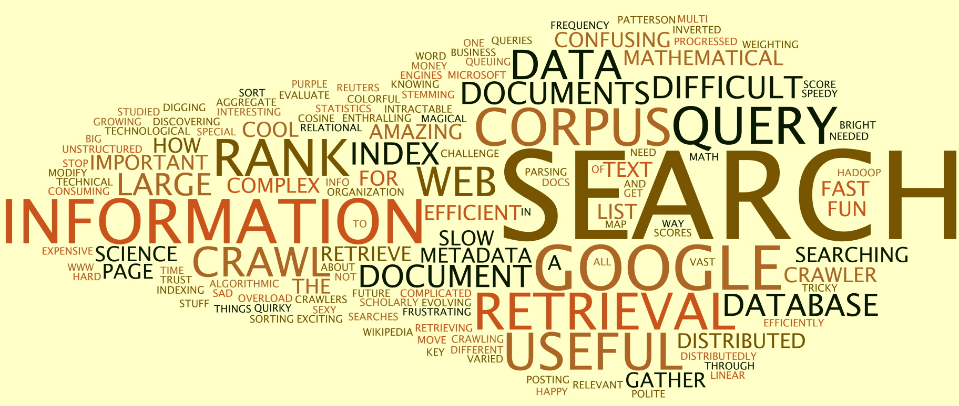



Information Retrieval and Machine Learning for Conducting Medical Systematic Reviews
Alexandros - PhD student since October
Supervisors: Dr Halvey & Dr Azzopardi

Slide 2
Understanding some of the different types of reviews

Slide 3
Systematic reviews
Systematic review process
Rapid reviews
Scoping reviews
Narrative reviews
Literature reviews
Cost & time of different reviews
Summary table
Living systematic reviews
Search strategy/protocol

Slide 4
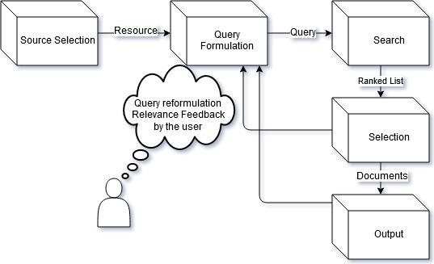
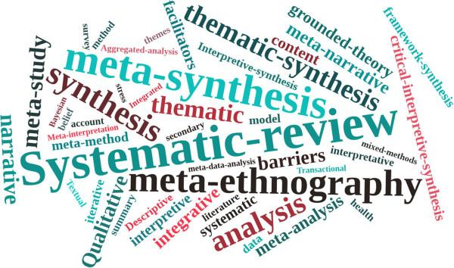
What are Systematic Reviews ?
Systematic review lifecycle
😒
Notes:
This is the question that your experiment answers

Slide 5
many definitions are given to systematic reviews

Slide 6
essay reviews, which are in accordance to 3 principles:
being stated evidently and in detail
being severely precise
and being diaphanous
(Greenhalgh et al., 2004)
a research procedure which produces a condensed presentation of a scientific concern
(Dr A K Akobeng, 2005)
an effort to establish the identity and worth of all observed facts also known as empirical evidence
(Cochrane Library, 2008)

Slide 7
objectives
to provide an entire and detailed summary of contemporary literature applicable to a research concern.
assist researchers in the strictness, range & depth of their literature reviews
(Mallet et al., 2012)

Slide 8
objectives
to provide an entire and detailed summary of contemporary literature applicable to a research concern.
assist researchers in the strictness, range & depth of their literature reviews
(Mallet et al., 2012)
provide a critical methodology encompassing critical thinking, search for evidence & advancing evidence-based health care (Glanville, 2016)
to protect the correctness of ethics of patient involvement in research (Glanville, 2016)
in the context of medical domain

Slide 9
Systematic review
components
objectives
to provide an entire and detailed summary of contemporary literature applicable to a research concern.
assist researchers in the strictness, range & depth of their literature reviews
(Mallet et al., 2012)
provide a critical methodology encompassing critical thinking, search for evidence & advancing evidence-based health care (Glanville, 2016)
to protect the correctness of ethics of patient involvement in research (Glanville, 2016)
The stages of systematic review are
approximately the same, some
definitions use and assign
slightly different descriptive
terms to corresponding stages
(ISJMI, 2007)
in the context of medical domain

Slide 10
Systematic Review Process
Step 1
Step 2
Step 3
Step 4
Step 5
Query Formulation
user’s new query is transformed to structured query and it’s used by the search engine in the next step
Retrieval for screening
focuses on how the information retrieval system uses the queries to seek for studies
Ranking
rank the documents retrieved from the query in an ordered list according to relevance
Selection
determine the rank position reviewers will stop screening the documents to diminish the number of irrelevant studies reviewed
Results/Bias
connecting the results
&
reporting the findings associated with bias

Slide 11
disadvantages of
systematic reviews

Slide 12
an adequate systematic review is a resource-demanding (time & cost) procedure (Mallet et al., 2012)
IPD* systematic reviews are an example of time & cost absorbing process (Stern et al., 1997)
* Individual participant data
cochrane and other SRs have no acknowledged agreements for measuring the impact of research on the medical domain (Higgins et al., 2008)
public health employees had challenges to find relevant Cochrane reviews when searching The Cochrane Library/other electronic databases (PubMed) (Costello et al., 2014)

Slide 13

What are Rapid Reviews ?
😒
Notes:
This is the question that your experiment answers

Slide 14
a form of knowledge synthesis in which components of the SR process are excluded to produce awareness in a timely manner
(Tricco et al., 2015)
Literature is discovered through extensive searching & results are key messages & recommendations

Slide 15
goals of rapid reviews

Slide 16
have an accurate, diaphanous & explicit process, with recenct & useful results
(Grant et al., 2014)

Slide 17
constraints of rapid reviews

Slide 18
by shortening the conventional SR process the risk of bias increases
exclude older, negative, non-english articles, articles based on location & unpublished material -> significant data loss (Pittler et al., 2000)
REA* have short timescales making it more constraining to reformulate question/inclusion/exclusion criteria
*Relevance evidence assessments

Slide 19

What is a Scoping review ?
😒
Notes:
This is the question that your experiment answers

Slide 20
a literature review that aims to quickly map the relevant research in a field of interest
(Pham et al., 2014)
assess scope & breadth and they are less constrained & iterative
(The National Archives, 2014)
search is implemented on few bibliographic databases & in the
screening stage only electronically available texts
🔑
🔑
(Armstrong et al., 2011)

Slide 21
What is a Narrative review ?
😒
Notes:
This is the question that your experiment answers

Slide 22
Narrative reviews/Traditional reviews
research summaries lacking
explicit descriptions of SRs
no search strategy
broad questions examined
cover breadth &
include historical aspects
sometimes evidence-based
inferences
narrative reviews of the same study, produce conflicting results
screening stage has difficulties in the assessment & utility of the conclusions on the study
may be evidence-based but not useful scientific evidence
constraints
description
(Pae, 2015)

Slide 23

What are Literature reviews ?
😒
Notes:
This is the question that your experiment answers

Slide 24
Literature review
📖
Definition
an evaluative report of information found in the literature for a topic
(CQ University*, 2017)
Objective
answer what is
known so far
regarding a topic
Advantage
it’s descriptive
Constraint
it’s low-evidence type of review
Disadvantage
contains bias
no protocol &
no systematic steps
Challenge
hard to
reproduce it
(Ahmed Negida**, 2015)
*http://libguides.library.cqu.edu.au/litreview [Accessed 11/2017]
**https://www.slideshare.net/AhmedNegida/systematic-review-and-meta-analaysis-course-part-1 [Accessed 11/2017]

Slide 25
Understanding the differences between the reviews

Slide 26
Review of reviews
full systematic review with meta-analyses
Breadth of search
Critical appraisal
Cost
Time
Full systematic reviews
80k-120k £
Rapid reviews
20k-50k £
Quick scoping reviews
10k-30k £
Literature reviews
< 5k £
Narrative reviews

Slide 27
Summary Table
 | Study Question | Search Strategy | Inclusion/exclusion criteria | Study analysis | Synthesis
Systematic reviews | Often focused and clearly defined (e.g. clinical) | Systematic, Transparent, Systematic | Usually clear & explicit Defined a priori theoretical deduction | Yes (statistical analysis resources) | Usually quantitative But also qualitative plus meta-analysis
Rapid reviews | Focused & well defined (refining research question use of framework) | Limits are applied (e.g. time, language) | Screen search results according to parameters defined use of worksheet | Evidence summary tables (review tables) used to track important features of appraised studies | Descriptive summary of the findings
Scoping reviews | Often broad | Systematic and Transparent | Flexible | None / minor thematic comparisons | Typically qualitative
Narrative reviews | Sometimes broad in scope (collect supportive data for a viewpoint) | Usually it’s not specified, ad-hoc searches | Usually it’s not specified (no clear selection reasons) | Sometimes there are biases in study design | Usually qualitative summaries (may not be based on study quality)
Literature reviews | Usually a general topic (wide scope)or a specific question | Strategy not explicitly stated | It is not explicit and clear | synthesis matrix | existence of bias, may be influenced by the reviewers theories
10<T<18m
6m < T < 12m
2m<T<4m
2w<T<2m
1<T<2week

Slide 28

within 2 y of the publication of SRs, 23% are out of date
what are some model parameters that predict the periodic frequency that medical SRs should be updated ?
recency of studies
frequency of studies
time since first/last interaction with studies
only few SRs are updated within 2y of publication most are updated between the range of 2.5 and 6.5y

Slide 29
Search strategy
Objective: to have less irrelevant
studies included for review
various search strategies... ...general strategies, term selection strategies, specific strategies... ...incorporate different symbols, operators, functionality... implemented by libraries & individuals…

Slide 30
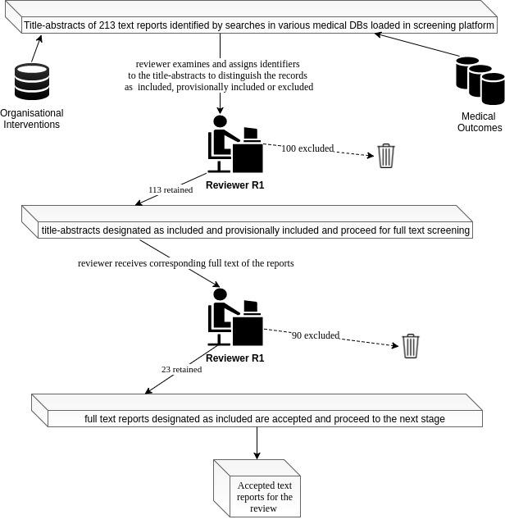
Design of a medical DB search strategy/protocol (single screening)

Slide 31
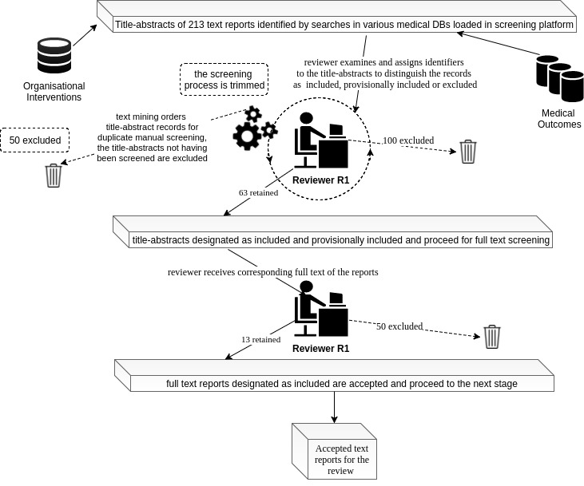
In a typical PubMed search strategy
5,000 potentially eligible documents are retrieved but only 250 (5%) will ultimately be deemed eligible
Design of a medical DB search strategy/protocol (single screening with text mining)

Slide 32
References - BibTeX (works cited)
1. @article{greenhalgh2004diffusion, title={Diffusion of innovations in service organizations: systematic review and recommendations}, author={Greenhalgh, Trisha and Robert, Glenn and Macfarlane, Fraser and Bate, Paul and Kyriakidou, Olivia}, journal={The Milbank Quarterly}, volume={82}, number={4}, pages={581--629}, year={2004}, publisher={Wiley Online Library} }
2. @article{akobeng2005understanding, title={Understanding systematic reviews and meta-analysis}, author={Akobeng, AK}, journal={Archives of disease in childhood}, volume={90}, number={8}, pages={845--848}, year={2005}, publisher={BMJ Publishing Group Ltd} }
3. @article{cochrane1, author={Cochrane Library}, title={About Cochrane Reviews. What is a systematic review?}, journal={Cochrane Handbook for Systematic Reviews of Interventions}, editor={Julian P. T. Higgins, Sally Green}, year={2008}, publisher={Wiley-Blackwell} howpublished = {\url{https://books.google.co.uk/books?id=NKMg9sMM6GUC&printsec=frontcover#v=onepage&q&f=false}}, note = {Accessed: 2010-09-30}
4. @article{baker2014benefits, title={The benefits and challenges of conducting an overview of systematic reviews in public health: a focus on physical activity}, author={Baker, Philip RA and Costello, Joseph T and Dobbins, Maureen and B. Waters, Elizabeth}, journal={Journal of Public Health}, volume={36}, number={3}, pages={517--521}, year={2014}, publisher={Oxford University Press} }
5. @article{karimi2010boolean, title={Boolean versus ranked querying for biomedical systematic reviews}, author={Karimi, Sarvnaz and Pohl, Stefan and Scholer, Falk and Cavedon, Lawrence and Zobel, Justin}, journal={BMC medical informatics and decision making}, volume={10}, number={1}, pages={58}, year={2010}, publisher={BioMed Central} }

Slide 33
6. @article{grant2014supporting, title={Supporting the Development of a New Health R\&D Strategy: A Rapid Review of International Theory and Practice for Norway's HelseOmsorg21}, author={Grant, Jonathan and Pollitt, Alexandra and Castle-Clarke, Sophie and Cochrane, Gavin and Sondergaard, Susanne and Horvath, Veronika}, journal={Rand health quarterly}, volume={4}, number={2}, year={2014}, publisher={The RAND Corporation} }
7. @article{tricco2015scoping, title={A scoping review of rapid review methods}, author={Tricco, Andrea C and Antony, Jesmin and Zarin, Wasifa and Strifler, Lisa and Ghassemi, Marco and Ivory, John and Perrier, Laure and Hutton, Brian and Moher, David and Straus, Sharon E}, journal={BMC medicine}, volume={13}, number={1}, pages={224}, year={2015}, publisher={BioMed Central} }
8. @article{pham2014scoping, title={A scoping review of scoping reviews: advancing the approach and enhancing the consistency}, author={Pham, Mai T and Raji{\'c}, Andrijana and Greig, Judy D and Sargeant, Jan M and Papadopoulos, Andrew and McEwen, Scott A}, journal={Research synthesis methods}, volume={5}, number={4}, pages={371--385}, year={2014}, publisher={Wiley Online Library} }
9. @article{khangura2014rapid, title={Rapid review: an emerging approach to evidence synthesis in health technology assessment}, author={Khangura, Sara and Polisena, Julie and Clifford, Tammy J and Farrah, Kelly and Kamel, Chris}, journal={International journal of technology assessment in health care}, volume={30}, number={1}, pages={20--27}, year={2014}, publisher={Cambridge University Press} }
10. @article{pittler2000location, title={Location bias in controlled clinical trials of complementary/alternative therapies}, author={Pittler, MH and Abbot, NC and Harkness, EF and Ernst, E}, journal={Journal of clinical epidemiology}, volume={53}, number={5}, pages={485--489}, year={2000}, publisher={Elsevier} }
11. @article{pae2015systematic, title={Why Systematic review rather than narrative review?}, author={Pae, Chi-Un}, journal={Psychiatry investigation}, volume={12}, number={3}, pages={417--419}, year={2015} }

