Slide 1
Agent-based intelligent sandbox design to deceive and analyze sophisticated malware
24-25J-025

Slide 2
Overview
Cybersecurity threats are evolving with sophisticated malware employing sandbox evasion techniques.
Traditional detection methods are reactive, identifying threats only after they have been observed in the wild.

Slide 3
Research Question
How can proactive detection methods be effectively implemented to identify malware within a sandbox environment?

Slide 4
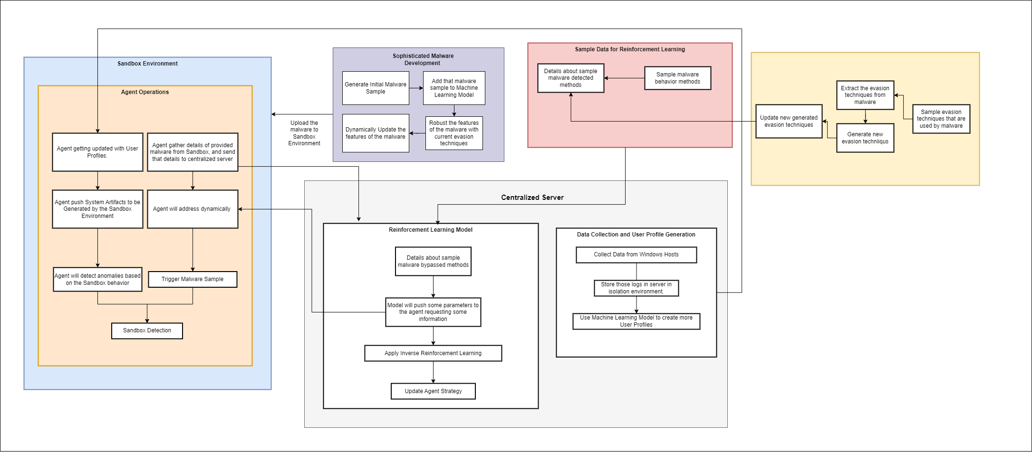
Overall System Diagram

Slide 5
Sub Objectives
Main Objective
To develop Reinforcement Learning (RL) Agent that dynamically adapt the sandbox environment (cuckoo) with the proactive detection methods, then the Cuckoo Sandbox can detect specific malware(s) that previously could not.
To Create specific malware(s) with robust evasion techniques and known evasion/malicious functionalities, so that it may bypass the cuckoo sandbox’s current detection techniques.
To develop a system that generates realistic and dynamic user behavior profiles to emulate user behavior within the sandbox environment.
Develop a VAE-based generative model to analyze and detect sandbox evasion techniques employed by malware and generate potential evasion strategies.
Develop an RL agent to dynamically modify the sandbox environment based on evasion strategies of specific malware.
IT21261046 | W.M.M.S.D.S. Perera | 24-25J-025

Slide 6

IT21261046 | W.M.M.S.D.S. Perera
Cyber Security
IT21261046 | W.M.M.S.D.S. Perera | 24-25J-025

Slide 7
Overview
Malware evasion techniques is keep getting robust, is a massive problem since the malware writers knows the sandbox environment and try to write malware that can adapt to sandbox checks and surprisingly bypassing them.
There is already lack of comprehensive studies that is focused on developing malware that can bypass advanced sandbox environments (like Cuckoo), especially using reinforcement learning (RL) [1].
Even though there is some researches based on Evasion techniques that is on the RL models, it is only tested against different types of detection models and commercialize AV [3].
IT21261046 | W.M.M.S.D.S. Perera | 24-25J-025

Slide 8
Research Problem
How to develop network and application level specific malware that can effectively evade detection by the
Cuckoo sandbox, utilizing RL to enhance the evasion capabilities dynamically?
Majority of this research components, based on the defensive approach. But the offensive approach is also much needed for the take a better idea
about whole research area/domain.
IT21261046 | W.M.M.S.D.S. Perera | 24-25J-025

Slide 9
Sub Objectives
Specific Objective
To Create specific malware(s) with robust evasion techniques and known evasion/malicious functionalities, so that it may bypass the cuckoo sandbox’s current detection techniques.
To manually develop specific network level and application level malware(s) with advanced evasion techniques.
To generate malware(s) with RL Model with provided malware samples.
To Fine tune the malware (both developed and sample) by enhancing the stealth and evasion techniques using RL Agent.
To check against the cuckoo sandbox environment to check effectiveness and have a feedback loop.
IT21261046 | W.M.M.S.D.S. Perera | 24-25J-025

Slide 10


Research Gap – From Lit Review
Research Paper | Check against the malware detection ML models | Manual Malware Development | Check against the Commercialize AV | Check against the Cuckoo Sandbox
MERLIN- Malware Evasion with Reinforcement LearnINg (2022)
An IRL-based malware adversarial generation method to evade anti-malware engines (2020)
Developing Stealth and Evasive Malware Without Obfuscation (2021)
Proposed Approach
IT21261046 | W.M.M.S.D.S. Perera | 24-25J-025

Slide 11
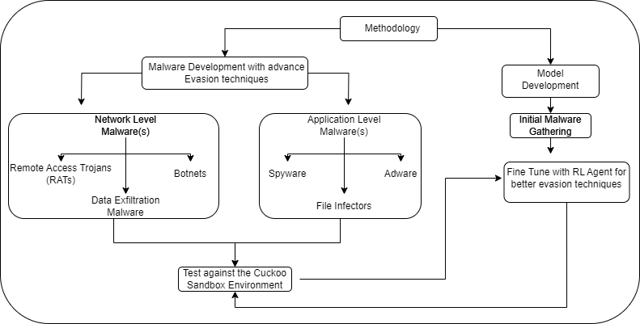
Methodology
P1p
P2p
There are two parallel processes when it comes to the high-level methodology of the research.
Developing malware manually with a predefined scope will give the advantage of knowing malware’s functionalities exactly.
With that known functionality, it can be easily checked against Cuckoo Sandbox and identify potential improvements.
The model development initially starts with a sample malware gathering process
Then those sample malware and the developed malware will be fine-tuned with RL agent and again tested with Cuckoo Sandbox.
IT21261046 | W.M.M.S.D.S. Perera | 24-25J-025

Slide 12
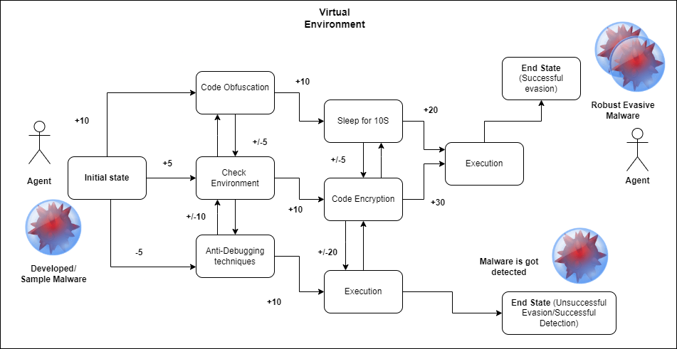
RL Agent Fine Tuning the Malware
IT21261046 | W.M.M.S.D.S. Perera | 24-25J-025

Slide 13
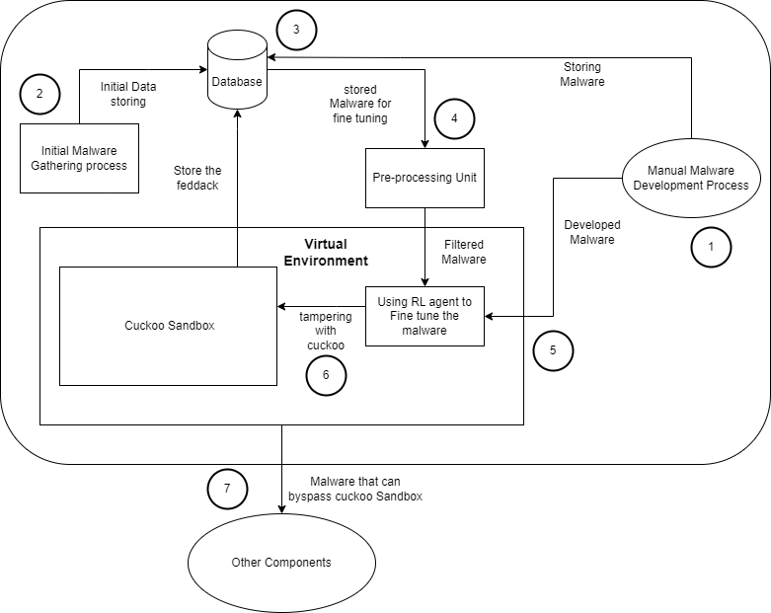
System Diagram
IT21261046 | W.M.M.S.D.S. Perera | 24-25J-025

Slide 14
Functional and Non-Functional Requirements
Functional Requirements
Non- Functional Requirements
Initial Malware Gathering Process (Data Collection, Meta-data Retrieval)
Database Management ( Storage, Retrieval, Update)
Virtual Environment Setup (Sandbox Configuration, Automation the setup)
Developing Reinforcement Learning Model (Develop, Fine-tuning, Co-existing)
Manual Malware Development Process
Cuckoo Sandbox Integration (Analyze malware, Detect and log sandbox techniques to analyze malware, Storing results)
Develop Feedback Loop (Store feedback and use feedback to refine and improve malware samples, Update RL Model based on Feedback)
Performance (Handling large number of malware samples, Optimization of RL tuning process to reduce computation time)
Scalability (Database must accommodate to growth, scale horizontally for most systems)
Security (Access Controls, Secure Storage and transmission of Malware samples)
Maintainability (Use of Version Control mechanisms, clean, modular and well-document code for manual malware development)
IT21261046 | W.M.M.S.D.S. Perera | 24-25J-025

Slide 15
Tools and Technologies
System and Personal Requirements
Reinforcement Learning (RL Agent)
TensorFlow or PyTorch
Scikit-learn and Pandas
Open AI GYm
Manual Malware Development
Cuckoo Sandbox
Reverse Engineering Tools (Ghidra /IDA)
IDEs (VS Code)
Programming Languages (Python, C/C++)
Data Collection and Management
Github Repositories
VirusTotal APIs
Database Systems (MongoDB / PostgreSQL)
System Requirements
High-performance computational environment with RAM and GPU support for RL Agent to train. Isolated environment (Malware Development Lab) for manual malware development.
Personal Requirements
Proficiency in Python, C/C++ languages.
Knowledge of malware development and evasion strategies.
Expertise in RL models and specially in Deep-Q Networks.
IT21261046 | W.M.M.S.D.S. Perera | 24-25J-025

Slide 16
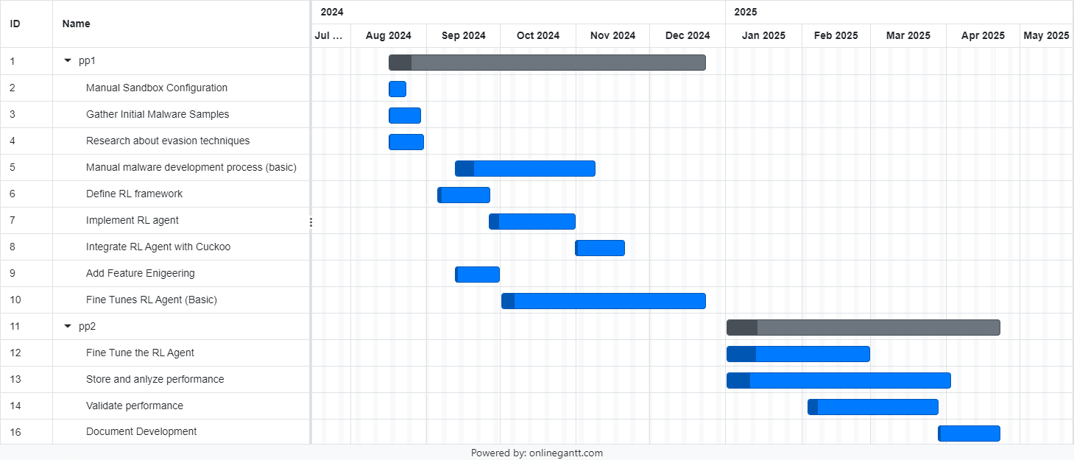
Gantt Chart (Time-line)
IT21261046 | W.M.M.S.D.S. Perera |

Slide 17
References
[1] X. Li and Q. Li, “An IRL-based malware adversarial generation method to evade anti-malware engines,” Computers & Security, vol. 104, p. 102118, May 2021, doi: 10.1016/j.cose.2020.102118.
[2] Koutsokostas, Vasilios and Patsakis, Constantinos (2021) Python and malware: Developing stealth and evasive malware without obfuscation.
[3] Quertier, Tony et al. (2022) Merlin -- malware evasion with Reinforcement Learning.
[4] Mohanta, A. and Saldanha, A. (2020) Malware analysis and Detection Engineering: A comprehensive approach to detect and analyze modern malware. Berkeley, CA: APress.
[5]Geng, J. et al. (2024) ‘A survey of strategy-driven evasion methods for PE malware: Transformation, concealment, and attack’, Computers &amp; Security, 137, p. 103595. doi:10.1016/j.cose.2023.103595.
IT21261046 | W.M.M.S.D.S. Perera | 24-25J-025

Slide 18

IT21261664 | dias m.a.s.s.a
Cyber Security
IT21261664 | Dias M.A.S.S.A | 24-25J-025

Slide 19
Realistic User Behaviour Simulation to Counter Sandbox-Evasive Malware
Modern malware often employs sandbox-evasion techniques to analyze the presence of user behavior[1].
If the malware detects an absence of genuine user interactions, it can identify that it is within a sandbox and alter its behavior to avoid detection[1].
IT21261664 | Dias M.A.S.S.A | 24-25J-025

Slide 20
Research Problem
How can realistic user behavior profiles with dynamic behaviour be generated, to enhance the realistic user behaviour within the sandbox environment ?
IT21261664 | Dias M.A.S.S.A | 24-25J-025

Slide 21

Research Gap – From Lit Review
Research Paper | User Behaviour Simulation | Dynamic Data Utilization | Generative Model Usage | Realism of Simulated Behaviour
Enhancing malware analysis sandboxes with emulated user behavior (2022)
User behavior simulation with large language model based agents(2023)
Investigating anti-evasion malware triggers using automated sandbox reconfiguration techniques (2020)
Proposed Approach
IT21261664 | Dias M.A.S.S.A | 24-25J-025

Slide 22
Main Objective & Sub Objectives
Main Objective
To develop a system that generates realistic and dynamic user behaviour profiles to emulate user behaviour within the sandbox environment.
Sub Objectives
To define the user profile schema.
To collect and preprocess diverse user behaviour data.
To design and train a variation of GAN model to generate realistic user behaviours.
To generate scripts using the generated user profile to simulate user behaviour.
To integrate generated scripts into the sandbox.
IT21261664 | Dias M.A.S.S.A | 24-25J-025

Slide 23
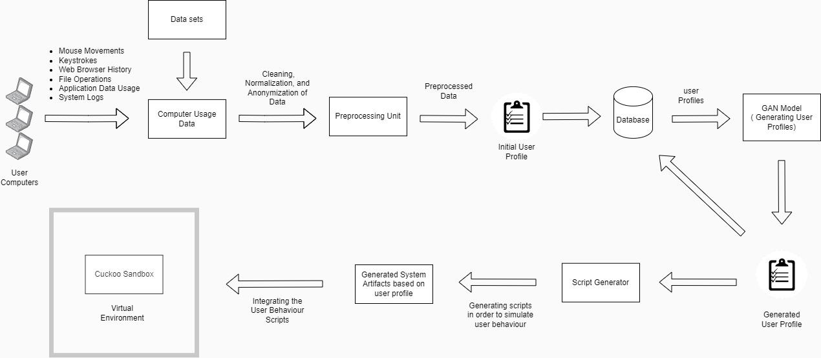
Methodology
IT21261664 | Dias M.A.S.S.A | 24-25J-025

Slide 24
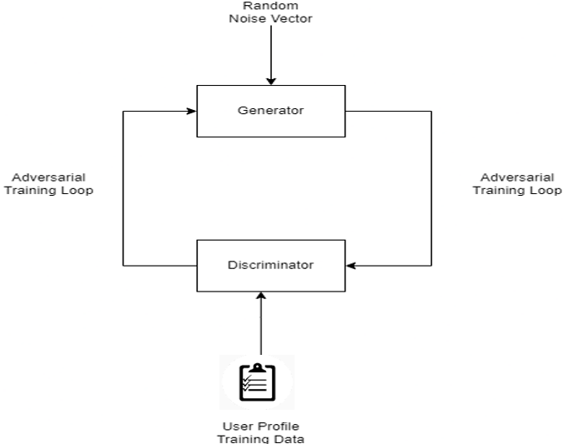
GAN Model
The User profile data is used to train the discriminator.
The Generator will generate the fake user profiles.
The Discriminator checks whether the data is fake or real.
The adversarial process continues until the Generator produces data that the Discriminator cannot reliably distinguish from real data.
IT21261664 | Dias M.A.S.S.A | 24-25J-025

Slide 25
Functional and Non-Functional Requirements
Functional Requirements
Non- Functional Requirements
Collect and preprocess user behavior data, including mouse movements, keystrokes, and application usage.
Define and generate user profiles using statistical analysis of the collected data.
Design and train a GAN model to generate realistic user behaviors.
Integrate generated user profiles into the sandbox environment.
Implement continuous updates and cleaning scripts to avoid detection by malware.
Performance (Ensure system performance and timely processing of user profiles).
Scalability (Design to handle increasing data and complex profiles).
Maintain high reliability and fault tolerance.
Security (Implement robust security measures to protect data and sandbox environment).
IT21261664 | Dias M.A.S.S.A | 24-25J-025

Slide 26
Technologies to be used
Data Collection and Preprocessing
Sysmon, Selenium, Python modules, Pandas, Numpy
Programming Language
Python
GAN model development
TensorFlow, PyTorch
Integration to sandbox
pywinauto for Windows GUI automation, PowerShell
IT21261664 | Dias M.A.S.S.A | 24-25J-025

Slide 27
System & Personal Requirements
System Requirements
High-performance computational environment with GPU support for training the GAN model.
Storage capacity to store the collected data.
Virtual environment to test the generated user behaviour.
Personal Requirements
Expertise in machine learning and deep learning, particularly in generative models.
Proficiency in Python, experience with scripting languages like PowerShell.
Experience with VirtualBox or VMware for creating and managing VMs.
Knowledge in malware analysis.
IT21261664 | Dias M.A.S.S.A | 24-25J-025

Slide 28
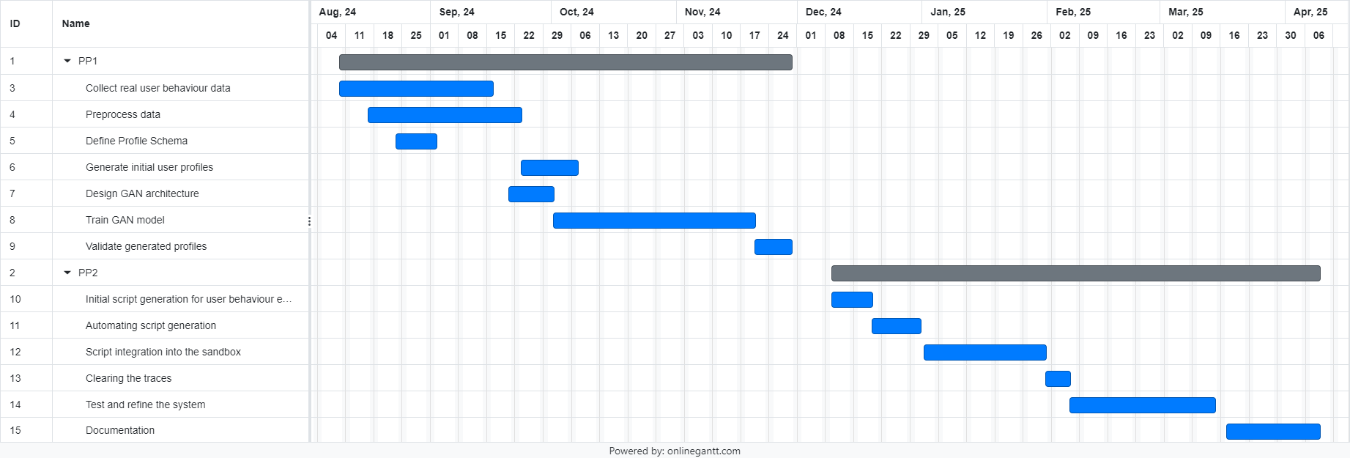
Gantt Chart
IT21261664 | Dias M.A.S.S.A | 24-25J-025

Slide 29
References
[1] S. Liu, P. Feng, S. Wang, K. Sun, and J. Cao, “Enhancing malware analysis sandboxes with emulated user behavior,” Comput. Secur., vol. 115, no. 102613, p. 102613, 2022.
[2] C. Xie et al., “EnvFaker: A method to reinforce Linux sandbox based on tracer, filter and emulator against environmental-sensitive malware,” in _2021 IEEE 20th International Conference on Trust, Security and Privacy in Computing and Communications (TrustCom), 2021.
[3] L. Wang et al., “User behavior simulation with large language model based agents,” arXiv [cs.IR], 2023.
[4] A. Dunmore, J. Jang-Jaccard, F. Sabrina, and J. Kwak, “Generative Adversarial Networks for malware detection: A survey,” arXiv [cs.CR], 2023.
[5] A. Mills and P. Legg, “Investigating anti-evasion malware triggers using automated sandbox reconfiguration techniques,” J. Cybersecur. Priv., vol. 1, no. 1, pp. 19–39, 2020.
IT21261664 | Dias M.A.S.S.A | 24-25J-025

Slide 30

IT21299452 | Dilhara W. M. A.
Cyber Security
IT21299452 | Dilhara W. M. A. | 24-25J-025

Slide 31
Developing a Generative Model to Analyze and Detect Sandbox Evasion Techniques Employed by Malware and Generate Potential Evasion Strategies
malware developers do not want their malware to be analyzed in isolated environments. Therefore, they design their code to detect virtual machine and sandbox environments and avoid executing malicious behavior while running in these isolated environments.
Agent Tesla remote access trojan (RAT) shuts down if it detects a sandbox environment as an example of malware sandbox evasion [1].
Malware authors are no stranger to code-reuse and cut&paste approaches[2].
IT21299452 | Dilhara W. M. A. | 24-25J-025
Notes:
My component focusing on "Developing a Generative Model to Analyze and Detect Sandbox Evasion Techniques Employed by Malware." This project represents an intersection of cybersecurity and machine learning, where we aim to enhance malware detection methods.
Malware developers are increasingly designing their malicious software to detect when it's running in a sandbox or virtual machine environment—places where we typically analyze malware. This detection allows them to avoid executing their malicious payload, which makes traditional analysis methods less effective.
For example, the Agent Tesla remote access trojan (RAT) is known to shut down if it detects a sandbox environment. Such evasion techniques pose a significant challenge to cybersecurity professionals who rely on sandboxing as a key defense mechanism.
Also most of those who create malware frequently use existing pieces of code from other malware or sources rather than writing new code from scratch
So In this project, I aim to address this challenge of sandbox evasion and advantage of code reuse

Slide 32
Research Question
Primary issue - Existing products and services in the malware detection domain focus primarily on identifying known threats and previously observed evasion tactics.
Problem Statement: How can a VAE-based generative model be utilized to both detect and generate sandbox evasion techniques employed by malware ?
IT21299452 | Dilhara W. M. A. | 24-25J-025
Notes:
Given this context, the core question driving my research is: "How can a VAE-based generative model be utilized to both detect and generate sandbox evasion techniques employed by malware?”
This question underpins the innovative approach of my project, focusing on not just detection but also the proactive generation of potential evasion strategies.

Slide 33


Research Gap
Research | Analyze & Detect Malware evasion techniques | Integrate with a sandbox for analyze | Comparative detection | Generating new potential evasion techniques
M. Ficco, "Malware Analysis by Combining Multiple Detectors and Observation Windows," June 2022 [3].
"Comparative Study of Detection and Analysis of Different Malware with the Help of Different Algorithm,2023”[4].
"On the Effectiveness of Perturbations in Generating Evasive Malware Variants, 2023”[5].
Proposed Approach
IT21299452 | Dilhara W. M. A. | 24-25J-025
Notes:
Most existing systems focus on identifying known evasion techniques only after they've been deployed in the wild. This leaves a significant gap on malware detection
As the draft shows some of these recent research are able to detect malware evasion but not in a proactive manner ,
Some are analyzing without integrating with a sandbox so their analyses are heavly limited in a dyanamic level
And our proposed approach will brige those gaps by covering all these areas

Slide 34
Specific and Sub Objectives
Specific Objective
Develop a VAE-based generative model to analyze and detect sandbox evasion techniques employed by malware and generate potential evasion strategies.
Sub Objectives
Data Collection and Preprocessing
Gather and preprocess a comprehensive dataset of known sandbox evasion techniques and malware behavior patterns.
Model Development
Design and train a VAE model to
Detection: Utilize the VAE to detect high reconstruction errors indicative of the evasion techniques.
Generation: Sample from the latent space to generate new evasion techniques.
Evaluation : Assess the model's performance using detection accuracy and generation quality
IT21299452 | Dilhara W. M. A. | 24-25J-025
Notes:
To tackle this challenge, I’ve outlined several sub objectives based on the main:
So as the specific aobjective I aim to develop a VAE-based generative model that can analyze and detect sandbox evasion techniques. And generate potential evasion strategies
And to brake down this
,First I will collect and preprocess a comprehensive dataset of known sandbox evasion techniques and malware behavior patterns.
Next, I will design and train the VAE model to detect high reconstruction errors indicative of the evasion technique of a malware sample
Then I will Sample from the latent space to generate new, potential evasion techniques
Finally, I’ll evaluate the model’s performance in terms of detection accuracy and generation quality.

Slide 35
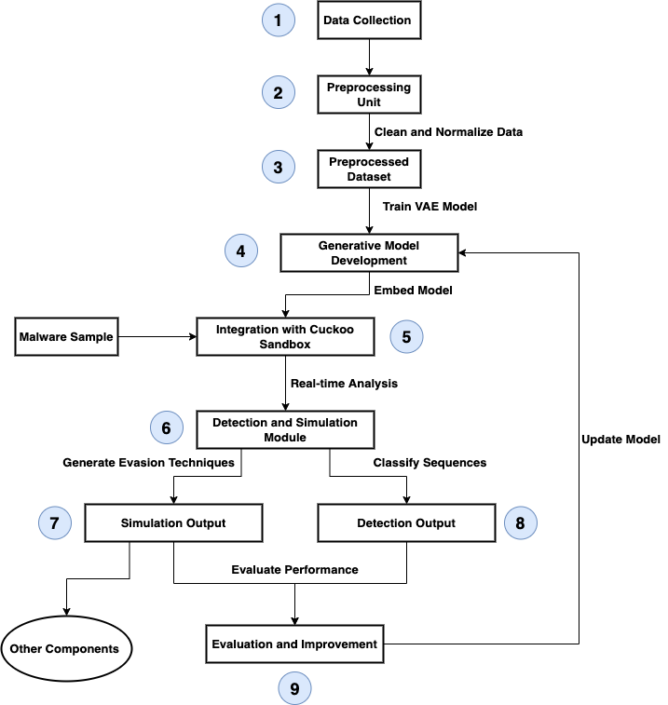
System Diagram
IT21299452 | Dilhara W. M. A. | 24-25J-025
Notes:
Here’s a high-level overview of the system architecture. At the heart of the system is the VAE model, which integrates with a sandbox environment like Cuckoo Sandbox.
The data collected by the system
Dynamic malware analysis consists of running a suspicious application inside a controlled and instrumented environment to observe and collect different aspects of the program behavior. The data collected by the system can then be used to look for evidence of malicious behavior, extract artifacts and indicators of compromise, or classify the sample in a particular class or malware family.

Slide 36
Functional and Non-Functional Requirements
Functional Requirements
Collected data should ensure consistency and suitability for model training.
The trained VAE model must be integrated into the Cuckoo Sandbox to work seamlessly in detecting evasion techniques
The trained VAE model should simulate potential sandbox evasion techniques used by malware.
Non-Functional Requirements
Proformance – Handeling of Large Datasets.
Scalability - Ability to accommodate complex models when traning.
Reliiability - The system must be highly reliable, with minimal downtime.
Usability - The interfaces for model training and integration should be user-friendly
IT21299452 | Dilhara W. M. A. | 24-25J-025
Notes:
To achieve the project’s objectives, several functional and non-functional requirements have been defined:

Slide 37
Technologies to be Used
Programming Languages
Python: For implementing the VAE model and data processing
Machine Learning Frameworks
TensorFlow or PyTorch: For building and training the VAE model.
Data Handling
Pandas and NumPy: For data manipulation and preprocessing.
Scikit-learn: For feature extraction and evaluation metrics.
Cybersecurity Tools
Threat Intelligence Platforms and Malware Analysis Tools: For data collection.
IT21299452 | Dilhara W. M. A. | 24-25J-025
Notes:
The technology stack for this project includes:
The choice of Variational Autoencoders (VAEs) is based on their ability to learn complex data distributions and generate new samples, making them ideal for both detecting and generating evasion techniques.
Python and its associated libraries are chosen for their robustness and extensive use in machine learning and cybersecurity research.

Slide 38
System, Personal, and Software Requirements Specification
System Requirements
High-performance computing environment with GPU support for training deep learning models, Storage capacity to handle large datasets of malware samples and evasion techniques.
Personal Requirements
Expertise in machine learning and deep learning, particularly in generative models.
Knowledge of cybersecurity and malware analysis techniques.
Proficiency in Python programming and data science tools.
Software Requirements
Operating System: Windows, Linux, or macOS
Python 3.x
TensorFlow or PyTorch
Pandas, NumPy, Scikit-learn
Matplotlib, Seaborn
IT21299452 | Dilhara W. M. A. | 24-25J-025
Notes:
These are the requirements in terms of system personal and software

Slide 39
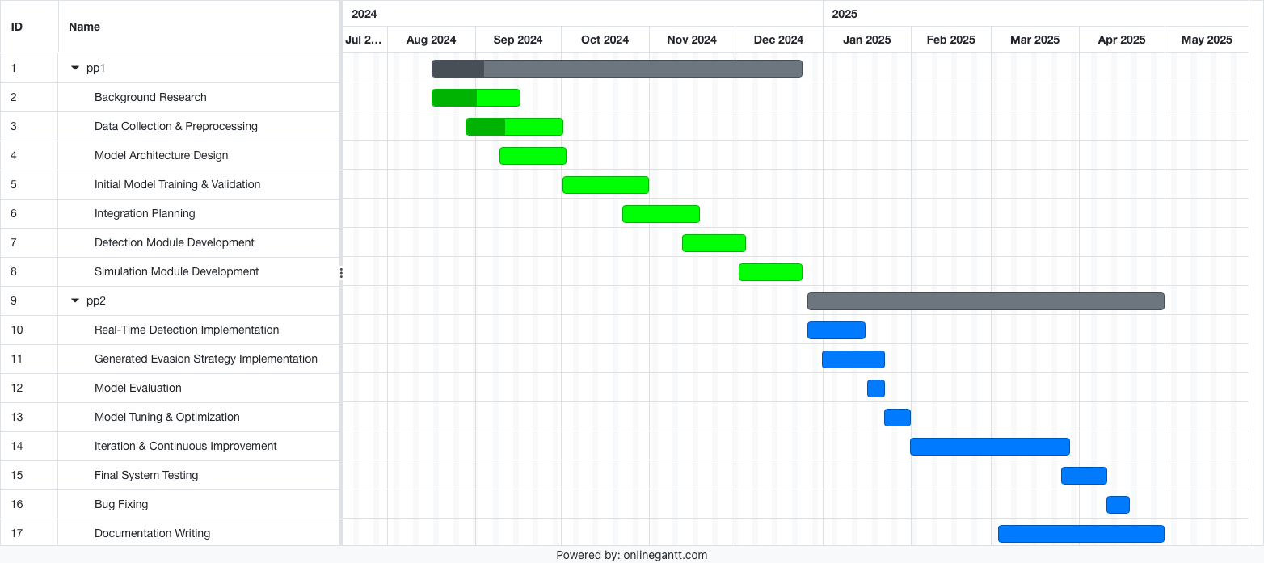
Completion of the project
IT21299452 | Dilhara W. M. A. | 24-25J-025
Notes:
And this is a chart of how I estimate the. Time for this project

Slide 40
References
[1] S. Gallagher and M. Picado, “Agent Tesla amps up information stealing attacks,” 02Feb2021.https://news.sophos.com/enus/2021/02/02/agent-tesla-amps-up-informati on-stealing-attacks/.
[2] S. Gallagher and M. Picado, “Agent Tesla amps up information stealing attacks,” 02Feb2021.https://news.sophos.com/enus/2021/02/02/agent-tesla-amps-up-informati on-stealing-attacks/.
[3] M. Ficco, "Malware Analysis by Combining Multiple Detectors and Observation Windows," vol. 71, no. 6, pp. 1276-1290, 1 June 2022, doi: 10.1109/TC.2021.3082002.
[4] P. A. Selvaraj, M. Jagadeesan, T. M. Saravanan, A. Kumar, A. Kumar and M. K. Singh, "Comparative Study of Detection and Analysis of Different Malware with the Help of Different Algorithm," 2023 International Conference on Computer Communication and Informatics (ICCCI), Coimbatore, India, 2023, pp. 1-6, doi: 10.1109/ICCCI56745.2023.10128452.
[5] B. Jin, J. Choi, J. B. Hong and H. Kim, "On the Effectiveness of Perturbations in Generating Evasive Malware Variants," in IEEE Access, vol. 11, pp. 31062-31074, 2023, doi: 10.1109/ACCESS.2023.3262265.
IT21299452 | Dilhara W. M. A. | 24-25J-025
Notes:
The references listed here provide the foundation for the project’

Slide 41

IT21300950 | VITHANAGE V. K. M.
Cyber Security
IT21300950 | VITHANAGE V. K. M. | 24-25J-025

Slide 42
A Reinforcement Learning agent to dynamically modify the behaviour of a sandbox based on specific malware samples
Modern malware employ variuos evasion strategies to hide their behaviour when inside a sandbox environment.
To detect malware in a sandbox environement, only reactive approaches have been applied.
The need of proactive approaches similar to adaptive sandbox environment is present in the industry.
IT21300950 | VITHANAGE V. K. M. | 24-25J-025

Slide 43
Research Question
How sandbox environments can be designed to dynamically modify their behaviour in response to the characteristics of specific malware samples with aid of an RL agent?
IT21300950 | VITHANAGE V. K. M. | 24-25J-025

Slide 44


Research Gap
Research | Malware detection and analysis | Use of Reinforcement Learning | Use of counter-evasion strategies | Use of an RL agent to modify the sandbox
“A Comparison Study to Detect Malware using Deep Learning and Machine learning Techniques,” (2023)
“Actor Critic Deep Reinforcement Learning for Neural Malware Control,” (2020)
“MERLIN - Malware Evasion with Reinforcement LearnINg,” (2022)
Proposed Approach
IT21300950 | VITHANAGE V. K. M. | 24-25J-025

Slide 45
Specific objective
Develop an RL agent to dynamically modify the sandbox environment based on evasion strategies of specific malware
Sub objectives
Conduct problem definition and requirement analysis
Structure the environment of RL agent with possible actions, rewards and states
Develop and train the RL agent
Execute performance test and analysis
Perform optimization and refinement of the agent
IT21300950 | VITHANAGE V. K. M. | 24-25J-025

Slide 46
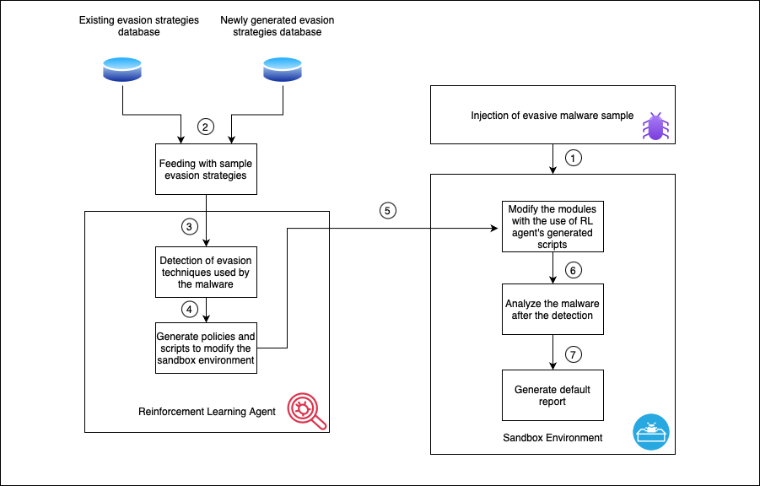
System Diagram
IT21300950 | VITHANAGE V. K. M. | 24-25J-025

Slide 47
Technologies to be used
Programming Languages
Python: For the implementation of RL agent
Reinforcement Learning framework
OpenAi Gym and Tensorflow: For the development and comparison RL algorithms
Sandbox environments
Cuckoo: To analyze malware
IT21300950 | VITHANAGE V. K. M. | 24-25J-025

Slide 48
System, Personal and Software Requirements Specification
System requirements
Memory: 16 GB RAM
Storage: Minimum 500 GB SSD/HDD
Processor: Multi-core CPU and optionally a GPU for training
Personal requirements
Proficiency in Python
Familiarity with RL concepts like policy, value functions and Q-learning
Software requirements
IDE’s: Visual Studio Code
Version Control: Github
Package management: pip
IT21300950 | VITHANAGE V. K. M. | 24-25J-025

Slide 49
Functional and Non-functional Requirements
Functional requirements
Non-functional requirements
Environment setup for the RL agent
Ability to explore and exploit skill of RL agent
Calculation of rewards and penalties for the agent’s actions
The system’s ability to train RL agent using the specified algorithm
Performance – Handling of large datasets and complex environments
Scalability – Ability to accommodate complex models when training
Usability – A user-friendly interface to configure the agent
IT21300950 | VITHANAGE V. K. M. | 24-25J-025

Slide 50
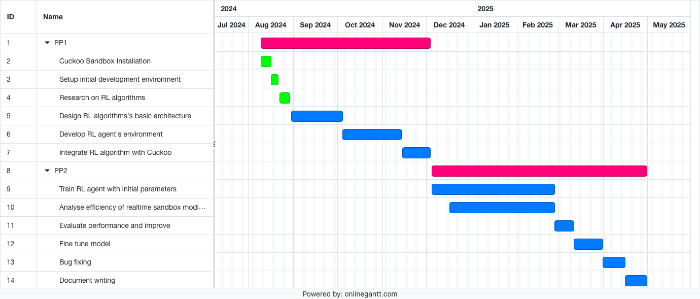
Gantt Chart
IT21300950 | VITHANAGE V. K. M. | 24-25J-025

Slide 51
REFERENCES
[1] B. Bokolo, R. Jinad, and Q. Liu, “A Comparison Study to Detect Malware using Deep Learning and Machine learning Techniques,” in 2023 IEEE 6th International Conference on Big Data and Artificial Intelligence (BDAI), IEEE, 2023.
[2] Y. Wang, J. Stokes, and M. Marinescu, “Actor critic deep reinforcement learning for neural malware control,” Proc. Conf. AAAI Artif. Intell., vol. 34, no. 01, pp. 1005–1012, 2020, doi: 10.1609/aaai.v34i01.5449.
[3] T. Quertier, B. Marais, S. Morucci, and B. Fournel, “MERLIN -- malware evasion with reinforcement LearnINg,” arXiv [cs.CR], 2022. [Online]. Available: http://arxiv.org/abs/2203.12980
[4] K. Sethi, R. Kumar, L. Sethi, P. Bera, and P. K. Patra, “A novel machine learning based malware detection and classification framework,” in 2019 International Conference on Cyber Security and Protection of Digital Services (Cyber Security), IEEE, 2019.
IT21300950 | VITHANAGE V. K. M. | 24-25J-025

Slide 52
Commercialization
A subscription based agent to enchance the flexibility for end users.
The final product will be minimalisitic as it can be used with an average level of resources
An easy to configure Graphical User Interface.

Slide 53
Budget
Item | Cost (Rs.)
Amazon Web Services | 50,000.00
Cloud based databases | 10,000.00
APIs | 12,000.00
Total | 72000.00

Slide 54
Thank you!

