Slide 1
SLIIT · Faculty of Computing · Research Proposal Defense
AI-Powered Stock Market
Insight Generator
(R26-IT-076)
for the Colombo Stock Exchange
Research Team · Department of INFORMATION TECHNOLOGY
Sri Lanka Institute of Information Technology (SLIIT)
2026

Slide 2


Supervisory Details
Supervisor
Dr. Kapila Dissanayaka
Co - Supervisor
Dr. Mahima Weerasinghe

Slide 3




Team Members
Fernando K C S
IT21471162
Fernando K C S
IT21471162
Harithra K
IT22065308
T G R N S Wijesooriya
IT22547088

Slide 4
Introduction & Background
02
7M+
Rise of Retail Investing
Growing participation in CSE driven by digital access
Retail Investors in Sri Lanka
Data Complexity Challenge
Stock trends, financial reports, news, and macro indicators are hard to interpret without expertise
CSE
Colombo Stock Exchange — Emerging Market
Emerging Market Context
Sri Lanka presents unique market dynamics — limited analytical tools tailored to local conditions
75%
Gap in Explainability
Existing tools show 'what' but not 'why' — investors need context-aware explanations
Investors lack formal financial literacy

Slide 5
Problem Statement
03
No Contextual Interpretation
Technical indicators are shown without plain-language explanations or reasoning
Information Overload
Retail investors cannot process financial statements, news, and price data simultaneously
Lack of Emerging Market Focus
Global platforms are not calibrated for CSE-specific behavior, regulations, or volatility patterns
No Explainability (XAI)
ML predictions are black-box — investors cannot understand why a trend is predicted
Unstructured Document Analysis Gap
Annual reports and earnings statements are not leveraged for retail investor insights

Slide 6
Proposed Solution
07
AI-Powered Insight Generator
for Colombo Stock Exchange
Market Modeling + XAI
LLM Document Analysis
ML models for trend & risk analysis. SHAP-based explainability shows key drivers.
GPT-based summarization of annual reports and earnings statements from CSE.
Sentiment & Event Modeling
Visual Insight Dashboard
NLP pipeline processes news headlines and macro events for financial sentiment signals.
Interactive MERN + Streamlit dashboard with explainable charts and plain-language outputs.
⚠ The system does NOT provide buy/sell recommendations — it supports data-driven market understanding.

Slide 7
High-Level System Architecture
08
DATA SOURCES
AI MODELS
EXPLAINABILITY
OUTPUT
Historical Prices & Volume
Financial PDFs (Annual Reports)
News Articles & Macro Events
ML Trend & Risk Models
NLP Sentiment Analysis
LLM Document Summarization
SHAP Value Analysis
Feature Attribution
Plain Language Generation
Interactive Dashboard
Insight Visualizations
Investor-Friendly Reports
Technologies: Python · Scikit-learn · SHAP · HuggingFace Transformers · OpenAI API · MERN Stack · Streamlit

Slide 8
Individual Components & Contributions
09
01 Market Modeling & Explainable AI
02 Financial Document Understanding
LSTM / Random Forest for price trend prediction
SHAP values to explain model outputs
Risk scoring and anomaly detection
PDF parsing of CSE annual reports
LLM-based summarization (key metrics extraction)
Question-answering over financial documents
03 Sentiment & Event-Driven Modeling
04 Explainable AI-Based Financial Market Risk Impact Engine
NLP pipeline for news article classification
Macro-economic event impact analysis
Real-time sentiment indicators for CSE stocks
Predicts stock market risk level as LOW, MEDIUM, or HIGH
Uses stock data with global indicators such as gold price, oil price, and VIX index
Applies Random Forest / LSTM for risk prediction and trend analysis
Uses SHAP Explainable AI to identify the main factors affecting the risk level
Provides simple explanations and visual insights for user understanding

Slide 9

Samarathunga A H S |IT21296482
Market Modeling and Explainable AI Insight Generation
Novelty: Integrates machine learning with Explainable AI to analyze stock market trends and provide transparent, interpretable insights instead of black-box predictions.
Analyzes historical market data (prices, volumes, indicators) to
identify patterns and risk signals,
supporting other
components to generate clear and
data-driven investment insights for
investors
IT21296482 R26-IT-076 16.03.2026

Slide 10
Market Modeling and Explainable AI Insight Generation
IT21296482 R26-IT-076 16.03.2026

Slide 11
Fernando K C S | IT21471162
Financial Document Understanding and Language-Driven Insight Extraction
Novelty: Uses Large Language Models(LLMs ) to interpret Financial reports
Converts complex financial information into understandable insights for retail investors.
.
Processes company financial documents such as annual reports and earnings statements
Extracts important financial indicators and ratios
Generates simplified investor-friendly explanations
IT21471162 R26-IT-076 16.03.2026

Slide 12
Financial Document Understanding and Language-Driven Insight Extraction
Investor Insights
Extracts investor-related information from company annual reports
Structured Output
Converts unstructured PDF content into structured JSON outputs
Financial Health
Helps retail investors understand performance, risks, governance and outlook
No Financial Advice
Does not provide buy / sell / hold recommendations
Prompt Benchmarking
Benchmarks 10 prompt strategies and selects the best prompt for the final system, ensuring reliable and consistent outputs
IT21471162 R26-IT-076 16.03.2026

Slide 13
Financial Document Understanding — Problem & User Requirements
Sub-Problem Addressed
User Requirements Addressed
Annual reports are lengthy and complex for retail investors to interpret.
Key data — revenue, EPS, liabilities, cash flow, risks, auditor opinion — is scattered across many pages.
LLM outputs vary if prompts are not tested systematically.
Some outputs may miss fields, change JSON structure, or include unsupported facts.
A reliable method is needed to select the best prompt using measurable evaluation.
Upload or select an annual report PDF
Extract investor-related information automatically
Maintain source grounding with page references
Compare multiple prompts and identify the best one
Produce investor-friendly insights without financial advice
IT21471162 R26-IT-076 16.03.2026

Slide 14
Methodology and Implementation
Prompt Benchmarking Framework
Evaluation Metrics
PDF text extracted using PyMuPDF and pdfplumber
Expected outputs generated from actual PDF text with source evidence
10 prompt strategies tested on the same annual report content
Each prompt output saved separately as JSON
Prompt outputs compared against expected outputs using scoring metrics
Field Coverage
Numeric Accuracy
Semantic Similarity
Source Faithfulness
Investor Relevance
Hallucination Penalty
IT21471162 R26-IT-076 16.03.2026

Slide 15
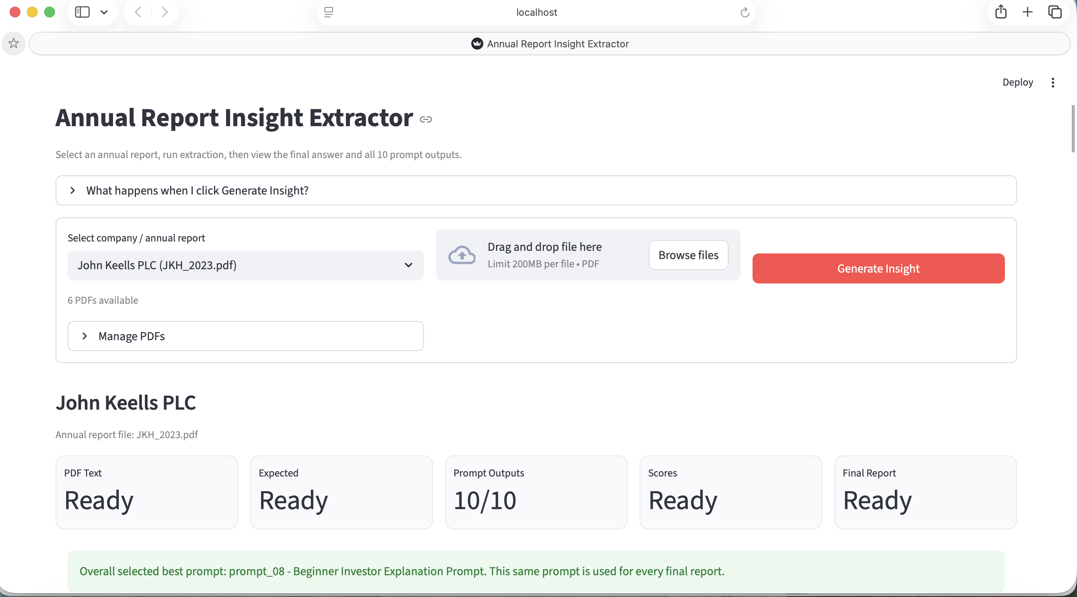
IT21471162 R26-IT-076 16.03.2026

Slide 16
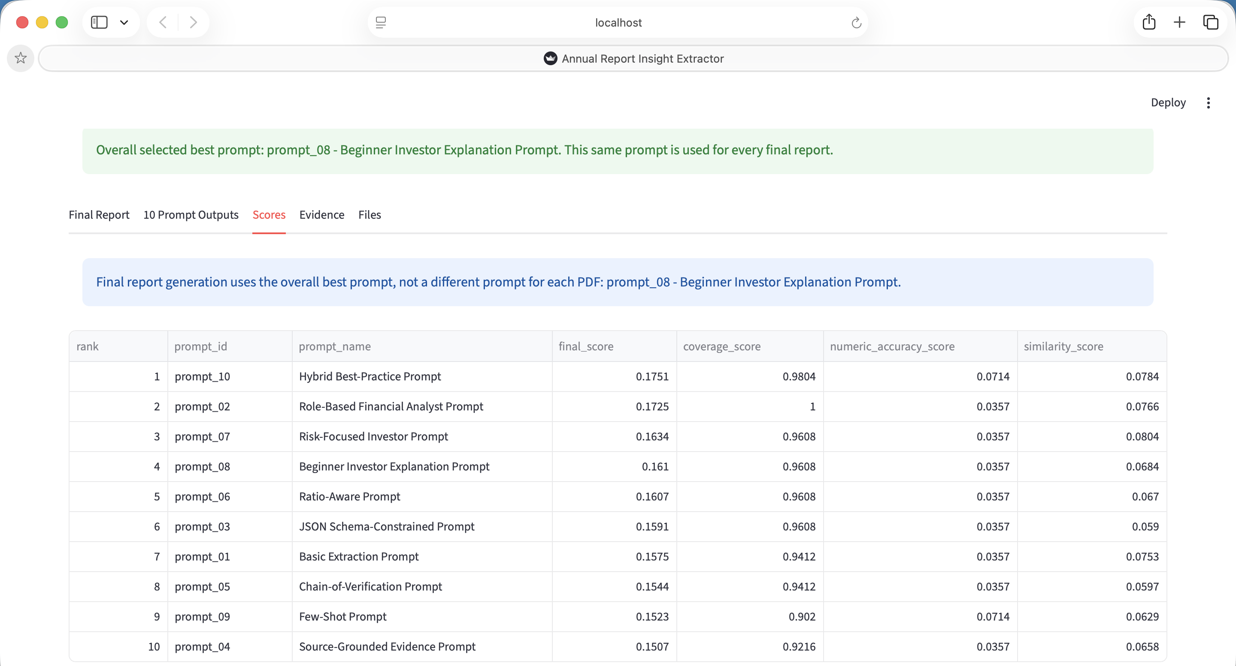
IT21471162 R26-IT-076 16.03.2026

Slide 17
Progress Results and Next Steps
Current Results
Next Step: RAG Integration
All 10 prompts were evaluated against expected outputs
Best overall prompt selected: Prompt 08 — Beginner Investor Explanation
Selected prompt exported as best_prompt_to_use.txt
Prompt can be reused across the full project pipeline
Use Prompt 08 inside the RAG pipeline
Retrieve relevant annual report chunks before generation
Generate structured investor-friendly insights from retrieved evidence
Improve source grounding and reduce hallucination risk
IT21471162 R26-IT-076 16.03.2026

Slide 18
HARITHRA.K | IT22065308
Sentiment and Event Driven Financial Insight Modeling
Novelty: Context‑aware sentiment and macro‑event driven analysis for interpreting stock behavior.
Contribution to Overall Solution: Provides sentiment and event‑based signals that explain market trends and support the system’s final investor insights.
IT22065308 R26-IT-076 16.03.2026

Slide 19
Ruchini | IT22547088
Explainable AI-Based Financial Market Risk Impact Engine
Novelty:my component predicts stock risk and explains why that risk occurs using SHAP Explainable AI. It combines stock data with global indicators like gold price, oil price, and VIX.
Contribution to Overall Solution: My component provides risk levels and explanation results to the dashboard. It helps users understand the stock risk clearly and make better financial decisions.
IT22547088 R26-IT-076 10.05.2026

Slide 20
Explainable AI-Based Financial Market Risk Impact Engine
Stock Risk Prediction
Predicts selected stock risk level as LOW, MEDIUM, or HIGH using historical market data.
Global Factor Analysis
Uses global indicators such as gold price, oil price, VIX index, exchange rate, and inflation.
Explainable AI
Applies SHAP Explainable AI to identify the most important factors affecting the risk prediction.
Risk Insights
Generates simple risk explanations to help users understand why a stock is risky.
Dashboard Output
Provides risk level, risk score, and top influencing factors for the final CSE AI dashboard.
IT22547088 R26-IT-076 10.05.2026

Slide 21
Explainable Financial Risk Engine — Problem & User Requirements
Sub-Problem Addressed
User Requirements Addressed
Stock market movements are affected by many internal and external factors, making risk difficult to understand.
Retail investors may see price changes, but they may not know why the risk level is increasing or decreasing.
Traditional prediction models mainly focus on accuracy, but they do not clearly explain the reason behind the prediction.
A reliable method is needed to predict stock risk and explain the key global factors affecting that risk.
Select a stock and view its risk level.
Analyze stock data with global financial indicators.
Classify risk as LOW, MEDIUM, or HIGH.
Show the main factors that affected the risk result.
Provide simple explanations and visual insights through the dashboard.
IT22547088 R26-IT-076 10.05.2026

Slide 22
Methodology and Implementation
Risk Prediction and Explainability Framework
Evaluation Metrics
stock data and global financial indicators are collected and cleaned.
Features such as price movement, trading volume, oil price, gold price, and VIX index are prepared.
A machine learning model is trained to classify stock risk levels.
SHAP Explainable AI is applied to explain the model prediction.
The final output is saved as risk level, risk score, and top factor explanations.
Risk Classification Accuracy
LOW / MEDIUM / HIGH Confusion Matrix
Recall
SHAP Feature Importance
IT21471162 R26-IT-076 16.03.2026

Slide 23
Progress Results and Next Steps
Current Results
Next Step: AI-Based User-Friendly Risk Explanation
Dataset cleaned and prepared for model training.
Risk levels were classified as LOW, MEDIUM, and HIGH.
Random Forest model was trained for risk classification.
SHAP explanation was integrated to identify top risk factors.
Initial model accuracy and classification report were generated.
Display the predicted risk level as LOW, MEDIUM, or HIGH.
Use AI to explain the risk result in simple language.
Show the main factors that affected the prediction, such as oil price, gold price, VIX, stock volatility, and volume.
Generate a user-friendly explanation instead of only showing technical model output.
Help users understand why the stock is risky and support better financial decision-making.
IT22547088 R26-IT-076 10.05.2026

Slide 24
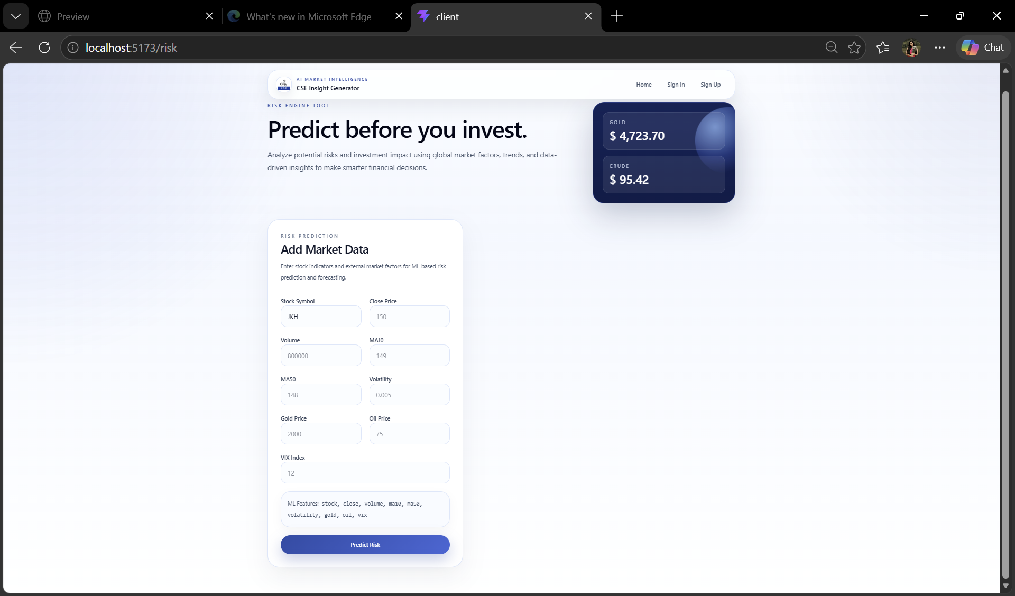
Prototype Demonstration – Input Dashboard and Backend Prediction
User can enter/select stock details through the frontend dashboard.
This is the user input interface of my component.

Slide 25
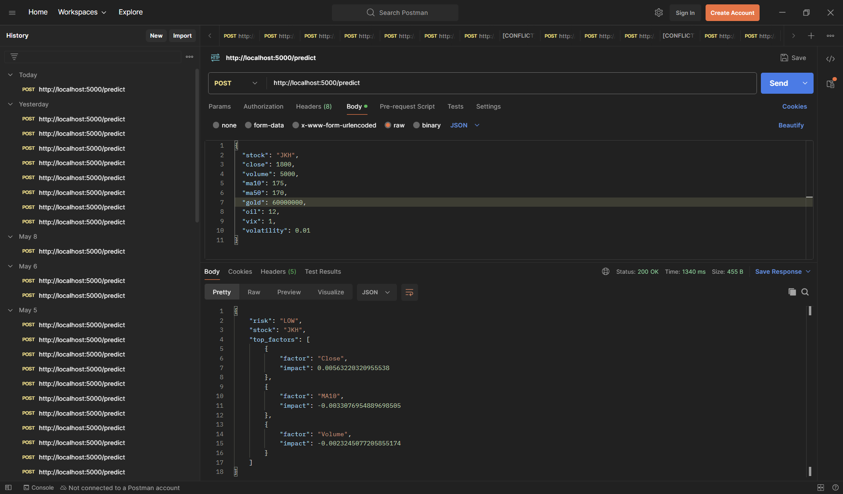
Postman Backend Output
Backend API processes the input using the trained risk model.
It returns predicted risk level, confidence score, and SHAP explanation factors.

Slide 26
Conclusion
SLIIT · Faculty of Computing · AI-Powered Stock Market Insight Generator for the CSE

