Slide 1



AI-Powered Stock Market
Insight Generator
for the Colombo Stock Exchange
R26-IT-076
faculty of computing

Slide 2


Problem & Motivation
Why This System Is Needed
  Growing investor participation has increased the need for trustworthy and understandable CSE analysis.
Growing Participation
  44,047 new CDS accounts were opened from January to October 2025—over three times the same period in 2024.
Strong Local Activity
  Local investors generated 88.8% of total CSE turnover in 2024.
Complex Information
  Investors must analyse prices, indicators, financial reports, news and external events.
Unreliable Analysis
  Non-expert investors may rely on rumours, social-media opinions and unsupported predictions.
Core Motivation
  Develop a transparent AI decision-support system that transforms fragmented CSE information into clear, evidence-based investor insights.
Sources: CDS Monthly Report, October 2025; CSE Annual Report 2024.

Slide 3
Research Gap
Existing Systems
Identified Gap
Proposed Contribution
  Historical price charts
  Technical indicators
  Separate financial reports
  News and sentiment feeds
  Black-box predictions
  Generic global-market analysis
  Information sources are analysed separately
  Limited support for the CSE context
  Predictions lack understandable reasoning
  Annual reports remain difficult to interpret
  AI summaries may contain unsupported information
  Dashboards are rarely evaluated for human understanding
  Multimodal financial-data integration
  CSE-specific analytical framework
  Explainable machine-learning outputs
  Source-grounded document insights
  Sentiment and event-based context
  Human-centred investor dashboard

Slide 4

Overall System Overview
Market Modelling & Explainable AI
LLM Document Analysis
ML based price prediction, deviation based anomaly scoring, and SHAP explanations of the factors influencing detected anomalies
OpenAI-based summarization of CSE annual reports and earnings statements using prompt engineering
Sentiment & Event Modeling
Explainable AI-Based Financial Risk Engine
NLP pipeline processes news headlines and macro events for financial sentiment signals.
ML-based stock risk prediction using market data and global indicators. SHAP-based explanations identify key factors affecting risk decisions.

Slide 5
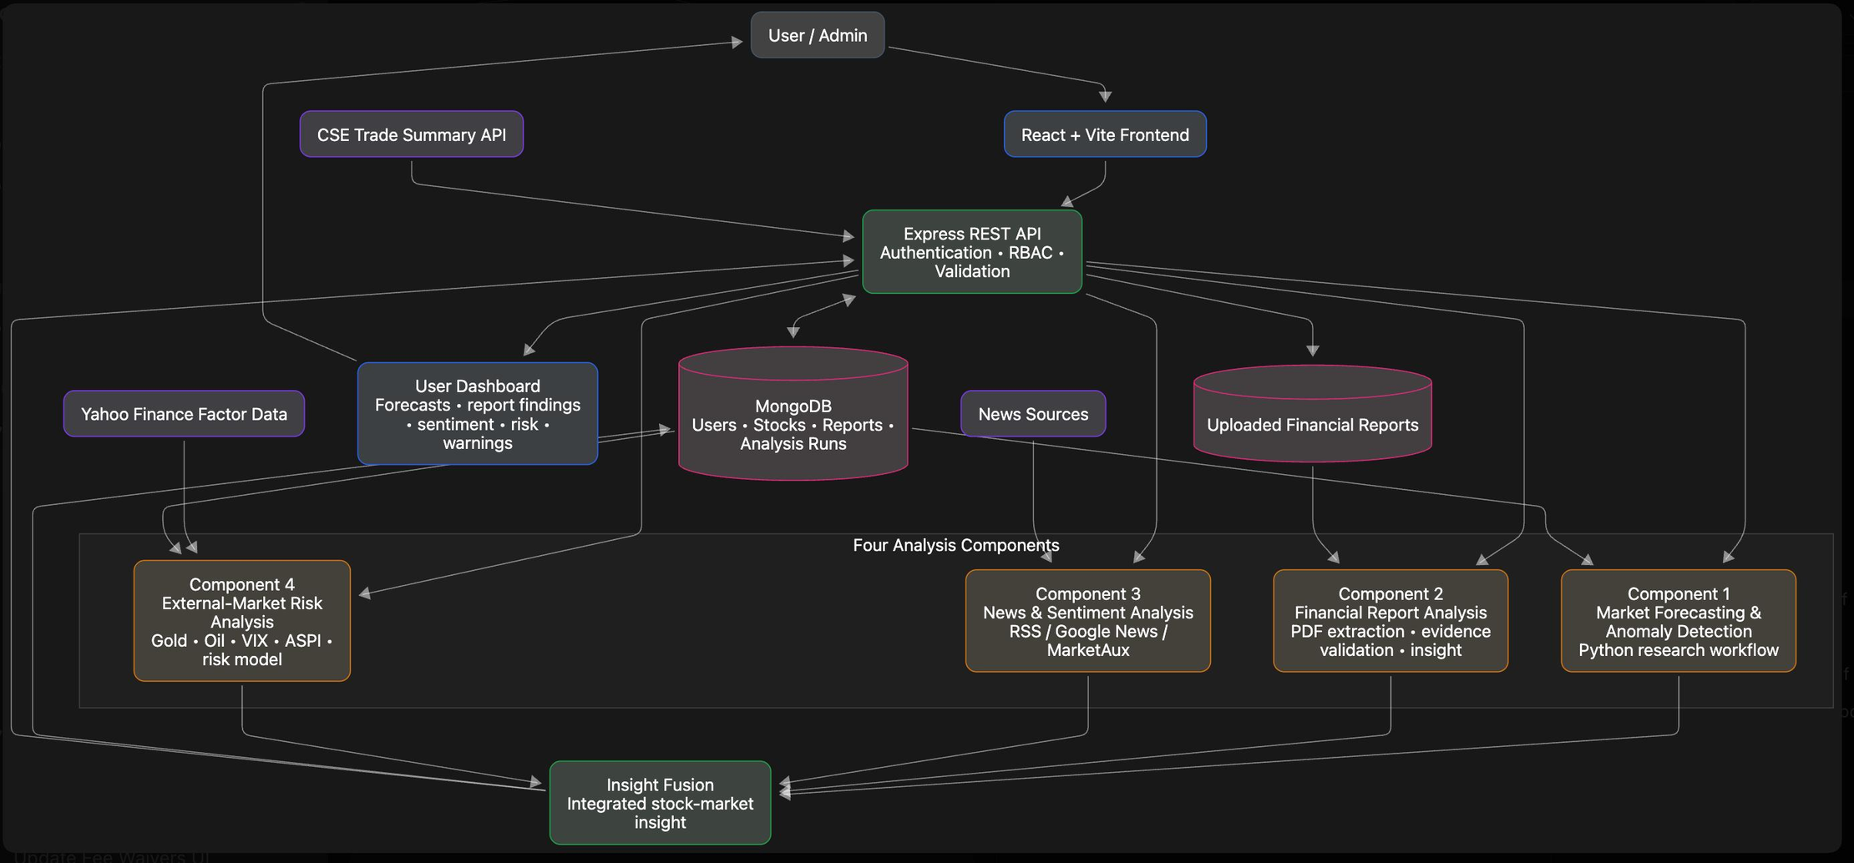

System Architecture

Slide 6

PP1 to PP2 Improvements
Basic system concept
Clearly defined multimodal architecture
Components presented separately
Integrated insight-generation workflow
General AI-generated explanations
Evidence-controlled OpenAI synthesis
Limited explanation of research novelty
Defined novelty for each component
Basic market predictions
Explainable and anomaly-aware modelling
General news sentiment
Company-specific sentiment and event extraction
Basic dashboard concept
Human interpretability evaluation framework
Limited validation direction
Technical and user-centred evaluation plans
Direct document summarization
Prompt benchmarking and RAG integration

Slide 7

Samarathunga A H S |IT21296482
Market Modeling and Explainable AI Insight Generation
Novelty
Contribution to Overall Solution
Liquidity aware anomaly detection for CSE stocks that combines price and volume deviation with ML based forecasting, then uses SHAP to clearly explain why an anomaly occurred
Provides sentiment and event‑based signals that explain market trends and support the system’s final investor insights.

Slide 8
Samarathunga A H S | IT21296482
Market Modeling and Explainable AI Insight Generation
Problem
Solution Approach
Outputs
Investors may see a price movement but cannot tell whether it is normal for that stock’s recent behaviour or an unusual movement needing attention
Learn normal price behaviour from historical price and trading volume. Estimate the expected closing price, compare it with the actual close, and calculate a volume adjusted anomaly score.
Expected price, actual price, signed deviation, absolute deviation, anomaly score, calibrated threshold, anomaly status, prediction band result, and SHAP factors influencing the anomaly score.
Anomaly score calculation
Volume Scaled=Trading Volume/1,000,000
Anomaly Score=(Absolute Deviation) /(Volume Scaled+ϵ​)
Signed Deviation = Actual Price - Expected Price
Absolute Deviation = |Actual Price - Expected Price|
Ex:-JKH Actual Price = Rs. 19.5000
Expected Price = Rs. 19.4813
Absolute Deviation = Rs. 0.0187
Volume = 7.972722 million
Anomaly Score = 0.0187 / 7.972722
= 0.002345
0.002345 < 0.446011 threshold
Result: No anomaly
Anomaly Score > Stock-Specific Threshold
OR
Price Outside Prediction Band
→ Unusual Market Behaviour

Slide 9

Fernando K C S | IT21471162
Financial Document Understanding and Language-Driven Insight Extraction
Novelty
Contribution to Overall Solution
A source-grounded prompt-engineering framework for financial reports that compares ten prompt strategies, evaluates their performance, and selects the best prompt to generate traceable, beginner-friendly investor insights with page-level evidence.
Provides verified financial-report insights, including company performance, financial position, cash flow, risks, ratios, and future outlook, which are combined with market, news, sentiment, and risk analysis to produce the final integrated stock insight.

Slide 10
Fernando K C S IT21471162
Financial Document Understanding and Language Driven insight
Extraction
Problem
Solution Approach
Outputs
Financial reports are lengthy and difficult for ordinary investors to understand. Important information is spread across financial statements, tables, risk sections, and management discussions. General AI summaries may also include unsupported or inaccurate information.
The system validates the uploaded report, extracts page-level text and tables, retrieves relevant financial evidence, and applies ten prompt-engineering strategies using the same report context and JSON schema. The prompt outputs are evaluated and the best prompt is selected.
Structured financial facts, page-level source evidence, company strengths, concerns, risks, ratios, cash-flow information, future outlook, missing fields, and a beginner-friendly investor summary integrated into the final stock insight.
Prompt Evaluation
Financial Report Insight Workflow
Prompt performance is evaluated using:
• Coverage – fields successfully extracted
• Numeric accuracy – financial values matched
• Semantic similarity – meaning similarity
• Source faithfulness – quotation and page verification
• Investor relevance – usefulness of the output
• Hallucination penalty – unsupported information
Prompt 08 achieved the highest average final score: 0.1693 across six reports.
1. Upload annual or interim financial report
2. Validate company and latest reporting period
3. Extract PDF text, tables, and page references
4. Retrieve relevant investor-related pages
5. Generate outputs using ten prompt strategies
6. Evaluate and rank prompt performance
7. Select Prompt 08 and verify source evidence
8. Generate the final investor-friendly insight

Slide 11

HARITHRA.K | IT22065308
Sentiment and Event Driven Financial Insight Modeling
Novelty
Contribution to Overall Solution
Context‑aware sentiment and macro‑event driven analysis for interpreting stock behavior.
Provides sentiment and event‑based signals that explain market trends and support the system’s final investor insights.

Slide 12
HARITHRA.K | IT22065308
Sentiment and Event Driven Financial Insight Modeling
Financial News
Collection
Text Processing &
Feature Extraction
Hybrid Sentiment
Engine
Explainable
Sentiment Output
Interactive
Dashboard
EconomyNext, google news , financial announcements, company news, market events and economic updates are collected and prepared for analysis.
News preprocessing,
normalization,
company identification,
financial keyword extraction
and market impact detection.
Rule-Based Financial
Lexicon + Naive Bayes Machine
Learning classifier classify
news into Positive, Neutral or
Negative sentiment with
confidence estimation.
Generates sentiment score, confidence score, market impact, company-specific news filtering and investor-friendly explanations.
Results are visualized through the Sentiment Analysis page and integrated into the Insight Preview dashboard to support investment decisions.
Novelty
Model Evaluation
Hybrid financial sentiment analysis combining domain-specific financial rules with Naive Bayes machine learning, explainable confidence scoring, market impact detection and seamless integration into an AI-powered CSE investment decision support system.
Model performance is evaluated using:
  Accuracy – overall percentage of correctly classified news articles
  Precision – correctness of predicted Positive, Negative, and Neutral classes
  Recall – ability to identify the actual sentiment classes
  F1-Score – balances Precision and Recall for each class
  Confusion Matrix
Evaluates the model's ability to classify news sentiment into Positive, Negative and Neutral categories.

Slide 13

WIJESOORIYA T G R N S | IT22547088
Explainable AI-Based Financial Market Risk Impact Engine
Novelty
Contribution to Overall Solution
Combines stock risk prediction with global financial indicators and SHAP-based Explainable AI to identify the factors influencing market risk.
Provides transparent stock risk insights by predicting LOW, MEDIUM, and HIGH risk levels and explaining the key factors behind the prediction for better financial decision-making.

Slide 14
Wijesooriya T G R N S | IT22547088
Explainable AI-Based Financial Risk Engine
Problem
Solution Approach
Outputs
Historical stock data and global financial indicators (Gold, Oil, and VIX) are analysed using Machine Learning. A Random Forest model predicts stock risk levels, while SHAP Explainable AI identifies the key factors influencing each prediction.
Stock risk classification (LOW, MEDIUM, HIGH); SHAP-based feature explanations; key risk factors; and user-friendly financial risk insights displayed through the dashboard.
Stock markets are influenced by multiple internal and external factors. Investors can observe price changes but often cannot understand why the risk level increases or decreases. Traditional ML models provide predictions but lack transparency and explanation.
Financial Risk Analysis Workflow
Model Evaluation
  Collect Historical Stock Market Data
  Preprocess and Prepare Financial Features
  Analyse Stock Data with Global Indicators
  Train Random Forest Risk Classification Model
  Predict LOW, MEDIUM, HIGH Risk Levels
  Apply SHAP Explainable AI Analysis
  Generate User-Friendly Risk Insights.
Random Forest Classifier Performance
  Accuracy – Overall correct predictions.
  Precision – Correctness of predicted risk classes.
  Recall – Ability to identify actual risk cases.
  F1-score – Balance between precision and recall.
  Confusion Matrix
Evaluates the model's ability to classify stock risk into Low, Medium, and High categories.

