Slide 1

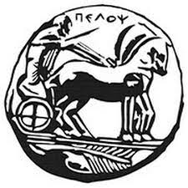
Abstract Art Generation with GANs
DMSc in Data Science
By Alexios Gkolovko
MSc Student

Slide 2
Project Objectives
The implementation and training of a Generative Adversarial Network (GAN) that will be able to create abstract paintings by itself.
The evaluation of the implemented GAN.

Slide 3
GANs
Generative Adversarial Network (GAN)
Class of Machine Learning frameworks
Introduced by Ian Goodfellow and his colleagues in June 2014
Generator: produces artificial data (usually images) based on a given dataset
Discriminator: tries to distinguish genuine from generated data

Slide 4
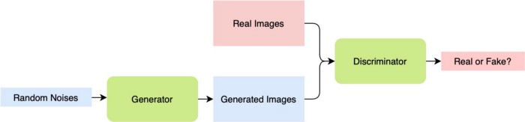
GAN example
source:https://towardsdatascience.com/building-a-gan-with-pytorch-237b4b07ca9a

Slide 5
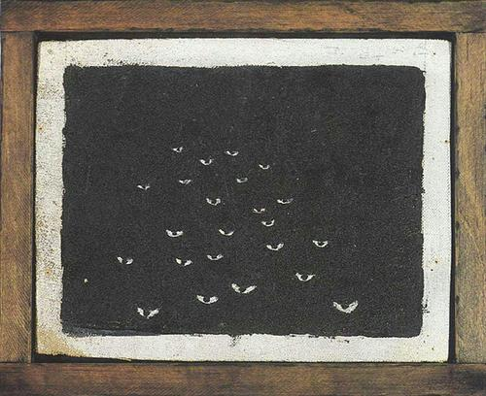
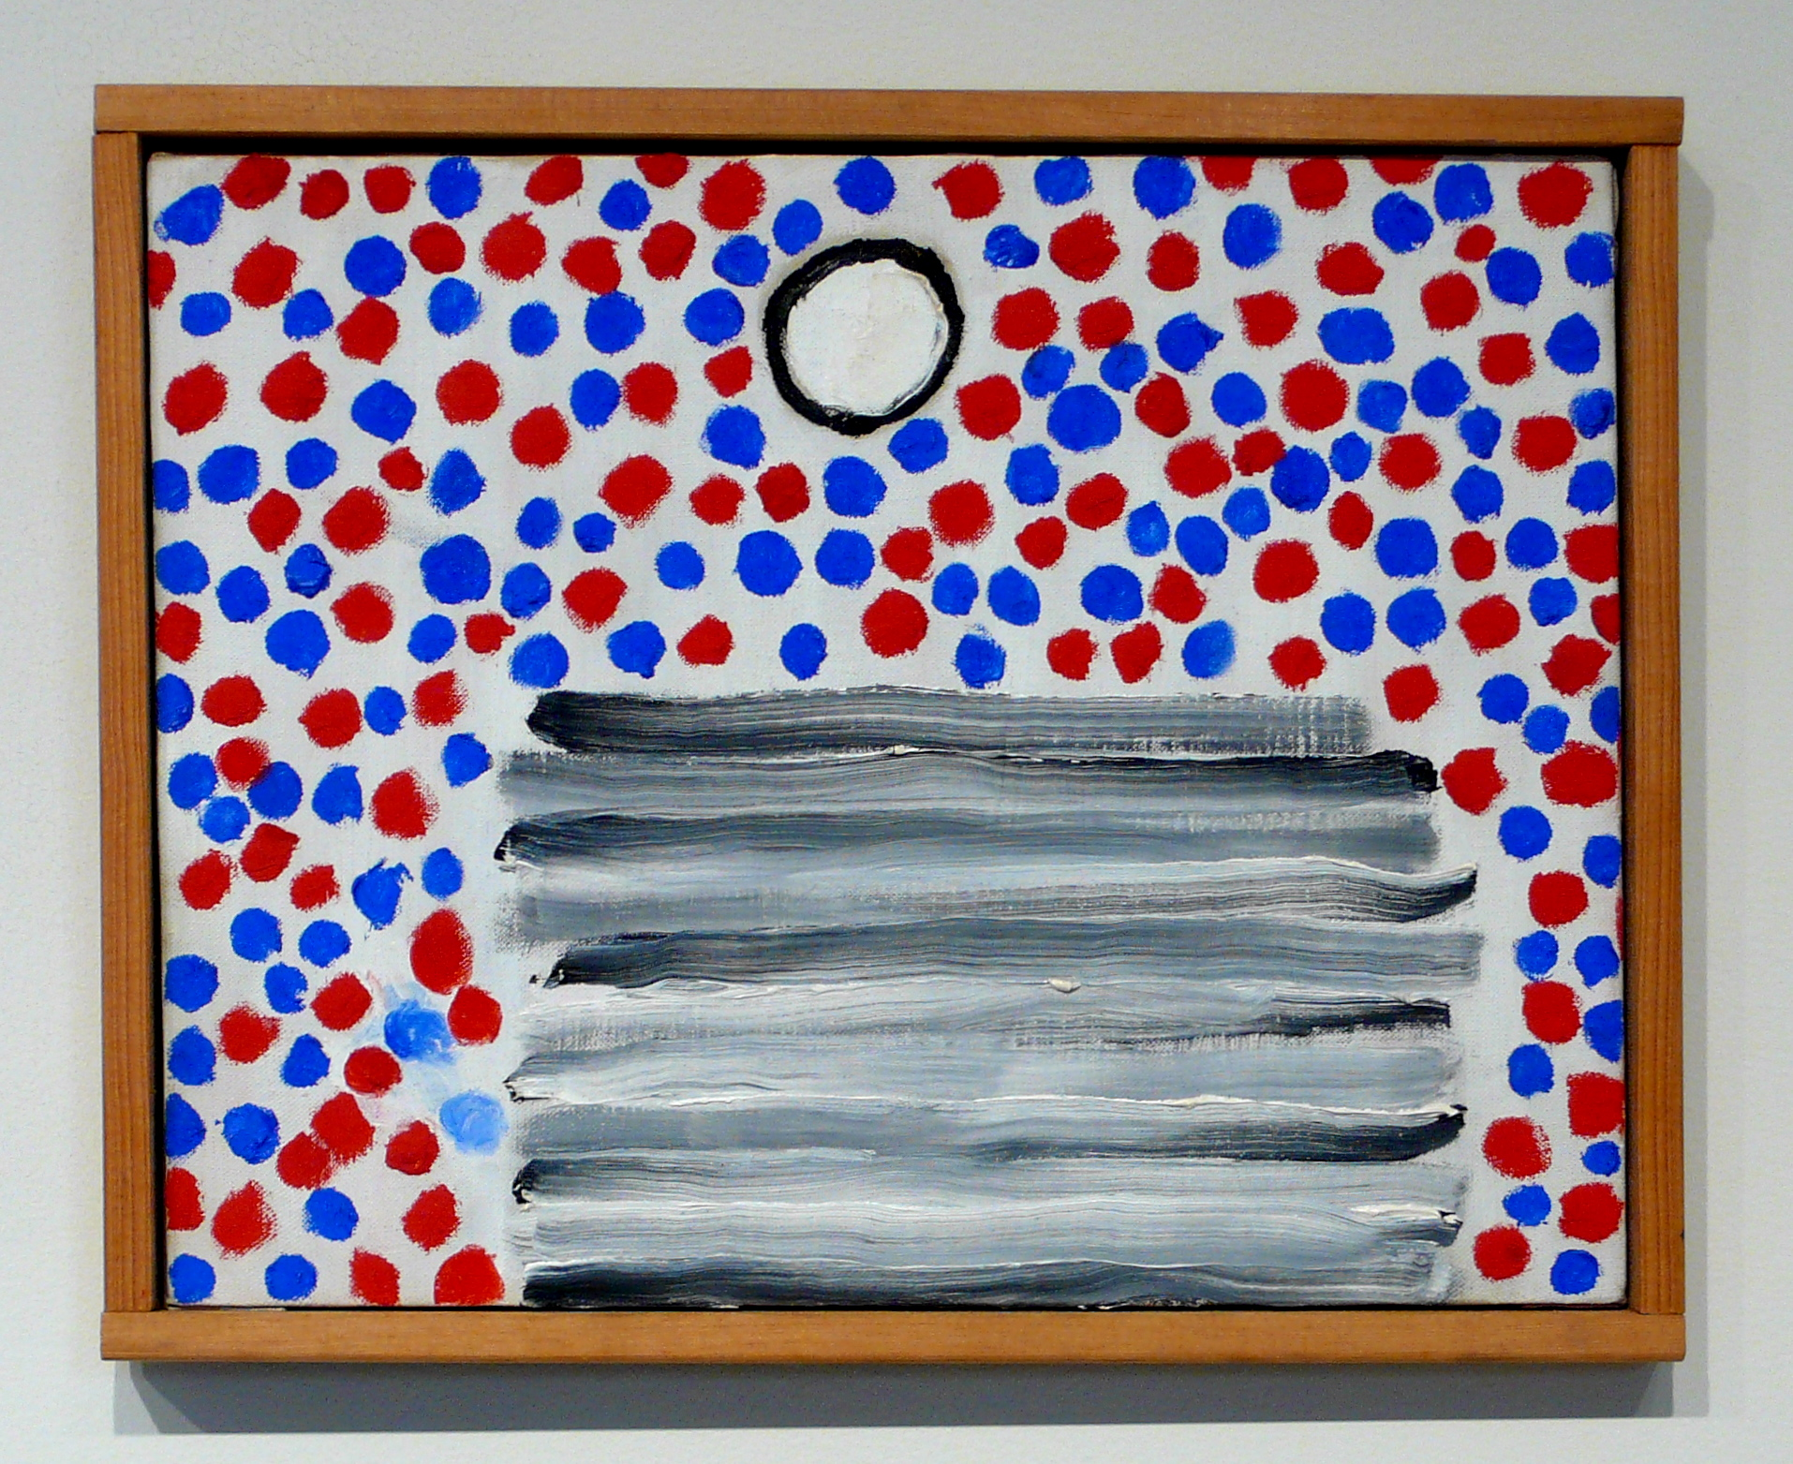
Abstract Art Gallery Dataset
Size: 727MB
2.782 images, depicting paintings by abstractionists
Large Dataset, slow training.
Solution: use subset
  Size: ~ 80MB
  571 images

Slide 6

Tools
Matplotlib for the diagrams
Tqdm
IPython and, the most fundamental,
PyTorch (including torchvision)

Slide 7
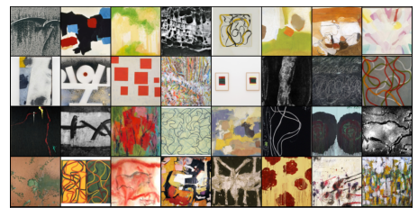
Preprocessing
Data transformation
  Resizing: to have pictures of the same size
  Cropping: to remove elements that could serve as noise (frames)
  Normalization (and denormalization): to improve the performance

Slide 8
Implementation of Discriminator and Generator
Discriminator
Uses Convolutional Neural Networks (CNNs) to distinguish genuine from fake paintings.
Leaky ReLU instead of ReLU: allows the pass of a small gradient signal for negative values, so the gradients from the discriminator flow stronger into the generator.
Generator
ConvTranspose2d layer from PyTorch
Latent tensor (vector of random numbers as seed to generate images)

Slide 9
Training
No of epochs: 10
Evaluation Measures:
loss of the discriminator
loss of the generator
correctly classified genuine images
correctly classified fake images
Completion time: ~1h

Slide 10
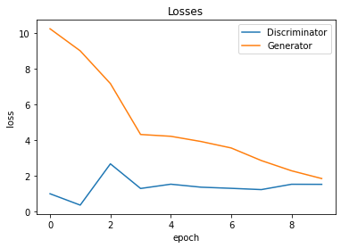
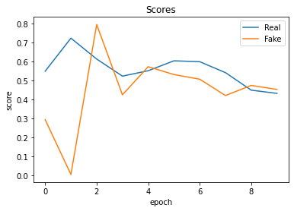
Results: Diagrams
Loss-to-Epoch diagram
Score-to-Epoch Diagram

Slide 11
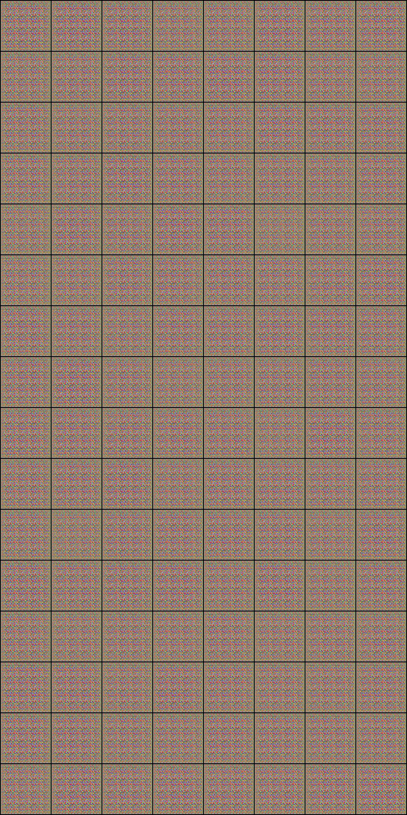
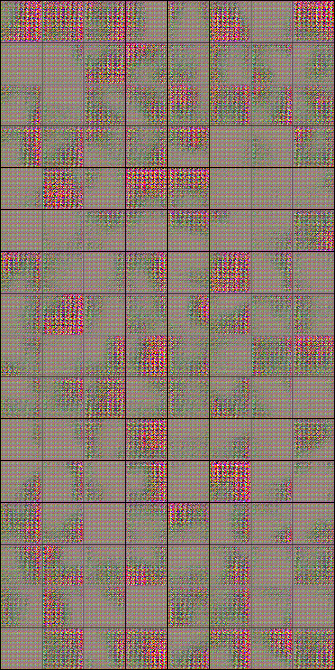
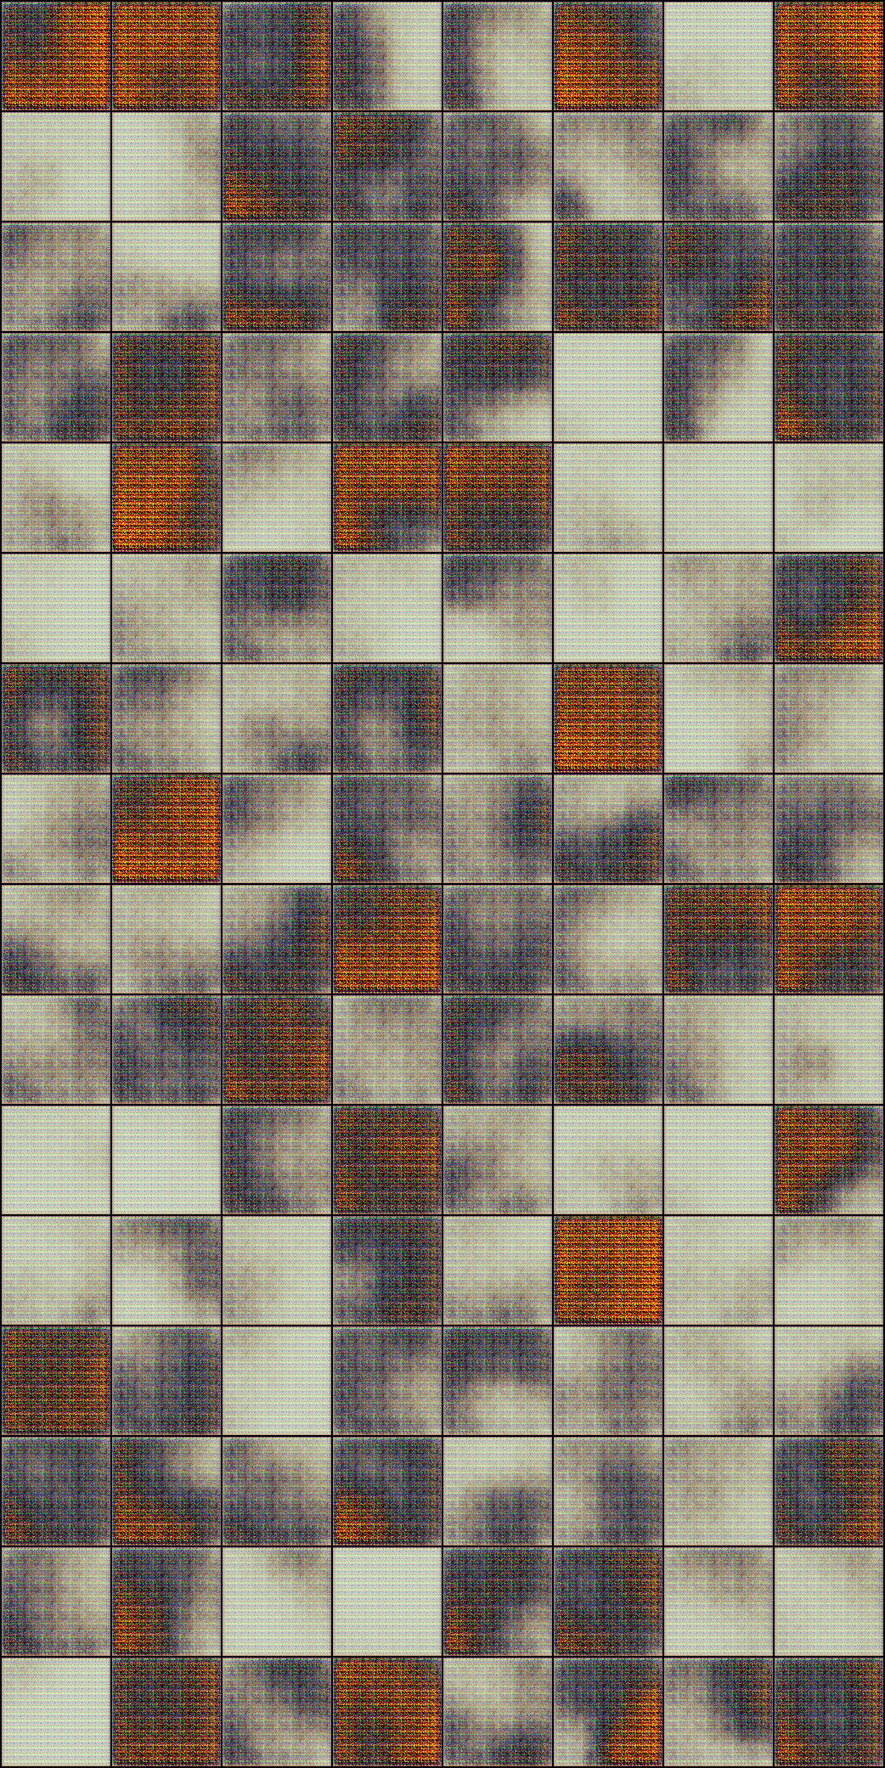
Results: Generated Paintings

Slide 12
Conclusion
It seems that the generated pictures improve in quality.
The generator’s performance improves by epoch (the loss decreases)
The discriminator’s performance is stable (decreases slightly)
It seems that training in more epochs would lead to an improvement in the quality of the generated pictures and an overall improvement in the performance of the generator.

Slide 13
Any Questions ?

Slide 14
Thank You!

