Slide 1
HALCOR EXPERIMENTS
Prediction - Estimation

Slide 2
Prediction
Time-series forecasting (regression)
Prediction Intervals:
  15-min
  1-hour
  4-hours
  8-hours
  1-day

Slide 3
Prediction
Single-step VS Multi-step prediction
Single-step:
  Data Granularity: 15-min intervals
  Prediction: Next 15 minutes (1 step)
Multi-step:
  Data Granularity: 15-min intervals
  Prediction: Next hour (4 steps)

Slide 4
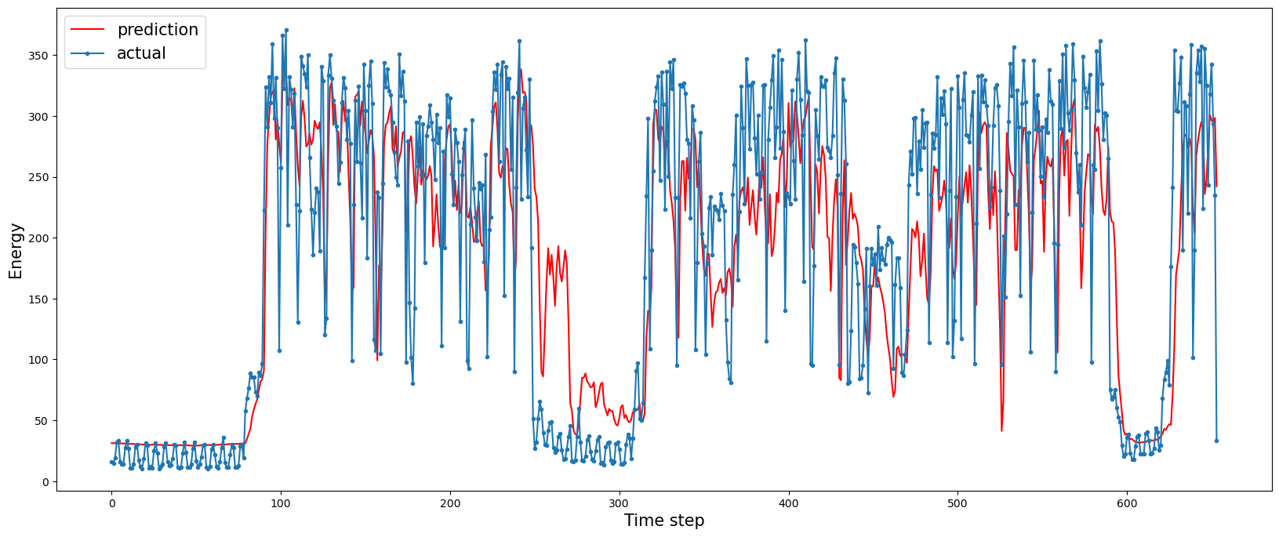
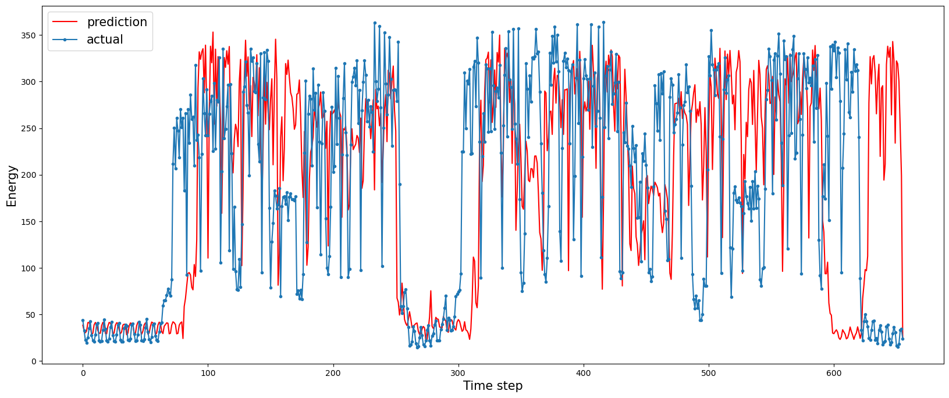
Prediction (15-min Interval)
 | LSTM | XGBoost
mae | 51.54 | 84.78
mse | 4529 | 14234
rmse | 67.29 | 119.3
r^2 | 0.6918 | -0.120
Adjusted r^2 | 0.684 | -1.31
LSTM
XGBoost

Slide 5
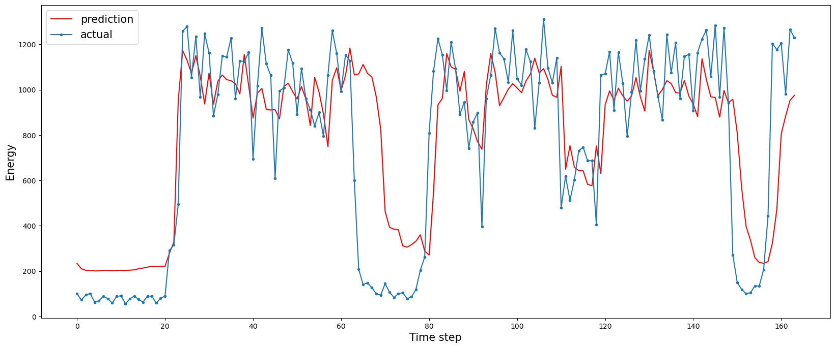
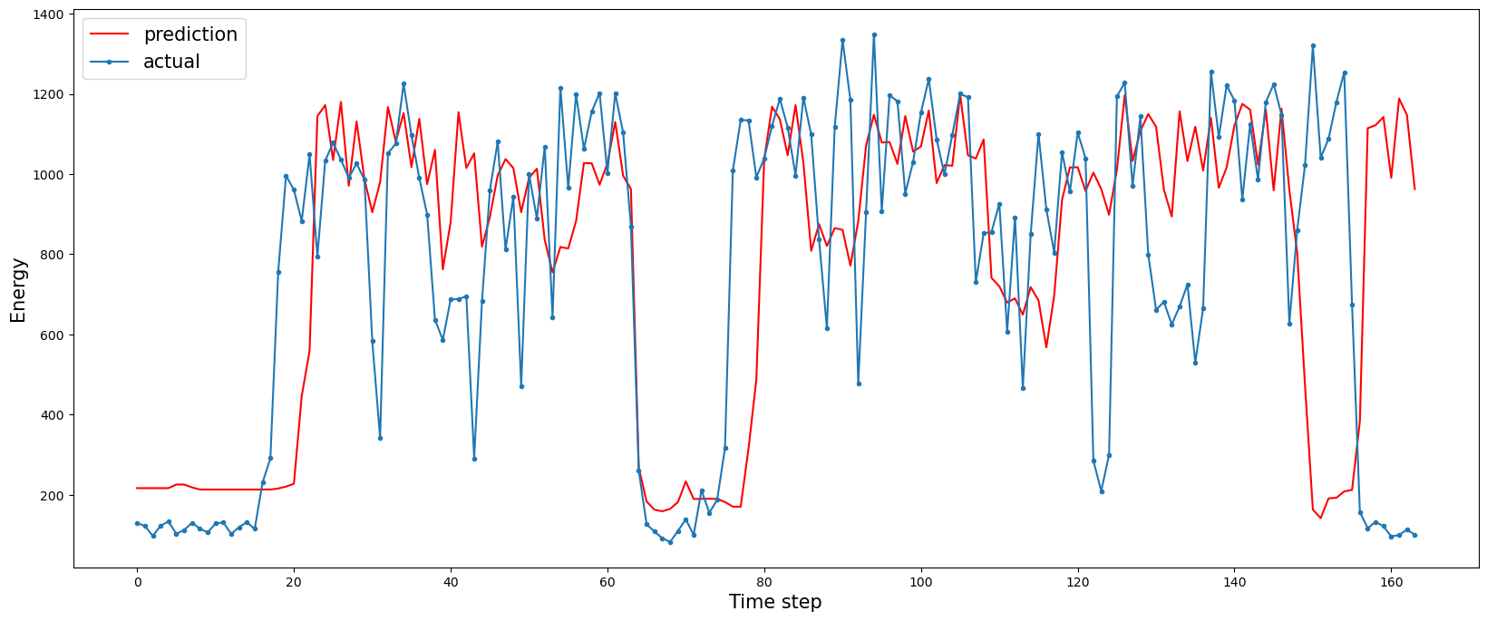
Prediction (1-hour Interval)
 | LSTM | XGBoost
mae | 193.54 | 262.27
mse | 76525.67 | 148930
rmse | 276.63 | 385.9
r^2 | 0.6127 | 0.087
Adjusted r^2 | 0.597 | 1.540
LSTM
XGBoost

Slide 6
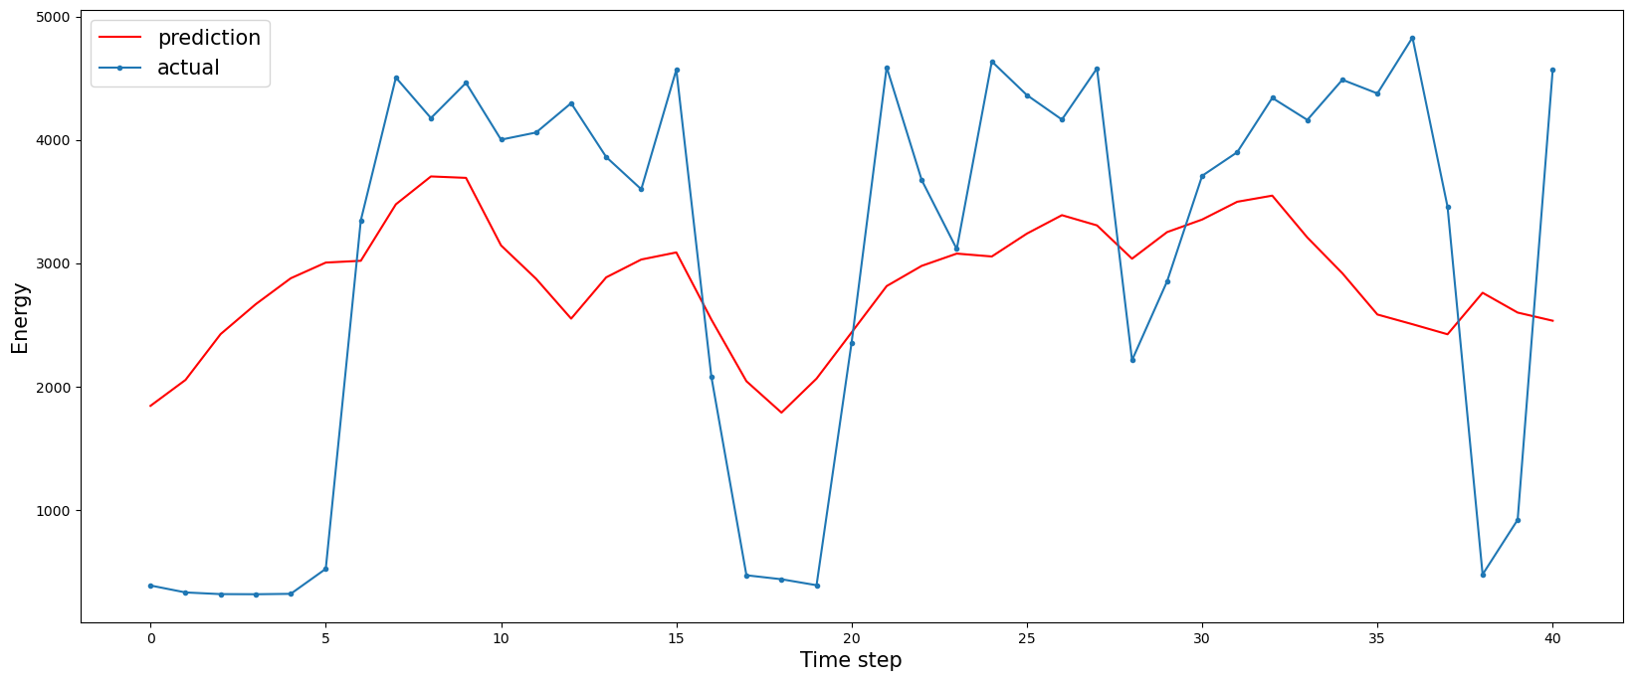
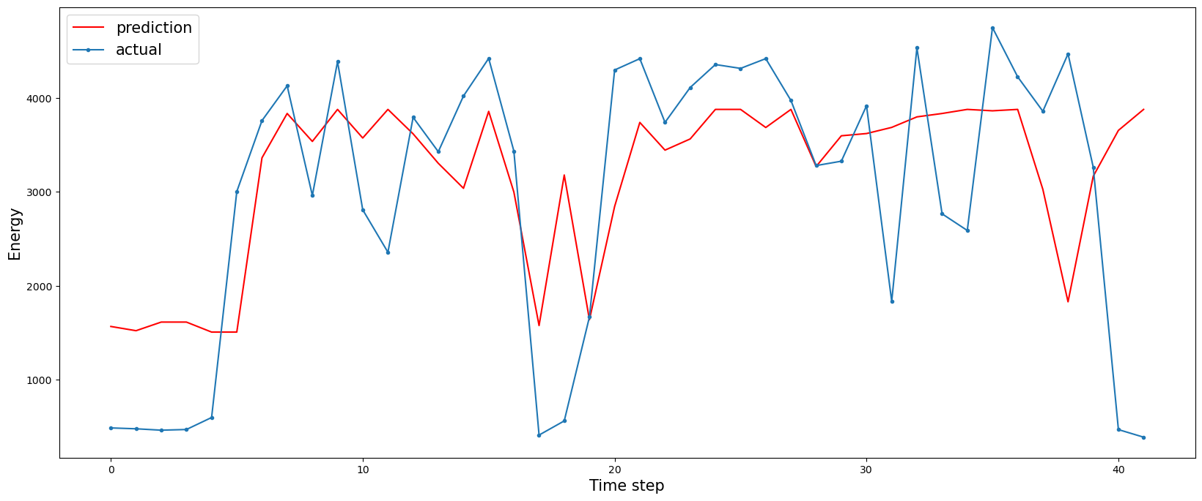
Prediction (4-hour Interval)
 | LSTM | XGBoost
mae | 1242.43 | 922
mse | 2008131 | 1507655
rmse | 1417 | 1227
r^2 | 0.27 | 0.310
Adjusted r^2 | 0.144 | 1.07
LSTM
XGBoost

Slide 7
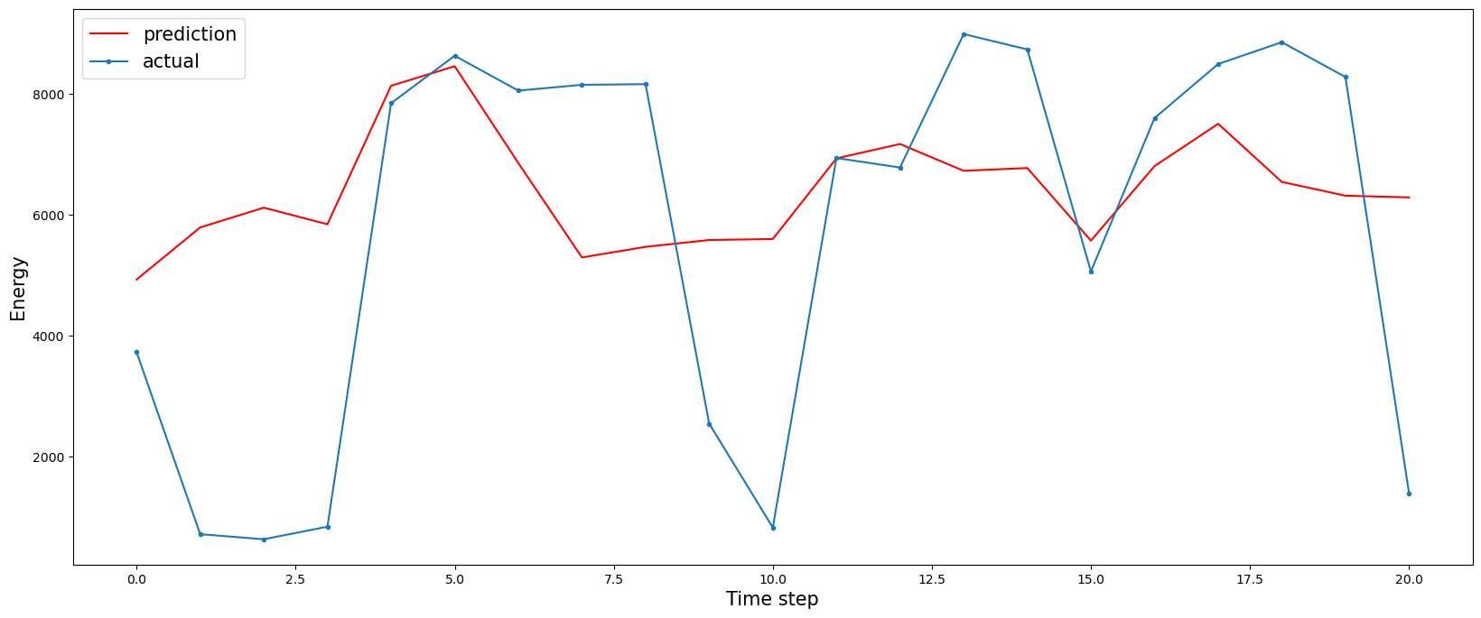
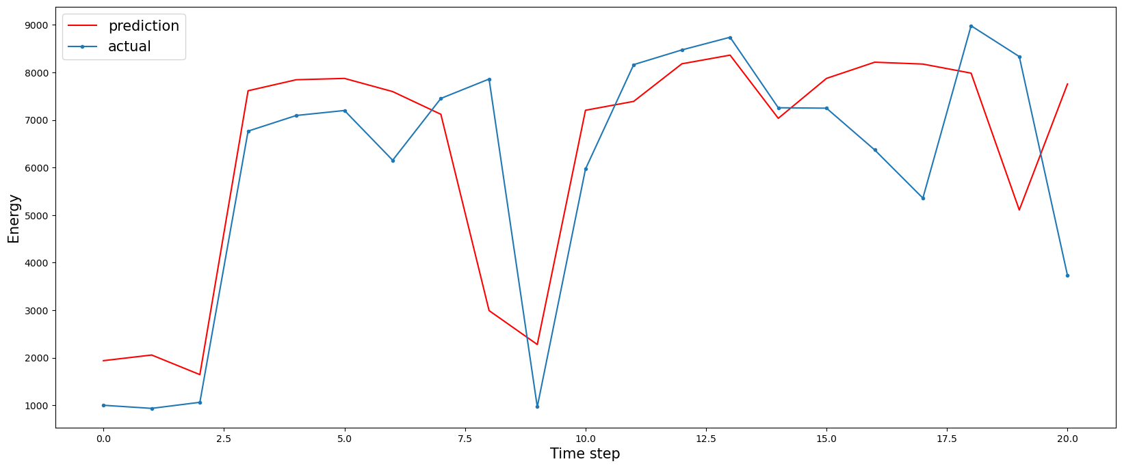
Prediction (8-hour Interval)
 | LSTM | XGBoost
mae | 2280.9 | 1395
mse | 8365356.4 | 3502159
rmse | 2892.2 | 1871
r^2 | 0.173 | 0.511
Adjusted r^2 | 0.027 | 1.029
LSTM
XGBoost

Slide 8
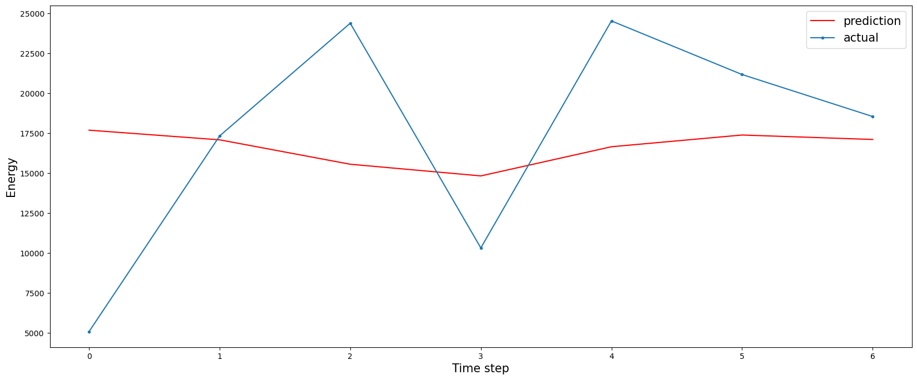
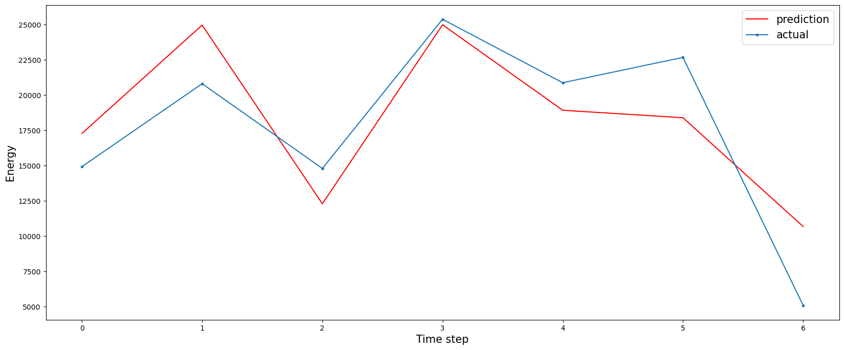
Prediction (1-day Interval)
 | LSTM | XGBoost
mae | 5612 | 3032
mse | 47953031 | 11805270
rmse | 6924 | 3435
r^2 | -0.058 | 0.703
Adjusted r^2 | -0.588 | 1.009
LSTM
XGBoost

Slide 9
Estimation
Supervised Learning (regression)
NO time features here
 | 15-min | 1-hour | 4-hours | 8-hours | 1-day
mae | 37 | 121 | 489 | 1052 | 1277
rmse | 50 | 176 | 770 | 1700 | 1638
r^2 | 0.802 | 0.806 | 0.715 | 0.65 | 0.818
Adjusted r^2 | 0.76 | -15 | 1.087 | 1.065 | 1.01

Slide 10
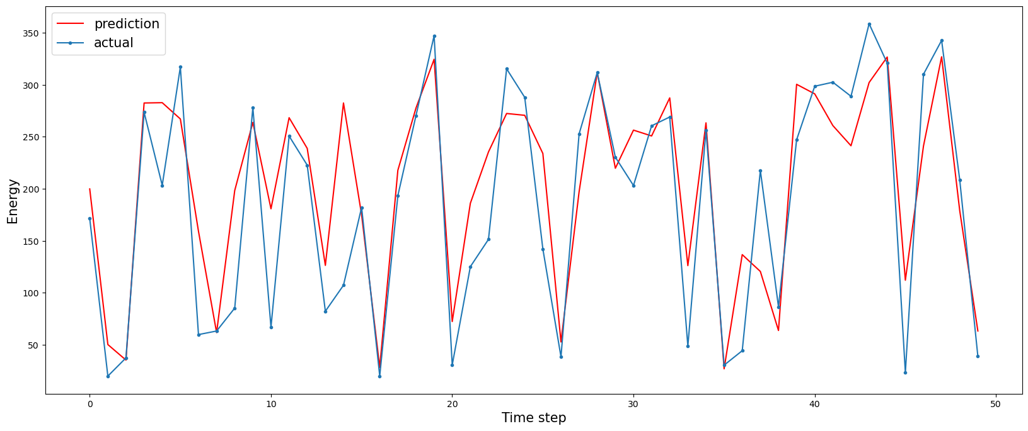
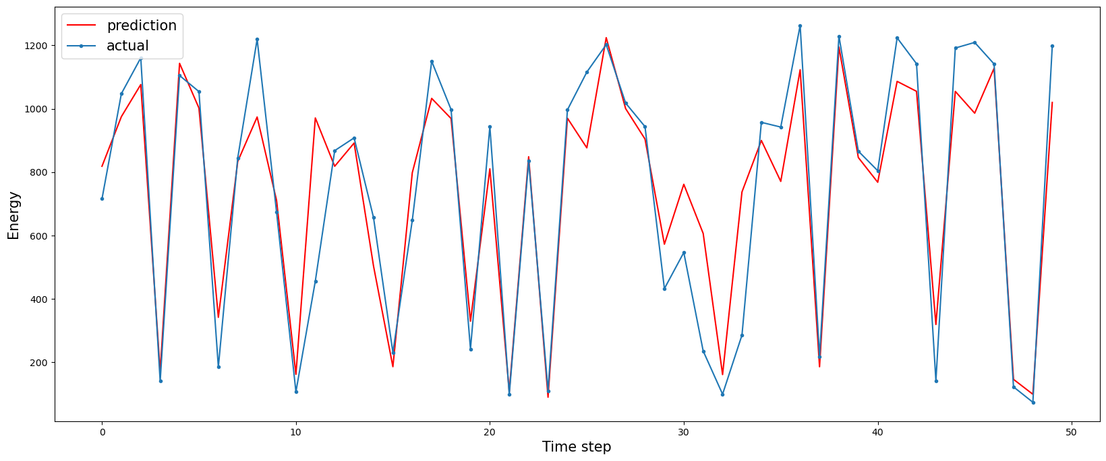
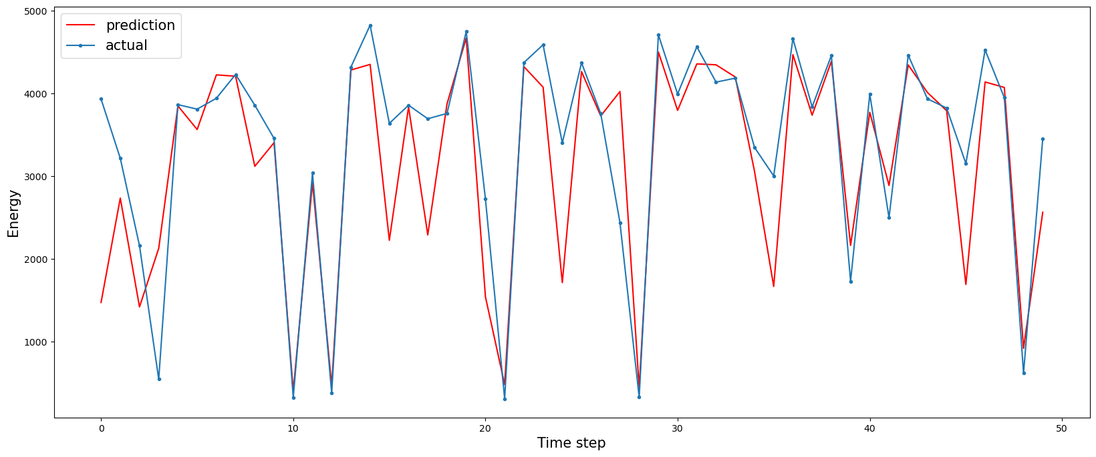
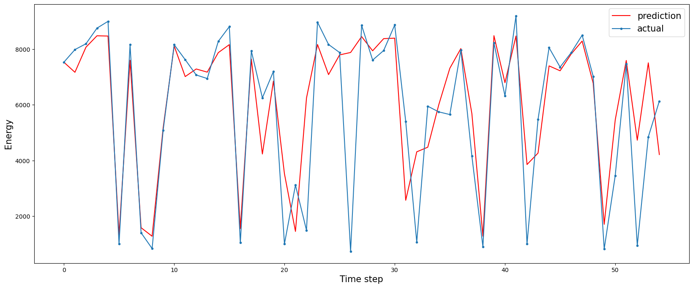
Estimation
15-min
1-hour
4-hour
8-hour

Slide 11
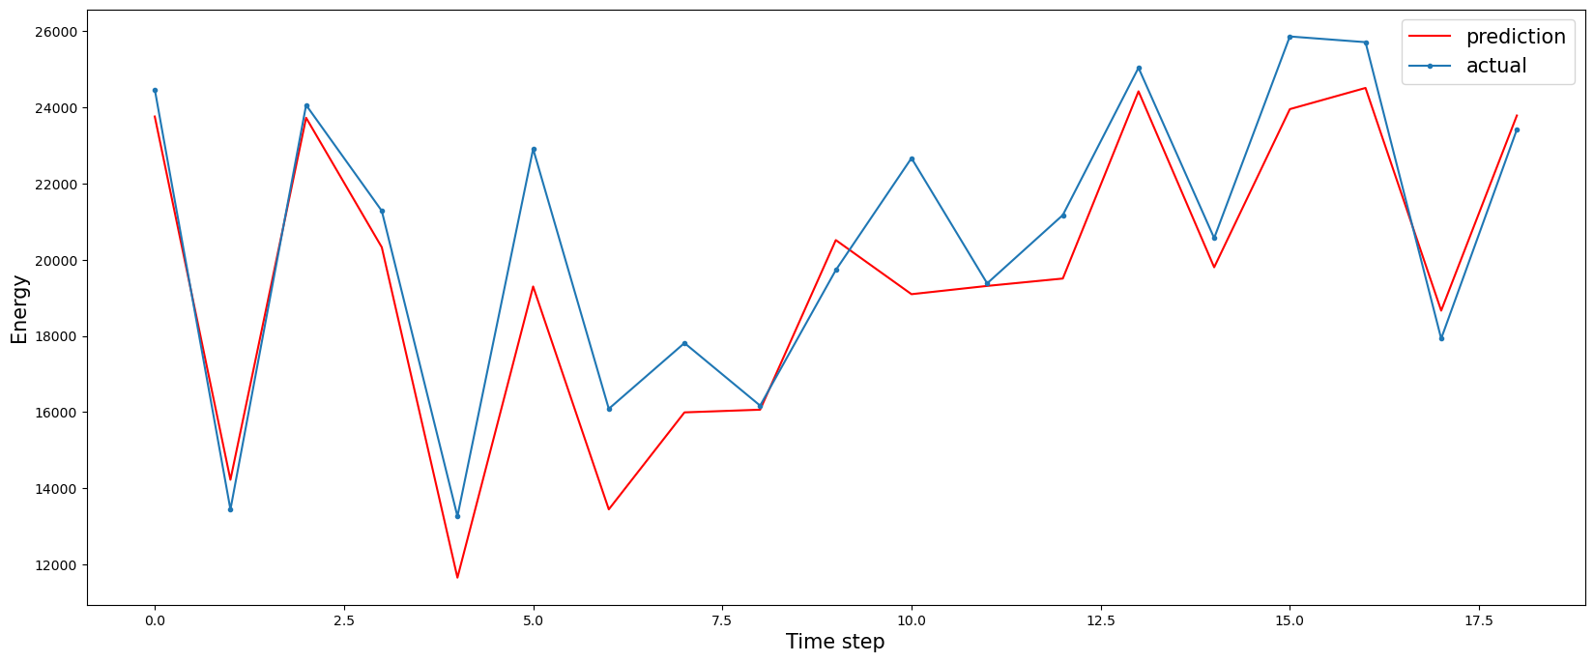
Estimation
1-day

Slide 12
To-do
Consider the multi-step prediction, especially for LSTM, since that will increase the data points
Try something different from XGBoost
Try something more SOTA than LSTM
Hyper-parameter tuning and cross-fold validation

