Slide 1
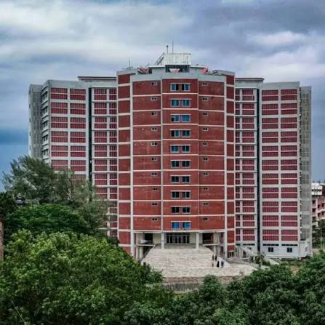


Mawlana Bhashani Science and Technology University
Department of Information and Communication Technology
SSH
(Secure Shell)
Data Communication Lab · ICT-3102
SUPERVISED BY
PRESENTED BY
Most. Roksana Akter
ID: IT24064
Session: 2023-24
Dept of ICT, MBSTU
Dr. Nazrul Islam
Associate Professor
Dept of ICT, MBSTU
Notes:
Introduce the topic: SSH, the Secure Shell.

Slide 2
Presentation Outline
01
Introduction: why is it called Secure Shell?
02
Related work: from Telnet to SSH
03
How SSH works and public-key cryptography
04
SSH in practice, features and comparison
05
Conclusions and best practices
SSH (Secure Shell)
COMPAS 2026
02
Notes:
Outline of the talk.

Slide 3
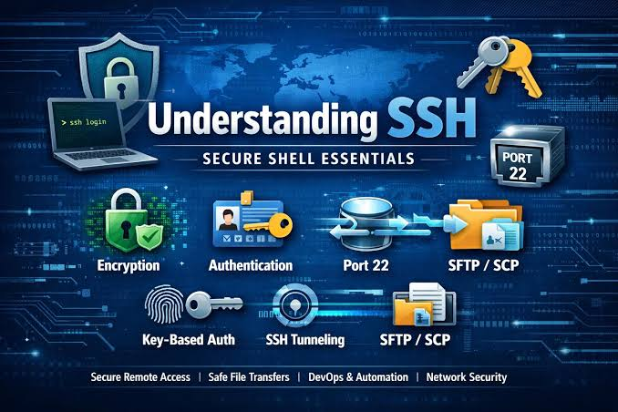
Introduction: Why “Secure Shell”?
SSH is called Secure Shell because all communication between client and host is encrypted.
01
Telnet sends passwords and commands in plain text
02
Anyone on the network can sniff and steal credentials
03
Goal: see how SSH secures remote access
SSH (Secure Shell)
COMPAS 2026
03
Notes:
Why is it called Secure Shell? Because the communication between host and client is in encrypted format. Telnet, by contrast, sends everything in plain text.

Slide 4
Related Work and Research Gap
Study / approach | Key idea | Relevant limitation
Telnet / rlogin / rsh | Remote login and commands | Plain-text passwords, easy to sniff
SSH-1 (Ylönen, 1995) | First encrypted replacement | Cryptographic weaknesses; superseded
SSH-2 (current) | Layered, modular protocol | MITM if host key is not verified
Research gap
Legacy tools sent data in plain text; a secure, authenticated channel was needed.
SSH (Secure Shell)
COMPAS 2026
04
Notes:
SSH-1 was designed in 1995 by Tatu Ylönen after a password-sniffing attack, as a replacement for rlogin, telnet and rsh.

Slide 5
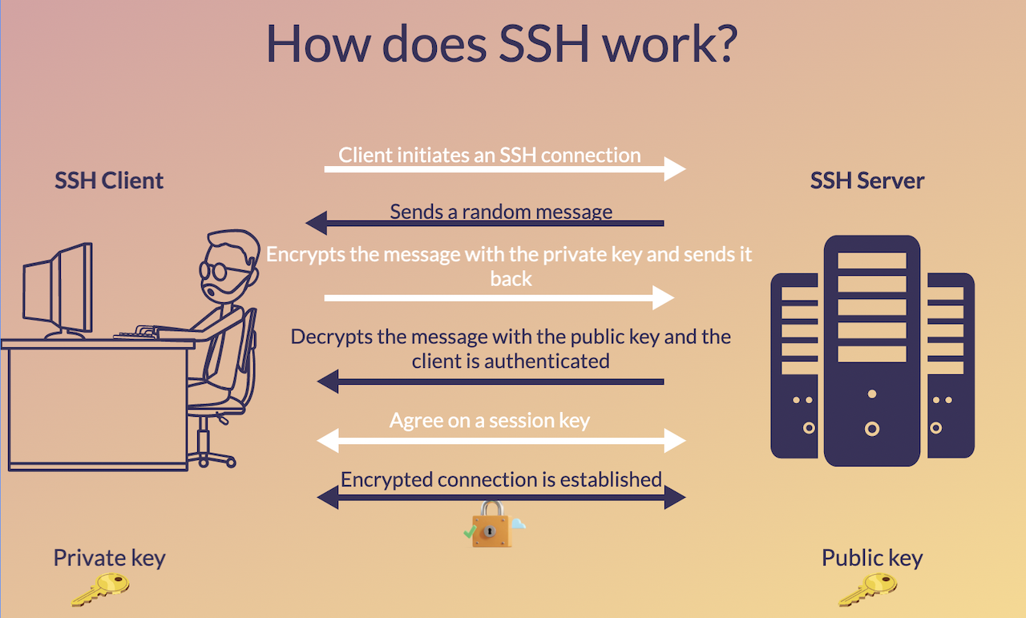
How SSH Works
Authentication and encryption of an SSH connection
01
Connect and verify server
Client connects; host key checked
02
Authenticate the user
Private key signs a challenge
03
Encrypted session
Both sides agree on a session key
SSH (Secure Shell)
COMPAS 2026
05
Notes:
Walk through: client initiates, server sends a random message, client encrypts it with the private key, server decrypts with the public key and the client is authenticated, then a session key is agreed and the connection is encrypted.

Slide 6
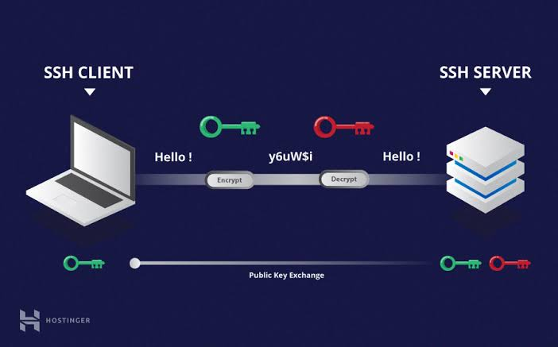
Public-Key Cryptography in SSH
Key idea
A public key and a private key form a pair.
Data locked with one key opens only with its partner.
Public-key exchange between SSH client and server (source: Hostinger)
SSH (Secure Shell)
COMPAS 2026
06
Notes:
Public key and private key pair; what one key encrypts only the other can decrypt.

Slide 7
SSH Setup and Configuration
Default port
TCP port 22; can be changed to a port above 1023
Protocol layers
Transport, User Authentication, Connection
Configuration files
/etc/ssh/: sshd_config, ssh_config, ssh_known_hosts
Implementations
OpenSSH, SSH Tectia, PuTTY, MindTerm
SSH (Secure Shell)
COMPAS 2026
07
Notes:
Default port 22. Layered protocols: transport (server authentication, confidentiality, integrity), user authentication, connection (multiplexes channels). OpenSSH config lives in /etc/ssh/.

Slide 8
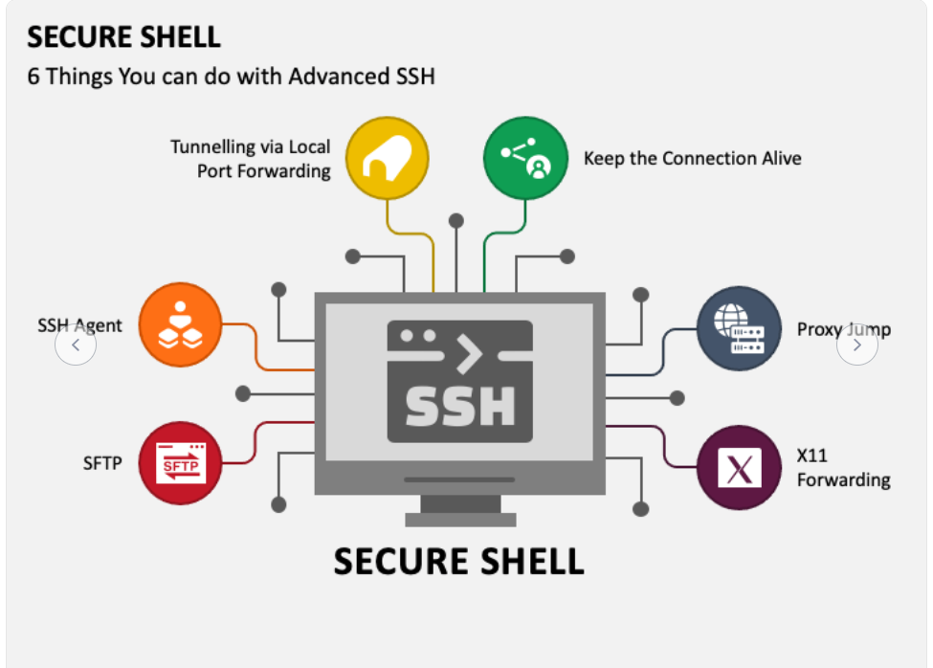
Advanced SSH Features
Key features
Strong encryption
Strong authentication
Authorization
Integrity of communication
Forwarding / tunneling
Six advanced capabilities: tunneling, SSH agent, SFTP, proxy jump, X11, keep-alive
SSH (Secure Shell)
COMPAS 2026
08
Notes:
Advanced uses: local port forwarding, SSH agent, SFTP, proxy jump, X11 forwarding, keep-alive.

Slide 9
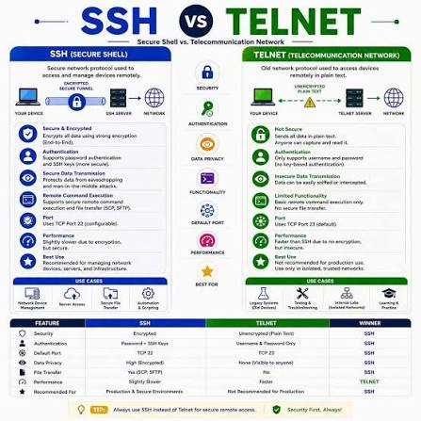
SSH vs Telnet
Main finding
SSH encrypts everything; Telnet sends plain text.
Use SSH for all remote access.
SSH (TCP 22, encrypted) versus Telnet (TCP 23, plain text)
SSH (Secure Shell)
COMPAS 2026
09
Notes:
SSH versus Telnet: encrypted vs plain text, port 22 vs 23.

Slide 10
Protocol Comparison
Protocol | Encryption | Default port | Authentication
Telnet | None (plain text) | 23 | Password only
SSH-1 | Weak, deprecated | 22 | Password / keys
SSH-2 | Strong encryption | 22 | Password / public key
SSH keeps Telnet’s remote-shell function but adds encryption, authentication and integrity.
SSH (Secure Shell)
COMPAS 2026
10
Notes:
Table comparing Telnet, SSH-1 and SSH-2.

Slide 11
Conclusions and Best Practices
SSH is the secure standard for remote access, encrypting every session.
01
Provides encryption, authentication, integrity and tunneling
02
Limitation: man-in-the-middle if the host key is not verified
03
Best practice: key-based login, verify host keys, never use Telnet
SSH (Secure Shell)
COMPAS 2026
11
Notes:
Attacks on SSH: man-in-the-middle (easy if the client lacks the server public key beforehand), denial of service, covert channels.

Slide 12
Selected References
[1] T. Ylönen, C. Lonvick, “The Secure Shell (SSH) Protocol Architecture,” RFC 4251, 2006.
[2] T. Ylönen, C. Lonvick, “The Secure Shell (SSH) Authentication Protocol,” RFC 4252, 2006.
[3] T. Ylönen, C. Lonvick, “The Secure Shell (SSH) Transport Layer Protocol,” RFC 4253, 2006.
[4] J. Postel, J. Reynolds, “Telnet Protocol Specification,” RFC 854, 1983.
SSH (Secure Shell)
COMPAS 2026
12
Notes:
References.

Slide 13
Thank you
Questions and Discussion
Most. Roksana Akter
Mawlana Bhashani Science and Technology University, Bangladesh
Any questions?
SSH (Secure Shell)
COMPAS 2026
13
Notes:
Questions and discussion.

