Slide 1


Olist Brazilian E-Commerce
Data Warehouse & BI Solution
IT3101 · DATA WAREHOUSING AND BUSINESS INTELLIGENCE
From raw marketplace data to an SSAS cube and three Power BI dashboards
SQL Server
SSIS
SSAS
Power BI
Group: IT24104110 · IT24103860 · IT24103869 · IT24104178
Notes:
Good morning. Our project builds a complete data warehouse and business intelligence solution on the Olist Brazilian e-commerce dataset, using the Microsoft BI stack: SQL Server, SSIS for ETL, SSAS for the OLAP cube and Power BI for the dashboards. I will give a short overview of how the solution was built, then spend most of the time on the three dashboards and what they tell the business.

Slide 2
The project at a glance
PROJECT OVERVIEW
Olist is a Brazilian online marketplace that connects small sellers with customers. We turned its order data into a warehouse that managers can query by time, product, seller and location.
99,441
112,650
3
R$ 13.49M
orders, September 2016 to October 2018
order items sold by 3,095 sellers
source types: database, CSV files, JSON API
real revenue analysed in the cube
Dataset: Brazilian E-Commerce Public Dataset by Olist (Kaggle), 9 CSV files, about 1.55 million rows
Notes:
The dataset comes from Olist's order management system, published on Kaggle. It has about one hundred thousand orders from September 2016 to October 2018, in nine related CSV files. That makes it a realistic OLTP source: normalised tables linked by keys. Our cube reports 13.49 million reais of real revenue, which excludes cancelled and unavailable orders.

Slide 3



Three sources of three different types
TASK 1 AND 2
S1 · Operational database
S2 · Reference CSV files
S3 · Holiday web API
Nager.Date REST API returns Brazilian public holidays as JSON for 2016 to 2018, with a saved copy as fallback.
SQL Server database Olist_OLTP_DB with 7 tables and primary and foreign keys: customers, sellers, products, orders, items, payments, reviews.
Geolocation (latitude and longitude per zip prefix) and the Portuguese to English category translation, read as UTF-8.
42 holidays
1,000,163 + 71 rows
550,688 rows
Notes:
We used three sources of three different formats, as a real company would. S1 is the operational SQL Server database holding the seven transactional tables. S2 is two CSV reference files: geolocation and the category translation. S3 is a live web API that returns Brazilian public holidays as JSON, which we use to flag holidays in the Date dimension. They join through zip code prefix, category name and calendar date.

Slide 4

A four-layer architecture
TASK 3
1 · SOURCE
2 · INTEGRATION
3 · STORAGE
4 · PRESENTATION
Olist_OLTP_DB
SSIS packages 00 to 03
Staging (stg)
SSAS cube Olist_Cube
CSV reference files
Warehouse (dw)
Holiday REST API
Extract, transform, load
Data marts (mart)
Power BI Desktop
ETL log (etl)
3 dashboard pages
16 validation checks
All storage lives in one SQL Server database, Olist_DW, separated by four schemas.
Notes:
The architecture has four layers. Sources are read once by SSIS: package 01 extracts everything into staging, packages 02 and 03 transform and load the dimensions and facts, and master package 00 runs them in order and then runs 16 validation checks. Storage is one database, Olist_DW, split into four schemas: staging, the warehouse, the data marts and the ETL log. On top, the SSAS cube provides the OLAP model and Power BI connects live to it.

Slide 5
Quality problems found, and how we handled them
TASK 2 · DATA PROFILING
Finding | Evidence | Handling in the ETL
One person, many customer IDs | 99,441 rows, 96,096 real customers | One customer per customer_unique_id
Orders never delivered | 2,965 without a delivery date | Delivery measures left empty
Products without a category | 610 products | Category set to Unknown
Several reviews per order | 99,224 reviews, 98,673 orders | Keep the latest review
Geolocation points outside Brazil | 42 points | Removed, then averaged per zip
State-only holidays | 3 of 42 not nationwide | Flag national holidays only
Notes:
Before designing the ETL we profiled the data with SQL queries. The biggest finding is that customer_id changes with every order, so 99,441 customer rows are really 96,096 people. We also found undelivered orders, products without a category, duplicate reviews, geolocation points outside Brazil and three state-only holidays in the national list. Each finding has a rule that is applied during transformation.

Slide 6
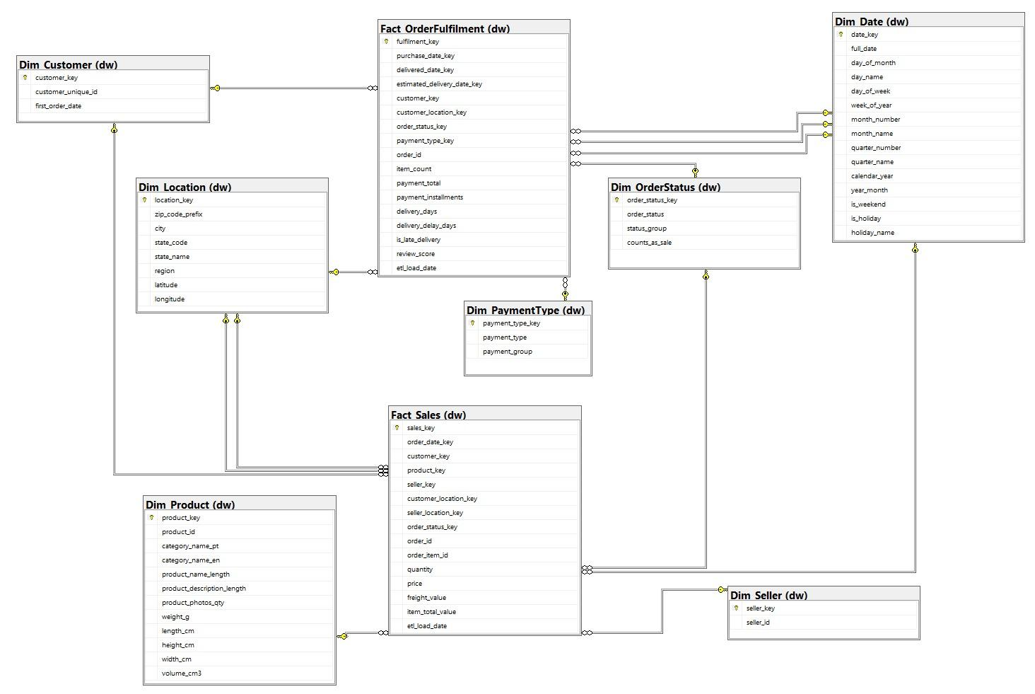
Fact constellation schema
TASK 4
Fact_Sales
One row per order item · 112,650 rows
Fact_OrderFulfilment
One row per order · 99,441 rows
7 shared dimensions with surrogate keys and an Unknown member. Date plays 3 roles; Location plays 2 (customer and seller).
Notes:
The warehouse uses two fact tables that share the same dimensions, which is a fact constellation or galaxy schema. Fact_Sales stores one row per item for sales analysis. Fact_OrderFulfilment stores one row per order, because delivery, payment and review values belong to the whole order and repeating them on every item would distort averages. Date is a role-playing dimension used for purchase, delivered and estimated dates, and Location is used for both customer and seller locations.

Slide 7

ETL with four SSIS packages
TASK 5
PACKAGE 01
PACKAGE 02
PACKAGE 03
PACKAGE 00
Extract
Dimensions
Facts
Master
7 OLE DB flows, 2 flat file flows, Script Task calls the holiday API
T-SQL source queries clean, standardise and derive, then load 7 dimensions
Look up surrogate keys and load both fact tables
Runs 01, 02, 03 in order, then the validation procedure
16 of 16 validation checks passed: row counts, item price R$ 13,591,643.70, freight and payment totals all match the source
Notes:
The ETL is one SSIS project with four packages. Package 01 extracts all three sources into staging. Package 02 transforms and loads the seven dimensions, using T-SQL source queries for cleaning, standardising and deriving attributes. Package 03 looks up the surrogate keys and loads the two fact tables. The master package runs them in order and then a validation procedure with 16 checks. All 16 passed on repeated runs, so the load is complete and repeatable.

Slide 8
Two department data marts
TASK 6
Sales Mart
Delivery & Satisfaction Mart
Users: sales and marketing managers
Users: operations and customer service
Grain: one row per sold item, from Fact_Sales
Grain: one row per order, from Fact_OrderFulfilment
Rule: only real sales; 549 items from cancelled or unavailable orders removed
Rule: only delivered orders, so every delivery measure is meaningful
112,101 rows
96,476 rows
Built as SQL views in the mart schema, so they always show current warehouse data.
Notes:
From the warehouse we built two department data marts as views. The Sales Mart gives sales and marketing a flat table of real sales: it removes the 549 items of cancelled and unavailable orders, leaving 112,101 rows. The Delivery and Satisfaction Mart gives operations one row per delivered order with delivery time, lateness, payment and review score, 96,476 rows. Because they are views, they need no extra ETL step.

Slide 9
SSAS cube Olist_Cube
TASK 7 · OLAP
Hierarchies for drill-down and roll-up
Verified against the warehouse
Calendar · Year › Quarter › Month › Date
Measure | Cube result
Revenue (real sales) | 13,494,400.74
Sales orders | 98,199
Items sold | 112,101
Delivered orders | 96,476
Avg delivery days | 12.50
Avg review score | 4.09
Geography · Region › State › City › Zip
Product · Category › Product
Payment · Group › Type
Status · Group › Status
Two measure groups, calculated members for revenue and averages.
Notes:
The OLAP layer is an SSAS multidimensional cube. It has the seven dimensions, with Location used twice and Date used three times, two measure groups for sales and order fulfilment, and calculated members for revenue, average delivery days, average review score and late delivery percentage. The user hierarchies give us drill-down and roll-up. Every cube total was checked against the warehouse, and Power BI shows the same numbers because it connects live to the cube. In the cube browser we demonstrated roll-up, drill-down, slice, dice and pivot.

Slide 10
The dashboards
POWER BI · LIVE CONNECTION TO THE CUBE
01 Executive Summary
02 Trend Analysis
03 Interactive Analysis
Overall performance at a glance
Growth, seasonality, delivery and satisfaction over time
Regions, states and drill-down
Every page covers January 2017 to August 2018; the five nearly empty months are filtered out.
Notes:
Now the main part: the dashboards. The Power BI report connects live to the cube, so every number matches the cube. All three pages share one design: a sidebar with page navigation and slicers for Year, State City and Product Category. A month filter removes the five nearly empty months at the start and end, so every page covers January 2017 to August 2018.

Slide 11
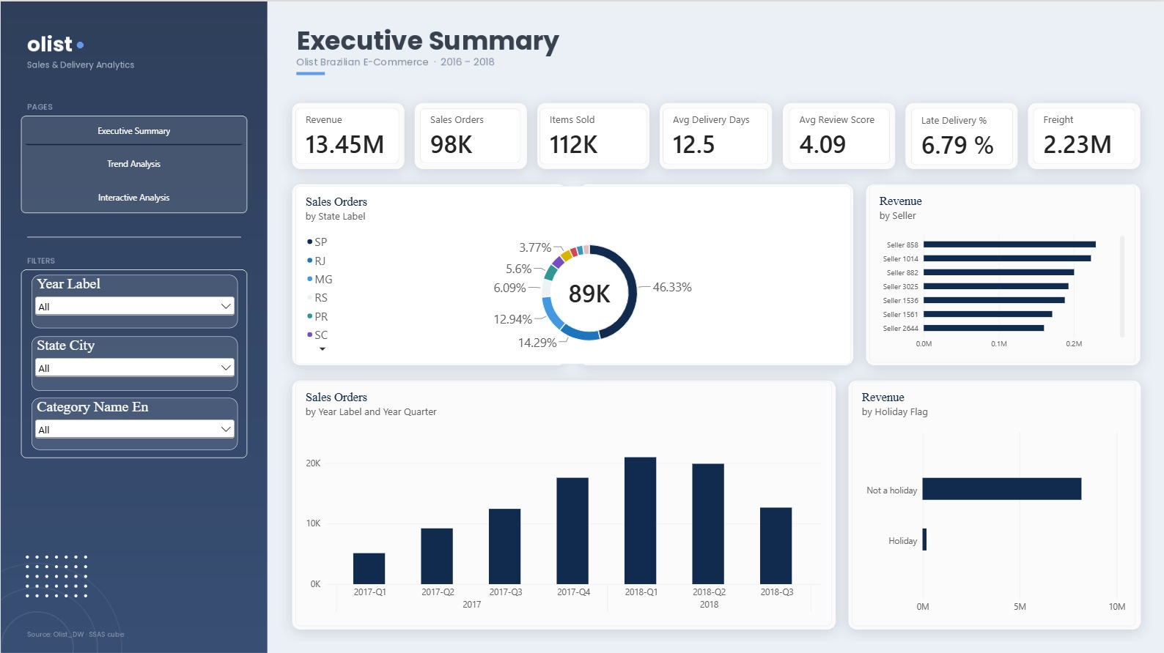
Executive Summary
DASHBOARD 01
R$ 13.45M
revenue, 98K orders, 112K items
46%
of orders go to São Paulo state
4.09 ★
average review, 12.5 delivery days, 6.79% late
~2%
of revenue from the largest seller
Notes:
The Executive Summary gives managers the overall position. Seven KPI cards show revenue of 13.45 million reais for January 2017 to August 2018, about 98 thousand orders and 112 thousand items, an average delivery of 12.5 days, 6.79 percent late deliveries and an average review of 4.09. The donut shows that São Paulo state receives about 46 percent of orders. The quarterly chart shows orders growing from about 5 thousand in 2017 Q1 to about 21 thousand in 2018 Q1. Health and beauty, watches and gifts, and bed bath table lead the categories, and the largest seller brings only about 2 percent of revenue, so the business does not depend on one seller.

Slide 12
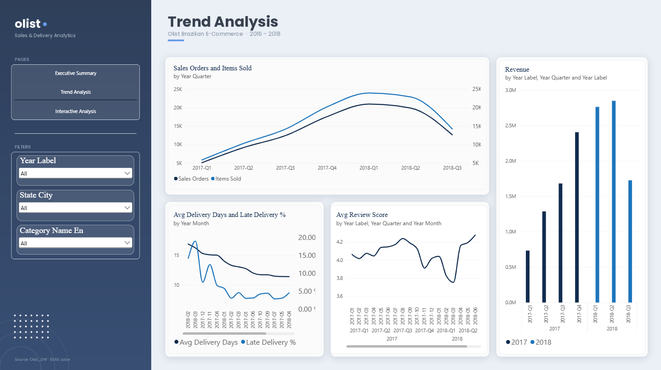
Trend Analysis
DASHBOARD 02
×4
orders from 2017-Q1 to 2018-Q1
7,544
orders in Nov 2017, the biggest month
~17 days
delivery in Feb 2018, the slowest month
3.75 ★
review low in Mar 2018, after the peaks
Notes:
The Trend Analysis page shows change over time. Orders grew about four times from 2017 Q1 to 2018 Q1, and revenue 3.8 times. Growth then levelled off in 2018. November 2017, Black Friday, was the biggest month with 7,544 orders. The delivery chart shows the slowest deliveries in February 2018 at about 17 days, and the review chart shows the score dropping to about 3.9 in November 2017 and 3.75 in March 2018, right after the two busiest periods, before recovering to about 4.3 by June 2018. The revenue chart compares each quarter of 2017 with 2018. The 2018 Q3 drop is only because that quarter holds July and August.

Slide 13
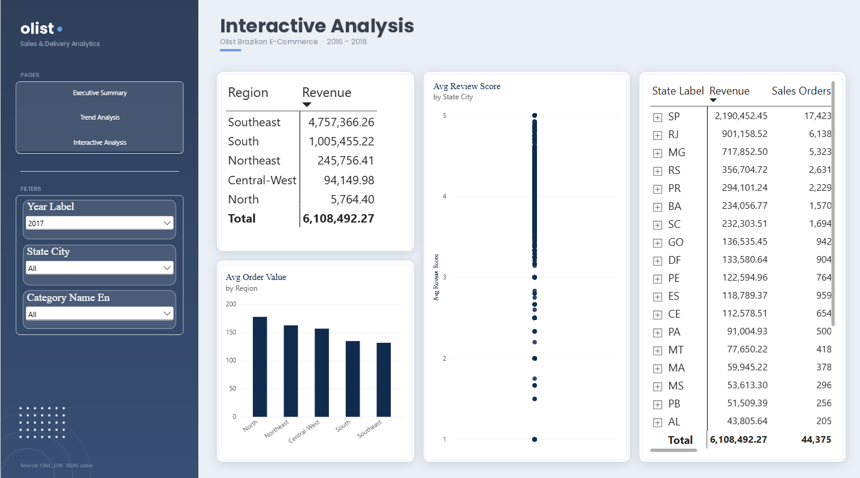
Interactive Analysis
DASHBOARD 03 · YEAR SLICER = 2017
77.9%
of 2017 revenue from Southeast sellers
R$ 178
order value in the North vs R$ 130 Southeast
35.9%
of 2017 revenue from São Paulo alone
Notes:
The Interactive Analysis page is for exploring. Here the Year slicer is set to 2017. The region table shows that sellers in the Southeast produced 77.9 percent of 2017 revenue, more than the 64 percent bought by Southeast customers, so a lot of goods ship long distances. The bar chart shows customers in remote regions spend more per order: about 178 reais in the North against 130 in the Southeast. The matrix on the right uses the Geography hierarchy: clicking plus on a state drills down to its cities, and the up arrow rolls back up. São Paulo alone produced 35.9 percent of 2017 revenue.

Slide 14
Key insights and recommendations
TASK 8
×4 demand
Nov 2017
62.4%
Fast growth
Biggest spike, then a plateau
Revenue from SP, RJ, MG
Plan carriers and staff on the 2018 run rate
Prepare stock and delivery before November
Protect them; target BA, SC and GO next
77.9%
3.75 ★
1.03
Sellers in the Southeast
Slow peaks hurt reviews
Orders per customer
Recruit sellers closer to other regions
Add capacity before peaks; warn late customers
Start a repeat-purchase programme
Notes:
From the dashboards we drew eight insights; here are six. Demand grew about four times in a year, so capacity must be planned on the 2018 level. November 2017 was the biggest spike and growth then levelled off, so peaks need early preparation. São Paulo, Rio and Minas Gerais bring 62.4 percent of revenue. Sellers are even more concentrated: 77.9 percent of revenue comes from Southeast sellers, so we recommend recruiting sellers nearer other regions. Delivery slowed after the two busiest periods and reviews fell to about 3.75, so capacity should be added before peaks. And customers rarely come back, about 1.03 orders per customer, so a repeat-purchase programme is the clearest opportunity.

Slide 15
Thank you · Questions?
Notes:
To summarise: three different sources are integrated by an SSIS ETL that is validated by 16 checks, stored in a fact constellation warehouse with two department data marts, analysed through an SSAS cube, and presented in three Power BI dashboards that support decisions on growth, regions, sellers, delivery and customer retention. The main limitations are that there is no cost or profit data, the first and last months are incomplete, and customers and sellers are anonymised. Thank you, we are happy to take questions.

