Slide 1
New output variables in SIMC
Reynier Cruz Torres
May 31, 2017
simc version: “simc_gfortran.12”

Slide 2
Momentum variables
h_spec_p: hadron spectrometer central momentum [MeV/c]
h_pfi: hadron generated momentum [MeV/c]
h_pf: hadron reconstructed momentum [MeV/c]
e_spec_p: electron spectrometer central momentum [MeV/c]
e_pfi: electron generated momentum [MeV/c]
e_pf: electron reconstructed momentum [MeV/c]
Angular variables
h_spec_th: hadron spectrometer central angle
theta_pi: hadron generated in-plane angle
theta_p: hadron reconstructed in-plane angle
e_spec_th: electron spectrometer central angle [degrees]
theta_ei: electron generated in-plane angle [degrees]
theta_e: electron reconstructed in-plane angle [degrees]
theta_rq: recoil-q angle [degrees]
Other variables
xB: Bjorken scaling variable

Slide 3
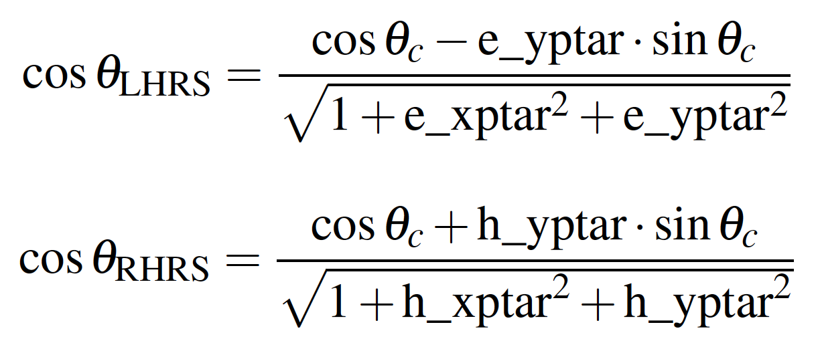
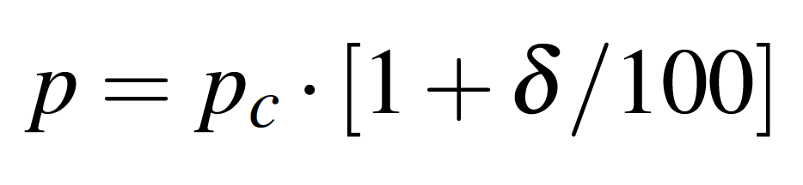
Generated and reconstructed, proton and electron in-plane angles (theta_pi, theta_p, theta_ei, theta_e)
Generated and reconstructed, proton and electron momenta (h_pfi, h_pf, e_pfi, e_pf)
All the variables with subscript C denote spectrometer central parameters.
All the variables starting with e_ (h_) denote electron (hadron) arm variables
θrq = acos(-PmPar/Pm)
Recoil – q angle (theta_rq)
Pm: Missing momentum magnitude
PmPar: Missing momentum component parallel to the q vector

Slide 4

Approximation for the in-plane angle equation
In the limit where xptar and yptar are small (as is the case most of the time), the denominator can be neglected. Also: yptar≈sin(yptar) and 1≈cos(yptar). Thus:
(
)
(
)

