Slide 1
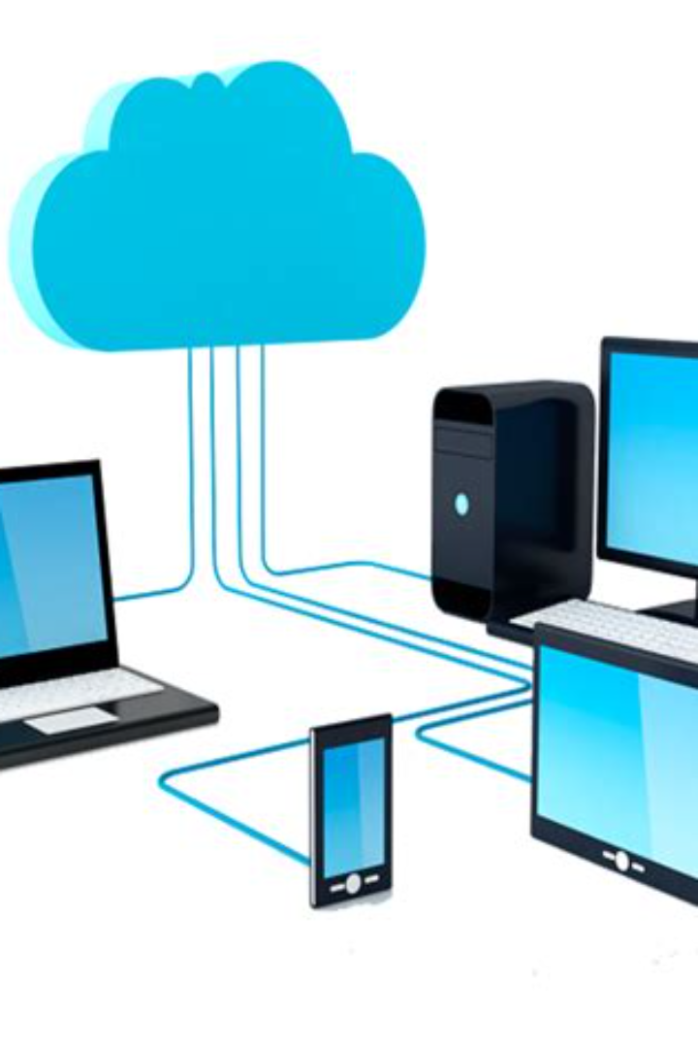

Menoufia University
Faculty of Computers and Information
Department of Information Technology
Network Management and Analysis
Network Management and Analysis course. This will be an overview of the different topics that we will cover in this course.
by Dr /Amina Mohamed
4 -10 -2023

Slide 2

Agenda
Lecture 1

Slide 3
Agenda
Main course topics
  Datacenters
  Desktop and service virtualization
  Multimedia network application
  Network management
  Firewall
  SAN & NAS Storage networks.
  Software Defined Networks (SDN)

Slide 4
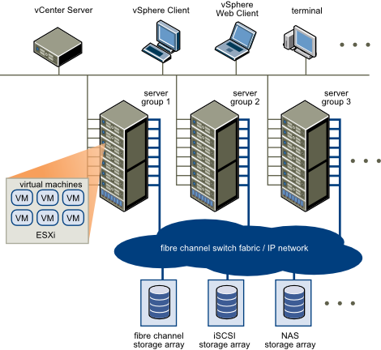
Datacenter

Slide 5

Desktop and Service Virtualization
Virtualization is the creation of a virtual version of something, such as a server, operating system, storage device, or network resource. Desktop and service virtualization allows organizations to optimize resources, reduce costs, and improve efficiency.
In this section, we will explore how desktop and service virtualization work and their benefits in network management.

Slide 6
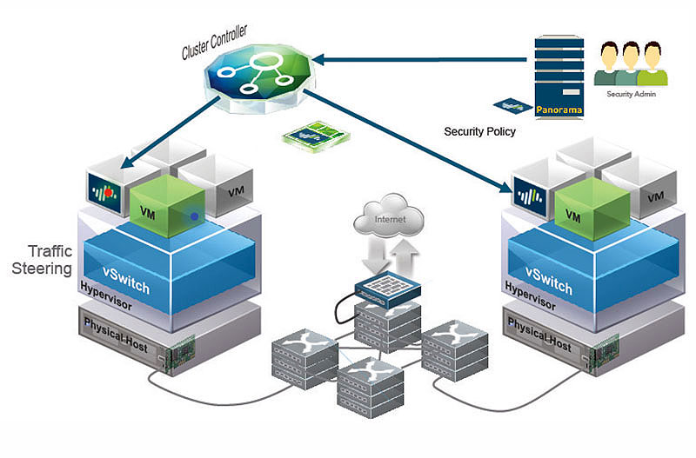
Desktop and Service Virtualization

Slide 7

Multimedia Network Application
Multimedia network application refers to any network application that employs audio or video. In this section, we will discuss the properties of video and audio, their compression formats, and the different types of multimedia network applications.

Slide 8

Network Management
Network management is the process of administering, managing, and maintaining a network infrastructure. It ensures the performance, availability, and security of the network infrastructure.
In this section, we will discuss the different network management tools and techniques that are used to manage a computer network effectively.

Slide 9

Firewall
A firewall is a software or hardware-based network security system that controls incoming and outgoing network traffic by analyzing data packets and determining whether they should be allowed through or not. Firewall protection is essential to secure a network from external threats.
In this section, we will discuss how firewalls work and their role in network management.

Slide 10
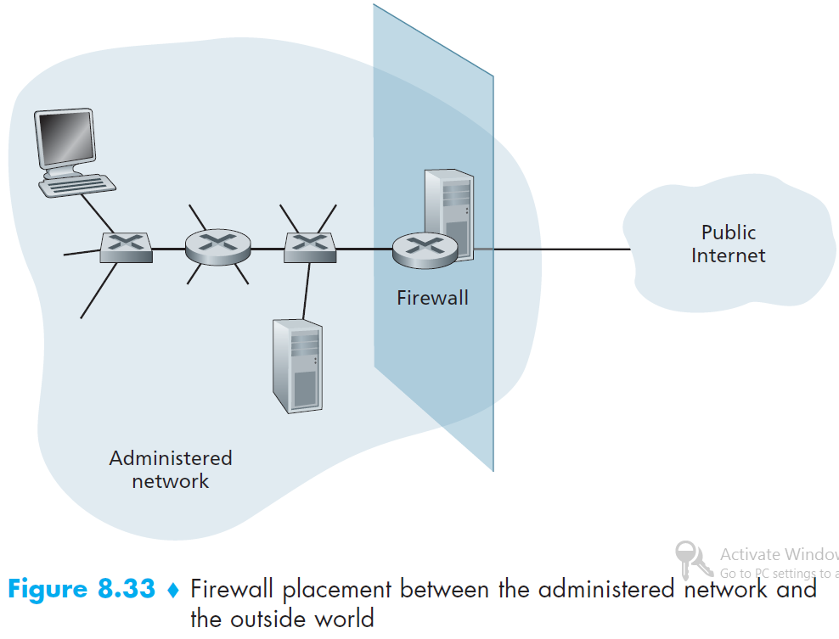
Operational Security: Firewalls

Slide 11
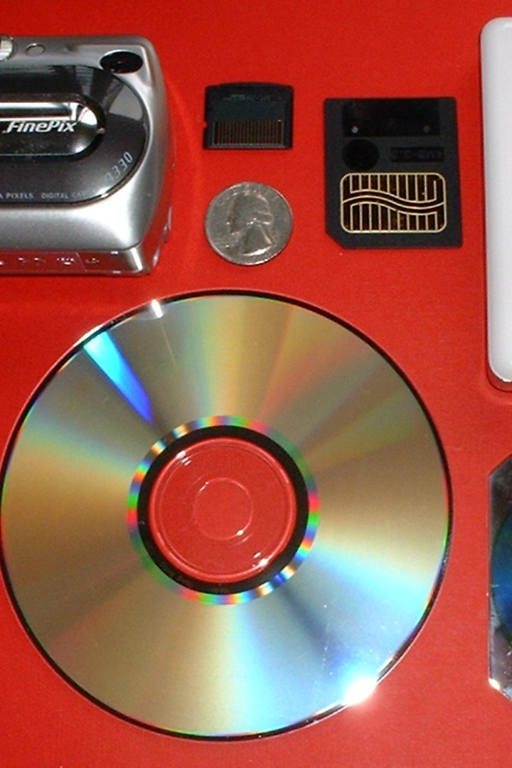
SAN & NAS Storage Networks
Storage Area Network (SAN) and Network Attached Storage (NAS) are two different storage architectures that are used to store and manage data in computer networks.
In this section, we will explore the differences between SAN and NAS, their benefits and disadvantages, and their role in network management.

Slide 12
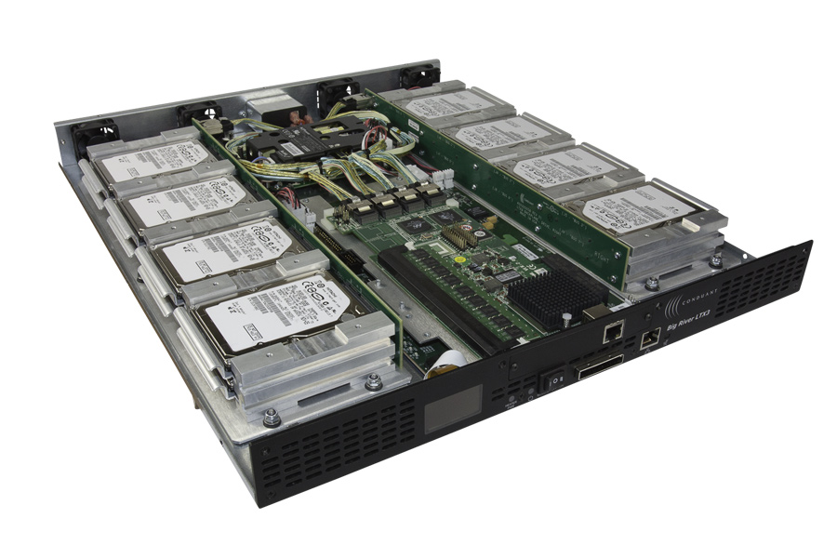
SAN & NAS Storage Networks
Example of Storage Array

Slide 13
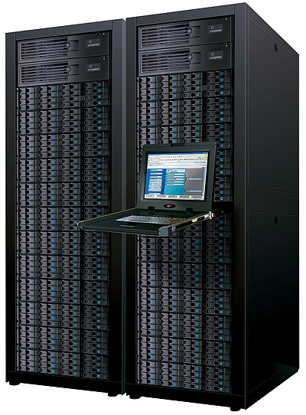
SAN & NAS Storage Networks
Example of Storage Array

Slide 14
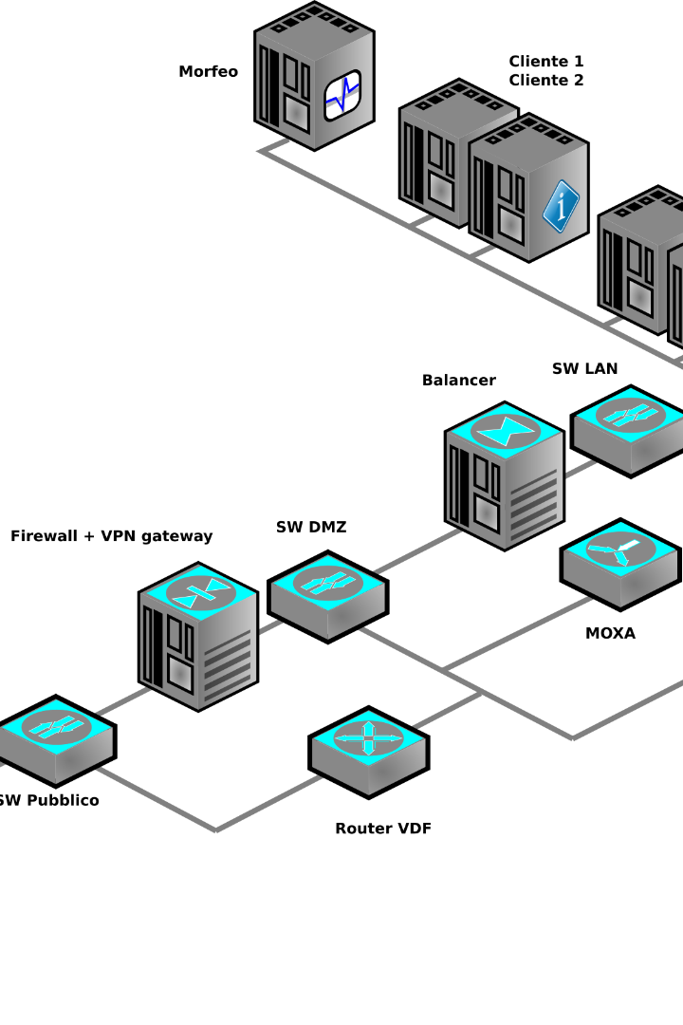
Software Defined Networks (SDN)
Software-defined networking (SDN) is an architectural approach to network management that enables the centralized management of network infrastructures through software.
In this section, we will discuss how SDN works, its benefits, and its role in network management.

Slide 15
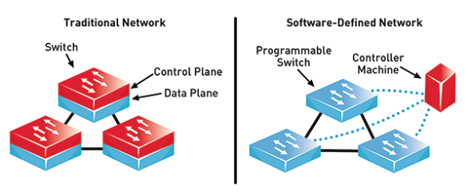
Software Defined Networks (SDN)

Slide 16

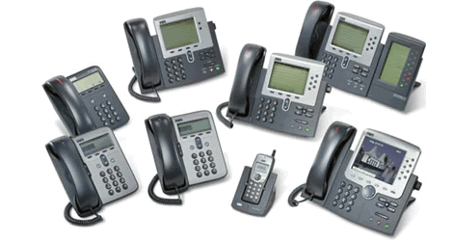

Network Multimedia Applications
Dr. Tamer Fathy

