Slide 1
Perl – The Master Manipulator

Slide 2
Introduction
Perl: Perl stands for Practical Extraction and Reporting Language.
The language was developed by Larry Wall.
Perl is a popular programming language because of its powerful pattern matching capabilities, rich library of functions for arrays, lists and file handling.

Slide 3
A perl program runs in a special interpretive model
The entire script is compiled internally in memory before being executed. Script errors, if any, are generated before execution.
Unlike awk, printing isn’t perl’s default action. Like C, all perl statements end with a semicolon.
Perl statements can either be executed on command line with the –e option or placed in .pl files.

Slide 4
Sample script
#!/usr/bin/perl
print "Please enter the first number: \n";
$n1 = <STDIN>;
print "Please enter the first number: \n";
$n2 = <STDIN>;
print "Please enter the third number: \n";
$n3 = <STDIN>;
$sum = $n1 + $n2 + $n3;
printf ("The sum of three numbers %d, %d, and %d is %d \n\n", $n1,$n2, $n3,$sum);

Slide 5
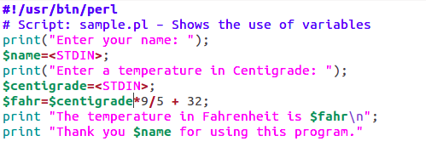
Sample script

Slide 6
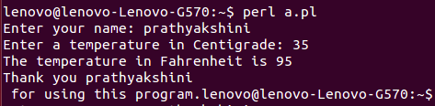
output

Slide 7
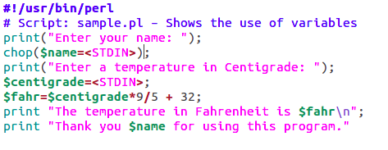
Sample script: using chop()

Slide 8
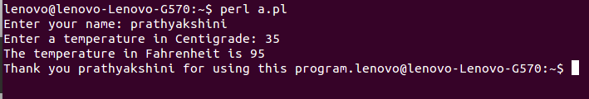
output

Slide 9
The chop function
The chop function is used to remove the last character of a line or string.
In the above program, the variable $name will contain the input entered as well as the newline character that was entered by the user.
In order to remove the \n from the input variable,
we use chop($name).
Example:
chop($var); will remove the last character contained in the string specified by the variable var.

Slide 10
Variables and Operators
Perl variables have no type and need no initialization. However we need to precede the variable name with a $ for both variable initialization as well as evaluation.
Example:
$var=10;
print $var;

Slide 11
Important Points
1. When a string is used for numeric computation or comparison, perl converts it
into a number.
2. If a variable is undefined, it is assumed to be a null string and a null string is
numerically zero. Incrementing an uninitialized variable returns 1.
3. If the first character of a string is not numeric, the entire string becomes
numerically equivalent to zero.
4. When Perl sees a string in the middle of an expression, it converts the string to an
integer. To do this, it starts at the left of the string and continues until it sees a
letter that is not a digit. Example: "12O34" is converted to the integer 12, not
12034.

Slide 12
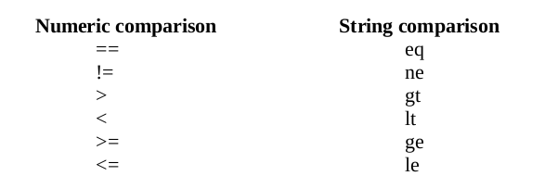
Comparison Operators
Perl supports operators similar to C for performing numeric comparison.

Slide 13
Concatenating and Repeating Strings
Perl provides three operators that operate on strings:
The . operator, which joins two strings together;
The x operator, which repeats a string; and
The .= operator, which joins and then assigns.

Slide 14
The . operator joins the second operand to the first operand:
Example:
$a = “Info" . “sys"; # $a is now “Infosys"
$x=”microsoft”; $y=”.com”; $x=$x . $y; # $x is now “microsoft.com”

Slide 15
This join operation is also known as string concatenation.
The x operator (the letter x) makes n copies of a string, where n is the value of the right operand:
Example:
$a = “R" x 5;
# $a is now “RRRRR"
The .= operator combines the operations of string concatenation and assignment:
Example:
$a = “VTU";
$a .= “ Belgaum";
# $a is now “VTU Belgaum"

Slide 16
String Handling Functions
1. length determines the length of its argument.
2. index(s1, s2) determines the position of a string s2 within string s1.
3. substr(str,m,n) extracts a substring from a string str, m represents the starting point of extraction and n indicates the number of characters to be extracted.

Slide 17
4. uc(str) converts all the letters of str into uppercase.
5. ucfirst(str) converts first letter of all leading words into uppercase.
6. reverse(str) reverses the characters contained in string str.

Slide 18
Perl Command Line Arguments
The @ARGV array holds the command line argument.
To access your script's command-line arguments, you just need to read from @ARGV array.
Perl allows using @ARGV array as filenames by using <>. The $ARGV contains the name of the current file when reading from <>.

Slide 19
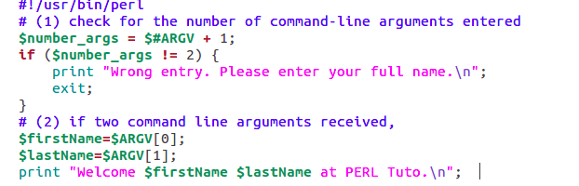

Slide 20

output

Slide 21
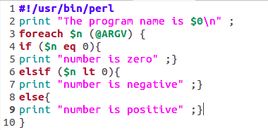

Slide 22

output

