Slide 1

SIMPLE FILTERS

Slide 2
SIMPLE FILTERS
Commands which accept data from standard input, manipulate it and write the results to standard output
Each filter performs a simple function
Some commands use delimiter, pipe (|) or colon (:)
Many filters work well with delimited fields, and some simply won’t work without them

Slide 3
The piping mechanism allows the standard output of one filter serve as standard input of another
The filters can read data from standard input when used without a filename as argument, and from the file otherwise

Slide 4
THE SIMPLE DATABASE
Several UNIX commands are provided for text editing and shell programming (emp.lst)
Each line of this file has six fields separated by five delimiters
The details of an employee are stored in one single line
2233 | a.k.shukla | g.m | sales | 12/12/52 | 6000

Slide 5
pr : paginating files
We know that,
cat dept.lst
  01|accounts|6213
  02|progs|5423
  03|marketing|6521
  04|personnel|2365
  05|production|9876
  06|sales|1006

Slide 6
pr command adds suitable headers, footers and formatted text
pr adds five lines of margin at the top and bottom
The header shows the date and time of last modification of the file along with the filename and page number

Slide 7
pr dept.lst
  May 06 10:38 1997 dept.lst page 1
  01:accounts:6213
  02:progs:5423
  03:marketing:6521
  04:personnel:2365
  05:production:9876
  06:sales:1006

Slide 8
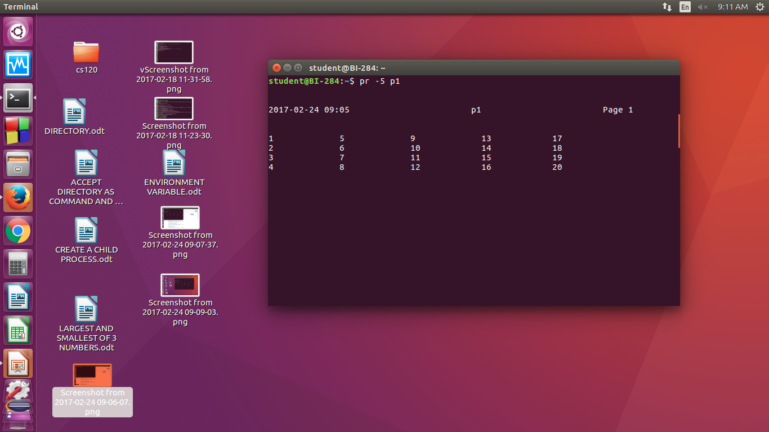
pr options
Notes:
pr adds five lines of margin at the top and bottom. The header shows the date and time of last modification of the file along with the filename and page number

Slide 9
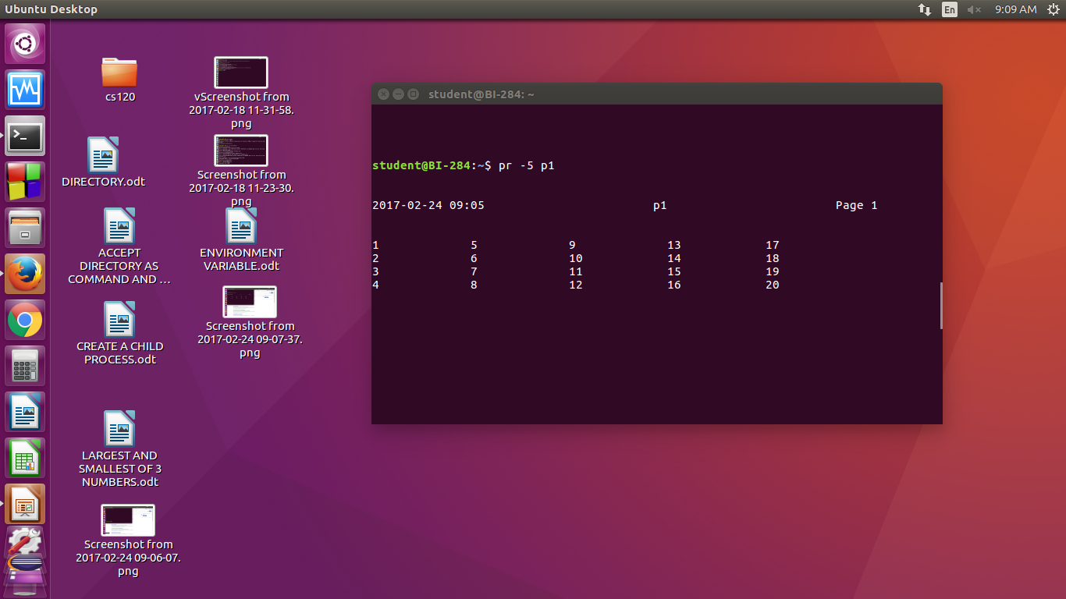
pr option -k

Slide 10
pr options
-k prints k (integer) columns
-t to suppress the header and footer
-h to have a header of user’s choice
-d double spaces input
-n will number each line and helps in debugging
-on offsets the lines by n spaces and increases left margin of page

Slide 11
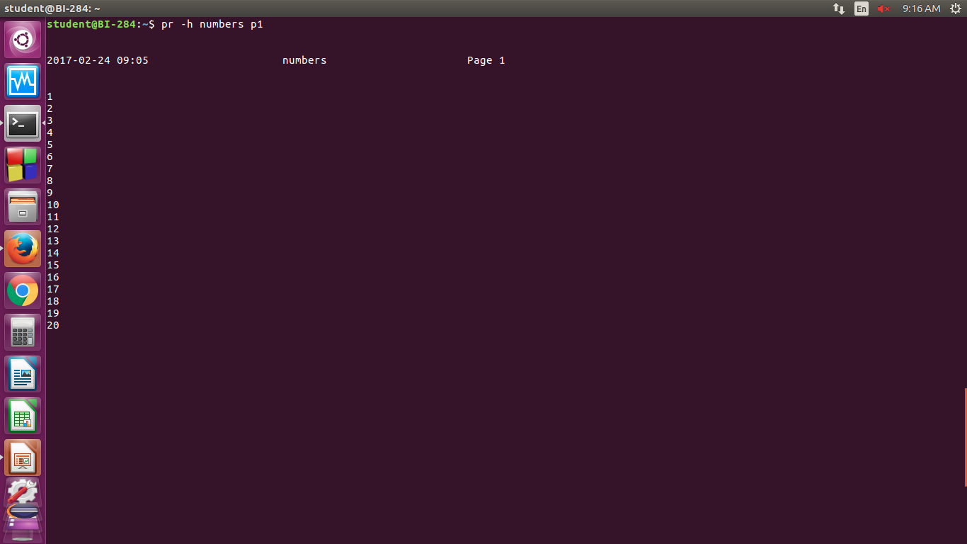
-h option

Slide 12
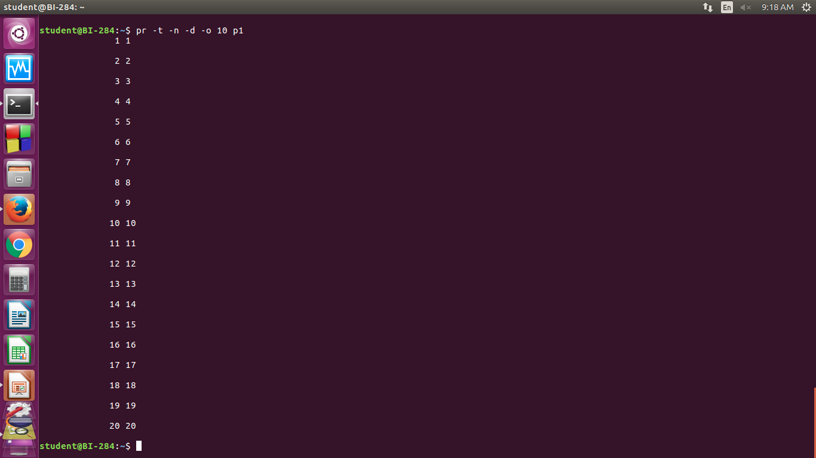
Example

Slide 13
pr +10 chap01
starts printing from page 10
pr -l 54 chap01
this option sets the page length to 54

Slide 14
head
Displays the top of the file
It displays the first 10 lines of the file, when used without an option
head emp.lst
-n to specify a line count
head -n 3 emp.lst

Slide 15
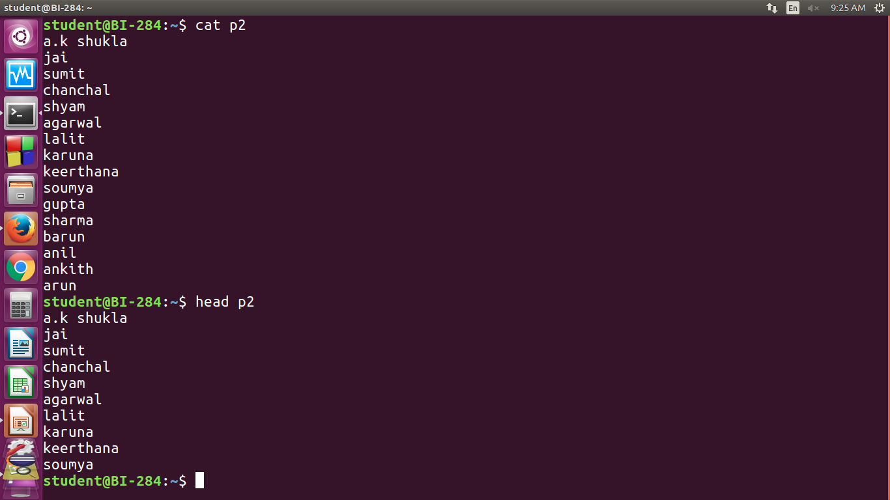
Example
Notes:
head p2 shows firstb10 lines. –n option specifies line count

Slide 16
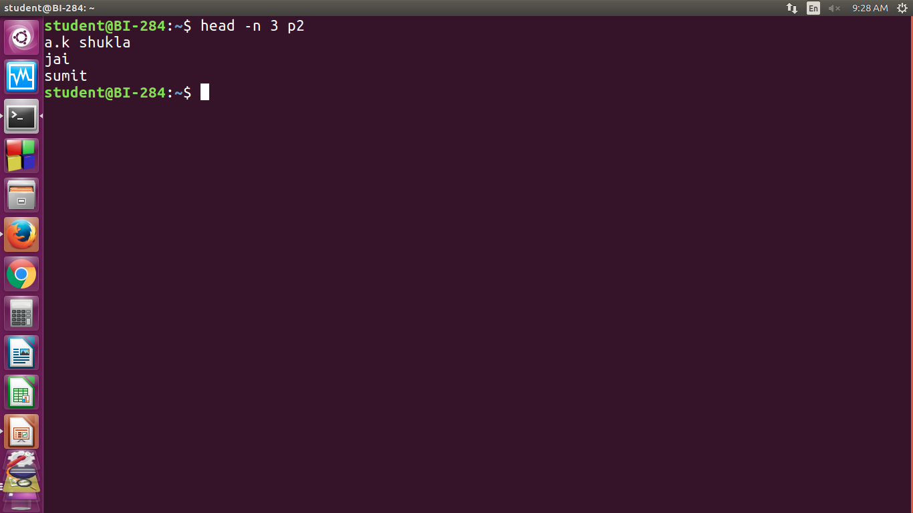

Slide 17
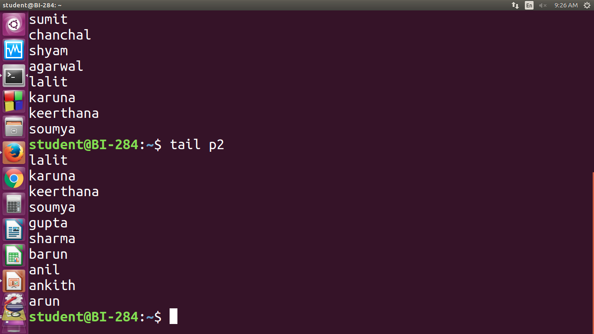
Notes:
tail p2 shows last 10 lines of file when option is not used.

Slide 18
tail
Displays the end of the file
It displays the last 10 lines of the file, when used without an option
tail emp.lst
-n to specify a line count
tail -n 3 emp.lst
Monitoring the file growth (-f)
Extracting bytes rather than lines (-c)

Slide 19
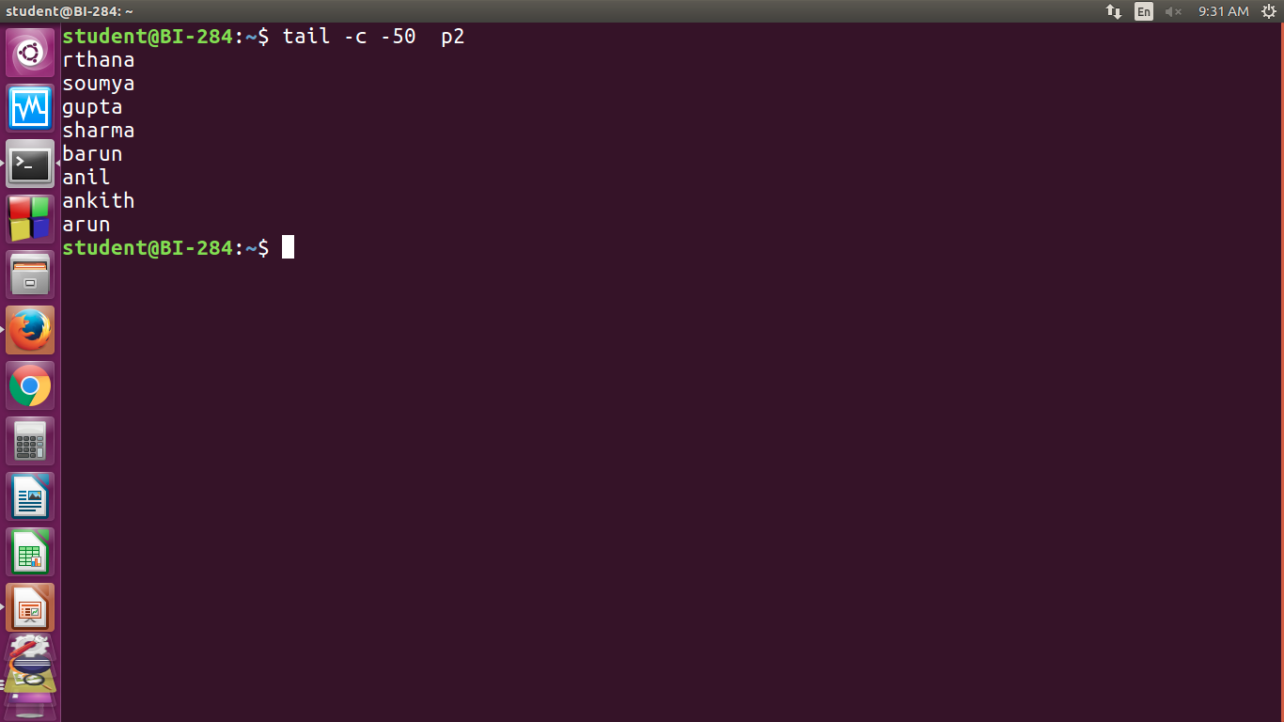
Notes:
tail –c -50 p2 copies last 50 bytes from p2. tail –c +50 p2 copies everything after skipping 50 bytes.

Slide 20
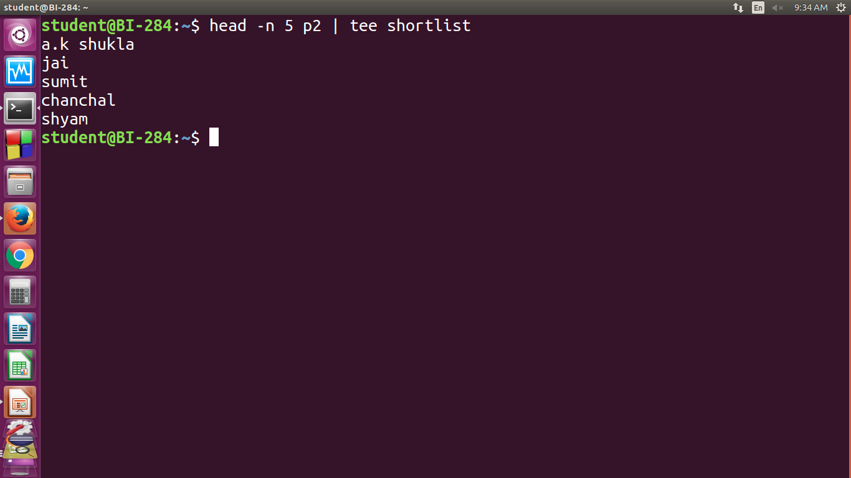
Notes:
Here tee saves the output in shortlist & also displays it on the terminal

Slide 21
cut
It is used for slitting the file vertically
head -n 5 emp.lst | tee shortlist
will select the first five lines of emp.lst and saves it to shortlist
We can cut by using -c option with a list of column numbers, delimited by a comma (cutting columns)
cut -c 6-22,24-32 shortlist
cut -c -3,6-22,28-34,55- shortlist

Slide 22
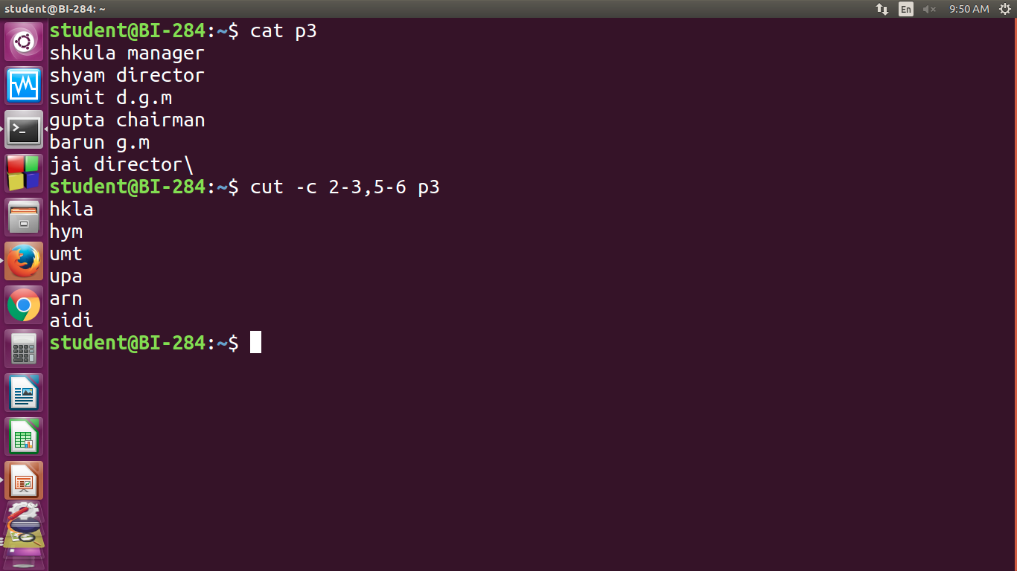
Example

Slide 23
Most files don’t contain fixed length lines, so we have to cut fields rather than columns (cutting fields)
-d for the field delimiter
-f for the field list
cut -d \ | -f 2,3 shortlist | tee cutlist1
will display the second and third columns of shortlist and saves the output in cutlist1. here | is escaped to prevent it as pipeline character

Slide 24
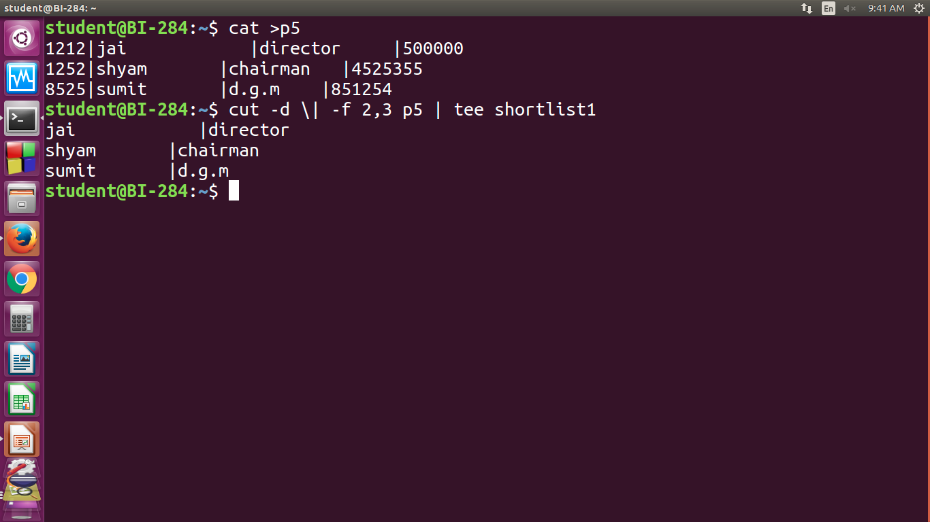
Example

Slide 25
paste
When we cut with cut, it can be pasted back with the paste command, vertically
paste cutlist1 cutlist2
We can view two files side by side

Slide 26
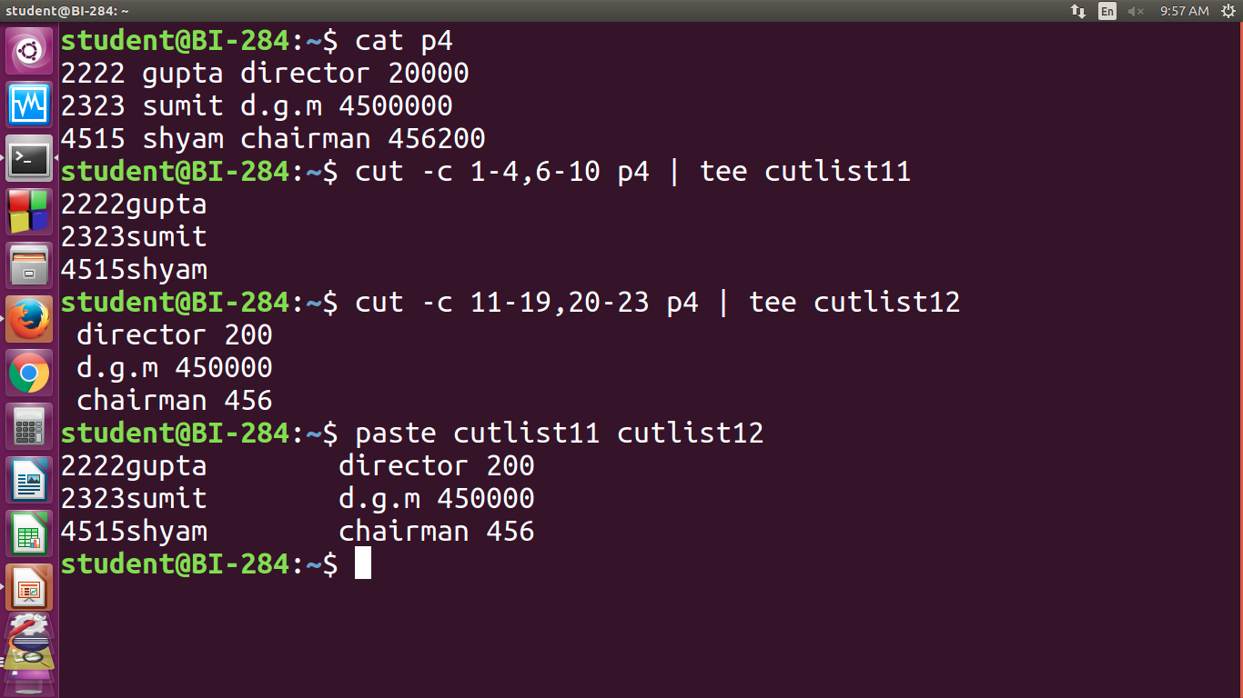
Notes:
Paste uses tab as default delimiter but we can specify one or more delimiter with -d

Slide 27
$paste -d”|” cutlist1 cutlist2
Specifyling delimiter using -d option.
$cut -d \| -f 1,4- shortlist | paste -d “|” cutlist1 -
You can reverse the order of pasting by altering the location of the – sign.

Slide 28
$cut -d \| -f 1,4- shortlist | paste -d “|” - cutlist1
Joining Lines : (-s)
Joins all the lines to form a single line.
Example- address book

Slide 29
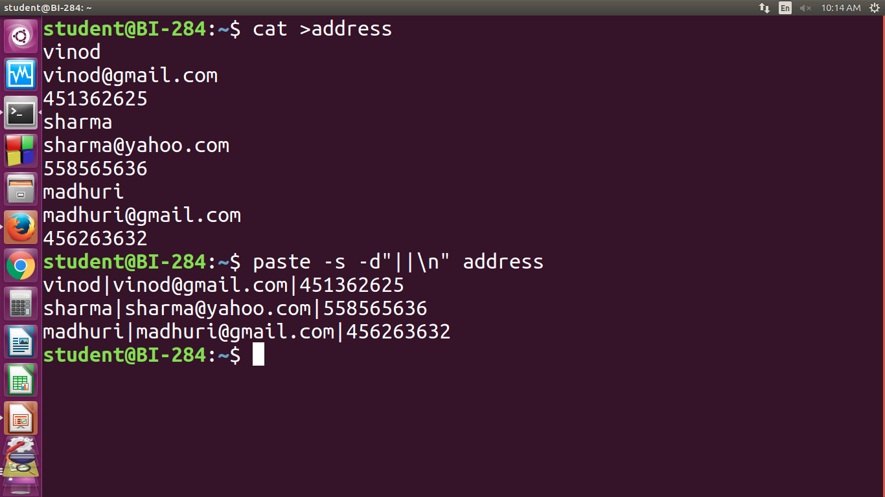
Example

Slide 30
The first and second lines would be joined with the | as delimiter, and the same would be true for the second and third line.
Third and fourth line would be separated by a newline.

Slide 31
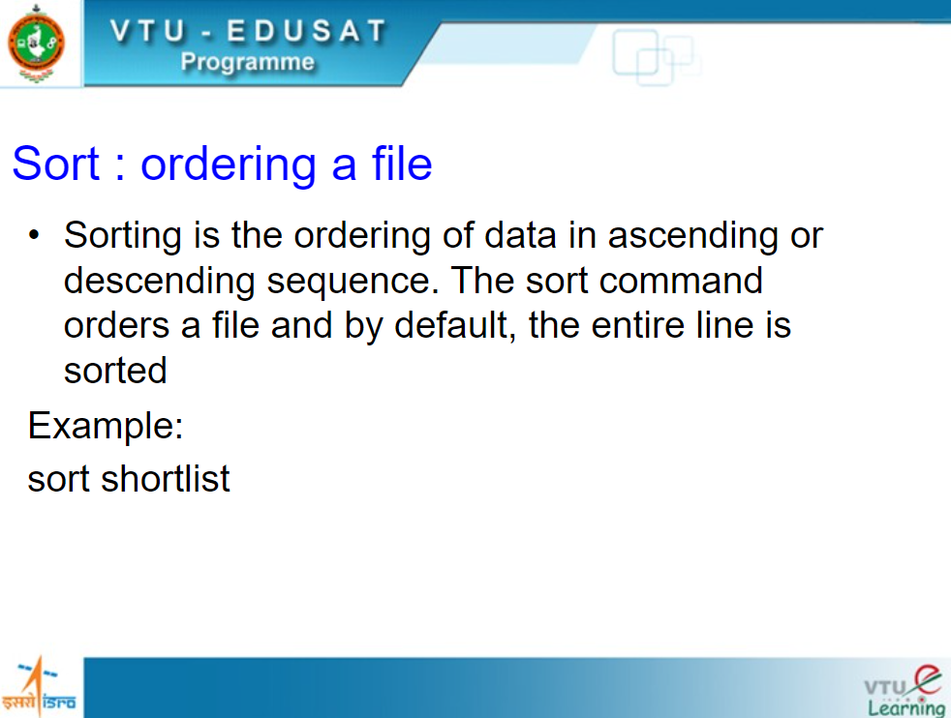

Slide 32
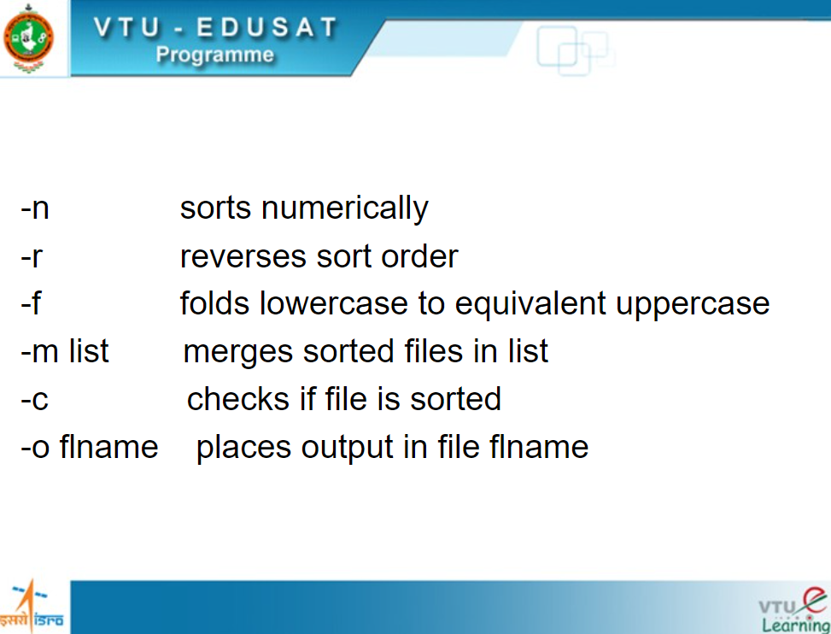

Slide 33
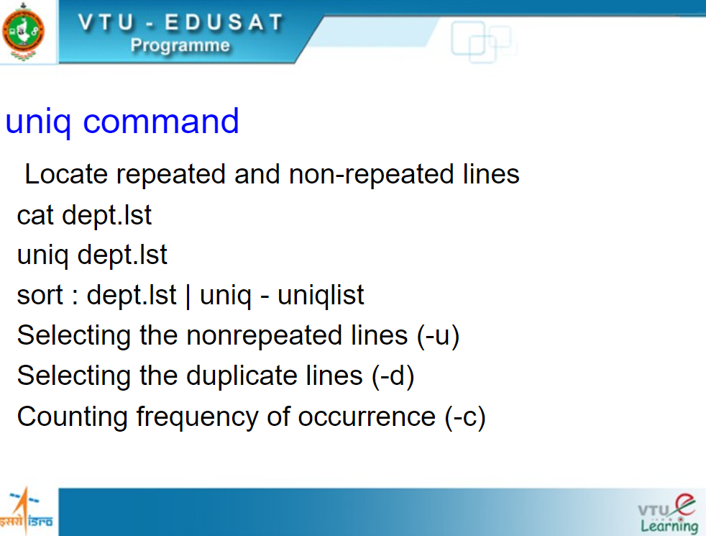

Slide 34
Consider a sorted dept.lst that includes repeated lines:
cat dept.lst
It displays all lines with duplicates. Where as,
uniq dept.lst
It simply fetches one copy of each line and writes it to the standard output.

Slide 35
Selecting the nonrepeated lines (-u)
cut –d “|” –f3 emp.lst | sort | uniq –u
Selecting the duplicate lines (-d)
cut –d “|” –f3 emp.lst | sort | uniq –d
Counting frequency of occurrence (-c)
cut –d “|” –f3 emp.lst | sort | uniq –c

Slide 36
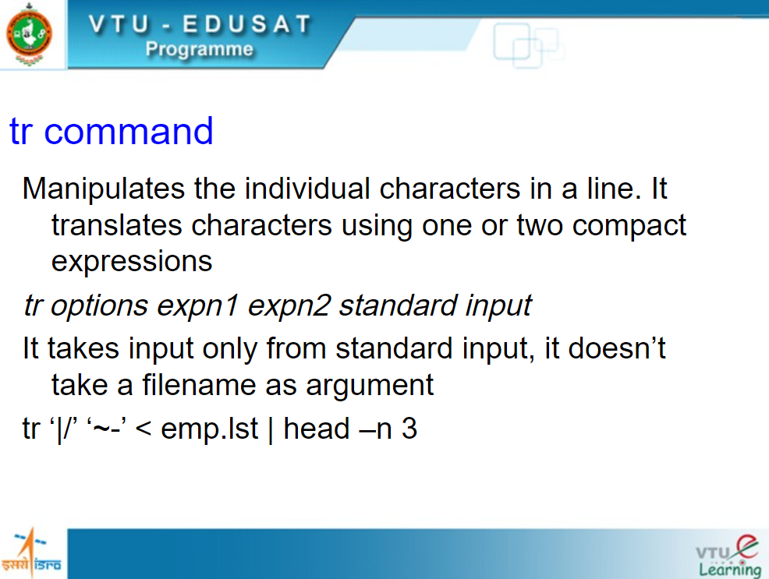

Slide 37
Changing case of text is possible from lower to upper for first three lines of the file.
head –n 3 emp.lst | tr ‘[a-z]’ ‘[A-Z]’

