Slide 1


STARTX : SMART ENTRY SYSTEM FOR STARTUP ECOSYSTEMS
Theme Project Guide NMNT ID
Team Name Team Members
: Information / Communication Technology
: Mrs . N . Anu Lavanya , AP/CSBS
: NMNTSTD9213832
: Medeors
: Saranya P (921321244046)
Swedha S (921321244056)

Slide 2


PROBLEM STATEMENT
How might we simplify the approval process by creating a single-window platform that allows entrepreneurs to easily obtain all necessary approvals from various government agencies, reducing delays and improving efficiency?

Slide 3
ABSTRACT
Streamlined Approval Workflow - Multi-stage approval process - business startup approvals involve multiple regulatory bodies, causing inefficiencies and delays.
Unified Digital Platform - it creates a unified web application platform where entrepreneurs can submit documents, track approval statuses, and receive real-time updates.
Biometric Authentication - Fingerprint sensor authentication - provides biometric identity verification, preventing impersonation and unauthorized access.
Tamper-Proof Security - Blockchain integration - ensures data integrity and prevents tampering.
Scalable & Secure Storage - Cloud computing - provides secure storage and seamless access to documents.

Slide 4
EXISTING SYSTEM
Lack of Biometric Security - The absence of biometric authentication increases the risk of identity fraud and duplicate registrations.
Manual Verification Challenges - Government systems rely on in-person document checks, causing delays and inefficiencies.
Fragmented Document Submission - Verification processes require physical submissions and multiple touchpoints, making them cumbersome.
Paper-Intensive Approval System - The lack of digital workflows results in slow approvals with no real-time tracking, reducing transparency.
Administrative Bottlenecks -Manual reviews overload officials, while applicants face long wait times without status updates.
Need for a Smart Digital Solution -An automated web application , secure system with biometric integration and end-to-end tracking is essential for efficiency and transparency.

Slide 5
PROPOSED SYSTEM
Secure User Registration - Users provide personal details (name, email, password) and upload identification documents (Aadhaar front/back, PAN card) for verification
Biometric Authentication for Security - Fingerprint-based OTP authentication enhances security and ensures user identity verification.
Seamless Government Service Requests -Registered users can submit forms for government services, initiating an approval request.
Efficient Document Verification Process -Administrators review applications, verify identity documents, and assess user submissions for accuracy.
Approval and Digital Certification -Approved users receive a digital certificate via email, confirming their successful registration and authentication.
Rejection Handling and Notifications -If rejected, users receive a rejection notice with details to address any discrepancies.

Slide 6
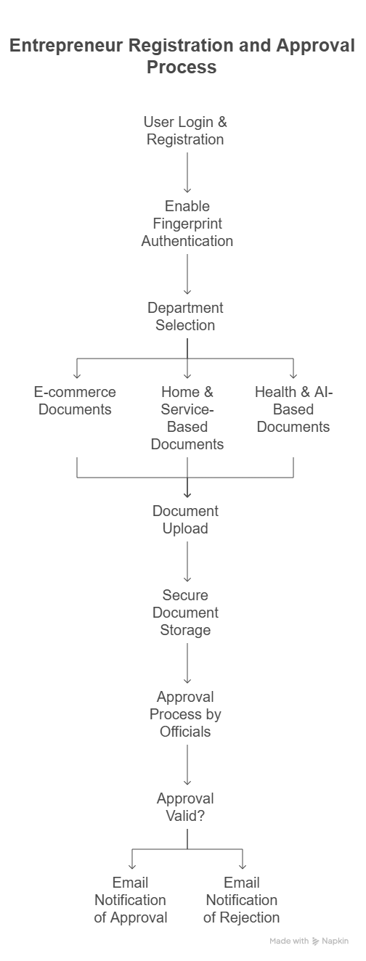
WORKFLOW

Slide 7
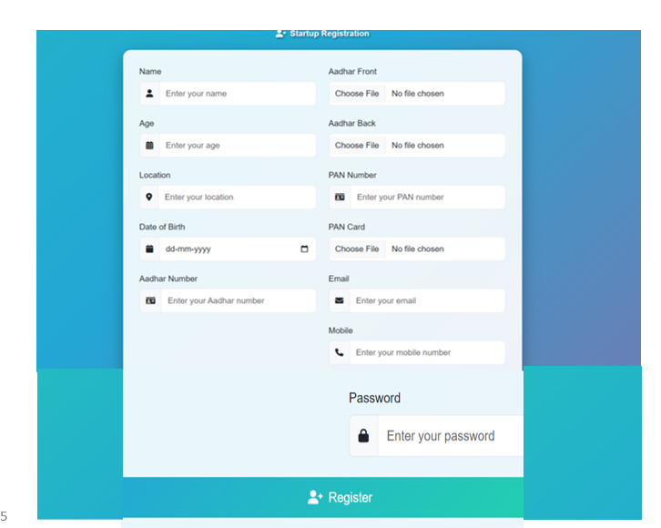
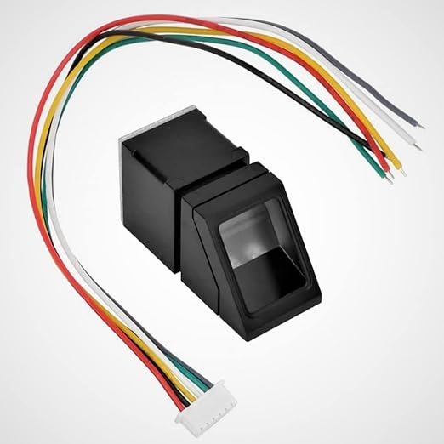
MODULE DESCRIPTION
A . User Registration & Authentication - This module ensures secure user onboarding for entrepreneurs, allowing them to register, log in, and access business approval services. It incorporates Multi-factor authentication (MFA) and role-based access control to prevent unauthorized access and authenticating via fingerprint-based OTP.

Slide 8
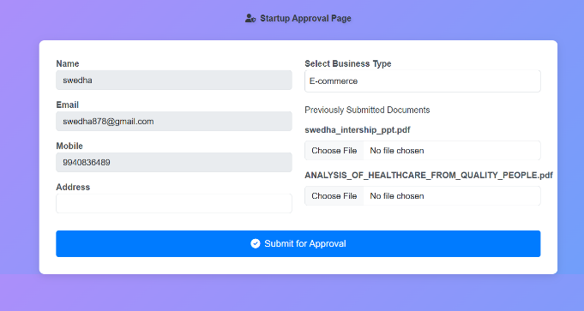
B. Business Profile & Document Submission - This module is designed to streamline the business registration process by allowing entrepreneurs to submit essential business details and required documents digitally. It ensures accuracy, efficiency, and compliance with regulatory requirements, reducing delays in approvals. It consists of approvals like ( E-commerce, home services, smart Home automation )

Slide 9
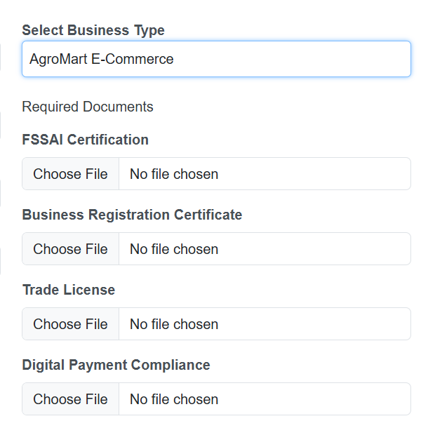
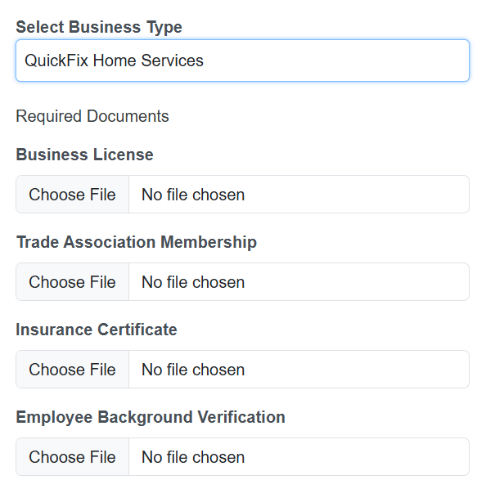
C. Government Approval System for Business Registration - Mandatory registration with the Registrar of Firms (ROF) and according to the level of small-scale company level, Businesses must secure relevant licenses like FSSAI (Food), Trade License, Import-Export Code (IEC), and MSME Registration.

Slide 10
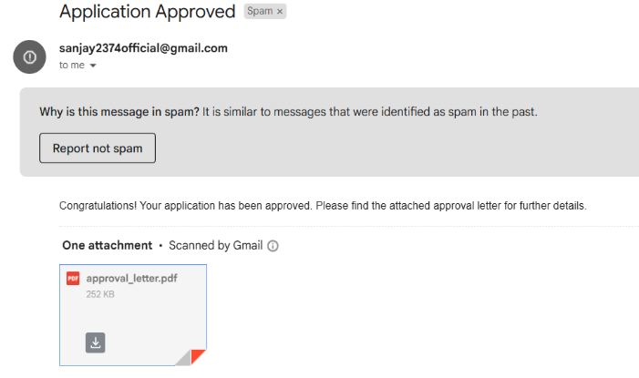
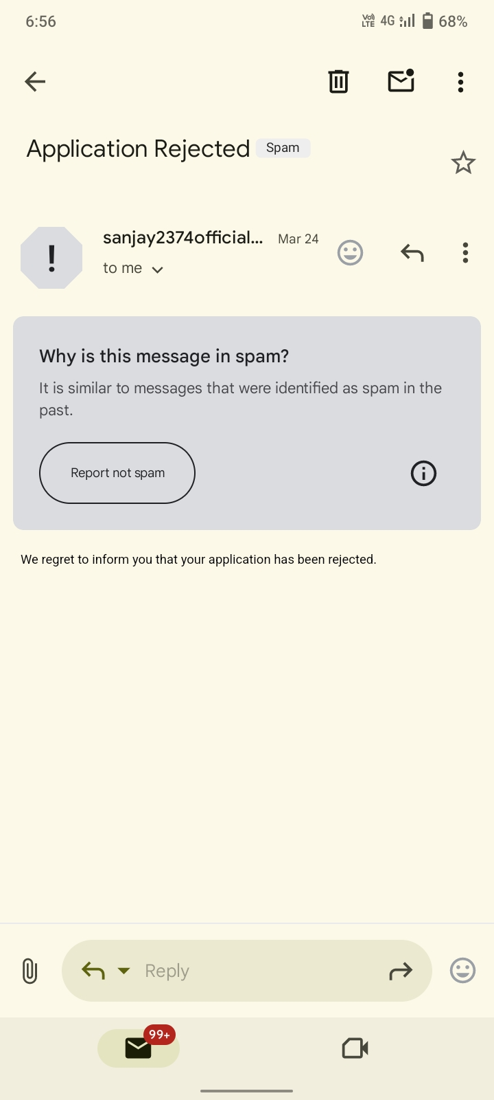
D. Real-Time Application Tracking & Notifications
Dashboard showing application status ( Approved, Rejected). Instant Email to the Entrepreneurs. The mail gets rejected due to incomplete application form , missing or invalid documents , mismatched information , unverified identity etc

Slide 11
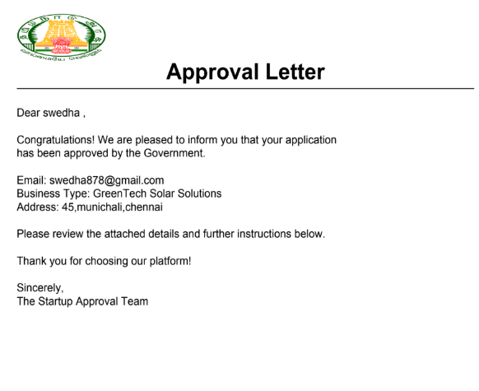
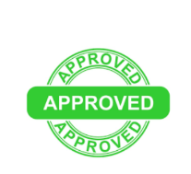
E.. Blockchain-Based Licensing & Certification
Once approved, the system auto-generates business licenses, GST numbers, and tax IDs.Entrepreneurs can download official certificates from the Mail.

Slide 12
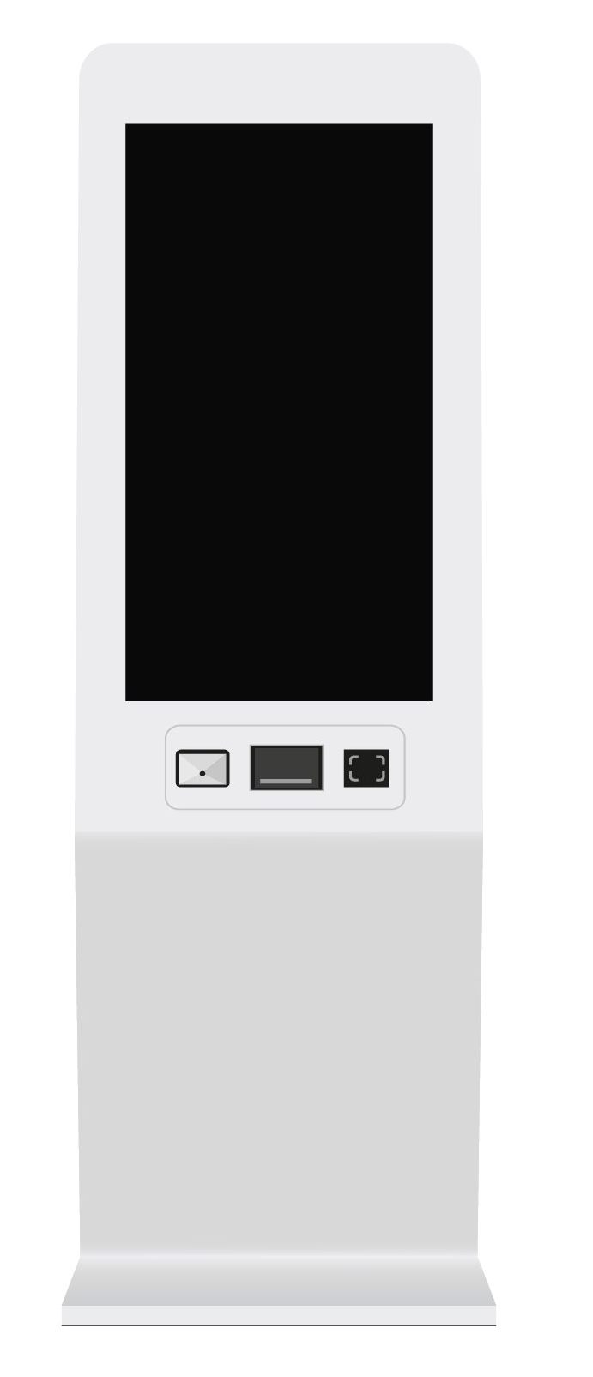
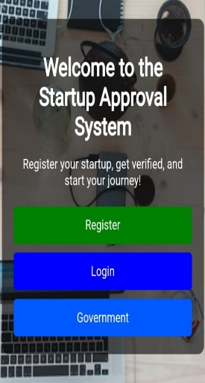
FUTURE ENHANCEMENT
TOUCHSCREEN DISPLAY
(Fill Forms, Upload Documents,
View Status)
DOCUMENT SCANNER
(Scan Physical Documents )
FINGER PRINT SENSOR
( User Authentication )
USB PORT
(Upload Digital Documents )
SMART KIOSK

Slide 13
Self-Service Kiosk Setup
A physical kiosk machine will be developed and installed in government offices.
The kiosk will serve as a one-stop self-service portal for entrepreneurs to apply for business licenses.
User Registration
Users (entrepreneurs) can start by filling in their personal and business details on the kiosk interface.
A user-friendly form will guide them through the registration process.
Document Upload
Based on the type of business license required, the system will display a list of necessary documents.
Users can upload these documents directly through:
USB drive
Cloud (via login)
Built-in Document Scanner – for scanning physical copies on the spot.

Slide 14
Automatic Document Verification
The kiosk will verify the uploaded or scanned documents using AI-based
validation techniques.
The system will check for completeness, authenticity, and validity of documents.
Fingerprint Authentication
For added security, the kiosk will include a built-in fingerprint sensor.
Users must authenticate themselves using their fingerprint to proceed further.
License Approval & Print
Once the documents are verified and the application is approved:
The approval letter/business license will be automatically generated.
Users can directly print their approved license from the kiosk.

Slide 15
Rejection Handling
If the application is rejected, the kiosk will:
Display the reason for rejection clearly on the screen.
Optionally, suggest steps or documents required to resolve the issue.
Smart Notification System (Optional Enhancement)
Users can opt-in to receive updates via:
SMS
Email
Future scalability
The kiosks can be deployed across multiple government locations.
Can be expanded to support other services like renewal, feedback submission, or
helpdesk chat.

Slide 16
DEPARTMENTS
Data Protection & Privacy Regulatory Authorities
Corporate Affairs Department
Technology & Innovation Regulatory Authorities
Environmental Protection Department
Energy Regulatory Commission
Taxation Department
Quality and Environmental Management Standards Organization
Health & Medical Regulatory Department

Slide 17
STARTUP AND DEPARTMENTS
E-commerce
Home & Service-Based Businesses
Renewable Energy & Sustainability
Health & AI-Based Businesses
Transportation & Mobility
Automobile & Maintenance
Smart Technology & Automation

Slide 18
HARDWARE REQUIREMENTS
Fingerprint Sensor – USB Biometric Scanner
QR Code Generation – Python QR Code Library.
Processor – Intel Core i5 or higher
RAM – Minimum 8GB.
Storage – 256GB SSD or more.

Slide 19
SOFTWARE REQUIREMENTS
Frontend Development – HTML, CSS, JavaScript .
Backend Development – Python (Flask).
Operating System – Windows
Database – MySQL.
Blockchain – Hyperledger Fabric. (Private Blockchain)
Cloud Storage – Google Cloud.

Slide 20
THANK YOU

