Slide 1




FINAL PRESENTATION
REQUIREMENTS ANALYSIS AND DESIGN
INSTRUCTOR: PHAM THAI KY TRUNG
NAME: PHAM TRAN TIEN PHAT
ID: 521H0285

Slide 2
1. ANALYZE USER STORIES

Slide 3
Product Management:
The Product Catalog Management feature allows administrators to perform basic operations on products including viewing product listings, adding a new product. A product should have a minimum of information such as: barcode / QR Code, product name, import price, retail price, category, creation date.

Slide 4
User Story | Actor | Purpose | Action
Allows administrators to perform basic operations on products including viewing product listings, adding a new product, updating a product's information, and deleting products. | Admin | To manage the all of information, which associated with the product exist in the agent or retail store. | The admin will input the information of product( barcode / QR Code, product name, import price, retail price, category, creation date). Besides that, admin not only view the product list, but also adding, updating, deleting the product’ s information. In addition, based on it in the payment or shopping process, the sale staff or customer also know the information of product(show in information product card).

Slide 5
User Story | Actor | Purpose | Action
Sales staff are allowed to view the product list but cannot change any content. They cannot see the original price of the product. | Sale staff | To ensure accuracy, quality management, data insecurity of product and agent. | During the billing process for customers, the sale staff only know the retail store, and the total of the bill. Moreover, it also help for avoiding fraud which can help reduce the standard and reputation of agent or retail store.

Slide 6
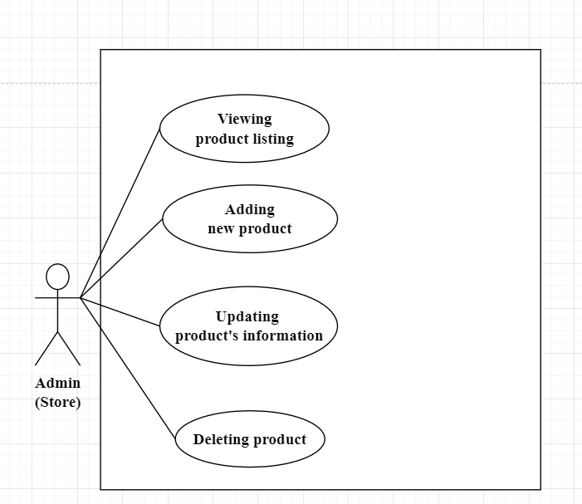
Use Case
2 main Use Cases

Slide 7
1.1 Use Cases Description

Slide 8
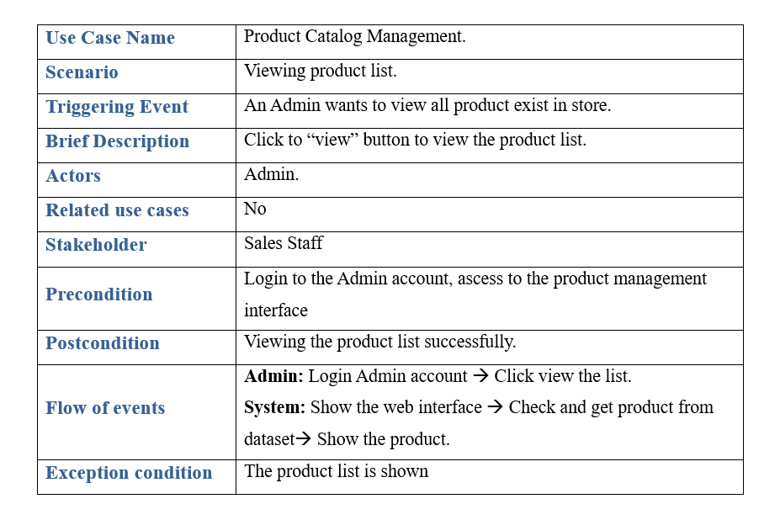
Viewing the product list

Slide 9
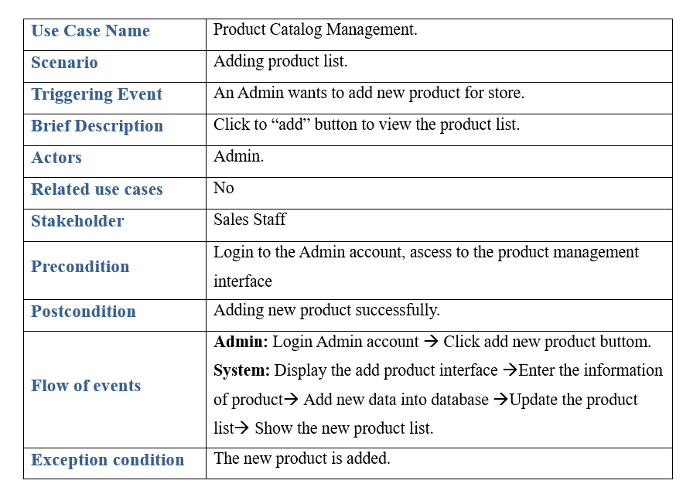
Adding new product

Slide 10
1.2 Activity Diagram

Slide 11
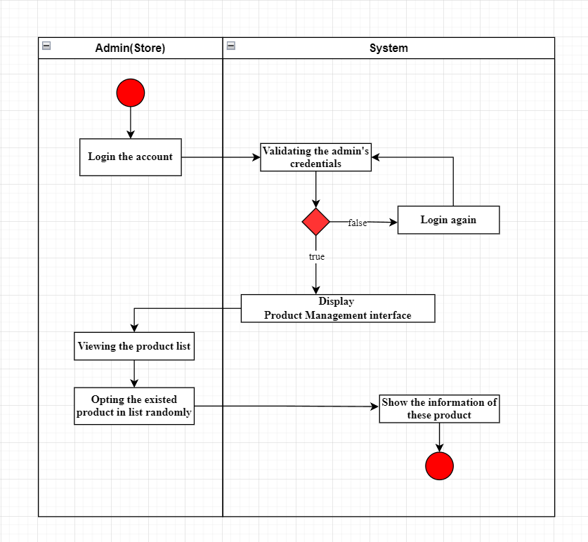
Viewing the product list

Slide 12
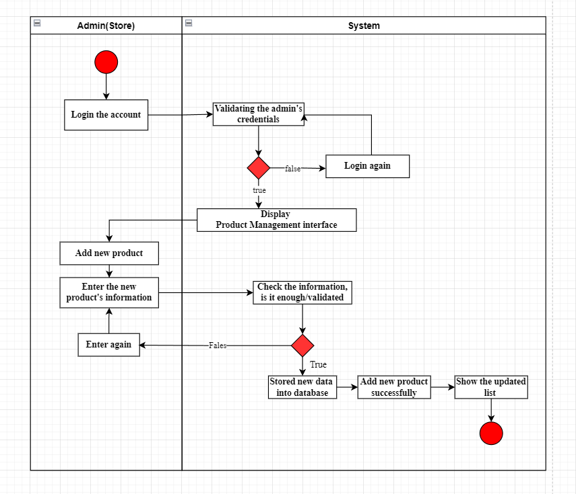
Adding new product

Slide 13
1.3 System Sequence Diagram (SSD)

Slide 14
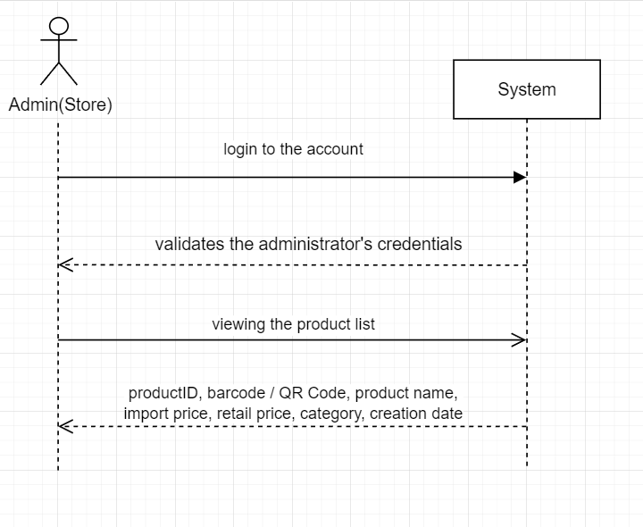
Viewing the product list

Slide 15
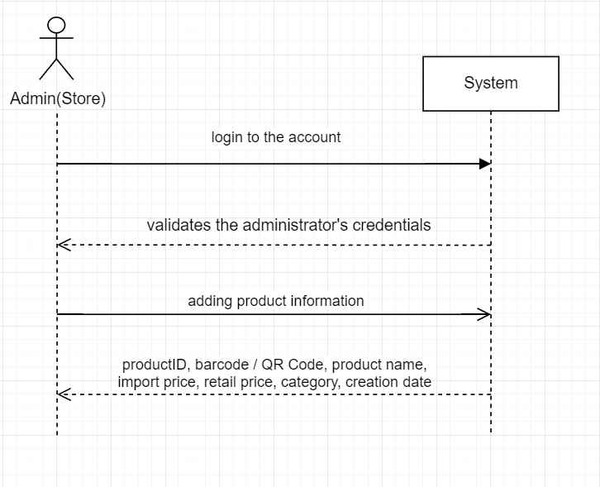
Adding new product

Slide 16
1.5 State Machine Diagram

Slide 17
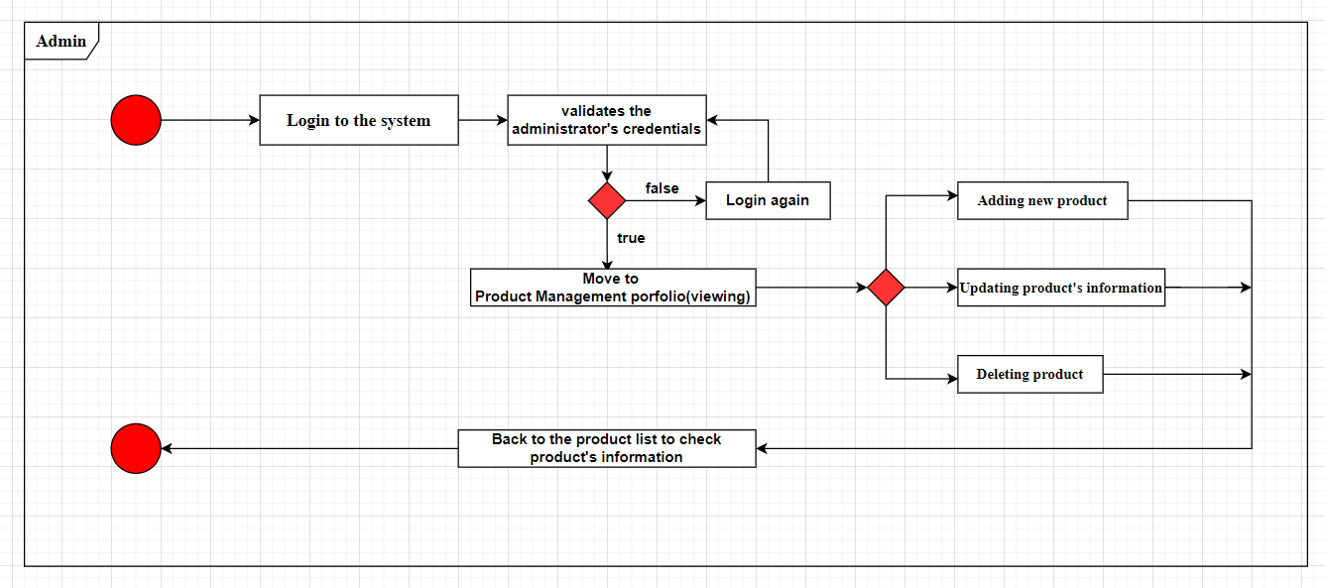

Slide 18
1.6 Domain Class Diagram

Slide 19
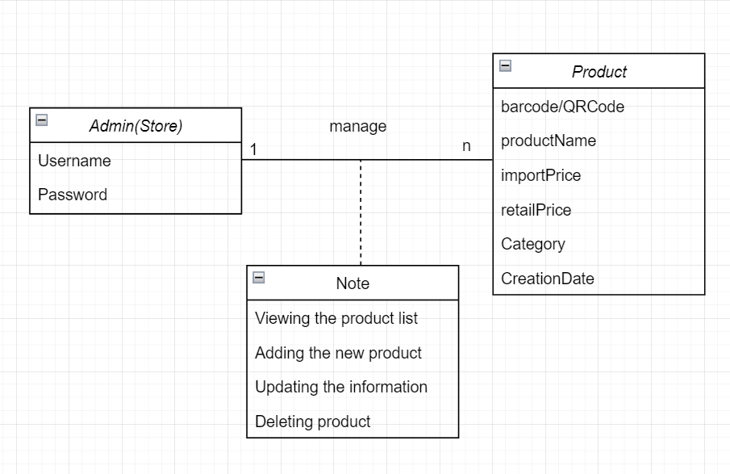

Slide 20
2. DESIGN PHASE

Slide 21
2.1 Convert Domain Class to Design Classes

Slide 22
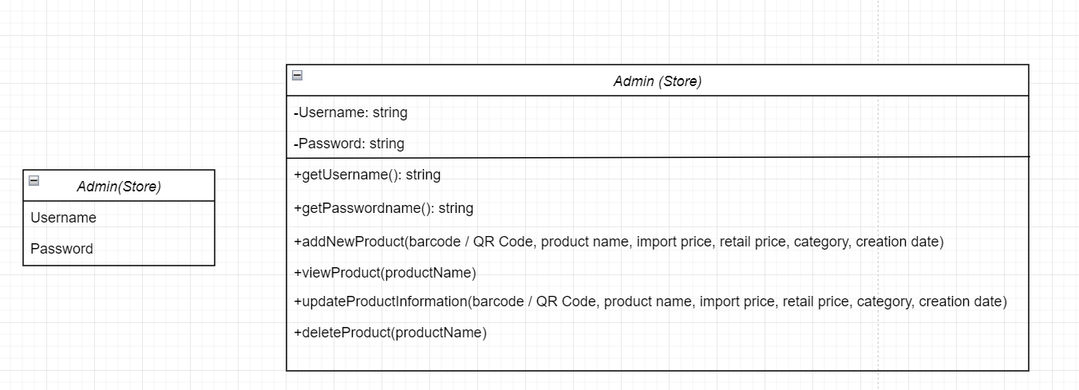
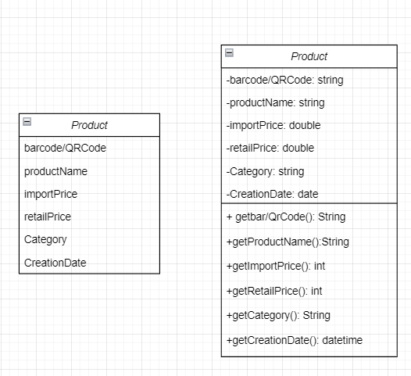

Slide 23
2.2 Design Class Diagram with CRC

Slide 24
Product
Responsibilities: | - Store and provide access to product details such as barcode / QR code, product name, import price, retail price, category, and creation date. - Manage the deletion of products based on their order status.
Collaborators: | -Administrator
Administrator
Responsibilities: | - Perform all operations related to product management, including addition and viewing of product listings
Collaborators: | - Product

Slide 25
2.3 OOD with Communication Diagram

Slide 26
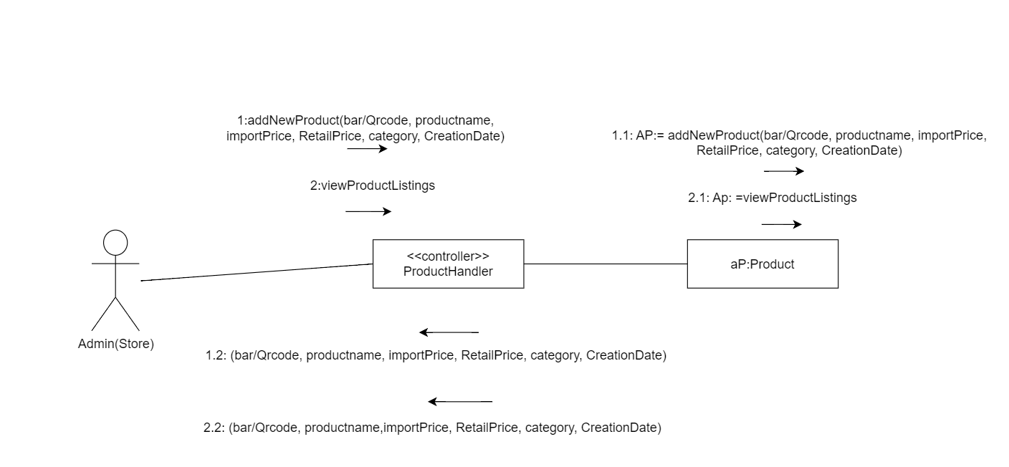

Slide 27
2.4 Sequence Diagram

Slide 28
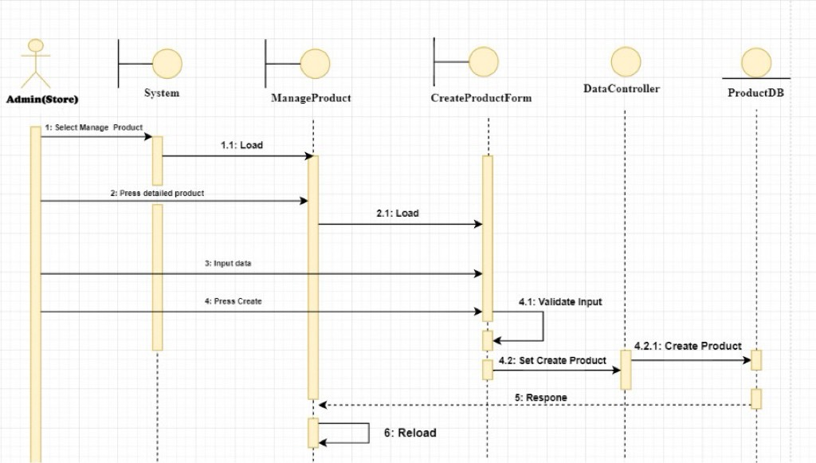
Adding new product

Slide 29
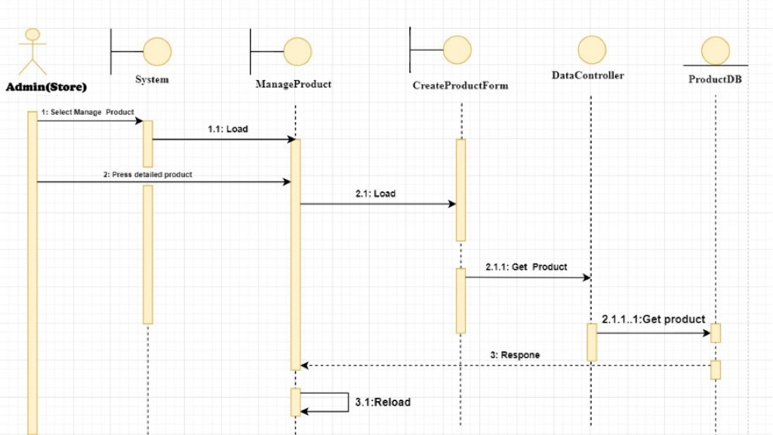
Viewing product list

Slide 30
3. TEST CASE

Slide 31
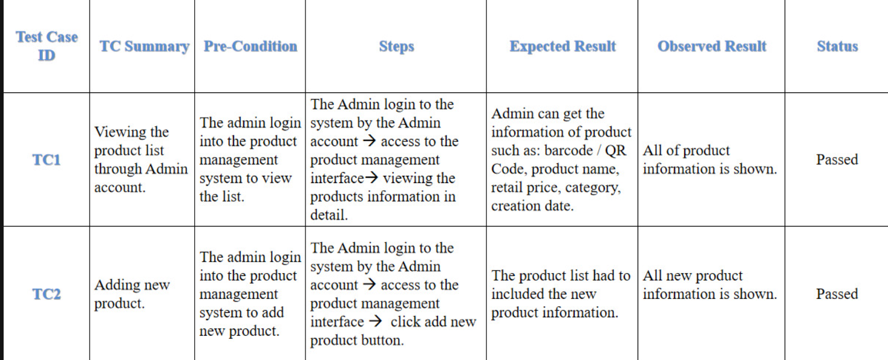

Slide 32
4. USER INTERFACE

Slide 33
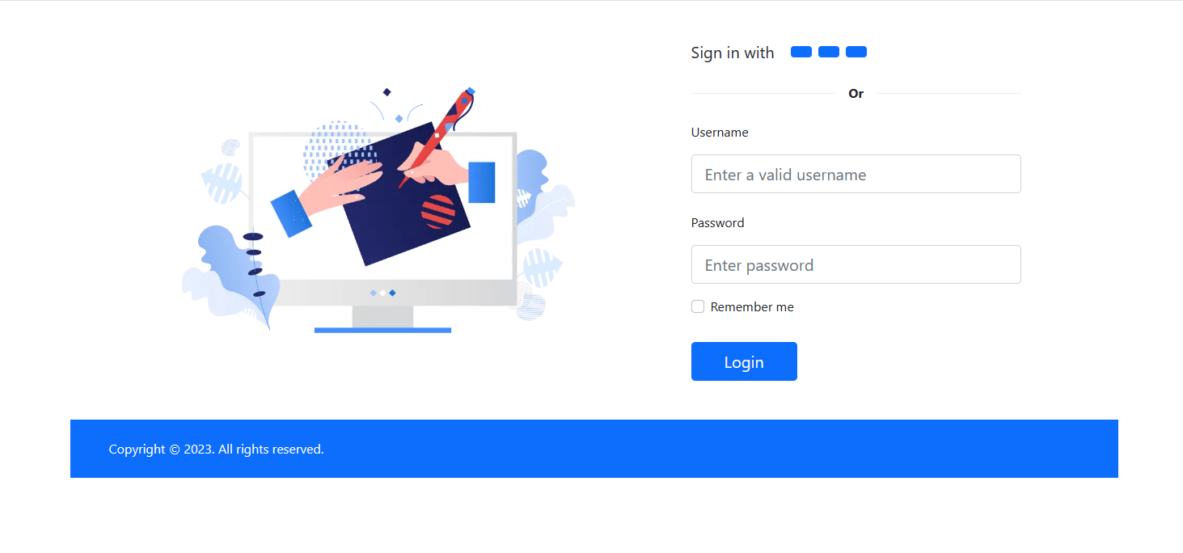
Login Interface

Slide 34
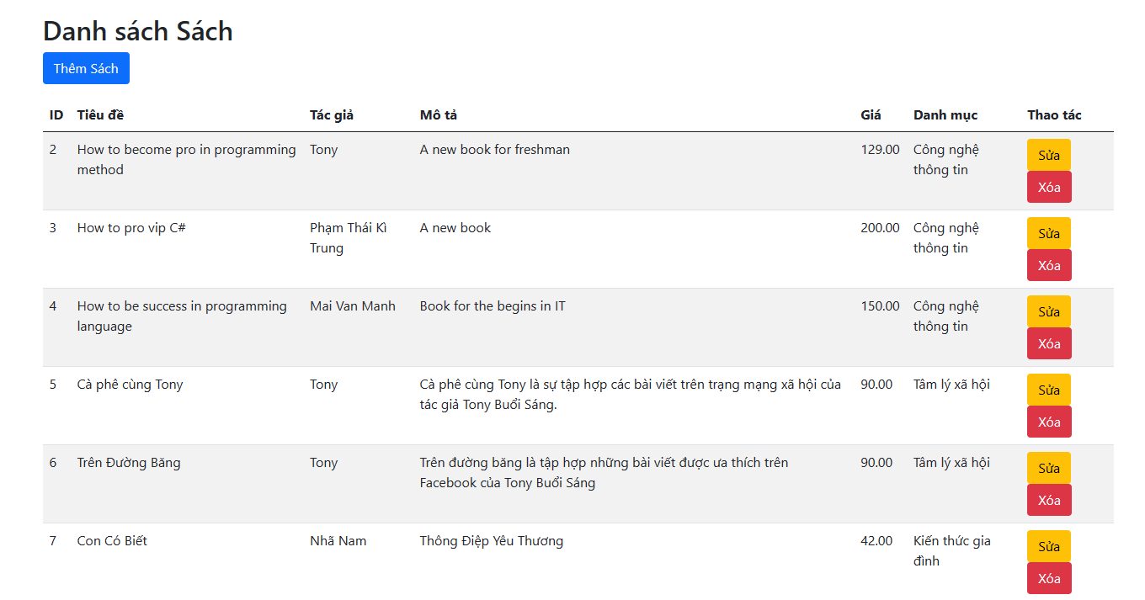
Viewing product list

Slide 35
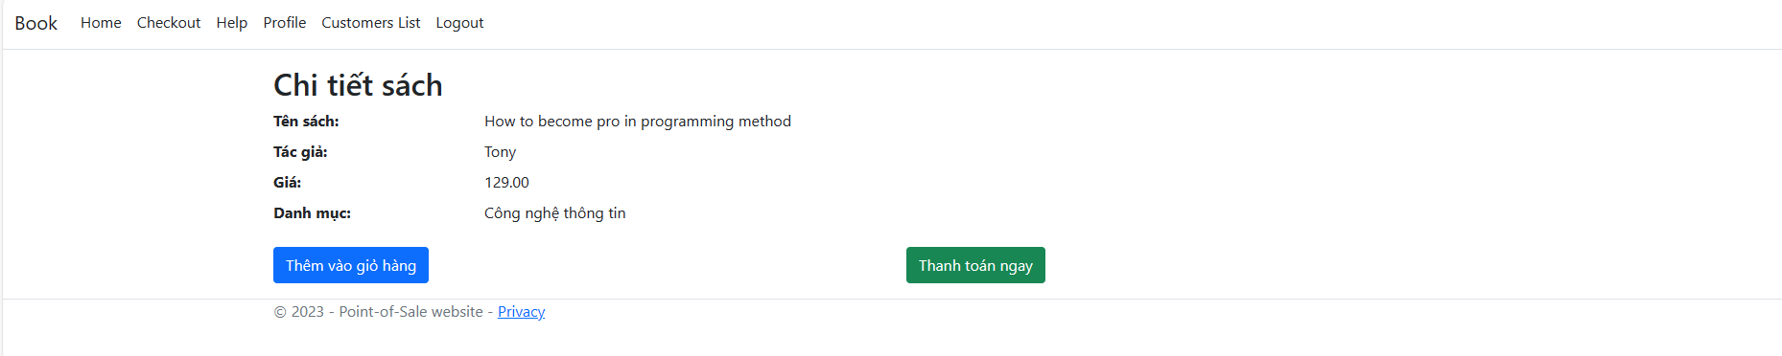
Viewing product information in detail

Slide 36
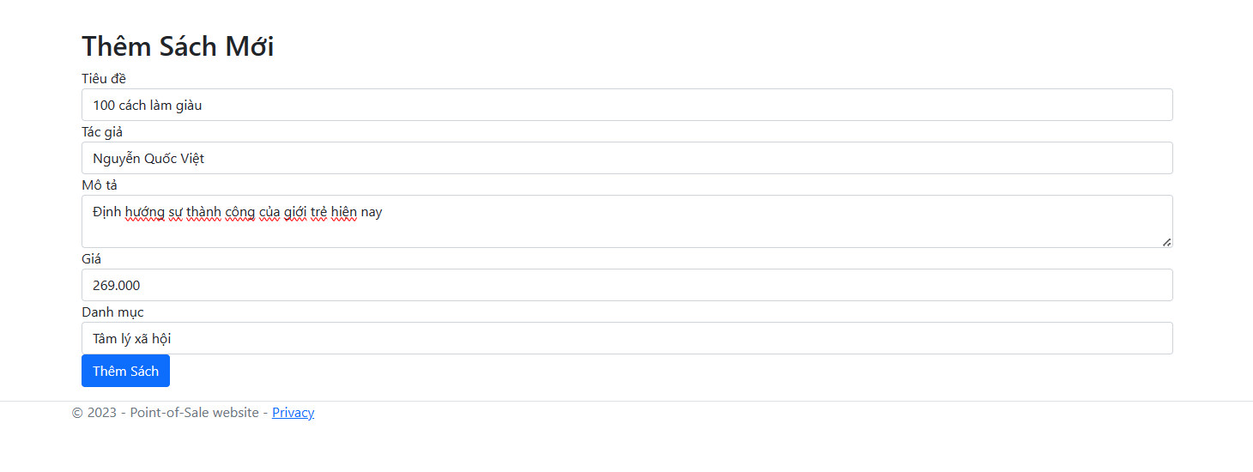
Adding new Product

Slide 37
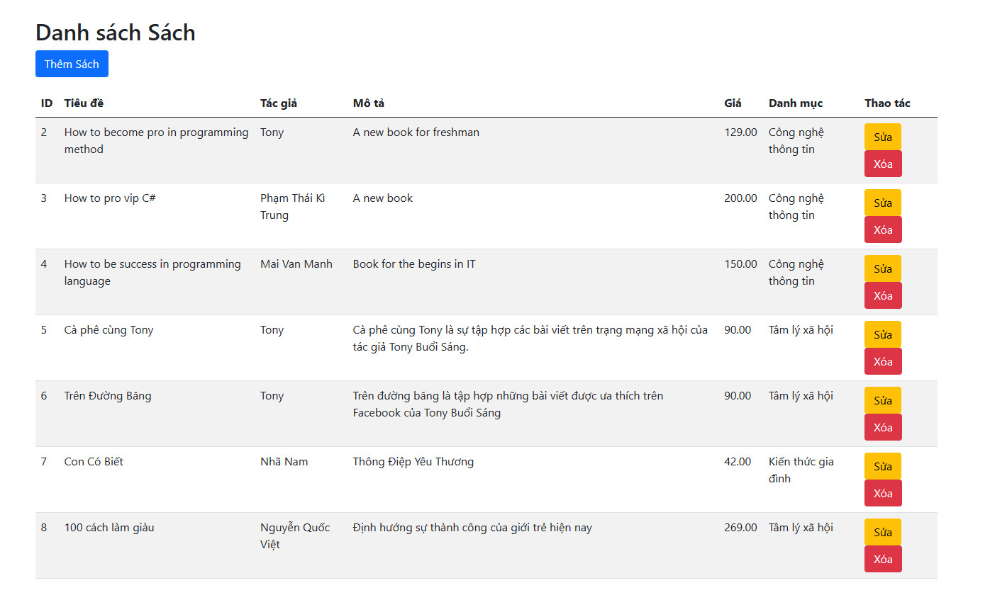
New Product is added

