Slide 1
FINAL REPORT
Develop a software for Distributor selling Mobile Phones products to authorized reseller / agents

Slide 2
MEMBER OF GROUP
Van Cong Nguyen Phong - 521H0287 | Win Form + Web Form
Phan Thanh Dat - 521H0218 | Report + PowerPoint + Video Clip

Slide 3
01
Create Goods Received
You can enter a subtitle here if you need it

Slide 4
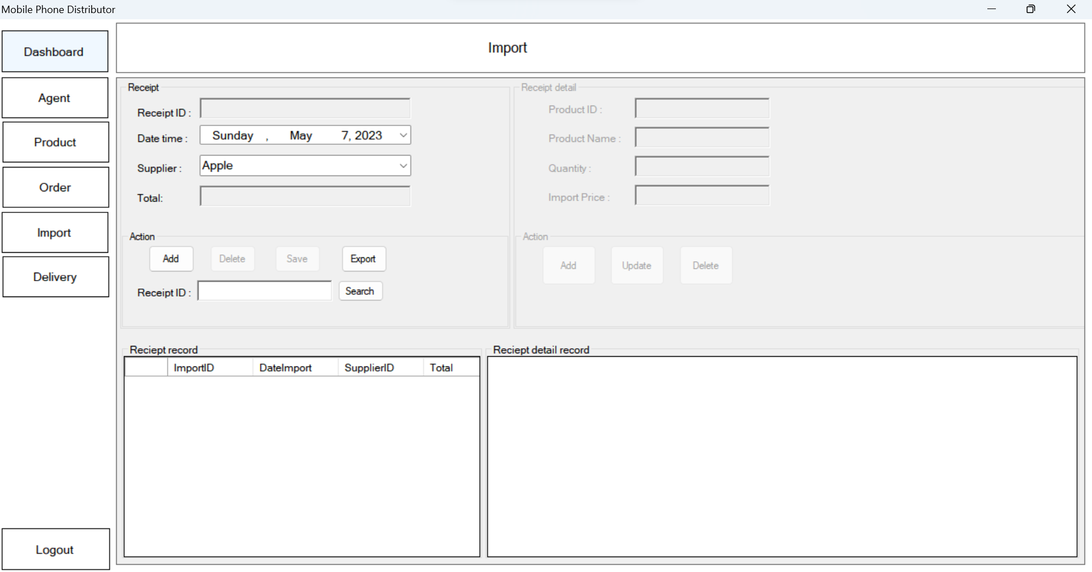
Create Goods Receive.

Slide 5
02
order of items and choose a payment method

Slide 6
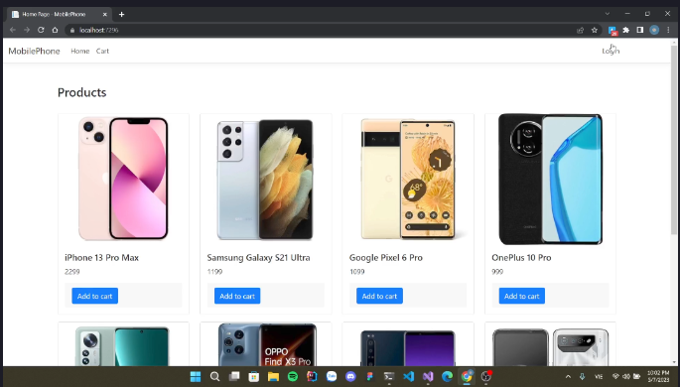

Slide 7
create Goods Delivery Note to agents
03

Slide 8
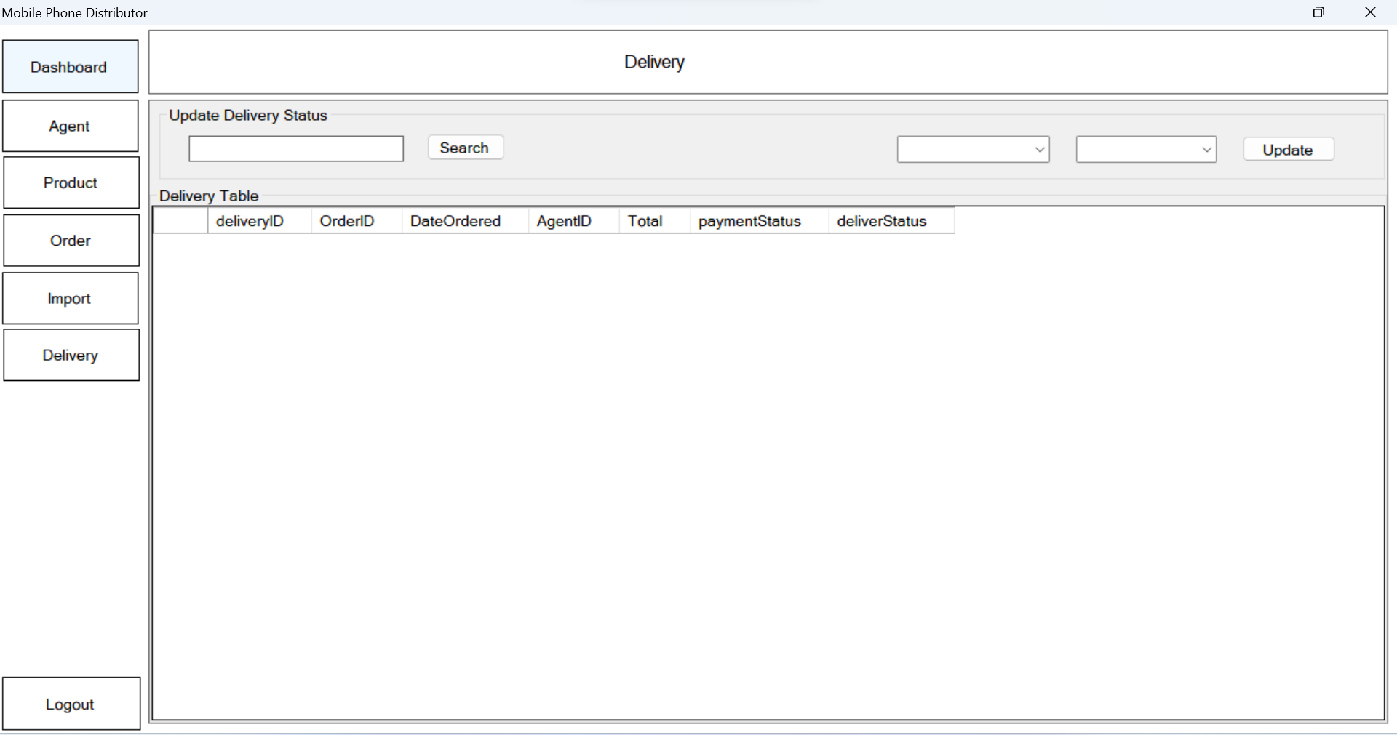
create goods delivery note to agents

Slide 9
View incoming/outgoing stock report.
04

Slide 10
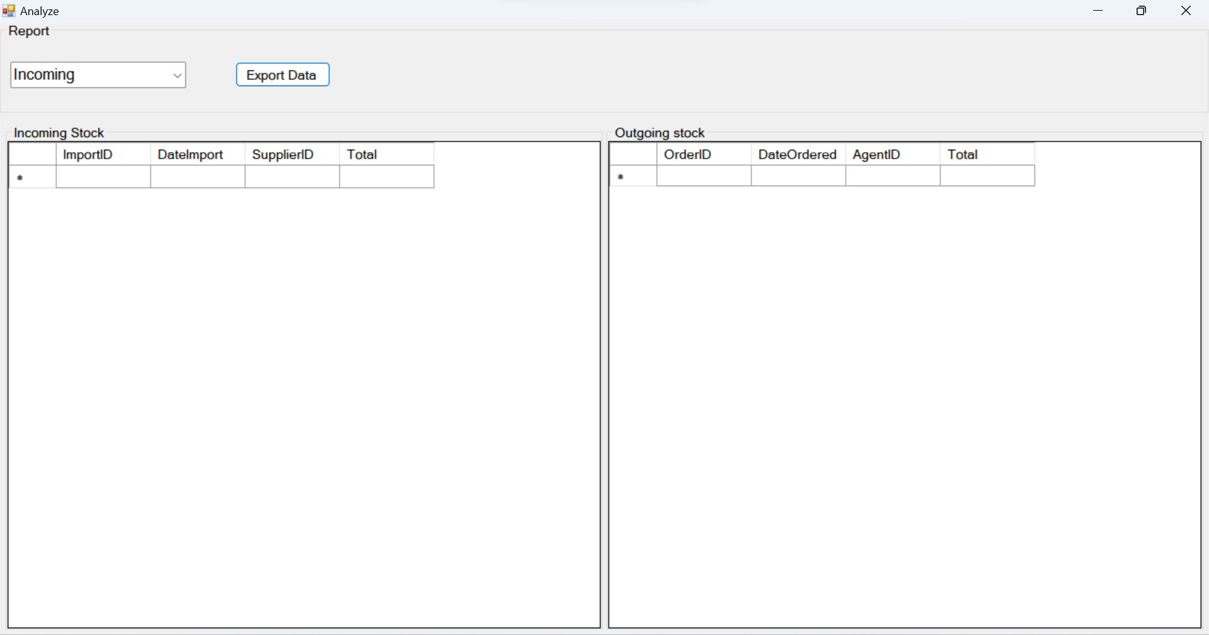

Slide 11
What did we gain from final project?
Technical skills: Developing a software requires technical skills such as programming, database management, user interface design, and software testing. By working on a final project, students can improve their technical skills in these areas.
Project management skills: Developing a software requires project management skills such as planning, scheduling, and coordination. By working on a final project, students can improve their project management skills.
Collaboration skills: Developing a software requires collaboration with other team members, such as programmers, designers, and testers. By working on a final project, students can improve their collaboration skills.
Problem-solving skills: Developing a software requires problem-solving skills such as identifying and fixing bugs, resolving conflicts, and optimizing algorithms. By working on a final project, students can improve their problem-solving skills.
Practical experience: Developing a software for a final project provides students with practical experience that can be applied in real-world situations. This experience can be valuable when seeking employment in the software development industry.

