Slide 1
SIS1 SYSTEM PROGRAMMING
Process creation
Tagayev Ilyas 17BD110339

Slide 2
What is the process?
A program loaded into memory and executing is called a process. In simple, a process is a program in execution
Unique number called PID(process ID)
Process can create child processes

Slide 3
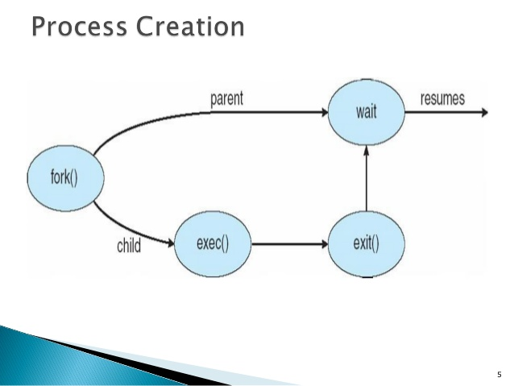
Process creation(fork)

Slide 4
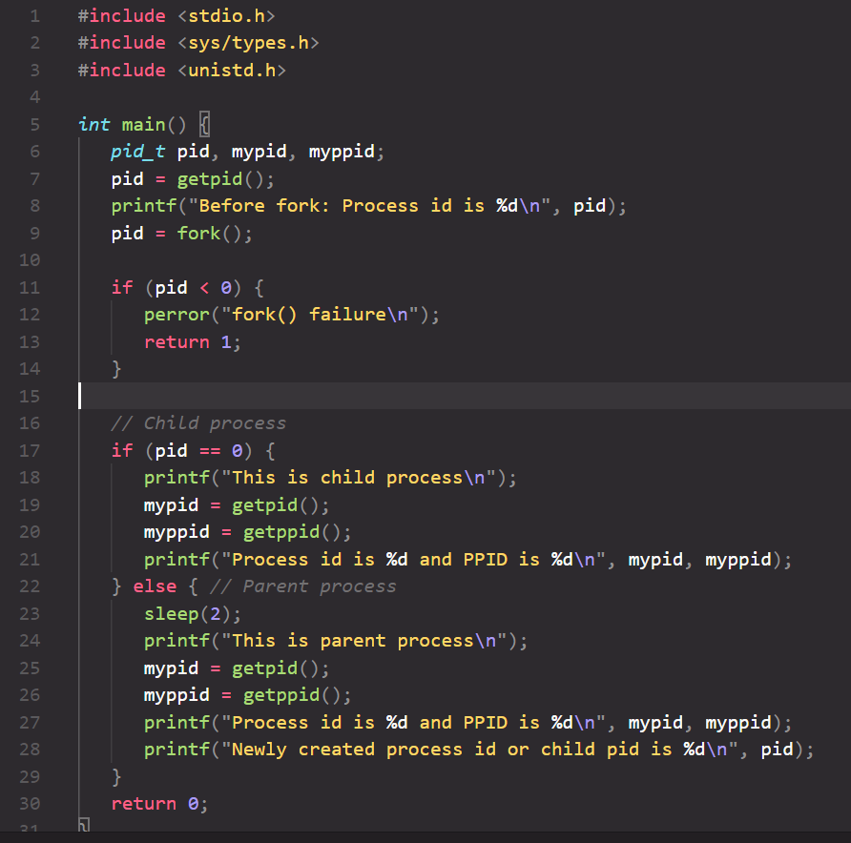
Code

Slide 5
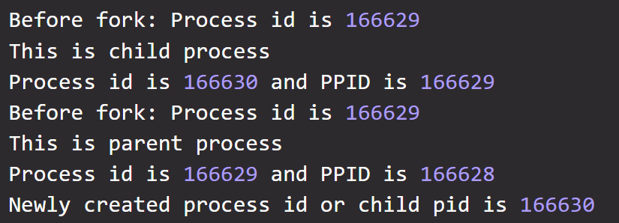
Result

Slide 6
Thank you for your attention!
https://github.com/itagaev/SystemProg

