Slide 1
Who’s In?
Iteration 1

Slide 2
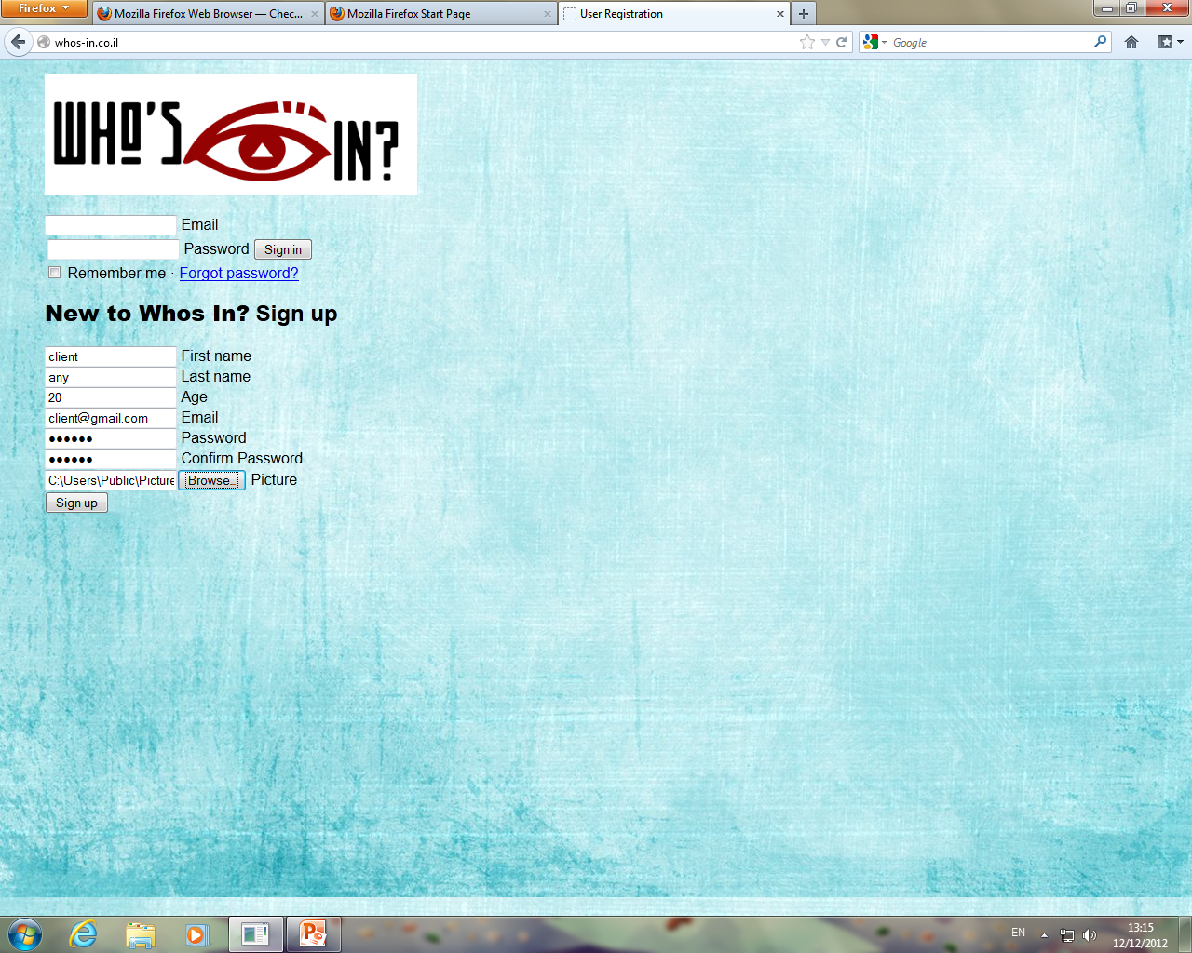
Home page

Slide 3
Home page
In the home page, if it’s the users first time in our site, he will need to register.
He will need to fill in the next fields:
first name, last name, age (18+), password, and to upload picture (jpg, jpeg, bmp, gif).
If he is already registered, he can enter via sign in.

Slide 4
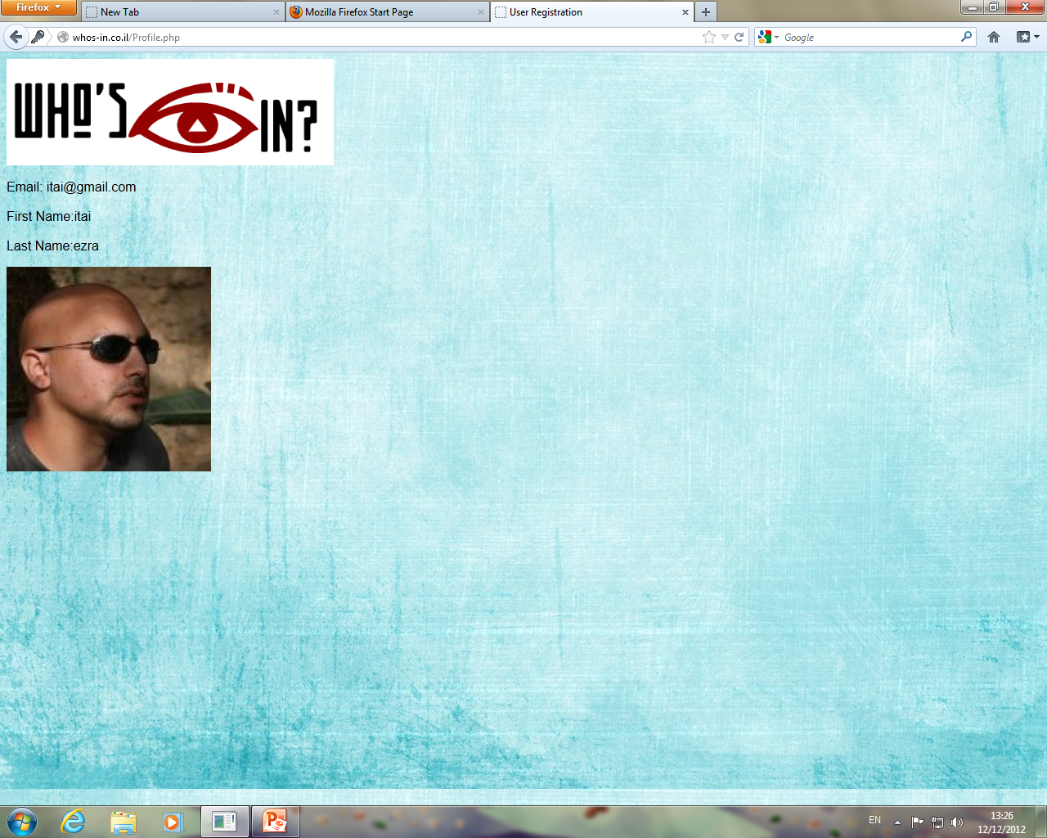
Profile Page

Slide 5
Profile page
In the users profile page, he can see his details (name, Email and picture).
In the next iteration we will add to this page:
edit profile option, log out button, list of RE’s.

Slide 6
Summary
For now, user can register and sign in to our website and see his profile page. We succeeded in establishing a connection to the server, and we can upload an extract data along the way. That was our main concern.
After the next iteration user can: log out from his session.
edit his profile.
The RE will have his two tabs, where he can post messages, and show users pictures.

