Slide 1
Who’s in?
Iteration2

Slide 2
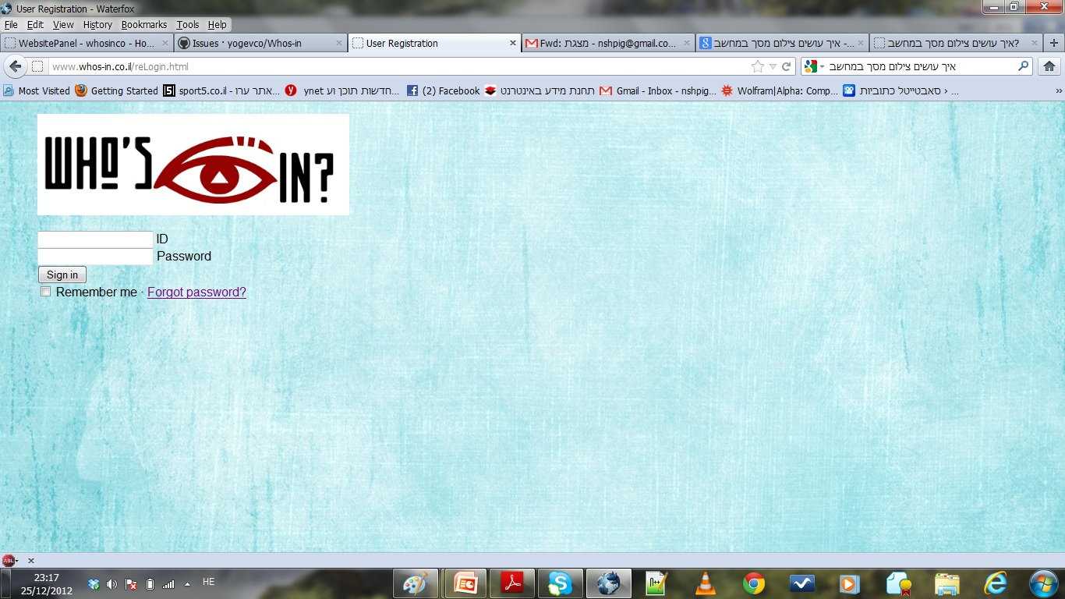
Business Owners Login

Slide 3
Business Owners Login
In this page the BOW can access his own business page.
BOW’s cannot register. The dev-team registers them

Slide 4
RE Profile

Slide 5
RE Profile
In this page there are 3 options:
1)Profile- information about the place.
2)Post- where the BOW can post stuff so every one can see it. Like: discounts, birth-days, etc.
3)Gallery- where you can see the photos of every one that is in the RE

Slide 6
summary
At this moment a BOW can talk to us and we will sign him in by inserting his information to the DB manually, so he can login to his own page.
In his page all the features we were asked by the client to implement are done.

