Slide 1



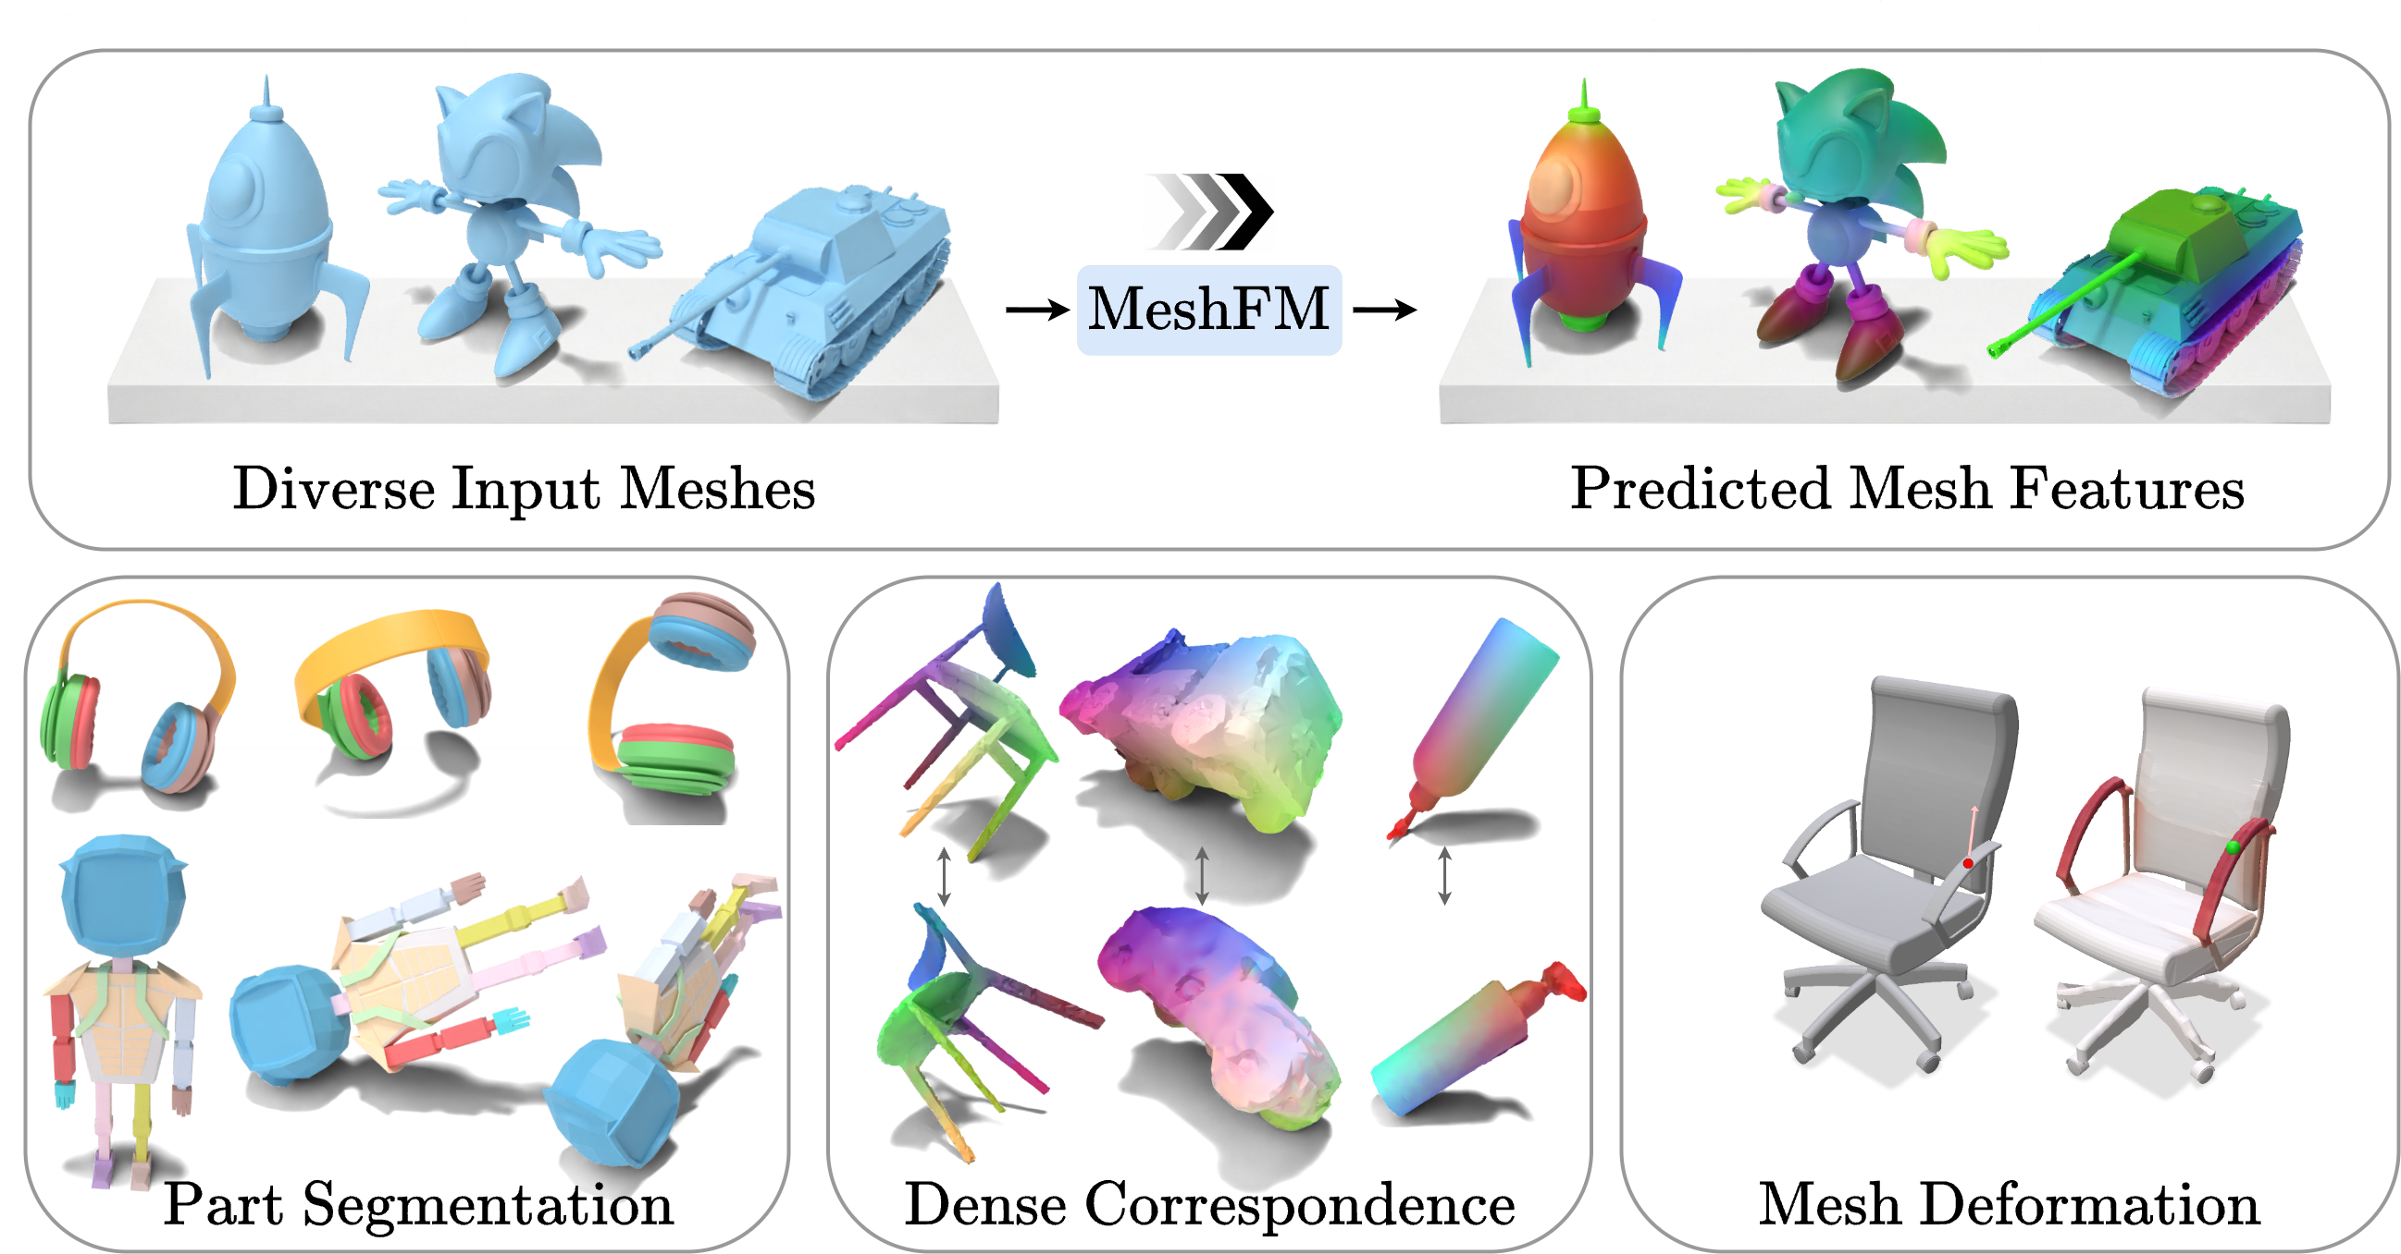
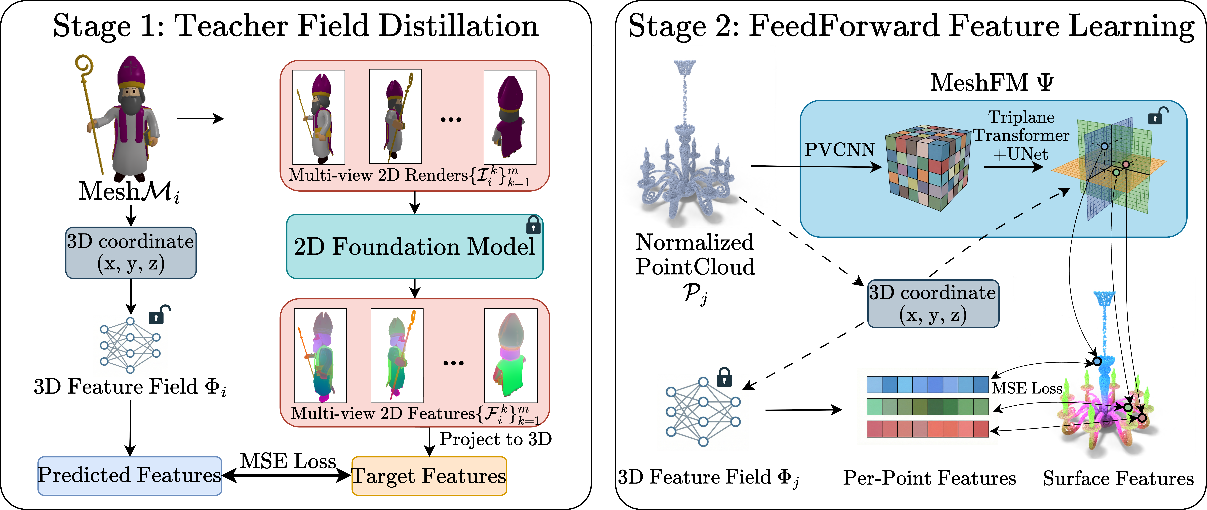
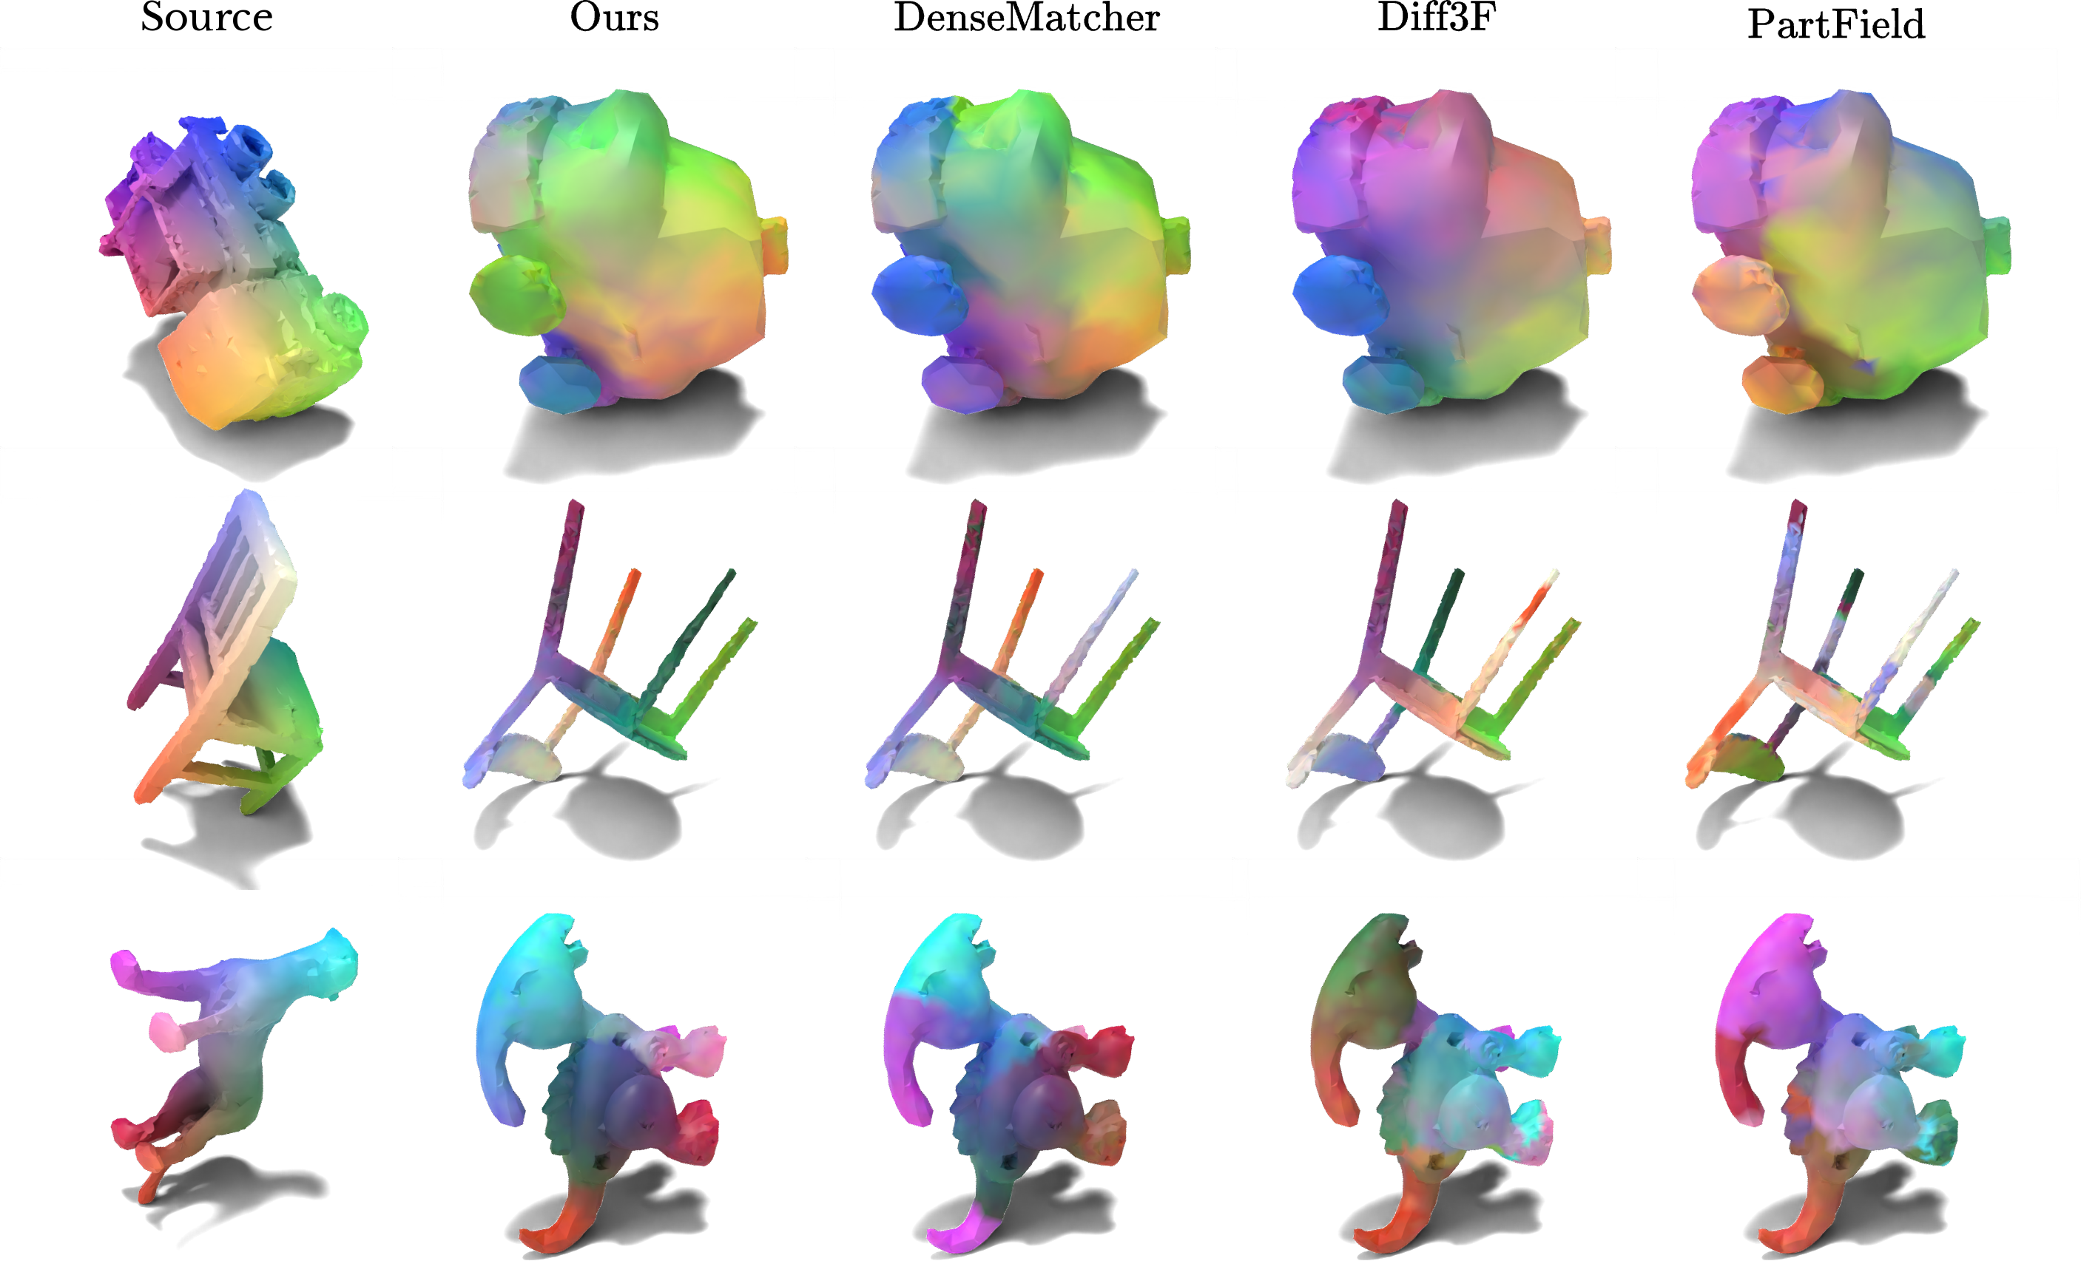
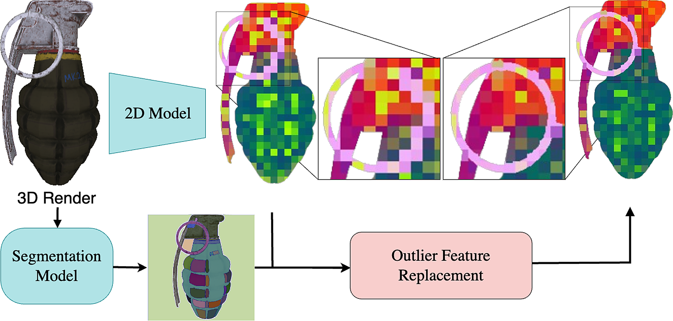
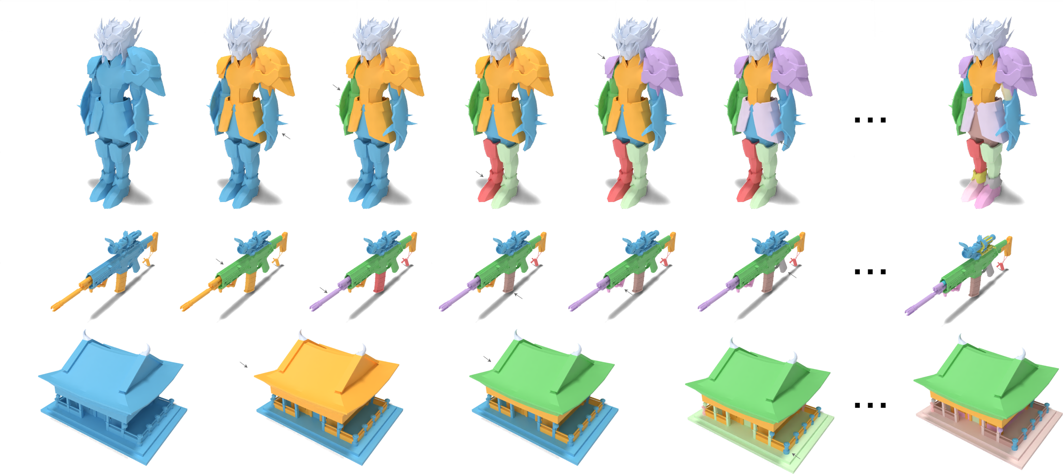
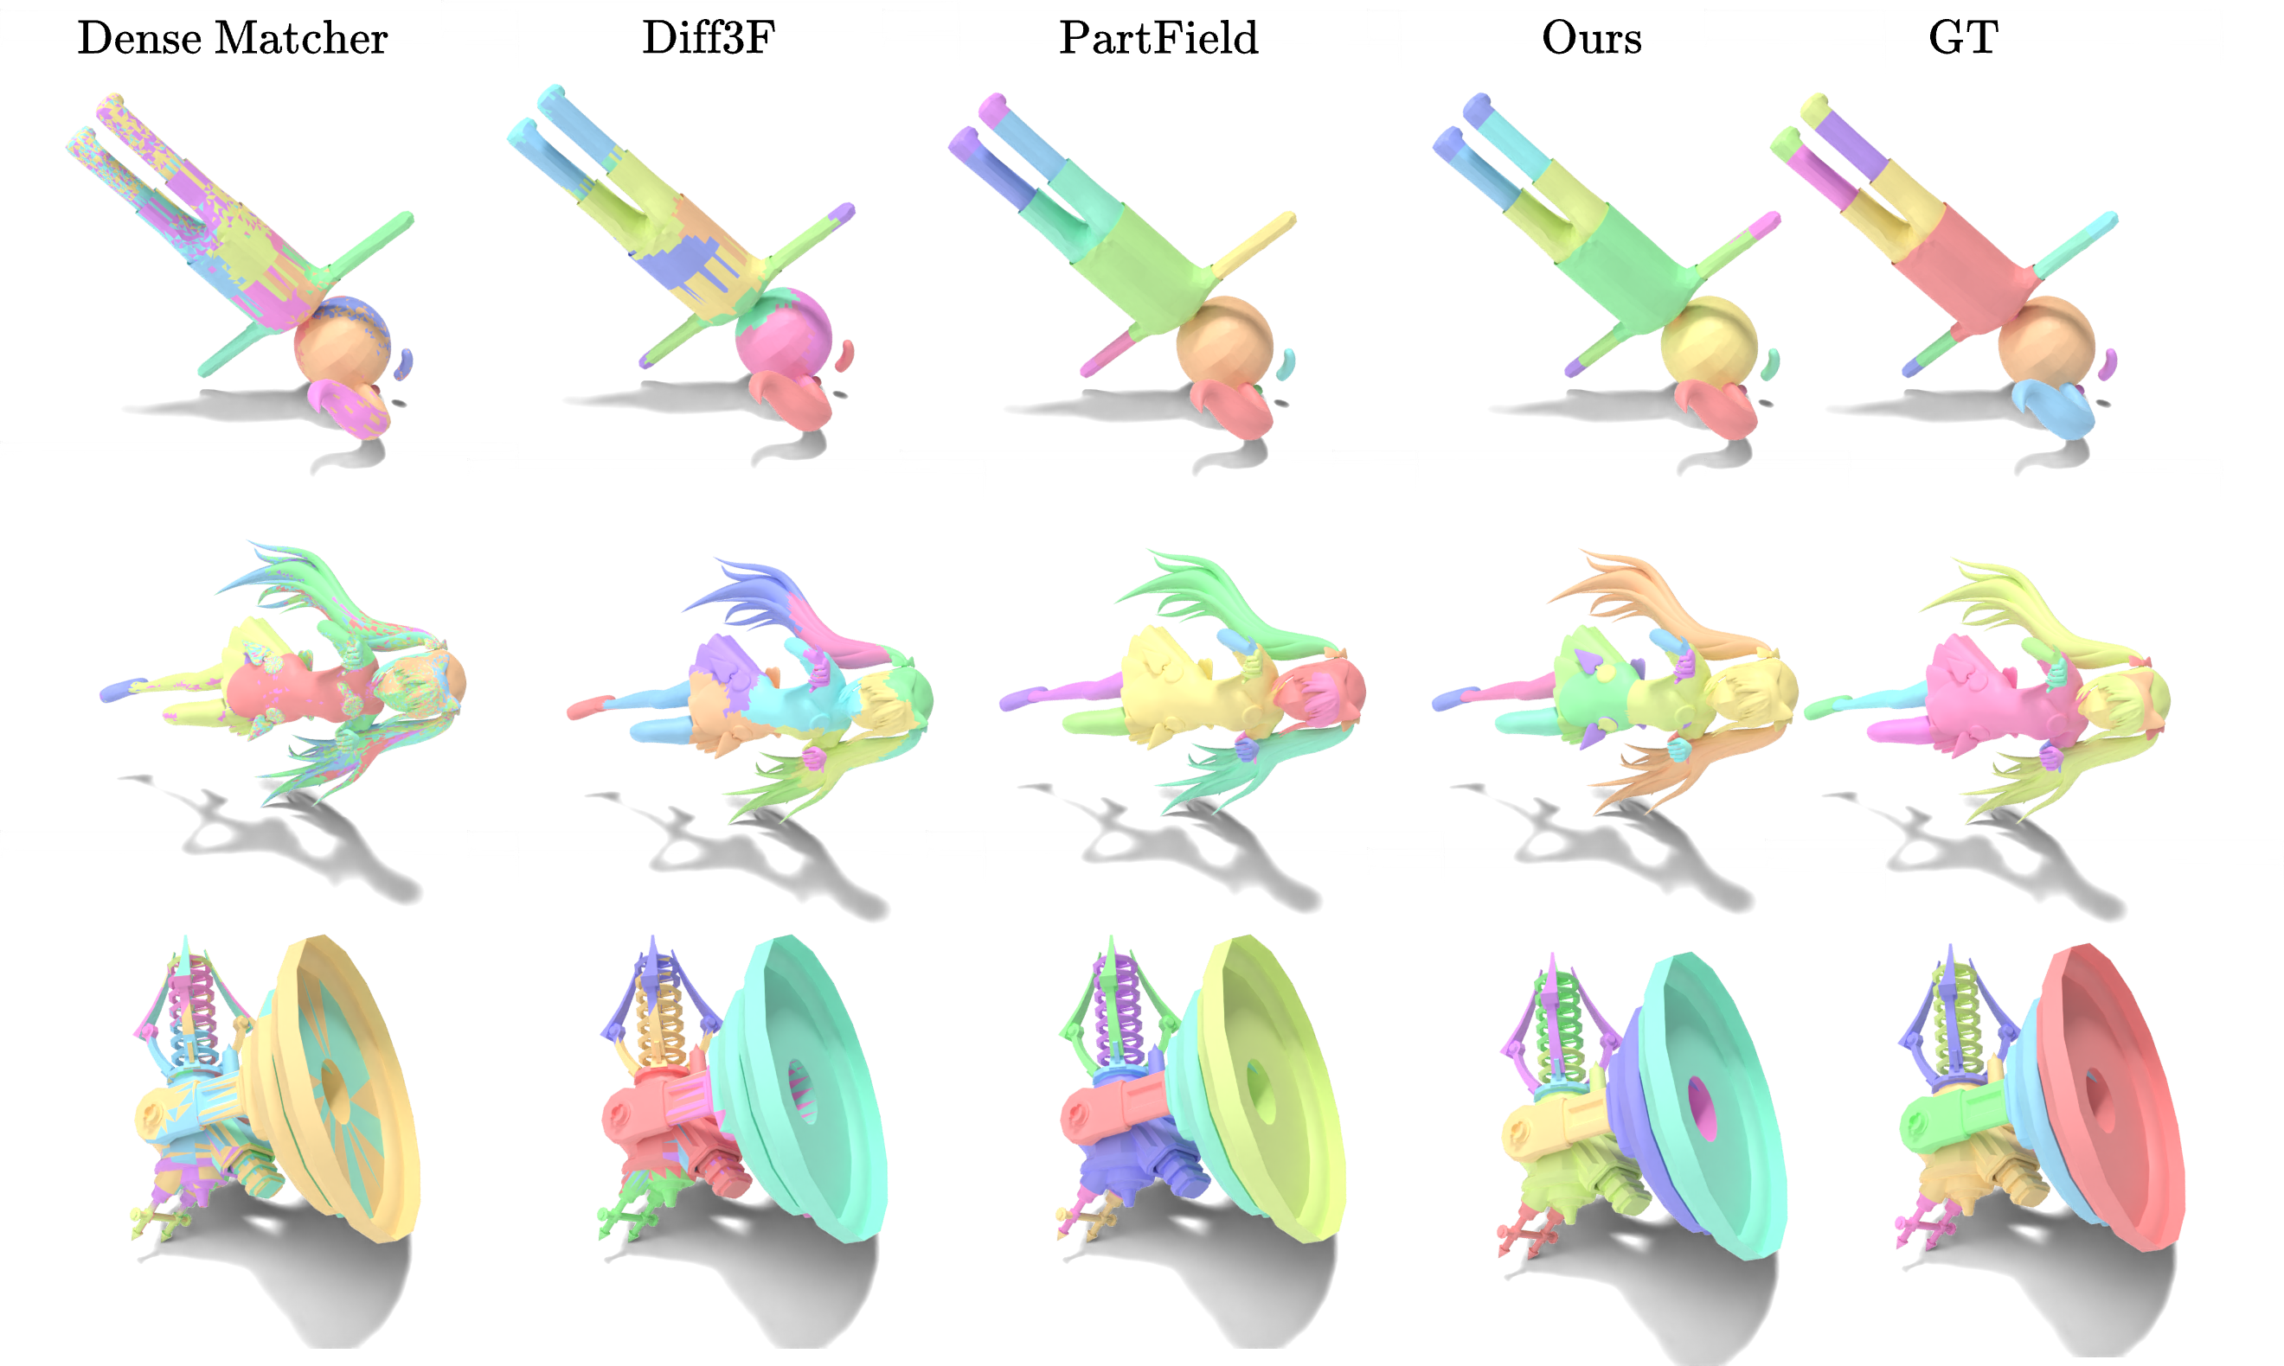
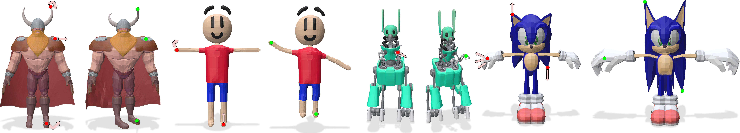



MeshFM: 2D Features Are All You Need for 3D Shape Understanding
Jinfan Zhou*, Richard Liu*, Itai Lang, Rana Hanocka
University of Chicago
* Equal contribution
Concept
Method
Dense Correspondence
Are 2D foundation-model features, on their own, enough for 3D shape understanding?
We train a feed-forward feature prediction model for 3D meshes without any 3D annotations.
We compute dense correspondence between two shapes by feeding our features into a standard functional map.
1
4
5
2
3
6
MeshFM predicts a general-purpose, rotation-robust feature field for any mesh in one forward pass, learned from 2D supervision only.
1
Render m views of the mesh
2
Encode each view with a 2D foundation model (DINOv2) + SAM aliasing correction
3
Fit a continuous 3D teacher field Φ, supervised at every rasterized pixel
The match is visualized by transferring color. Baselines carry a strong canonical-pose bias; our features stay consistent when either shape is rotated.
Feature Aliasing Correction
4
A PVCNN encoder lifts the sampled point cloud onto a triplane
5
A triplane transformer forms Ψ, trained with SO(3) augmentation to a full 2π
6
Ψ regresses the frozen teacher field,
one forward pass per new shape
ViT patchification bleeds features across part boundaries. Distillation alone does not solve this!
Results
Part Segmentation Granularity
Canonical Orientation
Benchmark
Diff3F
D.M.
PartF.
Ours
The same MeshFM feature field supports segmentation at multiple semantic granularities.
PartObjaverse mIoU↑
.515
–
.542
.549
PartNetE mIoU↑
.496
–
.517
.520
DenseCorr3D AUC↑
.46
.50
.35
.52
TOSCA AUC↑
.48
.11
.25
.34
Manifold40 acc↑
.88
.82
.85
.92
SO(3) Rotated
Benchmark
Diff3F
D.M.
PartF.
Ours
PartObjaverse mIoU↑
.488
–
.393
.539
PartNetE mIoU↑
.501
–
.499
.510
DenseCorr3D AUC↑
.42
.46
.24
.50
Each SAM mask is one semantic cluster: pixels deviating from its median μ are replaced by μ. Boundaries stay sharp! Worth +3.1 mIoU for part segmentation.
TOSCA AUC↑
.28
.02
.05
.33
Manifold40 acc↑
.33
.28
.41
.85
– DenseMatcher fails on the non-manifold meshes in the segmentation benchmarks.
On par with task-specific SOTA in canonical pose — and the only method that holds up under arbitrary rotation, from one feature set.
Part Segmentation
Our method trains without any 3D annotations and fully utilizes the power of 2D foundation visual models.
Our features are highly discriminative and rotation-robust, enabling part segmentation through direct feature clustering.
By changing only the clustering granularity, we reveal coherent parts from coarse assemblies to fine geometric details.
Feature extraction: 0.13 s per shape, 7,400× faster than Diff3F!
Mesh Deformation
More Information
We use MeshFM with the recent feature-based deformation method DFD [Liu et al., CVPR 2026].
Project Page
Paper
Code
Compared with recent baselines, our method produces substantially more accurate segmentations under arbitrary shape rotations.
Red marks transformed handles and green marks their targets.
Our flexible semantic features produce smooth, plausible shape deformations.
MeshFM: 2D Features Are All You Need for 3D Shape Understanding
ECCV 2026 · Malmö, Sweden

